Slide 1
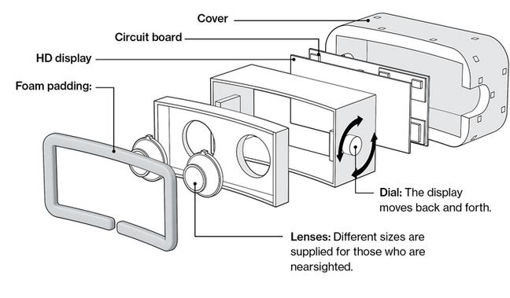
Fig. 1. Internal structure of Oculus Rift Headset

Slide 2
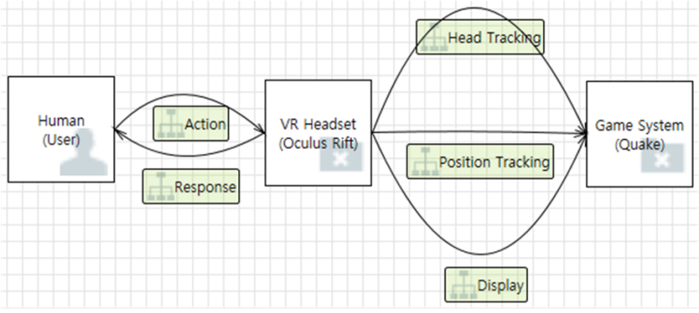
Fig. 2. Context Diagram of VR Device and Game System

Slide 3
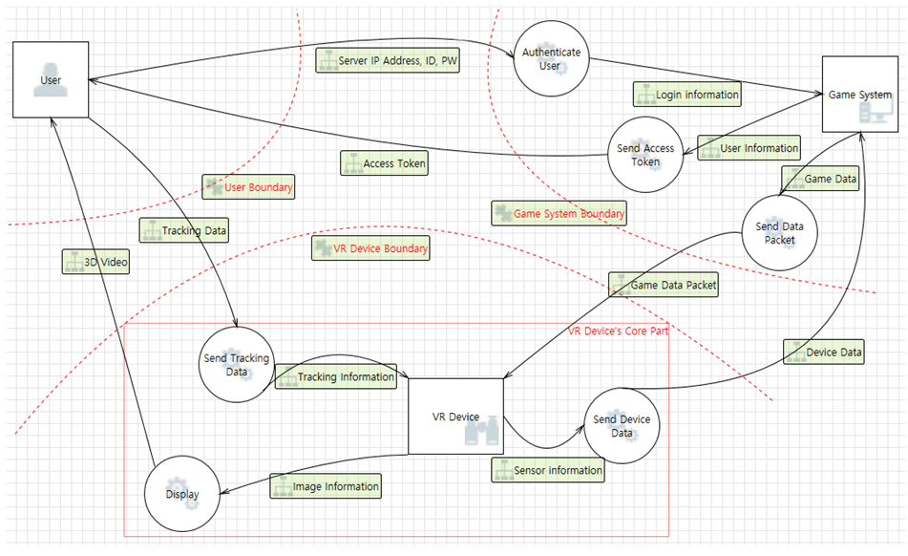
Fig. 3. VR Device and Game System with Data Flow Diagram Level0

Slide 4
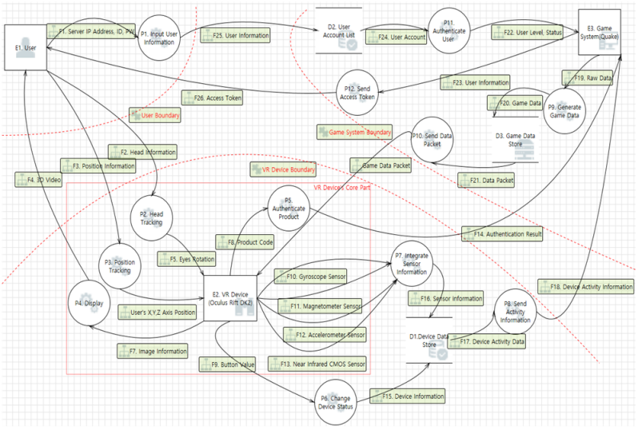
Fig. 4. VR Device and Game System with Data Flow Diagram Level1

Slide 5
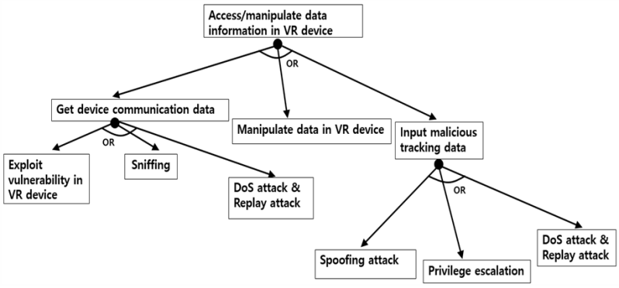
Fig. 5. Attack Tree(VR device)

Slide 6
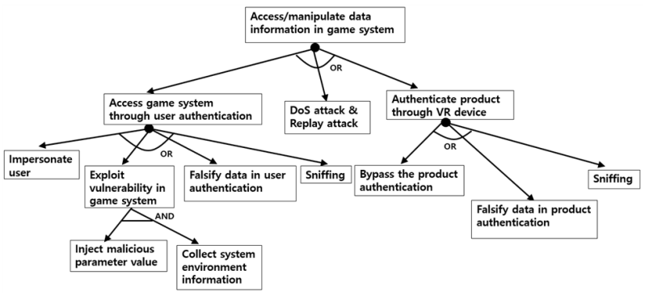
Fig. 6. Attack Tree(Game System)

Slide 7
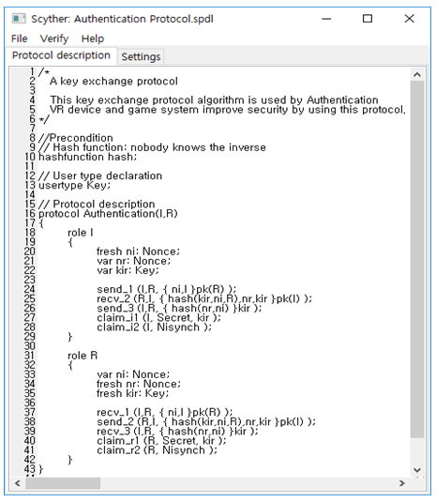
Fig. 7. Authentication Protocol(Scyther)

Slide 8
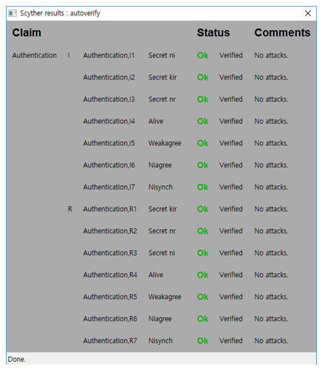
Fig. 8. Auto Verification (Scyther)

Slide 9
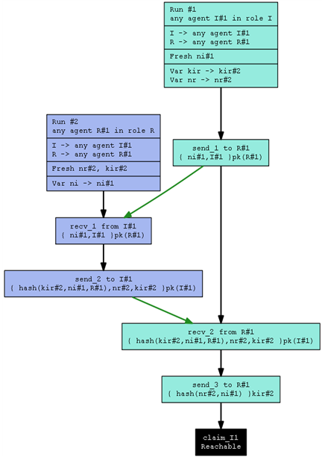
Fig. 9. Authentication Protocol Flow Chart

Slide 10
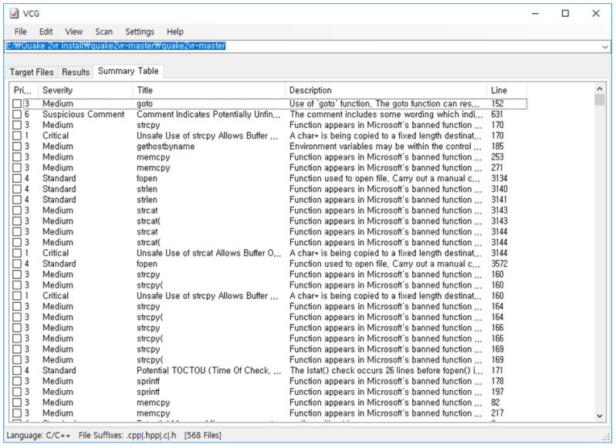
Fig. 10. Visual Code Grepper

