Slide 1
WasteWise
Canteen Food-Waste Intelligence - measure, understand, reduce
Team No 15
Seminar presentation | Supports UN SDG 12.3

Slide 2
Problem statement
• Institutional canteens and hostel messes serve hundreds of meals a day, yet waste is rarely recorded.
• Where it occurs (preparation, surplus, serving line, plate, spoilage) and why is unknown.
• Without per-meal measurement, managers cannot target fixes or check whether a fix worked.
• Open per-meal Indian canteen data is not available (none found), so tools cannot be tested on real data.
Team No 15 | WasteWise | all demo data is SYNTHETIC

Slide 3
Context: SDG 12.3
• UN SDG Target 12.3: halve per-capita global food waste at retail and consumer level, and reduce food losses along production and supply chains, by 2030.
• Canteens are a practical, controllable setting for measurement and pilots.
• WasteWise is a prototype that turns simple logs into evidence for action.
Team No 15 | WasteWise | all demo data is SYNTHETIC

Slide 4
Literature 1: Plate waste in school meals (Rezekne, Latvia)
• Zenodo record, DOI 10.5281/zenodo.14164542 (read).
• Measured plate waste: about 21.1% of food served (89 g per child) at the start of the school year, 19.4% (81 g) at the end.
• Relevance: shows plate waste can be measured as a share of food served per meal - the same denominator logic WasteWise uses (kg per meal served).
• Caveat: school study in Latvia, not India. Used as context only.
Team No 15 | WasteWise | all demo data is SYNTHETIC

Slide 5
Literature 2: Food wastage in Panjab University girls' hostels
• Questionnaire study, 135 respondents. DOI 10.22271/27067483.2024.v6.i1f.279 (read).
• Perceived most-wasted items: rice 56.25%, vegetables 30%, chapati 13.5%.
• Perceived reasons for leftovers: bad taste 46%, poor serving 27%, overeating 18%, nutrition 9%.
• Relevance: closest Indian hostel setting; motivates tracking rice and disliked sabzi, and a taste/serving-focused action.
• Caveat: perceptions, not measured kg.
Team No 15 | WasteWise | all demo data is SYNTHETIC

Slide 6
Literature 3: WRI - Food Loss and Waste in India: The Knowns and The Unknowns
• World Resources Institute working paper, DOI 10.46830/wriwp.20.00106 (abstract and key findings read).
• States that empirical research on food waste in India is very scarce and existing data are not comparable.
• Relevance: confirms the evidence gap that standardised, per-meal logging (WasteWise) aims to address.
• Caveat: we cite only its abstract-level conclusions.
Team No 15 | WasteWise | all demo data is SYNTHETIC

Slide 7
Gap and our idea
• Gap: little measured, comparable, per-meal canteen data in India; no easy tool for kitchens.
• Idea: a lightweight logging + analytics tool: structured entries, kg per meal served, evidence-linked rule-based suggestions, and baseline vs follow-up tracking.
• Deliberately no machine learning and no environmental-impact claims in the MVP.
Team No 15 | WasteWise | all demo data is SYNTHETIC

Slide 8
Features
• Structured logging: date/session, meal, item, stage, avoidable/unavoidable/unknown, kg, method, provenance.
• Dashboard summaries and filters; kg/meal shown only with a meals-served denominator.
• Rule-based recommendations (R1-R10) with a Suggested action and Evidence (rule, thresholds, numbers).
• Intervention tracking: kg/meal before vs after, days covered, coverage, causation caveat.
• Validation: rejects weight <= 0 or > 500 kg, future dates, duplicates. CSV export. Synthetic labels.
Team No 15 | WasteWise | all demo data is SYNTHETIC

Slide 9
Architecture and stack
• Streamlit UI (app.py) over Python modules: db (SQLite), analytics, recommendations, demo_data + seed.
• Local SQLite with initialisation, migration and a deterministic, idempotent synthetic seed.
• Tests: pytest, 29 passing (run locally). Deployed on Streamlit Community Cloud.
• Honest limitation: SQLite on Streamlit Cloud is ephemeral; data resets on restart, then the demo re-seeds.
Team No 15 | WasteWise | all demo data is SYNTHETIC

Slide 10
Synthetic demo dataset (clearly labelled)
• 8 weeks, hostel mess + college canteen, 24 Indian items, about 3,956 waste rows, 316 meals-served rows.
• Fixed RNG seed, reproducible; every row source_type = synthetic; INR prices are assumptions.
• Embedded patterns: dinner rice overproduction, disliked lauki sabzi, spoilage events, exam/holiday days, a mid-period intervention.
• Not real, not validated, not India-measured.
Team No 15 | WasteWise | all demo data is SYNTHETIC

Slide 11
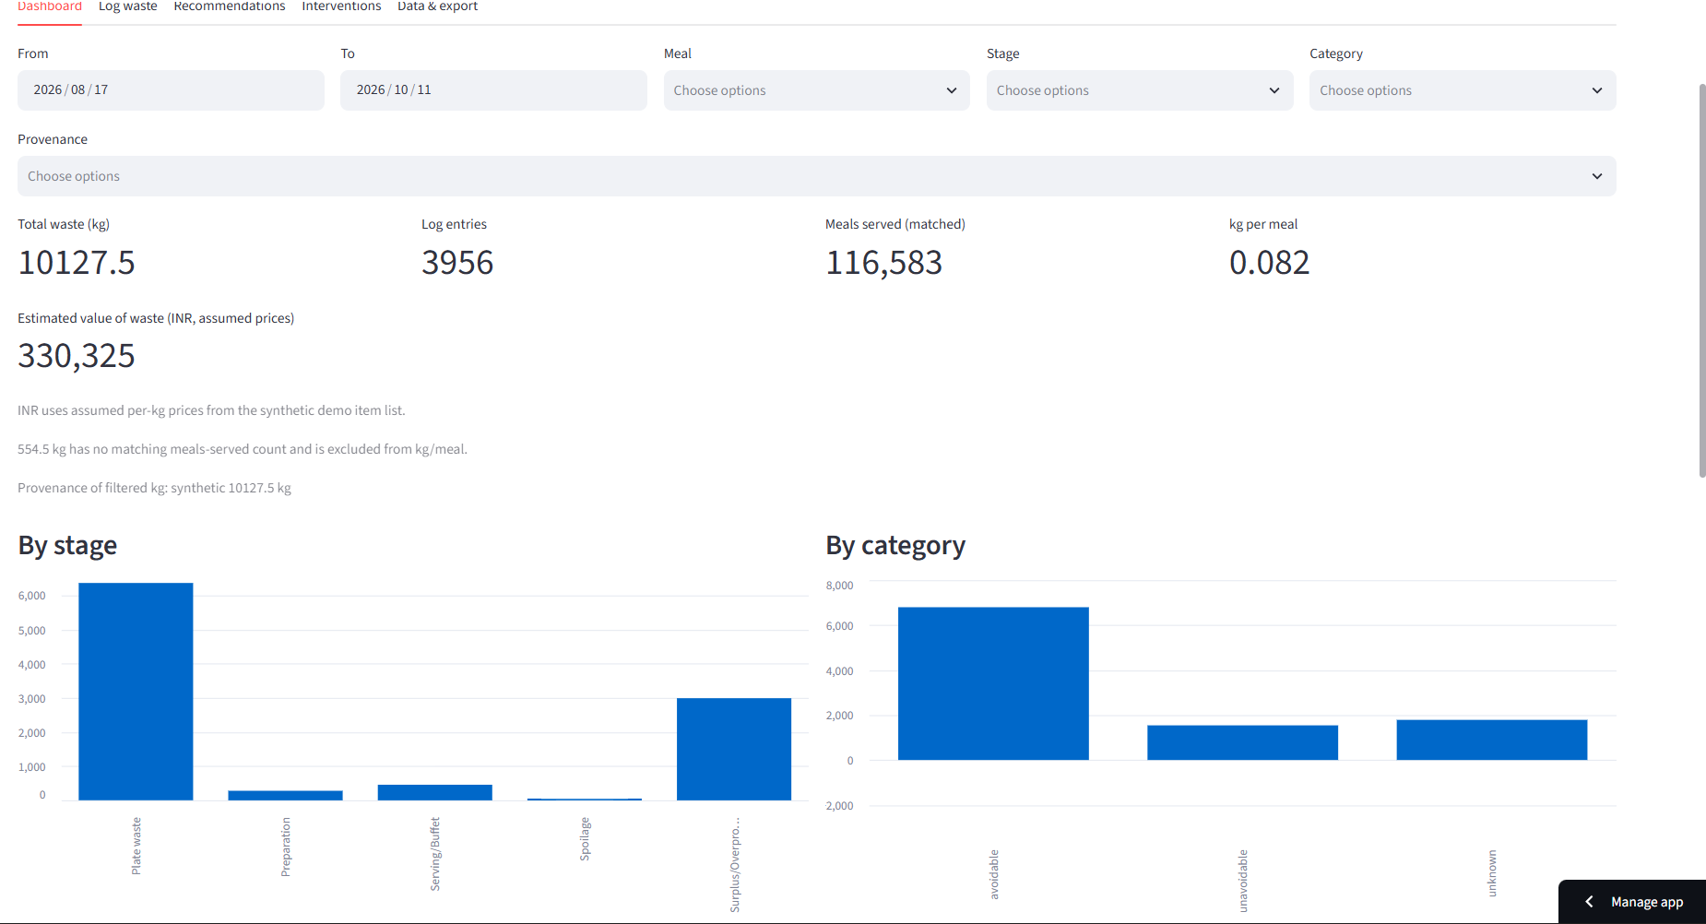
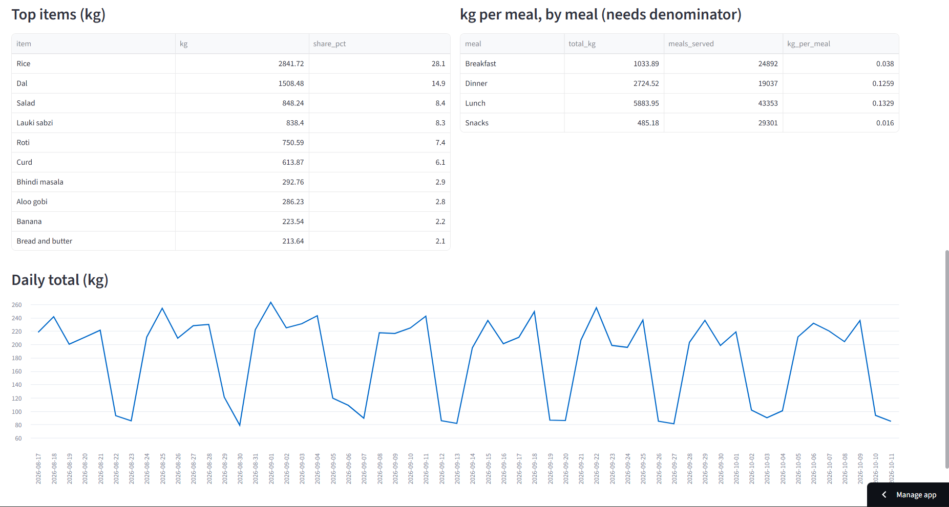
Live demo: dashboard (deployed app, owner-captured 2026-10-11)
Team No 15 | WasteWise | all demo data is SYNTHETIC

Slide 12
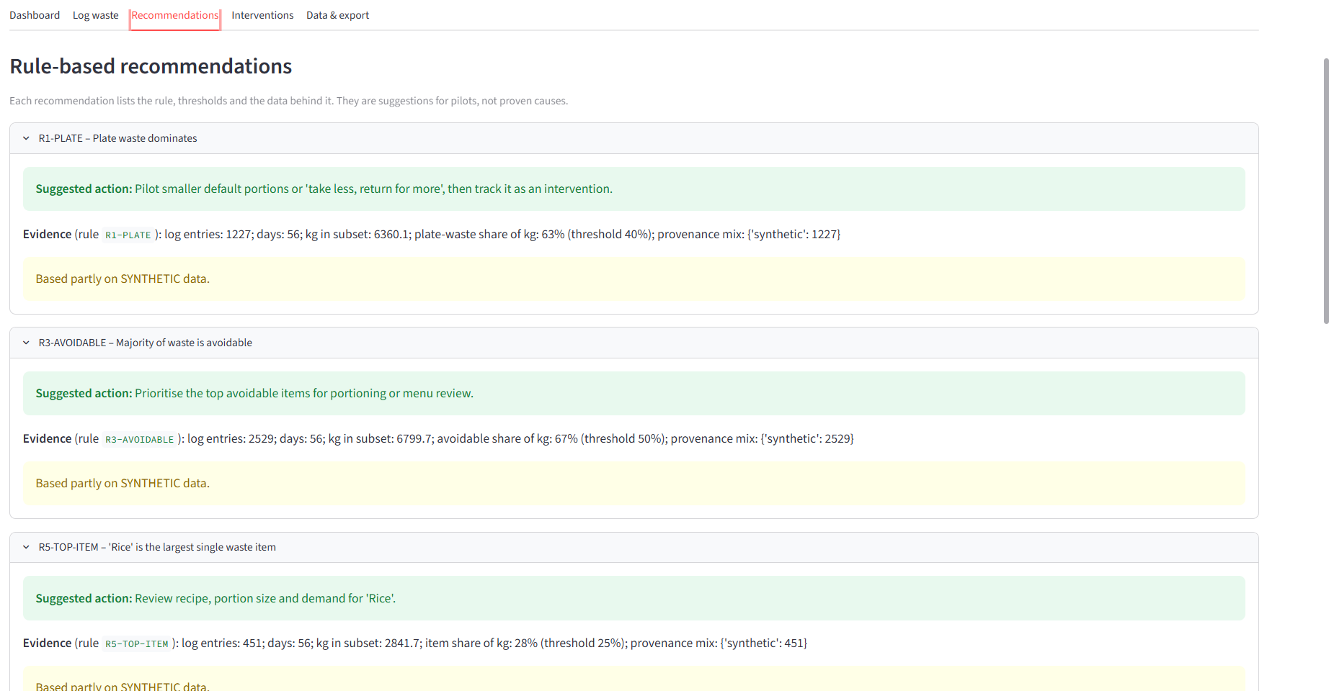
Live demo: recommendations with action and evidence
Team No 15 | WasteWise | all demo data is SYNTHETIC

Slide 13
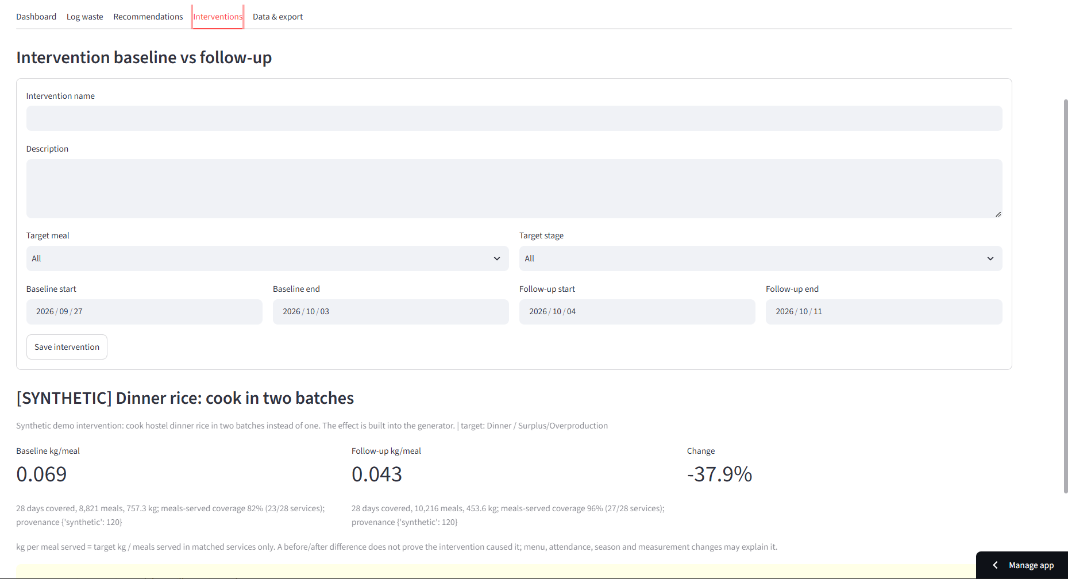
Live demo: intervention impact
Synthetic demo outcome (about -38% dinner-rice kg/meal) is built into the generator - illustration, not a finding.
Team No 15 | WasteWise | all demo data is SYNTHETIC

Slide 14
Results, verification and limitations
• Tests run: pytest 29 passed, 0 failed.
• Verified live by the project owner (screenshots, 2026-10-11): app loads with auto-seeded synthetic data, dashboard, recommendations, intervention impact, export tab.
• Not verified live: add-record submit, CSV download.
• Limits: synthetic data, ephemeral storage, no ML, no auth, before/after does not prove causation.
Team No 15 | WasteWise | all demo data is SYNTHETIC

Slide 15
Future work
• Pilot with a real canteen using weighed logs (with consent, no personal data).
• Durable storage (hosted database) and authentication.
• Richer analysis after real data exists; compare against published ranges.
• Menu/attendance forecasting only once enough validated data is collected.
Team No 15 | WasteWise | all demo data is SYNTHETIC

Slide 16
Thank you - Team No 15
• Repo: github.com/commanderbadie/wastewise-food-waste-intelligence
• Live: wastewise-food-waste-intelligence-qeykaa8immms9xxex9aoin.streamlit.app
• Questions?
Team No 15 | WasteWise | all demo data is SYNTHETIC

