Slide 1
Creating
Game Engines
Bennett Friesen

Slide 2




What is a Game Engine?
Assets
Engine
Game

Slide 3
What is a Game Engine?
Assets
Engine
Game

Slide 4
What is a Game Engine?
Code
Images
3D Models
Sound Effects
Music
Assets
Engine
Game

Slide 5
What is a Game Engine?
Assets
Engine
Game

Slide 6



What is a Game Engine?
Engine
Game
Assets
Editor
Runtime

Slide 7
What is a Game Engine?
Engine
Application Programming Interface
Editor
Runtime

Slide 8

Example of an API
The sign “using” button on websites
Here is a prime example of how we leverage api’s on a daily basis

Slide 9
The Importance of API’S in a Game Engine
01
Interact with the runtime
02
Simple class method -> complicated system
03
Glue that holds the engine together

Slide 10
Engine
Editor
Runtime

Slide 11
Engine
Editor
Runtime

Slide 12
Engine
Editor
Runtime

Slide 13
Engine
Editor
Runtime

Slide 14
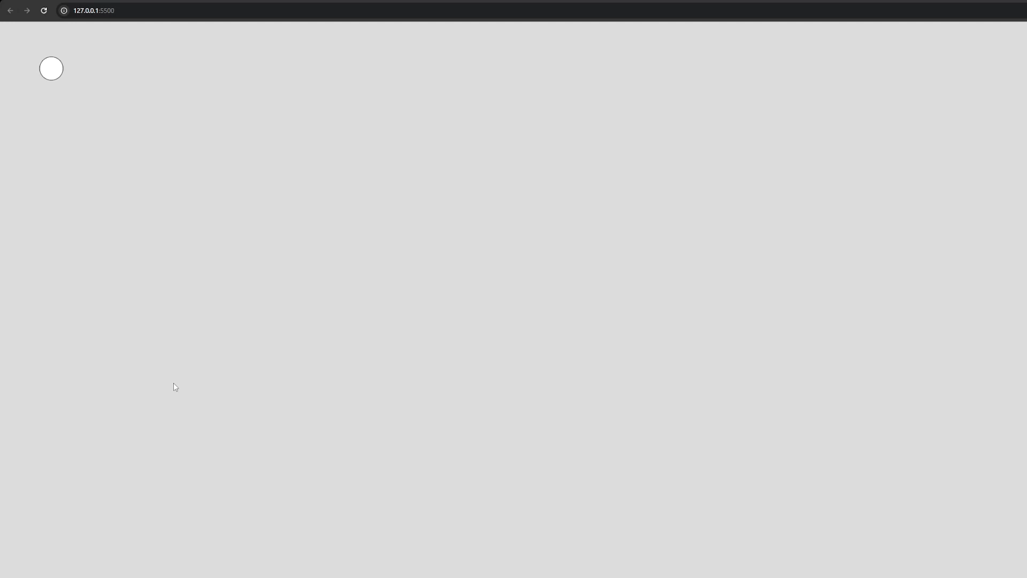
Engine
Editor
Runtime

Slide 15
Engine
Editor
Runtime

Slide 16
02
Tools
What can use and what you maybe should use
You can enter a subtitle here if you need it

Slide 17
What Language To Chose??
Language
Lowish Level
Some higher level abstractions to save time
Something you are familiar with!!

Slide 18
Best options: C++ Rust C Zig
Language

Slide 19
Secondary options: C# Python JavaScript
Language

