Slide 1
Creating
Game Engines
Bennett Friesen

Slide 2




What is a Game Engine?
Assets
Engine
Game

Slide 3
What is a Game Engine?
Assets
Engine
Game

Slide 4
What is a Game Engine?
Code
Images
3D Models
Sound Effects
Music
Assets
Engine
Game

Slide 5
What is a Game Engine?
Assets
Engine
Game

Slide 6



What is a Game Engine?
Engine
Game
Assets
Editor
Runtime

Slide 7
What is a Game Engine?
Engine
Application Programming Interface
Editor
Runtime

Slide 8

Example of an API
The sign “using” button on websites
Here is a prime example of how we leverage api’s on a daily basis

Slide 9
The Importance of API’S in a Game Engine
01
Interact with the runtime
02
Simple class method -> complicated system
03
Glue that holds the engine together

Slide 10
Engine
Editor
Runtime

Slide 11
Engine
Editor
Runtime

Slide 12
Engine
Editor
Runtime

Slide 13
Engine
Editor
Runtime

Slide 14
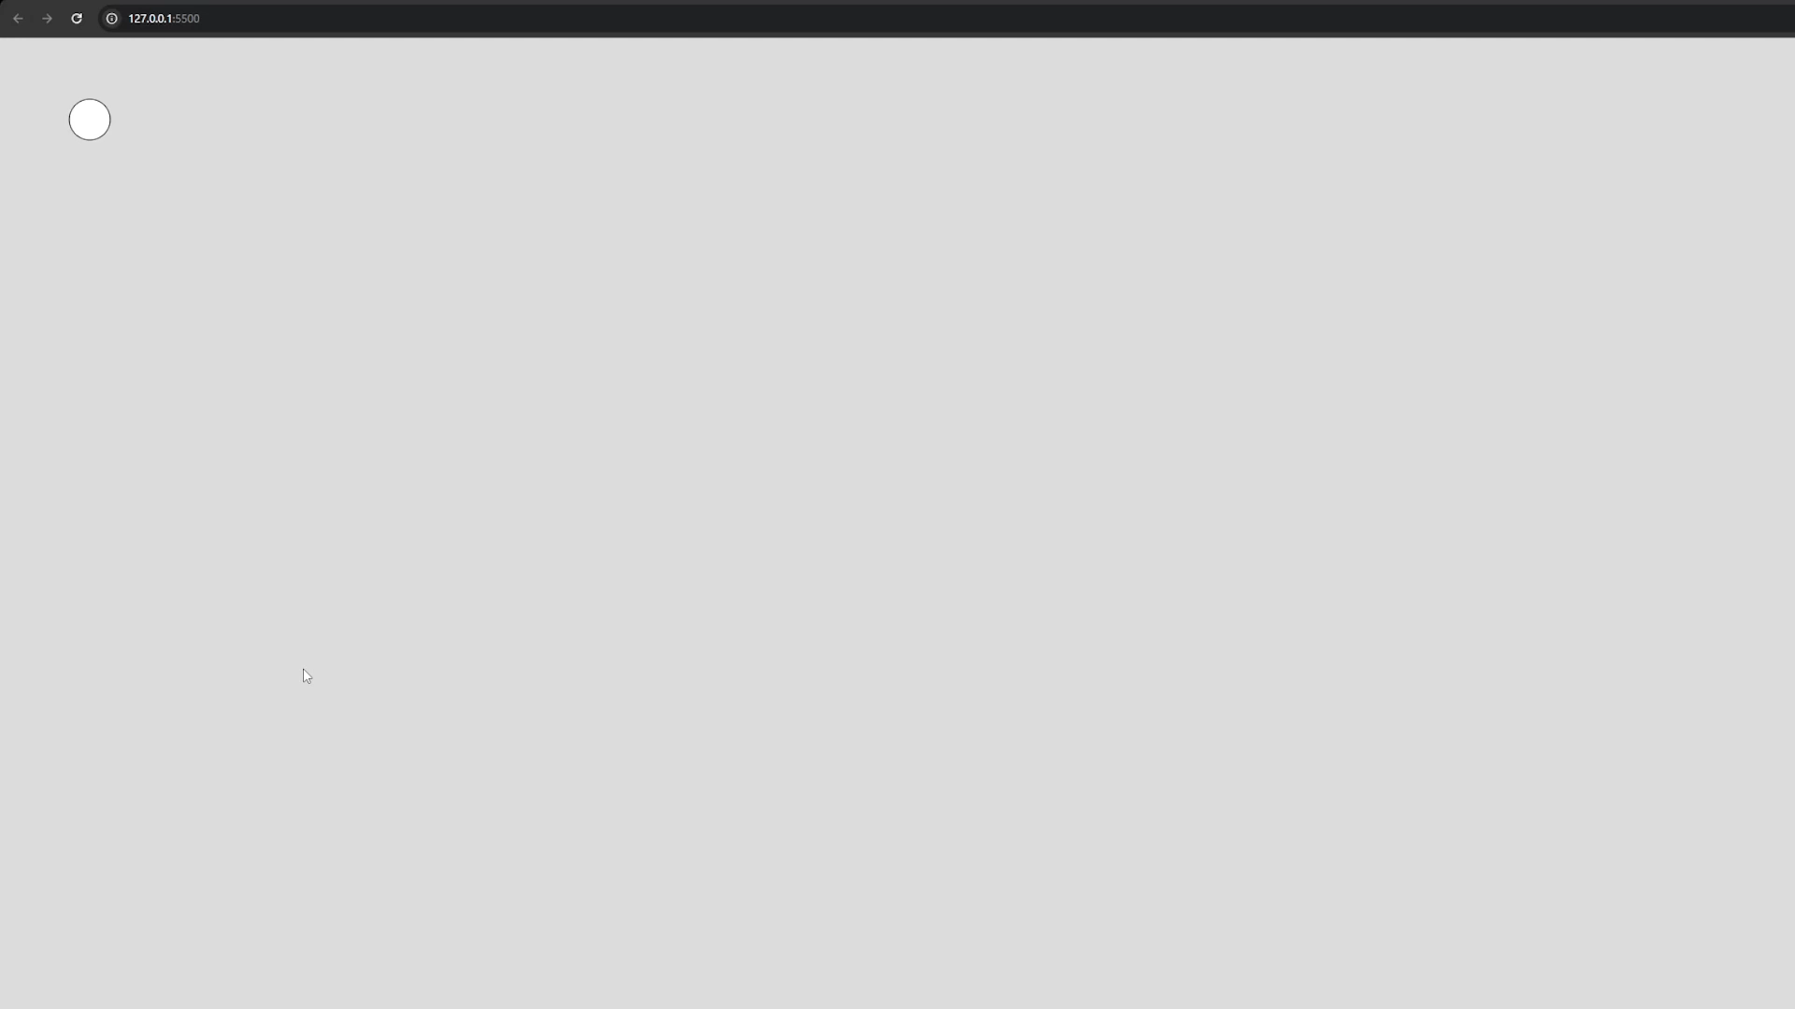
Engine
Editor
Runtime

Slide 15
Engine
Editor
Runtime

Slide 16
Game Engine
Rendering System
Shaders
Lighting
Textures
GPU Management
Physics Engine
Rigid Body Dynamics
Soft Body Dynamics
Collision Detection & Response
Particle Effects
Audio System
Sound Effects
Background Music
Spatial Audio
Input System
Keyboard Input
Mouse Input
Controller Input
Scripting System
Scripting Language Integration
Game Logic and Behavior
Animation System
Sprite Sheets
AI System
Pathfinding
State Machines
Decision-Making Algorithms
Networking System
Client-Server Communication
Game State Synchronization
Latency and Data Transfer
UI System
HUD
Text Rendering
Menu and UI Elements
Resource/Asset Management System
Asset Loading
Memory Management
Asset Optimization
Scene Management System
Game Object Management
Scene Loading/Unloading
Level Transitions
Event System
Event Handling
Gif

Slide 17
02
Tools
What can use and what you maybe should use
You can enter a subtitle here if you need it

Slide 18
What Language To Chose??
Language
Lowish Level
Some higher level abstractions to save time
Something you are familiar with!!

Slide 19
Best options: C++ Rust C Zig
Language

Slide 20
Secondary options: C# Python JavaScript
Language

