Slide 1
Comment Anywhere Week 10 Report
Karl Miller Luke Bates Frank Bedekovich

Slide 2
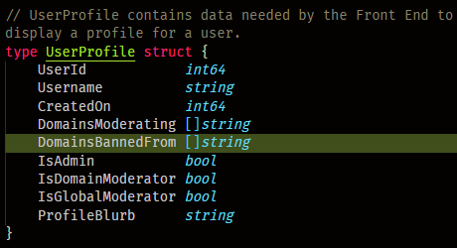
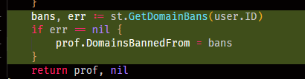
Back-End
User ban pipeline
The DomainsBannedFrom field was added.
A GetDomainBans query is used to populate this data.

Slide 3
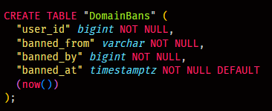

Back-End
The DomainBans table has no primary key.
This table is queryed using a dual key of user_id and banned_from.
Prevents users from having multiple “ban instances” on one domain.
The particular DomainBan is deleted upon un-ban.
Actual ban records are kept in another table.

Slide 4
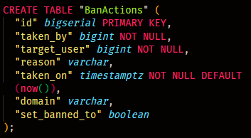
Back-End
Created the BanActions table.
Keeps track of all bans and un-bans (specific domain or globally)
The record will not be added if it is redundant. (If you tried to ban a user twice, the second request will be ignored)
The next slide will demonstrate this implementation

Slide 5
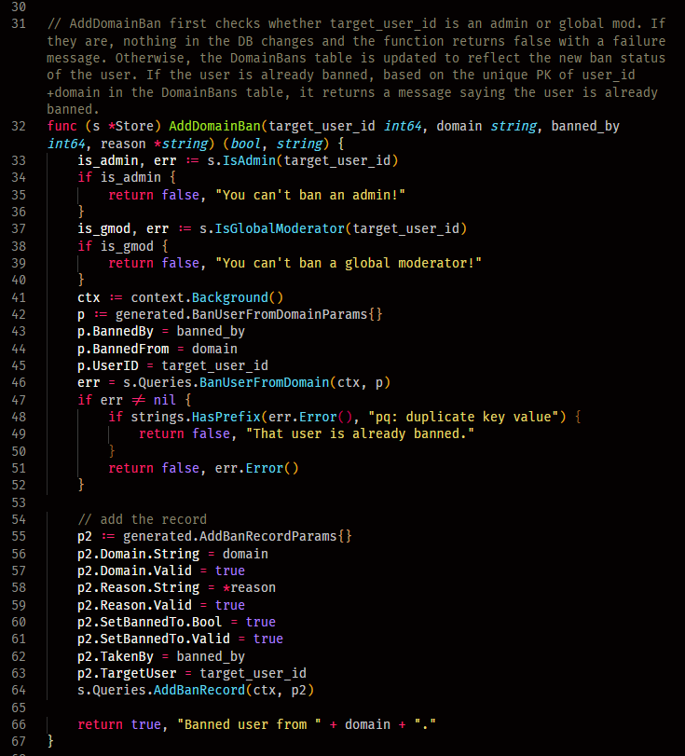
Back-End
Store.AddDomainBan prevents admins and global moderators from being banned.
Line 48 prevents multiple redundant ban instances.
It checks for a returned PSQL error being “pq: duplicate key value”, retrieved from line 46.
It is called from UserManager, because it updates any active controllers afterwards.

Slide 6
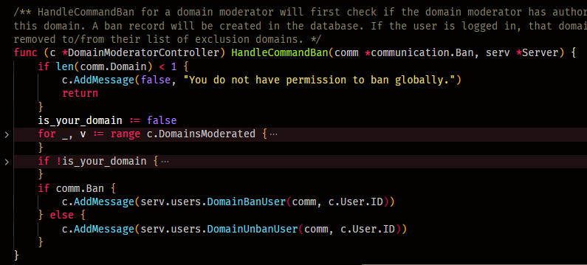
Back-End
This demonstrates a domainModeratorController calling...
UserManager.DomainBanUser(...)
UserManager.DomainUnbanUser(...)
Implementation of this function will be discussed next.

Slide 7
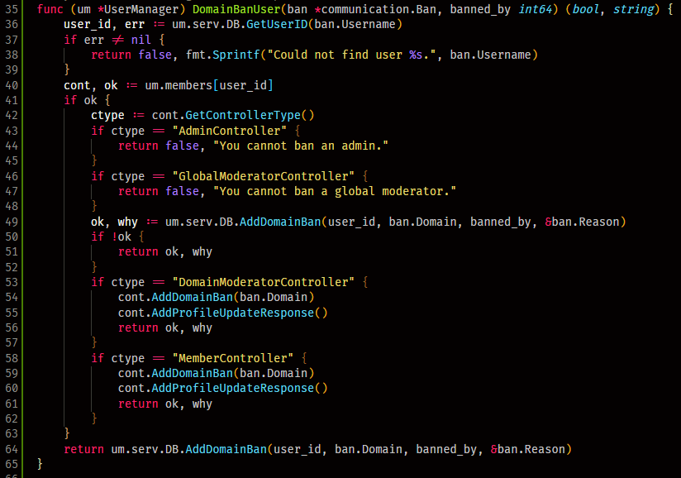
Back-End
Realizes conditions for
Admin
Global Moderator
Domain Moderator
Members
Non-existing users
Admins and global mods cannot be banned.
Banning a nonexistent user will return an error.

Slide 8
Back-End
Improved abstraction for controller.AddProfileUpdateResponse
Handles user profile updates (edited blurb, email, domains moderated, domains banned)
Used by various polymorphic objects (such as user controllers)

Slide 9
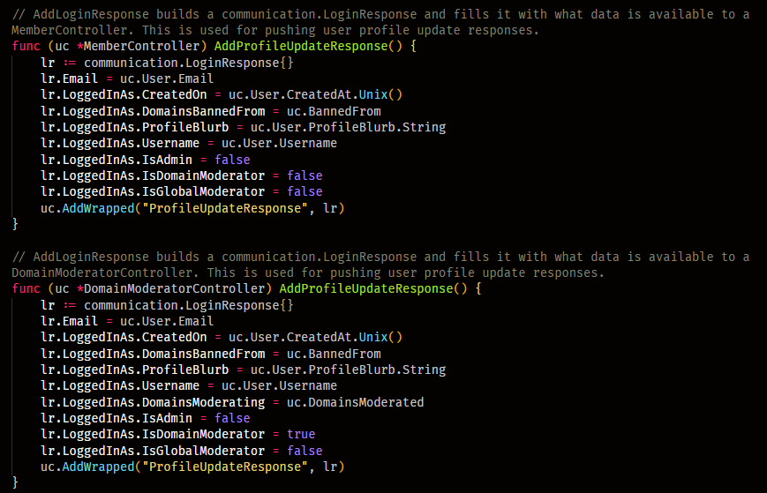
Back-End
Uses the addWrapped function to add a communication.LoginResponse to the controller’s nextResponses array.
LoginResponse is what a user would see with a login request.
The same data structure is used for a profile update response.

Slide 10
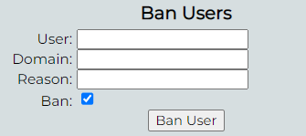
Front-End
Implemented the Ban Users Section.
Accessible by
Domain Moderators
Global Moderators
Admins
If the domain field is empty, a global ban is invoked. (only for global mods & admins)

Slide 11
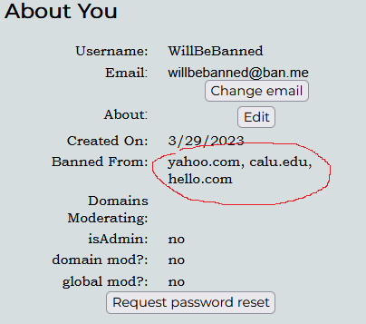
Front-End
A list of domains a user is banned from is displayed in their profile settings.
Updated in real-time as bans change.
Notice the domains this user is banned from.

Slide 12
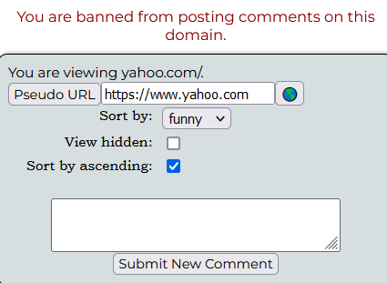
Front-End
In this example, the user is banned from https://www.yahoo.com.
They receive an error message if they attempt to post a comment.

Slide 13
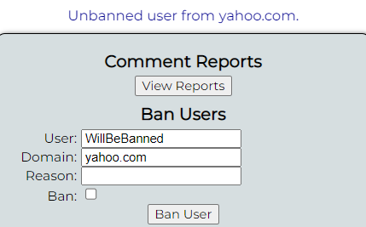
Front-End
Now, let us un-ban this user from this domain.
Specify the username.
Specify the domain.
“Ban” is currently checked.
Uncheck ban and submit.

Slide 14
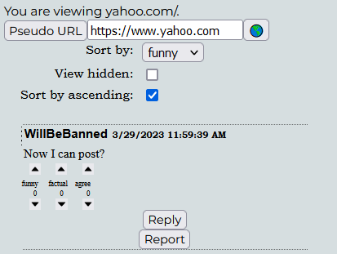
Front-End
Your profile settings will be updated.
The user may now comment on that domain.

Slide 15
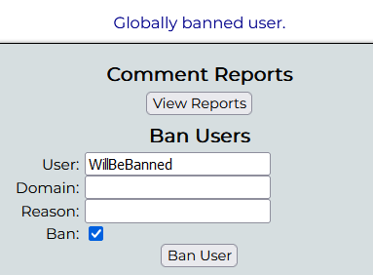
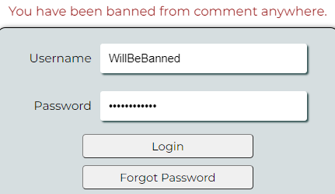
Front-End
Leave the domain field blank to globally ban a user.

Slide 16
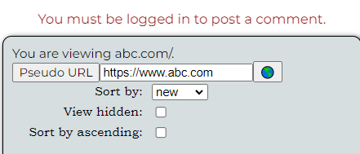
Front-End
A user will be automatically logged out if they were banned.

Slide 17
Front-End
Created an EventManager<T> class.
Will keep track of active event listeners.
This feature has already been implemented by specific components for click event listeners.
The class may be used by any component to create any type of event listener
Required for objects that are frequently created and destroyed. (Individual comments, individual reports).
Event listeners persist unless manually destroyed.
This results in memory leaks.

Slide 18
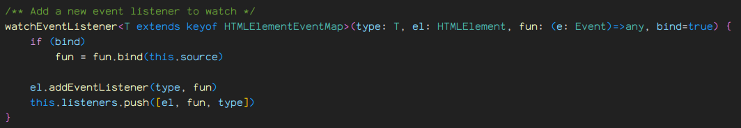
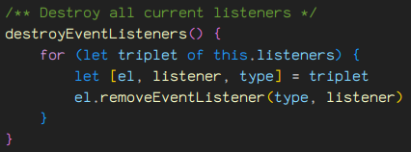
Front-End
The class saves an array of all “watched” listeners.

Slide 19
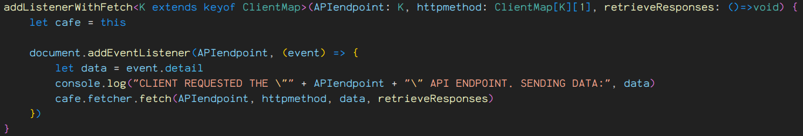
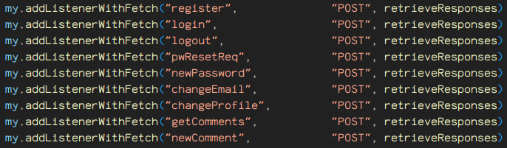
Front-End
Abstracted a function for easily creating API-endpoint event listeners.

Slide 20
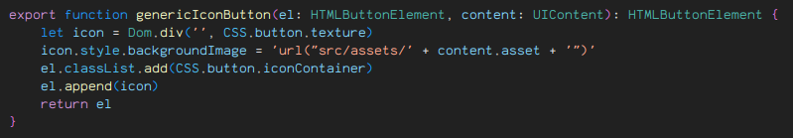
Front-End
CafeDom utility function for creating a button holding an icon.

Slide 21
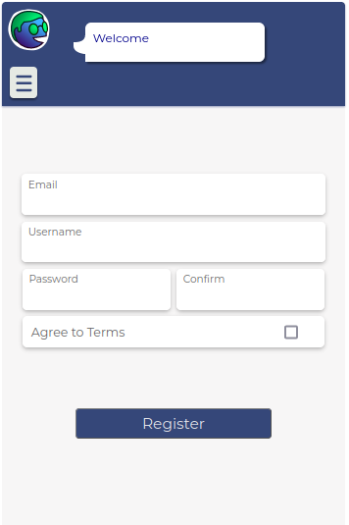
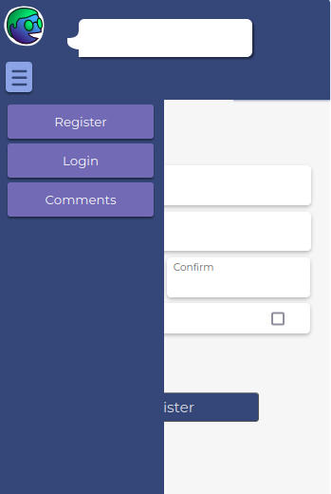
Front-End
Front-end UI refactors
Most of the issues came from stylesheets not applying correctly.
The hamburger menu was intended to be on the right side of the speech bubble
Some elements would show overtop the menu panel. This was fixed by setting the pane’s “z-index” to an absurdly large integer.

Slide 22
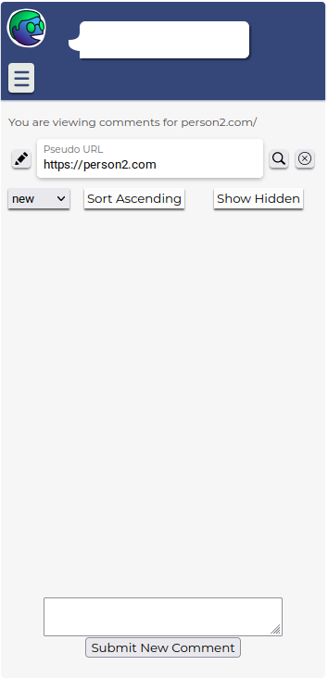
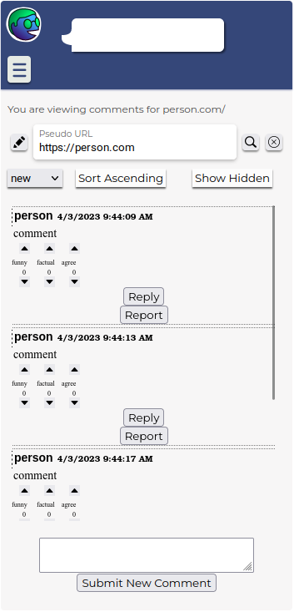
Front-End
Comments page refactoring progress
Attempting to utilize scrollable elements.
Goal is to make the extension height more static.

Slide 23
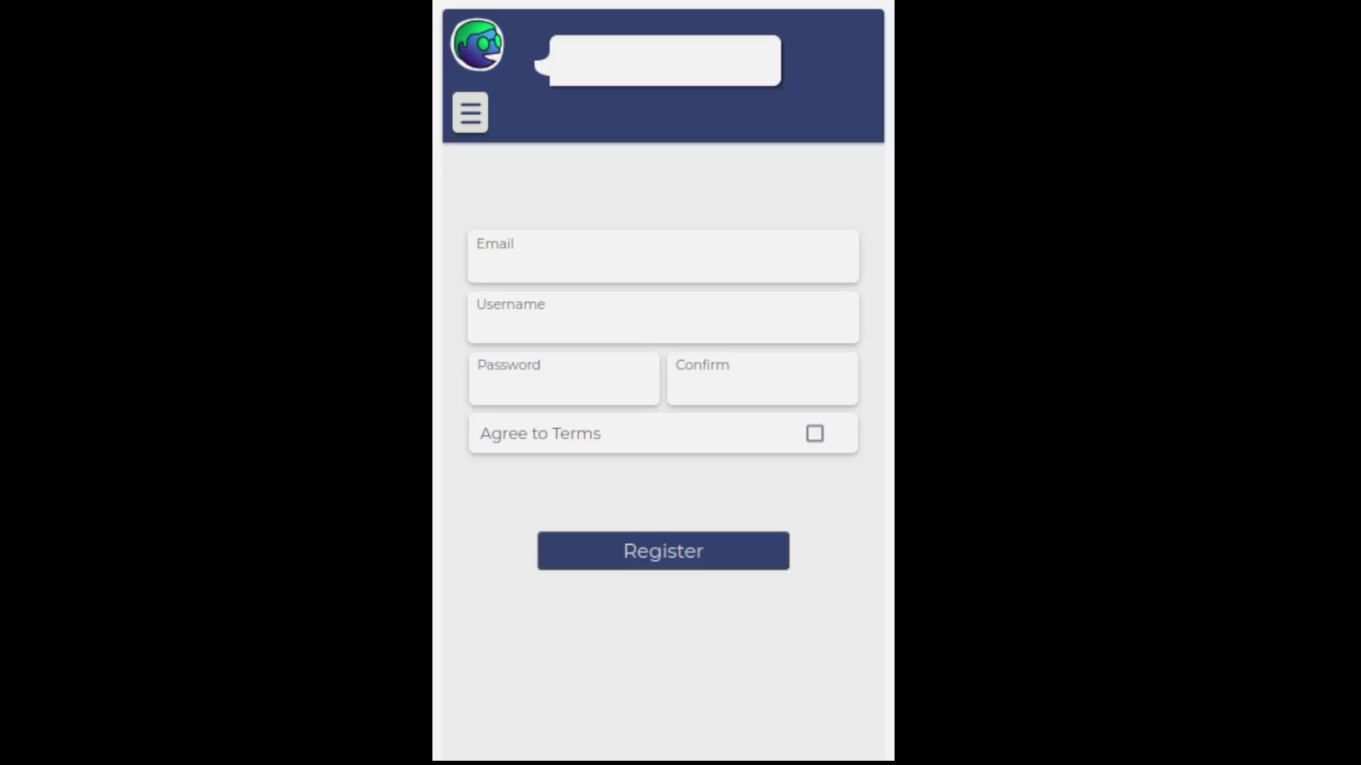
Front-End
Improved nav-bar

