Slide 1
Comment Anywhere Week 8 Report
Karl Miller Presenting
3/20/2023

Slide 2
Comment Reports
The data a moderator needs to see is different from what is optimally stored in the database.
Once again, data transformations are necessary

Slide 3
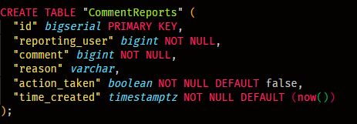
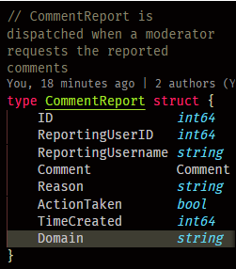
Transforming CommentReports
We have a more complex and specific server-client communication entity compared to the raw data in the database

Slide 4
Transforming CommentReports
ID, ReportingUserID, Reason, ActionTaken, and TimeCreated are all directly ascertainable from the table row
Comment, Username, and Domain require additional queries, however

Slide 5
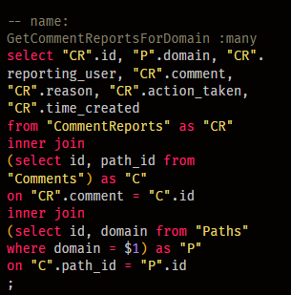
Transforming CommentReports
This is the base query for getting the rows of comment reports.
The important thing is that it can filter on domain, which requires 2 joins.
That’s because ‘domain’ is only first accessible in the “Paths” table, and we need to first get the Comment row to find the path_id.

Slide 6
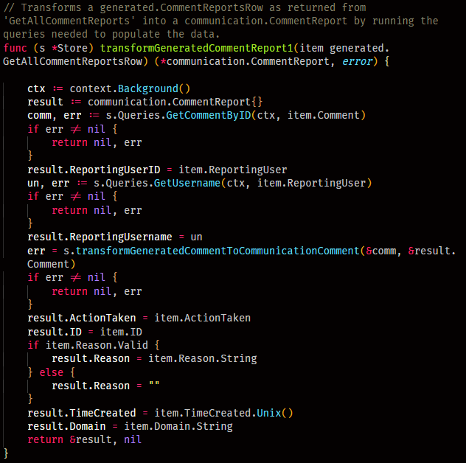
Transforming CommentReports
We could have run a more complex postgres query using more inner joins to populate the generated.GetAllCommentReportsRow more closely like the final communication.CommentReport.
Rather than write a complex query with many joins, I instead reused functions I had already written such as transformGeneratedCommentToCommunicationComment to get the same result.
This is more reliable, especially if there are any schema changes down the road. It’s also more readable.
I did not test if it was faster, but it will certainly terminate earlier if there is an error.

Slide 7
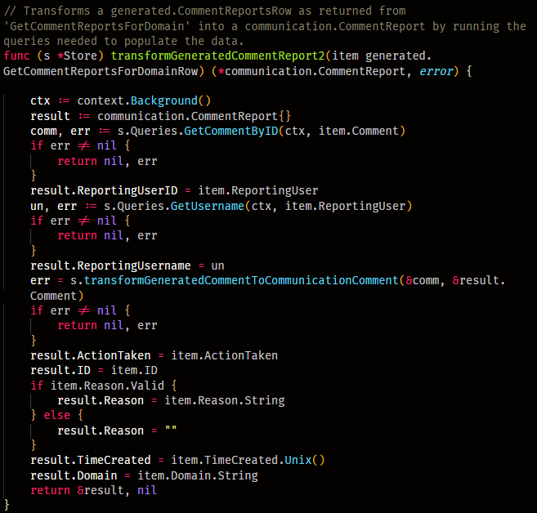
Transforming CommentReports
There was some boilerplate repetition, however.
There are two sql queries used, one for providing all CommentReports and one for providing reports filtered for a particular domain. Though the returned objects, an array of generated.GetCommentReportsForDomainRow or generated.GetAllCommentReportsRow have identical fields, I had to copy paste the same function for transforming each of them.
I may clean this up in a future refactor by providing an interface. For now, it shows a minor downside to using generated code; the code generator can’t identify abstraction-optimizations.

Slide 8
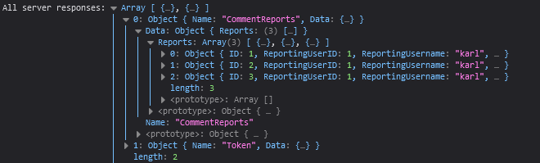
Transforming CommentReports
The image below is an example of a server response of a successful test, prior to user-interface implementation. It is logged in the browser console.
It shows the server correctly responding with an array of communication.CommentReports that have been built from database data.
As with all server responses, it also provides the front end with an updated token every time they communicate.

Slide 9
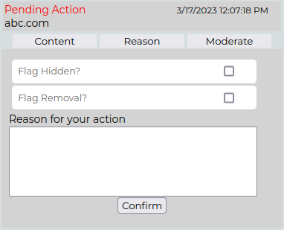
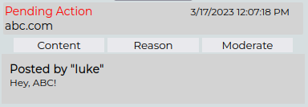
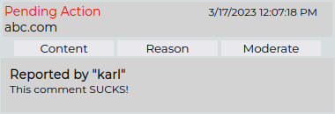
Transforming CommentReports
The image below is an example of the current UI for viewing CommentReports, designed by Luke

Slide 10
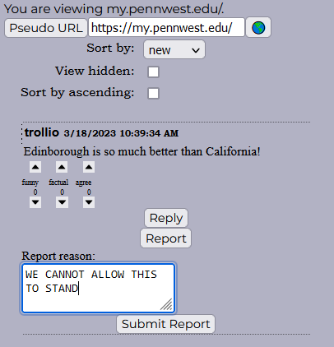
New CommentReports
We also needed to add a way for users to report comments.
On the right is pictured the current user interface for submitting a comment report.
As with reply, clicking the “Report” button shows a few input items and labels needed to submit a new report. Clicking “Report” again hides that area.

Slide 11
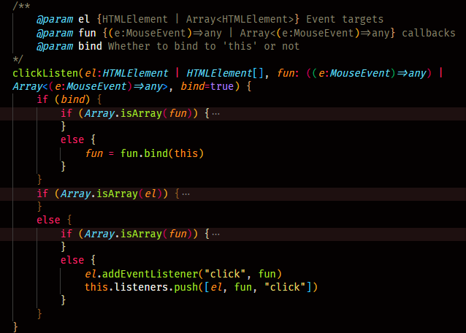
New CommentReports
One interesting aspect of many of our UI elements are the way they handle event listeners. In their base classes, they maintain a data structure that references all listeners which have been added. When a listener is added using the super call to clickListen, the listener, target element, and event type are all added to this array.
This is important for when we want to destroy the UI element. If we don’t clean up the listeners, they could eventually slow down the front end as they aggregate.

Slide 12
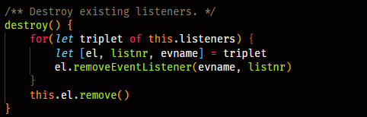
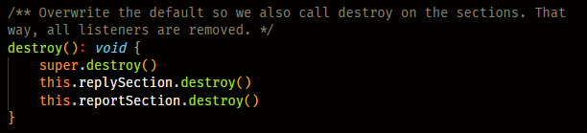
New CommentReports
By maintaining references to all applied listeners, we can destroy those listeners along with our element if necessary. UIInput.destroy is pictured to the right. When we have nested sections that create their own listeners, we must override destroy and call destroy on all sub-sections as well. CafeComment.destroy is pictured to the right.
CafeComments in particular get destroyed often as the user changes pages.

Slide 13
Hamburger Button
The buttons we used for navigating between CafeWindows were ugly and took up too much space, and didn’t stack well.
We decided to go with a classic Hamburger button.

Slide 14
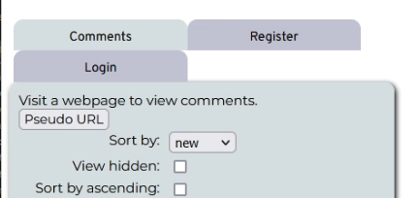
Hamburger Button
The old navigation buttons are shown below. As the number of buttons grow, it looks like a chaotic filing system.
It also leaves large amounts of blank space when there are an odd number of buttons.

Slide 15
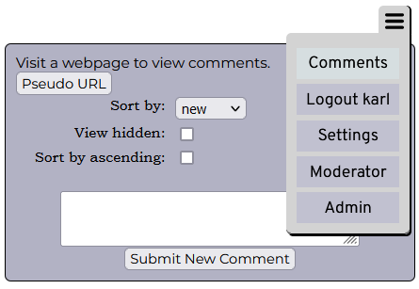
Hamburger Button
The new navigation system is a classic hamburger drop down. Users can toggle it to show or hide the navigation links.
The new button also has the CSS position:”fixed” so that it always remains at the same position in the page, no matter how far down the user scrolls. That way, they don’t have to scroll up to navigate.

Slide 16
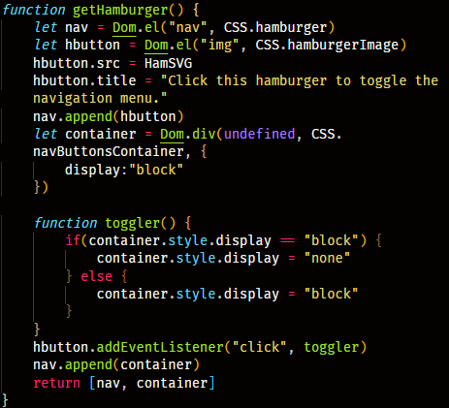
Hamburger Button
The code was relatively simple. It was functionalized to keep the navbar constructor from being too chaotic.
The new navigation system is a classic hamburger drop down. Users can toggle it to show or hide the navigation links.
The new button also has the CSS position:”fixed” so that it always remains at the same position in the page, no matter how far down the user scrolls. That way, they don’t have to scroll up to navigate.
It returns the nav and the container for the nav buttons so the constructor can do what it needs to do.

Slide 17


Hamburger Button
Javascript / Typescript has a nifty feature called destructuring assignment.
You can initialize variables to array elements, as shown to the right here.
It makes returning multiple variables as an array much more readable.
The first element returned is the button which toggles the drop-down menu. The second is the container for buttons. These are used in the constructor to build the nav menu, in essentially the same way it was built before.

Slide 18
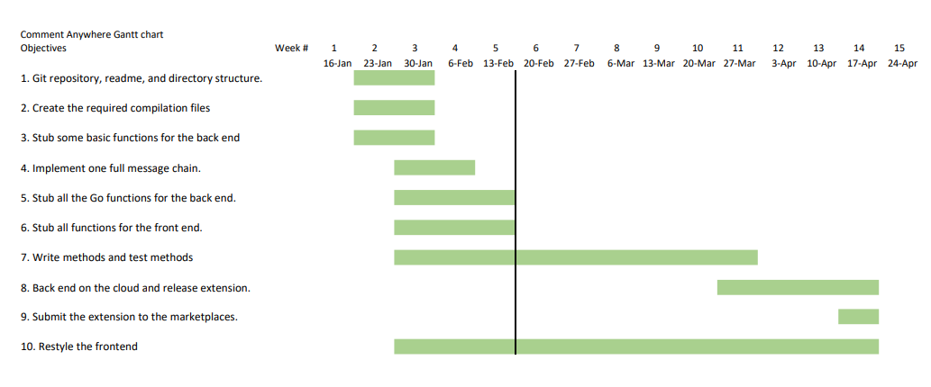
New Gantt Chart
We allocated more time for “Write methods and test methods” and less to cloud deployment.
We need to average 3-4 pipelines per week to meet our target now.

Slide 19
Devlog videos
I created a video of some development
See https://comment-anywhere.github.io week 8 update

