Slide 1
Comment Anywhere Week 4 Report
Karl Miller Luke Bates Frank Bedekovich

Slide 2
Overview
Goals
Login
Logout
ChangeProfileBlurb
ChangeEmail
pwResetRequest
2-7-23 Backend CLI and logger
2-9-23 Implemented login page
2-10-23 Integration test 1
2-12-23 Integration test 2

Slide 3
Backend CLI and Logger
Karl added a command line interface (CLI) and logger to the server.
The server and CLI run concurrently in separate threads.
The CLI can display server logs and active users.
The CLI can properly shutdown the server.
Middleware functions
Log requests when they first come in.
Log requests before they are done.

Slide 4
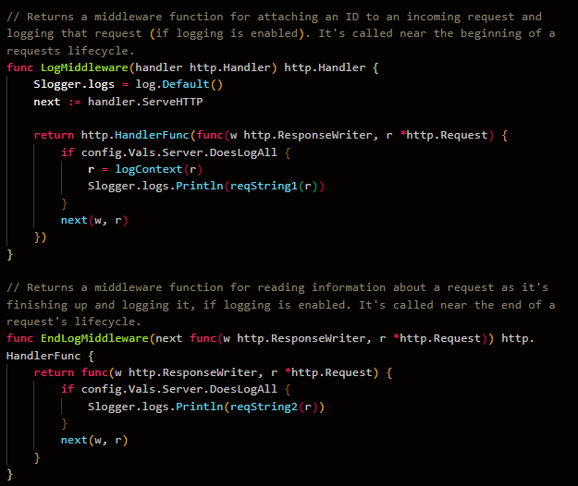
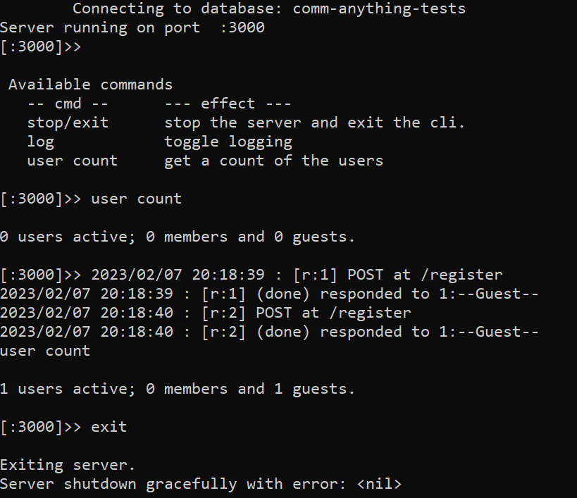
Backend CLI and Logger

Slide 5
Cookie Authentication Issues
Previously
A cookie would contain an encrypted token.
The server will receive a cookie from the client.
The server will decrypt the token and authenticate the request.
The Problem
Only works on webpages provided by the server.
Clients are sending requests from a browser extension.

Slide 6
First Solution - Enable CORS
The Idea
CORS (Cross-Origin Resource Sharing) allow requests from one domain to another.
We would enable CORS. This would, theoretically, allow the server to accept cookies from any clients’ browser extension.
The Next Problem
To use cookies, every permitted domain must be explicitly provided.
Cookies are disabled for the “every domain” Option. Otherwise, this could result in cross site request forgery attacks.

Slide 7
Second Solution - Custom Headers
The Solution
Tokens are stored privately rather than on the Client’s browser.
Uses a new “Token” Server-Client Communication Entity.
This token is no longer stored in a Cookie.
The token is added to the ServerResponse array, which is sent to the client.
The frontend’s Fetcher is responsible for writing its token as a custom header to its requests.

Slide 8
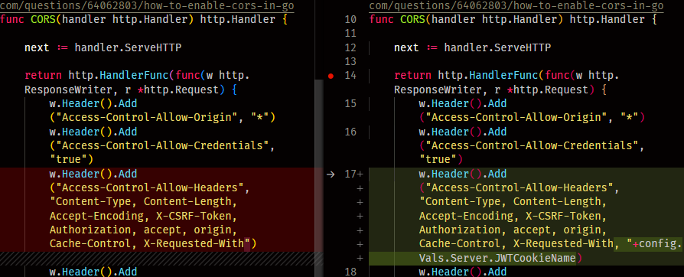
Before and After - CORS Middleware

Slide 9
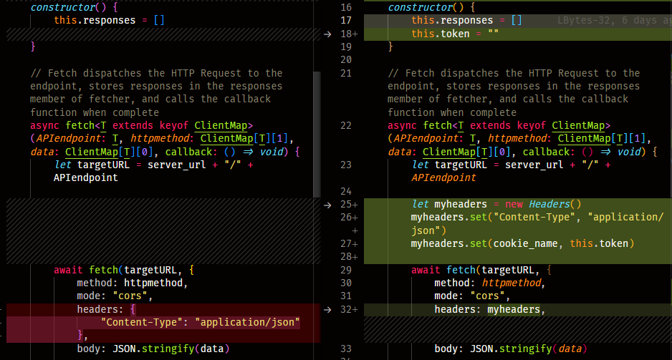
Before and After - Client Fetch Requests

Slide 10
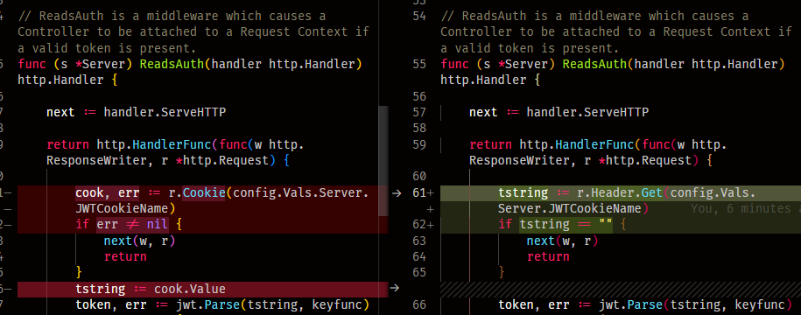
Before and After - Token Extraction Middleware

Slide 11
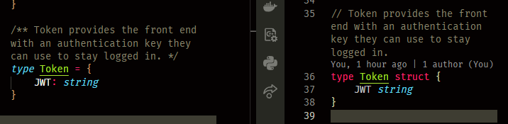
“Token” Client-Server Communication Entity

Slide 12
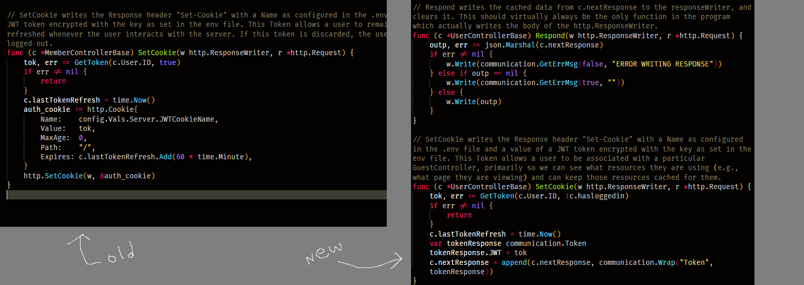
Token + ServerResponse

Slide 13
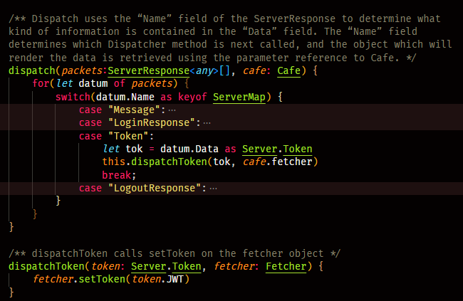
Dispatch the Token

Slide 14
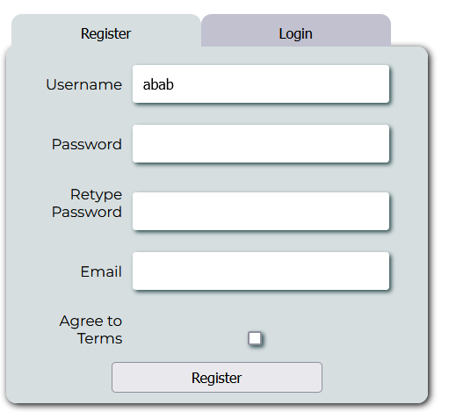
Slight CSS Updates

Slide 15
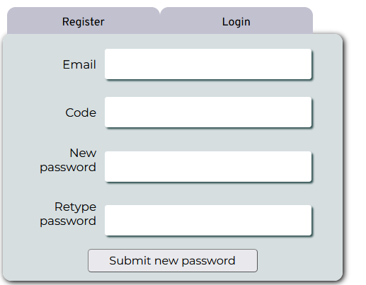
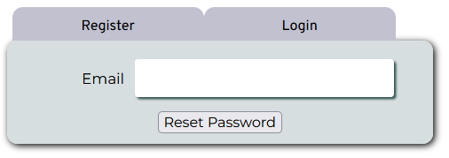
Password Reset

Slide 16
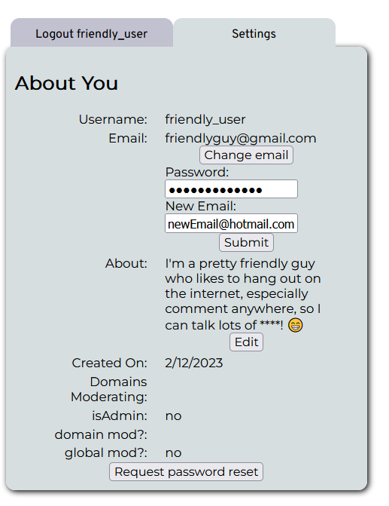
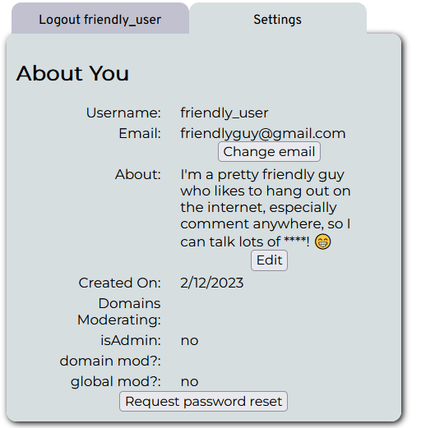
Settings Window

Slide 17
Design Choices
Sections
A container to hold HTML elements.
Everything (except for the collapse/expand button) is hidden by default.
Click the button to collapse/expand the contents.
Used in the settings window.

Slide 18
Design Choices
Password Reset Code
The code input box will be presented on the same page as the new password field.
The code will be sent to the server alongside the new password as a “SetNewPass” client-server communication entity.

Slide 19
Bugs
Settings Window
Incorrect email upon entering settings. (Correct once edited)
New email not validated if edited in settings.
If an email was edited, and successfully updated in the database, the server would respond with SUCCESS=FALSE to the client. This would cause an unwanted error message to appear on the frontend.
The profile blurb was not updated once changed. The user would need to leave settings, then go back.

Slide 20
Design Document Refactors
Added a Fetcher parameter to determine the HTTP request method.
Cookies are no longer used for authentication. Added a “Token” client-server communication entity, removed associated API endpoints.
Merged the “password reset code” and “set new password” pipeline.

