Slide 1
Comment Anywhere Week 7 Report
Karl Miller Luke Bates Frank Bedekovich

Slide 2
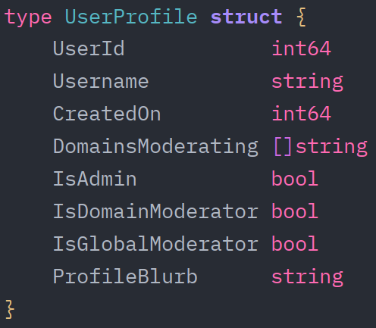
Back-End
The login response now contains the correct data to determine whether a user is a global moderator, a domain moderator, and the domains they moderate.

Slide 3
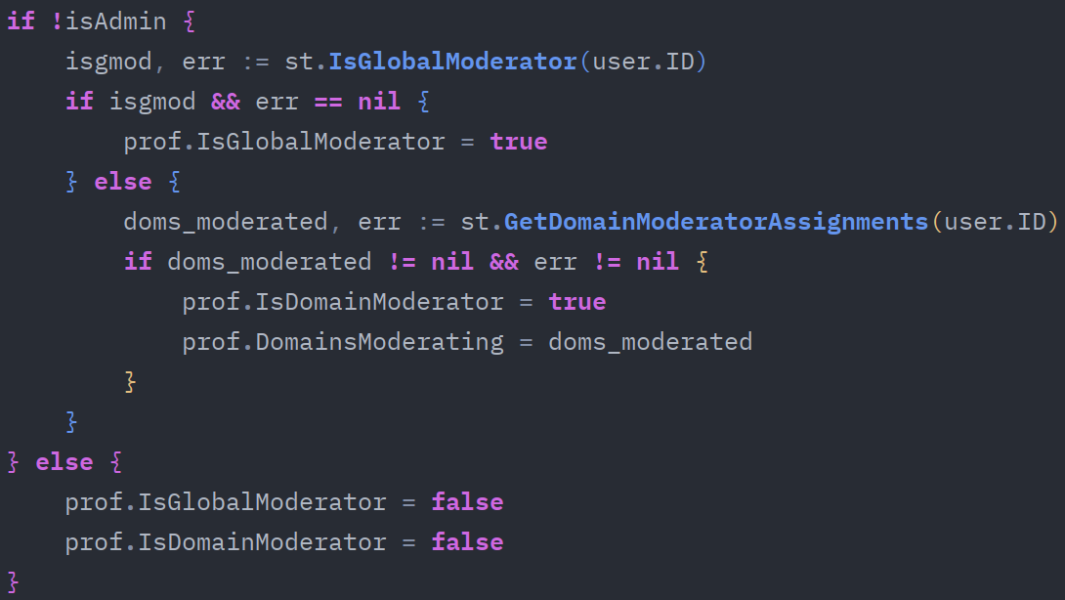
Back-End
Snippet from back-end GetCommUser() function
Are you an admin?
Are you a global moderator?
Do you moderate one or more domains?
If so, you must be a domain moderator.

Slide 4
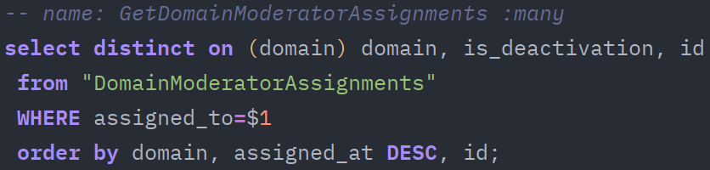
Back-End
Query a list of assigned global moderators.
Query a list of assigned domain moderators.

Slide 5
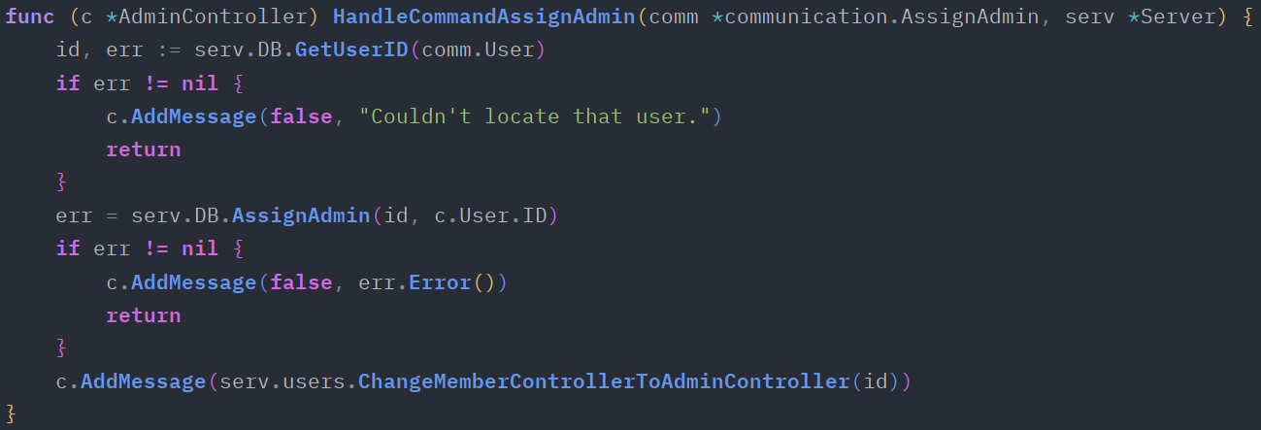
Back-End
Only admins (of which have an AdminController) may assign other admins. This function will associate the specified user (from the client-server communication entity) as an admin.

Slide 6
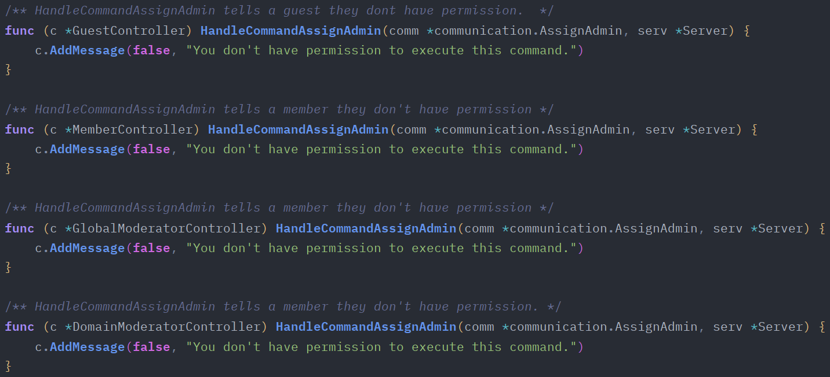
Back-End
There are four other variants of the HandleCommandAssignAdmin() function for all possible user controllers. However, these functions will respond with an error, due to insufficient privileges.

Slide 7
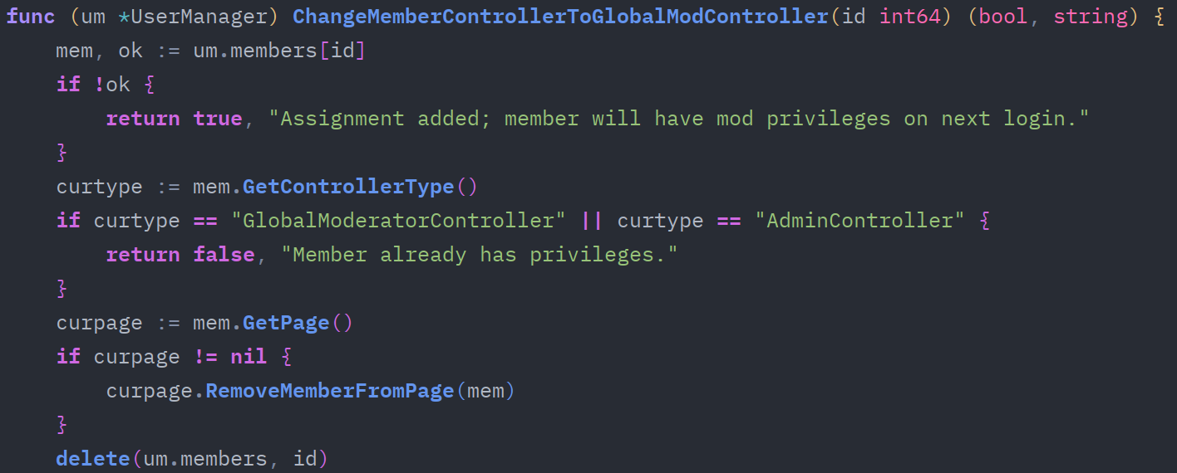
Back-End
While a user is logged in, and they are assigned a global moderator, this function will swap their “lesser” user controller with a Global Moderator Controller. (If they aren’t already one)
The first portion of the function assures whether the function should swap the controller or not. After the first check, the current controller type is saved.

Slide 8
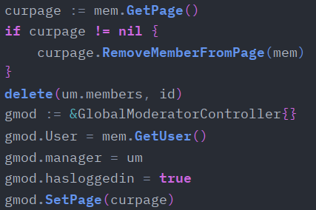
Back-End
The second portion begins the swap, where the user’s “lesser” controller is removed.
The user is then associated with the newly created GlobalModeratorController.

Slide 9
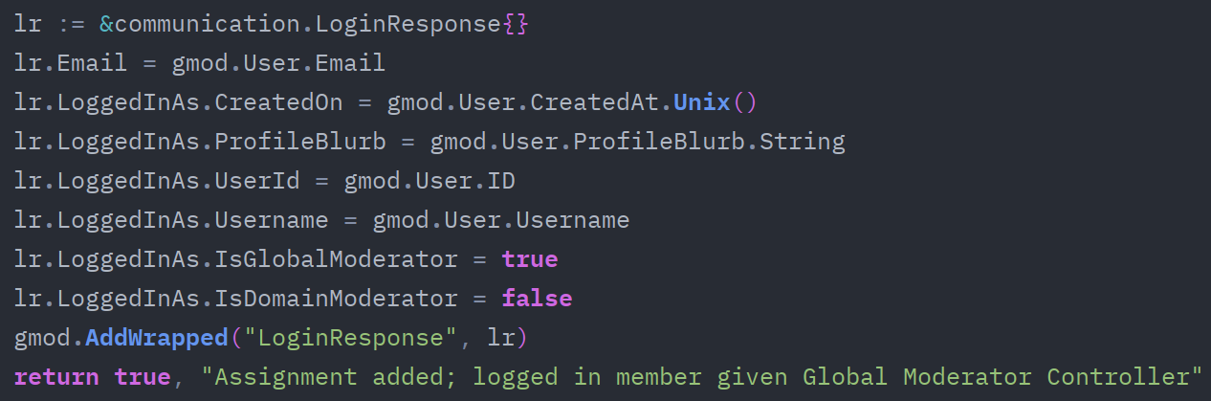
Back-End
Lastly, a LoginResponse is created to log the user in as a global moderator.

Slide 10
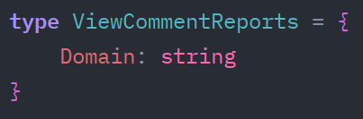
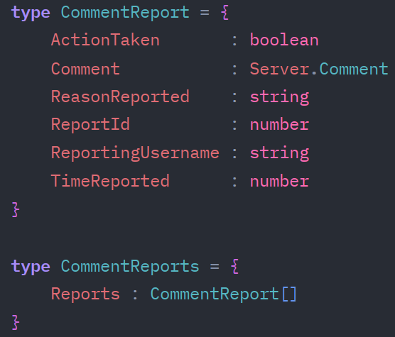
Front-End
The fetcher and dispatcher was configured to handle CommentReport communications. This is utilized when a global or domain moderator requests a list of reported comments.
The Client dispatches a ViewCommentReports entity to the server. The user would have provided the domain they wish to query reported comments from.
The server responds with a CommentReports entity. This will be dispatched to the CafeModeratorWindow

Slide 11

Front-End
This is a portion from the CafeAdminWindow. When granted, an AssignAdmin communication event is dispatched to the server. This will invoke the UserManager.ChangeMemberControllerToAdminController() function, as discussed earlier.

Slide 12
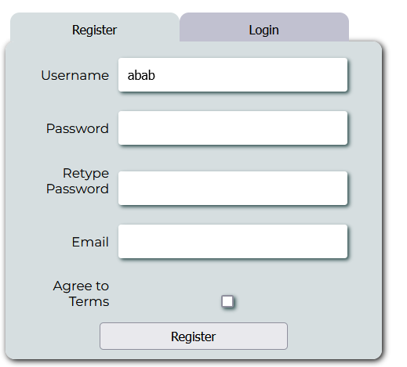
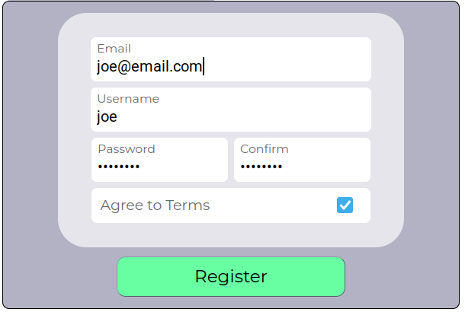
Front-End
Some UI improvements. So far, only the register window has been updated. This utilizes the CafeDom namespace, used for wrapping primitive button and input elements into container elements, and applying a consistent style.
New Design
(Work in progress)
Old Design

