Slide 1

Comment Anywhere Week 12 Report
Frank Bedekovich, Karl Miller, Luke Bates
4/17/2023

Slide 2
New format for this week and this week’s changes
This week the presentation format will have all the sections in one because they are so interlinked with eachother.
In the frontend we continued to restyle some of the UI.
We also tested out some new features in the extensions debug panel.
In the backend there were numerous changes and new sections involveing server ports and connections.
We now have password encryption working in the backend.

Slide 3
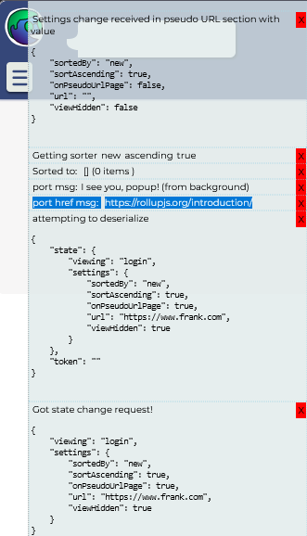
Getting the url on the frontend
the highlighted line is showing that we are succesfully getting the current URL from a content script in the extension

Slide 4
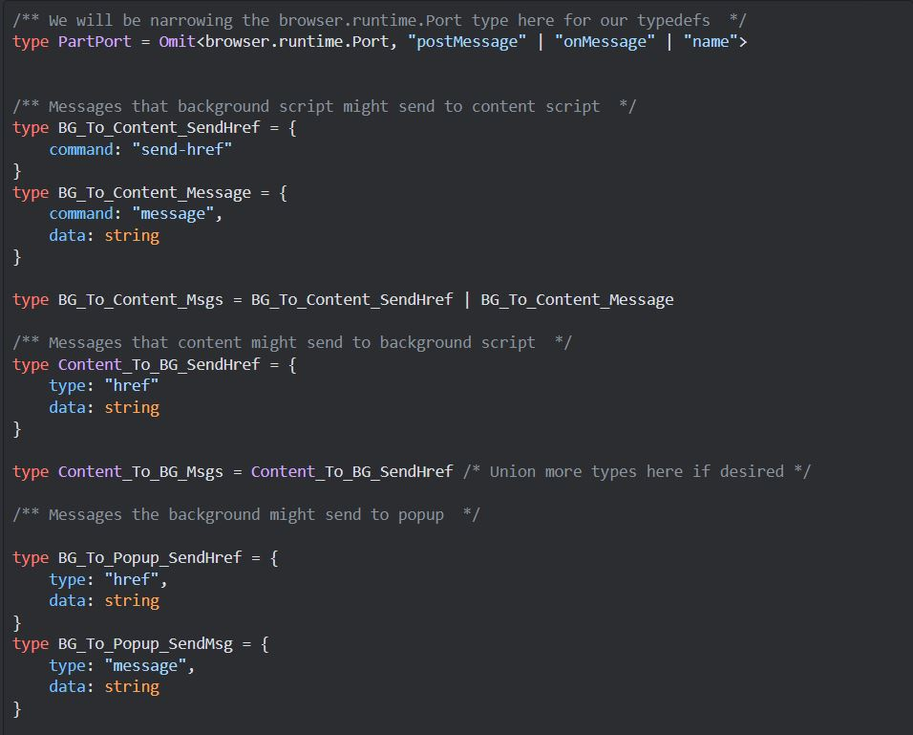
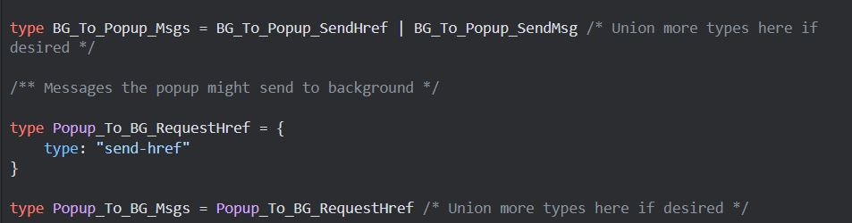
General custom port types
The content script must communicate with a background script and the background script communicates with the popup script, all through the extensions api.

Slide 5
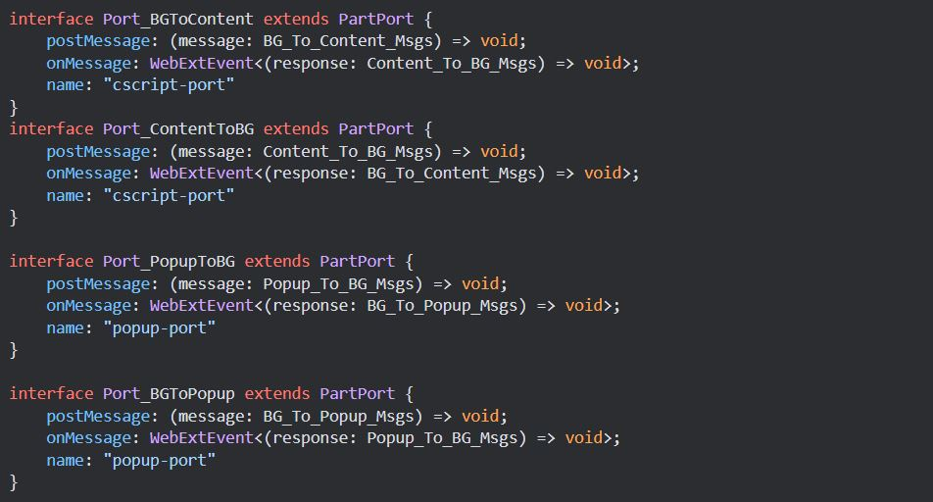
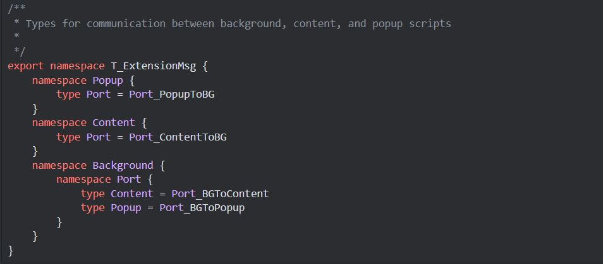
General custom port types cond.

Slide 6
General custom port types cond.

Slide 7
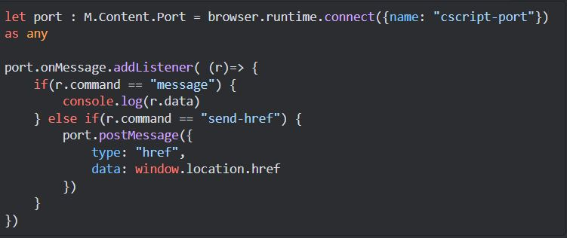
Content script port
when content script receives a "send-href" message, it immediately posts a "href" message containing the current url

Slide 8
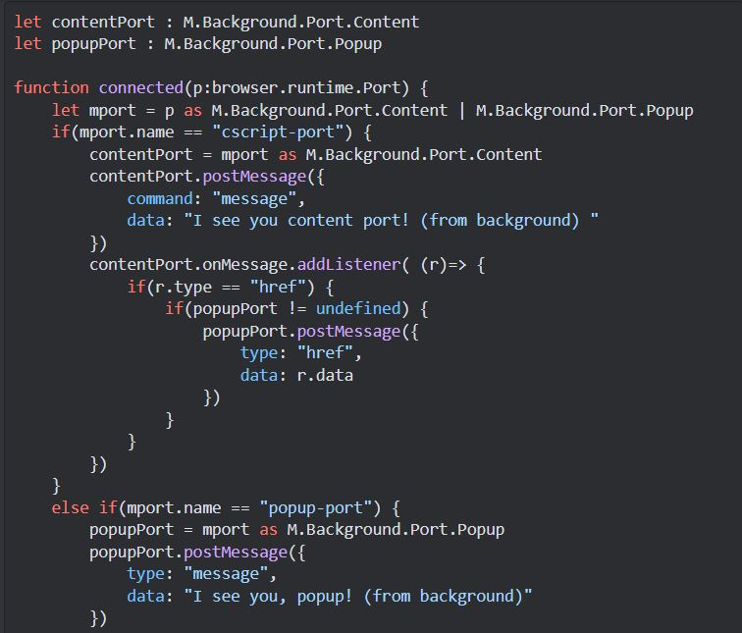
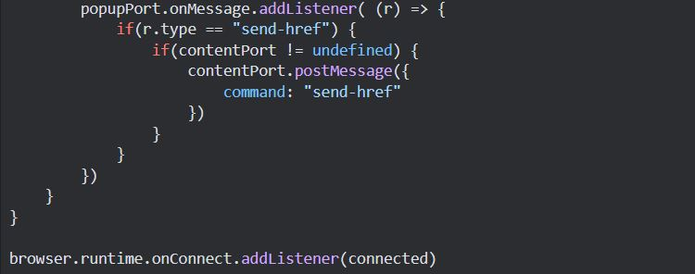
backround script
Whenever a port is connected, the background script identifies it and sets the listeners

Slide 9
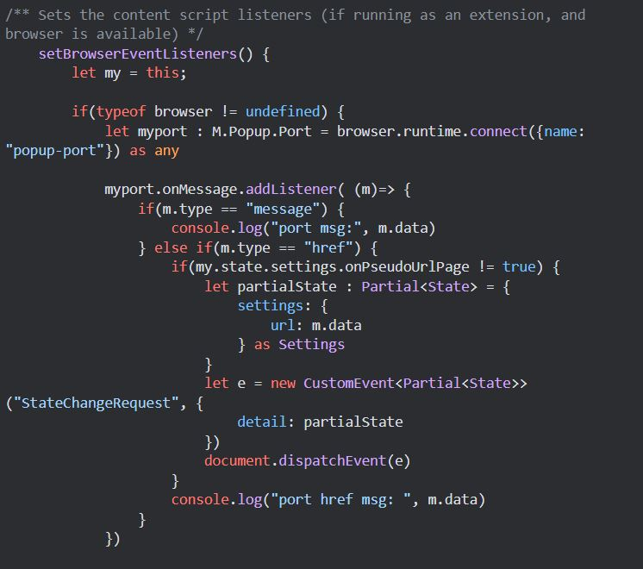
Setbrowser event listener
It emits a stateChangeRequest if the user was not previously on a pseudoURL page at the time that the popup is opened.
checkActiveUrl is called in the Cafe constructor, but it's just a null-operating function when CA is running as a webpage rather than a browser extension.

Slide 10
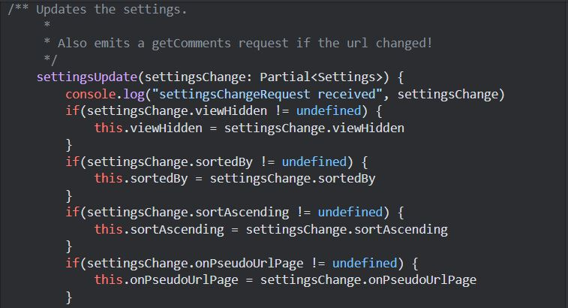
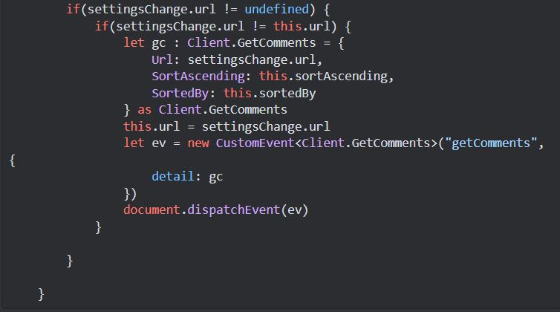
Settings Update Function
Ultimately, the request to the server for the comments is actually emitted by the Settings object at the time it is updated, if the URL it was passed is not what it already had.

Slide 11
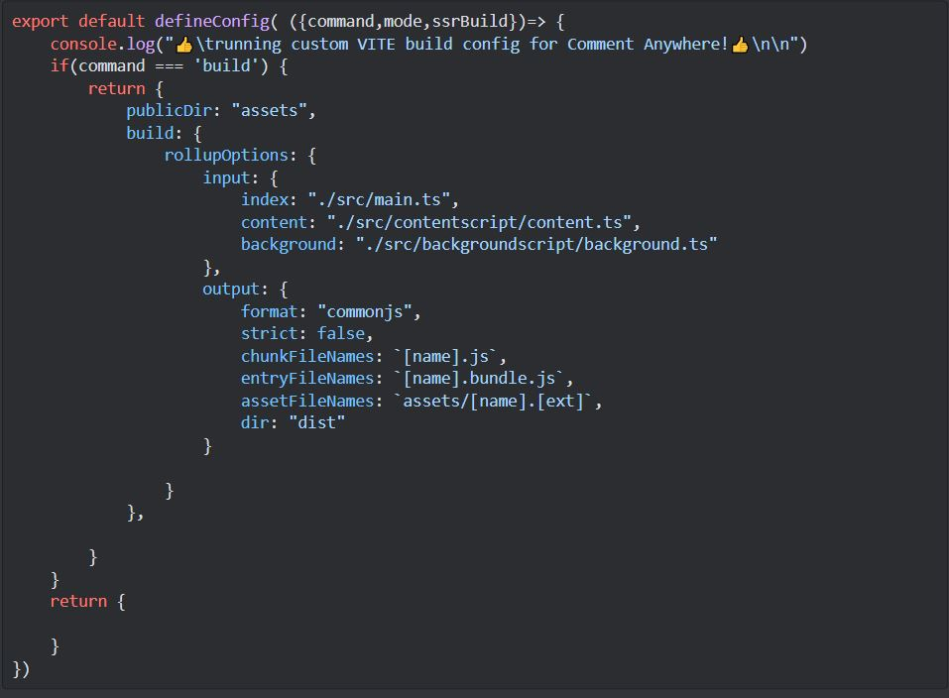
Configuration using vite.config.ts
The vite.config.ts file is used to configure the build for when the extension is being built.
If the mode is not build then it just does dev/serve as usual.
Otherwise, it outputs the content script and the background script as well as the popup It also copies all files over from the assets, so we don't need the redundant npm scripts for linux and window build commands.

Slide 12
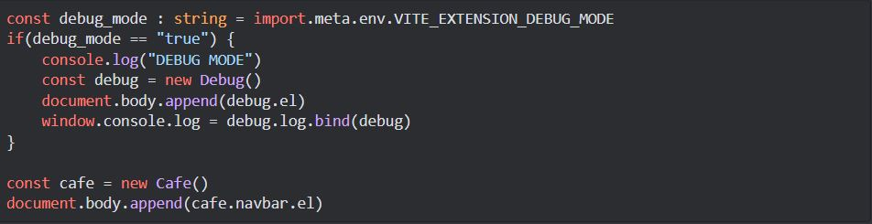
New Debug mode module
One thing I recognized early was that it was hard to get debug output when CA was running in an extension So I created a debug module that prints everything sent to console.log on the screen, so we can see it in the extension now, this is the popup (main part of Cafe) entry point

Slide 13
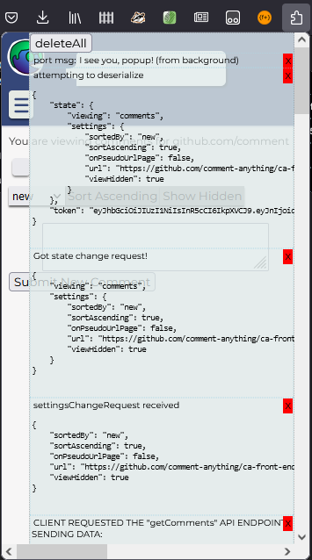
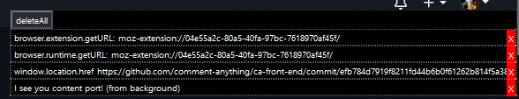
Debug mode Frontend and content script
When debug mode is on, whenever a console.log is called, an object is built in the UI rather than relying on the regular browser console, which isn't hooked into the extension.
The same is used for the content script that's injected into every page, though it's not particularly useful yet.

Slide 14
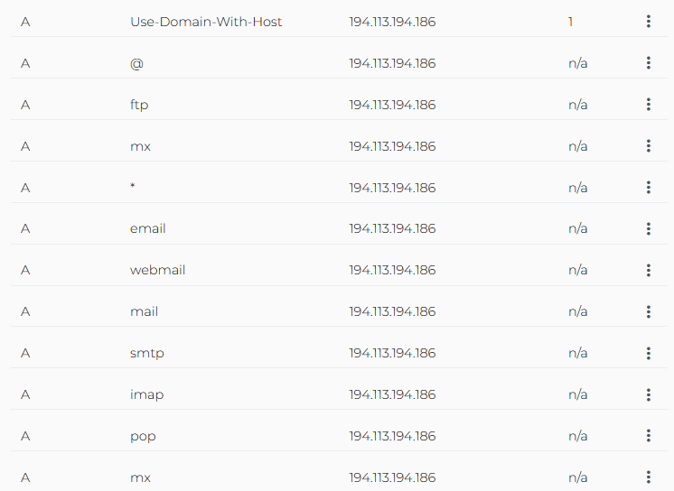
Connecting the website to the host ip
To point a domain to an IP, you must update the DNS records with the domain name provider; our DN provider is domain.com.
Specifically, you must update the A record.
Explanation: When a website name is typed into a browser, the browser tracks down the NS record by querying the DNS Server.
This translates the word the user typed into the IP address. Once done, the user can see the website.
"A" records point to a specific IP address. - this is the most popular/most important; turns the domain name into an IPV4 address - aka "Address Mapping Record" or sometimes "DNS Host Record" 5.

Slide 15
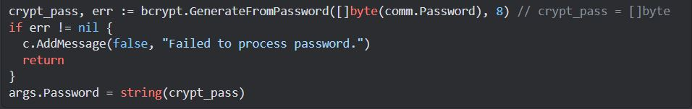
Password hashing and decryption
Passwords are now being hashed in the back end.
We are not actually decrypting our passwords but instead the hash a given string creates is just checked to make sure it's the hash that was saved from last time.

Slide 16
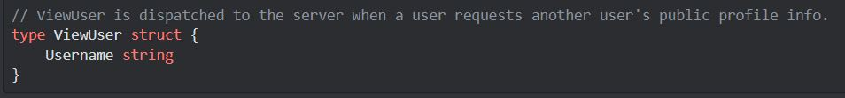
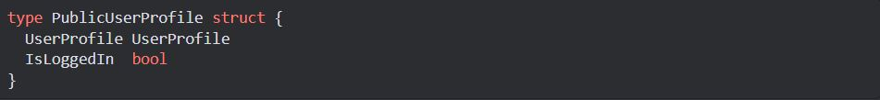
Viewuser api endpoint
the api endpoint /viewUser expects a value of type ViewUser and responds with a PublicUserProfile type.

Slide 17
Rebuilding the server
We can use ssh-keygen to generate keys and ssh-copy-id to send a public key to the server
In order to do this you have to set the local access permissions for the private key file to be more restrictive after all that, this file, build.bat just works: →
It runs a remote script on the server, which uses the Makefile to rebuild the server remote_script.sh.

Slide 18
Things for next week
According to the Gantt chart we will finish up restyling the frontend,work on putting the backend on the cloud and releasing the extension and submit the extension to the marketplace.
We need to continue working on and finish up the user manual.
We will also meet after class to discuss the next sections and pipelines to work on.

