Slide 1


Comment Anywhere Week 6 Report
Karl Miller, Frank Bedekovich, Luke Bates
2/27/2023

Slide 2
Changes To The Front End
Many small changes were made to the front end this week all over the place ( comment dates, comment hiding etc.
Comment sorting is now up and running.
The Program can now be run as a browser extension instead of just a webpage.
Worked on the administrator panel.

Slide 3
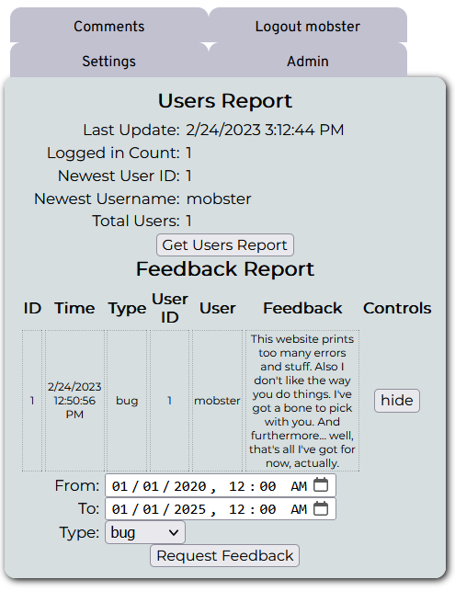
Administrator Panel

Slide 4
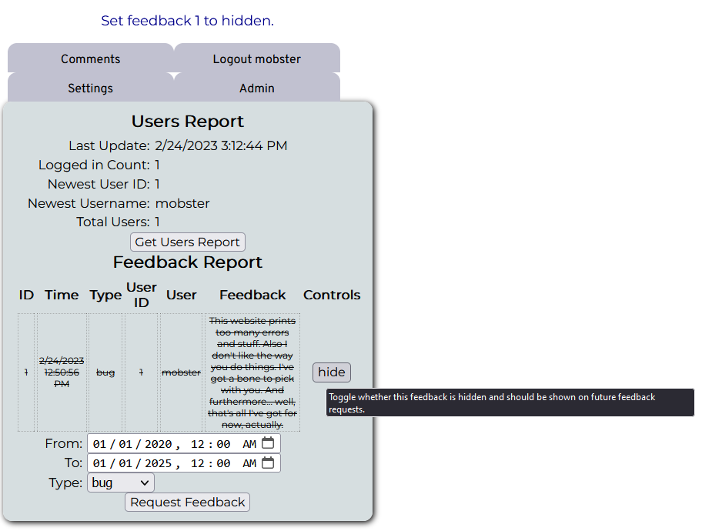
Administrator panel hide feature

Slide 5
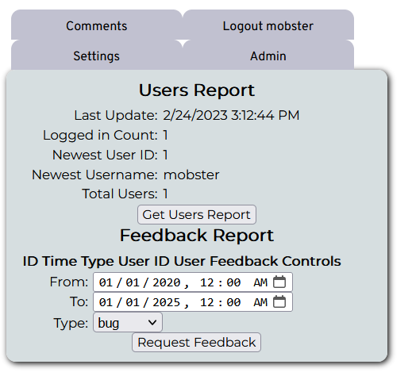
Administrator panel hidden feedback
It won't show the next time you request a feedback report though it is still saved/archived in the database.

Slide 6
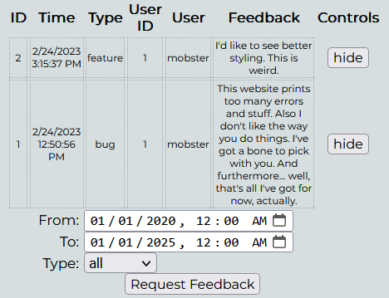
Administrator panel feedback sort
Feedback can now be sorted by type like features or bugs.

Slide 7
Changes To The Back end
There were also some changes made to the backend this week.
Added data re ( a check for whether a user is an admin ).
Added 3 new pipelines , newFeedback , viewFeedback and viewUsersReport.
Added a path and domain to fullPage response.

Slide 8
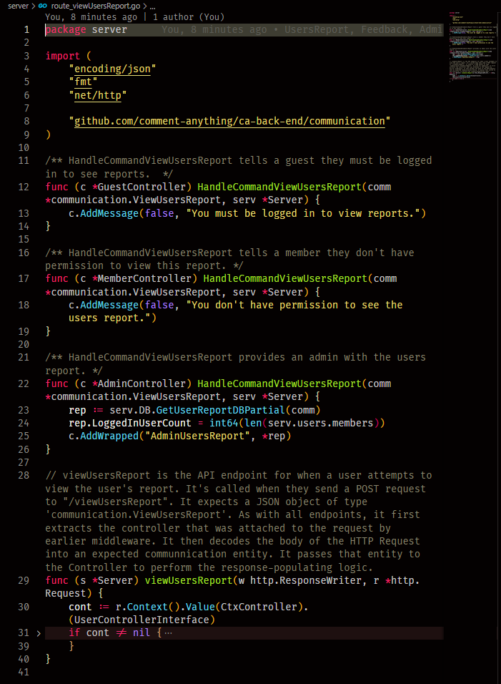
Example of the admin pipeline
polymorphically implemented differently for members and users.

Slide 9
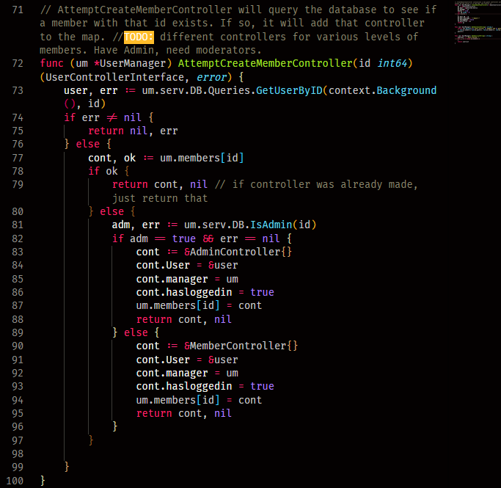
More parts of the Admin section
assigning admin controllers instead of member controllers if the database says they're an admin

Slide 10
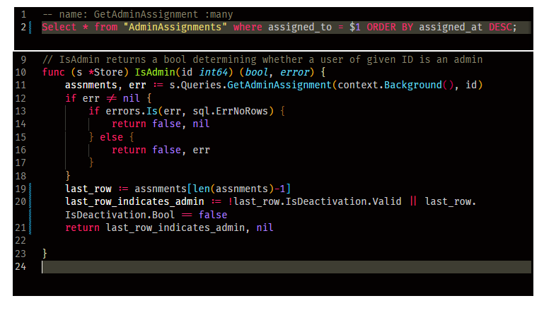
Admin Assignment
admin assignment is determined by looking at the most recent entry only.

Slide 11
Things for next week
According to the Gantt chart we will continue writing and testing new methods and restyling the frontend.
There are a few minor bugs and features that need fixed like upvotes and the program in extension form not working currently.

