Slide 1

Comment Anywhere Week 9 Report
Karl Miller, Frank Bedekovich, Luke Bates
3/27/2023

Slide 2
Changes To The Front End
There were several changes to the front end this week.
The viewLogs pipeline was created and several parts of the moderation pipeline were worked on.
There were also a few bugs fixed such as the login button doesn’t display after logging out.

Slide 3
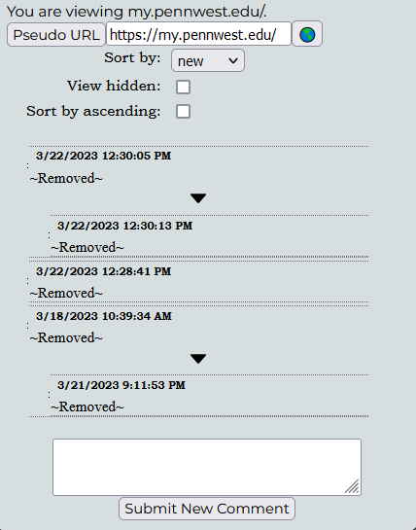
Comments section with removed comments
The comments are still sent to the user but have their content removed.

Slide 4
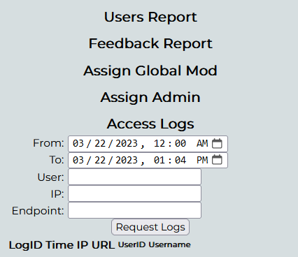
viewAccessLogs in the admin panel
The starting date defaults to the current date and goes to the current time.
If entered as is it will pull up the logs from all dates.

Slide 5
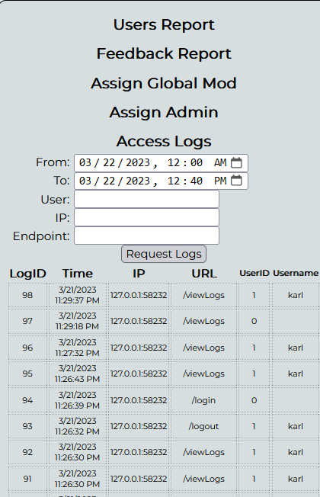
viewAccessLogs with all feedback requested

Slide 6
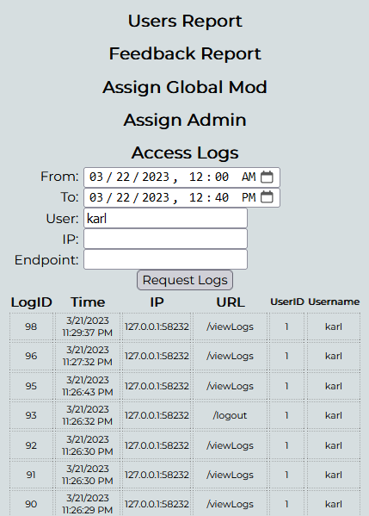
viewAccessLogs of one user

Slide 7
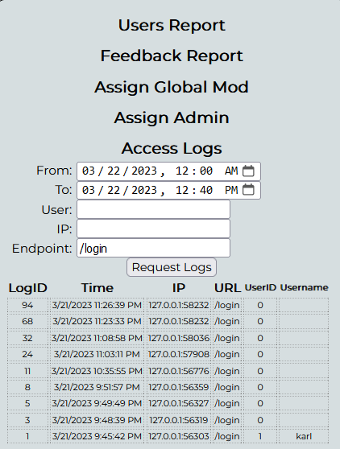
viewAccessLogs of /login actions

Slide 8
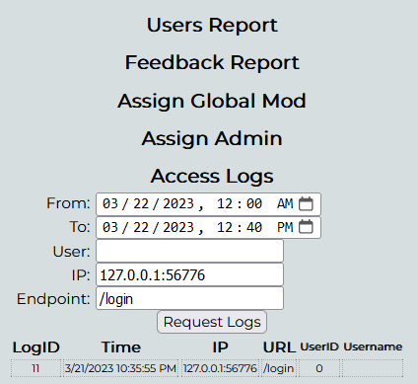
viewAccessLogs with multiple request types
How this filtering actually works will be further discussed in the backend section.

Slide 9
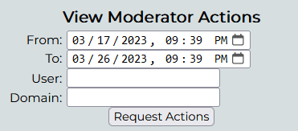
View Moderator Actions Panel
Just like with view access logs the moderator actions panel
Can be filtered with different options to get a specific moderator or actions of a specific domain.

Slide 10
Changes to the back end
This week the backend implemented many features the frontend needed in order to function.
The backend half of the moderation and several sorting sections have been implemented.

Slide 11
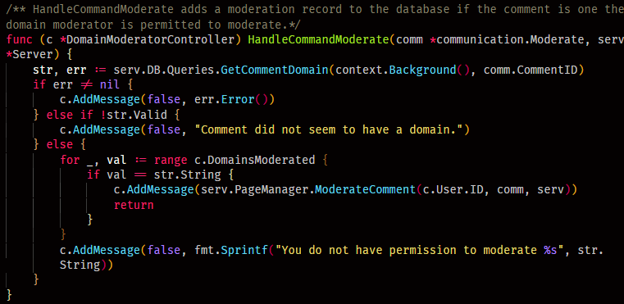
DomainModeratorController function
This function sends a valid input into the PageManager function.

Slide 12
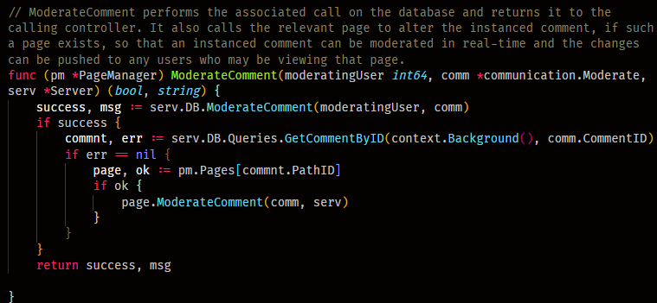
PageManager function
The PageManager function makes shure the comments are updated in the database and catche.

Slide 13
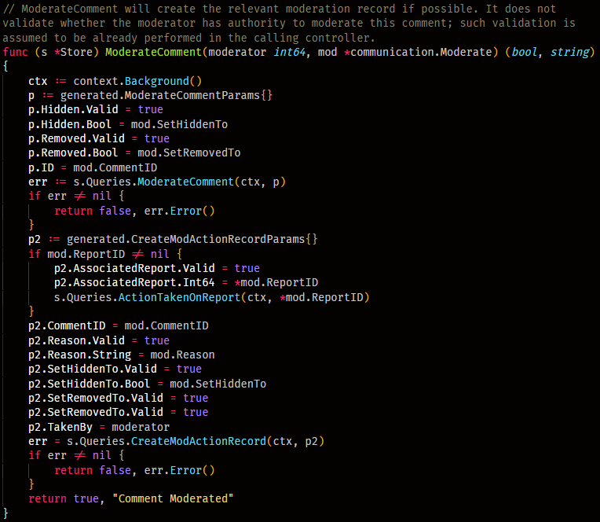
ModerateComment function
If performing the database queries was succesful, PageManager calls Page.ModerateComment to update the cached comment data and push comment changes to users currently viewing the page.

Slide 14
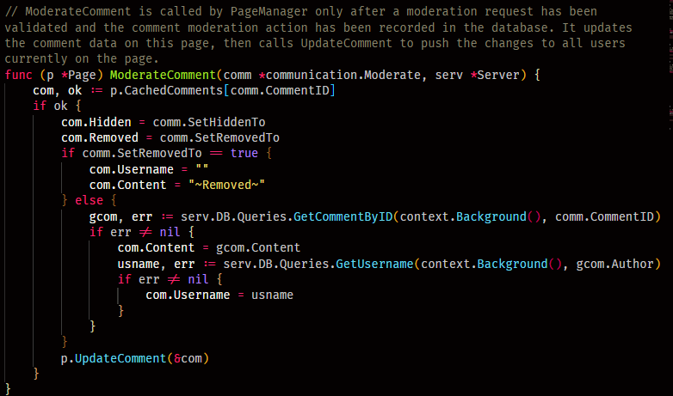
ModerateComment function
Page may also utilize the database if a comment was unremoved by a moderation action, to repopulate it with the database data.

Slide 15
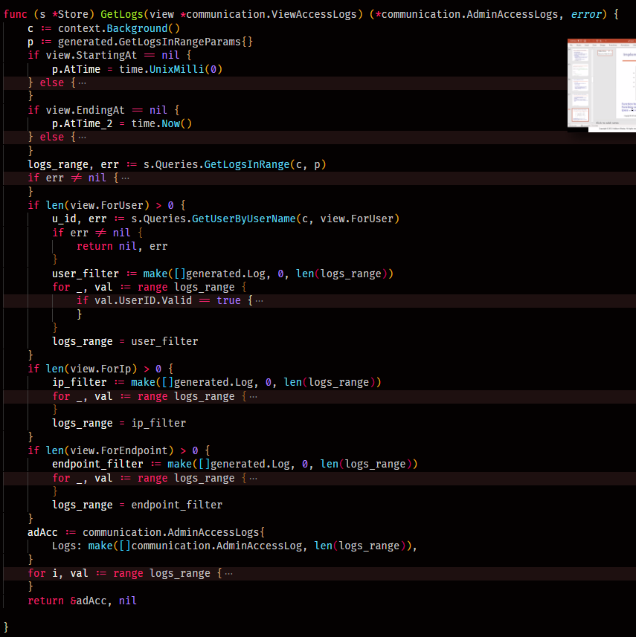
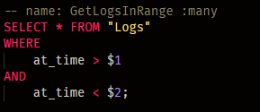
filters for frontend ViewAccessLogs
The sql query does the date filtering only
[1:10 PM]
The sql query does the date filtering only
[1:10 PM]
The sql query does the date filtering only.
The rest of the filtering occurs in Store.GetLogs.

Slide 16
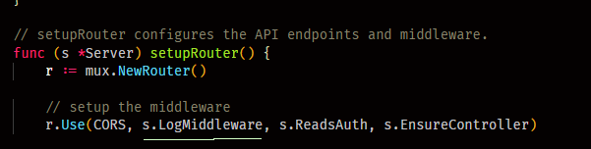
setupRouter function
On the back end, logging is implemented through a middleware function, the same one which has been logging to our server CLI.

Slide 17
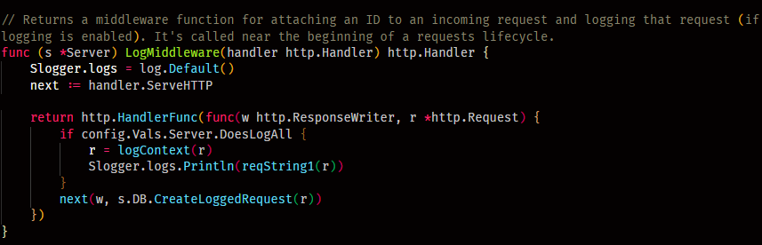
LogMiddleware function
this is the logger middleware. We can see before it calls "Next" it makes a call to Store (server.DB).

Slide 18
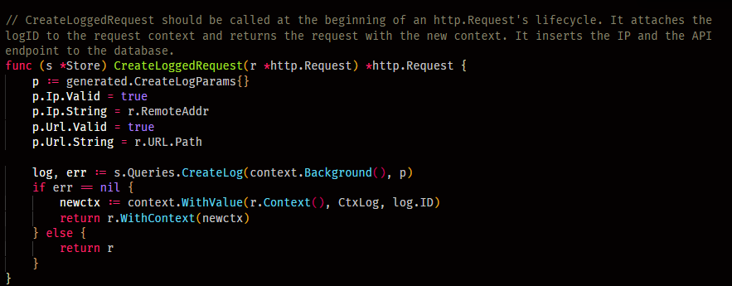
CreateLoggedRequest function
besides adding the log entry to the database, this DB function adds the logID to the write-only Context member of the http.Request. This is so that additional information can later be added to the log as the request is further processed.

Slide 19
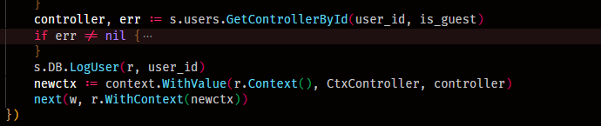
A closer look at the createLoggedRequest function
Specifically, when a user becomes associated with a request in the ReadsAuth middleware, another call to Store is made, passing the http.Request as a parameter once again, and the ID of the user that was attached to the controller.

Slide 20
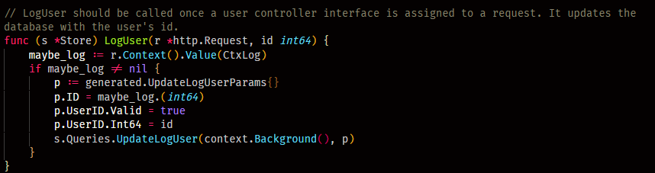
LogUser function
At that point, the logID that was previously attached to the request context is used again to update the log in the database with the username and ID.

Slide 21
Things for next week
According to the Gantt chart we will continue writing and testing new methods and restyling the frontend.
We will also meet after class to discuss the next sections and pipelines to work on.

