Slide 1


Comment Anywhere
Progress Report
23 January 2023
Karl Miller
Frank Bedekovich
Luke Bates

Slide 2
Comment Anywhere
Overview
Progress Report
Identify progress prior to the Spring 2023 semester
Created a Trello Board
Organized our Discord server
Failed to create a Student Repo account
Created a Gantt chart
Created a webpage with Jekyll
Created a GitHub repository

Slide 3
Comment Anywhere
Prior Progress
Progress Report
Karl developed a prototype front-end and back-end of Comment Anywhere throughout the Fall 2022 semester.
Proved to be an incredibly useful resource for understanding our project goals.
We will be using the TypeScript and Golang programming languages.
Luke created the Implementation repository for the Comment Anywhere GitHub organization.

Slide 4
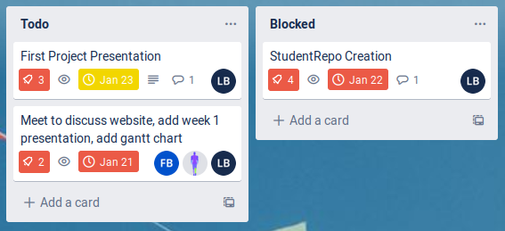
Comment Anywhere
Trello Board
Progress Report
Trello Board is a service that allows a team to manage goals and progress in an intuitive way.
On January 18, Karl set up a Trello Board instance.

Slide 5
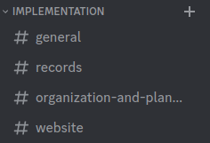
Comment Anywhere
Discord Server
Progress Report
A Discord server was set up as our primary means of communication.
We organized different channels for different topics.

Slide 6
Comment Anywhere
Student Repo
Progress Report
On January 18, Luke attempted to create a Student Repo account.
Unfortunately, the account could not be created, as the conformation email failed to send.
This issue was later confirmed by Karl, as his attempt to create an account failed as well.

Slide 7
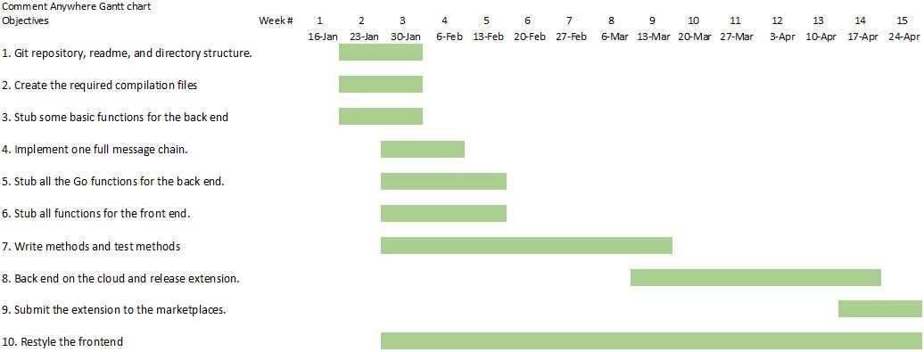
Comment Anywhere
Gantt Chart
Progress Report
On January 20, Frank finished creating the Gantt chart.

Slide 8
Comment Anywhere
Jekyll
Progress Report
Karl introduced a technology named Jekyll: a tool that generates a static webpage from a series of Markdown files, and properly organizes these files into separate tabs.
Allows for a global theme, which eliminates the time and effort needed to manually code a style.

Slide 9
Comment Anywhere
GitHub
Progress Report
Hosts the repositories for the implementation phase and static website.
Karl provided a helpful set of instructions detailing the process of making posts to the static webpage, available in the Readme.

