Slide 1
Comment Anywhere Week 2 Report
Karl Miller, Luke Bates, Frank Bedekovich
1/30/2023

Slide 2
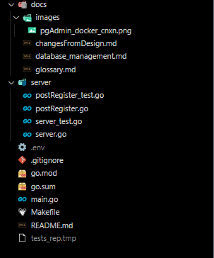
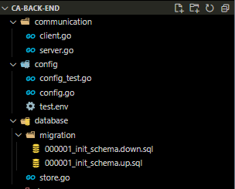
Ca-back-end project glance

Slide 3
.env file
An environment variable is a dynamic-named value that can affect the way running processes will behave on a computer. (Wikipedia)
They are just key value pairs.
.env file typically lives in the root of a project.
It’s added to a .gitignore file so it’s not uploaded to a remote repository
It contains sensitive data such as passwords, API keys, and encryption keys.

Slide 4
.env file
# The .env file provides important constants. It should not be included in public repos. CA_TESTING_MODE = true
# DB_IMAGE is the docker image that the database will be built from.
DB_IMAGE=postgres:14.5-alpine
# DB_CONTAINER_NAME is the name of the container in docker.
DB_CONTAINER_NAME=923postgres
# DB_CONTAINER_PORT is the port the container will be listening on in its environment. It will be mapped to the value of DB_HOST_PORT on the host device. These values can be the same but if you already have postgres installed on your computer like I do, you may want to map to a different port.
DB_CONTAINER_PORT=5432
DB_HOST=localhost
DB_HOST_PORT=5433
DB_USER=root
DB_PASSWORD=dbsuperuser991
# SERVER_PORT is the port that Go will be served on.
SERVER_PORT=3000
SERVER_LOG_ALL=true
# --- Production Environment
# The port that Go will listen to database with(for port mapping)
DB_DATABASE_NAME=comm-anything
# --- Test Environment
TEST_DB_DATABASE_NAME = comm-anything-tests

Slide 5
Makefile
Make simplifies the build process.
Make comes with most Linux distros but has to be downloaded for windows.
On Windows I used Chocolatey to install make: “choco install make”
Otherwise we would have looked at a bat file or VSCode’s “tasks.json” file to handle the various build commands.
All make commands are executed with “make <makecommand>”

Slide 6
Makefile – initializing the project
include .env
dependencies:
docker pull ${DB_IMAGE}
docker pull kjconroy/sqlc
go get .
go install -tags 'postgres' github.com/golang-migrate/migrate/v4/cmd/migrate@latest
build_postgres:
docker run --name ${DB_CONTAINER_NAME} -p ${DB_HOST_PORT}:${DB_CONTAINER_PORT} -e POSTGRES_USER=${DB_USER} -e POSTGRES_PASSWORD=${DB_PASSWORD} -d ${DB_IMAGE}
start_postgres:
docker start ${DB_CONTAINER_NAME}
stop_postgres:
docker stop ${DB_CONTAINER_NAME}
remove_postgres:
docker stop ${DB_CONTAINER_NAME}
docker rm ${DB_CONTAINER_NAME}

Slide 7
Database Schema
CREATE TABLE "Users" (
"id" bigserial PRIMARY KEY,
"username" varchar UNIQUE NOT NULL,
"password" varchar NOT NULL,
"email" varchar UNIQUE NOT NULL,
"created_at" timestamptz NOT NULL DEFAULT (now()),
"last_login" timestamptz NOT NULL DEFAULT (now()),
"profile_blurb" varchar,
"banned" boolean
);
CREATE TABLE "DomainBans" (
"user" bigint,
"banned_from" varchar,
"banned_by" bigint,
"banned_at" timestamptz NOT NULL DEFAULT (now())
);
CREATE TABLE "Comments" (
"id" bigserial PRIMARY KEY,
"pathid" bigint NOT NULL,
"author" bigint NOT NULL,
"content" varchar NOT NULL,
"created_at" timestamptz NOT NULL DEFAULT (now()),
"parent" bigint,
"hidden" boolean DEFAULT false,
"removed" boolean DEFAULT false
);
CREATE TABLE "VoteRecord" (
"commentId" bigint,
"category" varchar,
"userId" bigint,
"value" int8,
PRIMARY KEY ("commentId", "category")
);

Slide 8
Makefile – Creating the Database
create_db:
docker exec -it ${DB_CONTAINER_NAME} createdb --username=${DB_USER} --owner=${DB_USER} ${DB_DATABASE_NAME}
create_test_db:
docker exec -it ${DB_CONTAINER_NAME} createdb --username=${DB_USER} --owner=${DB_USER} ${TEST_DB_DATABASE_NAME}
migrate_up:
migrate -path database/migration -database "postgresql://${DB_USER}:${DB_PASSWORD}@${DB_HOST}:${DB_HOST_PORT}/${DB_DATABASE_NAME}?sslmode=disable" -verbose up
migrate_test_up:
migrate -path database/migration -database "postgresql://${DB_USER}:${DB_PASSWORD}@${DB_HOST}:${DB_HOST_PORT}/${TEST_DB_DATABASE_NAME}?sslmode=disable" -verbose up
migrate_down:
migrate -path database/migration -database "postgresql://${DB_USER}:${DB_PASSWORD}@${DB_HOST}:${DB_HOST_PORT}/${DB_DATABASE_NAME}?sslmode=disable" -verbose down
migrate_test_down:
migrate -path database/migration -database "postgresql://${DB_USER}:${DB_PASSWORD}@${DB_HOST}:${DB_HOST_PORT}/${TEST_DB_DATABASE_NAME}?sslmode=disable" -verbose down

Slide 9
‘Test’ Mode Changes which DB accessed
// loadDBEnv loads environment variables into the configuration struct. If it fails to load a variable, it terminates the program process. Correct environment variables are required for the server to run.
func (c *config) loadDBEnv() {
// omitted code
if os.Getenv("CA_TESTING_MODE") != "true" {
c.DB.DBname = os.Getenv("DB_DATABASE_NAME")
if c.DB.DBname == "" {
badEnvTerminate("DB_DATABASE_NAME")
}
} else {
c.DB.DBname = os.Getenv("TEST_DB_DATABASE_NAME")
if c.DB.DBname == “" {
badEnvTerminate("TEST_DB_DATABASE_NAME")
}
}
}

Slide 10
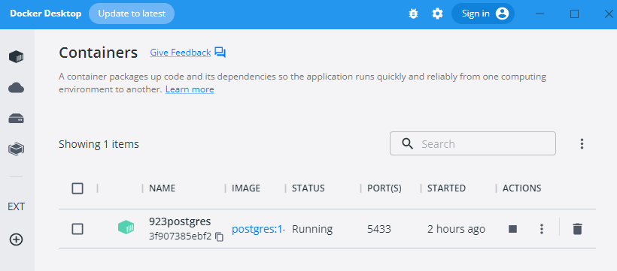
Docker Container Running

Slide 11
Docker Container – psql command line
> docker exec -it 923postgres psql -U root comm-anything
psql (14.5)
Type "help" for help.
comm-anything=# select * from "Users";
id | username | password | email | created_at | last_login | access_level
----+----------+-----------+--------------+-------------------------------+-------------------------------+--------------
1 | klm123 | 1xtdf | 7@7.com | 2022-09-26 20:39:59.997411+00 | 2022-09-26 20:39:59.997411+00 | 3
2 | aaaaa | aaaaaaaa | aaa@aaa.com | 2022-09-26 21:06:35.134534+00 | 2022-09-26 21:06:35.134534+00 | 0
4 | bbbbb | bbbbbb | bbb@bbbb.com | 2022-10-05 18:55:23.635117+00 | 2022-10-05 18:55:23.635117+00 | 0
5 | ccccc | cccccccc | cccc@ex.com | 2022-10-05 18:57:12.134446+00 | 2022-10-05 18:57:12.134446+00 | 0
6 | dddddd | dddddd | ddddd@d.com | 2022-10-05 18:57:56.410344+00 | 2022-10-05 18:57:56.410344+00 | 0
7 | dadadada | dddddddd | dddddd@d.com | 2022-10-05 19:00:41.268855+00 | 2022-10-05 19:00:41.268855+00 | 0
8 | xxxxxx | xxxxxxxx | xxxxx@x.com | 2022-10-05 19:03:14.709491+00 | 2022-10-05 19:03:14.709491+00 | 0
9 | yyyyyy | yyyyyyyyy | yyyy@yyy.com | 2022-10-05 19:07:36.684935+00 | 2022-10-05 19:07:36.684935+00 | 0
(8 rows)
comm-anything=#

Slide 12
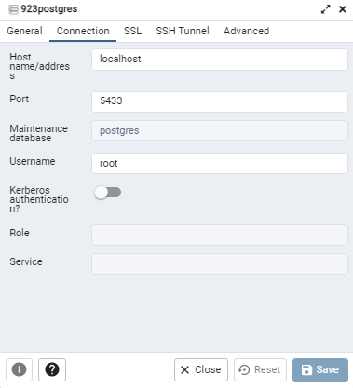
pgAdmin - Connecting

Slide 13
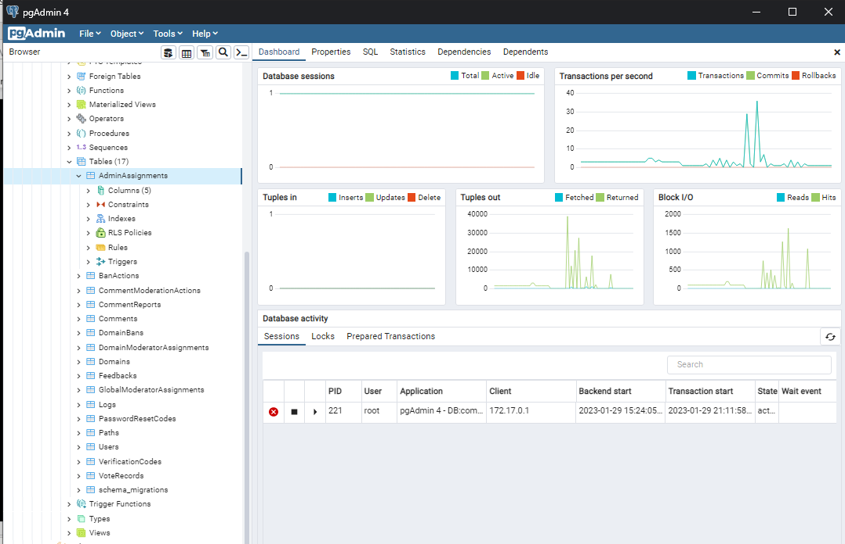
pgAdmin - Connected

Slide 14
server.go snippets
/* New returns a new server with routing applied and a database connection initialized. */
func New() (*Server, error) {
if config.Vals.IsLoaded != true {
return nil, errors.New("Configuration object must be initialized to the create server.")
}
s := &Server{}
s.setupRouter()
s.httpServer = http.Server{
Addr: config.Vals.Server.Port,
}
return s, nil
}
// setupRouter configures the API endpoints and middleware.
func (s *Server) setupRouter() {
r := mux.NewRouter()
r.HandleFunc("/register", s.postRegister).Methods(http.MethodPost)
s.httpServer.Handler = r
}
/* Start causes the Server to start listening on the port defined in the config.go. */
func (s *Server) Start() {
fmt.Println("Server listening on port ", config.Vals.Server.Port)
s.httpServer.ListenAndServe()
}

Slide 15
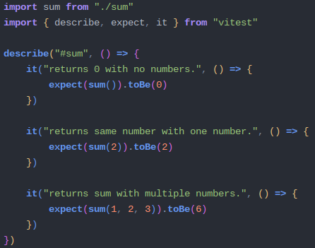
Front End Tests with Vitest

Slide 16
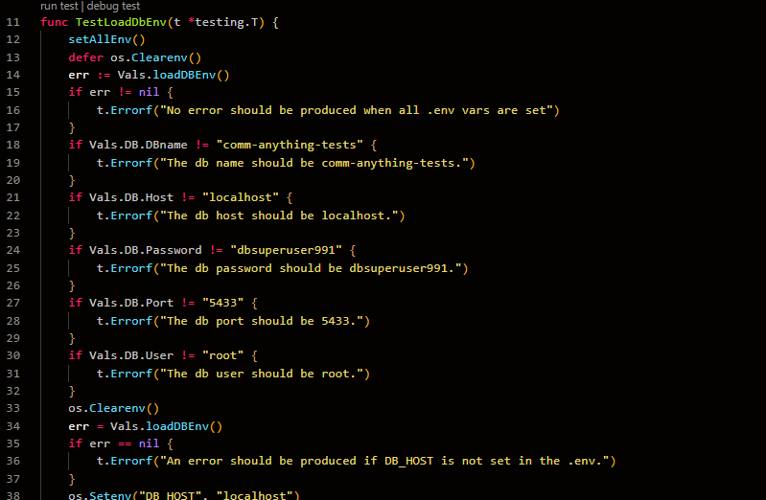
Back End Tests with Go

Slide 17
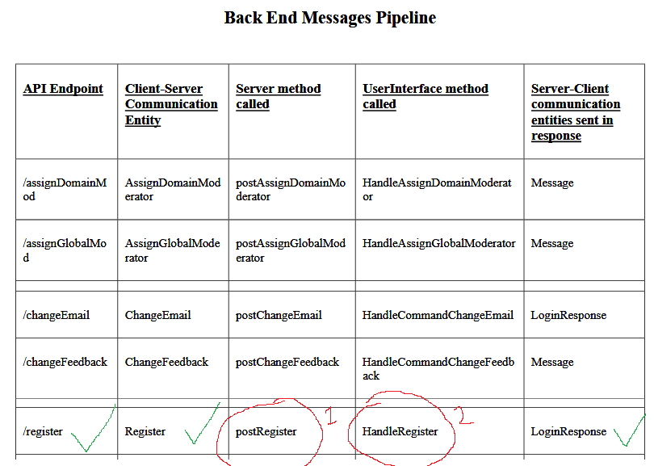
Next big goal: 1 full message chain
From the design document

Slide 18
Communication Entities
package communication
// LoginResponse is sent to the client when they successfully log in.
type LoginResponse struct {
LoggedInAs UserProfile
}
// UserProfile contains data needed by the Front End to display a profile for a user.
type UserProfile struct {
UserId int64
Username string
CreatedOn int64
DomainsModerating []string
IsAdmin bool
IsDomainModerator bool
IsGlobalModerator bool
ProfileBlurb string
}
package communication
// Register is dispatched to the server when the client clicks “Submit” on the register form.
type Register struct {
Username string
Password string
RetypePassword string
Email string
AgreedToTerms bool
}

Slide 19
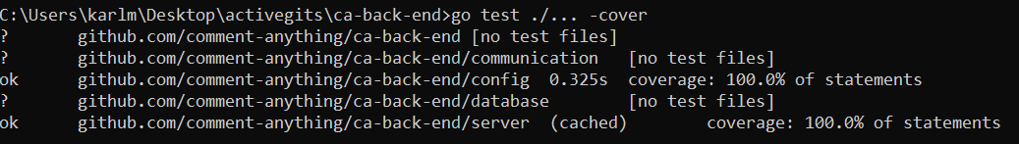
Ca-back-end project glance

