Slide 1
Commerce Case Study
Rio Bastian
10/2021

Slide 2
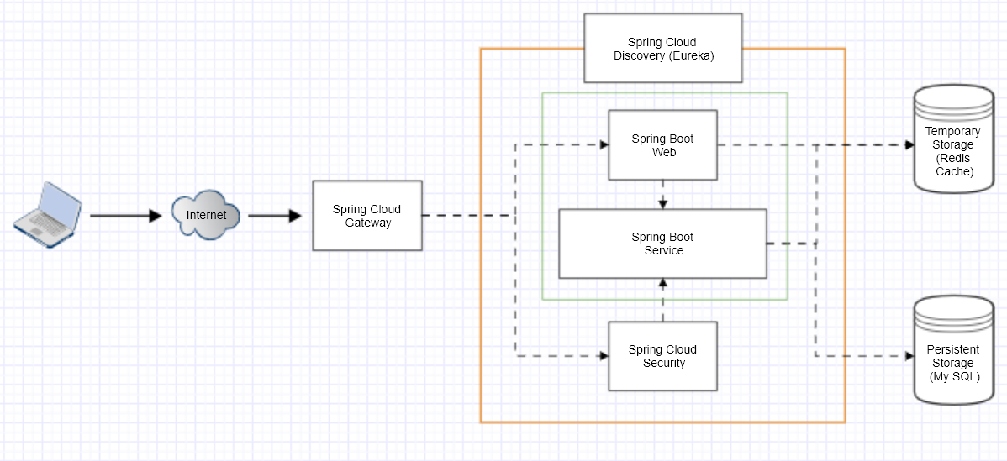
Architecture (1/9)

Slide 3
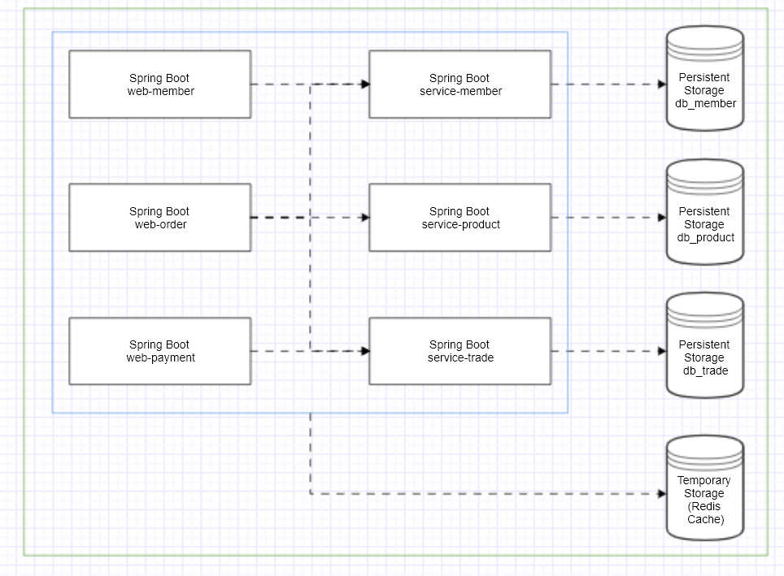
Service Relationship (2/9)

Slide 4
Deployment (tobe) (3/9)
Merge Development branch into Master
It will be automatically trigger build and push Image to Docker Repository.
2. Do Tagging on Branch
It will be automatically trigger pull Image from Docker and deploy to the server.

Slide 5
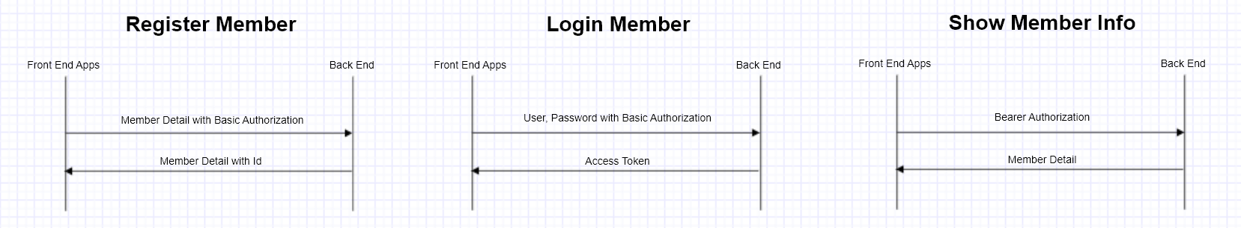
User (4/9)

Slide 6
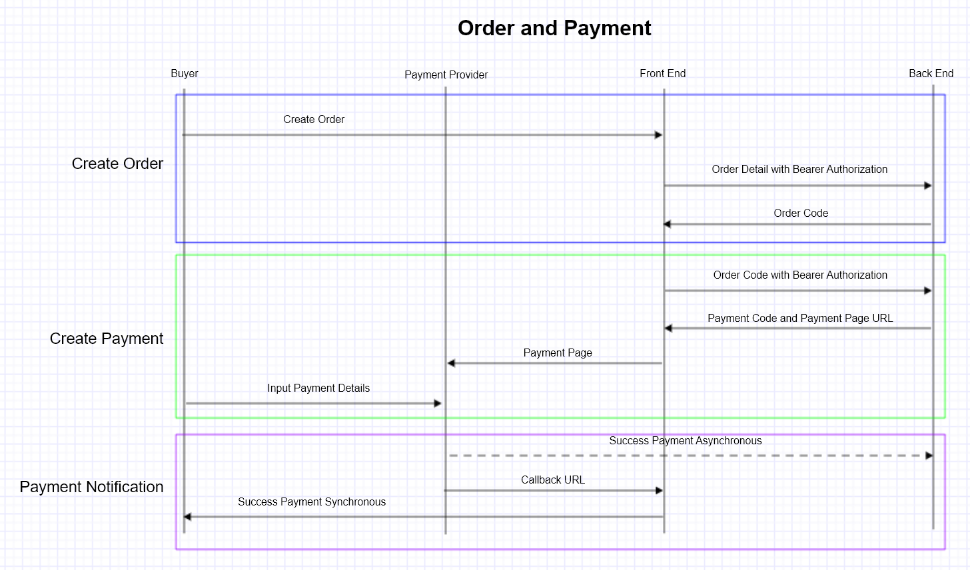
Order and Payment #1 (5/9)

Slide 7
Order and Payment #1 (6/9)
Pros
No need to Setup PCI DSS Standard
Cons
User Experience is depend on Payment Provider

Slide 8
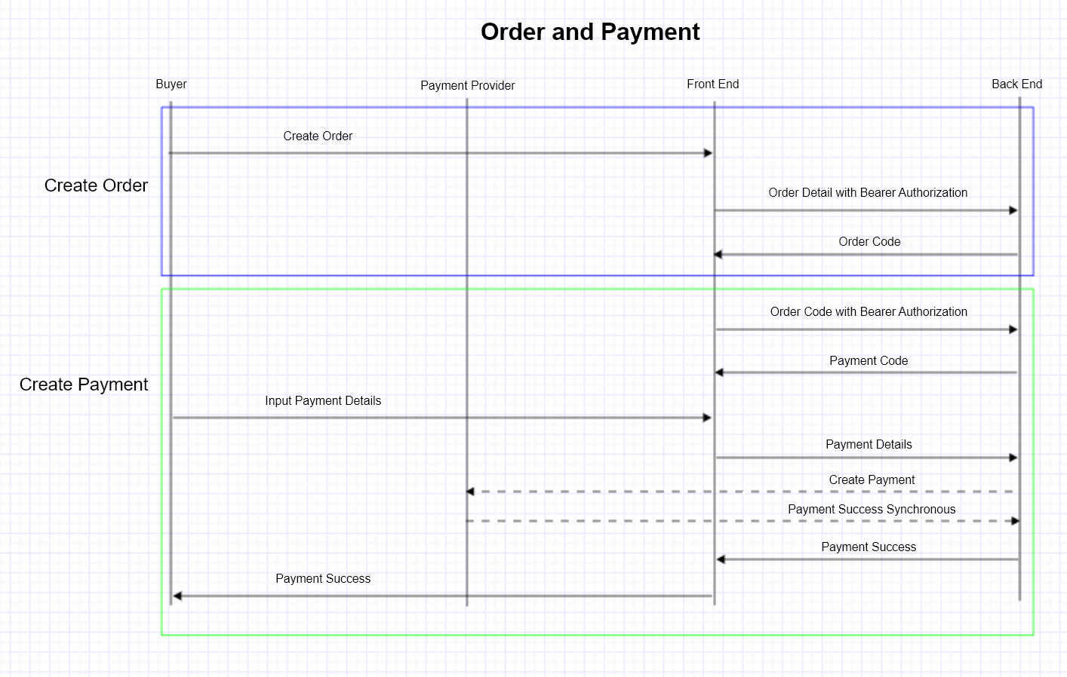
Order and Payment #2 (7/9)

Slide 9
Order and Payment #1 (8/9)
Pros
No Dependencies in User Experience
Cons
Need to setup PCI DSS Standard

Slide 10
Glossary (9/9)
Project Overview
https://github.com/commerce-case-study/a-documentation
Repository
https://github.com/commerce-case-study
Sample Request
https://github.com/commerce-case-study/a-documentation/blob/main/sample-request-response.txt

Slide 11
Thank you for your Time
done

