Slide 1
Comparing population dynamics equations for HER and LS
Jane Sullivan
Last updated: 2019-06-25

Slide 2
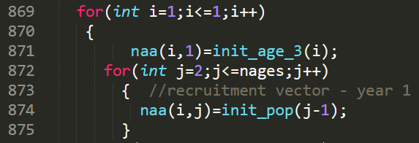
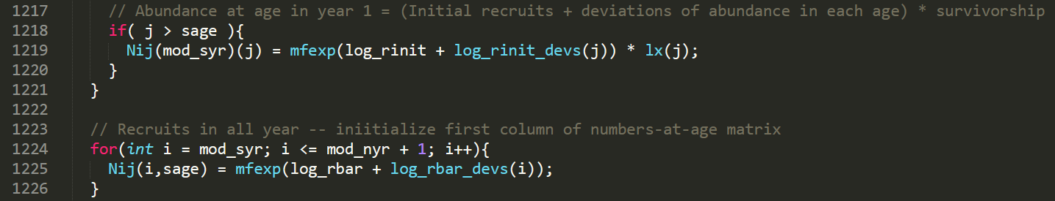
Initializing N matrix
LS
One parameter for each age 4-8+ in initial year and one for parameter for age-3 in each year, Estimated on natural scale.
HER
One mean initial numbers at age and recruitment parameter plus deviations. Estimated on log-scale.

Slide 3
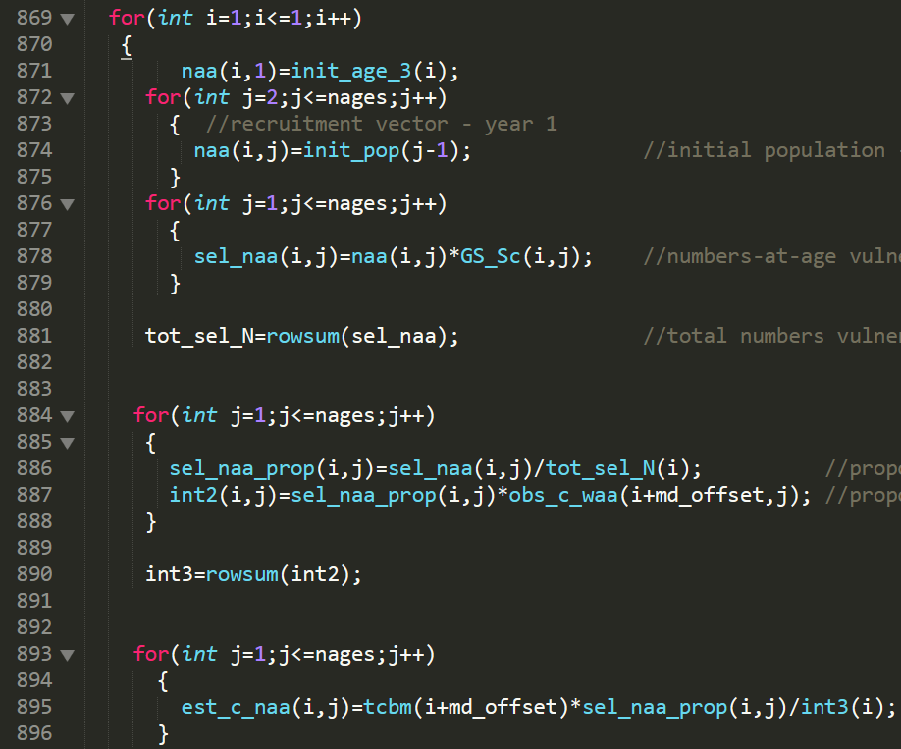
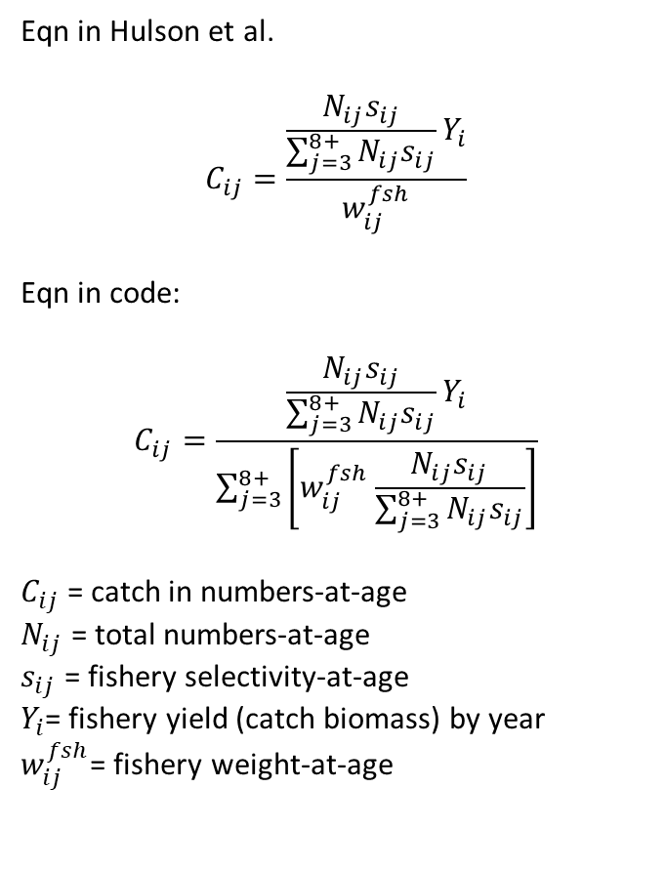
Catch in numbers-at-age
LS (conditioned on catch)
Eqn in Hulson et al.
$$C_{ij}=\frac{\frac{N_{ij}s_{ij}}{\sum_{j=3}^{8+}{N_{ij}s_{ij}}}Y_{i}}{w_{ij}^{fsh}}$$
Eqn in code:
$$C_{ij}=\frac{\frac{N_{ij}s_{ij}}{\sum_{j=3}^{8+}{N_{ij}s_{ij}}}Y_{i}}{\sum_{j=3}^{8+}{\left[w_{ij}^{fsh}\frac{N_{ij}s_{ij}}{\sum_{j=3}^{8+}{N_{ij}s_{ij}}}\right]}}$$
$C_{ij}$ = catch in numbers-at-age
$N_{ij}$ = total numbers-at-age
$s_{ij}$ = fishery selectivity-at-age
$Y_{i}$= fishery yield (catch biomass) by year
$w_{ij}^{fsh}$= fishery weight-at-age
These equations are not equivalent. Variable int3 is the average weight of catch conditional on vulnerable proportions-at-age.

Slide 4
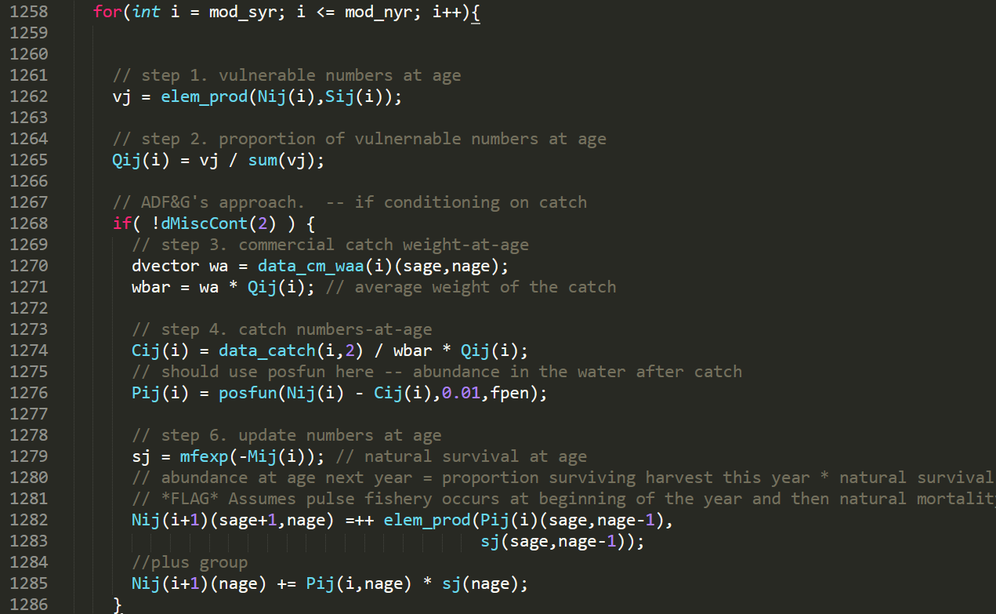
Catch in numbers-at-age
HER (conditioned on catch)
Same equation as what’s in LS code.

Slide 5
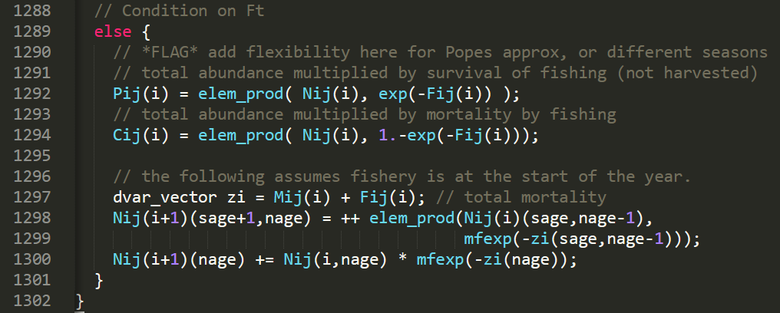
Catch in numbers-at-age
HER (conditioned on effort)
Baranov catch equation assuming discrete fishing mortality (pulse fishery that occurs at the beginning of the year.

Slide 6
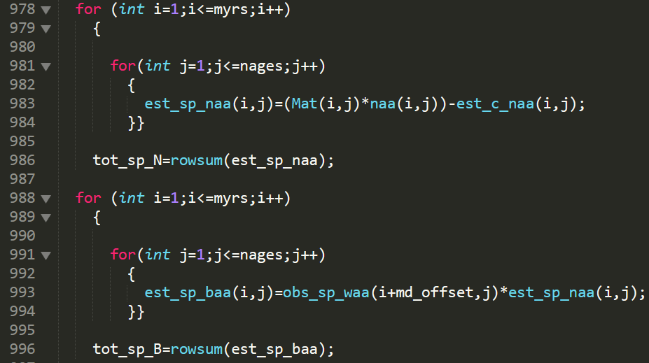
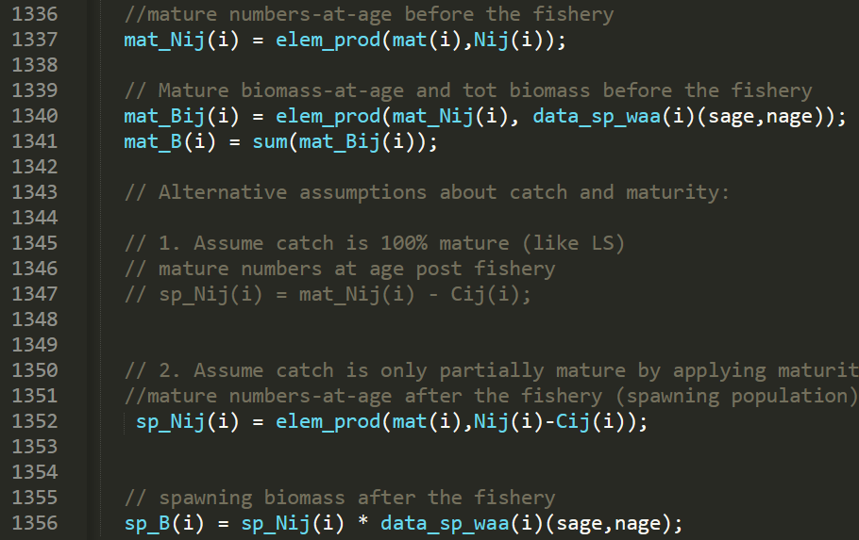
Spawning/mature numbers and biomass
LS
Assumes catch is 100% mature. Uses spawner weight-at-age.
Total mature biomass uses both catch and spawner weight-at-age.
HER
Takes difference between total population and catch before applying maturity curve. Will not run when assuming catch is 100% mature.
Total mature biomass uses only spawner weight-at-age.

Slide 7
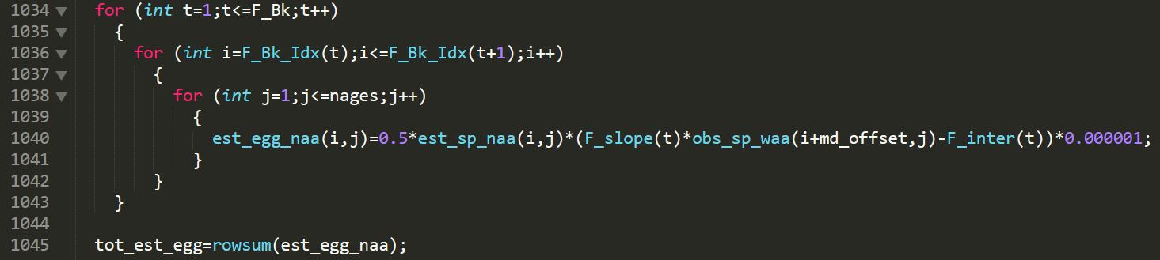
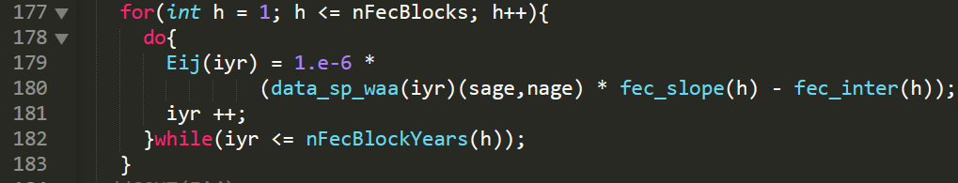
Egg deposition
Same equation in LS and HER
LS
HER

Slide 8
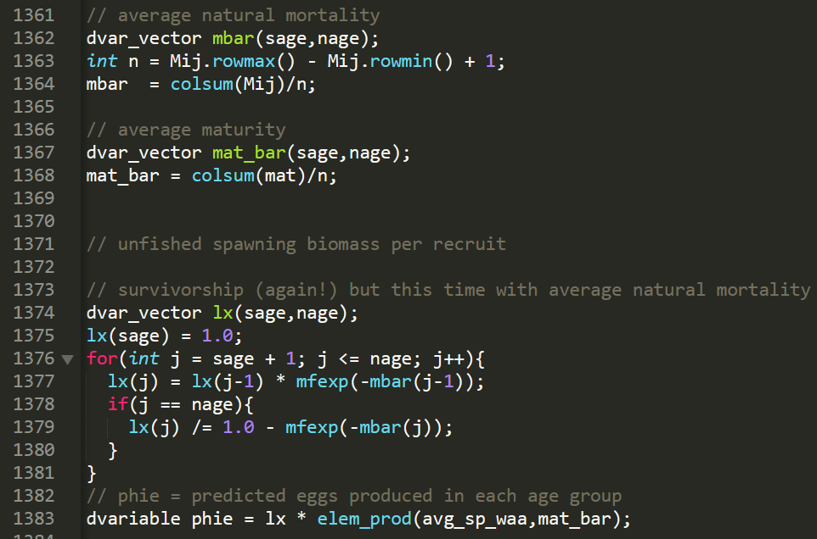
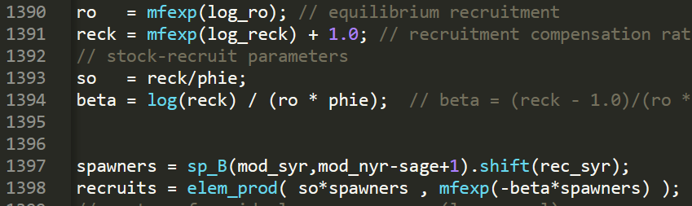
Stock recruit function
LS
HER
Different parameterization of the Ricker model.
Good reference for these equations: Martell, Steven JD, William E. Pine, and Carl J. Walters. "Parameterizing age-structured models from a fisheries management perspective." Canadian Journal of Fisheries and Aquatic Sciences 65.8 (2008): 1586-1600.

Slide 9
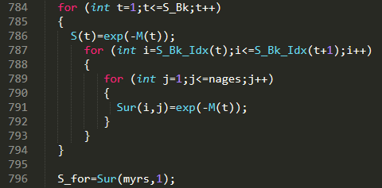
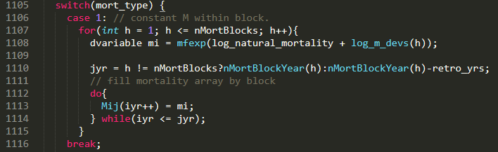

Natural mortality/survival
LS
Separate/independent M estimated for each block
HER
Mean M with deviations for each time block. Deviations are assumed lognormally distributed

Slide 10
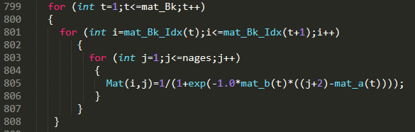
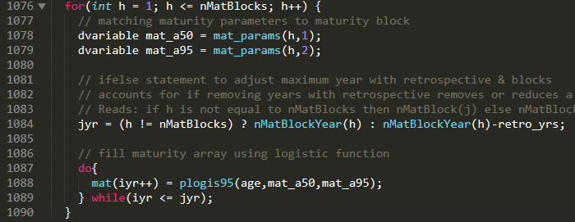

Maturity
LS
Logistic, a50/slope parameterization
HER
Logistic, a50/a95 parameterization

Slide 11
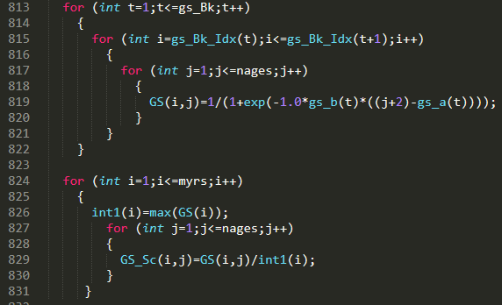
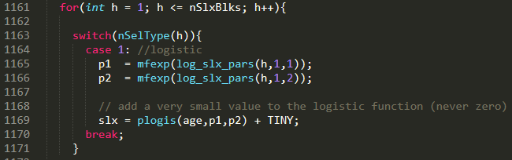
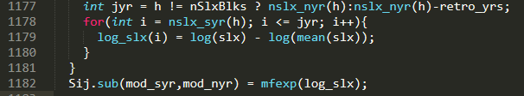
Selectivity
LS
Logistic, a50/slope parameterization. Scale to 1 by dividing by max (not differentiable)
HER
Logistic, a50/slope parameterization. Scale by taking difference of log selectivity and log mean selectivity (differentiable). Estimate in log space to keep values positive.

Slide 13
Model naming conventions:
Time block parameterization = # survival time blocks, # maturity time blocks, # selectivity time blocks
E.g. HER_123 = 1 survival time block, 2 maturity blocks, 3 survival blocks
The model number for model selection is shown before the time block parameterization.
E.g. HER 10_123 = Model 10 with 1 survival time block, 2 maturity blocks, 3 survival blocks
HER_bestLS_### = HER model with best-fitting parameterization of LS model by AICc
HER_best_condCatch.#_### = HER model with best-fitting parameterization of HER by AIC when conditioned on catch
HER_best_condEffort.#_### = HER model with best-fitting parameterization of HER by AIC when conditioned on effort

Slide 14
Folder directory (part 1): General overview
AlaskaHerring
YEAR_forecast – all data, code, and results for a given forecast year
smartell_archive – deprecated code from Steve Martell’s contract
technical_docs – documentation for the statistical catch-at-age model
.gitignore – all file types and folders not tracked by git
ReadMe.md – Summary of repository

Slide 15
Folder directory (part 2): Forecast folders
AlaskaHerring
2019_forecast
admb – all relevant admb files for final models including HER_bestLS, HER_best_conditionCatch, HER_best_conditionEffort
data – currently only includes LS model results for comparison with HER.
r – all R scripts for running HER, generating figures, doing Bayesian analysis, running model selection, retrospective analysis, and sensitivity analysis
results – figures, csv output, and archive of all models run in model selection, retrospective, and sensitivity analyses

Slide 16
Folder directory (part 3): 2019 results folder
AlaskaHerring
2019_forecast
results – figures, csv output, and archive of all models run in model selection, retrospective, and sensitivity analyses
HER_bestLS_321 – includes comparison figures of this model’s results with LS best, HER-specific figures, diagnostics for the Bayesian analysis, and csv files of all the posterior sample summaries
HER_best_condCatch.12_322 – same as above
HER_best_condEffort.12_322 – same as above
model_selection – includes model selection results for HER conditioned on catch and effort
retrospective – results for the retrospective analysis for HER_bestLS_321, HER_best_condCatch.12_322, and HER_best_condCatch.12_322
sensitivity_sigmaM – results for sensitivity analysis examining convergence diagnostics and model output for sigmaM from 0.05-0.10. sigmaM = 0.09 had best convergence diagnostics

