Slide 1
Comparing population dynamics equations for HER and LS
Jane Sullivan

Slide 2
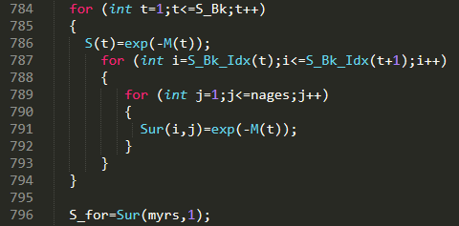
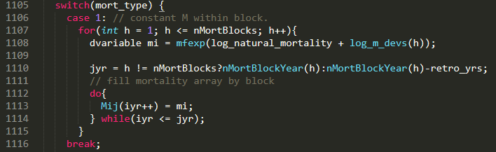

Natural mortality/survival
LS
Separate/independent M estimated for each block
HER
Mean M with deviations for each time block. Deviations are assumed lognormally distributed

Slide 3
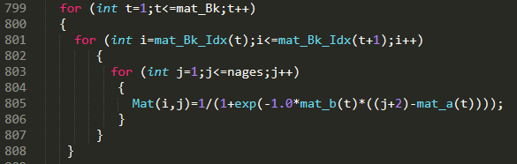
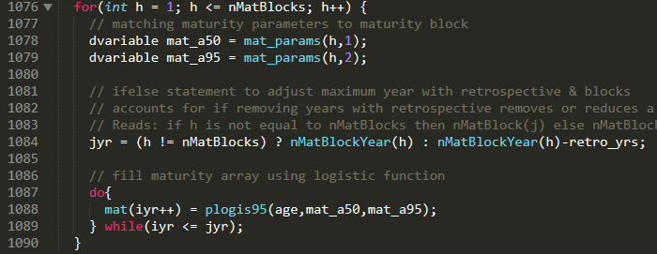

Maturity
LS
Logistic, a50/slope parameterization
HER
Logistic, a50/a95 parameterization

Slide 4
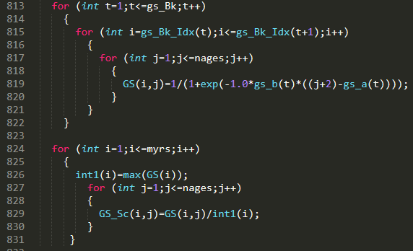
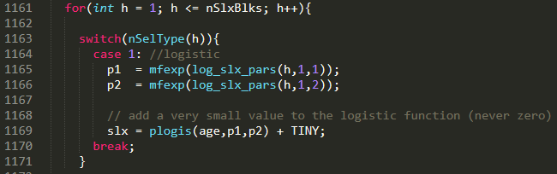
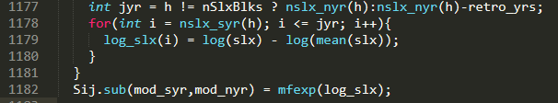
Selectivity
LS
Logistic, a50/slope parameterization. Scale to 1 by dividing by max (not differentiable)
HER
Logistic, a50/slope parameterization. Scale by taking difference of log selectivity and log mean selectivity (differentiable). Estimate in log space to keep values positive.

Slide 5
Selectivity
LS
Logistic, a50/slope parameterization. Scale to 1 by dividing by max (not differentiable)
HER
Logistic, a50/slope parameterization. Scale by taking difference of log selectivity and log mean selectivity (differentiable). Estimate in log space to keep values positive.

