Slide 1
Catchability options for using BSFRF data as a prior
January 2024 CPT meeting

Slide 2
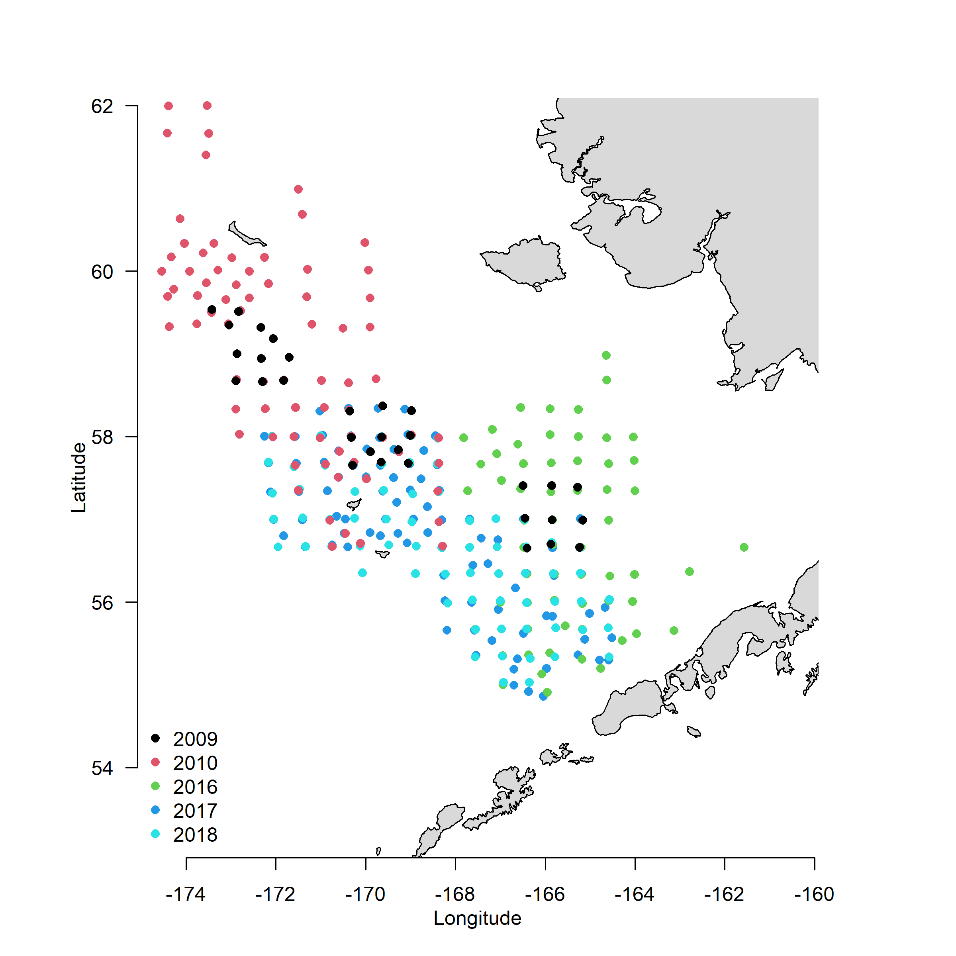
BSFRF data
Five years of data were used for developing priors
2009 and 2010 had the most overlap with snow crab distributions

Slide 3
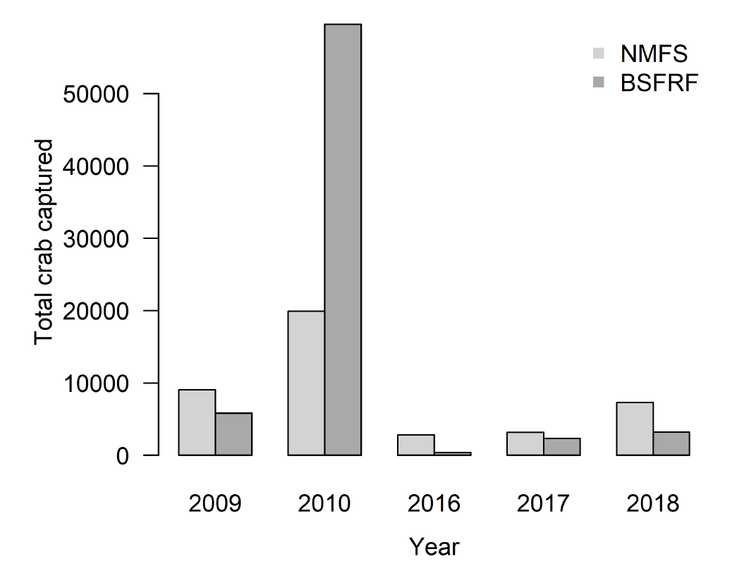
BSFRF data
Five years of data were used for developing priors
2009 and 2010 had the most overlap with snow crab distributions
2010 had the largest numbers of snow crab collected by both BSFRF and NMFS trawls

Slide 4
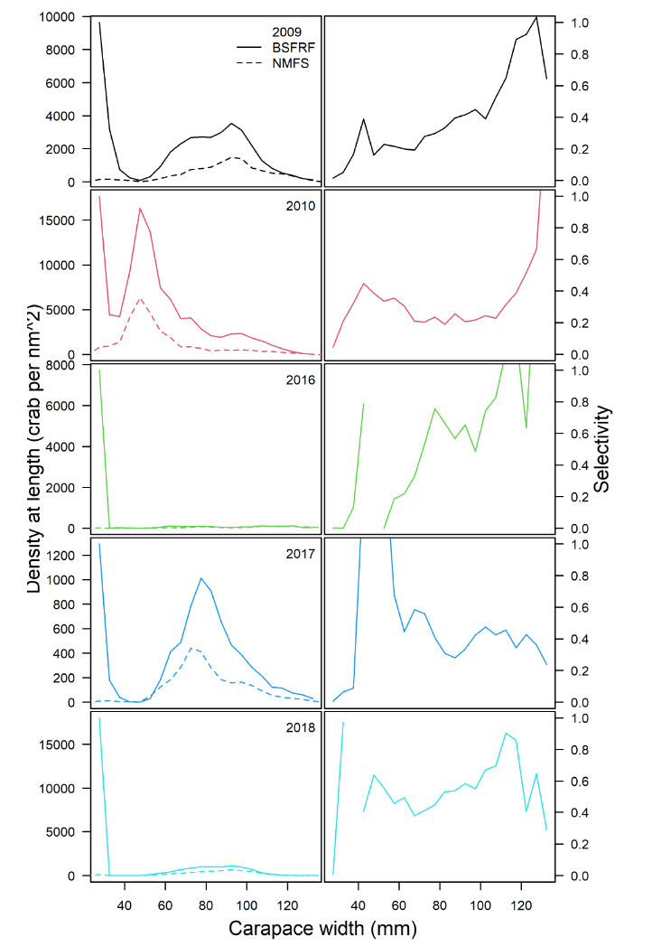
BSFRF data
Five years of data were used for developing priors
2009 and 2010 had the most overlap with snow crab distributions
2010 had the largest numbers of snow crab collected by both BSFRF and NMFS trawls
The numbers collected at size varied by year, with most crab collected by BSFRF either smaller than is included in the assessment or of sizes smaller than commercial size.

Slide 5
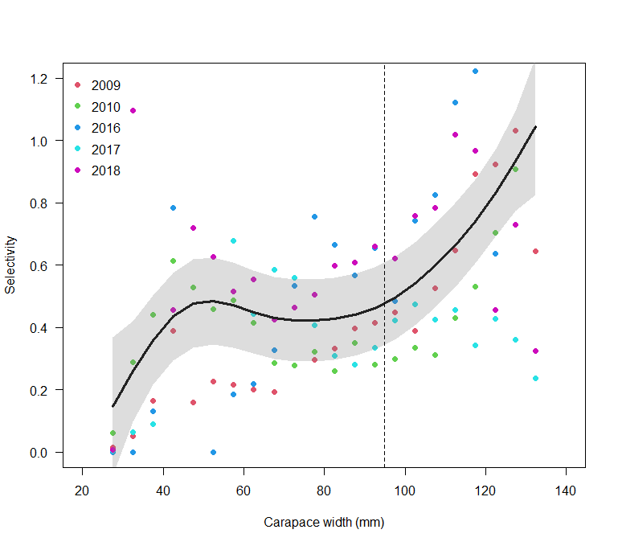
BSFRF data
Five years of data were used for developing priors
2009 and 2010 had the most overlap with snow crab distributions
2010 had the largest numbers of snow crab collected by both BSFRF and NMFS trawls
The numbers collected at size varied by year, with most crab collected by BSFRF either smaller than is included in the assessment or of sizes smaller than commercial size.
The calculated numbers at size and areas swept can be used to calculate an inferred selectivity of the NMFS gear given the assumption that the catchability of the BSFRF gear is 1.
Inferred selectivity was lowest for small animals, ~0.45 for crab from 40-95 mm carapace width, and increased to 1 at ~130 mm carapace width

Slide 6
How they used to be used
Historically, BSFRF data were incorporated into the assessment as an additional survey.
An ogive of availability parameters by size were estimated for each year and sex.
However, the ‘empirical’ availabilities did not match the estimated availabilities.
(These were also paired with a logistic selectivity, which might have been an issue)

Slide 7
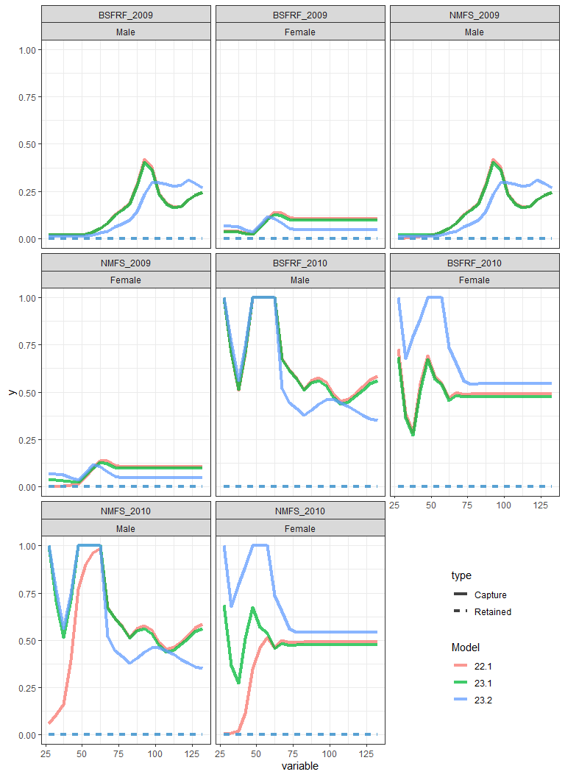
How they used to be used
Historically, BSFRF data were incorporated into the assessment as an additional survey.
An ogive of availability parameters by size were estimated for each year and sex.
However, the ‘empirical’ availabilities did not match the estimated availabilities.
(These were also paired with a logistic selectivity, which might have been an issue)

Slide 8
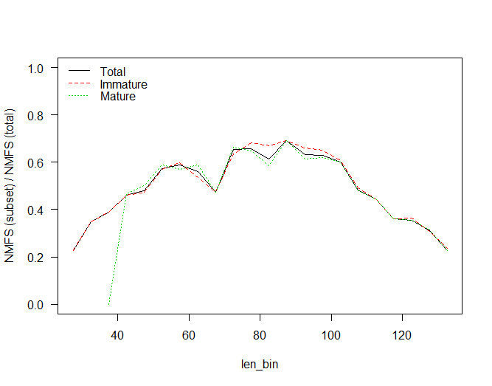
How they used to be used
Historically, BSFRF data were incorporated into the assessment as an additional survey.
An ogive of availability parameters by size were estimated for each year and sex.
However, the ‘empirical’ availabilities did not match the estimated availabilities.
(These were also paired with a logistic selectivity, which might have been an issue)

Slide 9
How they were used 2023
Incorporated directly as a normal prior on selectivity at size
GAM fit to the inferred selectivity at size by year weighted by the sample size by year
gam(sel~s(size),weights=sample_size)
Used predicted mean and standard error as input for prior on selectivity in GMACS
Set selectivity type to ‘0’ (parametric) in .CTL file
Catchability fixed at 1

Slide 10
##gear | par | sel |  |  |  |  |  |  | Sigma ## |  | start | end | Env | Link | Rand | Start | End
##index | index | par | sex | ival | lb | ub | prior | p1 | p2 | phz | period | period | Link | Par | Walk | period | period
## ——————————————————————————————————————————————————————
# Gear-3- NMFS
3 | 15 | 1 | 1 | 0.14 | 0.00 | 1.00 | 1 | 0.14 | 0.12 | 3 | 1982 | 2022 | 0 | 0 | 0 | 0 | 0 | 0
3 | 16 | 2 | 1 | 0.25 | 0.00 | 1.00 | 1 | 0.25 | 0.08 | 3 | 1982 | 2022 | 0 | 0 | 0 | 0 | 0 | 0
3 | 17 | 3 | 1 | 0.35 | 0.00 | 1.00 | 1 | 0.35 | 0.07 | 3 | 1982 | 2022 | 0 | 0 | 0 | 0 | 0 | 0
3 | 18 | 4 | 1 | 0.43 | 0.00 | 1.00 | 1 | 0.43 | 0.07 | 3 | 1982 | 2022 | 0 | 0 | 0 | 0 | 0 | 0
3 | 19 | 5 | 1 | 0.47 | 0.00 | 1.00 | 1 | 0.47 | 0.07 | 3 | 1982 | 2022 | 0 | 0 | 0 | 0 | 0 | 0
3 | 20 | 6 | 1 | 0.49 | 0.00 | 1.00 | 1 | 0.49 | 0.07 | 3 | 1982 | 2022 | 0 | 0 | 0 | 0 | 0 | 0
3 | 21 | 7 | 1 | 0.47 | 0.00 | 1.00 | 1 | 0.47 | 0.07 | 3 | 1982 | 2022 | 0 | 0 | 0 | 0 | 0 | 0

Slide 11
How they were used 2023
Reasonable, not perfect, fits
Selectivities are the same from 1982-1987 and 1988-present, which should be revisited
Priors for males and females were the same given this should reflect size selectivity

Slide 12
Future directions
I prefer using the inferred, non-parametric selectivity directly as priors rather than as an additional survey
More direct
Misspecification less of an issue
There are likely other ways of developing the priors
Models to develop prior
Prior specification in GMACS (currently normal)
Still need to address availability issues between the sexes and survey eras

