Slide 1
Sablefish assessment updates
March 4, 2021
Jane Sullivan

Slide 2
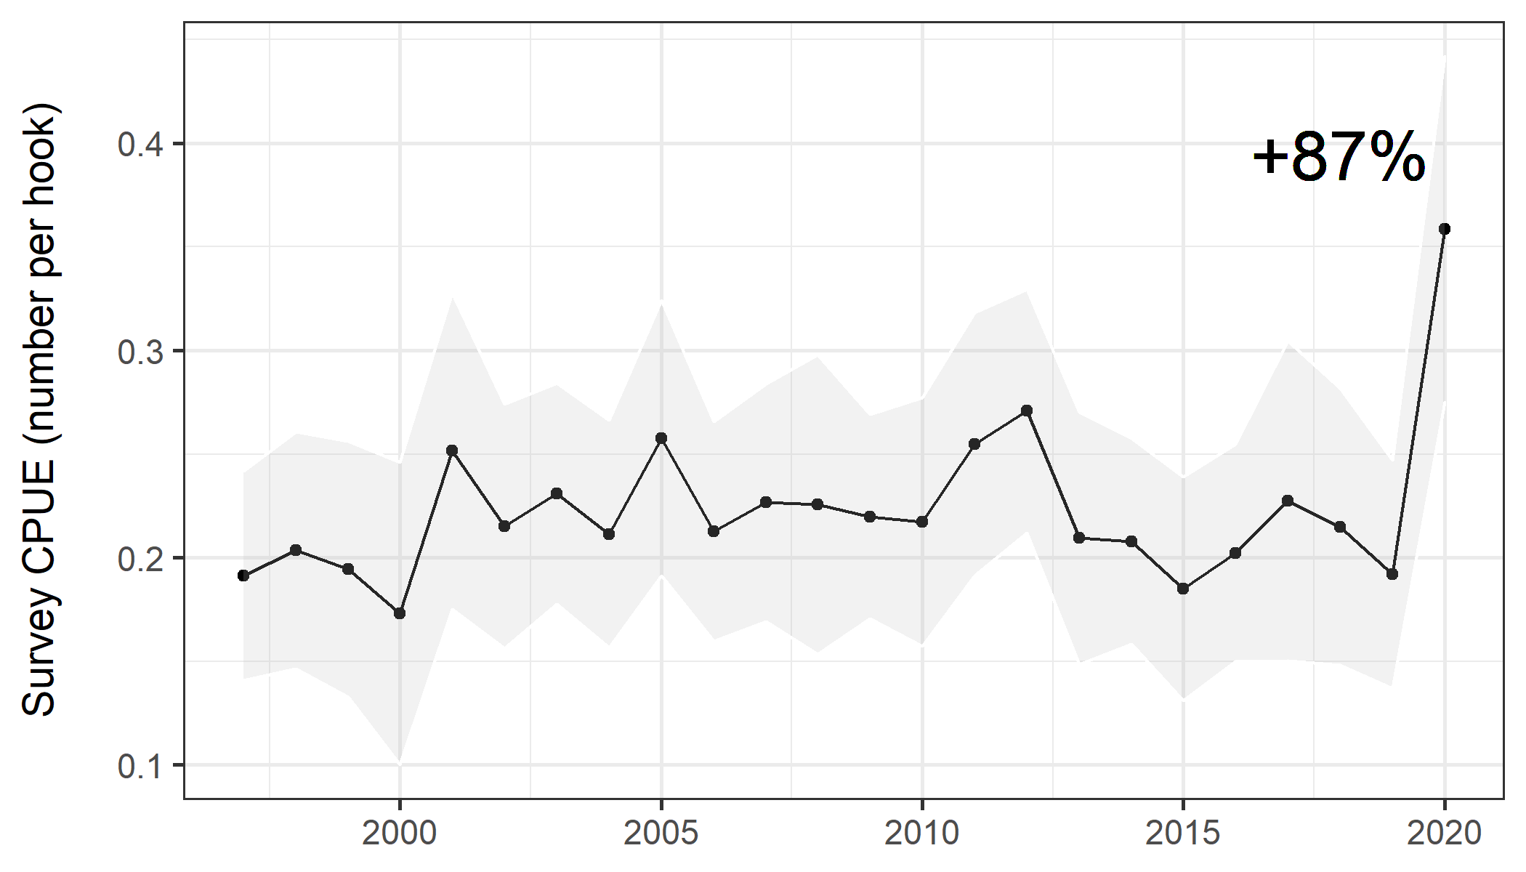
Chatham longline survey CPUE

Slide 3
Data updates
Ex-vessel prices for 2021 – DONE
Tag release data issue: errors in discard status – RESOLVED – waiting to request data
Tag recovery data issue: 19 tags without date or project code data – UPDATE FROM RHEA

Slide 4
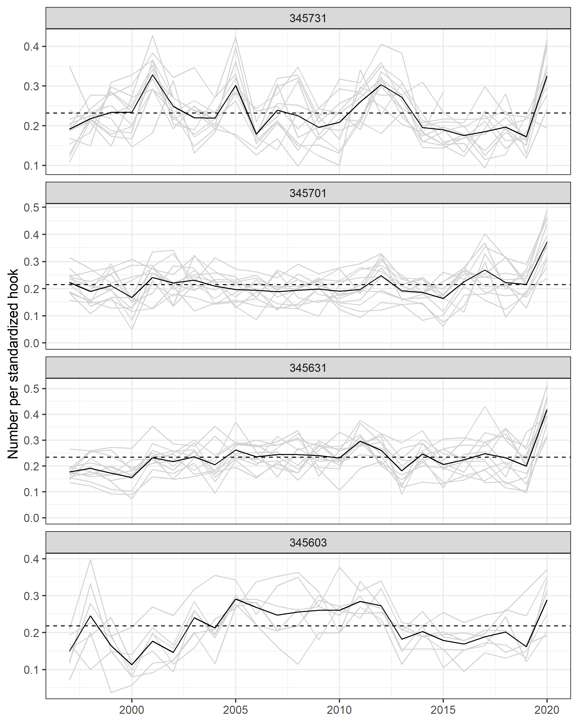
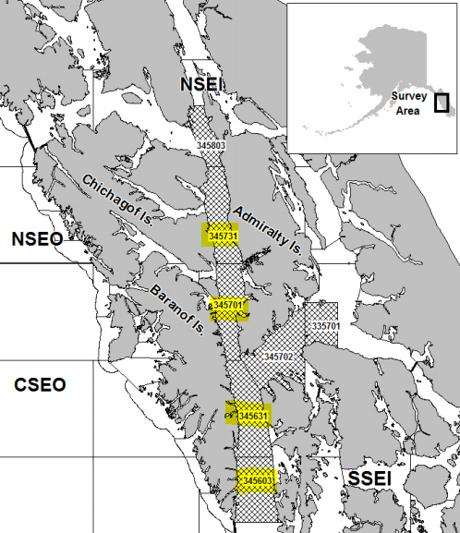
Sablefish CPUE by stat area

Slide 5
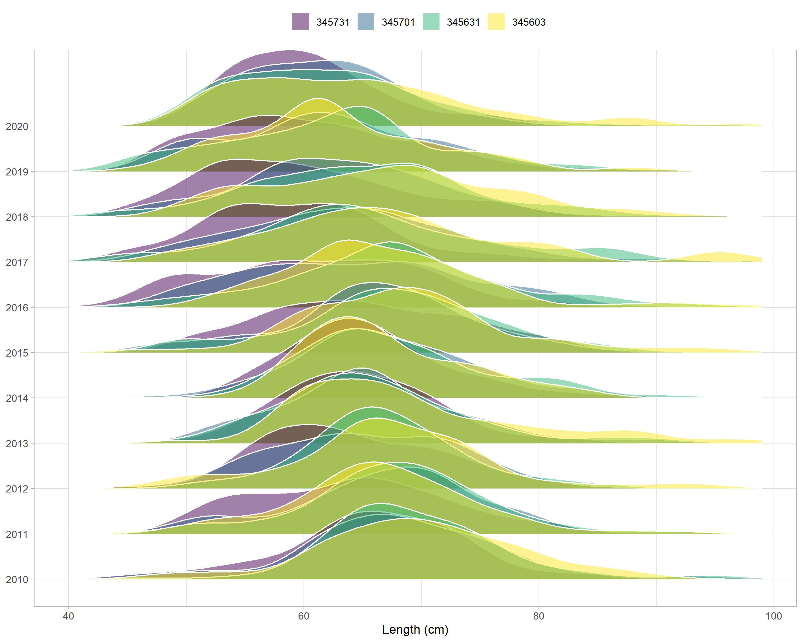

Slide 6
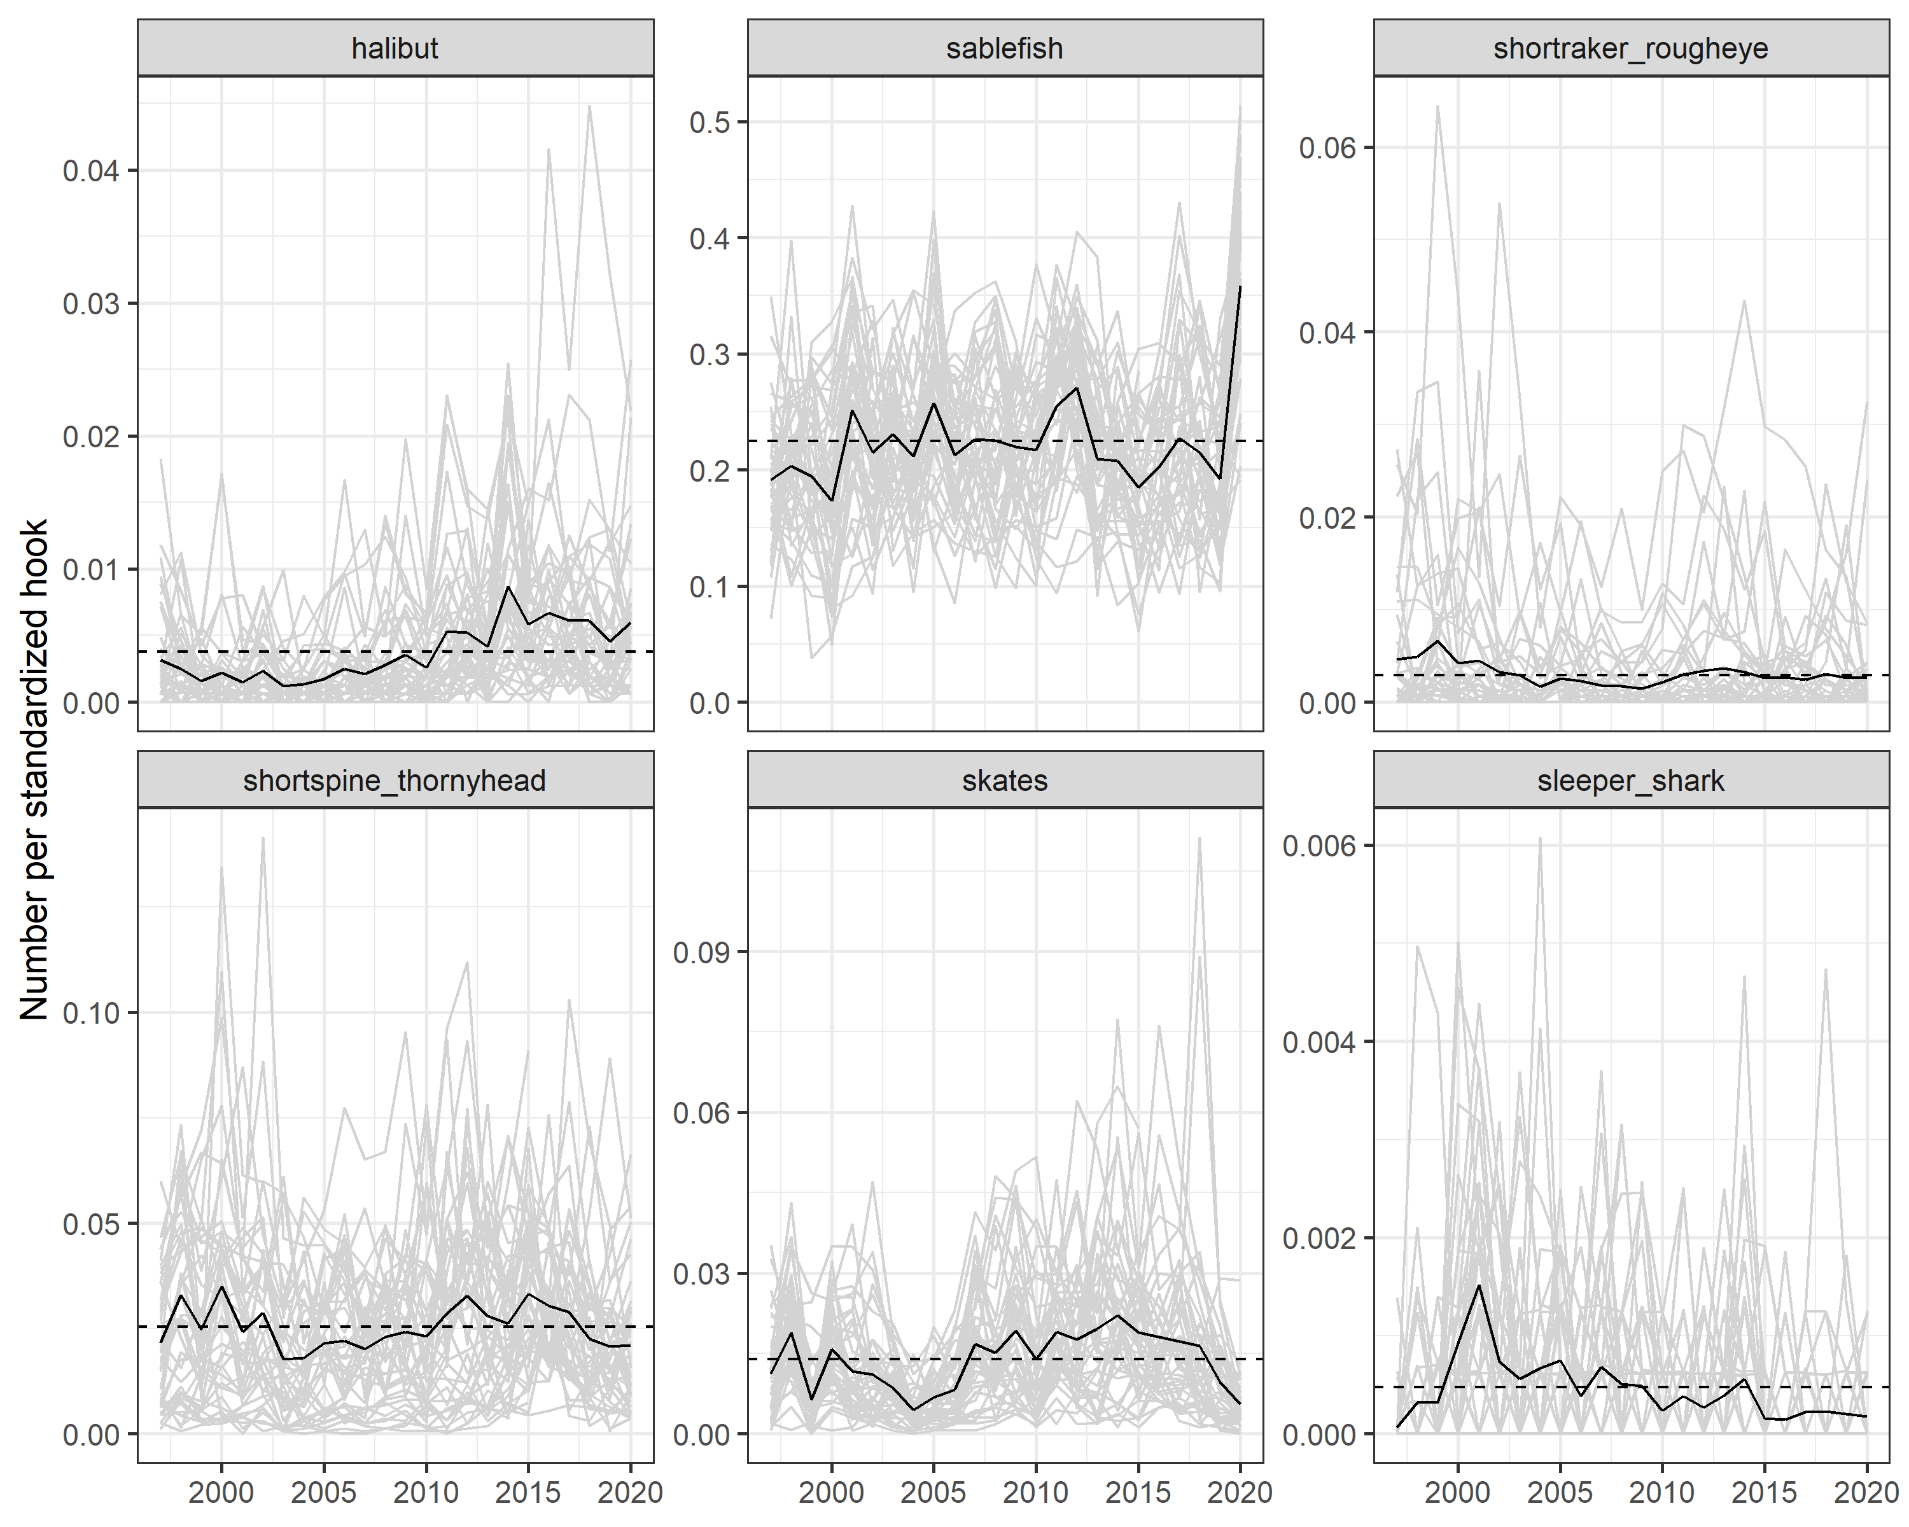
Longline survey catch: each grey line is a station
Hook competition

Slide 7
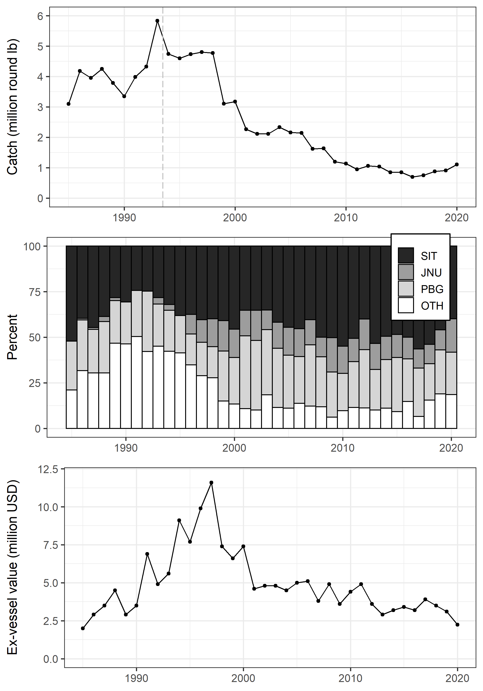
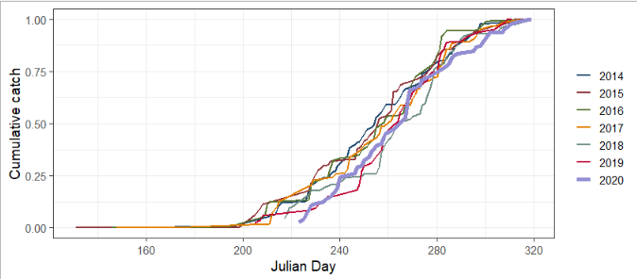
Catch

Slide 8
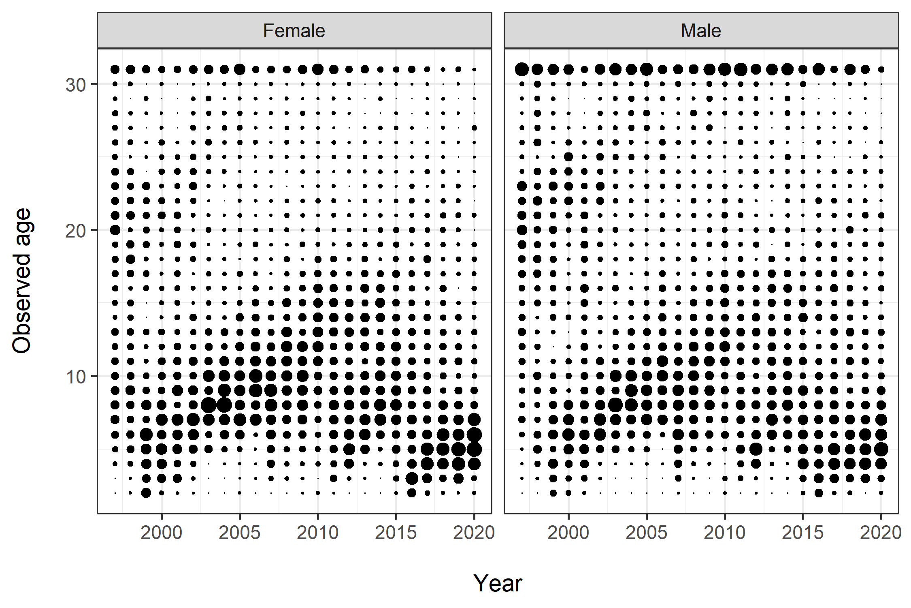
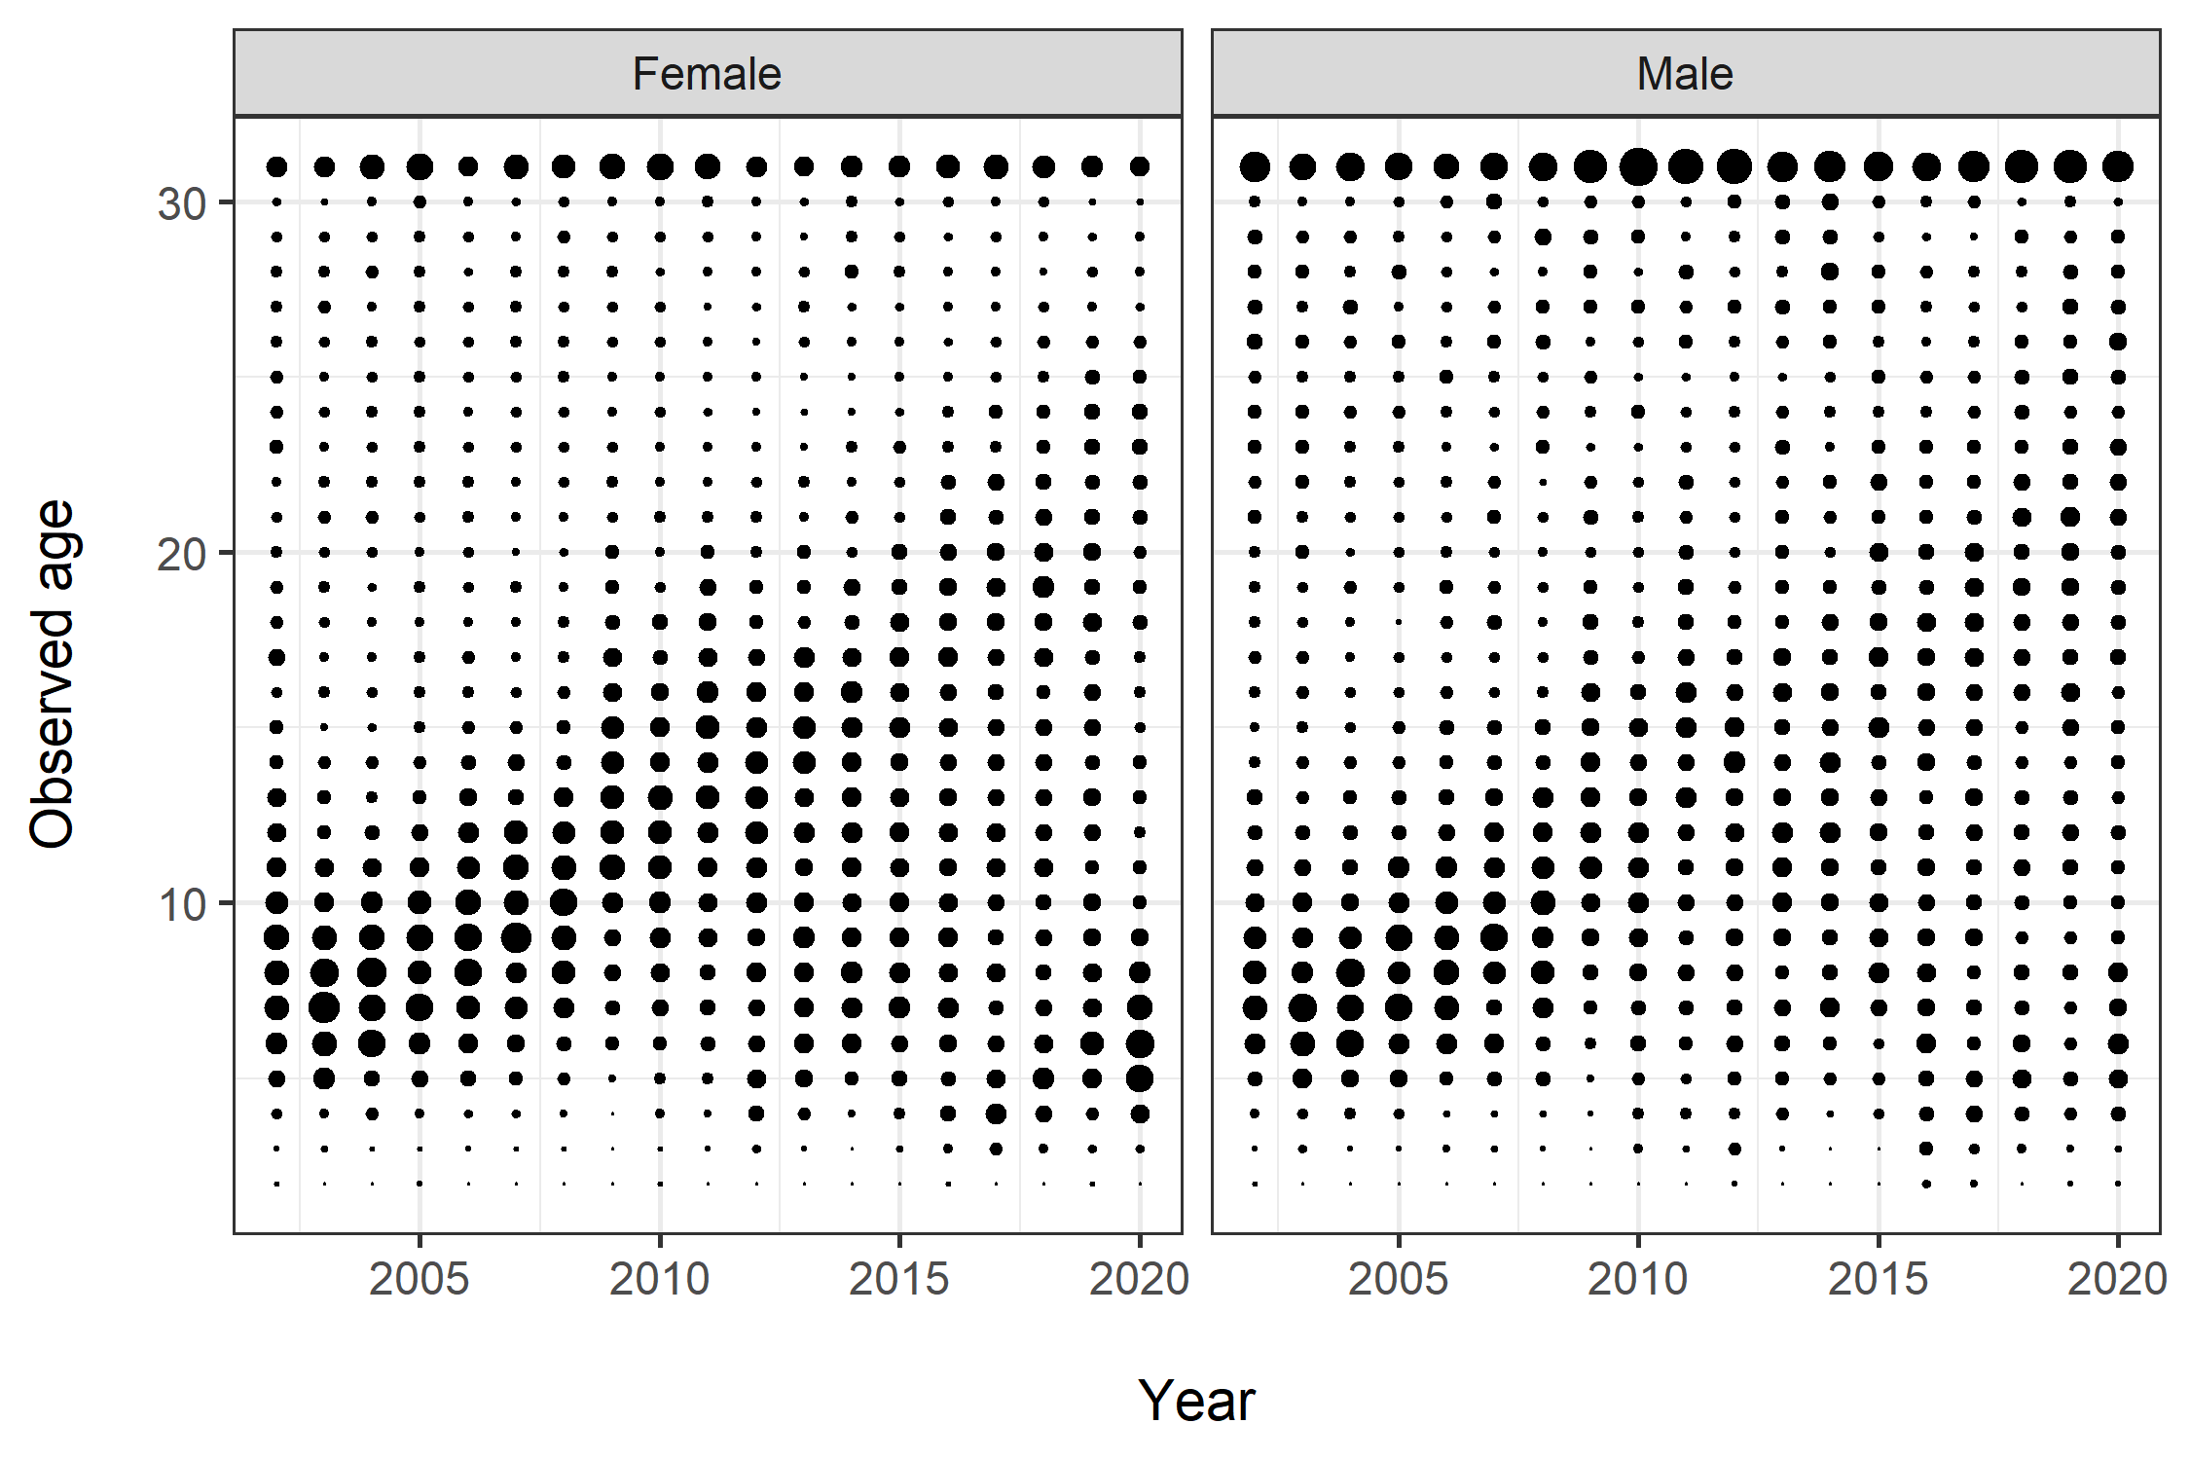
Age data
Longline survey
Fishery

Slide 9
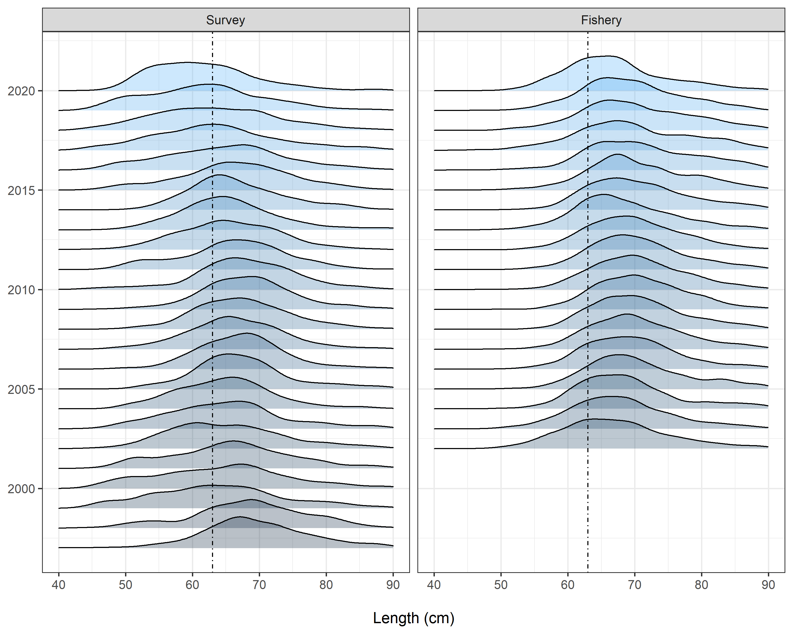
Length data
Vertical line at a50 = 63 cm
Mismatch between survey and fishery explained by voluntary release

Slide 10
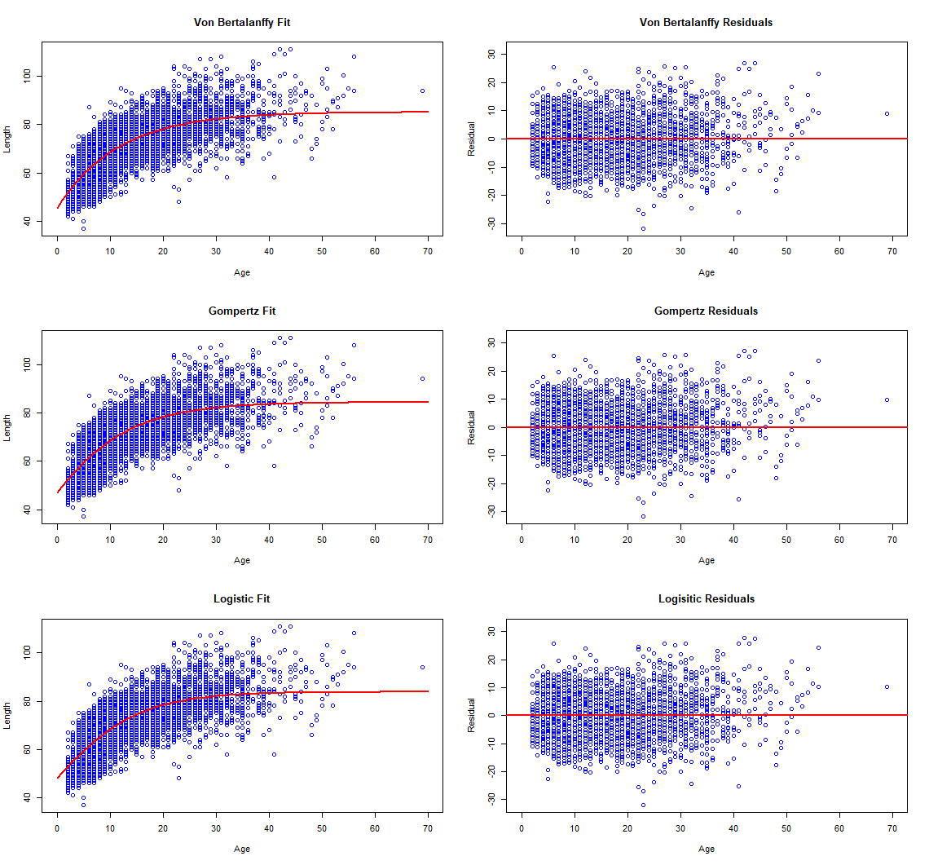
Growth
Growth curve code deprecated with R version >4.0
Migrated to fishmethods package

Slide 11
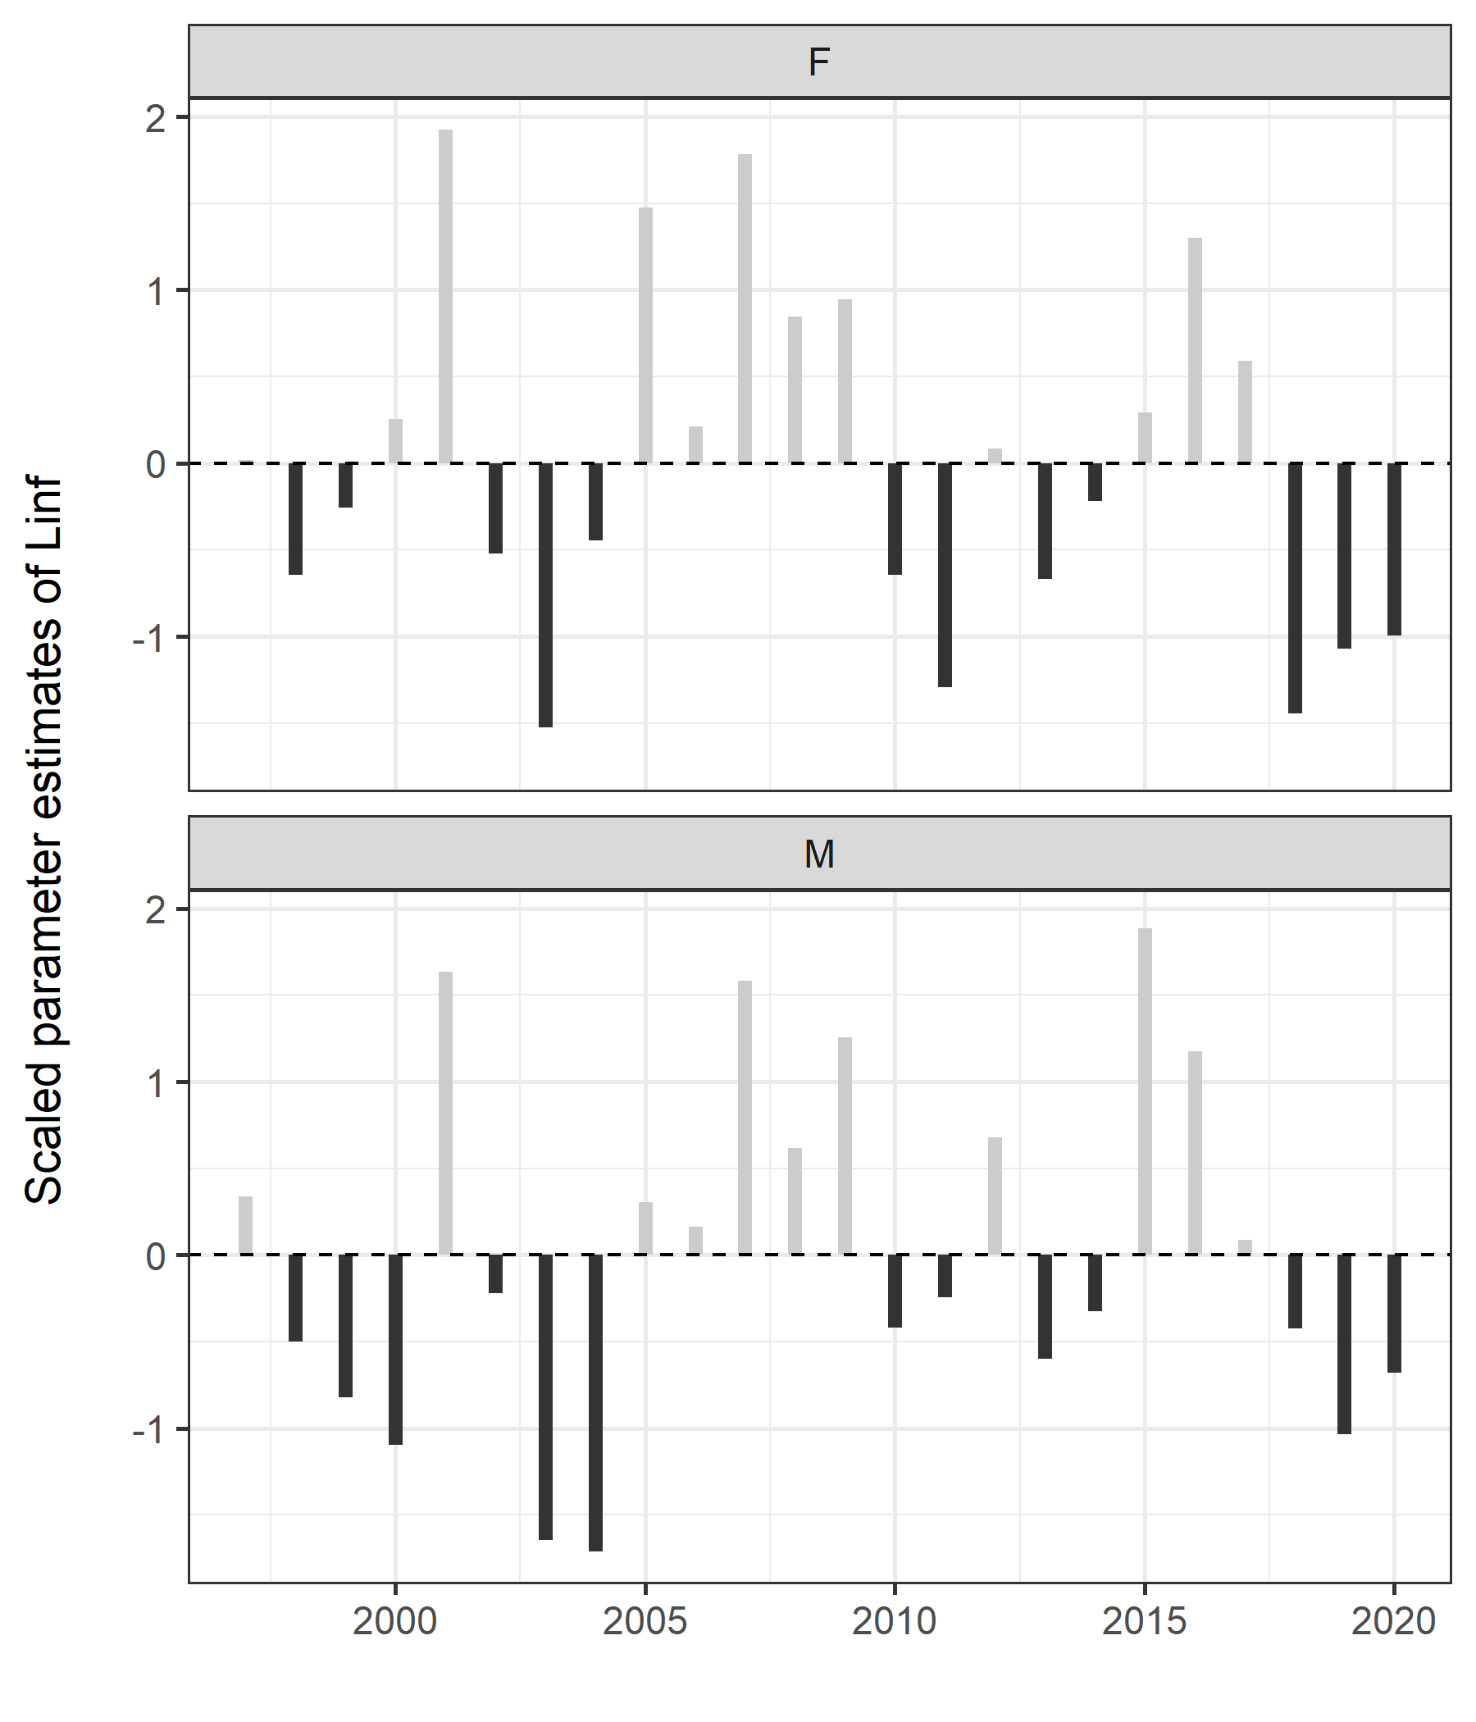
Annual trends in growth parameters

Slide 12
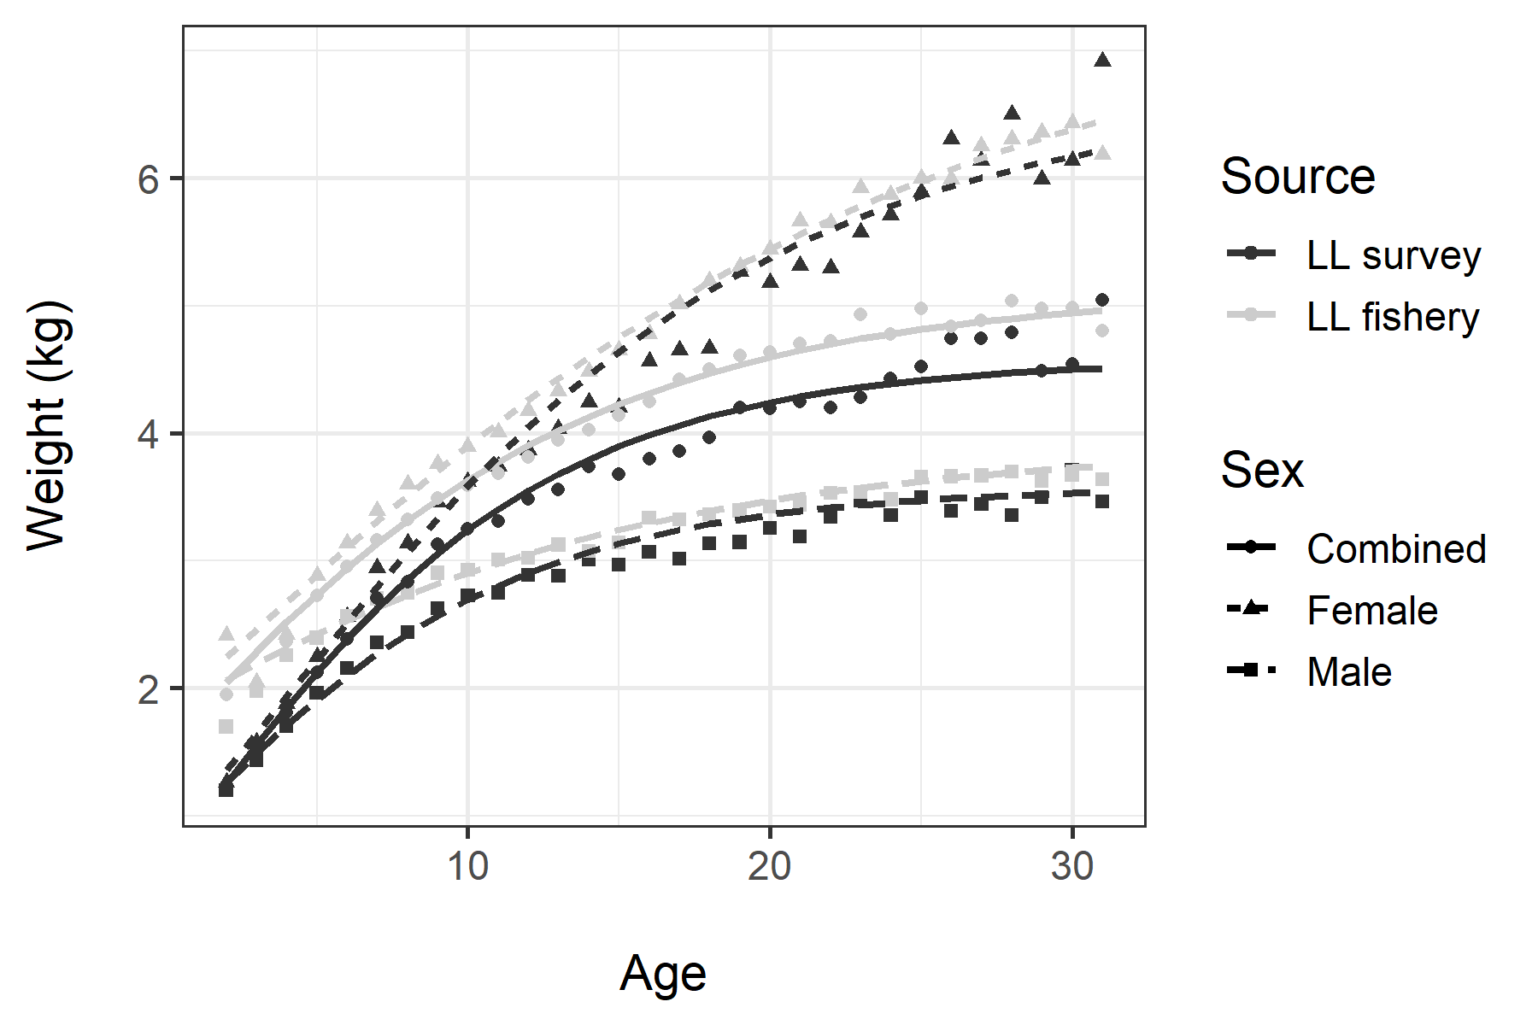
Notes on weight-at-age
Assessment uses predictions from weight-based von Bertalanffy growth curves
Updated annually, includes all years of data (1997 – 2020)
Assessment formerly used empirical weight-at-age (also updated annually)
Because of voluntary release, fishery weight-at-age used to fit landed catch

Slide 13
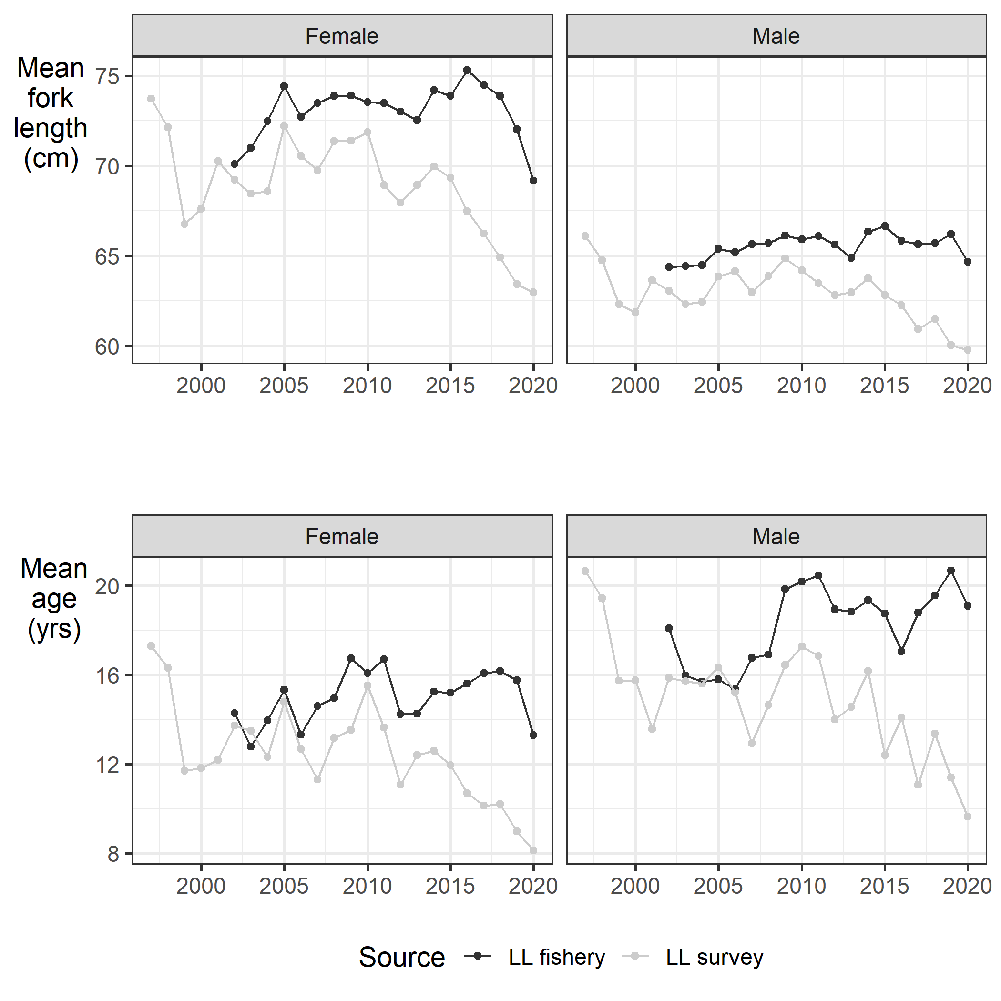
Trends in mean size/age
Demographic changes
Alternative hypotheses for reduced fishery mean size/age
Flood of small fish
Low prices
Reduced availability of large fish
Quarantine stress/social pressure to finish the trip as quickly as possible
Increased quota, coupled with above factors and cost of discarding

Slide 14
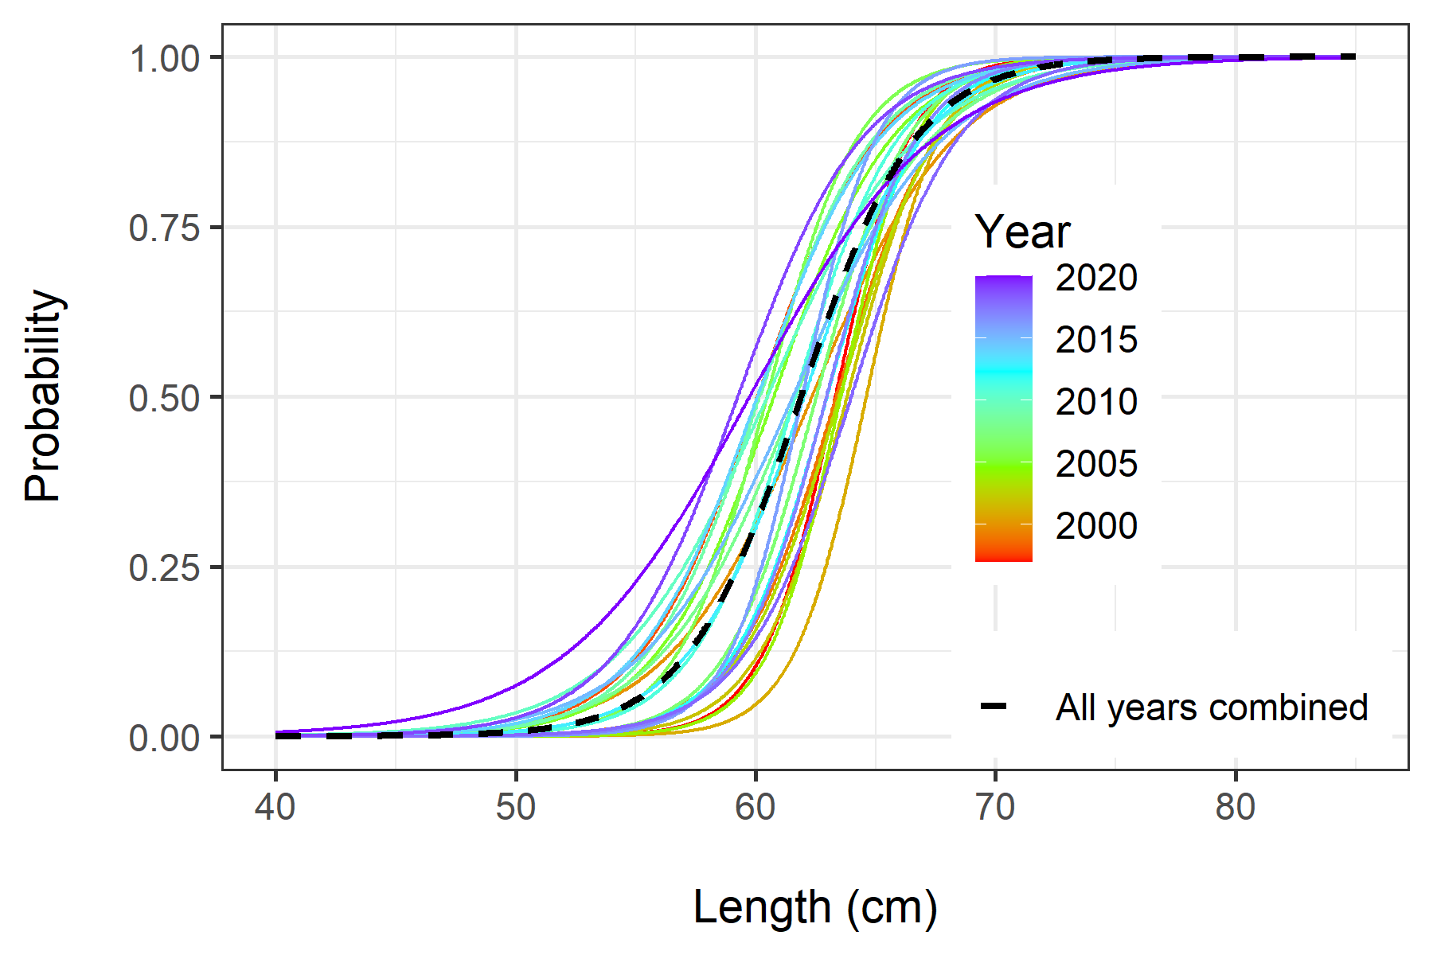
Maturity data
Only females considered in estimated of SSB
Method: length-based maturity converted to age using length-based von Bertalanffy
2019 and 2020 show reduced maturity-at-age – sampling effect or something else?
Since macroscopic maturity data are more reliable because they’re collected late in the year – maybe better to use fishery data because it’s collected in the fall?

Slide 15
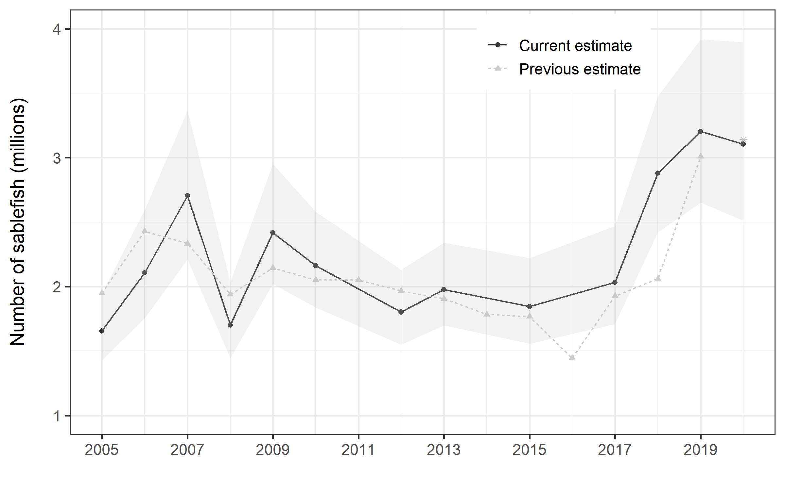
Marking project
Year | Total tags | Size-adj tags | Tags recaptured before LL survey | LL survey recaptures | Number sampled in LL survey | Tags recaptured outside Chatham during LL survey | Fishery recaptures | Number sampled in fishery | Tags recaptured outside Chatham during fishery | Abundance estimate | Lower 95% CI | Upper 95% CI
2005 | 7,118 | 7,118 | 9 | - | - | 104 | 1,234 | 319,773 | 153 | 1.66 | 1.43 | 1.94
2006 | 5,325 | 5,325 | 3 | - | - | 46 | 916 | 371,590 | 68 | 2.12 | 1.75 | 2.59
2007 | 6,158 | 6,055 | 2 | - | - | 43 | 619 | 278,916 | 107 | 2.73 | 2.21 | 3.37
2008 | 5,450 | 5,412 | 4 | 40 | 15,319 | 54 | 770 | 283,910 | 110 | 1.71 | 1.45 | 2.03
2009 | 7,071 | 7,054 | 7 | - | - | 51 | 526 | 192,765 | 116 | 2.44 | 2.02 | 2.95
2010 | 7,443 | 7,307 | 4 | 54 | 14,765 | 60 | 654 | 209,019 | 50 | 2.17 | 1.84 | 2.58
2012 | 7,582 | 7,548 | 23 | - | - | 70 | 745 | 189,809 | 83 | 1.81 | 1.55 | 2.13
2013 | 7,961 | 7,921 | 24 | - | - | 89 | 723 | 196,273 | 200 | 1.99 | 1.70 | 2.34
2015 | 6,862 | 6,765 | 1 | - | - | 73 | 486 | 140,717 | 56 | 1.86 | 1.56 | 2.22
2017 | 7,096 | 6,933 | 3 | - | - | 42 | 394 | 120,818 | 11 | 2.05 | 1.71 | 2.47
2018 | 9,678 | 9,160 | 13 | - | - | 77 | 369 | 132,557 | 226 | 2.90 | 2.42 | 3.47
2019 | 11,094 | 10,208 | 6 | - | - | 51 | 309 | 95,185 | 217 | 3.22 | 2.65 | 3.92
2020 | 7,916 | 7,824 | 6 | - | - | 75 | 163 | 70,262 | 156 | 3.13 | 2.51 | 3.90

Slide 16
Jane’s to do list
Andrew request: Length frequencies by stat area (is increase in CPUE driven by small fish?) - DONE
Update the data/chatham_sablefish_abd_index.csv: keep the ABC as “recommended ABC”, change the age2abundance to the current SCAA model’s estimates of MR abundance (= exploitable abundance), and may as well export some other key model outputs. Put this in new code in the scaa.R model file so that it outputs properly.
Request tag release/recovery data once it’s finalized
Fix length comp array input issue

