Slide 1
REST „easy“
Moritz Klein

Slide 2







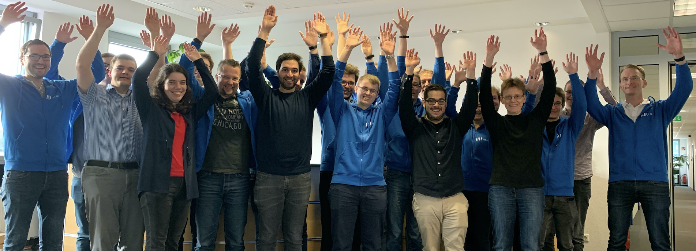





About MT AG
Founded
1994
Privately-Owned Corporation
36 Mio. Euro Revenue in 2020
>100 Active Clients
Head Office
Ratingen
Branch Offices
Frankfurt am Main
Cologne
Munich
Hamburg
280 Employees
45 APEX Experts
Oracle
Platinum Partner
Microsoft
Gold Partner
Your partner for digital change
Individual IT solutions from one source
Top Company for Trainees & Students
Non-Proprietary
Cross-Industry

Slide 3


Our talks at APEX Connect 2021
Business Modelling Basics
Niels de Bruijn Tuesday, 11:00-11:40
10 Alltagstipps für das Interactive Grid
Timo Herwix Dienstag, 14:00-14:40 Uhr
Low-Code Testing Tool (LCT)
Kai Donato Tuesday, 15:00-15:40
Advanced JavaScript in APEX
Moritz Klein & Ronny Weiß, Kontron AIS
Wednesday, 11:00-11:40
APEX richtig installieren und konfigurieren
Oliver Lemm Tuesday, 16:00-16:40
Basics of JavaScript in APEX
Till Albert Dienstag, 16:00-16:40 Uhr
REST „easy“ –
REST Data Source Connector Plug-Ins
Moritz Klein Wednesday, 13:00-13:40
APEX mit Web-Components erweitern
Philipp Hartenfeller Wednesday, 15:00-15:40
Advanced DevOps
Oliver Lemm Wednesday, 15:00-15:40

Slide 4

About Me
Principal Consultant APEX
Since November 2015 at MT AG
6 years as Data Warehouse Specialist at Ericsson Telekommunikation GmbH
APEX Developer since first public release in 2004 (HTMLDB 1.5)
Oracle Developer since 2001 (SQL, PL/SQL, OWB)
Host of Oracle APEX Meetups Frankfurt
Moritz Klein

Slide 5
Agenda
A quick take on REST
Standards?
REST Connector Plug-Ins
Demo / Code
What‘s ahead

Slide 6
REST and Standards
Representational State Transfer
Typically HTTP(s)
JSON Response
No world-wide standards for
Pagination
Sorting
Filtering

Slide 7
REST Connector Plug-Ins
Provide Metadata to APEX Components
Utilize APEX Component Metadata
Utilize APEX Component Runtime Information
Translate APEX way to REST Endpoint way
Pagination
Sorting
Filtering

Slide 8
Demo / Code
Repository Link on „Resources“ Slide
Let’s see it in action

Slide 9
What’s ahead
More complex examples
GraphQL
Utilize more APEX Component Runtime Information
Add DML operations (not only fetch)

Slide 10
Resources
Carsten Czarski – The Movie DB example
The Rest „easy“ Repository
APEX PL/SQL Packages
APEX_PLUGIN
APEX_PLUGIN_UTIL

Slide 11
Questions

