Slide 1


Slide 2
REST „easy“
Moritz Klein

Slide 3







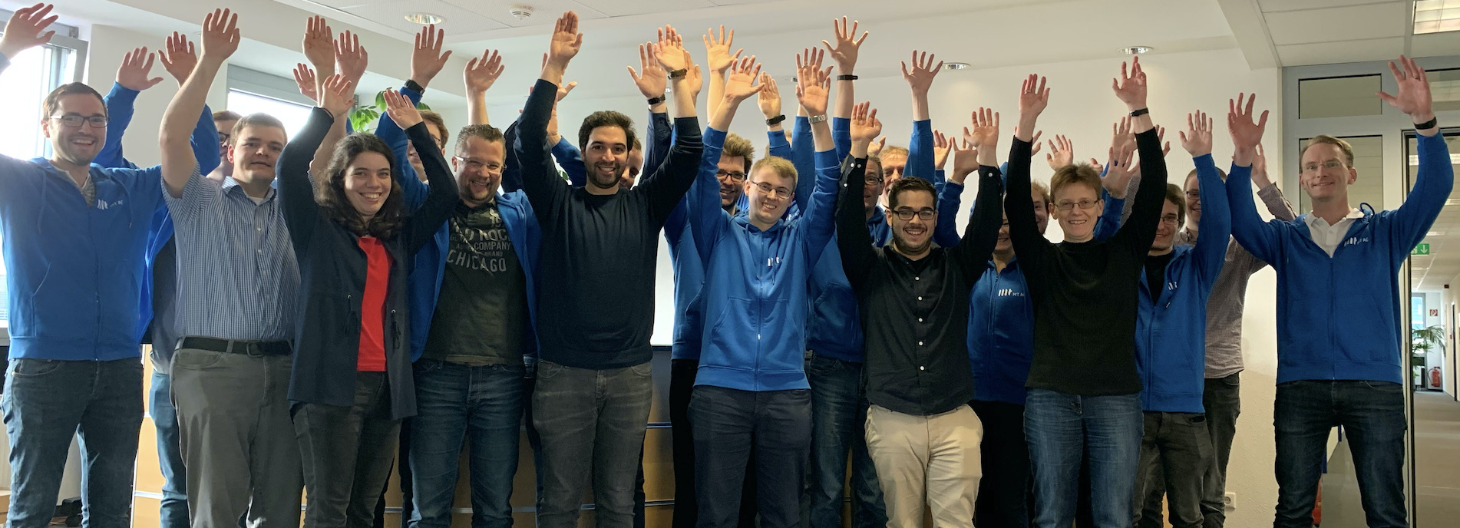





About MT AG
Founded
1994
Privately-Owned Corporation
36 Mio. Euro Revenue in 2020
>100 Active Clients
Head Office
Ratingen
Branch Offices
Frankfurt am Main
Cologne
Munich
Hamburg
280 Employees
45 APEX Experts
Oracle
Platinum Partner
Microsoft
Gold Partner
Your partner for digital change
Individual IT solutions from one source
Top Company for Trainees & Students
Non-Proprietary
Cross-Industry

Slide 4

About Me
Principal Consultant APEX at MT AG
APEX Developer since first public release ( 2004 called HTMLDB 1.5 )
Oracle Developer since 2001 (SQL, PL/SQL, OWB)
Host of Oracle APEX Meetups Frankfurt
Moritz Klein

Slide 5
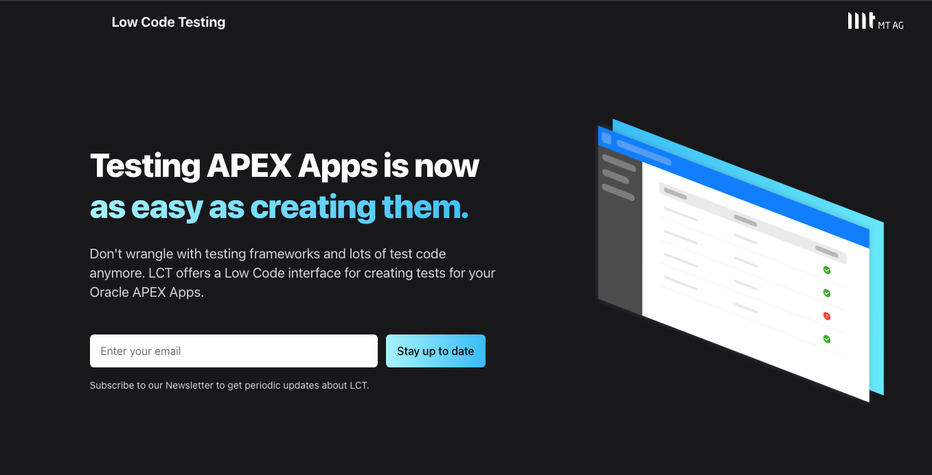
LCT Low Code Testing

Slide 6
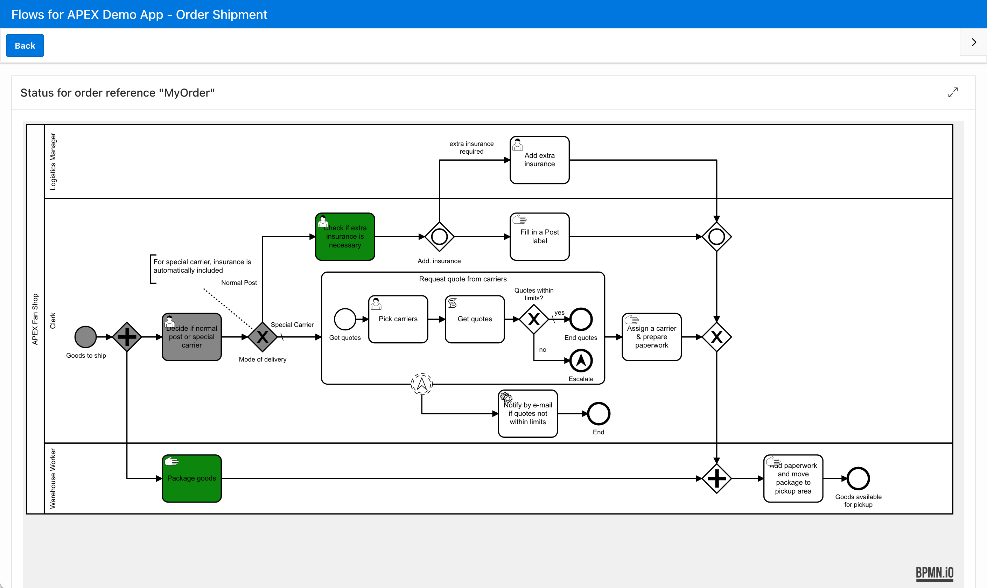
Flows for APEX
Model and run process flows all within APEX
Designed for APEX developers
Packaged App for APEX 20.1+ running on 12.2+
Open Source (MIT License)
Supports BPMN 2.0
Region Plug-In “BPMN Viewer” for existing apps
Interaction with a Flow Instance via
2 Process Plug-Ins
PL/SQL API

Slide 7
Agenda
A quick take on REST
Standards?
REST Connector Plug-Ins
Demo / Code
What‘s ahead

Slide 8
REST and Standards
Representational State Transfer
Typically HTTP(s)
JSON Response
No world-wide standards for
Pagination
Sorting
Filtering

Slide 9
REST Connector Plug-Ins
Provide Metadata to APEX Components
Utilize APEX Component Metadata
Utilize APEX Component Runtime Information
Translate APEX way to REST Endpoint way
Pagination
Sorting
Filtering

Slide 10
Approach
Pull sample response
Read API documentation
Dry runs
(swearing)
Compare to ORDS REST Service
(swearing)
Write a REST Connector Plug-In

Slide 11
Demo / Code
Repository Link on „Resources“ Slide
Let’s see it in action

Slide 12
What’s ahead
More complex examples
GraphQL
Utilize more APEX Component Runtime Information
Add DML operations (not only fetch)

Slide 14
Resources
Carsten Czarski – The Movie DB example
The Rest „easy“ Repository
APEX PL/SQL Packages
APEX_PLUGIN
APEX_PLUGIN_UTIL

Slide 15
Questions

