Slide 1
ORDS & APEX
21.03.2024
More than just delivering Apps

Slide 2
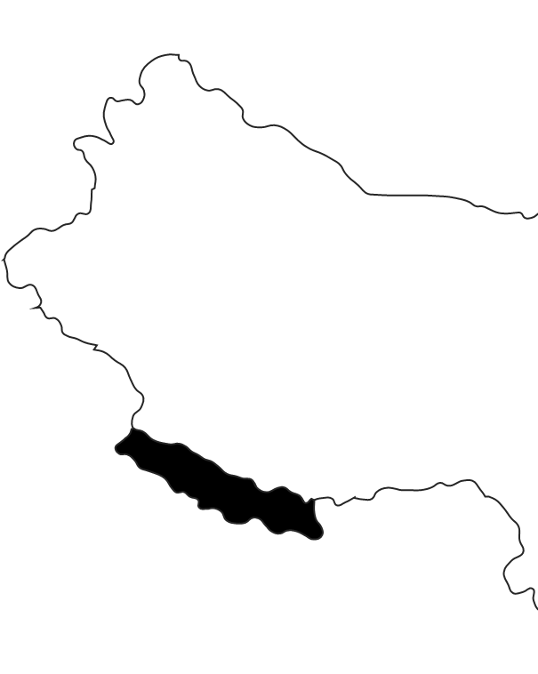
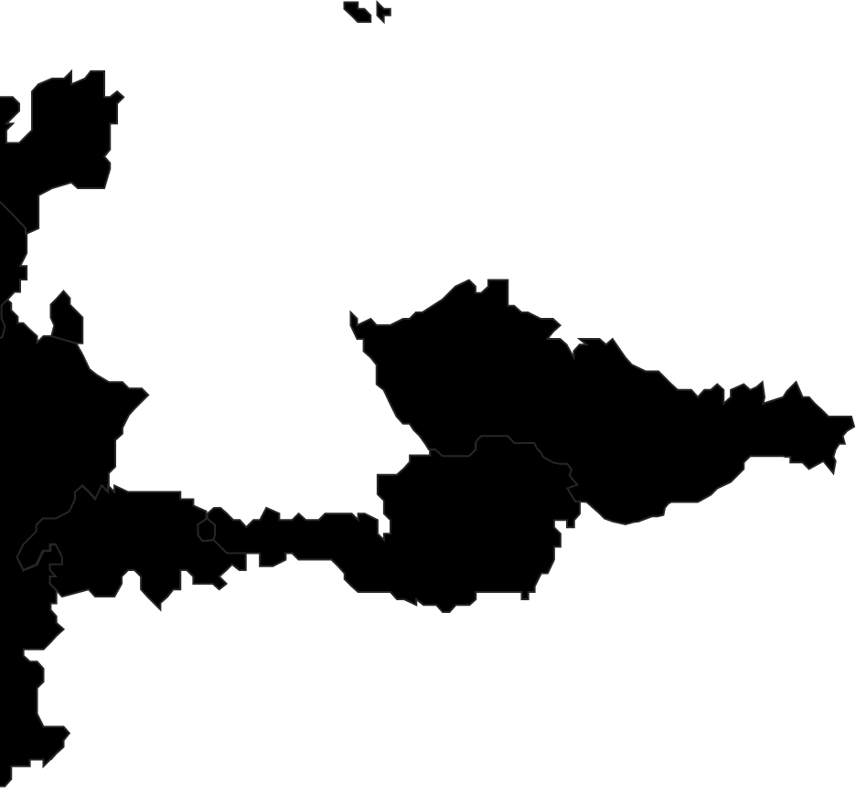


Kaunas
Vilnius
Hamburg
Berlin
Two become
Wolfsburg
Braunschweig
Ranked among the top 15 IT service providers in Germany
Dortmund
Ratingen
Wrocław
Cologne
Frankfurt
Ingolstadt
Munich
Pune
> 900 Employees (of which 160 in shoring locations)
> 150 Clients
> 10 Industries
16 Locations

Slide 3
Let's start with a little quiz

Slide 4
ORDS was called APEX Listener
True

Slide 5
ORDS can be used to upgrade APEX
False

Slide 6
ORDS can clone Pluggable Databases
True

Slide 7
ORDS can clone Pluggable Databases
True

Slide 8
ORDS can starve your Database
NULL

Slide 9
Demo Time
List PDBs
Clone PDB
Show APEX Instance Information
Show Database Users
Show Tables of a Database User

Slide 10
ORDS 23.4 Documentation
Landing Page
Oracle REST Data Services API
Installation & Configuration Guide

Slide 11
Sources on Github
https://github.com/commi235/ords-and-apex

Slide 12
Tools by Us
Low Code Testing Tool (lct.software)
Flows for APEX (flowsforapex.org)
And more (apex.mt-itsolutions.com)

Slide 13
Moritz.Klein@hyand.com
Say Hy_

