Slide 1
☕
Designing with Claude Code
From idea to precise implementation — a real UX case study
Coffee App Diary Feature · April 2026

Slide 2
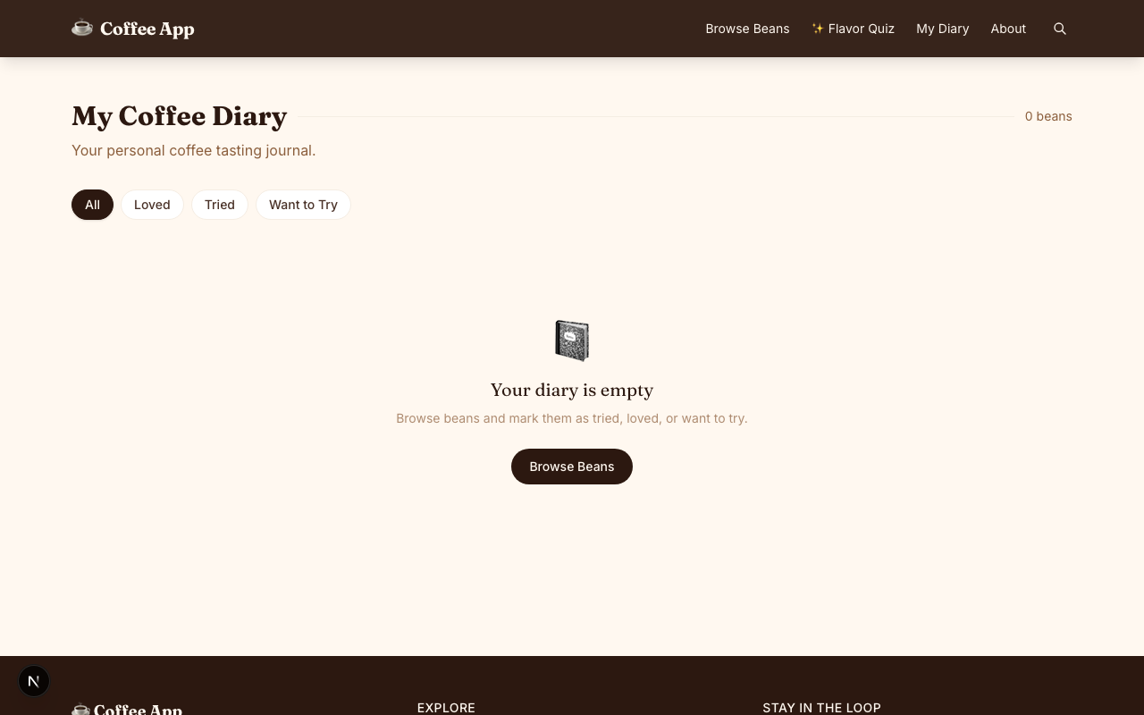
01
Emily's Original Branch
The Foundation
Status filter pills
(All / Loved / Tried / Want to Try)
Bean card grid
Clean, intentional,
functional.
emily-edits branch · commit bb7dc9d

Slide 3
02
Team Discussion → Feature Request
🗺
🏆
Map View
Ranking View
See where your
beans come from
geographically
Compare your beans
side by side
by score
"Add map and ranking views to the diary."

Slide 4
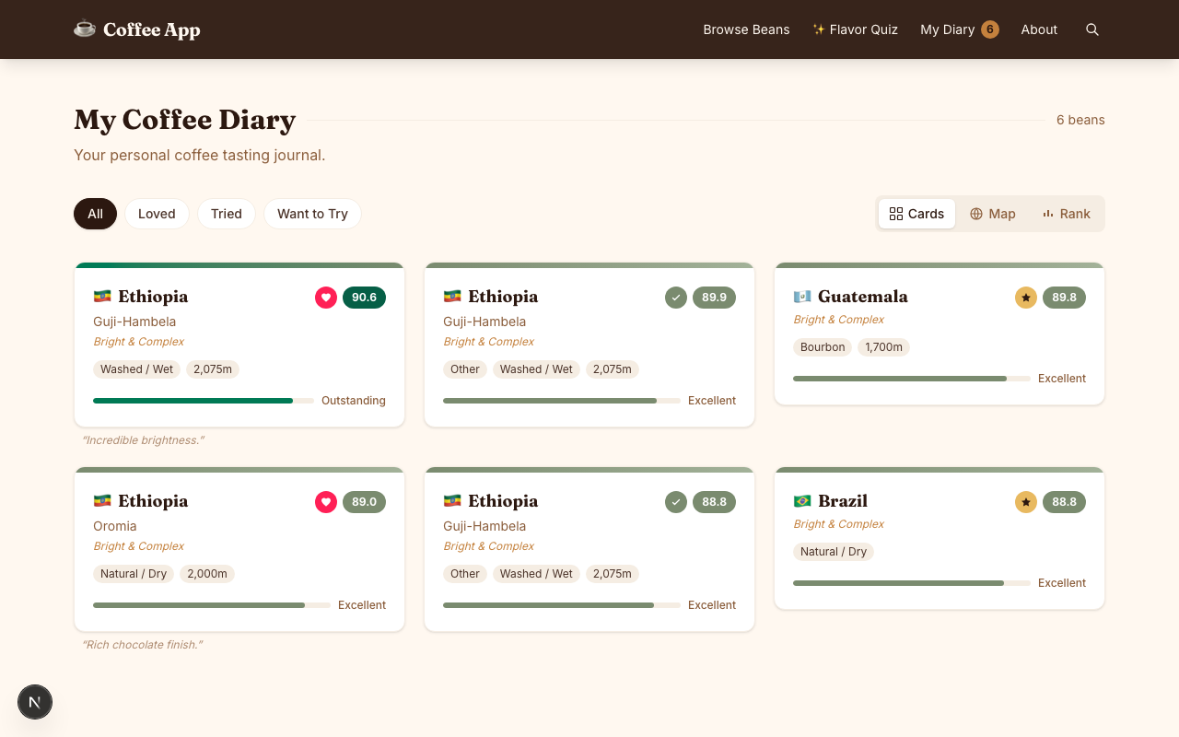
03
Claude Implements — Fast
⚡ Minutes
Map + Ranking added
What shipped:
Cards view
Map view
Rank toggle

Slide 5
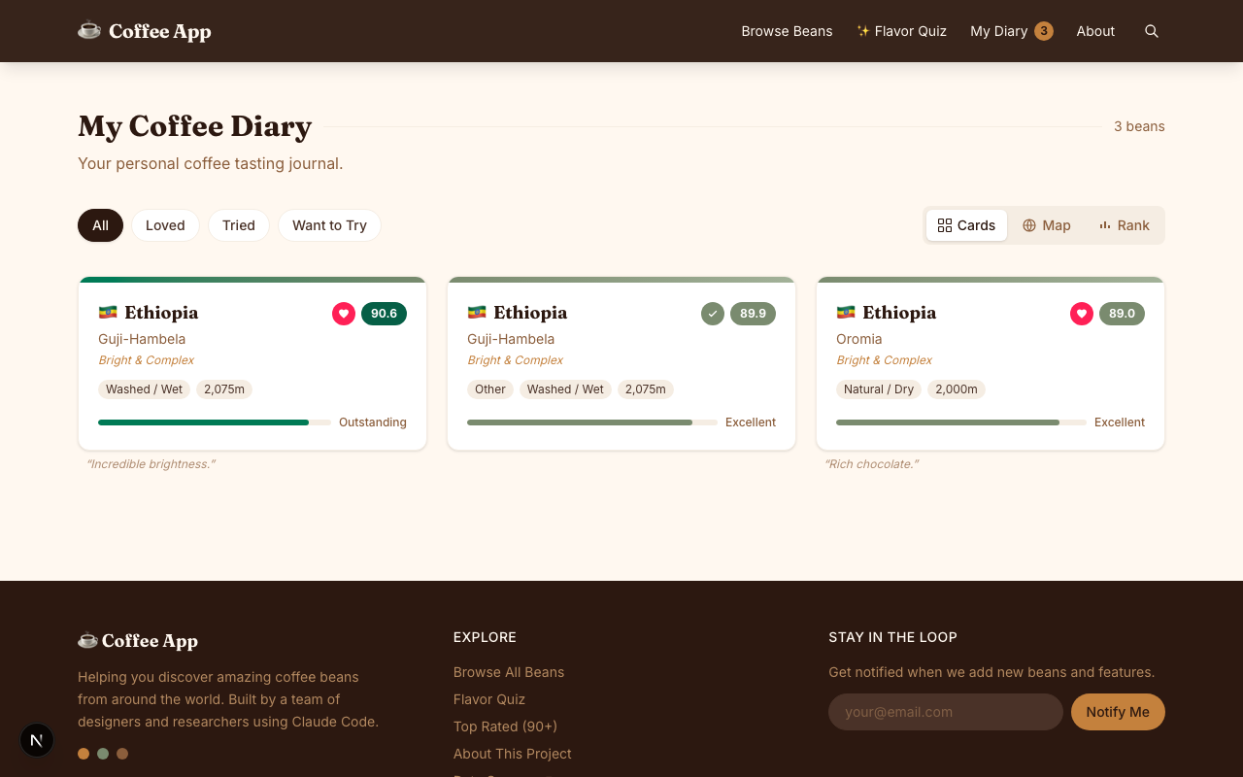
04
The Wrong Placement
The Problem
⚠ Ranking here
Ranking appears even
in Cards & Map views
Ranking feels like a
view mode, not a filter
Wrong grouping —
should be with pills
"The ranking pill shouldn't appear when in tabs other than ranking.
Ranking should be a pill button, not a separate section."

Slide 6
05
Multiple Iterations
1
2
3
Move pill to left row
Coordinate two states
Root cause found
Ranking moved into the filter pill group — but still toggled incorrectly. Active state showed alongside a status filter at the same time.
statusFilter and viewMode were two independent state variables with no awareness of each other. Selecting Ranking changed viewMode but left statusFilter still highlighted.
DiaryRankingView.tsx was a completely separate component, disconnected from filter state in DiaryView.tsx. Two parallel systems. Understanding the structure was the unlock.
Each fix revealed a new layer — until the architecture was understood.

Slide 7
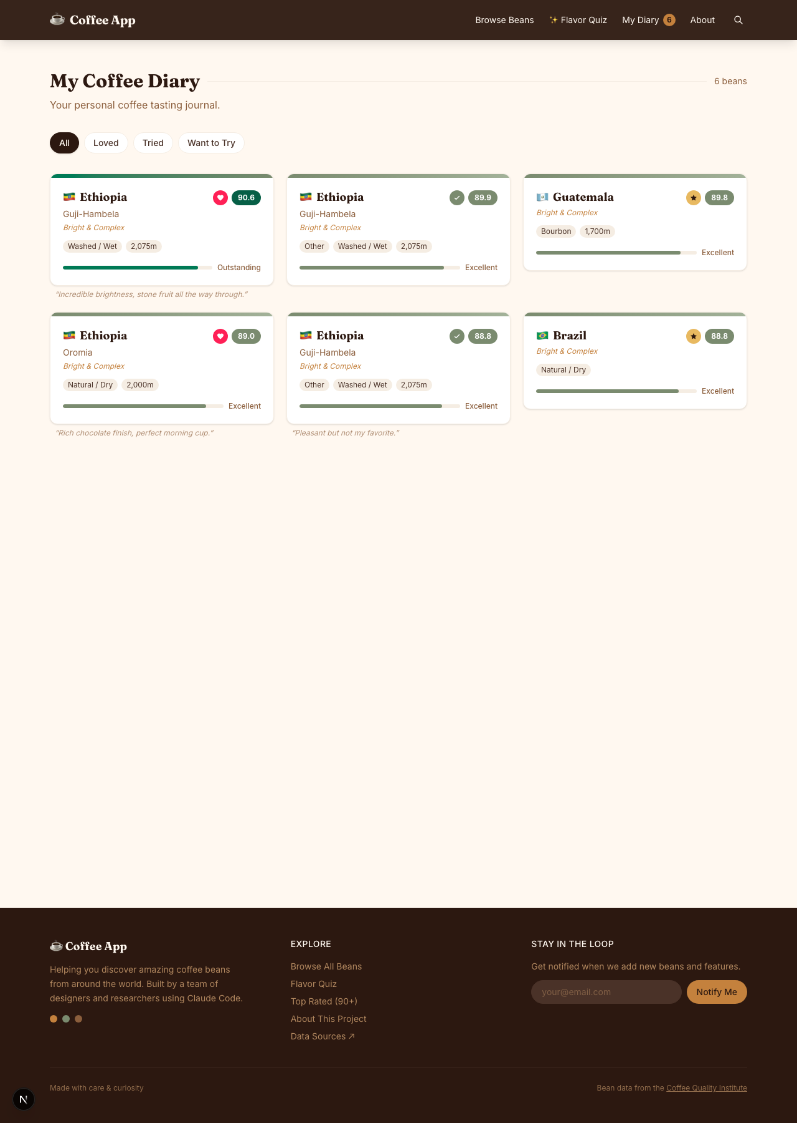
06
Enter Figma MCP
The Loop
1
Claude builds in Figma
2
You edit until it looks right
3
Claude reads Figma → codes it
→
Precise. One round.
Instead of describing the design in words —
give Claude something concrete to build from.

Slide 8
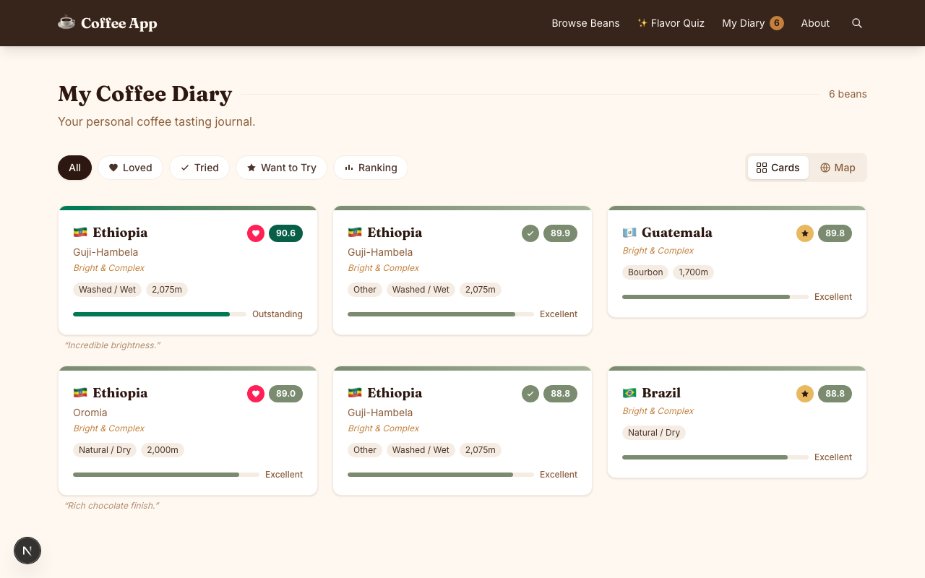
07
Updated Version — Precise Control
What changed
All pills one group
(status + Ranking)
Selecting any pill
deselects the others
Cards/Map toggle
sits separately
Ranking view only
appears when active

Slide 9
Reflection
⚡ Claude is fast
🎯 Precision matters
🔗 Figma MCP closes the loop
Turns ideas into working prototypes in minutes. That speed is real and valuable.
Claude does exactly what you ask — including the wrong thing. Ambiguous requests produce unexpected results.
When words aren't enough, Figma gives Claude something concrete to build from — and you something concrete to edit.
🧩 Understand the structure
🛠 Standardization helps
Knowing how components relate helps you diagnose faster. You don't have to write code, but architecture matters.
Shared patterns, component conventions, and developer-authored skills reduce back-and-forth significantly.

