Slide 1
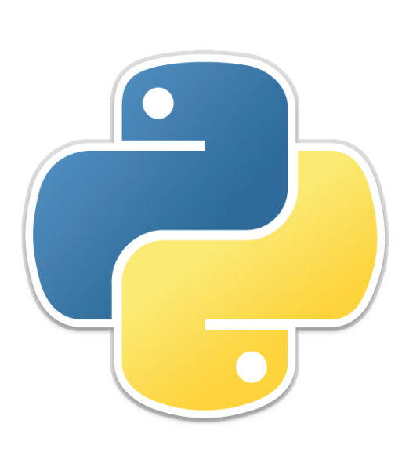
Introduction to Python Programming
What is Python?
Where we can use Python?
Features of Python?
Limitations of Python?
Python Versions
DATA Types
Logical Operators
Flow Control
Functions
This Photo by Unknown author is licensed under CC BY-SA.

Slide 2
What is Python?
Python is a general-purpose high-level programming language.
Python was developed by Guido Van Rossam in 1989 while working at National Research Institute at Netherlands.
But Officially Python was made available to public in 1991. The official Date of Birth for Python is : Feb 20th 1991.
To Print HelloWorld
Java
public class HelloWorld {
public static void main(String[] args) {
System.out.println("HelloWorld");
}
}

Slide 3
C
Python
#include <stdio.h>
int main() {
printf("HelloWorld\n");
return 0;
}
print("HelloWorld")

Slide 4
Where we can use Python?
We can use everywhere. The most common areas are:
For developing Desktop Applications
For developing web Applications
For developing database Applications
For Machine Learning
For Developing AI Applications
For Data Analysis
For Network Programming

Slide 5
Features of Python
Simple and easy to learn
Dynamically Typed
Both Procedure Oriented and Object Oriented
Interpreted
Extensive Library

Slide 6
Python Versions
Python 1.0V introduced in Jan 1994
Python 2.0V introduced in Jan October 2000
Python 3.0V introduced in Jan October 2008
Current Versions
latest stable version is 3.11.2
For more : https://www.python.org/downloads/

Slide 7
Limitations of Python
Performance wise not up to the mark because it is interpreted language.
Not using for mobile applications.

Slide 8
DATA Types
Data Type represents the type of data present inside a varaible.
In Python we are not required to specify the type explicitly. Based on value provided, the type will be assigned automatically.
Hence Python is dynamically Typed Language.

Slide 9
Python contains the following inbuilt data types.
Int
Float
String
List
Tuple
Dictionary
Set

Slide 10
int Data Type
We can use int data type to represent whole numbers(Integral Values)
Eg :
a=10
type(a) #int

Slide 11
Float Data Type
We can use floatdata type to represent floating point values(decimal values)
Eg:
f=1.234
type(f)
#float

Slide 12
String Data Type
str represents String data type
A string is a sequence of characters enclosed within single quotes and double quotes.
Slicing of Strings
Slice means a piece
[] operator is called slice operator which can we be used to retrieve parts of string

Slide 13
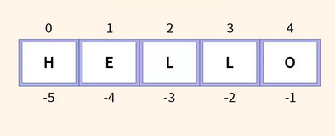
3. In Python Strings follows zero based index.
4. The index can be either +ve or –ve
5. +ve index means forward direction from left to right
6. -ve index means backward direction from Right to Left

Slide 14
List Data Type
If we want to represent a group of values as a single entity then we should go for list data type.
Properties of List
Insertion Order is preserved
Heterogeneous Objects are allowed
Duplicates are allowed
Growable in nature
Values should be enclosed within square brackets.

Slide 15
Tuple Data Type
Tuple data type is exactly same as list data type except that it is immutable. i.e we cannot change values.
Tuple elements can be represented within parenthesis.

Slide 16
Dict Data Type
If we want to represent a group of values as key-value pairs then we should go for dict data type.
Duplicates keys are not allowed but values can be duplicated.

Slide 17
Set Data Type
If we want to represent a group of values without duplicates where order is not important then we should go for set Data Type.
Insertion order is not preserved.
Duplicates are not allowed.
Hetrogeneous objects are allowed.
Index concept is not applicable.
It is mutable collection.
Growable in nature

Slide 18
Frozenset Data Type
It is exactly same as set except that is is immutable.
Hence we can not use add or remove functions.

Slide 19
Logical Operators
Logical operators in Python are used to perform logical operations on boolean values (True or False) and expressions.
Python provides three main logical operators: and, or, and not.
and: The and operator returns True if both operands are True, otherwise, it returns False
or: The or operator returns True if at least one of the operands is True, otherwise, it returns False.
not: The not operator is a unary operator that returns the opposite boolean value of the operand.

Slide 20
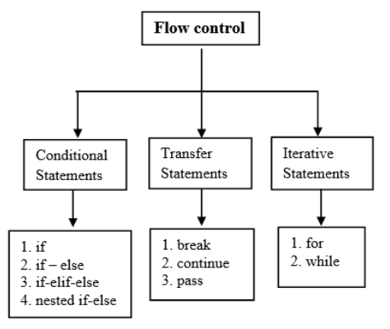
Flow Control
Flow Control describes the order in which statements will be executed at runtime.

Slide 21
Conditional Statements
if
if condition: statement
OR
Statement 1
Statement 2
Statement 3
If condition is true then stataments will be executed

Slide 22
If-else
if condition:
Action-1
else:
Action2
If condition is true then action-1 will be excuted otherwise action-2 will be excuted

Slide 23
if-elif-else
if condition1:
Action-1
elif condition2:
Action-2
elif condition3:
….
else:
Default Action

Slide 24
Iterative Statements
If we want to execute a group of statements multiple times then we should go for iterative statements.
Python Support 2 types of iterative statements.
for loop
If we want to execute some action for every element present in some sequence.
2. while loop
If we want to execute a group of statements iteratively until some condition false

Slide 25
Transfer Statements
break
We can use break statements inside loops to break loop execution based on some condition.
Continue
We can use continue statement to skip current iteration and continue next iteration.
Pass
It is an empty statement
It won't do anything

Slide 26
Function
If a group of statements is repeatedly required then it is not recommended to write these statements seperately. We have to define these statements as a single unit and we can call that unit any number of times based on our requirement without rewriting. This unit is nothing but function.
Python supports 2 types of functions
Built in Functions
User Defined Functions

Slide 27
Built in Functions
The functions which are coming along with Python, are called built in functions or pre defined functions.
Eg:
id()
type()
input()
eval()

Slide 28
User Defined Functions
The Functions which are developed by programmer explicitly according to requirements ,are called user defined functions.
Syntax
def function_name(parameters):
"""doc string"""
return value

Slide 29
Note
While creating functions we can use 2 keywords
def (mandatory)
return (optional)

Slide 30
Types of Arguments
There are 4 types of arguments are allowed in Python.
Positional Arguments
These are the arguments passed to function in correct positional order.
If we change the number of arguments then we will get error.
2. Keyword Arguments
We can pass argument values by keyword i.e by parameter name

Slide 31
3. Default Arguments
If we are not passing any name then only default value will be considered.
4. Variable Length Arguments
We can declare a variable length argument with * symbol as follows.
def f1(*n)

Slide 32


