Slide 1
Associative Democracy for an Associational Society
Dr Paul A. Stokes
University College Dublin

Slide 2
Government Crisis
Government failure
‘Hollowing out of the State’ (Rhodes)

Slide 3
Long Term Historical Trends
Nationalism – the ideology of ‘survival units’
Organizations and their interrelations as the ‘stuff’ of society
The Cutting Edge: Individualization

Slide 4
The Fate of Survival Units
‘Monopoly Mechanism’, and then ...
Dispersal of monopoly power
Lessening of power differentials between governors and governed and the development of multi-polar power
Diminution of requisite hierarchy
Historical increase in societal complexity
Complexification and entropification
Historical distortions of the viability model

Slide 5
Individualization
Only complex societies with high levels of coordination and control are capable of supporting a culture that valorizes the individual
In becoming more of themselves people propagate identities
Autonomy is a social project (Riesman)

Slide 6
Society of Organizations
Individualisation has been maieutically assisted by the development of an organizational society.
Organizations are privileged media of identity formation and identity stabilisation
Society of Organizations

Slide 7
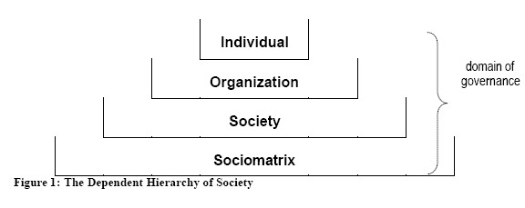
Society as a Dependent Hierarchy

Slide 8
The Identity Society
Decline of Mass Society based on demographics, mass managerial production-based capitalism
Postmodernism
New social movements e.g. greens
Respect and human rights
Support economy (Zuboff & Maxmin)

Slide 9
The Salience of ‘Identity’
The essential feature of human beings is a self-awareness that is mediated through the recognition of others
All social entities exist by virtue of their being an identity. Identities are the social actors in society
DeTocqueville claimed over 170 years ago in his celebrated Democracy in America that “the struggle for recognition is the dominant passion of modernity”
The identity project is animated by the desire for recognition and control

Slide 10
Identity leads to Complexity
Identities are
Autonomous
Undecidable
Recursive
A ‘Black Box’
They are problematic from the point of view of control
They add to the complexity and unpredictability of the environment

Slide 11
Horizontal Complexity
The major issue today is what Beer calls ‘horizontal relevance’
Horizontal trend in relationships has led t a veritable explosion of complexity
Vertical, bureaucratic structures of control have tried to chase this lateral revolution

Slide 12
Variety
Complexity is a function of the number of observed or active states of a system
Variety – the Measure of Complexity
According to Ashby’s Law every good regulator must have a model of the system to be regulated. The model must be sufficiently detailed unto the task and the behavioural repertoire of the control system must have sufficient range and flexibility relative to the system to be controlled or else regulation will fail

Slide 13
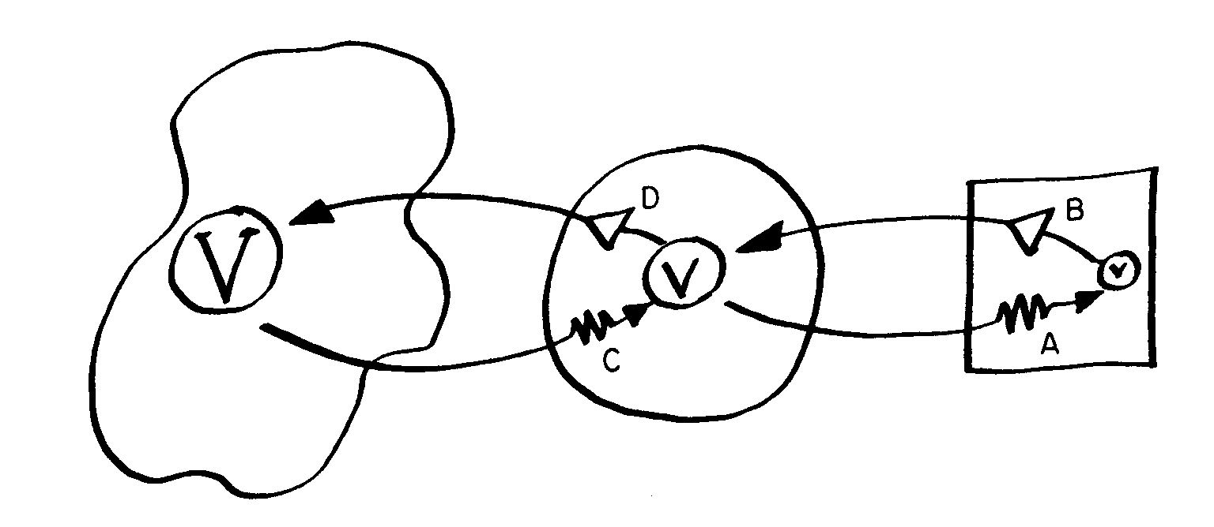
The Variety Equation

Slide 14
From Government to Governance
Governance has always been with us
Societal complexity challenges adequacy of existing structures and procedures
Existing institutions lack ‘requisite variety’ Governance is government ‘outside the box’

Slide 15
Outside the Box
Inter-penetration of state and civil society
Regulation also important for civil society
Control is a distributed property of all complex systems
Mixed mode governance involving:
State
Market
Civil society

Slide 16
Post-Parliamentary Governance
Limitations of periodic national elections as mechanisms of social and political regulation have been exposed
News forms of democracy
Deliberative
Associational

Slide 17
Society of Identities
Autonomy
Culture
Resource Bargaining and Institutionalisation (‘Here & Now’)
Anticipation and Goal-seeking (‘Project-ion’, ‘planning’ – ‘there and then’)
Closure

Slide 18
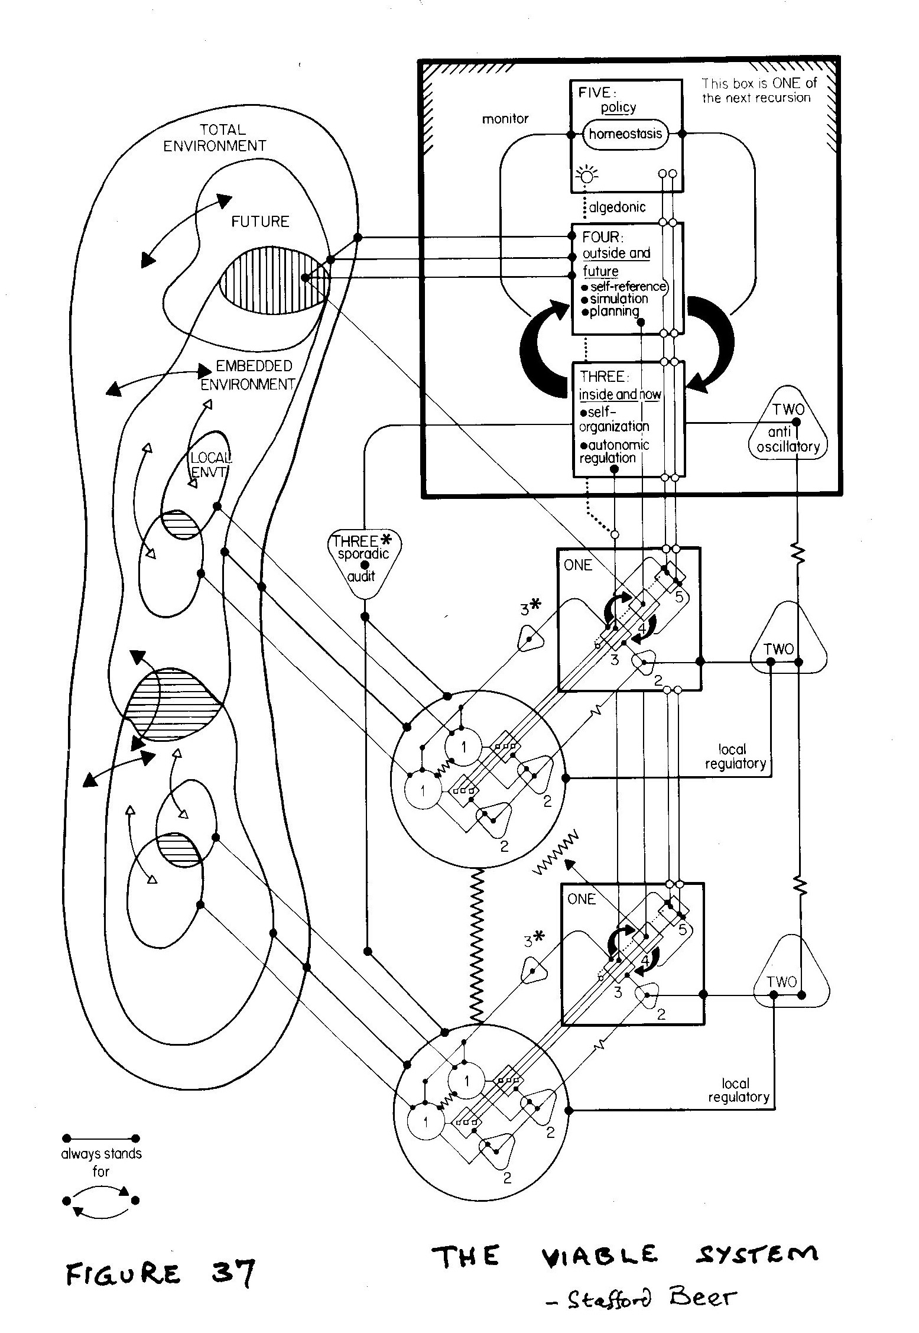
The Viable System Model

Slide 19
Summary
Governance crisis of society calls for a response
Social-Cybernetics has the key in the concept of identity
Time to move forward ... .

Slide 20
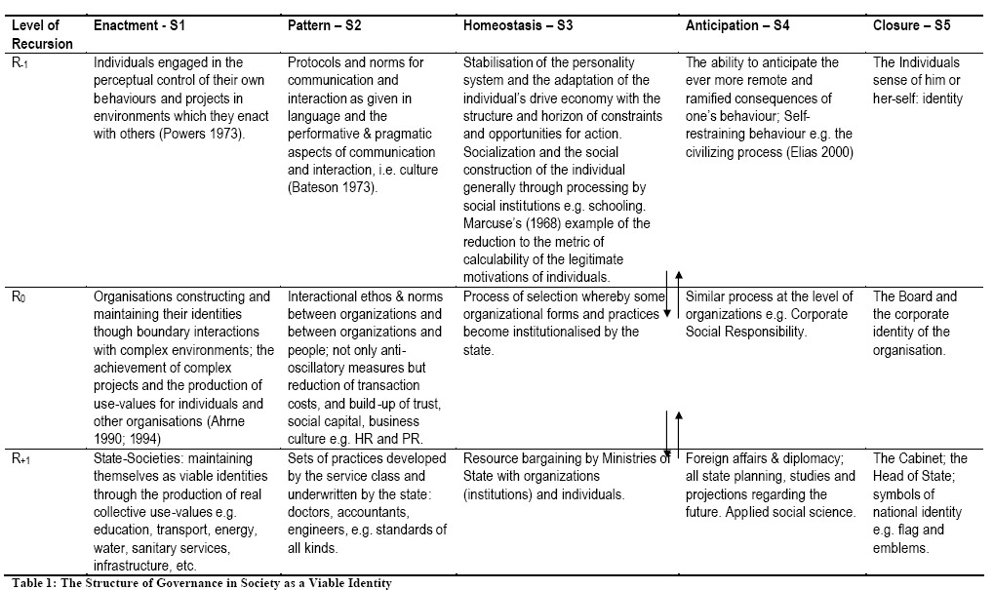
The Recursive Society

Slide 21
Identity as a cybernetic construct and project
Beer’s cybernetics and Wiener’s cybernetics are different. Why?
Beer discovered the cybernetic significance of identity
VSM is a model of identity:
Level 1. Enactment
Levels 2-5: The Metasystem
Level 2: Pattern
Level 3: Integration
Level 4: Anticipation
Level 5: Closure

Slide 22
Level 1. Enactment
R₋₁ Individuals engaged in the perceptual control of their own behaviours and projects in environments which they enact with others
R₀ Organizations constructing and maintaining their identities though boundary interactions with complex environments; the achievement of complex projects and the production of use-values for individuals and other organizations
R₊₁ State-Societies: maintaining themselves as viable identities through the production of real collective use-values e.g. education, transport, energy, water, sanitary services, infrastructure, etc

Slide 23
Level 2: Pattern – S2
R₋₁ Protocols and norms for communication and interaction as given in language and the performative & pragmatic aspects of communication and interaction, i.e. culture
R₀ Interactional ethos & norms between organizations and between organizations and people; anti-oscillatory measures but also reduction of transaction costs, and build-up of trust, social capital, business culture
R₊₁ Sets of practices developed by the service class and underwritten by the state: doctors, accountants, engineers, e.g. standards of all kinds

Slide 24
Level 3: Integration – S3
R₋₁ Stabilisation of the personality system and the adaptation of the individual’s drive economy with the structure and horizon of constraints and opportunities for action. Socialization and the social construction of the individual generally through processing by social institutions e.g. schooling.
R₀ Process of selection whereby some organizational forms and practices become institutionalised by the state
R₊₁ Resource bargaining by Ministries of State with organizations (institutions) and individuals

Slide 25
Level 4: Anticipation – S4
R₋₁ The ability to anticipate the ever more remote and ramified consequences of one’s behaviour; self-restraining behaviour e.g. the civilizing process
R₀ Similar process at the level of organizations e.g. Corporate Social Responsibility (CSR)
R₊₁ Foreign affairs & diplomacy; all state planning, studies and projections regarding the future. Applied social science

Slide 26
Level 5: Closure – S5
R₋₁ The Individuals sense of him or her-self: identity
R₀ The Board and the corporate identity of the organisation
R₊₁ The Cabinet; the Head of State; symbols of national identity e.g. flag and emblems

Slide 27
Summary
Governance crisis of society calls for a response
Cybernetics has the key in the concept of identity
Time to move forward ... .

Slide 28
The virtues of associations

Slide 29
Related Research
According to Archon Fung:
Over the past decade, there has been a resurgence of interest in and research into the connections between associations and democracy.

Slide 30
Associations enhance democracy in at least six ways
through the intrinsic value of associative life,
fostering civic virtues and teaching political skills,
offering resistance to power and checking government,
improving the quality and equality of representation,
facilitating public deliberation,
and creating opportunities for citizens and groups to participate directly in governance.

Slide 31
Quality of Representation
Associations can improve the quality of representation, and so the quality of democracy more broadly, in several ways when they transmit the needs and preferences of their members to government. The views communicated by associations in areas such as health care, social security, education, and national security policy are likely to be more detailed, nuanced, and information rich than thinner channels of representation such as voting. Furthermore, associations often organize interests with less regard to territorial boundaries and so may introduce geographically dispersed interests that would be otherwise politically mute. Finally, associations may be better able to transmit intensities of interest to officials than formal channels of representation (Fung:25).

Slide 32
habermas
Civil society is composed of those more or less spontaneously emergent associations, organizations, and movements that, attuned to how societal problems resonate in the private life sphere, distil and transmit such reactions in amplified form to the public sphere. The core of civil society comprises a network of associations that institutionalize problem solving discourses on questions of general interest inside the framework of organized public spheres. These “discursive designs” have an egalitarian, open form of organization that mirrors essential features of the kind of communication around which they crystallize and to which they lend continuity and permanence. (Habermas 1996, p. 367)

