Slide 1
Counting techniques
Basic Counting Principles, Pigeonhole Principle, Permutations and Combinations

Slide 2
Basic Counting Principles
The Product Rule: Suppose that a procedure can be broken down into a sequence of two tasks. If there are n₁ ways to do the first task and for each of these ways of doing the first task, there are n₂ ways to do the second task, then there are n₁n₂ ways to do the procedure.

Slide 3
Examples on the product rule
Example 1: A new company with just two employees, Sanchez and Patel, rents a floor of a building with 12 offices. How many ways are there to assign different offices to these two employees?
Solution: The procedure of assigning offices to these two employees consists of assigning an office to Sanchez, which can be done in 12 ways, then assigning an office to Patel different from the office assigned to Sanchez, which can be done in 11 ways. By the product rule, there are 12 · 11 = 132 ways to assign offices to these two employees.

Slide 4
Example 2: The chairs of an auditorium are to be labeled with an uppercase English letter followed by a positive integer not exceeding 100. What is the largest number of chairs that can be labeled differently?
Solution: The procedure of labeling a chair consists of two tasks, namely, assigning to the seat one of the 26 uppercase English letters, and then assigning to it one of the 100 possible integers.
The product rule shows that there are 26 · 100 = 2600 different ways that a chair can be labeled.
Therefore, the largest number of chairs that can be labeled differently is 2600.

Slide 5
Example 3: There are 32 microcomputers in a computer center. Each microcomputer has 24 ports. How many different ports to a microcomputer in the center are there?
Solution: The procedure of choosing a port consists of two tasks, first picking a microcomputer and then picking a port on this microcomputer. Because there are 32 ways to choose the microcomputer and 24 ways to choose the port no matter which microcomputer has been selected, the product rule shows that there are 32 · 24 = 768 ports.

Slide 6
The Sum Rule: If a task can be done either in one of n₁ ways or in one of n₂ ways, where none of the set of n₁ ways is the same as any of the set of n₂ ways, then there are n₁ + n₂ ways to do the task.

Slide 7
Examples on sum rule
Example 1: Suppose that either a member of the mathematics faculty or a student who is a mathematics major is chosen as a representative to a university committee. How many different choices are there for this representative if there are 37 members of the mathematics faculty and 83 mathematics majors and no one is both a faculty member and a student?
Solution: There are 37 ways to choose a member of the mathematics faculty and there are 83 ways to choose a student who is a mathematics major. Choosing a member of the mathematics faculty is never the same as choosing a student who is a mathematics major because no one is both a faculty member and a student. By the sum rule it follows that there are 37 + 83 = 120 possible ways to pick this representative.

Slide 8
Principle of inclusion-exclusion
It is also known as the subtraction rule. It states:
If a task can be done in either n₁ ways or n₂ ways, then the number of ways to do the task is n₁ + n₂ minus the number of ways to do the task that are common to the two different ways.

Slide 9
Principle of inclusion-exclusion
It is especially used to count the number of elements in the union of two sets. Suppose that A₁ and A₂ are sets. Then, there are | A₁ | ways to select an element from A₁ and | A₂ | ways to select an element from A₂. The number of ways to select an element from A₁ or from A₂, that is, the number of ways to select an element from their union, is the sum of the number of ways to select an element from A₁ and the number of ways to select an element from A₂, minus the number of ways to select an element that is in both A₁ and A₂. Because there are | A₁ ∪ A₂ |ways to select an element in either A₁ or in A₂, and |A1 ∩ A₂ | ways to select an element common to both sets, we have
| A₁ ∪ A₂ | = | A₁ | + | A₂ | − | A₁ ∩ A₂ |.

Slide 10
Examples
Example 1: A computer company receives 350 applications from computer graduates for a job planning a line of new Web servers. Suppose that 220 of these applicants majored in computer science, 147 majored in business, and 51 majored both in computer science and in business. How many of these applicants majored neither in computer science nor in business?

Slide 11
Solution: To find the number of these applicants who majored neither in computer science nor in business, we can subtract the number of students who majored either in computer science or in business (or both) from the total number of applicants. Let A₁ be the set of students who majored in computer science and A₂ the set of students who majored in business. Then A₁ ∪ A₂ is the set of students who majored in computer science or business (or both), and A₁ ∩ A₂ is the set of students who majored both in computer science and in business. By the subtraction rule
the number of students who majored either in computer science or in business (or both) equals
| A₁ ∪ A₂ | = | A₁ | + | A₂ | − | A₁ ∩ A₂ | = 220 + 147 − 51 = 316.
We conclude that 350 − 316 = 34 of the applicants majored neither in computer science nor in business.

Slide 12
Example 2: In a discrete mathematics class every student is a major in computer science or mathematics, or both. The number of students having computer science as a major (possibly along with mathematics) is 25; the number of students having mathematics as a major (possibly along with computer science) is 13; and the number of students majoring in both computer science and mathematics is 8. How many students are in this class?

Slide 13
Solution: Let A be the set of students in the class majoring in computer science and B be the set of students in the class majoring in mathematics. Then A ∩ B is the set of students in the class who are joint mathematics and computer science majors. Because every student in the class is majoring in either computer science or mathematics (or both), it follows that the number of students in the class is |A ∪ B|. Therefore,
|A ∪ B| = |A| + |B| − |A ∩ B|
= 25 + 13 − 8 = 30.
Therefore, there are 30 students in the class.

Slide 14
The pigeonhole principle
Suppose a flock of pigeons fly into a set of pigeonholes to roost
If there are more pigeons than pigeonholes, then there must be at least 1 pigeonhole that has more than one pigeon in it
If k+1 or more objects are placed into k boxes, then there is at least one box containing two or more of the objects

Slide 15
What for?
One of the basic combinatorial principles
Used extensively in mathematical proofs
Arises frequently in computer science
Hash table collisions
Parallel computing
...

Slide 16
Pigeonhole principle examples
In a group of 367 people, there must be two people with the same birthday
As there are 366 possible birthdays
In a group of 27 English words, at least two words must start with the same letter
As there are only 26 letters

Slide 17
Generalized pigeonhole principle
If N objects are placed into k boxes, then there is at least one box containing ⎡N/k⎤ objects

Slide 18
Generalized pigeonhole principle examples
Among 100 people, there are at least ⎡100/12⎤ = 9 born on the same month
How many students in a class must there be to ensure that 6 students get the same grade (one of A, B, C, D, or F)?
The “boxes” are the grades. Thus, k = 5
Thus, we set ⎡N/5⎤ = 6
Lowest possible value for N is 26

Slide 19
example
A bowl contains 10 red and 10 blue balls. A blindfolded person selects
balls at random, without replacement.
(a) How many balls must the person select to
be sure of getting at least 3 balls of the same colour?
we have 2 colours, red and blue
these are our pigeon holes
at least one pigeon hole must have at least 3 pigeons (coloured balls!)
using the generalised pigeon hole principle
⎡n/k⎤ = 3
where n is the smallest number of pigeons required
where k is the number of pigeon holes
⎡n/2⎤ = 3
∴ n = 5
note, we were not constrained by the number of balls!

Slide 20
exercise
A bowl contains 10 red and 10 blue balls. A blindfolded person selects
balls at random, without replacement.
(b) How many balls must she select to be sure of getting at least 3
blue balls?
again, the colours correspond to our pigeon holes
we have 2 pigeonholes
she could select 10 red balls one after the other
so she would then need to select 3 more
therefore she must select 13 to be sure of getting 3 blue balls!
Note: in this case it did matter that we started with 10 of each colour

Slide 21
Permutations and Combinations
compute permutations
compute combinations
distinguish permutations vs combinations

Slide 22
Permutations
A Permutation is an arrangement of items in a particular order.
Notice, ORDER MATTERS!
To find the number of Permutations of n items, we can use the Fundamental Counting Principle or factorial notation.

Slide 23
There are basically two types of permutation:
Repetition is Allowed: such as the lock to a safe. It could be "333".
No Repetition: for example the first three people in a running race. You can't be first and second.

Slide 24
Permutations
A permutation of a set S is an ordered arrangement of the elements of S.
In other words, it is a sequence containing every element of S exactly once.
Example: Consider the set S = {1; 2; 3}.
The sequence (3; 1; 2) is one permutation of S.
There are 6 different permutations of S. They are:
(1; 2; 3) ; (1; 3; 2) ; (2; 1; 3) ; (2; 3; 1) ; (3; 1; 2) ; (3; 2; 1)

Slide 25
Permutations
The number of ways to arrange the letters ABC:
____ ____ ____
Number of choices for first blank?
3 ____ ____
Number of choices for second blank?
3 2 ___
Number of choices for third blank?
3 2 1
3*2*1 = 6 3! = 3*2*1 = 6
ABC ACB BAC BCA CAB CBA

Slide 26

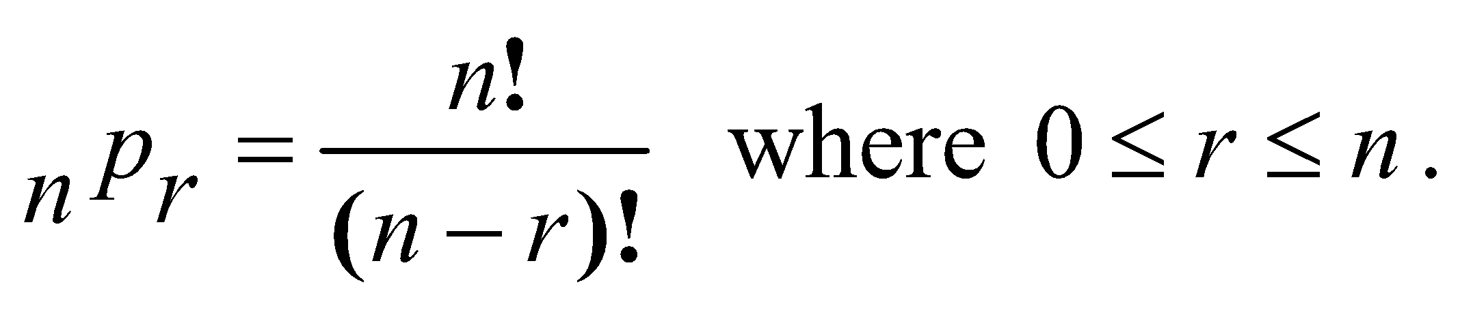
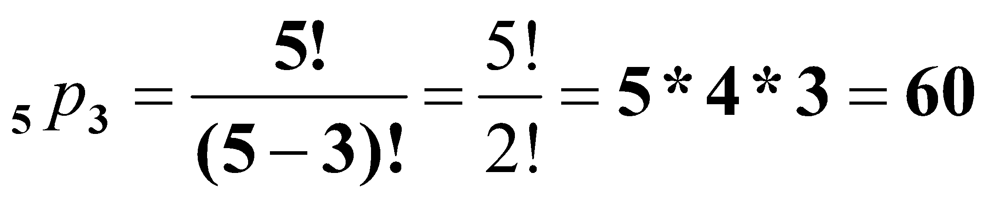
Permutations
To find the number of Permutations of n items chosen r at a time, you can use the formula

Slide 27
Permutations
Practice:
A combination lock will open when the right choice of three numbers (from 1 to 30, inclusive) is selected. How many different lock combinations are possible assuming no number is repeated?

Slide 28
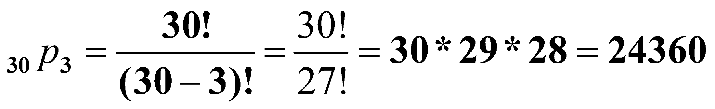
Permutations
Practice:
A combination lock will open when the right choice of three numbers (from 1 to 30, inclusive) is selected. How many different lock combinations are possible assuming no number is repeated?

Slide 29
Permutations
Practice:
From a club of 24 members, a President, Vice President, Secretary, Treasurer and Historian are to be elected. In how many ways can the offices be filled?

Slide 30
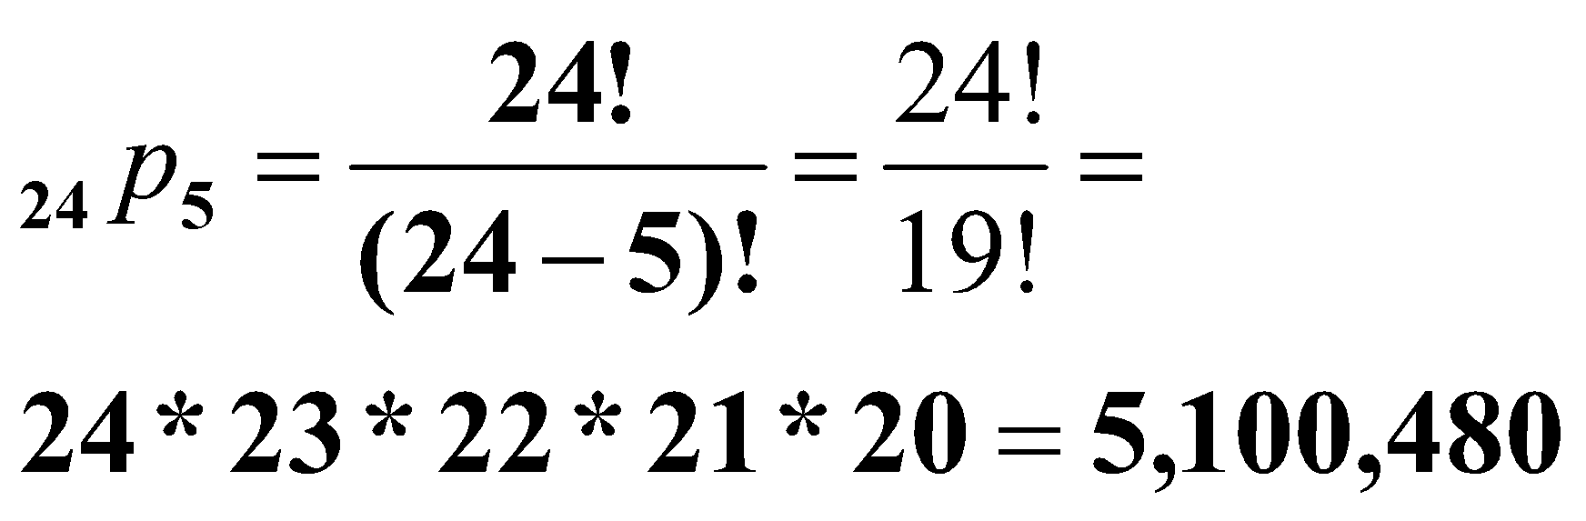
Permutations
Practice:
From a club of 24 members, a President, Vice President, Secretary, Treasurer and Historian are to be elected. In how many ways can the offices be filled?

Slide 31
Combinations
A Combination is an arrangement of items in which order does not matter.
ORDER DOES NOT MATTER!
Since the order does not matter in combinations, there are fewer combinations than permutations. The combinations are a "subset" of the permutations.

Slide 32
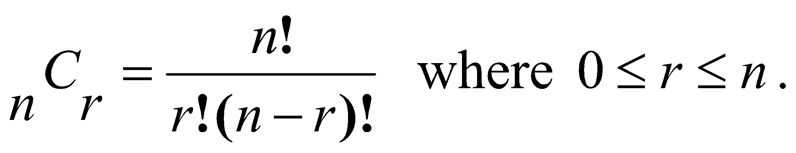
Combinations
To find the number of Combinations of n items chosen r at a time, you can use the formula

Slide 33
There are also two types of combinations (remember the order does not matter now):
Repetition is Allowed: such as coins in your pocket (5,5,5,10,10)
No Repetition: such as lottery numbers (2,14,15,27,30,33)

Slide 34
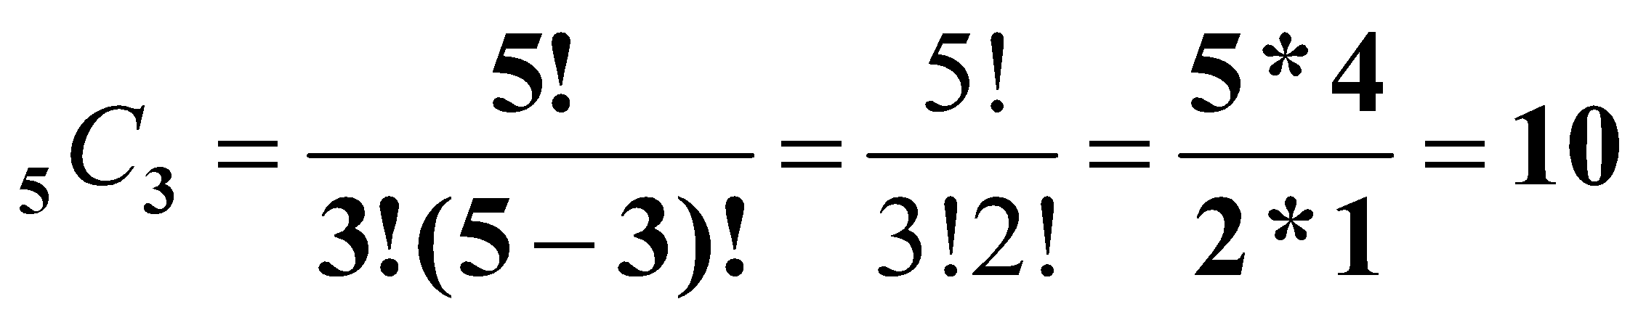
Combinations
A student must answer 3 out of 5 essay questions on a test. In how many different ways can the student select the questions?
Practice:

Slide 35
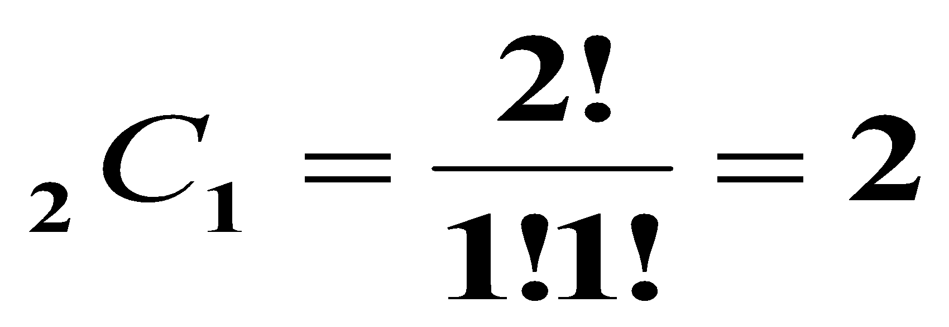
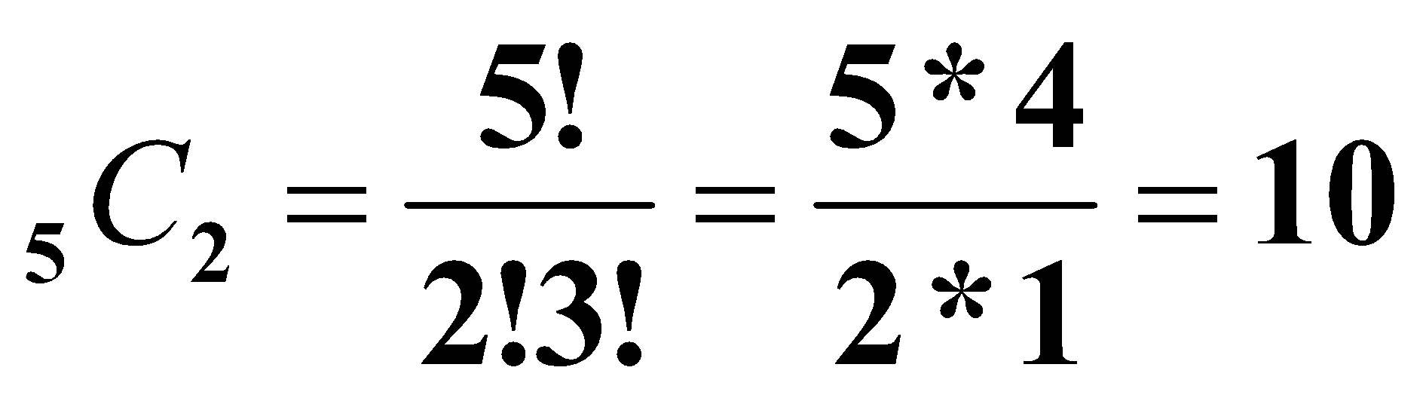
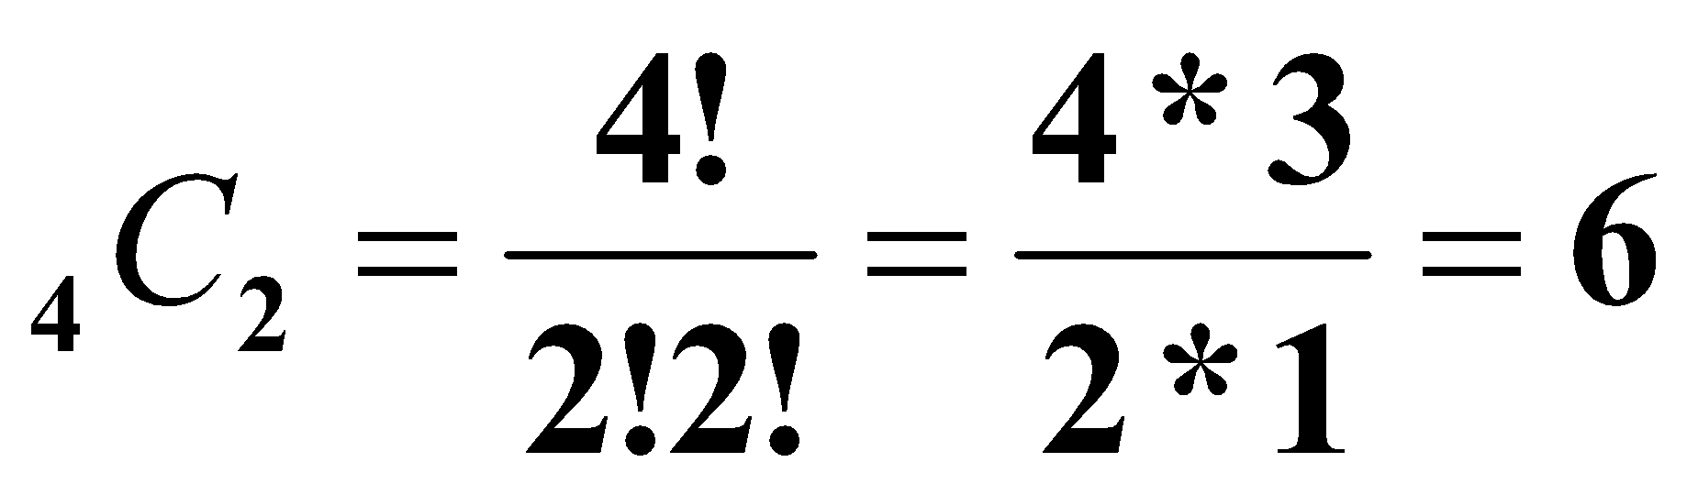
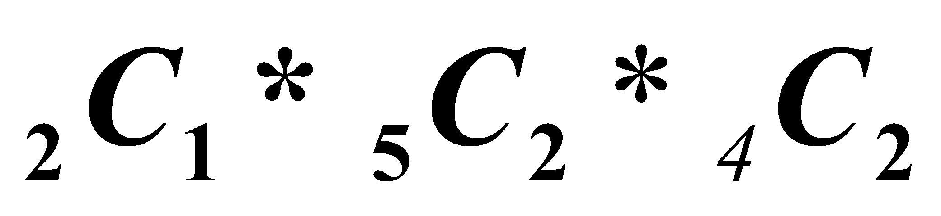
Combinations
Practice:
A basketball team consists of two centers, five forwards, and four guards. In how many ways can the coach select a starting line up of one center, two forwards, and two guards?
Center:
Forwards:
Guards:
Thus, the number of ways to select the starting line up is 2*10*6 = 120.

Slide 36
Permutations vs. Combinations
Both are ways to count the possibilities
The difference between them is whether order matters or not
Consider a poker hand:
A♦, 5♥, 7♣, 10♠, K♠
Is that the same hand as:
K♠, 10♠, 7♣, 5♥, A♦
Does the order the cards are handed out matter?
If yes, then we are dealing with permutations
If no, then we are dealing with combinations

Slide 37
Permutations
A permutation is an ordered arrangement of the elements of some set S
Let S = {a, b, c}
c, b, a is a permutation of S
b, c, a is a different permutation of S
An r-permutation is an ordered arrangement of r elements of the set
A♦, 5♥, 7♣, 10♠, K♠ is a 5-permutation of the set of cards
The notation for the number of r-permutations: P(n,r)
The poker hand is one of P(52,5) permutations

Slide 38
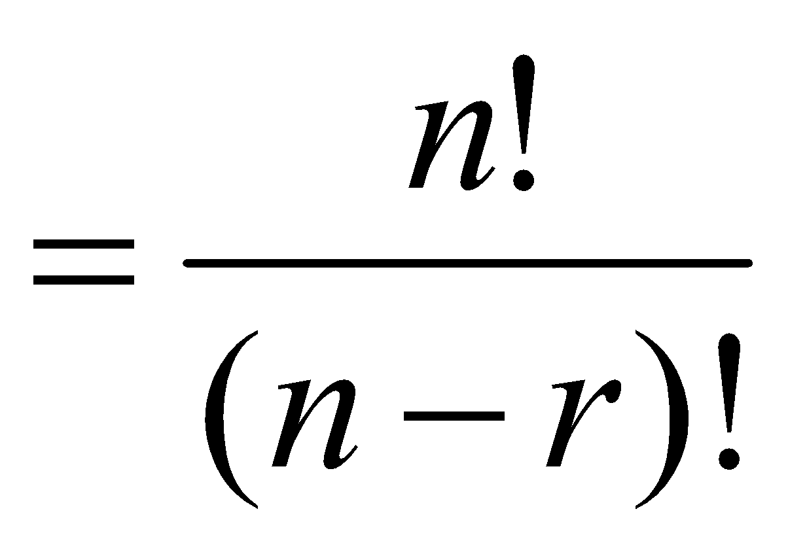
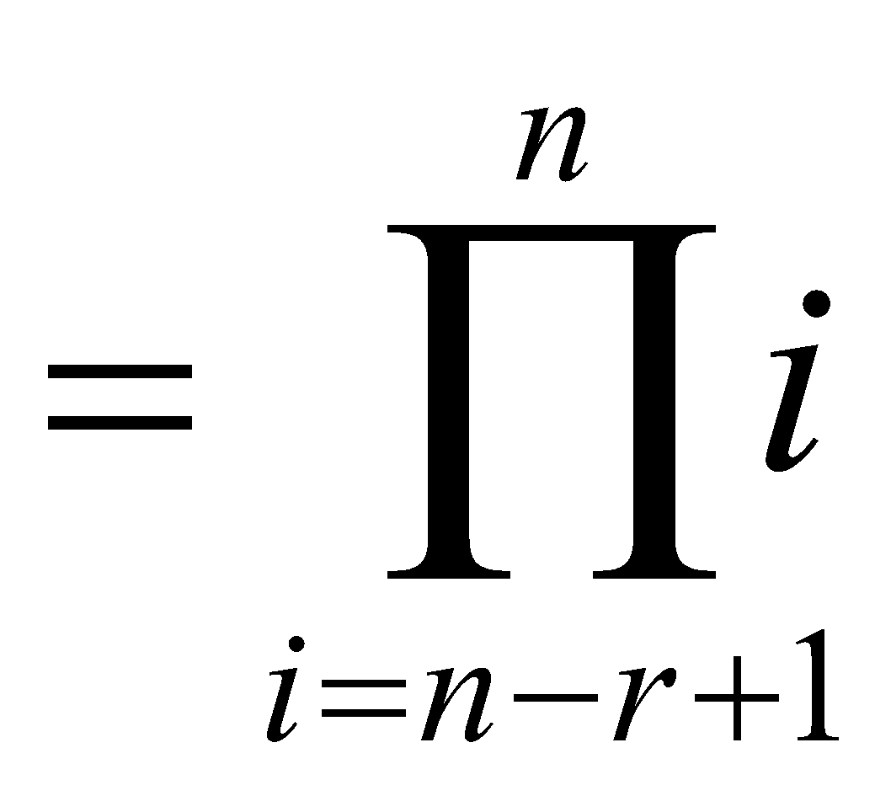
Permutations
Number of poker hands (5 cards):
P(52,5) = 52*51*50*49*48 = 311,875,200
Number of (initial) blackjack hands (2 cards):
P(52,2) = 52*51 = 2,652
r-permutation notation: P(n,r)
The poker hand is one of P(52,5) permutations

Slide 39
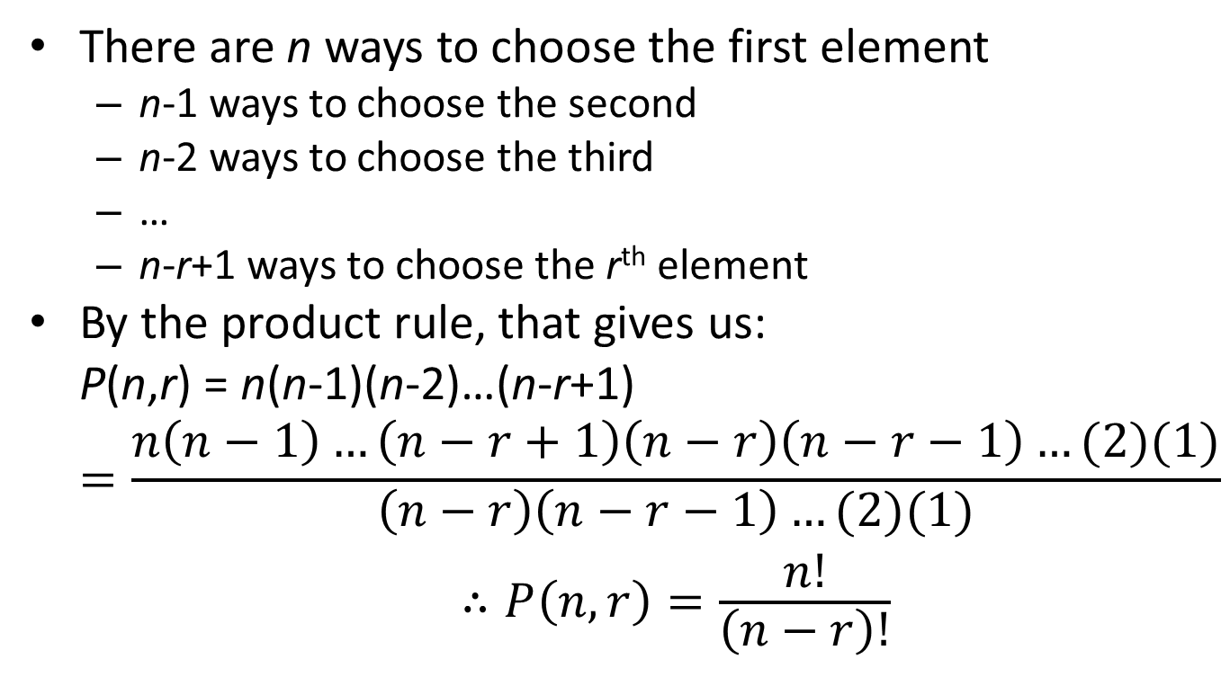
Permutation formula proof

Slide 40
Permutations vs. r-permutations
r-permutations: Choosing an ordered 5 card hand is P(52,5)
When people say “permutations”, they almost always mean r-permutations
But the name can refer to both
Permutations: Choosing an order for all 52 cards is P(52,52) = 52!
Thus, P(n,n) = n!

Slide 41
Sample question
How many permutations of {a, b, c, d, e, f, g} end with a?
Note that the set has 7 elements
The last character must be a
The rest can be in any order
Thus, we want a 6-permutation on the set {b, c, d, e, f, g}
P(6,6) = 6! = 720

Slide 42
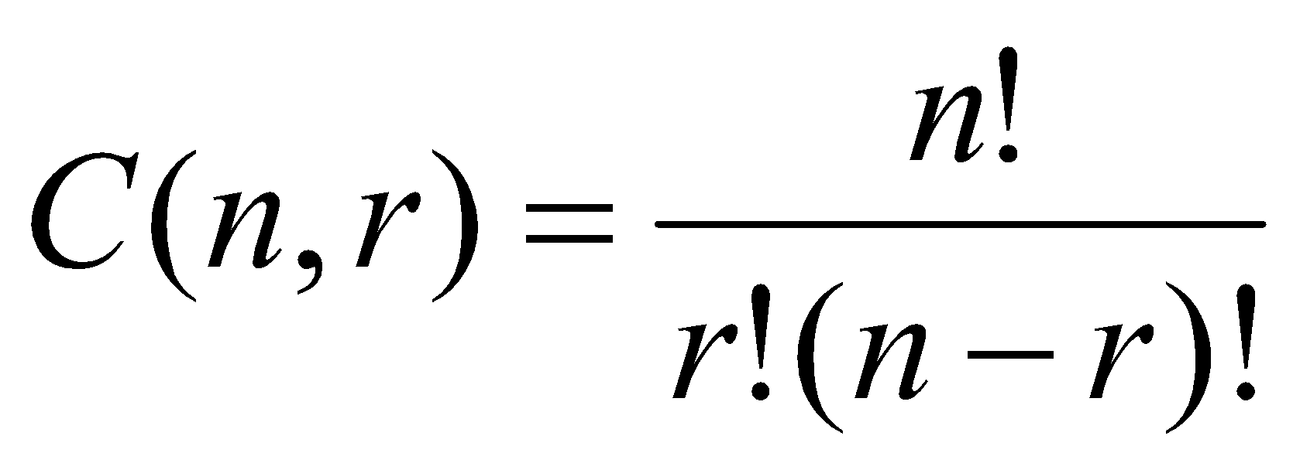
Combinations
What if order doesn’t matter?
In poker, the following two hands are equivalent:
A♦, 5♥, 7♣, 10♠, K♠
K♠, 10♠, 7♣, 5♥, A♦
The number of r-combinations of a set with n elements, where n is non-negative and 0≤r≤n is:

Slide 43
Combination formula proof
Let C(52,5) be the number of ways to generate unordered poker hands
The number of ordered poker hands is P(52,5) = 311,875,200
The number of ways to order a single poker hand is P(5,5) = 5! = 120
The total number of unordered poker hands is the total number of ordered hands divided by the number of ways to order each hand
Thus, C(52,5) = P(52,5)/P(5,5)

Slide 44
Combination formula proof
Let C(52,5) be the number of ways to generate unordered poker hands
The number of ordered poker hands is P(52,5) = 311,875,200
The number of ways to order a single poker hand is P(5,5) = 5! = 120
The total number of unordered poker hands is the total number of ordered hands divided by the number of ways to order each hand
Thus, C(52,5) = P(52,5)/P(5,5)

Slide 45
Combination formula proof
Let C(n, r) be the number of ways to generate unordered combinations
The number of ordered combinations (i.e. r-permutations) is P(n, r)
The number of ways to order a single one of those r-permutations P(r, r)
The total number of unordered combinations is the total number of ordered combinations (i.e. r-permutations) divided by the number of ways to order each combination
Thus, C(n, r) = P(n, r)/P(r, r)

Slide 46
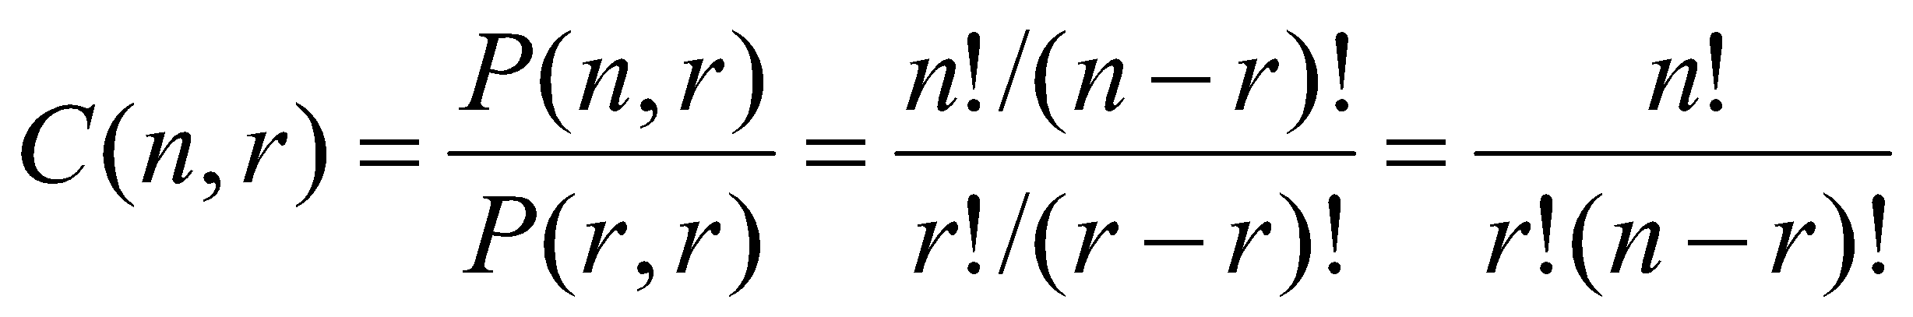
Combination formula proof

Slide 47
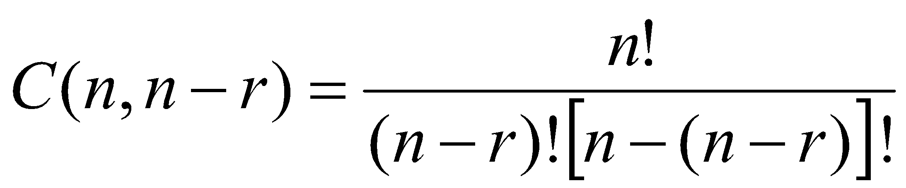
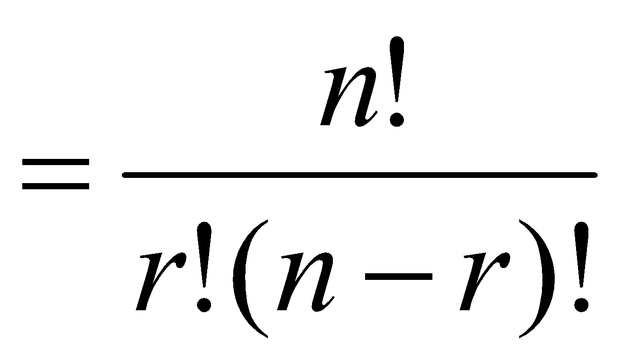
Corollary 1
Let n and r be non-negative integers with r ≤ n. Then C(n,r) = C(n,n-r)
Proof:

Slide 48
Corollary example
There are C(52,5) ways to pick a 5-card poker hand
There are C(52,47) ways to pick a 47-card hand
P(52,5) = 2,598,960 = P(52,47)
When dealing 47 cards, you are picking 5 cards to not deal
As opposed to picking 5 card to deal
Again, the order the cards are dealt in does matter

Slide 49
***Exercises
A witness to a hit-and-run accident tells the police that the license plate of the car in the accident, which contains three letters followed by three digits, starts with the letters AS and contains both the digits 1 and 2. How many different license plates can fit this description?
Ans: ₂₆P₁*₂P₂*₁₀P₁=520

Slide 50
How many ways are there to select 12 countries in the United Nations to serve on a council if 3 are selected from a block of 45, 4 are selected from a block of 57, and the others are selected from the remaining 69 countries?

Slide 51
How many car license plates can be made using either two or three letters followed by either two or three digits and contain no letter or digit twice?
How many different license plates can be made if each plate contains a sequence of three uppercase English letters followed by three digits (and no sequences of letters are prohibited, even if they are obscene)?

Slide 52
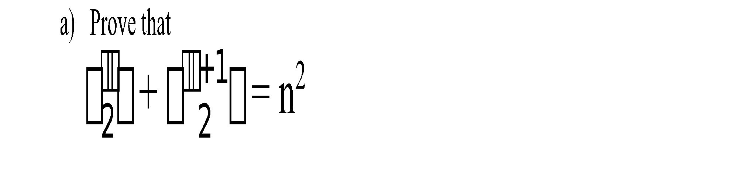
Suppose that a department contains 10 men and 15 women. How many ways are there to select a committee with six members if it must have At most three women? At least 1 woman and at least 1 man?

Slide 53
A laboratory cage contains eight white mice and six brown mice. Find the number of ways of choosing five mice from the cage if
They can be of either colour,
At least one of each colour must be chosen,
It must have at most two white mice?
A group contains n men and n women. How many ways are there to arrange these people in a row if the men and women alternate?

Slide 54
4 Mathematics books, 3 Chemistry books, 2 Physics books, and 1 Biology book are to be arranged on a bookshelf. How many different arrangements are possible if
the books in each particular subject must all stand together,
only the Chemistry books must stand together?

