Slide 1
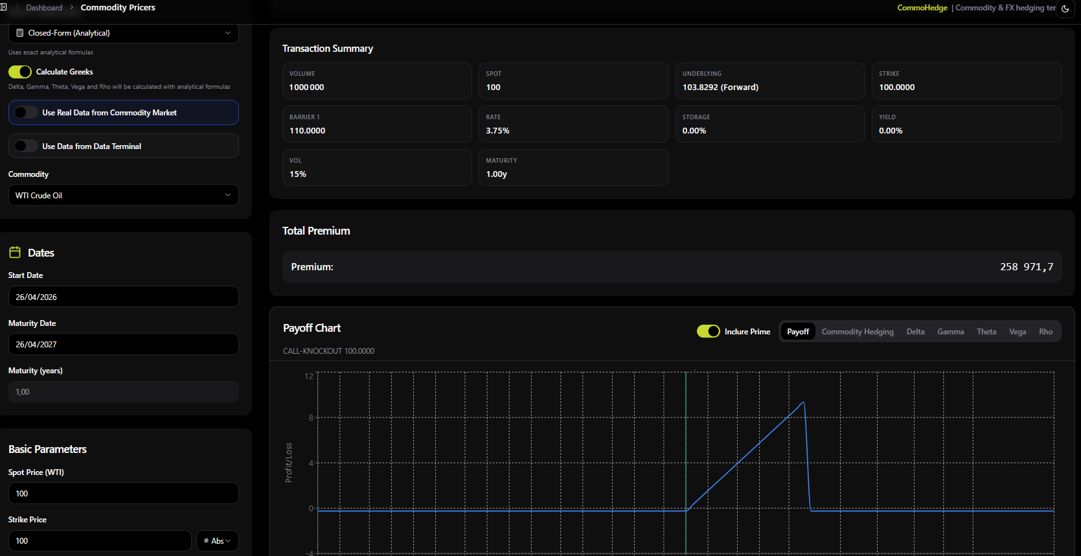
COMMERCIAL PITCH · 2026
COMMOHEDGE
Commodity hedging & intelligence terminal
Price, hedge, monitor and contextualize commodity
(and FX) risk in one professional workstation.
For corporate treasurers · commodity desks · brokers · shipping
COMMOHEDGE · Commodity hedging & intelligence terminal · Confidential
1 / 16

Slide 2
Agenda
Presentation roadmap
01
The problem
02
The CommoHedge solution
03
Product walkthrough (live UI)
04
Instruments, models & coverage
05
Buyers & competitive edge
06
Demo script & packaging
07
Closing & next steps
COMMOHEDGE · Commodity hedging & intelligence terminal · Confidential
2 / 16

Slide 3
The problem
Why mid-market risk teams stay fragile
Terminal cost
Fragmented tools
Opaque risk
Bloomberg / Murex / full quant stacks are too expensive and heavy for many corporates.
Pricing in Excel, exposures elsewhere, news elsewhere, freight elsewhere — no unified loop.
Barriers & digitals mispriced, approximate VaR, no path from strategy → book → committee.
COMMOHEDGE · Commodity hedging & intelligence terminal · Confidential
3 / 16

Slide 4
The solution
One-sentence pitch for the meeting open
CommoHedge replaces the Excel + Bloomberg + bank-email patchwork
with one terminal: desk-grade pricing, hedge book with live MTM,
market data (futures / vol / freight) and geopolitical intelligence.
PRICE
HEDGE
MEASURE
SENSE
Black-76, barriers, MC, Greeks
Exposures → book → MTM
VaR, stress, PDF reports
Data + Intel + AI
COMMOHEDGE · Commodity hedging & intelligence terminal · Confidential
4 / 16

Slide 5
Commodity Pricers
Desk-grade pricing with payoff & Greeks
Price vanillas, knock-outs, digitals and more.
• Closed-form & Monte Carlo engines
• Live Greeks (Δ Γ Θ Vega Rho)
• Cost-of-carry forwards
• Interactive payoff charts
• Feed from Market / Data Terminal
Show the client a knock-out call on WTI
in under a minute.
COMMOHEDGE · Commodity hedging & intelligence terminal · Confidential
5 / 16

Slide 6
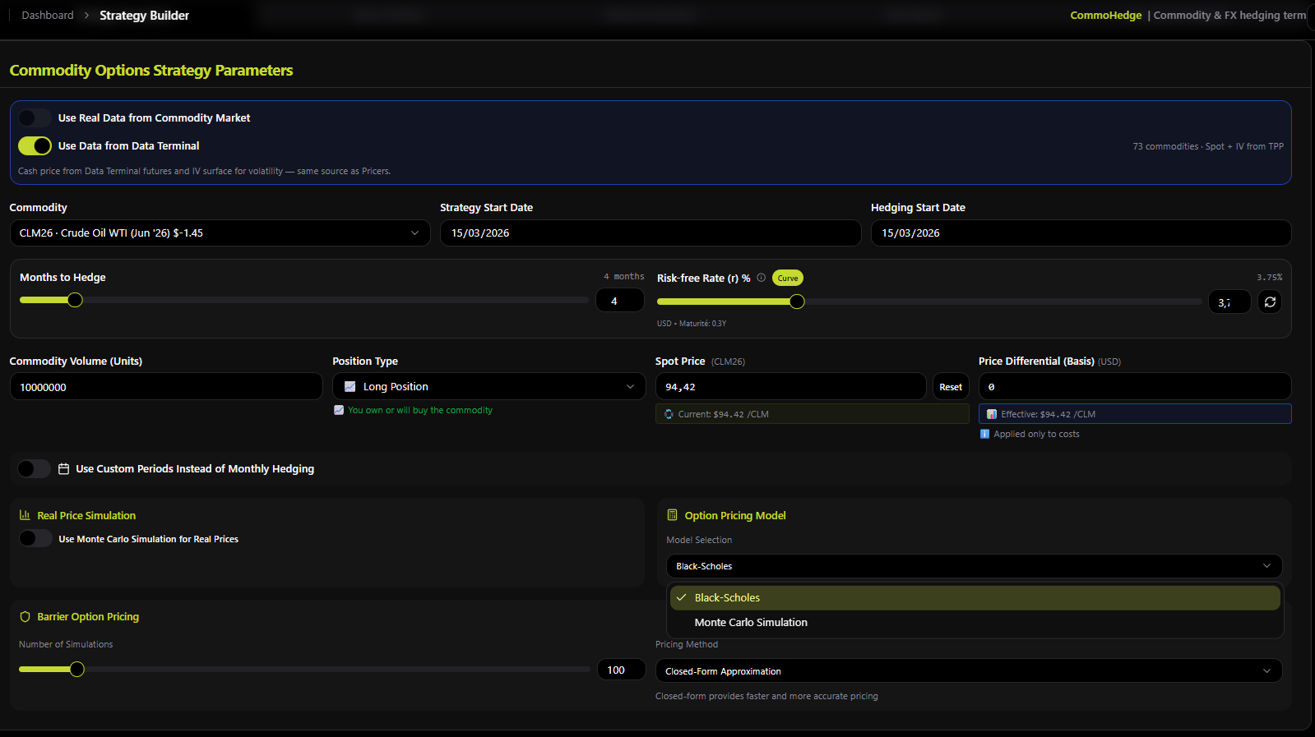
Strategy Builder
Design multi-month hedges with real terminal data
Build full hedge programs:
• Commodity + horizon + volume
• Long / short positioning
• Black-Scholes or Monte Carlo
• Barrier simulation controls
• Spot + IV from Data Terminal
• Stress & historical backtest
• Export into the hedge book
From idea → structure → book.
COMMOHEDGE · Commodity hedging & intelligence terminal · Confidential
6 / 16

Slide 7
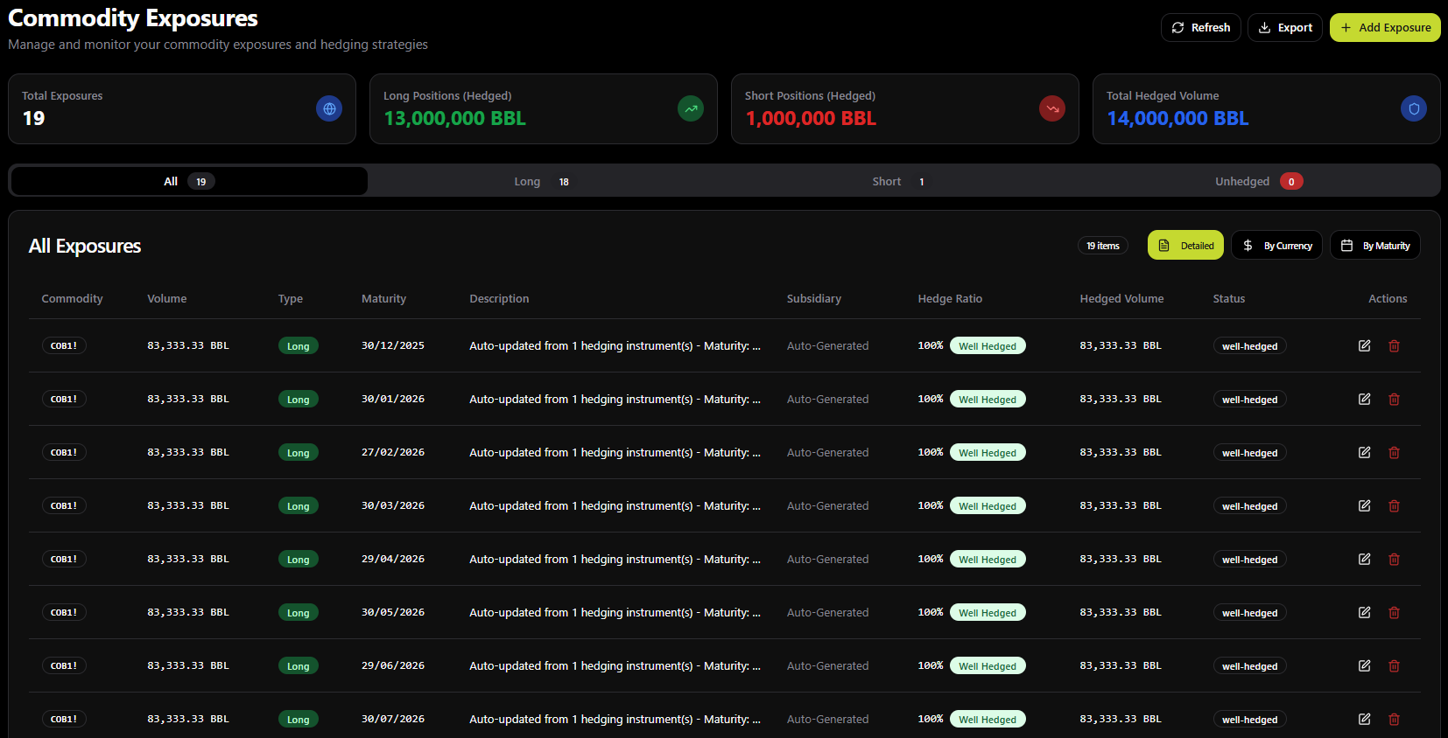
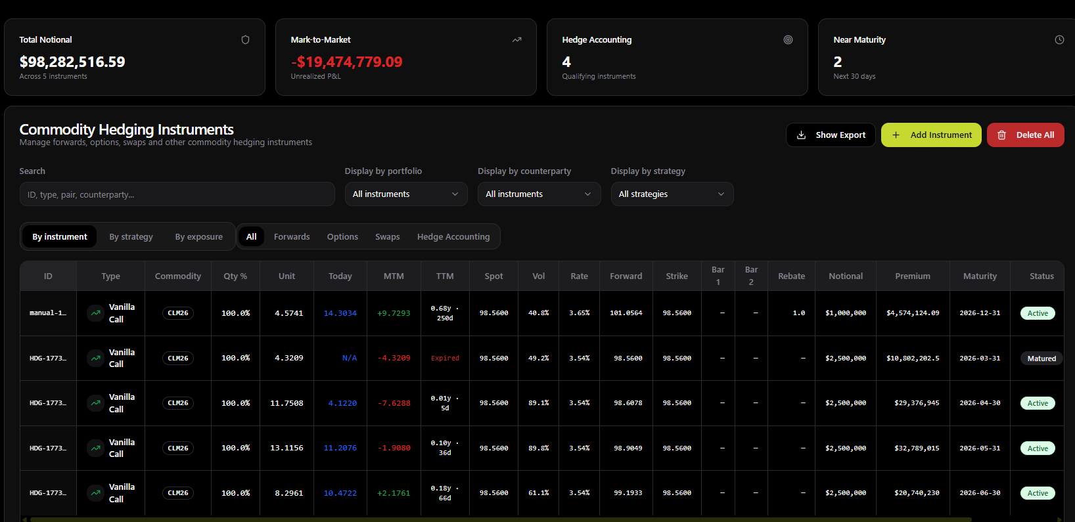
Exposures & Hedge Book
Operational loop: exposure → instrument → MTM
Exposures: long/short volumes, hedge ratios, auto-link from instruments, CSV export.
Hedging Instruments: notional, live MTM, near-maturity alerts, hedge-accounting flags, filters by strategy / portfolio.
COMMOHEDGE · Commodity hedging & intelligence terminal · Confidential
7 / 16

Slide 8
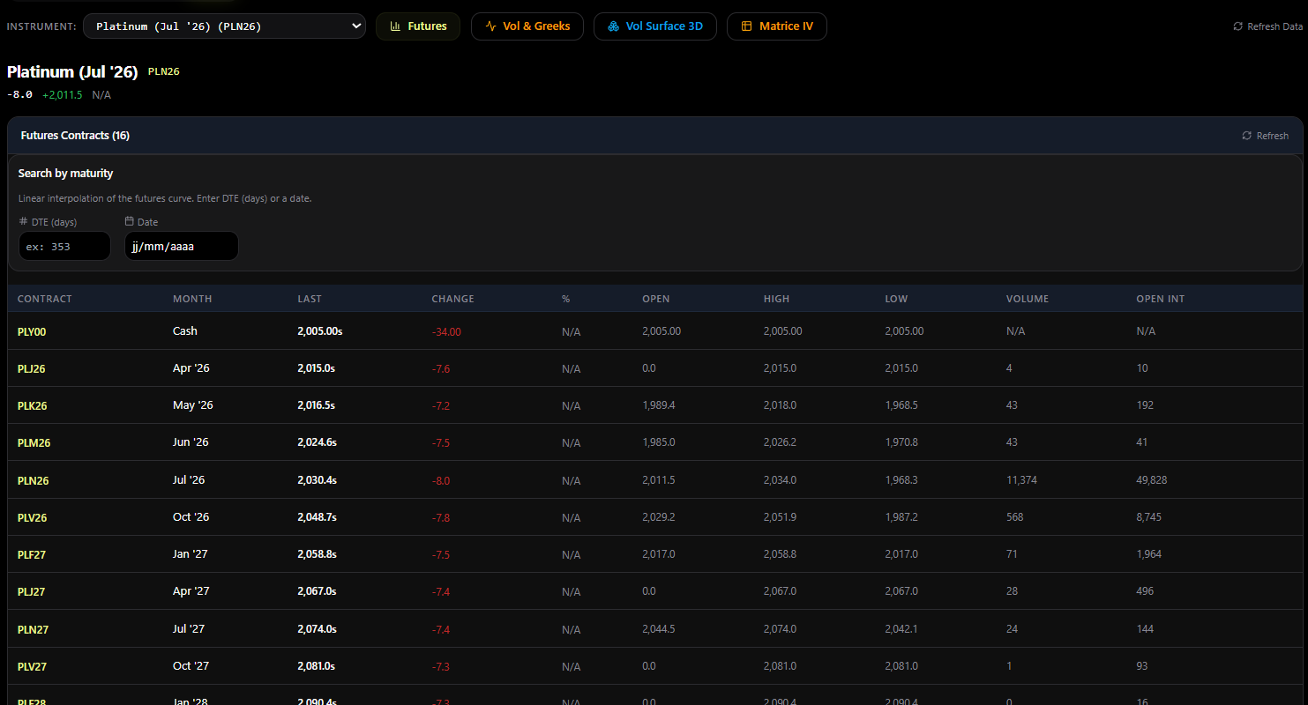
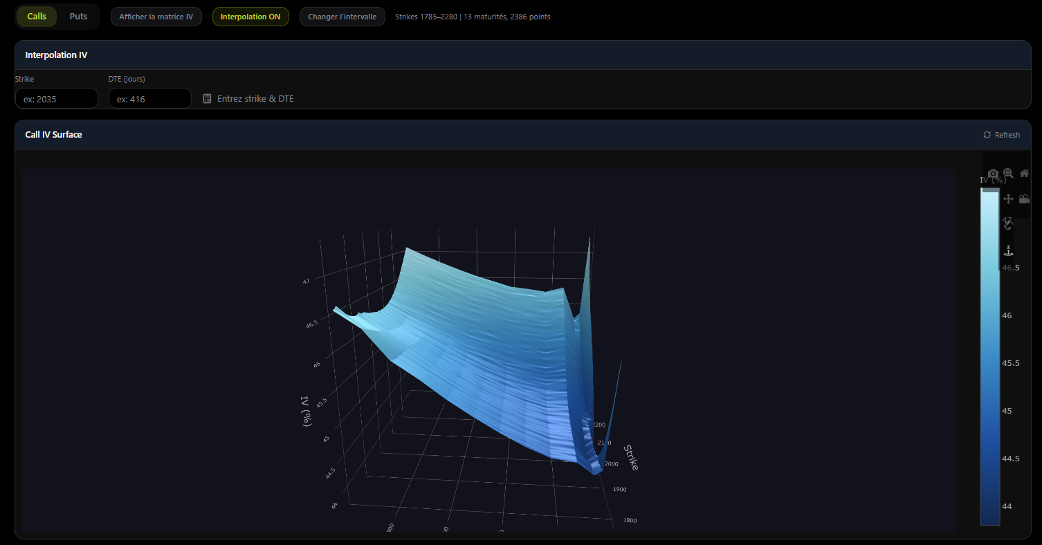
Data Terminal
Futures chain + 3D implied volatility surface
Futures curve with DTE interpolation · Vol & Greeks · IV Matrix · Vol Surface 3D — feeding Pricers and Strategy Builder.
COMMOHEDGE · Commodity hedging & intelligence terminal · Confidential
8 / 16

Slide 9
Value proposition
What the client gains
Reduce
Cost & dependency
Fewer terminal licenses and unmanaged spreadsheets.
Accelerate
Hedge decisions
From structure idea to committee PDF in one session.
Secure
Risk governance
Roles, cloud sync, MTM, VaR / stress that audit.
COMMOHEDGE · Commodity hedging & intelligence terminal · Confidential
9 / 16

Slide 10
Product map
6 modules · 20+ business pages
Pricing & Strategy
Risk Operations
Risk Analytics
Pricers, Strategy Builder
Exposures, Hedging, Positions
Risk, Regression, Reports
Multi-leg structures, stress, backtest
Exposure → hedge → MTM loop
VaR / ES, stress, PDF & CSV
Market Data
Intelligence
AI & Admin
Market, Terminal, Rates
Intel Workspace, Map, News
Hedge Assistant, Users, Settings
Futures, options, vol surface, curves
Geopolitics, AIS, macro context
AI advice, roles, white-label, sync
COMMOHEDGE · Commodity hedging & intelligence terminal · Confidential
10 / 16

Slide 11
Instruments & models
Desk credibility — beyond Excel
Instrument catalog
Pricing engine
▸ Forwards & Swaps
▸ Black-76 (options on forward)
▸ Vanilla Calls / Puts
▸ Black-Scholes & Garman-Kohlhagen (FX)
▸ Barriers KO / KI (single, reverse, double)
▸ Closed-form barriers + Monte Carlo
▸ Digitals & touches (one-touch, no-touch, range)
▸ Greeks: Δ Γ Θ Vega Rho + IV solver
▸ Multi-leg & zero-cost structures
▸ Cost of carry · interest-rate curves
COMMOHEDGE · Commodity hedging & intelligence terminal · Confidential
11 / 16

Slide 12
Coverage universe
26+ commodities · FX · rates · freight
ENERGY
WTI · Brent · NatGas · Heating Oil · RBOB
METALS
Gold · Silver · Platinum · Palladium · Cu · Al · Zn · Ni
AGRI / LIVESTOCK
Corn · Wheat · Soy · Coffee · Sugar · Cotton · Cattle · Hogs
FREIGHT / BUNKER
Baltic / container & dirty routes · Ship & Bunker
FX & RATES
Garman-Kohlhagen · USD EUR GBP JPY CHF CAD SGD
COMMOHEDGE · Commodity hedging & intelligence terminal · Confidential
12 / 16

Slide 13
Who buys
Priority segments & pitch angles
SEGMENT
NEED
PITCH ANGLE
Corporate treasury
Hedge energy / metals / agri without a full bank desk
Bloomberg-light workstation, decisions in minutes
Trading houses / brokers
Client-facing pricers + hedge book
Desk terminal + commercial PDF packs
Freight & shipping
Bunker, freight and energy on one screen
Rare edge vs metals/oil-only tools
Consultancies / white-label
Client-branded platform + governance
Logo, company settings, Admin → Viewer roles
COMMOHEDGE · Commodity hedging & intelligence terminal · Confidential
13 / 16

Slide 14
Competitive edge
Why CommoHedge wins mid-market
vs Bloomberg / Refinitiv
Cost & complexity too high
~80% of hedge-desk value at a fraction of the cost
vs Excel + VBA
Fragile, unauditable, no book
Institutional models + exposures / MTM workflow
vs Bank pricers
Opaque, slow, FX vs commodity silos
FX + commodity DNA in one terminal
vs Pure risk tools
Analytics without data or intel
Pricing + data + intel + AI together
COMMOHEDGE · Commodity hedging & intelligence terminal · Confidential
14 / 16

Slide 15
Demo script & packaging
20–25 min walkthrough · 3 commercial tiers
01
02
03
04
05
06
Landing + Access
Market / Terminal
Strategy + Pricers
Exposures → MTM
Risk + PDF
Intel + AI
Positioning & funnel
Data credibility
Core product wow
Operational proof
Committee language
Geopolitics & advice
ESSENTIAL
RECOMMENDED
PREMIUM
Core Hedge
Desk Pro
Intelligence
Dashboard, Exposures, Hedging,
Strategy, Pricers, Risk, Reports.
Best for treasury.
Core + Market + Data Terminal
+ Rate Explorer + Hedge Assistant.
For desks & brokers.
Desk Pro + Intel Workspace,
World Map, news, white-label,
advanced admin / SSO.
COMMOHEDGE · Commodity hedging & intelligence terminal · Confidential
15 / 16

Slide 16
CLOSING
Three lines to remember
1
A commodity hedge terminal (and FX) — not a toolbox of calculators.
2
From exotic pricing to committee reporting, in one workflow.
3
Market data + freight + geopolitical intel: the mid-market edge.
Next step: 25-min guided demo · request access · POC on your book
16 / 16

