Slide 1
Team & Solution Overview
Team name: Datathon_CSF
Members: Kapil, Susmit and Aniket
Challenge area: Turn a large school maths test into policy the state can act on
One-line solution: Find the competencies and the places to anchor numeracy work
Contact: Central Square Foundation, New Delhi
Evaluation: Depth of analysis | Policy relevance | Cross-dataset analysis | Innovation | Clarity of insights | Visualisation & presentation

Slide 2
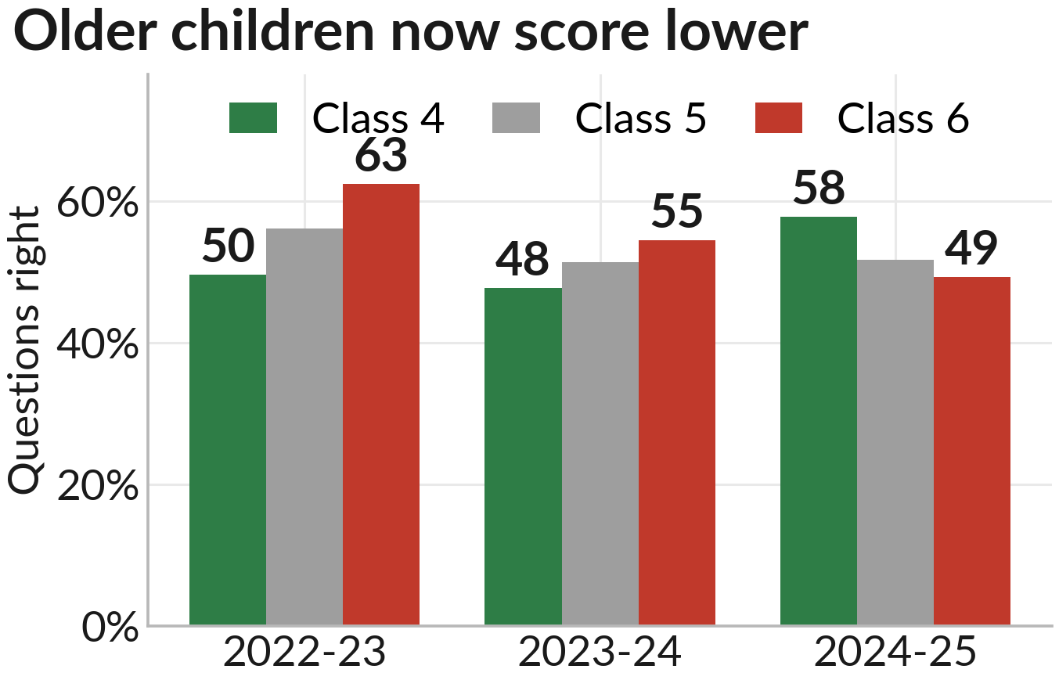
Problem Statement
Educational challenge: Class 6 children are getting worse at maths, not better.
Objectives: Check if the fall is real, find where, and see if the numbers can be trusted.
Key questions: Did scores really fall? Who is missing from the test? What do we fix first?
Why it matters: 13,79,087 answer sheets. Karnataka spends real money on what these say.
Class 6 was on top in 2022-23. Bottom by 2024-25.
Evaluation: Depth of analysis | Policy relevance | Cross-dataset analysis | Innovation | Clarity of insights | Visualisation & presentation

Slide 3
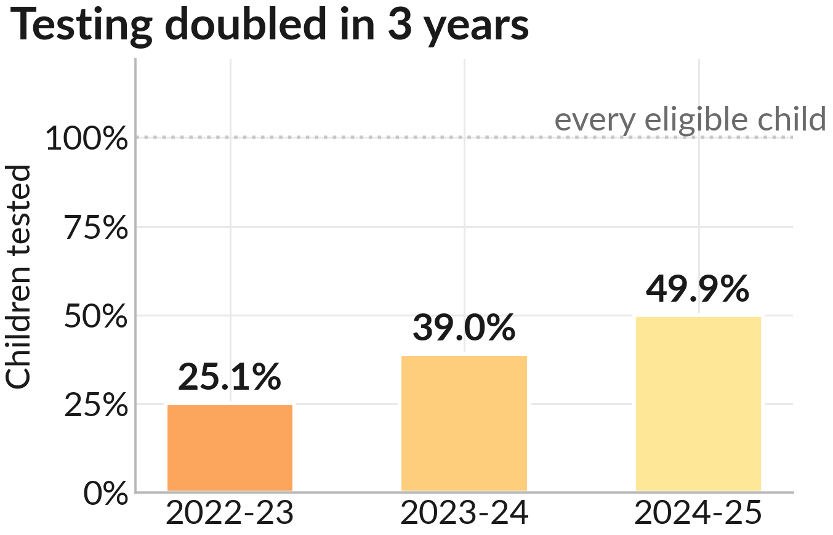
Dataset Understanding
Dataset summary: 13,79,087 answer sheets from 3 years of the GP Maths Contest.
Variables: Class, year, gender, district down to Gram Panchayat, 11 competencies.
Cleaning: Only right or wrong kept. A blank means the paper never asked that question.
Assumptions: Rural State Government schools only. No school ID, so we stop at Gram Panchayat.
Out of every eligible child, counted from UDISE+ enrolment.
Evaluation: Depth of analysis | Policy relevance | Cross-dataset analysis | Innovation | Clarity of insights | Visualisation & presentation

Slide 4
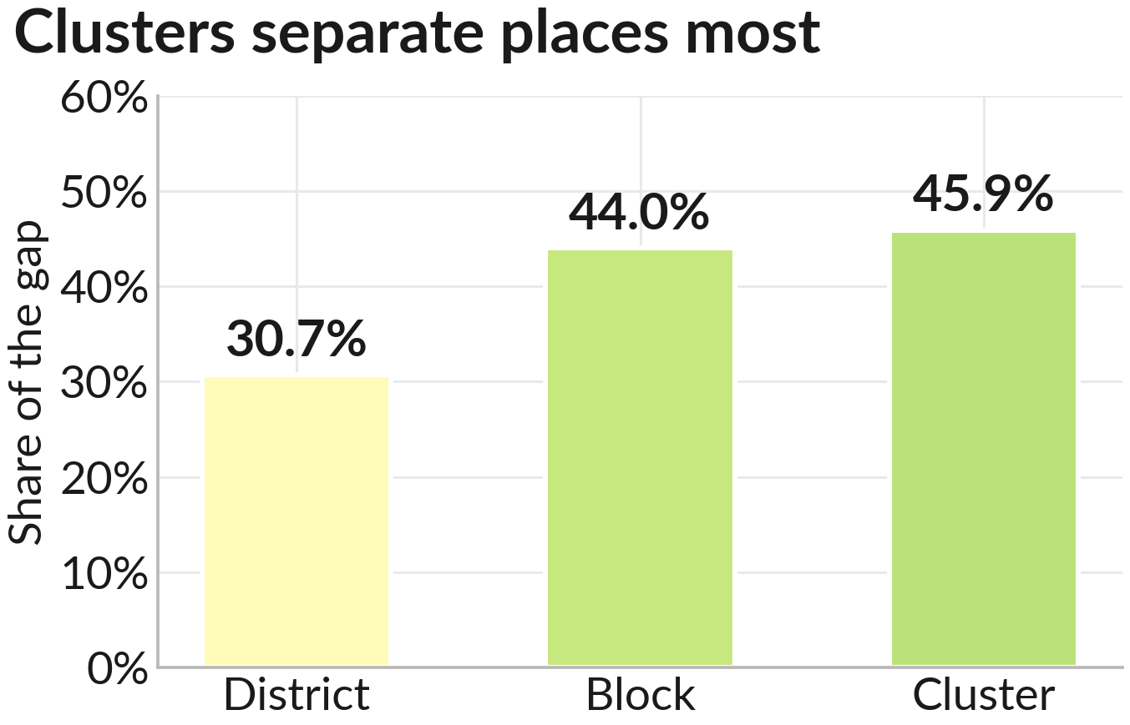
Analytical Approach
Workflow: 9 raw files, one clean table, 36 tests, 47 checked numbers.
Methods: We compare the same 2,182 Gram Panchayats over 3 years, so new places joining cannot fake a trend.
Models: Variance split, bright-spot residuals, an early-warning model.
Validation: Every number re-checked by the notebook, and against ASER 2024 and PARAKH 2024.
Each Gram Panchayat collapsed to its own average first.
Evaluation: Depth of analysis | Policy relevance | Cross-dataset analysis | Innovation | Clarity of insights | Visualisation & presentation

Slide 5
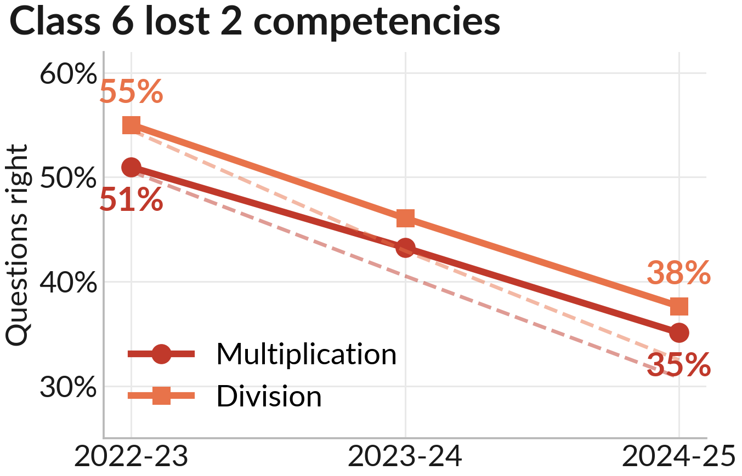
Key Insight 1
Finding: Class 6 fell hard. Multiplication 51% to 35%. Division 55% to 38%.
Evidence: Inside the same 2,182 Gram Panchayats the fall is bigger, not smaller: 20 and 22 points. 6 different tests all land between 18 and 22.
Interpretation: The fall is real. It is not weaker schools joining the test.
Dashed = the same 2,182 Gram Panchayats, present all 3 years.
Evaluation: Depth of analysis | Policy relevance | Cross-dataset analysis | Innovation | Clarity of insights | Visualisation & presentation

Slide 6
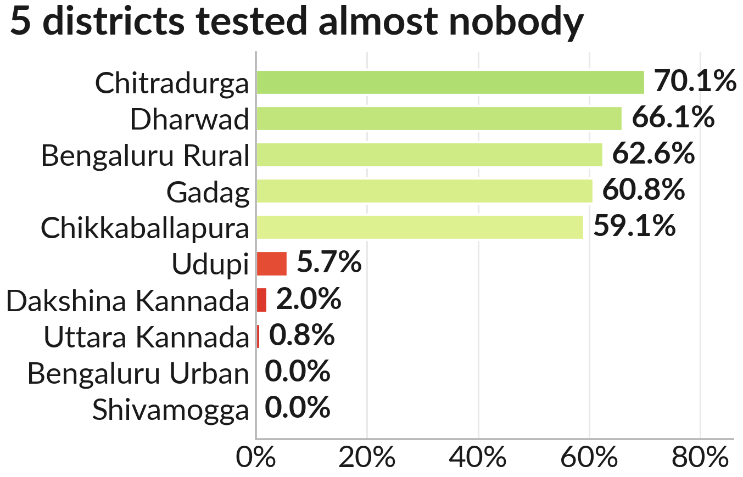
Key Insight 2
Finding: Only 38% of eligible children were tested. 2 districts tested nobody.
Evidence: The 3 best-scoring districts are the 3 worst-tested. Score and testing move opposite ways.
Implications: Do not rank districts yet. Fix who gets tested first.
Three years pooled. Two districts tested nobody at all.
Evaluation: Depth of analysis | Policy relevance | Cross-dataset analysis | Innovation | Clarity of insights | Visualisation & presentation

Slide 7
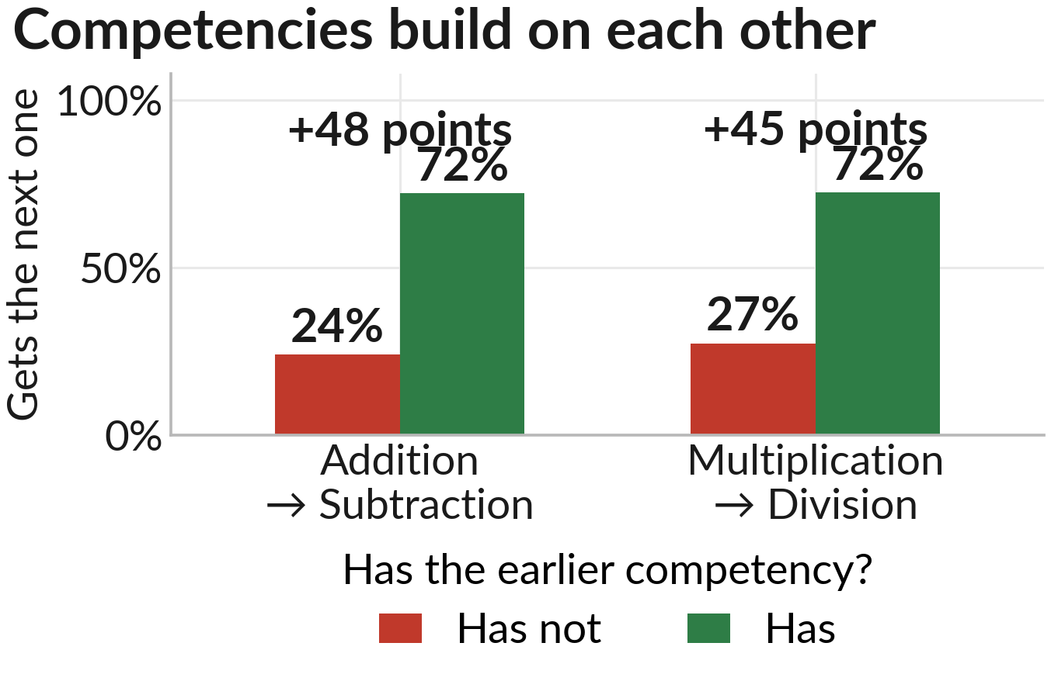
Key Insight 3
Finding: Competencies stack. A child who has Addition gets Subtraction right 48 points more often.
Evidence: A child who has Multiplication gets Division right 45 points more often. Division is the weakest of all, at 43%.
Implications: More division practice cannot fix division. Fix Multiplication first.
So more division practice cannot fix division. Fix what comes first.
Evaluation: Depth of analysis | Policy relevance | Cross-dataset analysis | Innovation | Clarity of insights | Visualisation & presentation

Slide 8
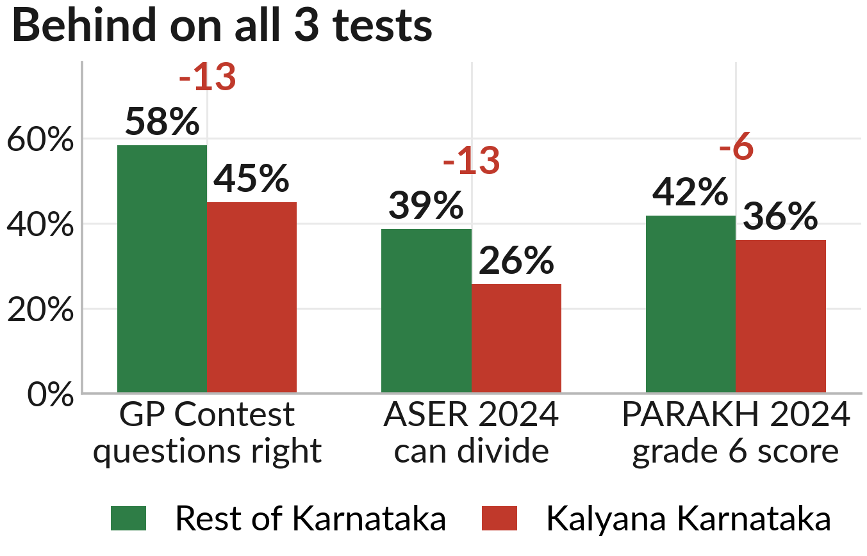
Key Insight 4
Finding: Three different tests all put Kalyana Karnataka's 7 districts behind the rest of the state.
Evidence: Our contest 45% against 58%. ASER 26% against 39%. PARAKH 36% against 42%.
Implications: This is not one odd test. Three different measures, three different sets of children, same answer.
Red number = points behind. The 3 tests measure different things.
Evaluation: Depth of analysis | Policy relevance | Cross-dataset analysis | Innovation | Clarity of insights | Visualisation & presentation

Slide 9
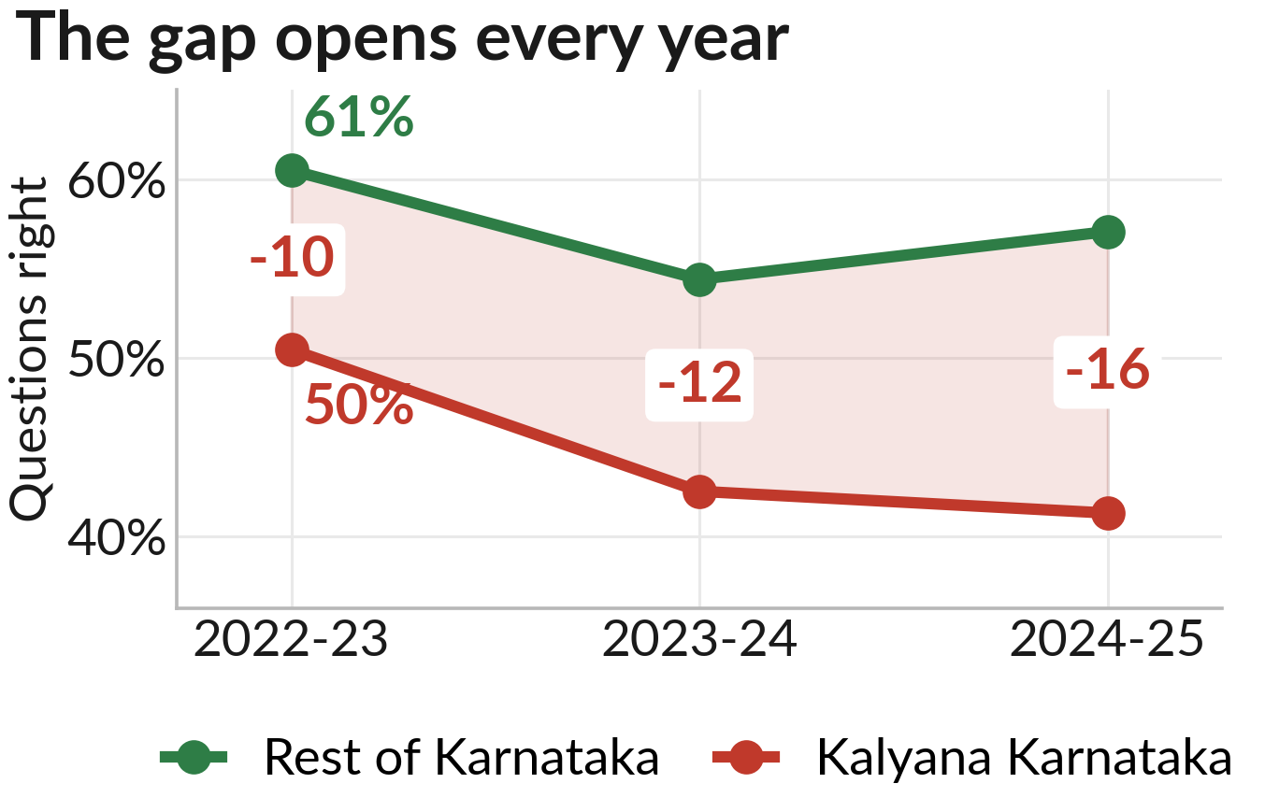
Key Insight 5
Finding: The gap is not steady. It opens every year: 10 points, then 12, then 16.
Evidence: The rest of the state dipped and recovered, 61% to 54% to 57%. Kalyana Karnataka fell in both years, 50% to 43% to 41%.
Implications: Nobody is catching up. Waiting one more round makes the job bigger, not smaller.
Red number = points behind. Kalyana Karnataka falls in both years.
Evaluation: Depth of analysis | Policy relevance | Cross-dataset analysis | Innovation | Clarity of insights | Visualisation & presentation

Slide 10
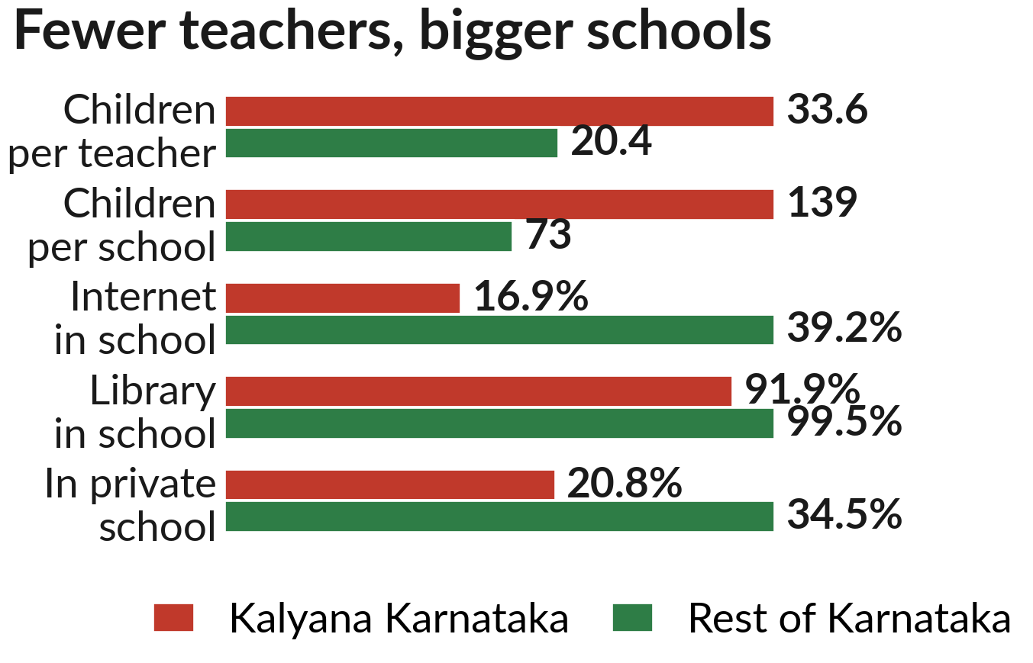
Key Insight 6
Finding: Those same districts have fewer teachers and more children.
Evidence: 34 children per teacher against 20. 139 per school against 73. Internet in 17% of schools against 39%. Libraries almost match, 92% against 99%.
Implications: Only 21% go to private schools against 35%, so government schools carry more children on fewer teachers. Allow for inputs and the gap drops to 5.
Each row has its own scale. Rural State Government schools, UDISE+ 2024-25.
Evaluation: Depth of analysis | Policy relevance | Cross-dataset analysis | Innovation | Clarity of insights | Visualisation & presentation

Slide 11
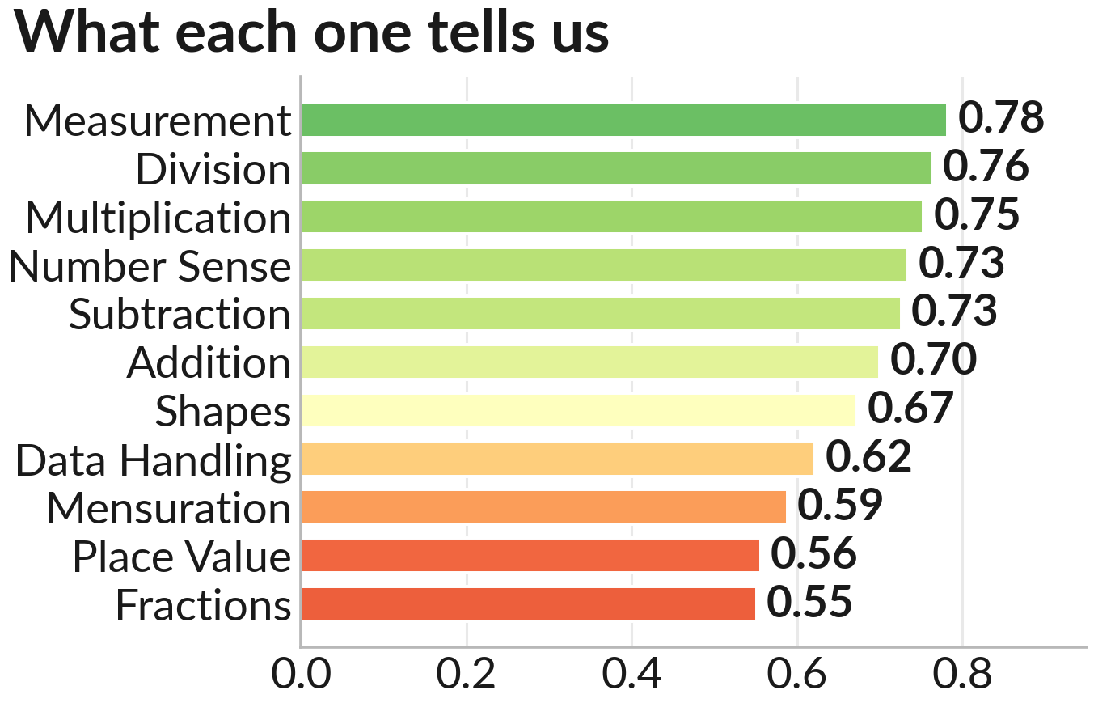
Predictive / Diagnostic Analysis
Model: We checked how closely each competency moves with a child's whole score.
Metrics: Bright-spot model explains 26% of block differences. Early-warning model 49%.
Important predictors: Measurement 0.78, Division 0.76, Multiplication 0.75. Place Value 0.56.
Early warning: 1,939 Gram Panchayats scored and flagged for the next round.
How closely a competency moves with the child's whole score.
Evaluation: Depth of analysis | Policy relevance | Cross-dataset analysis | Innovation | Clarity of insights | Visualisation & presentation

Slide 12
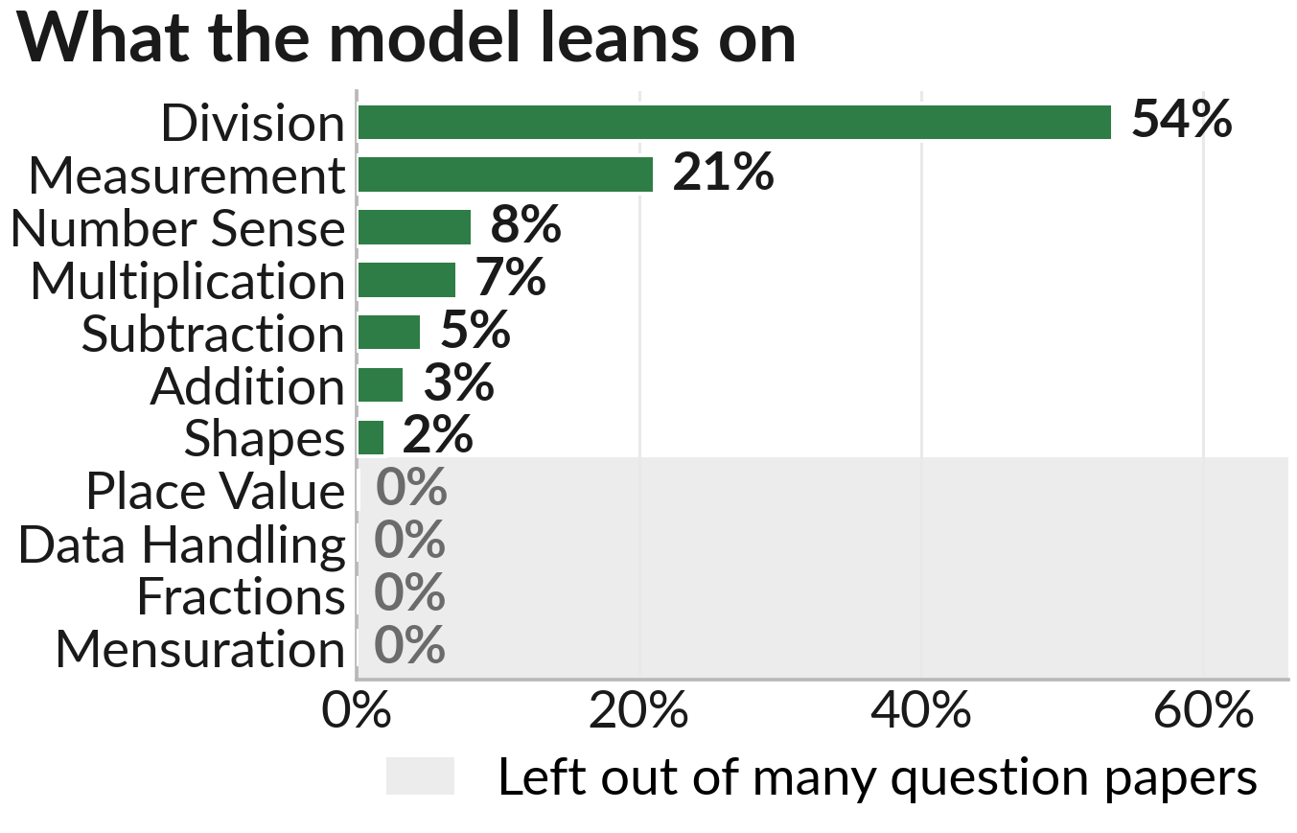
Predictive / Diagnostic Analysis
Model: A computer guessed each child's total from their 11 competency scores.
Metrics: It got 96% right. But the total IS those 11 scores added up.
Important predictors: It leans on Division (54%) and Measurement (21%).
Early warning: The 4 it ignores were left out of most question papers. Missing from the blueprint, not unimportant.
Shaded ones score 0% because they were rarely asked.
Evaluation: Depth of analysis | Policy relevance | Cross-dataset analysis | Innovation | Clarity of insights | Visualisation & presentation

Slide 13
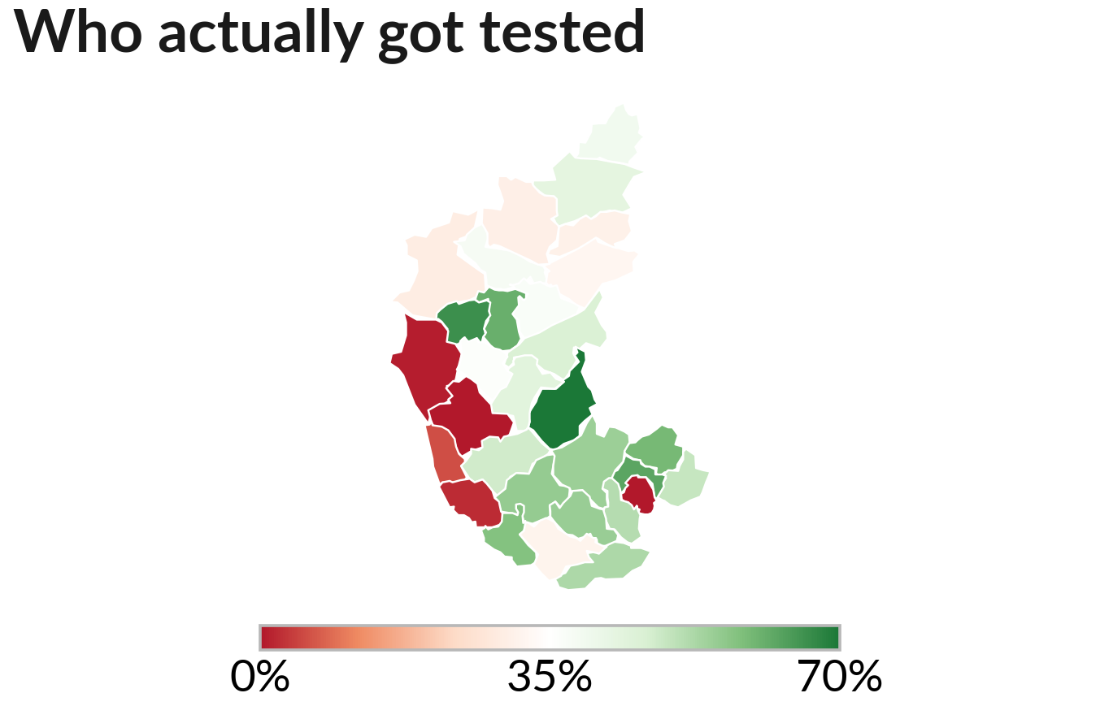
Visualization / Dashboard
Dashboard screenshots: 18 figures, every one built by one script, so every number traces back.
KPIs: 38% tested. Class 6 Multiplication 35%. Kalyana Karnataka 16 points behind.
Maps / charts: Map of who got tested. Dark red districts tested almost nobody, so their scores mean least.
Red = tested almost nobody. Grey = no contest data at all.
Evaluation: Depth of analysis | Policy relevance | Cross-dataset analysis | Innovation | Clarity of insights | Visualisation & presentation

Slide 14
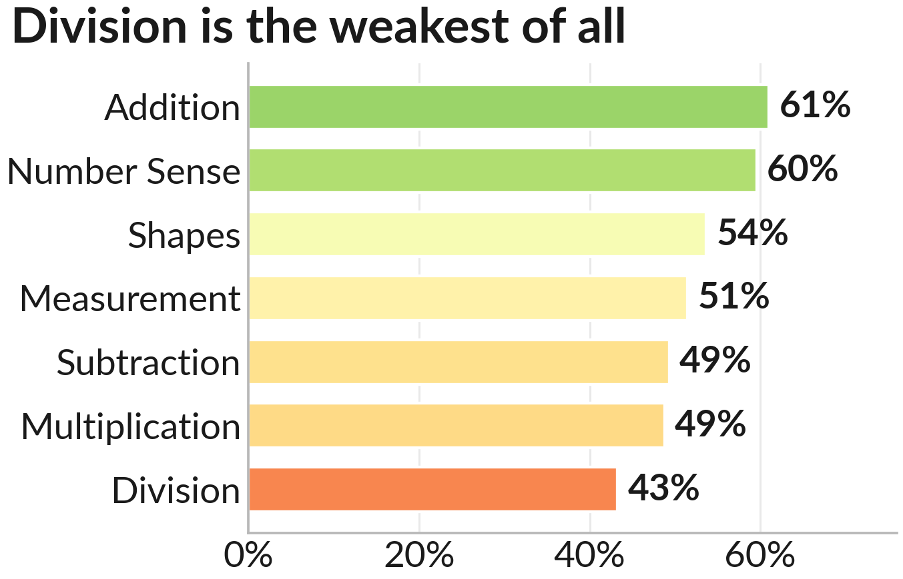
Recommendations and Road Map
Priority actions: 1. Move teachers into Kalyana Karnataka's 7 districts. 2. Class 5 and 6 catch-up on Multiplication and Division. 3. Print coverage beside every district ranking.
Impact: Children per teacher under 30 by June 2028. Class 6 Multiplication above 45% by 2026-27.
Feasibility: Owners: DSEL with KKRDB, then DSERT, then the MIS cell. GPSTR placed 11,494 teachers in 2023-24.
The 7 competencies present in all 9 question papers, all years.
Evaluation: Depth of analysis | Policy relevance | Cross-dataset analysis | Innovation | Clarity of insights | Visualisation & presentation

Slide 15
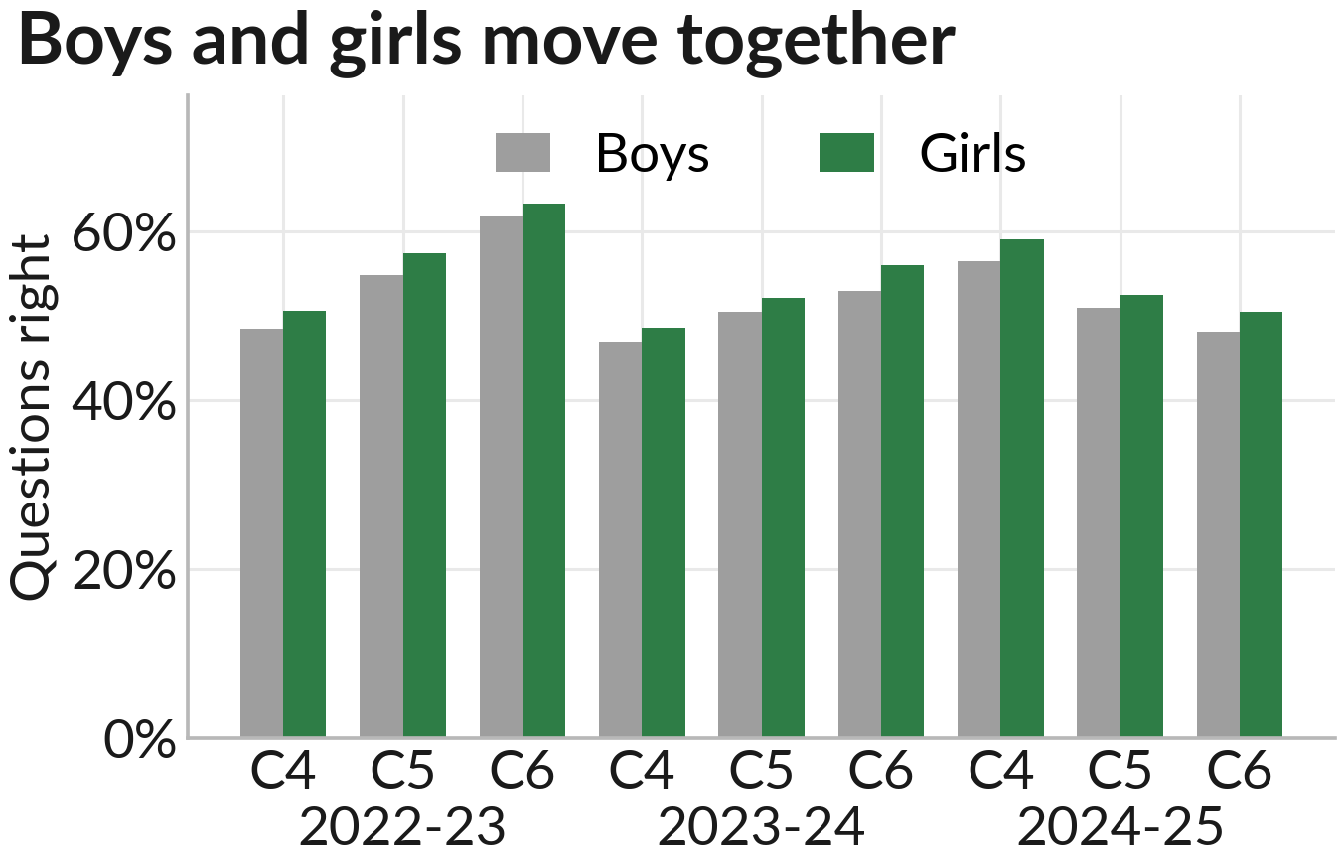
Innovation & Impact
Novelty: We tried 6 ways to disprove our own headline. We publish the 14 ideas that failed.
Scalability: One notebook. Run All rebuilds every number and chart.
Limitations: No school ID, so we cannot see inside a Gram Panchayat. We say consistent with, never proves.
Expected impact: Help aimed at the 2 competencies that carry the most, where it is needed most.
Girls lead in all 9 class-years, by 2.1 points on average.
Evaluation: Depth of analysis | Policy relevance | Cross-dataset analysis | Innovation | Clarity of insights | Visualisation & presentation

Slide 16
Conclusion & Key Takeaways
Top takeaways: 1. Class 6 maths is falling, and the fall is real. 2. Almost half the children are still missing from the test. 3. Multiplication and Division are the weakest and the most important.
Next steps: Move teachers. Run the catch-up. Test everyone. Re-check before calling a recovery real.
Thank you: Every number is in claims.json. github.com/common-del/datathon_csf
Evaluation: Depth of analysis | Policy relevance | Cross-dataset analysis | Innovation | Clarity of insights | Visualisation & presentation

