Slide 1
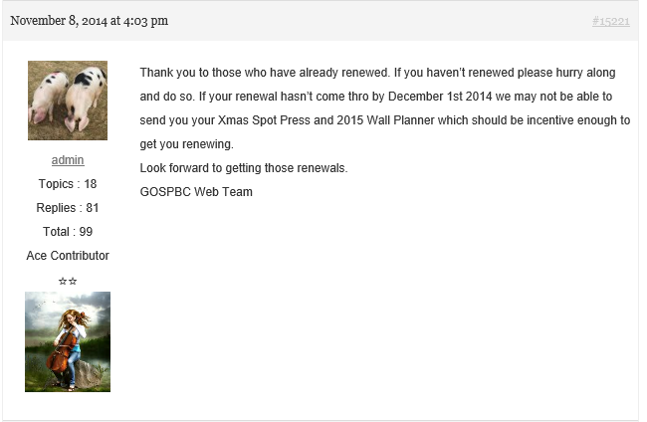
Topic Counts
Reply Counts
Total Counts
Rank Name
Level Symbols
Level Image

