Slide 1
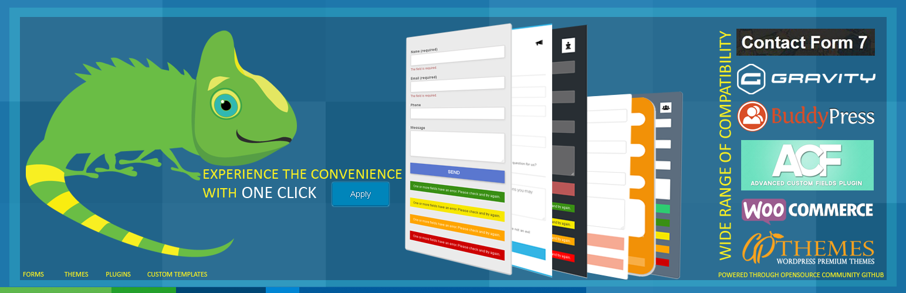

WordPress Plugin – Chameleon
https://github.com/uxglow

Slide 2

Idea Behind
Basically it’s a utility to provide you a quick and tidy styling for plug-in and themes which offer you default form layouts. It was an ignored part from a long time, developers mostly spend their time in development and R&D. UI designers and developers also ignore the user interface adjustments for those layouts which are provided by default by most of the plug-in and themes. Contact form 7 and WooCommerce are two main examples among those plug-in. So you might will notice that the layouts are not tweaked on websites and visitors experience glitches. Chameleon will help you to quickly fix the common layout issues, by changing a little color scheme you can deliver your project quickly.

Slide 3
Why Chameleon?
Our team think, this plug-in will offer a wide range of styles for almost all famous plug-in and layouts so that’s why it’s behavior is more like a Chameleon. Initially we are presenting it with selection and Apply Now button but later we will try to involve some automation in it. So according to your theme, color scheme around and other parameters, it will automatically adjust itself for appropriate layout styling.

Slide 4
Compatibility List
Contact form 7
Gravity Forms
Buddypress
ACF
WooCommerce
Twenty series of WordPress themes
Note: These are a few which are offered initially.

Slide 5
Logic Involved
Programmatically it was not easy to manage this idea as a plug-in because each plug-in is having a different kind of presentation and attributes hierarchy. If we take the example of contact form 7, this plug-in is using normal posts table and all the tables are WordPress posts in fact. But Gravity Forms plug-in is providing an independent table. Same like this for WooCommerce layouts, there is a challenge to manage all the forms with each style we have as default. What we did is, using a CSS selector we just replaced the parent wrapper class according to the form ID for contact form 7 and gravity forms. For upcoming versions we have to deal accordingly.

Slide 6
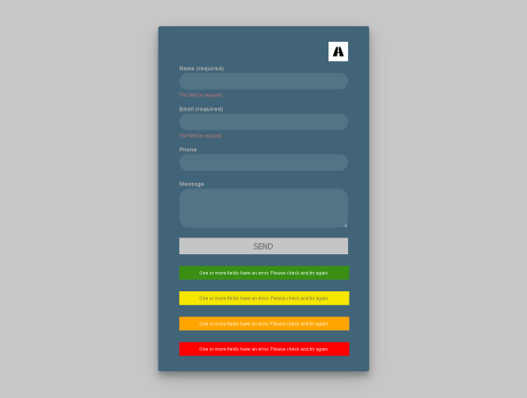
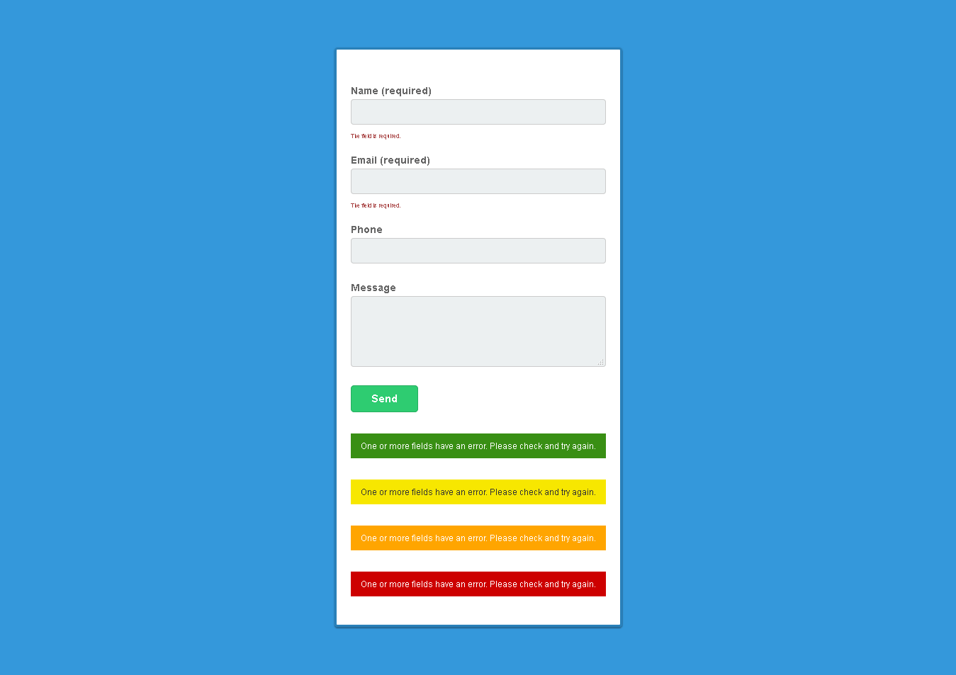
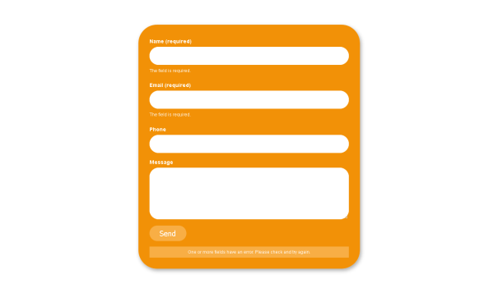
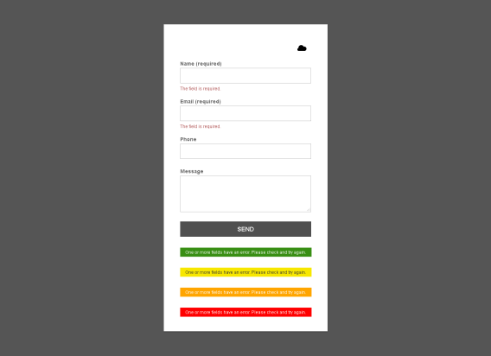
Styles Offered
Announcement
Asana
Barcode
Berry
Black-box
Charcoal
Chess
Classic
Cloud
Dark-web
Digital-ocean
Gum
Highway
Iphone
Magnet
Melon
Orange-candy
Paper-plane
Pink-phobia
Skype
Social
Yahoo

Slide 7
Community
You can contribute to this plugin in the same was as Aqib Raza and Fahad Mahmood managed initial repos. You have simply create a repo with the exact name of plug-in you want to add and then follow the same folder/files hierarchy inside. Once you will push your changes so after reviewing the compatibility issues, we will merge them in master. Your name and/or WordPress profile will be mentioned in changelog for thanks.
https://github.com/uxglow

Slide 8



Chameleon Team
WordPress Mechanic | Fahad Mahmood
https://profiles.wordpress.org/fahadmahmood/#content-about
UX Mechanic| Aqib Raza
https://profiles.wordpress.org/aqibraza#content-about

