Slide 1

RSS Feed Widget With customizable slider. Equipped with styles through WordPress Plugin Chameleon.

Slide 2
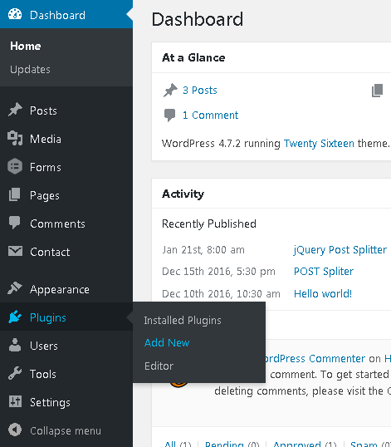
How to install RSS Feed Widget
Sidebar > Plugins > Add New

Slide 3
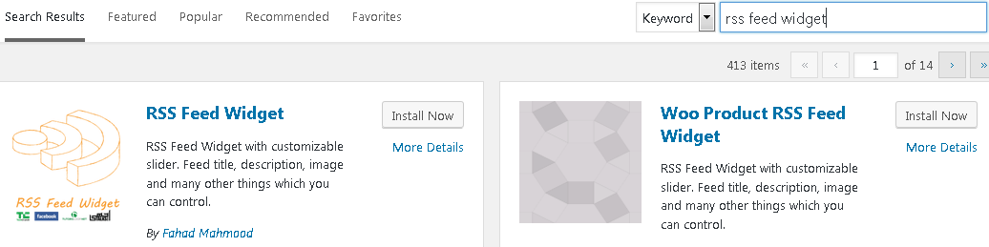
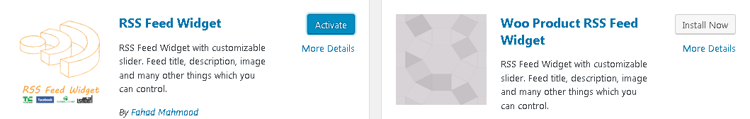
How to install and activate RSS Feed Widget
Write RSS Feed Widget in search bar as show below and you will see RSS Feed Widget by Fahad Mahmood.
Click on Install Now.
Then click on Activate.

Slide 4
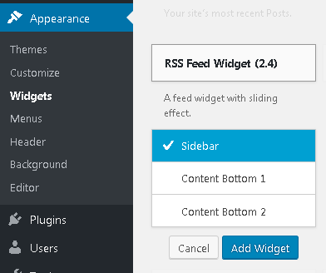
How to add RSS Feed Widget into sidebar
Appearance > Widgets
Find RSS Feed Widget and Click on it
Select a sidebar in which you want to add this widget
Click Add Widget

Slide 5
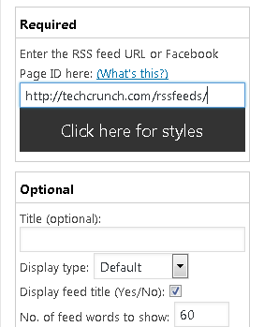
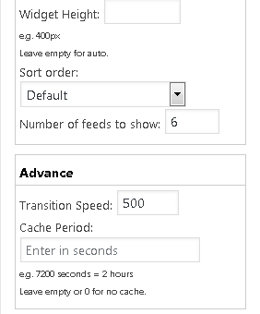
How to configure RSS Feed Widget
RSS Feed Widget Added
You need to paste feed URL
For example, check below
Choose any copy/paste here
e.g. https://techcrunch.com/rssfeeds

Slide 6
How to configure RSS Feed Widget
There are two sections: Required Optional Advance

Slide 7
How to configure RSS Feed Widget
Required
a) Facebook Page ID or b) RSS Feed URL

Slide 8
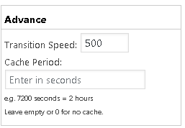
How to configure RSS Feed Widget
2. Optional Title Display type Display feed title (Yes/No) No. of feed words to show: 60 (Default) Widget Height Sort order Number of feeds to show

Slide 9
How to configure RSS Feed Widget
Advance Transition Speed
Cache Period

