Slide 1

RSS Feed Widget With customizable slider. Equipped with styles through WordPress Plugin Chameleon.

Slide 2
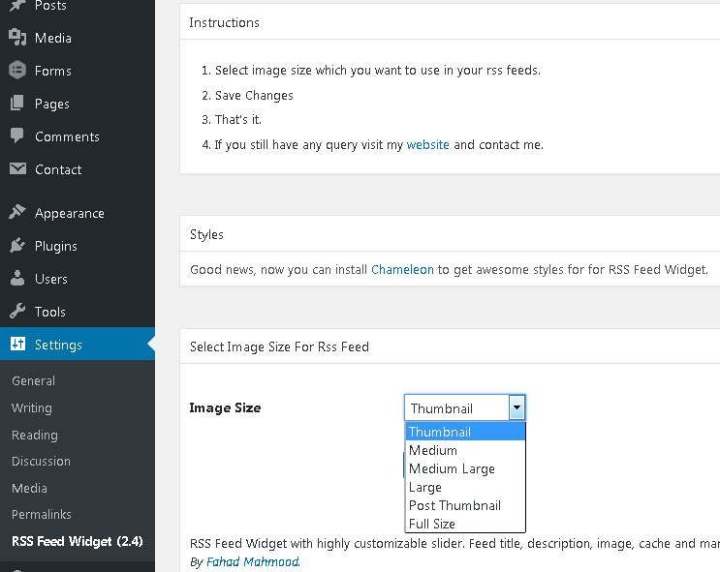
How to style RSS Feed Widget
Settings > RSS Feed Widget
Styles Section
Install Chameleon

Slide 3
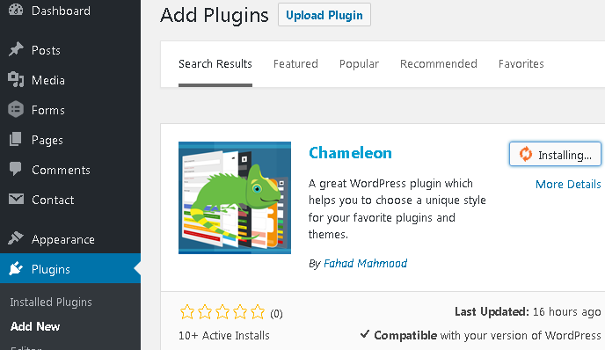
How to style RSS Feed Widget
Plugins > Add New
Write Chameleon in Search bar
Click on install
Activate

Slide 4
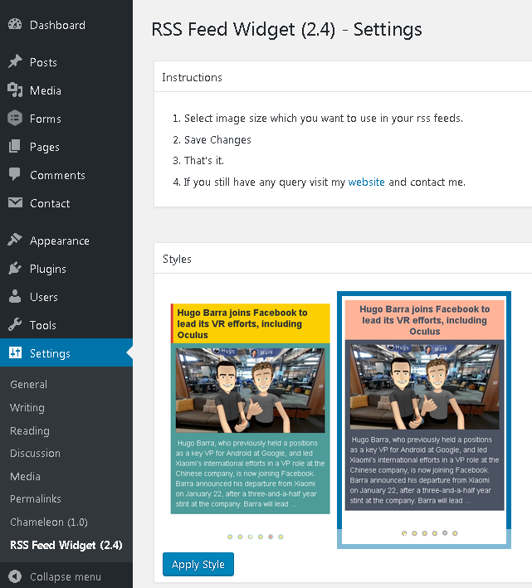
How to style RSS Feed Widget
Settings > RSS Feed Widget
Select and Apply Style

Slide 5

How to style RSS Feed Widget
Style implemented

