Slide 1

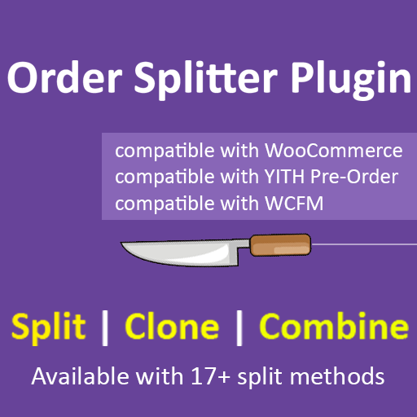
Order Splitter for WooCommerce
Gravity Forms plugin is used to create web forms and manage form entries within the WordPress admin. WooCommerce extension WooCommerce Gravity Forms Product Add-Ons used to display Gravity Forms on individual WooCommerce products.

Slide 2
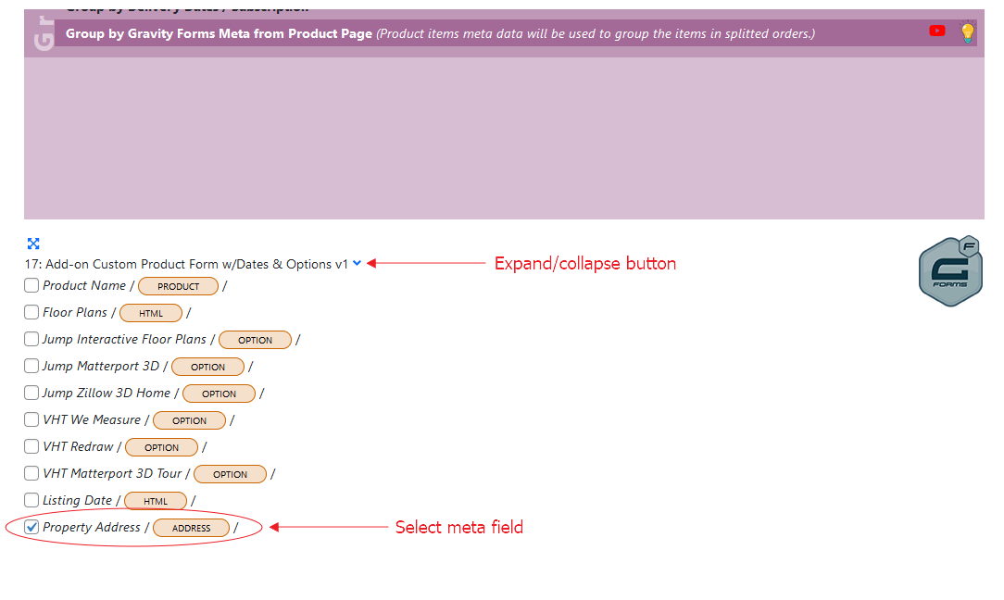
User can add meta date on product page through Gravity Forms. Order Splitter allow to split items on the basis of the meta added with Gravity Forms on product page. There method to achieve is a splitting this select Group by Gravity Forms Meta from Product Page.
In the following splitting method, product items meta data will be used to group the items into splitted orders. You must select meta field to define criteria for grouping items as per your requirement. In this example meta field Property Address is selected.
Group by Gravity Forms Meta from Product Page

Slide 3
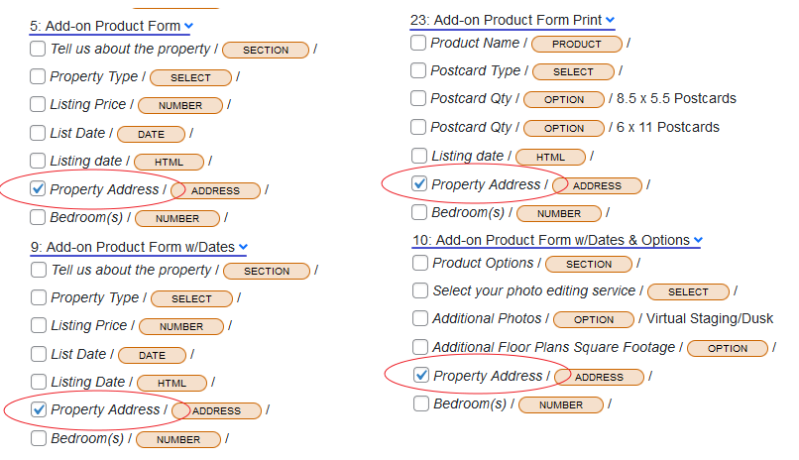
If same field is used and suppose to be grouping key so must select that field among all the forms. Click blue arrow to expand the form, all fields under the form will be visible.
Selecting Meta Field among All The Forms

Slide 4
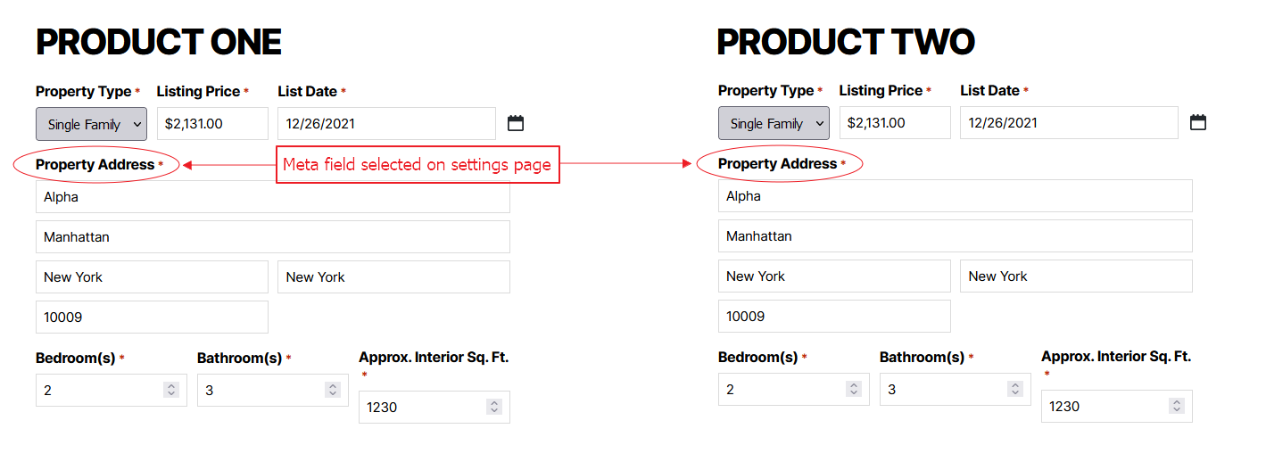
Meta field selected on settings page

Slide 5
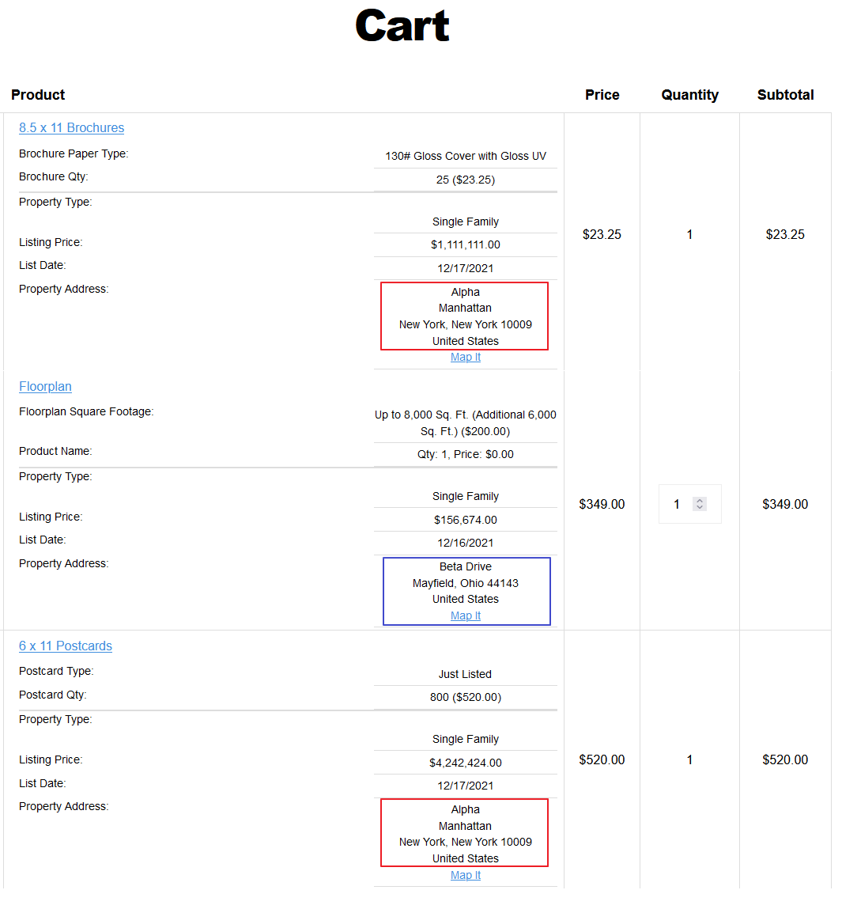
Items with same meta will be grouped in an order.
There are three items in the cart in this example. Meta field “property address” is selected on the settings page. So, items will be grouped on the basis of this meta field.
Two items 8.5x11 Brochures & 6x11 Postcards have the value Alpha in property address meta field and one item Floorplan has Beta Drive value in property address meta field.
When order will be placed, two items with the meta value Alpha will be grouped in one order and other item will be added in one order.

Slide 6
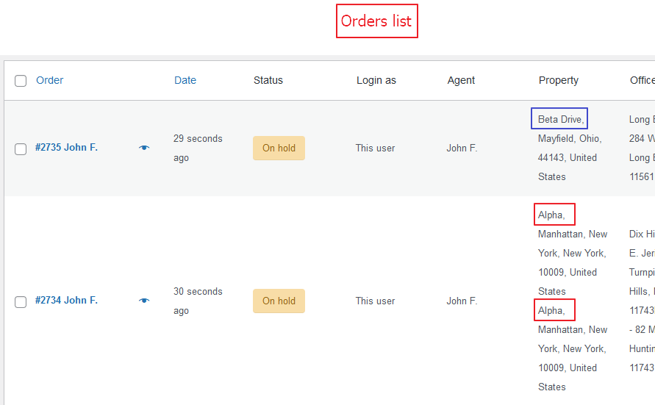
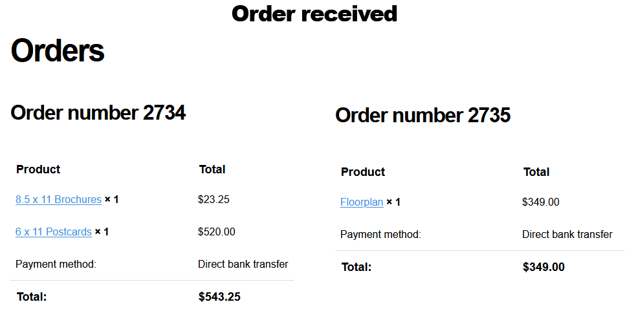
Main order is splitted into two orders
Items with same meta data are grouped in one order on the basis of meta field selected in the settings.

Slide 7
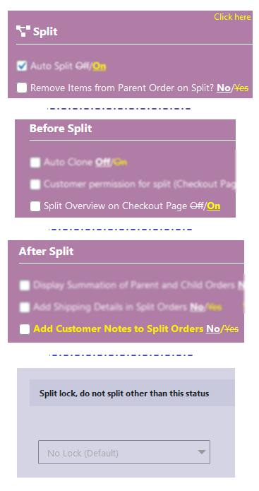
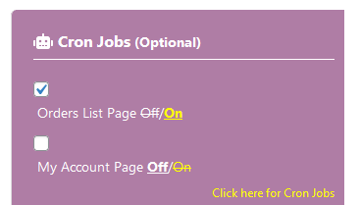
Important Notes:
Turn OFF these options from general settings tab:
  Remove Items from Parent Order on Split
  Add Customer Notes to Split Orders
  Split Overview on Checkout Page
  Set split lock to default (No Lock)
Turn ON Cron Jobs (general settings tab).

Slide 8


If you face any issue or you want to suggest a new feature you can open a ticket on support forums or contact the developer.

