Slide 1

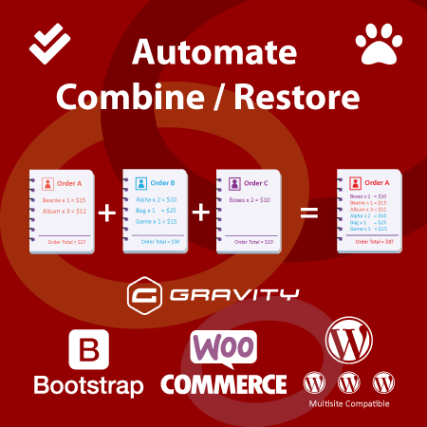
Ultimate Orde Combination
Gravity Forms plugin is used to create web forms and manage form entries within the WordPress admin. WooCommerce extension WooCommerce Gravity Forms Product Add-Ons used to display Gravity Forms on individual WooCommerce products.

Slide 2
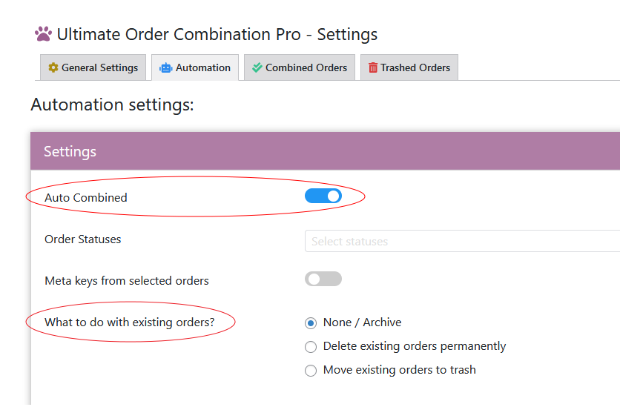
Combine by Gravity Form Based Meta Values
Ultimate Order Combination can combine order automatically with different rules. One of the rules is to combine orders Gravity Form Product Based Meta Values.
Turn ON auto combine in automation tab and select None / Archive for existing orders.
Existing Orders are the orders placed before the current combined order. You can choose to delete them permanently or move to trash also.

Slide 3
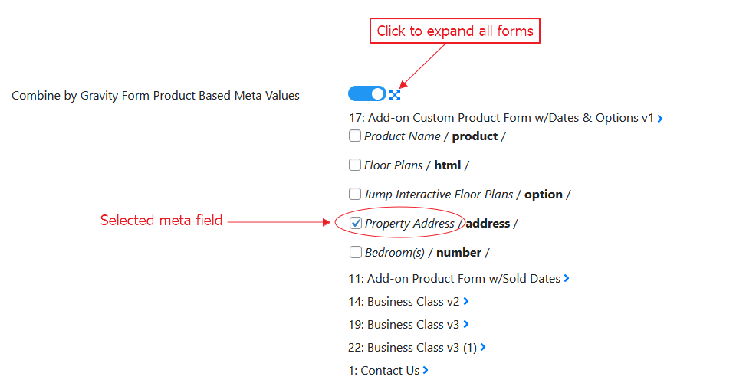
To make it work with gravity forms there turn ON the option from Rules under Automation tab. Select the meta field as per your scenario under the forms .
Meta Field Selection

Slide 4
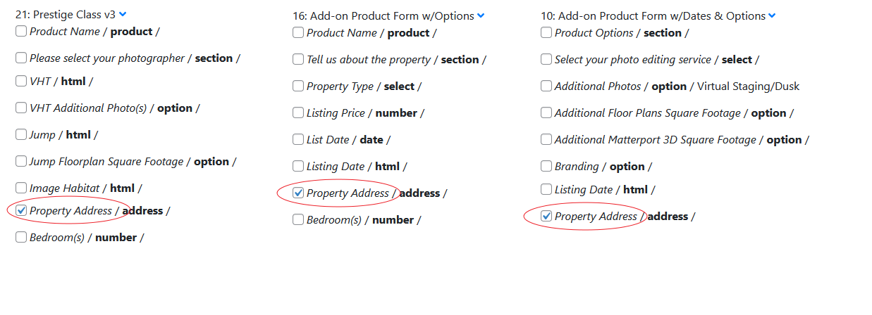
If field is required, supposed to be grouped among different forms the same fields must be selected under all forms in split settings tab to get accurate results. Click blue arrow to expand the form, all fields under the form will be visible.
Meta Field Selection for Different Forms

Slide 5
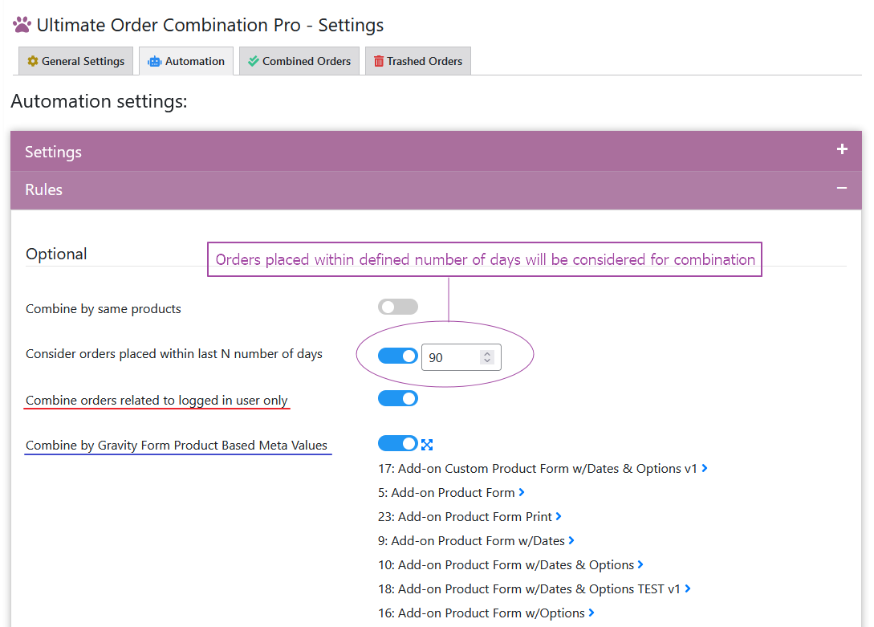
Consider orders placed within last N number of days
You can define number of days the orders consideration within last N number of days.
For example, if you set 90 days for the consideration. The plugin will consider only orders placed within 90 days for further combination. Orders placed before 90 days will not be considered for the combination.

Slide 6
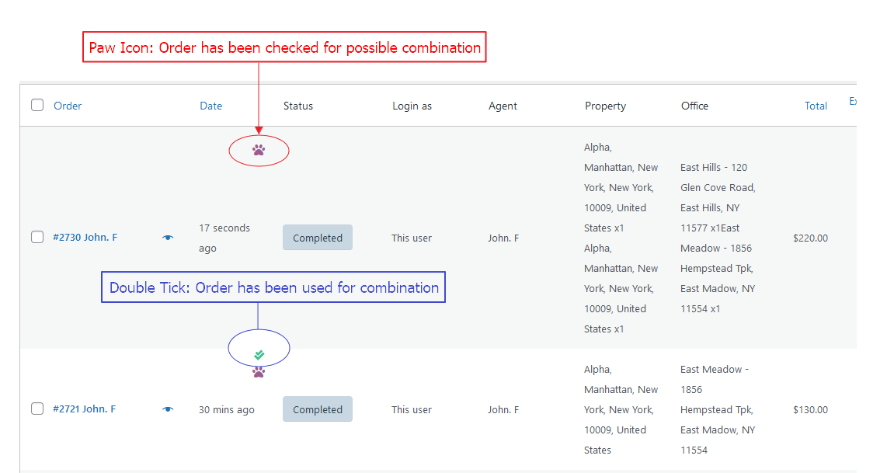
When the plugin script will run to check possible combination, every checked order will be marked with paw icon. If the order was already used in the combination, it will be marked with double tick. Orders marked with double tick will not be considered for further combinations.
Flag Combined Orders

Slide 7
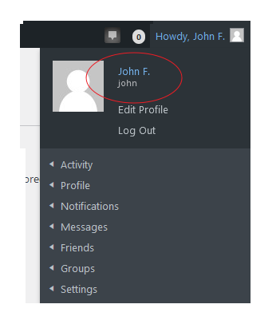
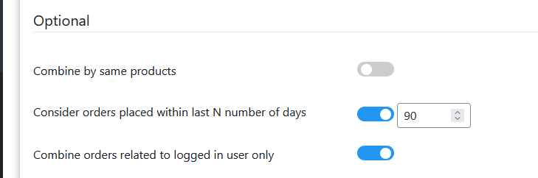
Combine orders related to logged in user only
Logged in user can see indication of his profile in top right corner of website pages. When Combine orders related to logged in user only option will be active, only orders related to logged in user will be combined. No other orders will be considered for combination.

Slide 8
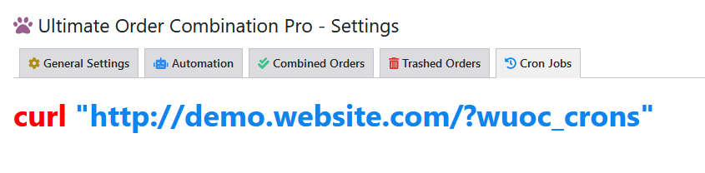


Cron Jobs
Cron Jobs are useful to automate repetitive tasks. You can run Cron Jobs by using the URL given in the tab.
In case you face any issue of you want to suggest a new feature you can
Or

