Slide 1

38.0505
°
N
EC
N
38.0500
°
N
6
38.0495
°
N
4
Latitude
2
38.0490
°
N
38.0485
°
N
Haplotype
38.0480
N
O
°
P
38.0475
°
N
300 m
118.734
°
E
118.736
°
E
118.738
°
E
Longitude
118.740
°
E
118.742
°
E

Slide 2

Plant haplotype
Plant leaf
Plant shoot
Correlation r
1.0
0.5
Soil EC
0.0
-0.5
Soil pH
-1.0
Soil P
Soil N
b_Richness
b_Chao1
b_Shannon
b_Evenness
f_Richness
f_Chao1
f_Shannon
f_Evenness

Slide 3
(A)
(B)
0.25
0.75
0.20
Phylum
Module
Proteobacteria
0.15
Module_12
0.50
Actinobacteria
Module_2
Relative abundance
Chloroflexi
Relative abundance
Module_23
Ascomycota
0.10
Module_24
Mortierellomycota
Module_27
0.25
Basidiomycota
0.05
Module_28
0.00
0.00
0
2
4
6
0
2
4
6
Electrical conductivity (mS/cm)
Electrical conductivity (mS/cm)

Slide 4
O
P
All
Core
Satellite
Bacteria
Fungi
Bacteria
Fungi
600
600
4000
400
4000
400
3000
Chao1
Observed ASVs
2000
2000
200
200
1000
0
0
0
0
0
2
4
6
0
2
4
6
0
2
4
6
0
2
4
6
Bacteria
Fungi
Bacteria
Fungi
5
0.75
7
4
0.90
Pielou’s Evenness
0.50
Shannon diversity
3
0.85
6
2
0.25
5
0.80
1
0.00
4
0
0
2
4
6
0
2
4
6
0
2
4
6
0
2
4
6
Electrical conductivity (mS/cm)

Slide 5
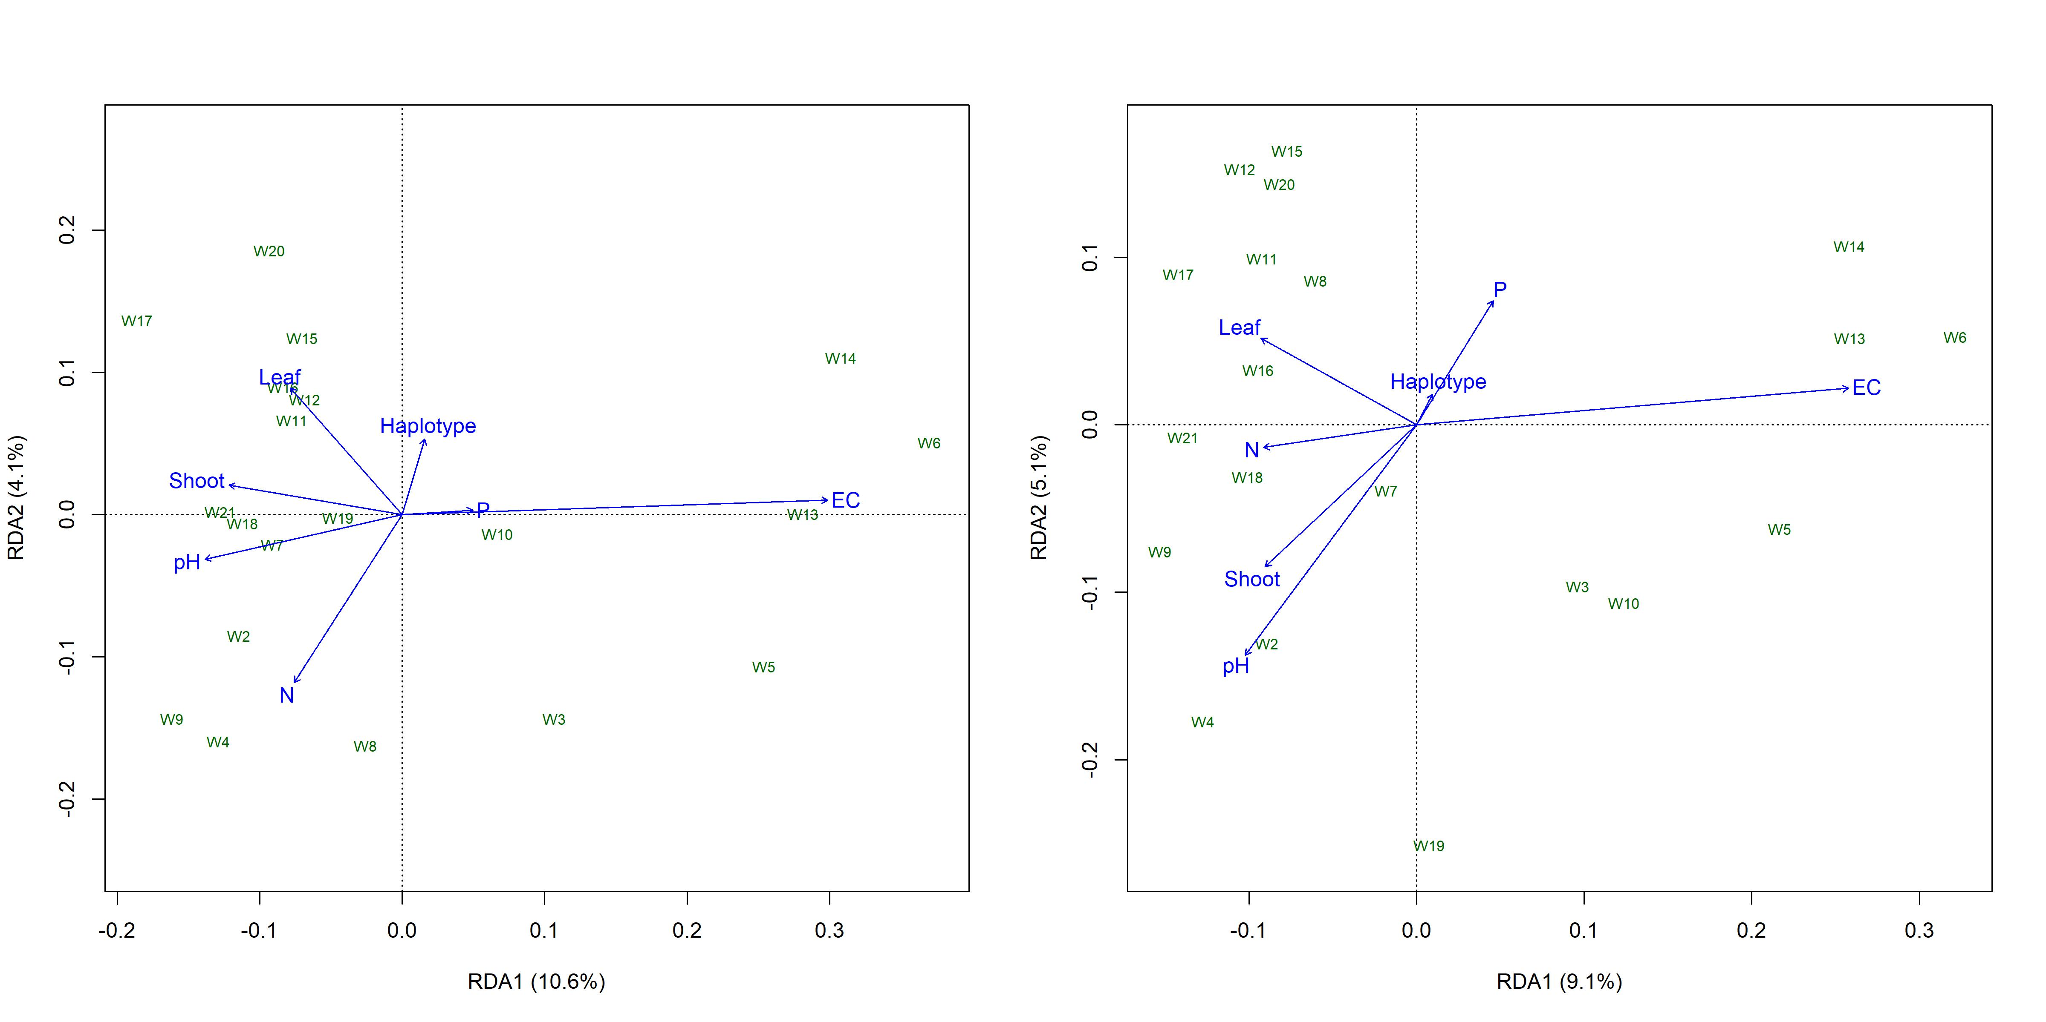

Slide 6
Bacteria
Fungi
1.00
0.75
Bray_Curtis distance
0.50
0.25
0
200
400
600
800
0
200
400
600
800
Geographical distance (m)

Slide 7
(A)
(B)
0.4
Salinity
0.2
0.2
Low
High
MDS2
MDS2
0.0
0.0
Haplotype
O
P
-0.2
-0.2
-0.8
-0.4
0.0
0.4
-0.4
0.0
0.4
MDS1
MDS1
Stress = 0.09
Stress = 0.15

Slide 8
3.5
3.0
Taxa
Bacteria
Fungi
Habitat Niche breadth (Bcom)
2.5
Haplotype
O
P
2.0
1.5
0
2
4
6
Electrical conductivity (mS/cm)

Slide 9
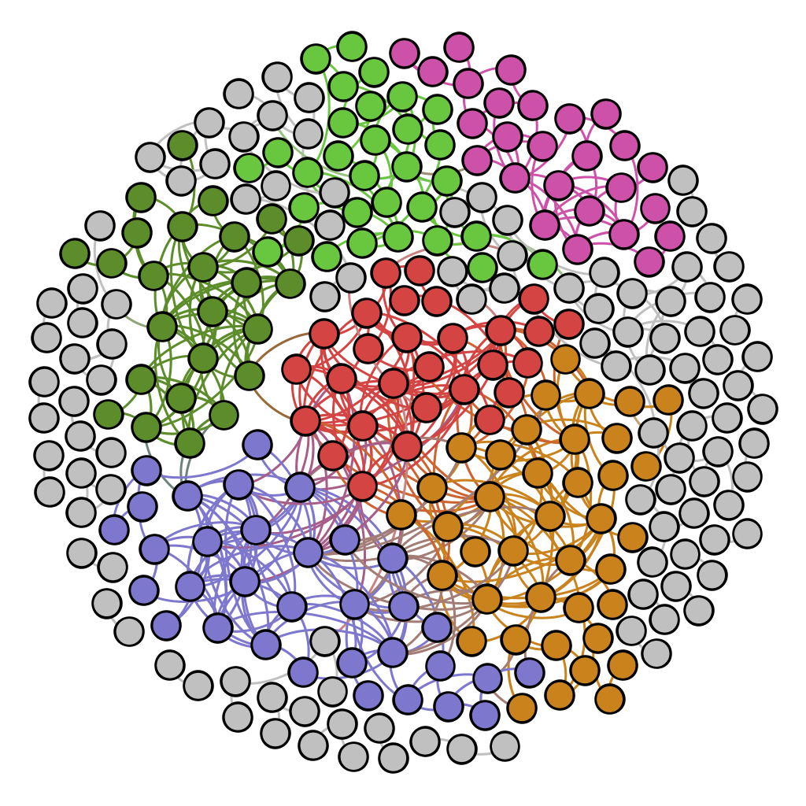
Notes:
R2 = 0.948
P < 0.001

