Slide 1

Philosophy behind Free Software
K.Sibi
Executive Committee Member –
Free Software Foundation , Tamil Nadu
sibi@fsftn.org

Slide 2
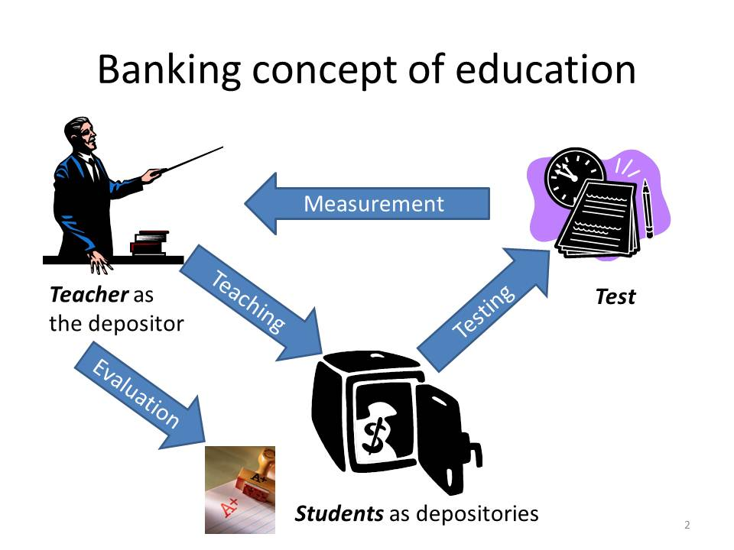
Against the "Banking" concept of education -Paulo Freire

Slide 3
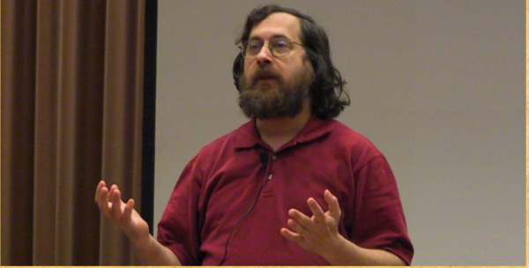

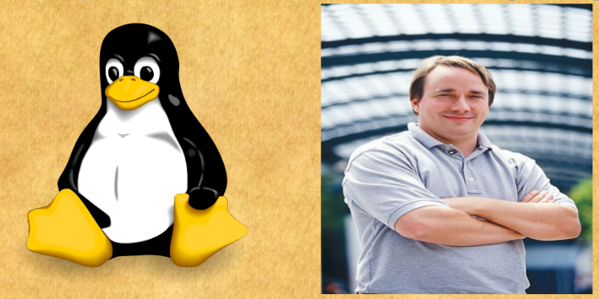
Free Software - A Brief history
The Story of Free Softwares- For want of a printer
RMS-Richard M Stallman a staff hacker at MIT AI LAB
Wrote gnu emacs, gcc, gdb GNU debugger, to name a few
Started Project GNU-GNU is not unix in the year 1984
Founded the Free Software Foundation in the year 1985 on 4th of October
GNU project adopted Linux Kernel and GNU/Linux OS was launched in late 80's

Slide 4

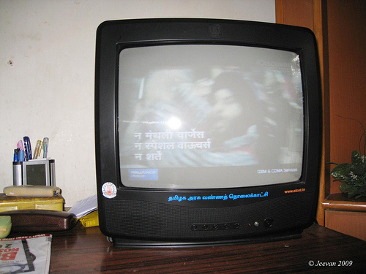
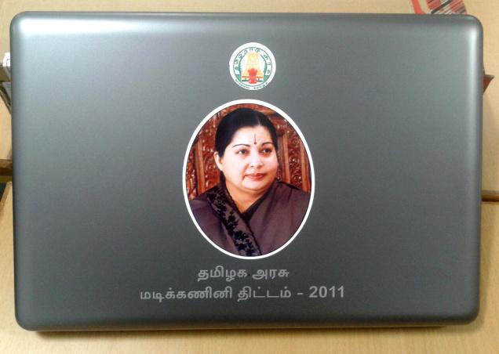
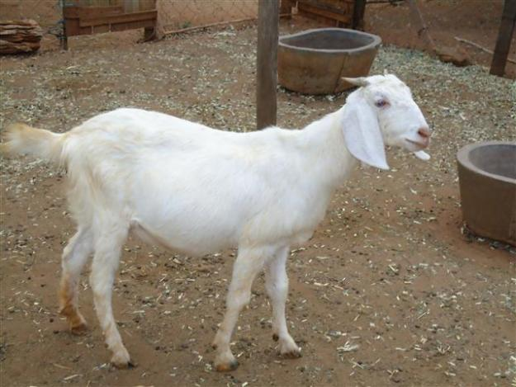
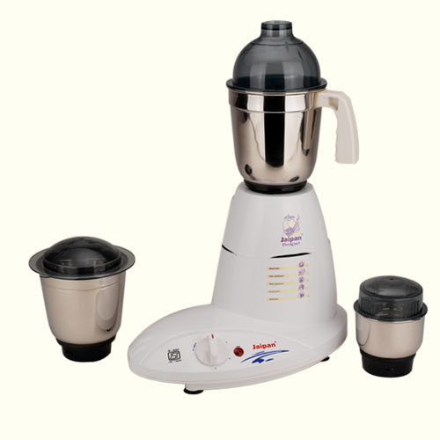

What is free as in free coffee??

Slide 5


What is free as in freedom??
Freedom in philosophy is the human value or situation to act according to one's will without being held up by the power of others.
From a philosophical point of view, it can be defined as the capacity to determine your own choices. It can be defined negatively as an absence of constraint, subordination, and servitude.

Slide 6
Free(dom) Software
A program is free software if the program's users have the four essential freedoms:
The freedom to run the program, for any purpose (freedom 0).
The freedom to study how the program works, and change it so it does your computing as you wish (freedom 1). Access to the source code is a precondition for this.
The freedom to redistribute copies so you can help your neighbor (freedom 2).
The freedom to distribute copies of your modified versions to others (freedom 3). By doing this you can give the whole community a chance to benefit from your changes. Access to the source code is a precondition for this.

Slide 7
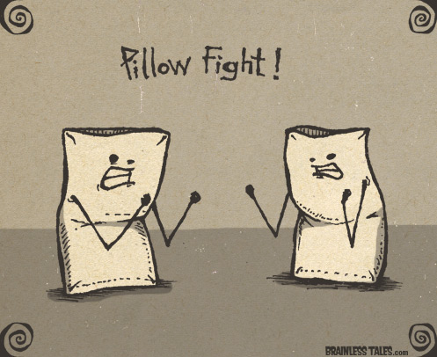
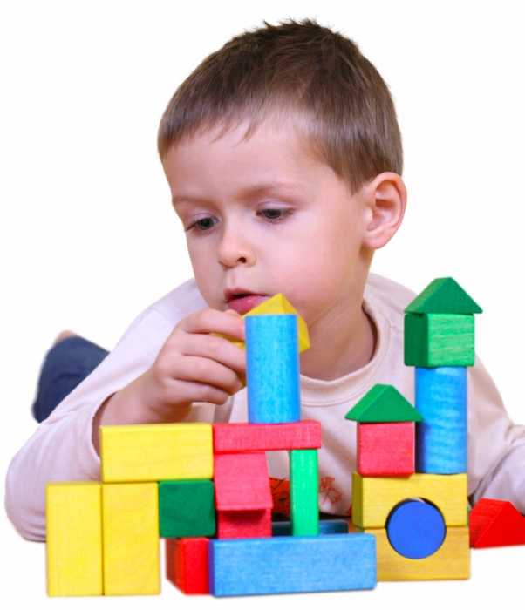
Freedom – 0 “Beauty lies in the eyes of the beholder”
The freedom to run the program, for any purpose - The freedom to run the program means the freedom for any kind of person or organization to use it on any kind of computer system, for any kind of overall job and purpose, without being required to communicate about it with the developer or any other specific entity.
-http://www.gnu.org/philosophy/free-sw.html

Slide 8
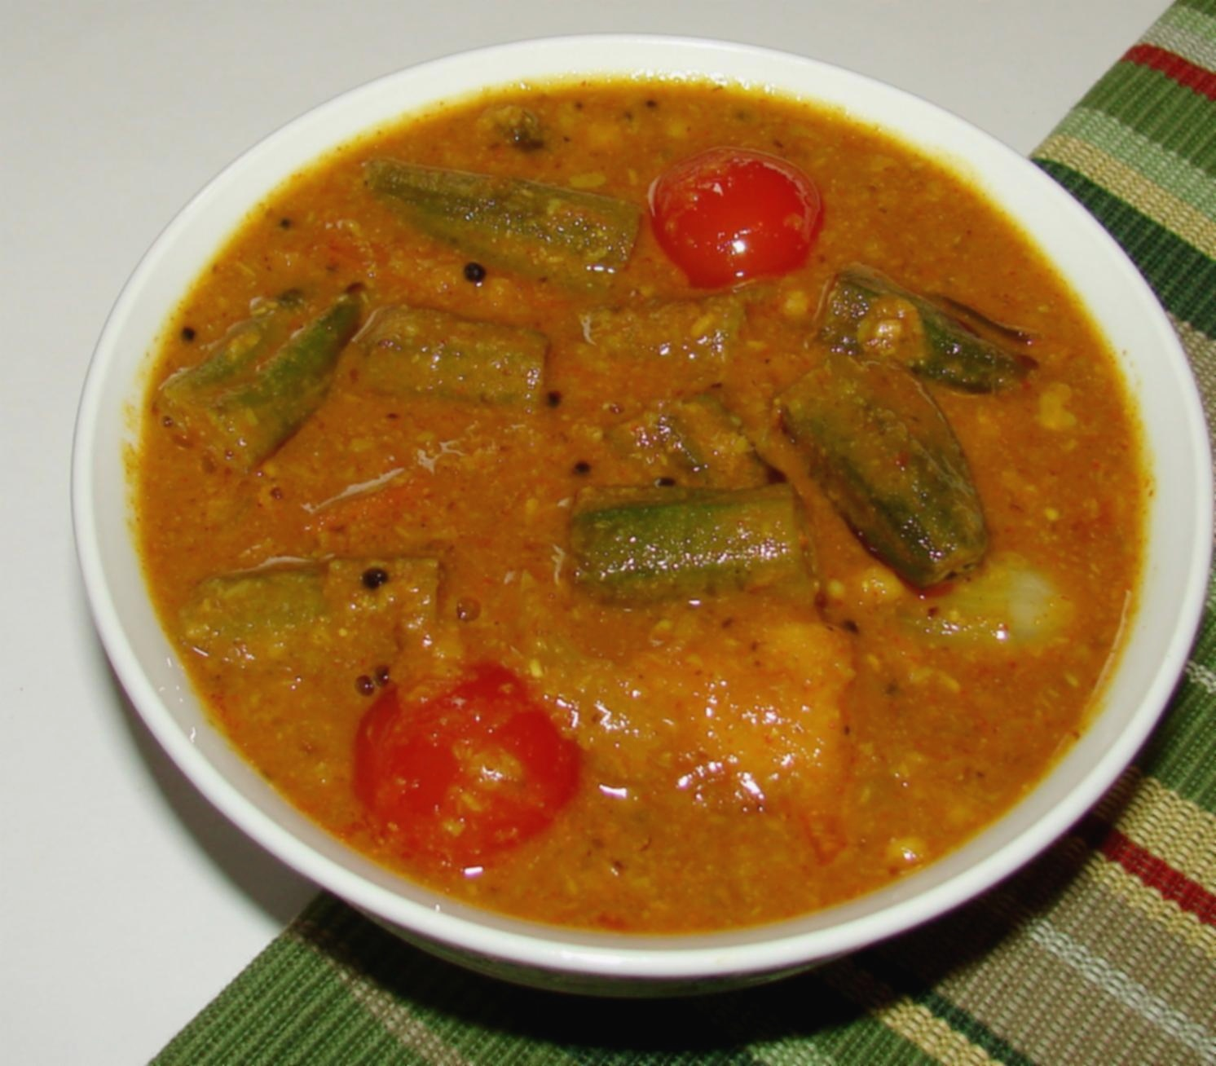

Freedom – 1
The freedom to study how the program works, and change it so it does your
computing as you wish (freedom 1). Access to the source code is a precondition for this.

Slide 9
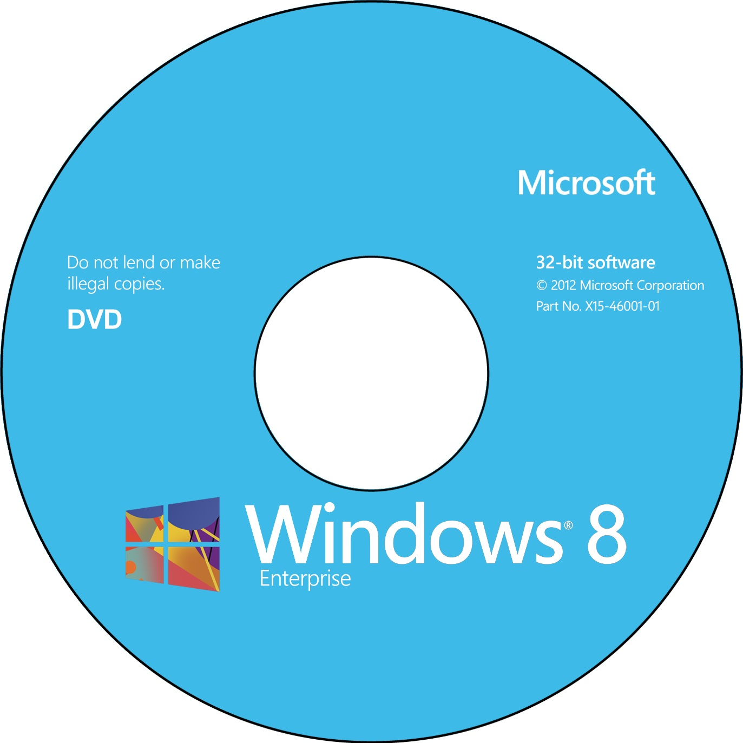
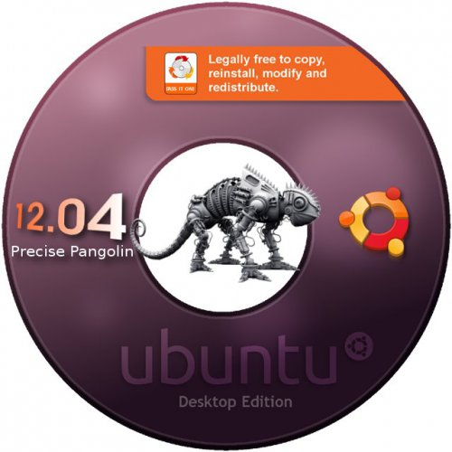
Freedom – 2
The freedom to redistribute copies so you can help your neighbour

Slide 10

Freedom – 3
The freedom to distribute copies of your modified versions to others (freedom 3). By doing this you can give the whole community a chance to benefit from your changes. Access to the source code is a precondition for this.

Slide 11
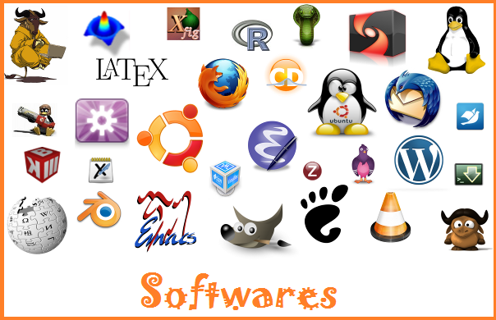
Pillar – 1
Free Software
-GCC, GNU/Linux Kernel
-Python, Java.PHP
-Drupal, Wordpress
-Firefox, VLC
More @
http://en.wikipedia.org/wiki/Portal:Free_software/categories

Slide 12
Pillar – 2
Open Standards
-World Wide Web architecture specified by W3C
-Peripheral Component Interconnect (PCI)
-Hypertext Markup Language (HTML) and Extensible HTML (XHTML)
-Portable Network Graphics (PNG)
-Ogg (audio formats) & Theora (a video format)
-OpenDocument Format (ODF)

Slide 13



Pillar - 3
Pillar 3 : Open Content
Wikipedia Crowd Sourcing Open Access

Slide 14
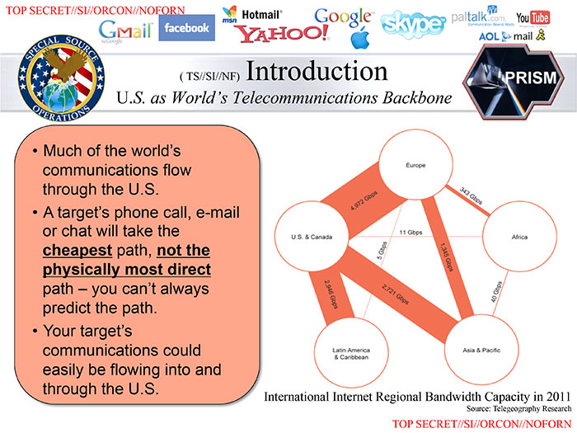

Some advantages of Free Software – Security
Your's ->Reliability,Stability Nation's Security
& Security
(“Given enough eyeballs all
the bugs are shallow)

Slide 15
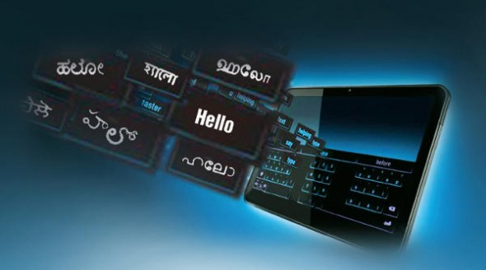
Some advantages of Free Software – Localization

Slide 16

Some advantages of Free Software – Entrepreneurship

Slide 17

Thank you

