Slide 1

Software Freedom Day - 2013
An Introduction to Free Software Tools , technologies and culture
-K.Sibi
Free Software Foundation , Tamilnadu

Slide 2
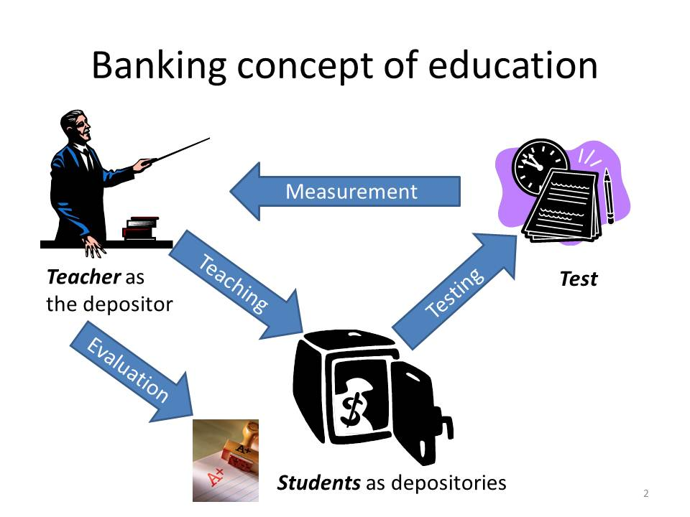
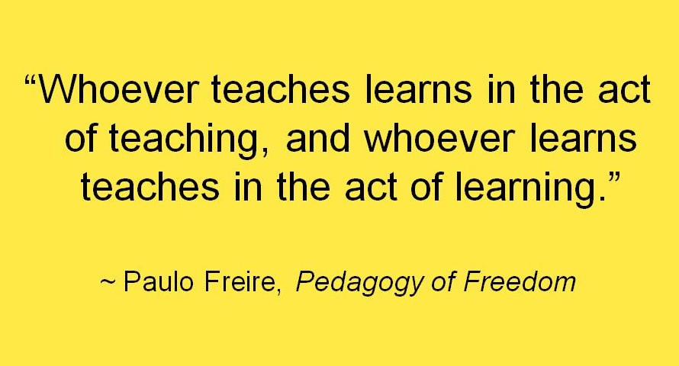
Relax First

Slide 3

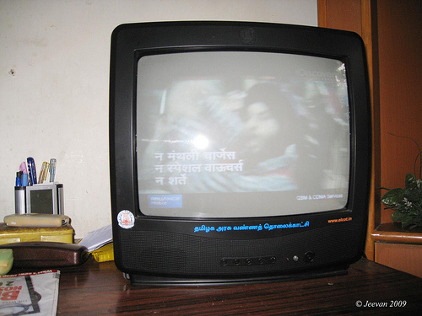
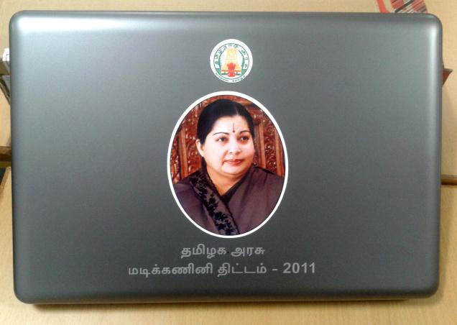
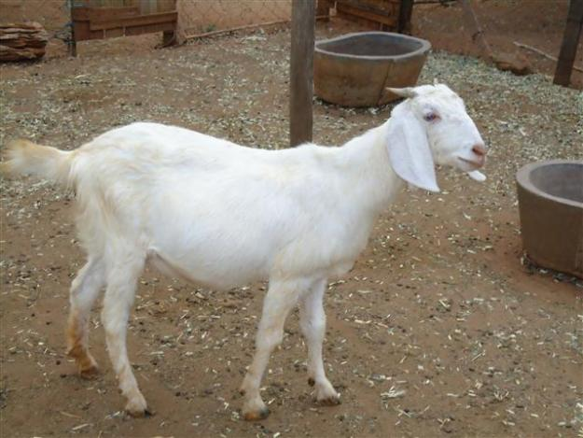

What is Free as in Free Coffee?

Slide 4


What is Free as in Freedom?

Slide 5

GNU

Slide 6
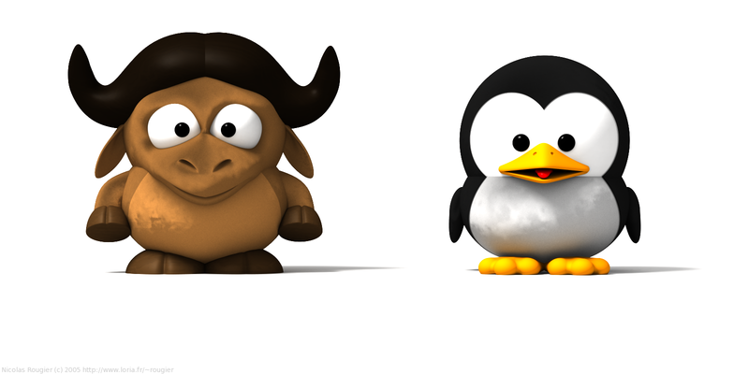
GNU/Linux

Slide 7
Freedom Software
A program is free software if the program's users have the four essential freedoms:
The freedom to run the program, for any purpose (freedom 0).
The freedom to study how the program works, and change it so it does your computing as you wish (freedom 1). Access to the source code is a precondition for this.
The freedom to redistribute copies so you can help your neighbor (freedom 2).
The freedom to distribute copies of your modified versions to others (freedom 3). By doing this you can give the whole community a chance to benefit from your changes. Access to the source code is a precondition for this.

Slide 8
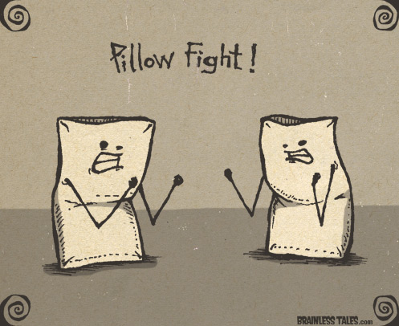
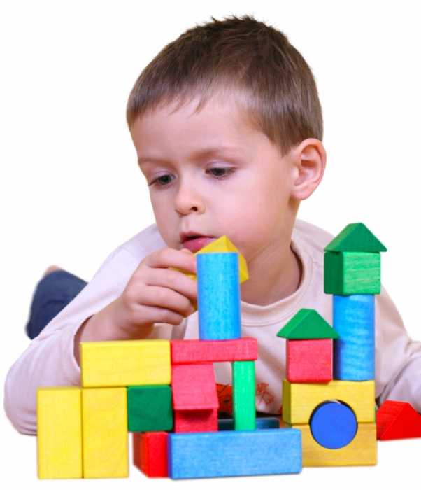
Freedom - 0

Slide 9
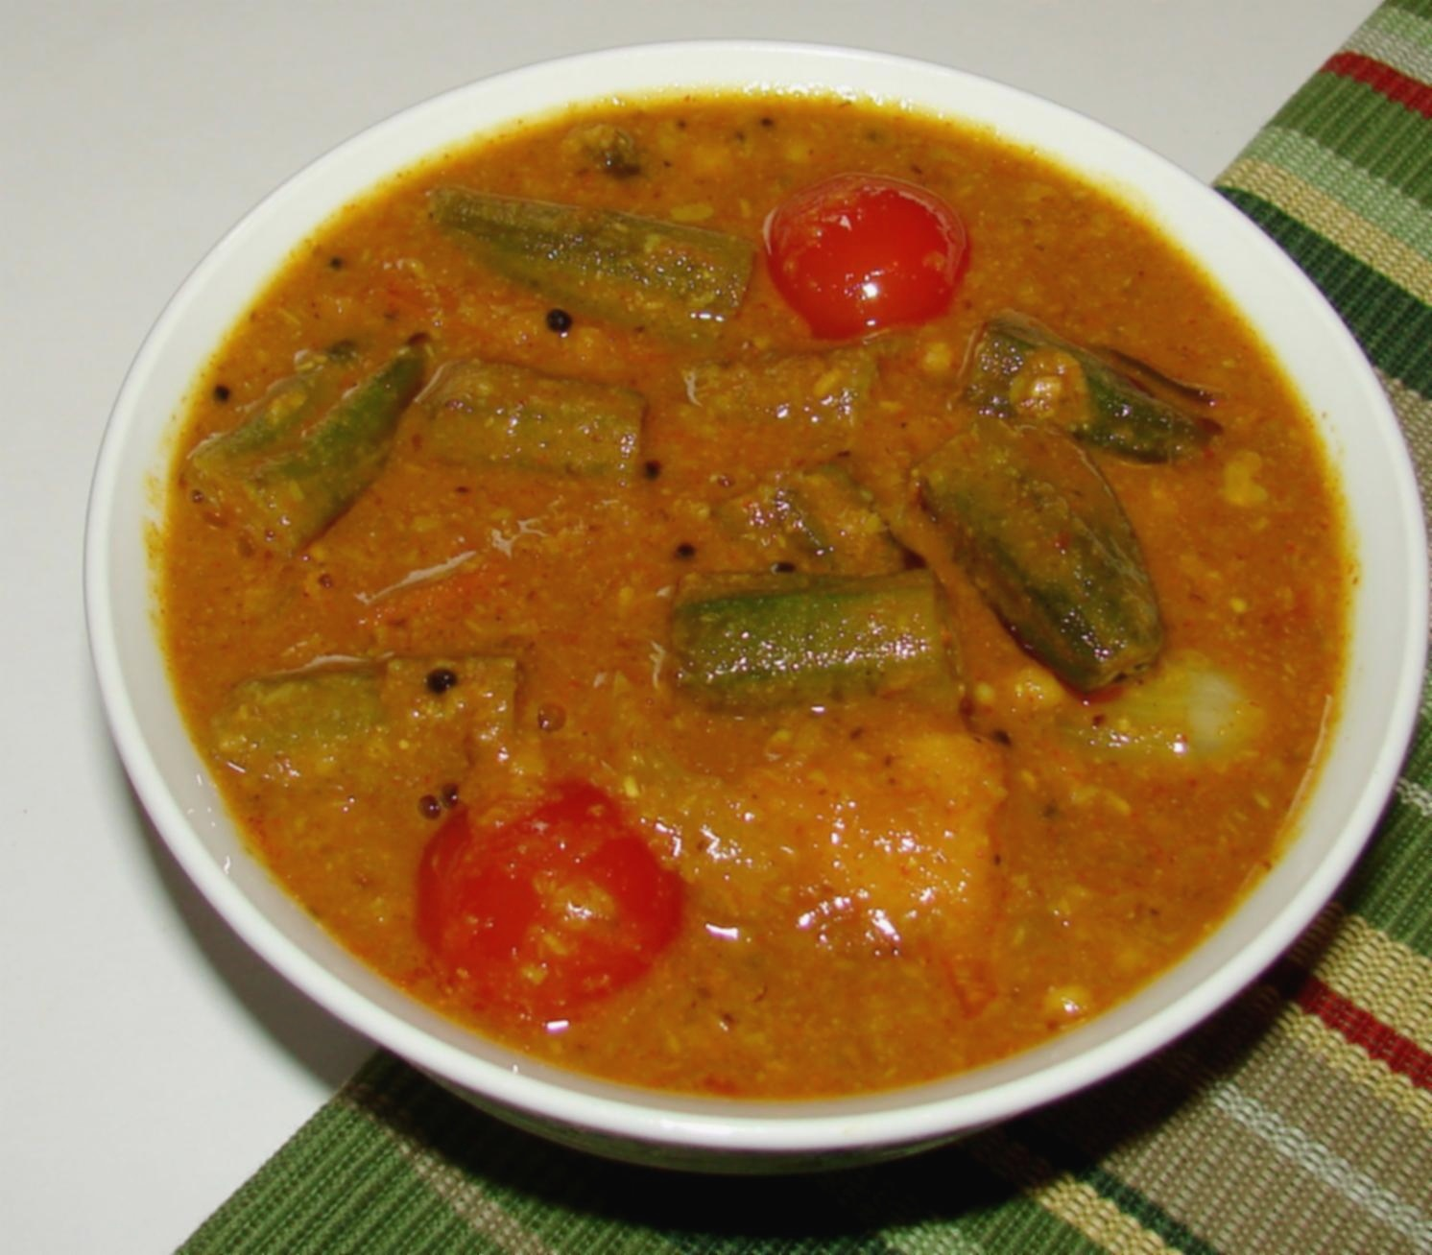

Freedom - 1

Slide 10
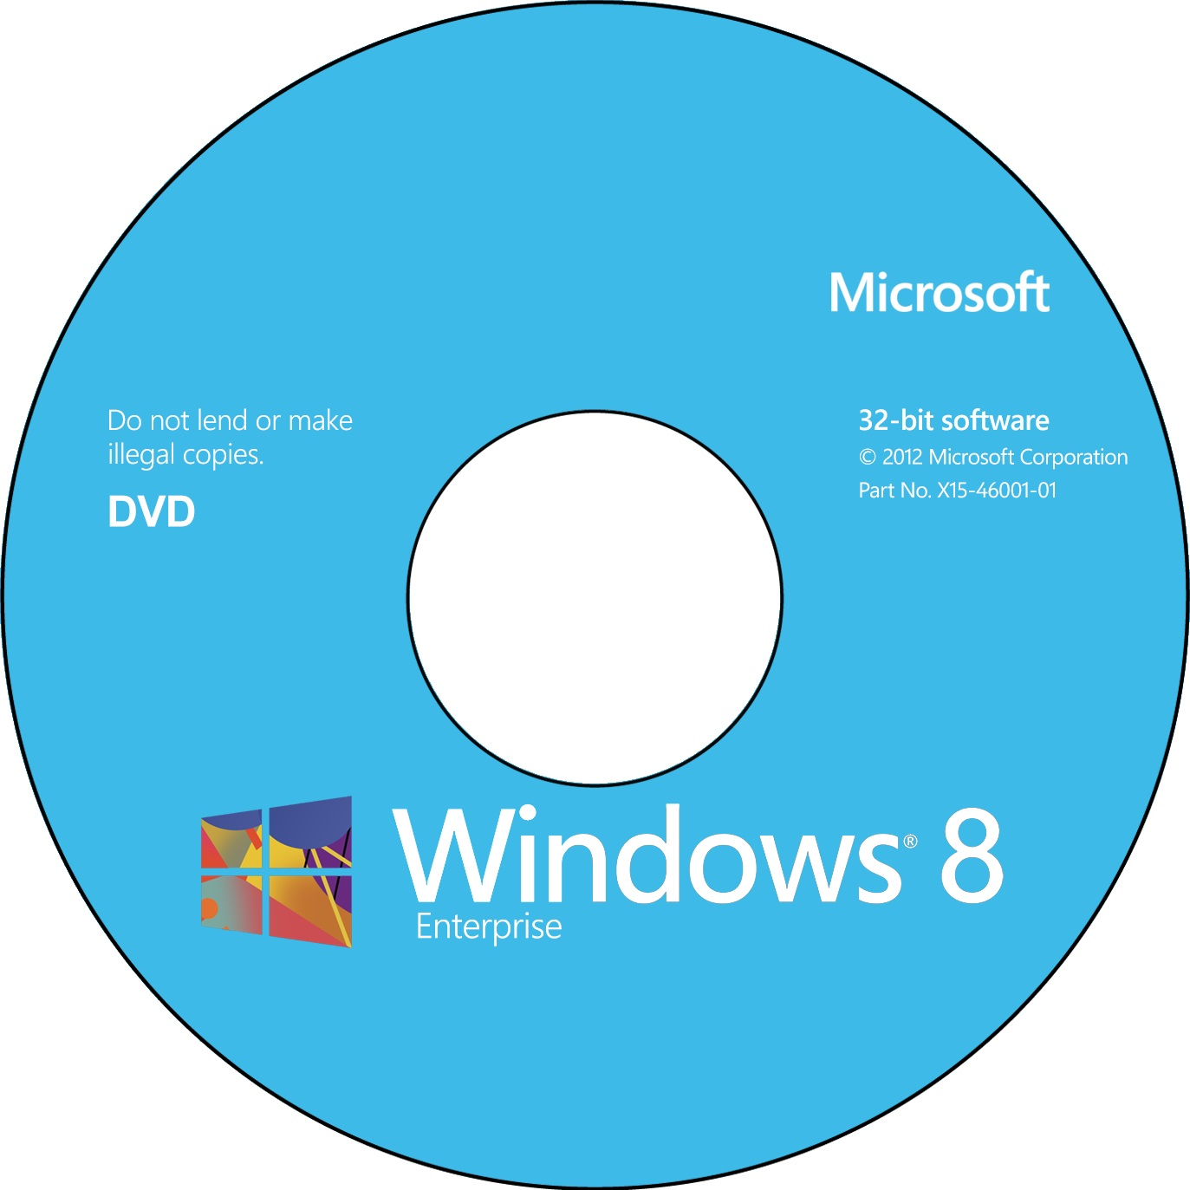
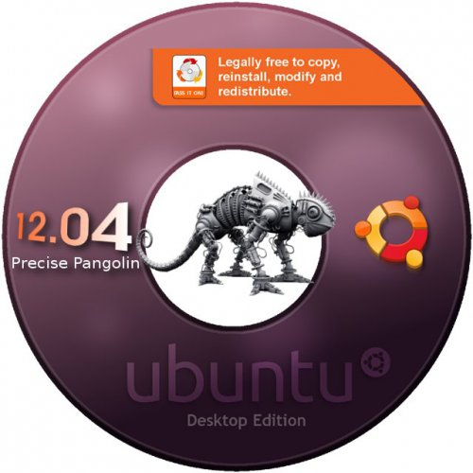
Freedom - 2

Slide 11

Freedom - 3

Slide 12

Where do I begin ?

Slide 13

You already have
x`

Slide 14

But a kind of Formal Introduction

Slide 15

Then?- Start Playing

Slide 16
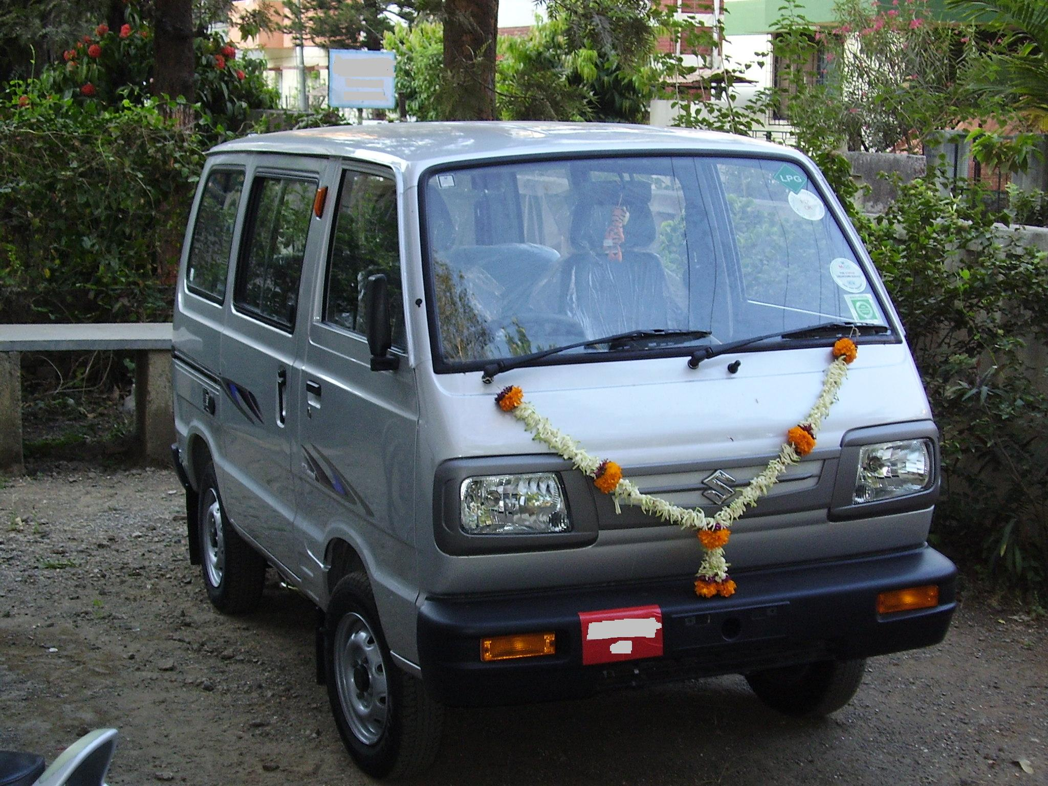
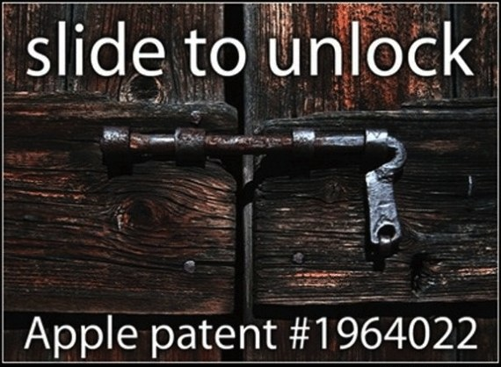
Patent

Slide 17

Open Access

Slide 18
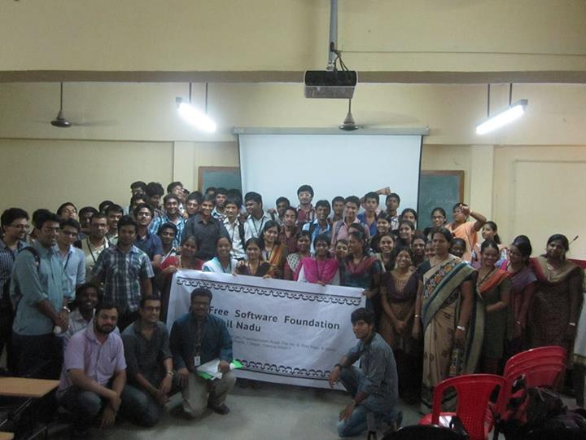
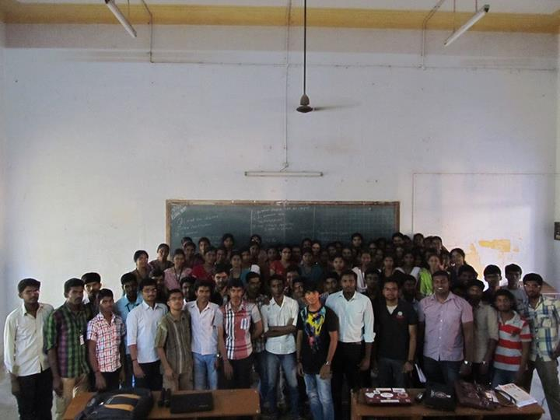
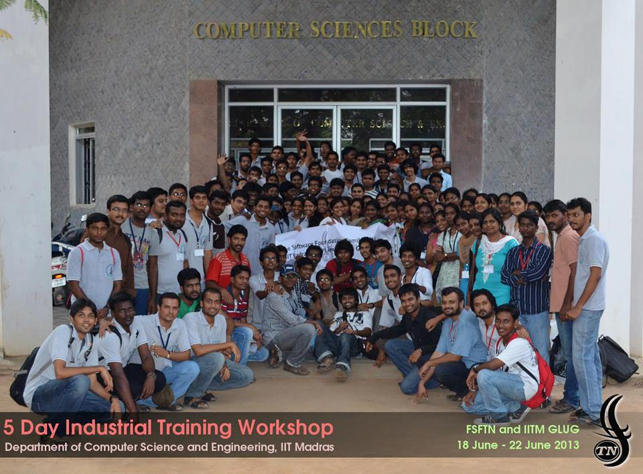
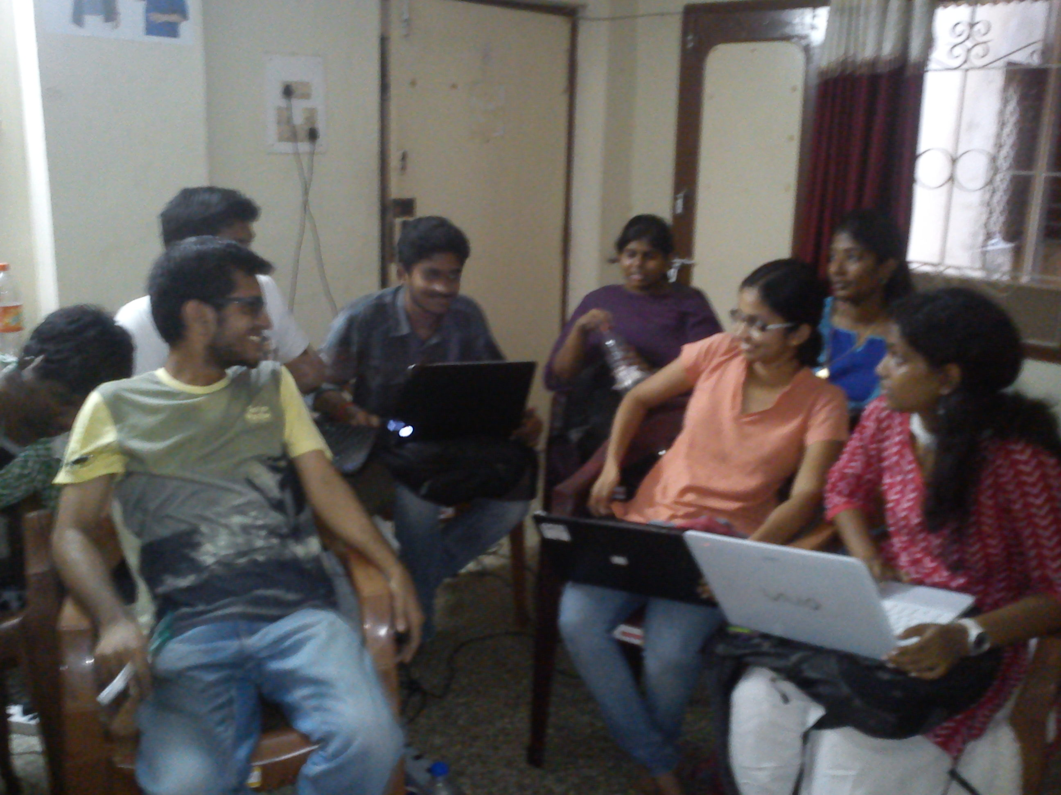
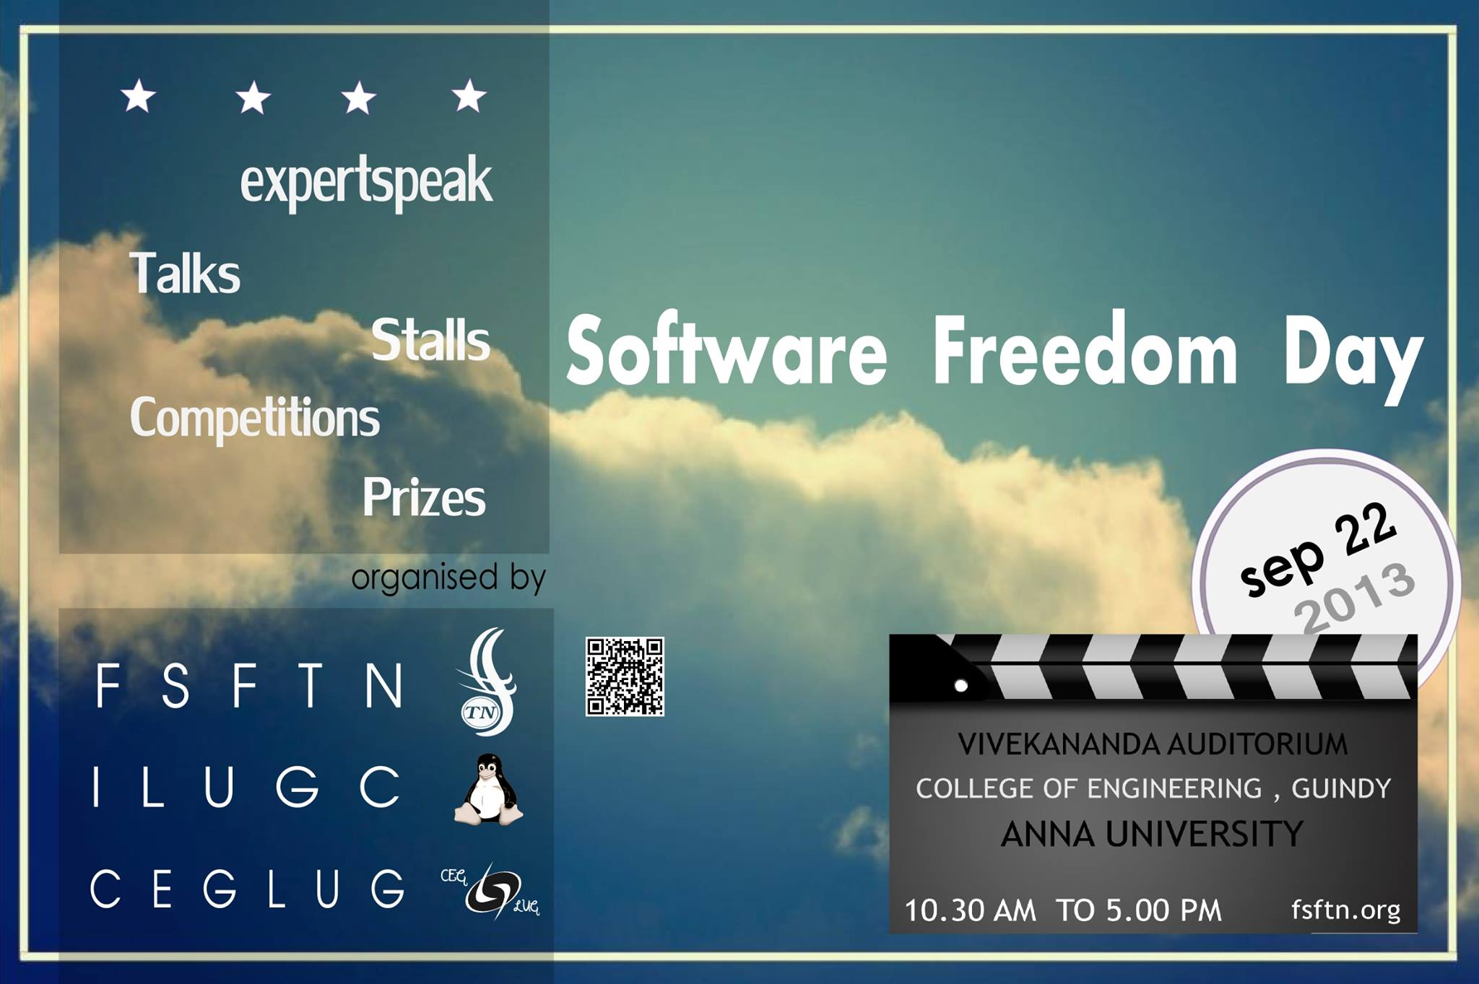

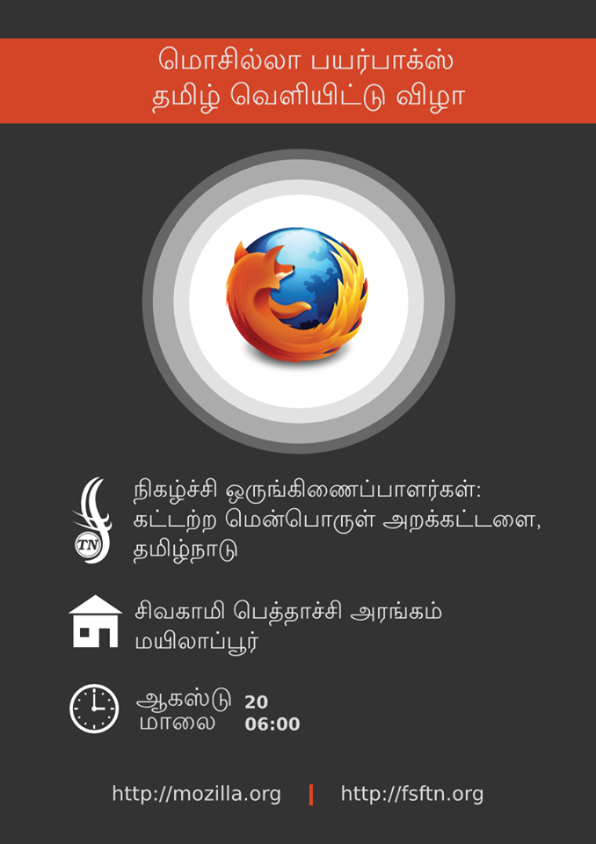
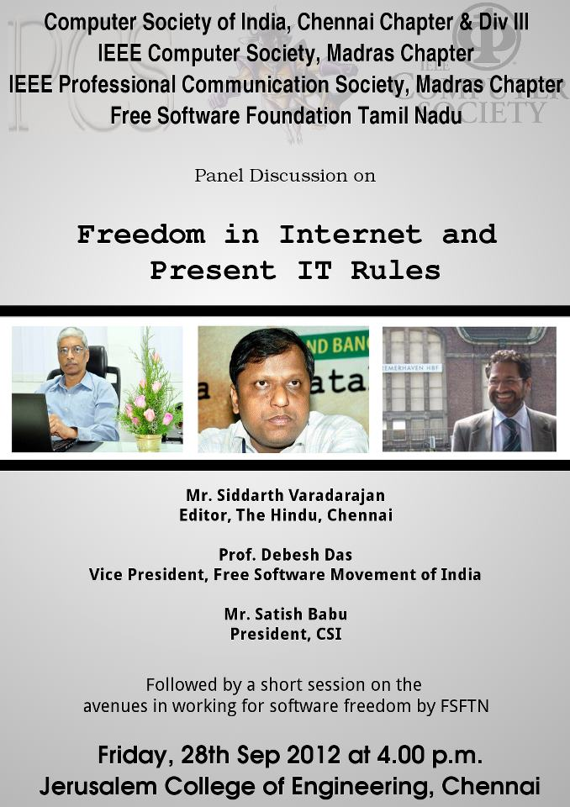
What do we do in FSFTN ?
Workshops followed by Setting
Up GLUGs in Colleges
Industrial Training workshops
Week end Free Technical sessions
Public Outreach
Gender Initiatives
Localisation
Panel Discussions

Slide 19
Thank you
Contact me at
sibi@fsftn.org
Doubts/Queries ask@fsftn.org
Join us mailinglist@fsftn.org
https://www.facebook.com/fsftn

