Slide 1
Software Freedom Day - 2013
Why Celebrate????
-K.Sibi
Free Sfotware Foundation , Tamilnadu n

Slide 2

GNU

Slide 3
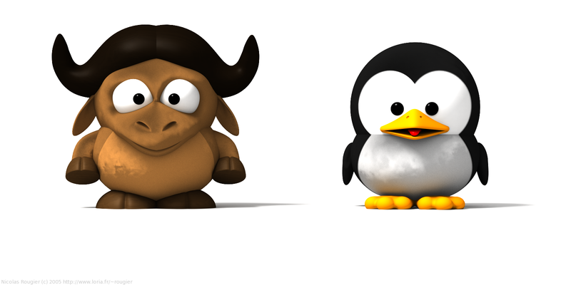
GNU/Linux

Slide 4

30 Years of GNU

Slide 5
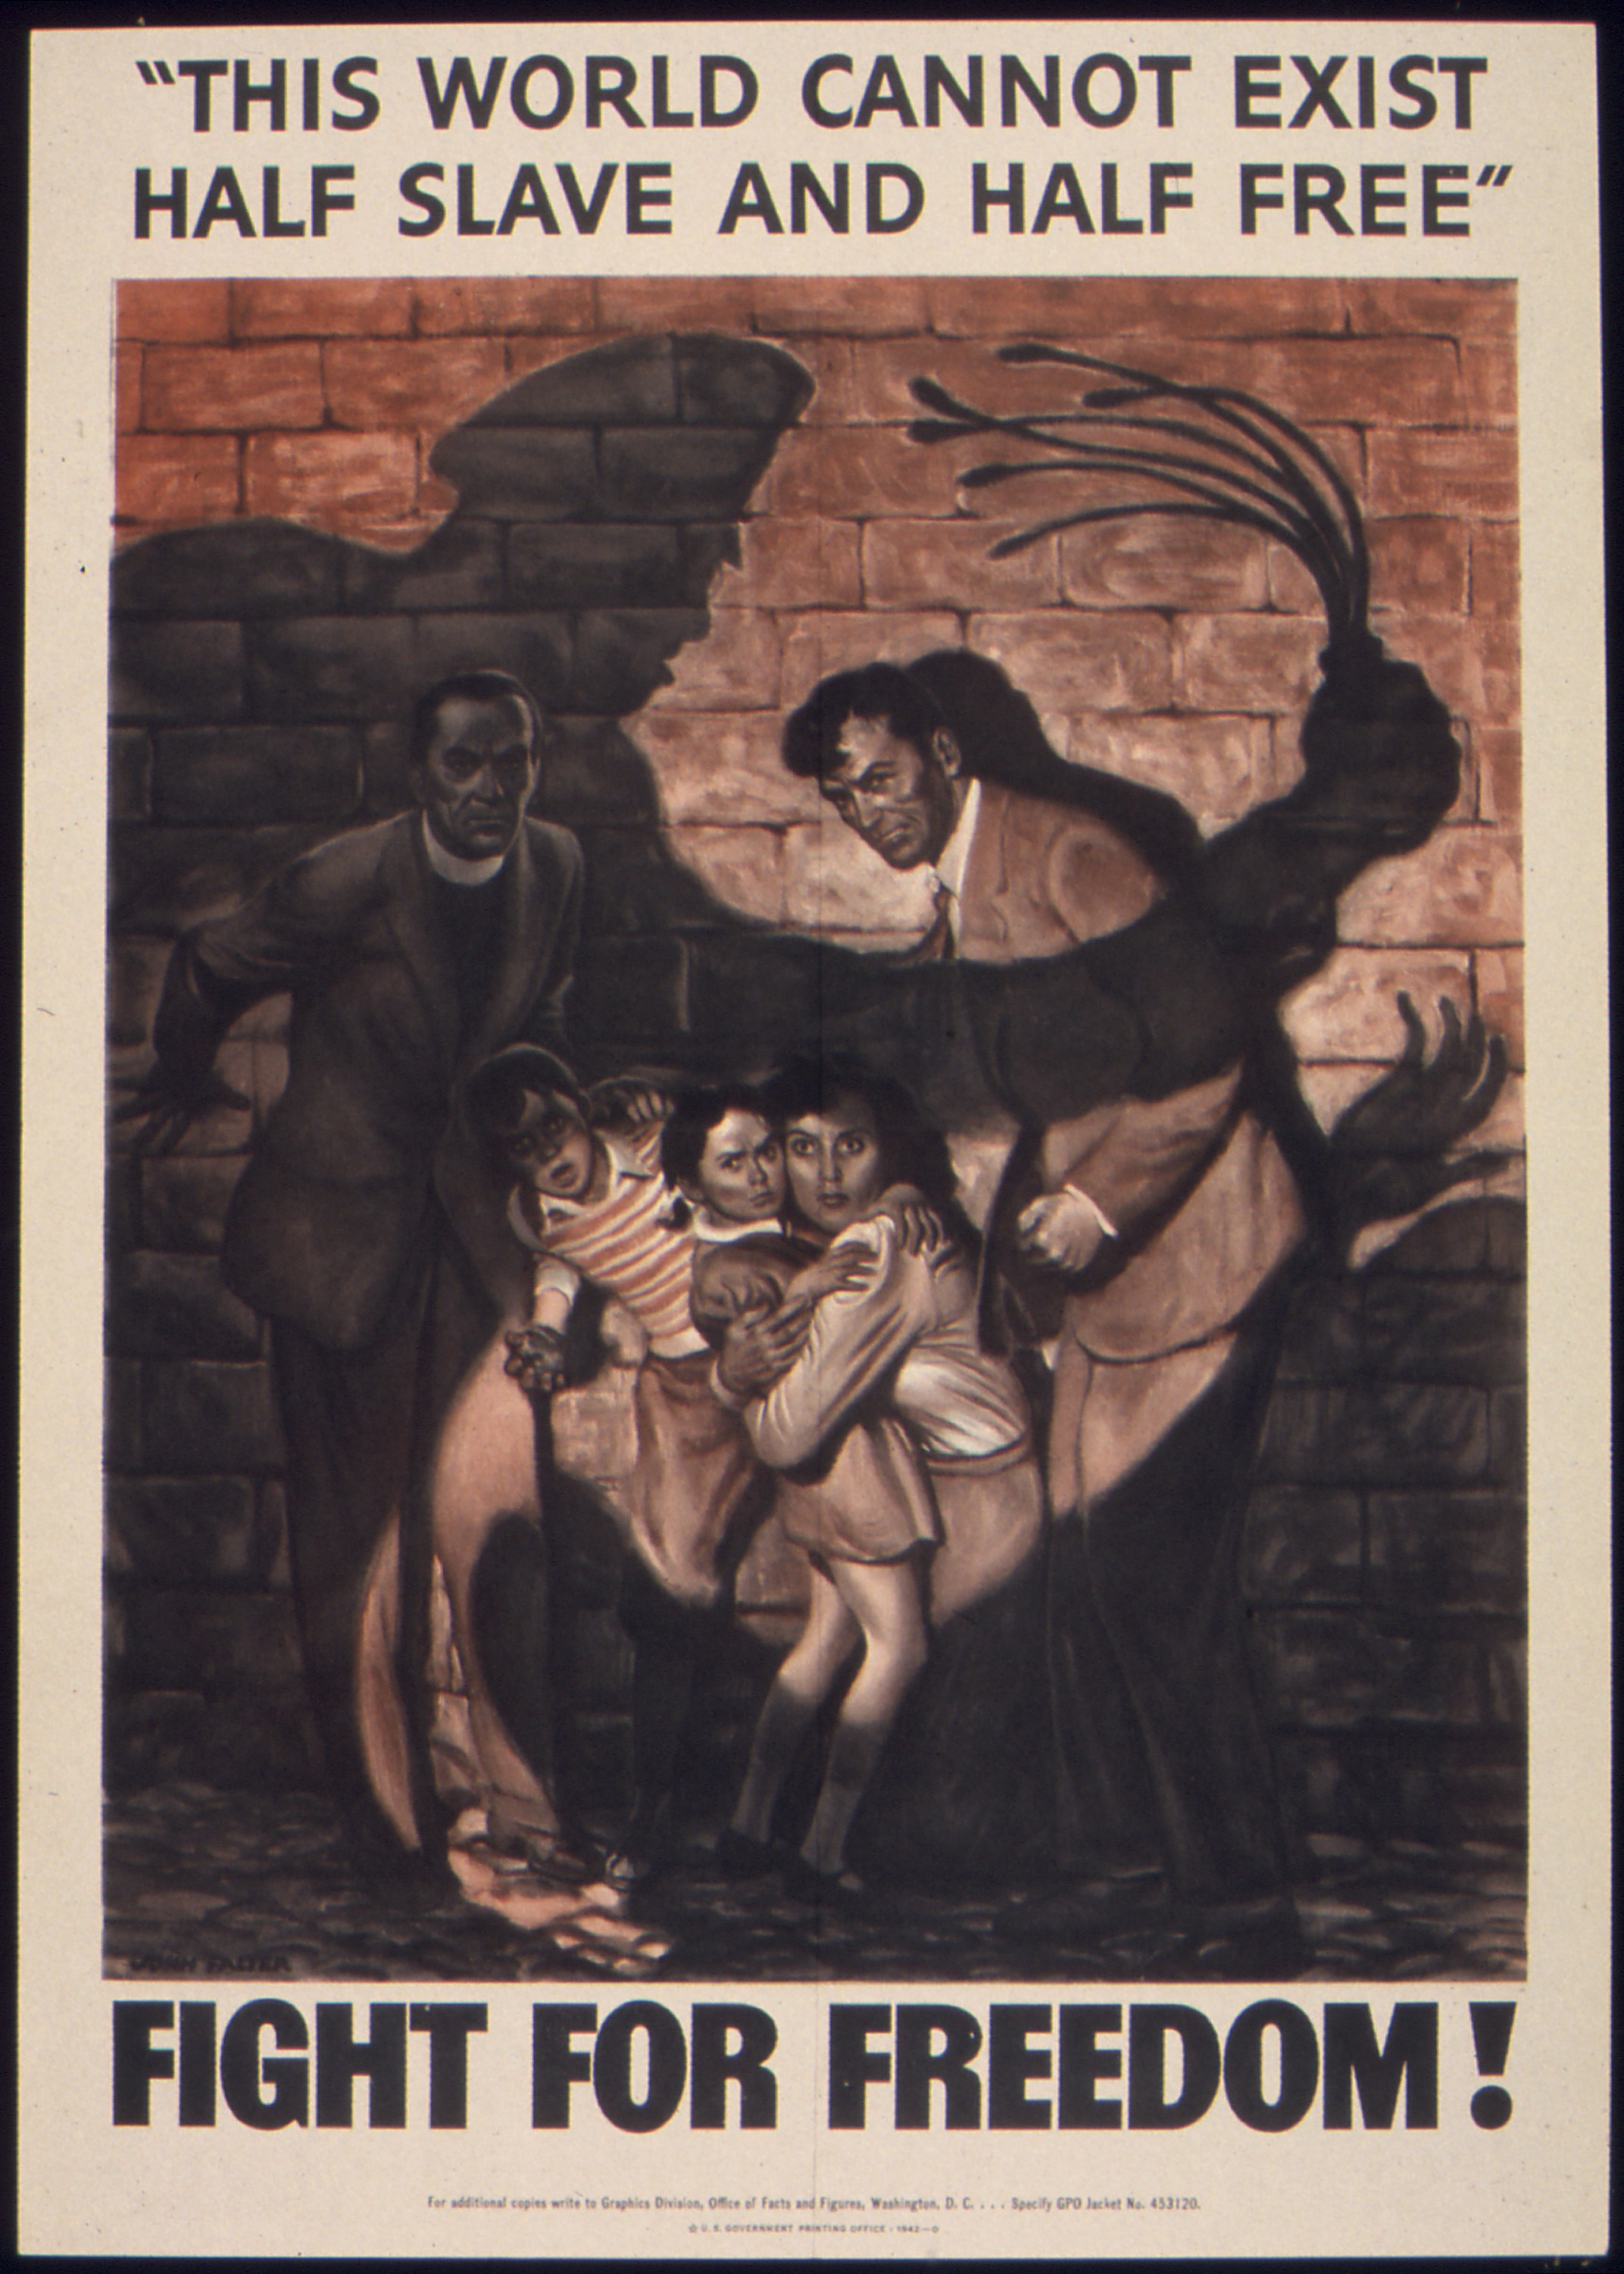
Then why celebrate

Slide 6

Wikipedia

Slide 7
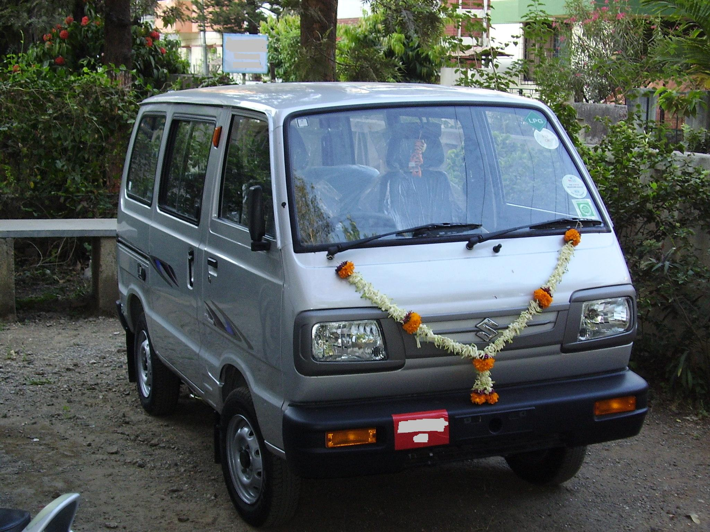
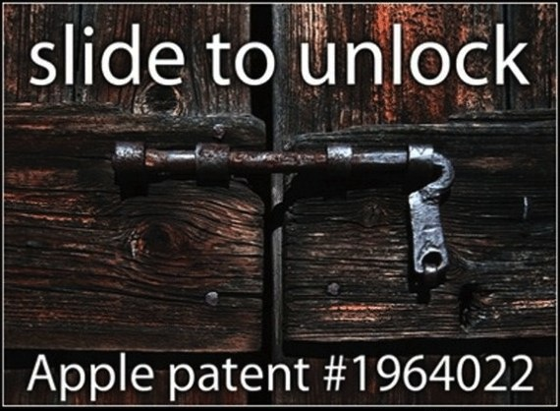
Patent

Slide 8

Open Access

Slide 9

Creative Commons

Slide 10

GNU General Public License

Slide 11
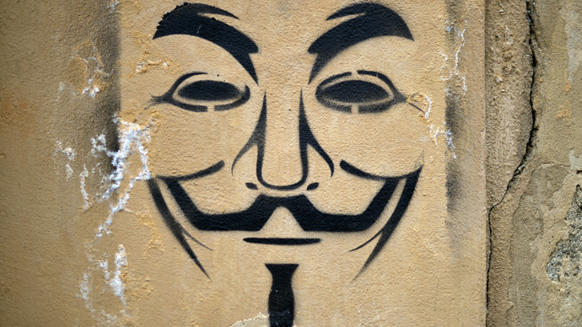
Anonimity

Slide 12
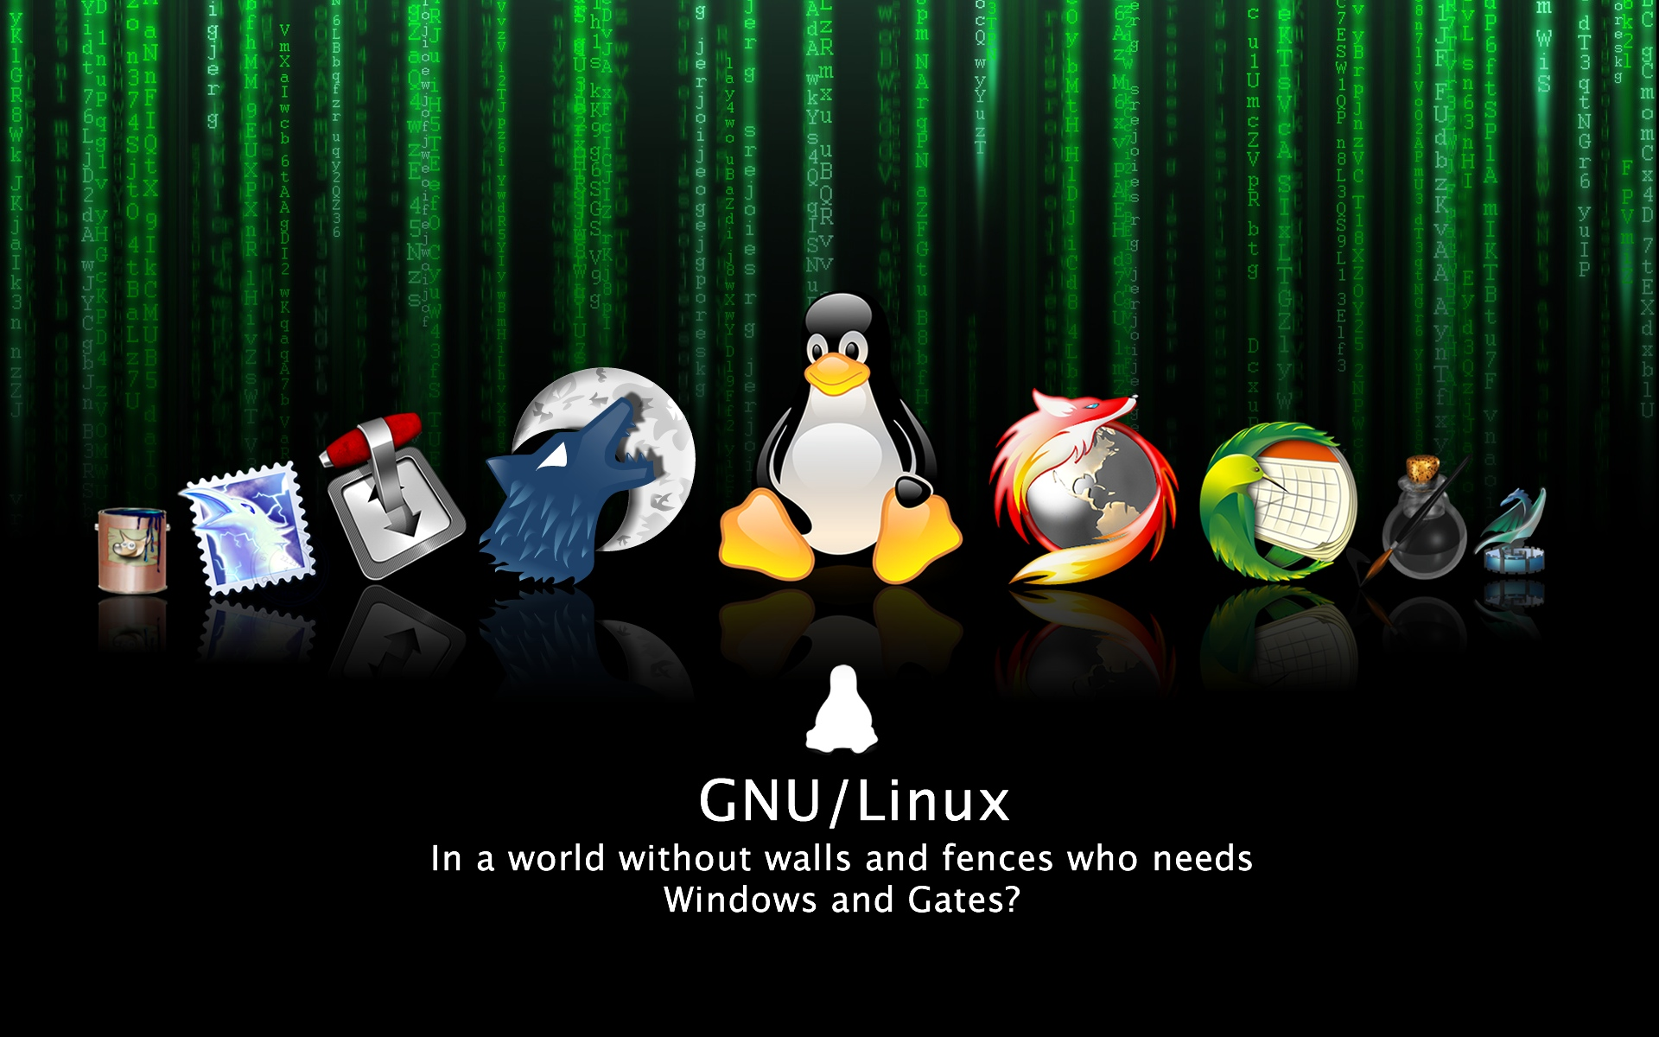
Thank you

