Slide 1
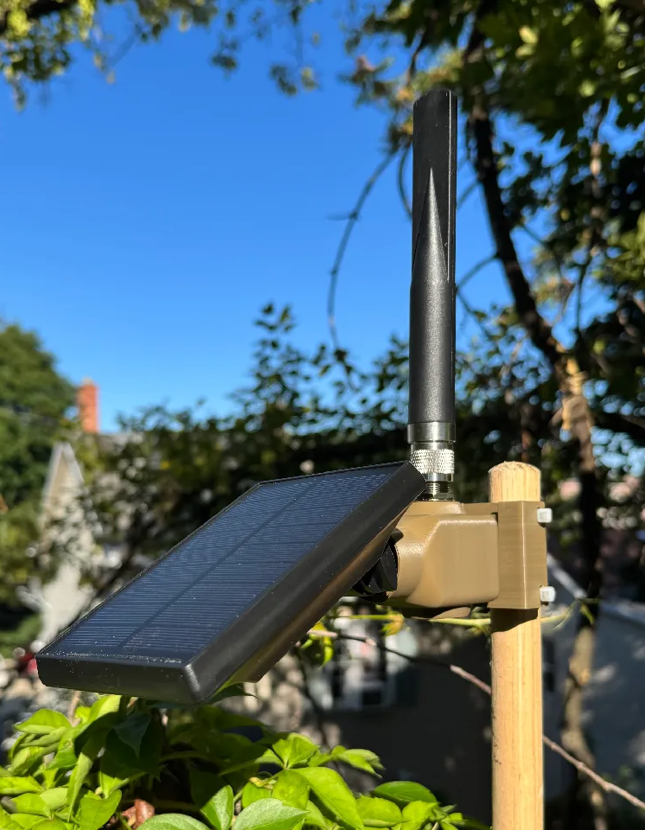
THE MAKER'S SPACE
MeshCore 102
Build The People's Repeater
Solar powered • Outdoor antenna • No light
Class materials can be found at:
https://github.com/commputethis/TheMaker-sSpace_MeshCore102
Notes:
Welcome participants and show the completed reference repeater. Explain that the class converts a Harbor Breeze solar light into a dedicated MeshCore repeater. The finished unit keeps the solar enclosure but does not retain the light.
Source: MeshCore102_PresenterGuide.md and class photographs supplied by the presenter.

Slide 2
Today's class
OVERVIEW
6:30
6:45
7:00
7:10
8:20
MeshCore roles
and Room Servers
Placement and
solar guidance
Firmware and
configuration
Guided build
and testing
Installation and
maintenance
The build block is protected
70 minutes for construction, inspection, testing, and closure
THE MAKER'S SPACE | MESHCORE 102
6:30 PM
2
Notes:
Review the pace. Keep optional discussion short so the guided build begins at 7:15 PM. Fast participants stop at each checkpoint rather than moving ahead into a safety-sensitive step.
Source: MeshCore102_PresenterGuide.md and class photographs supplied by the presenter.

Slide 3
MeshCore roles
REFRESHER
COMPANION
REPEATER
ROOM SERVER
Personal access
Coverage
Shared history
Gives a person access to the mesh.
Forwards packets and extends useful routes through the mesh.
Stores posts and delivers unseen history when a user returns.
This class builds a dedicated repeater. Room Servers and repeaters solve different problems.
THE MAKER'S SPACE | MESHCORE 102
3
Notes:
Keep this refresher brief. A Room Server acts like a shared message board. A dedicated repeater provides the full repeater feature set and remains the focus of this build.
Source: MeshCore102_PresenterGuide.md and class photographs supplied by the presenter.

Slide 4
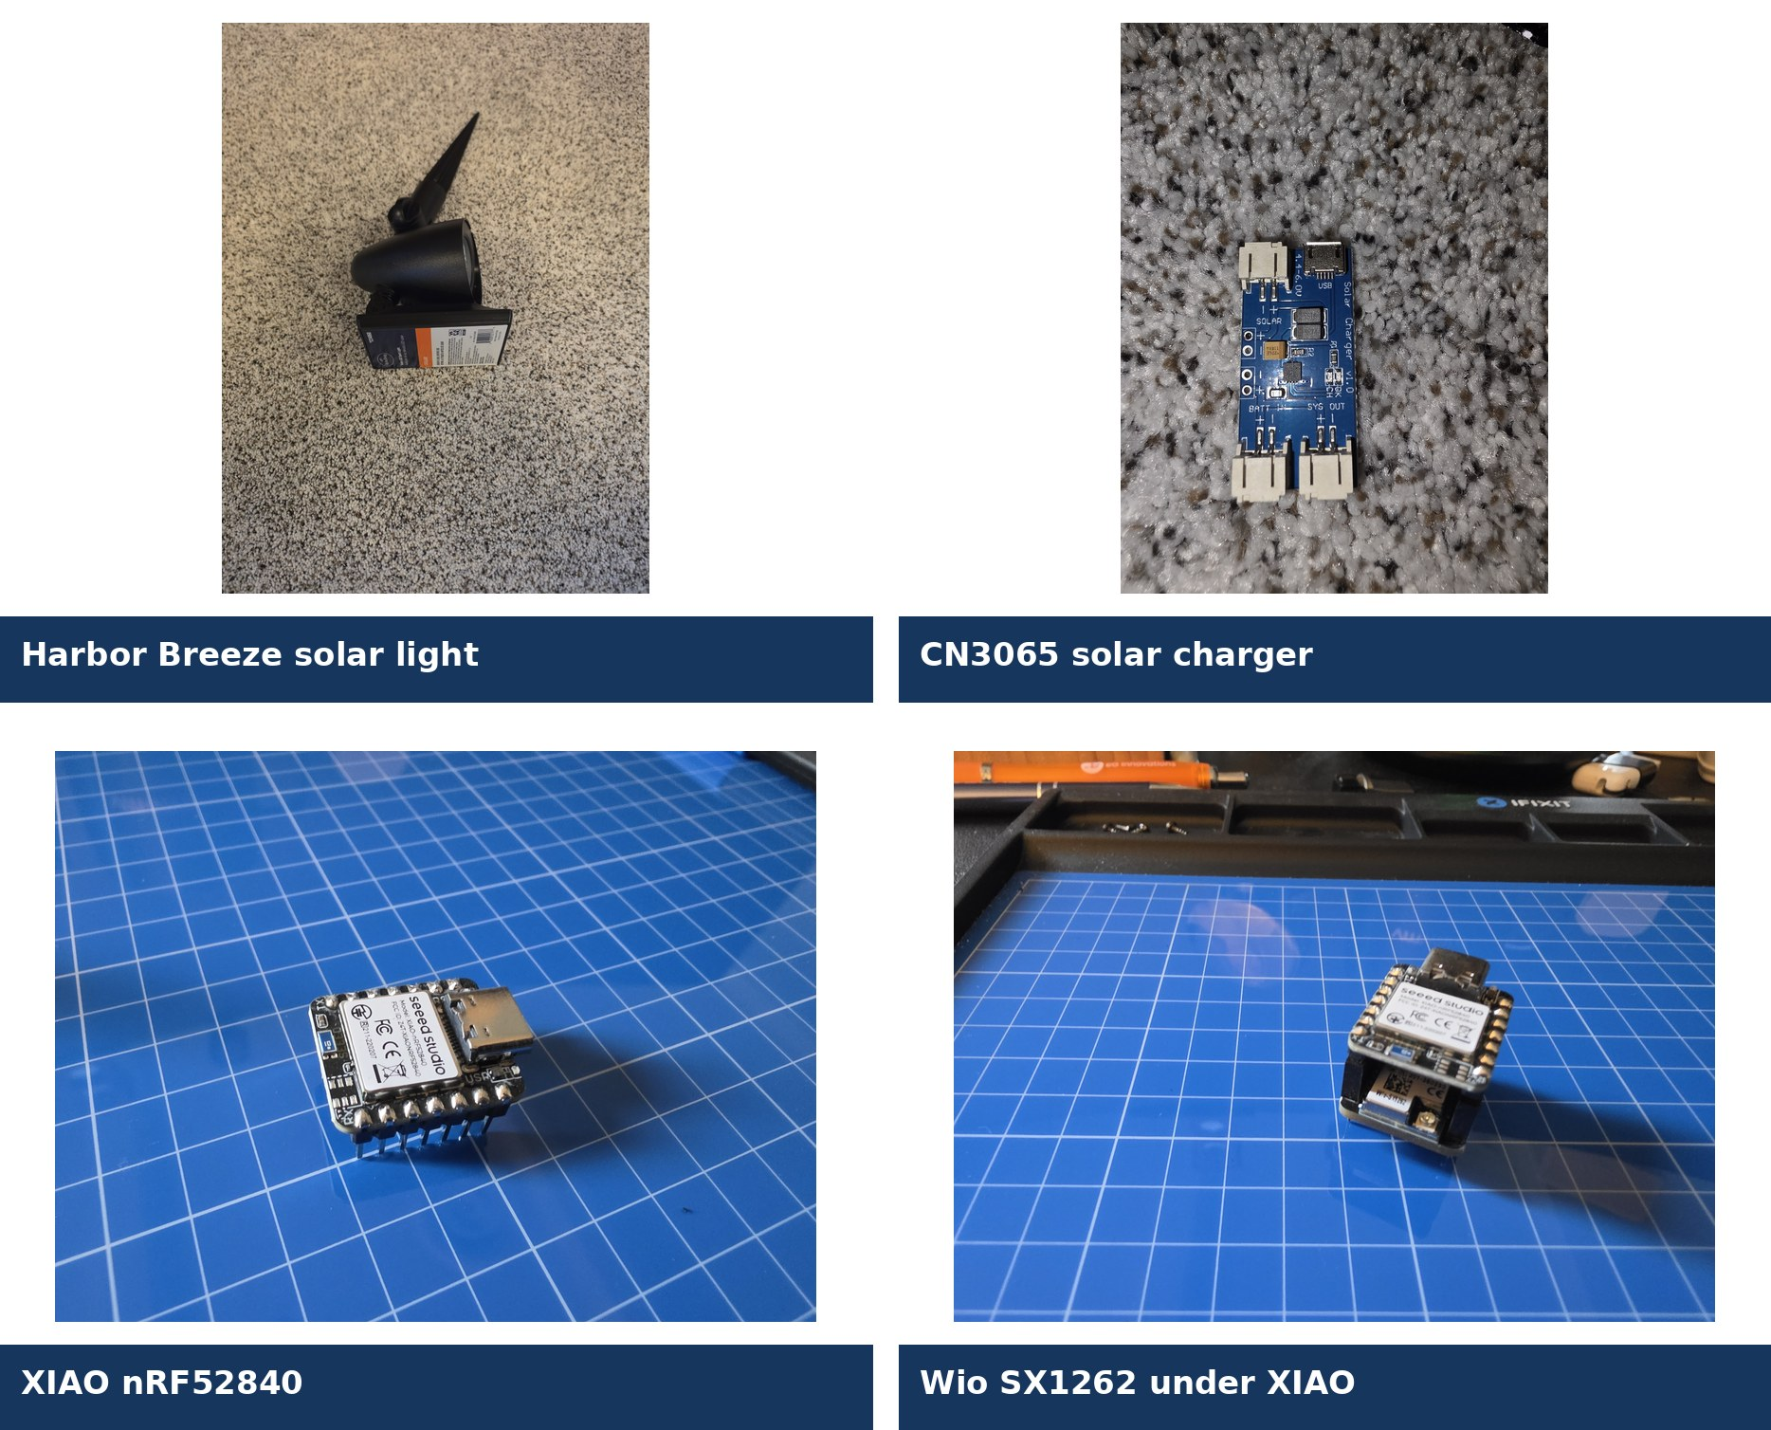
The People's Repeater
PROJECT OVERVIEW
Core system
Harbor Breeze solar enclosure and 1500 mAh 18650
XIAO nRF52840 with Wio-SX1262
CN3065 solar charger and three JST leads
5 dBi ALFA outdoor antenna and RG178 pigtail
PETG mount, connector clamp, and TPU gasket
THE MAKER'S SPACE | MESHCORE 102
4
Notes:
Identify each component on the reference unit. A larger compatible 18650 can add winter reserve, but chemistry, voltage, size, polarity, terminals, protection, and charger compatibility must all match.
Source: MeshCore102_PresenterGuide.md and class photographs supplied by the presenter.

Slide 5
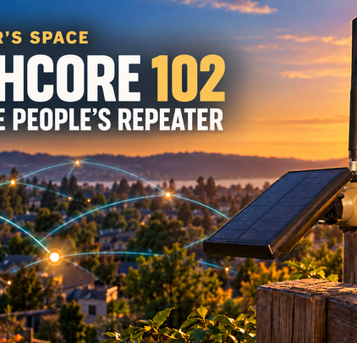
Placement starts with a coverage purpose
PLACEMENT
A useful site
Fills a dead zone or strengthens an important route
Has a reasonably clear path toward the area served
Keeps the antenna away from large metal objects
Can be retrieved, inspected, and repaired safely
Has the property owner's permission
MeshMapper: https://fwa.meshmapper.net/
THE MAKER'S SPACE | MESHCORE 102
6:45 PM
5
Notes:
Ask what area each participant hopes to serve. Demonstrate the purpose and radio-path tools at https://fwa.meshmapper.net/. Height helps, but placement also needs reliable sun, safe access, and long-term survivability.
Source: MeshCore102_PresenterGuide.md and class photographs supplied by the presenter.

Slide 6
Solar exposure and weather
INDIANA STARTING POINT
Avoid standing water and roof runoff
Orient seams and openings to shed water
Keep the antenna vertical
Plan for safe cleaning and battery service
Southerly exposure
≈ 40° panel angle
Adjust for site-specific shade and seasonal changes.
Solar angle: https://www.baess.app/tools/solar-tilt-angle-calculator
THE MAKER'S SPACE | MESHCORE 102
6
Notes:
A sunny November location may be shaded during another season. Explain water-shedding orientation and the need to inspect the site after severe weather.
Source: MeshCore102_PresenterGuide.md and class photographs supplied by the presenter.

Slide 7
Build safety
BEFORE DISASSEMBLY
Switch OFF before cutting. Remove the battery after opening.
BATTERY
Use fingers or a nonconductive tool. Keep the 18650 out during cutting and soldering.
POLARITY
Connector shape and wire color do not prove polarity. Visually verify the connections.
ANTENNA
Never transmit without an antenna connected.
STOP
Stop for heat, odor, “magic smoke”, uncertain wiring, or abnormal behavior.
THE MAKER'S SPACE | MESHCORE 102
7
Notes:
Deliver the safety briefing before anyone handles tools. There is no drilling or enclosure cutting in this build. Do not close the enclosure until the open-unit inspection and test pass.
Source: MeshCore102_PresenterGuide.md and class photographs supplied by the presenter.

Slide 8
Firmware and configuration demonstration
INSTRUCTOR DEMONSTRATION
1
2
3
4
Review the
OTAFIX bootloader
Review MeshCore
repeater firmware
Review names,
radio settings, and owner info
Use the labeled
prepared class board
Class boards arrive flashed, configured, tested, and labeled.
THE MAKER'S SPACE | MESHCORE 102
7:00 PM
8
Notes:
Keep the group synchronized. Use the Seeed Studio Xiao nRF52 WIO target and the Repeater role. The supplied antenna remains attached until configuration finishes.
Source: MeshCore102_PresenterGuide.md and class photographs supplied by the presenter.

Slide 9
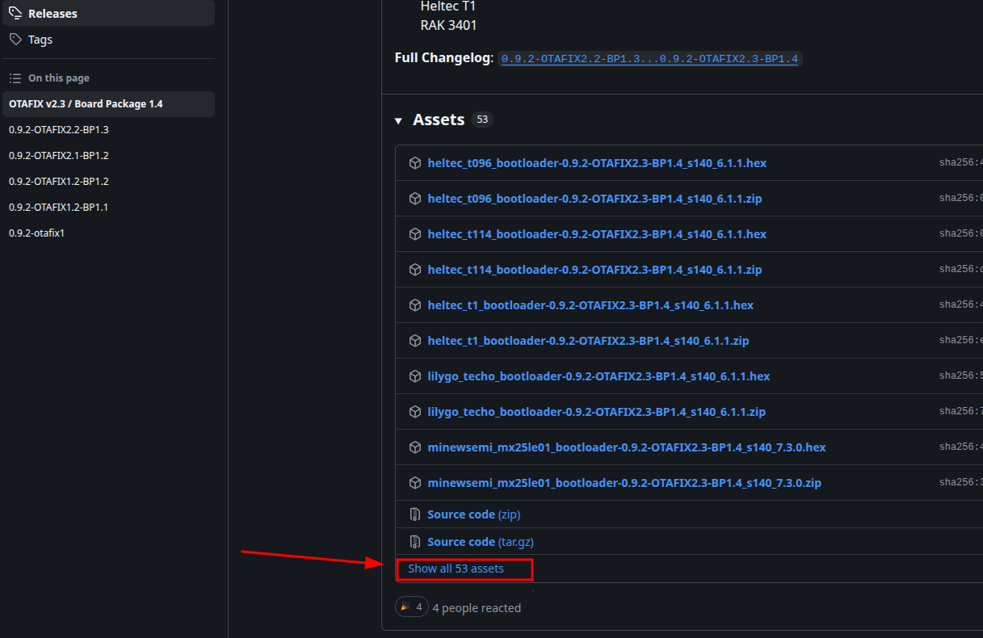
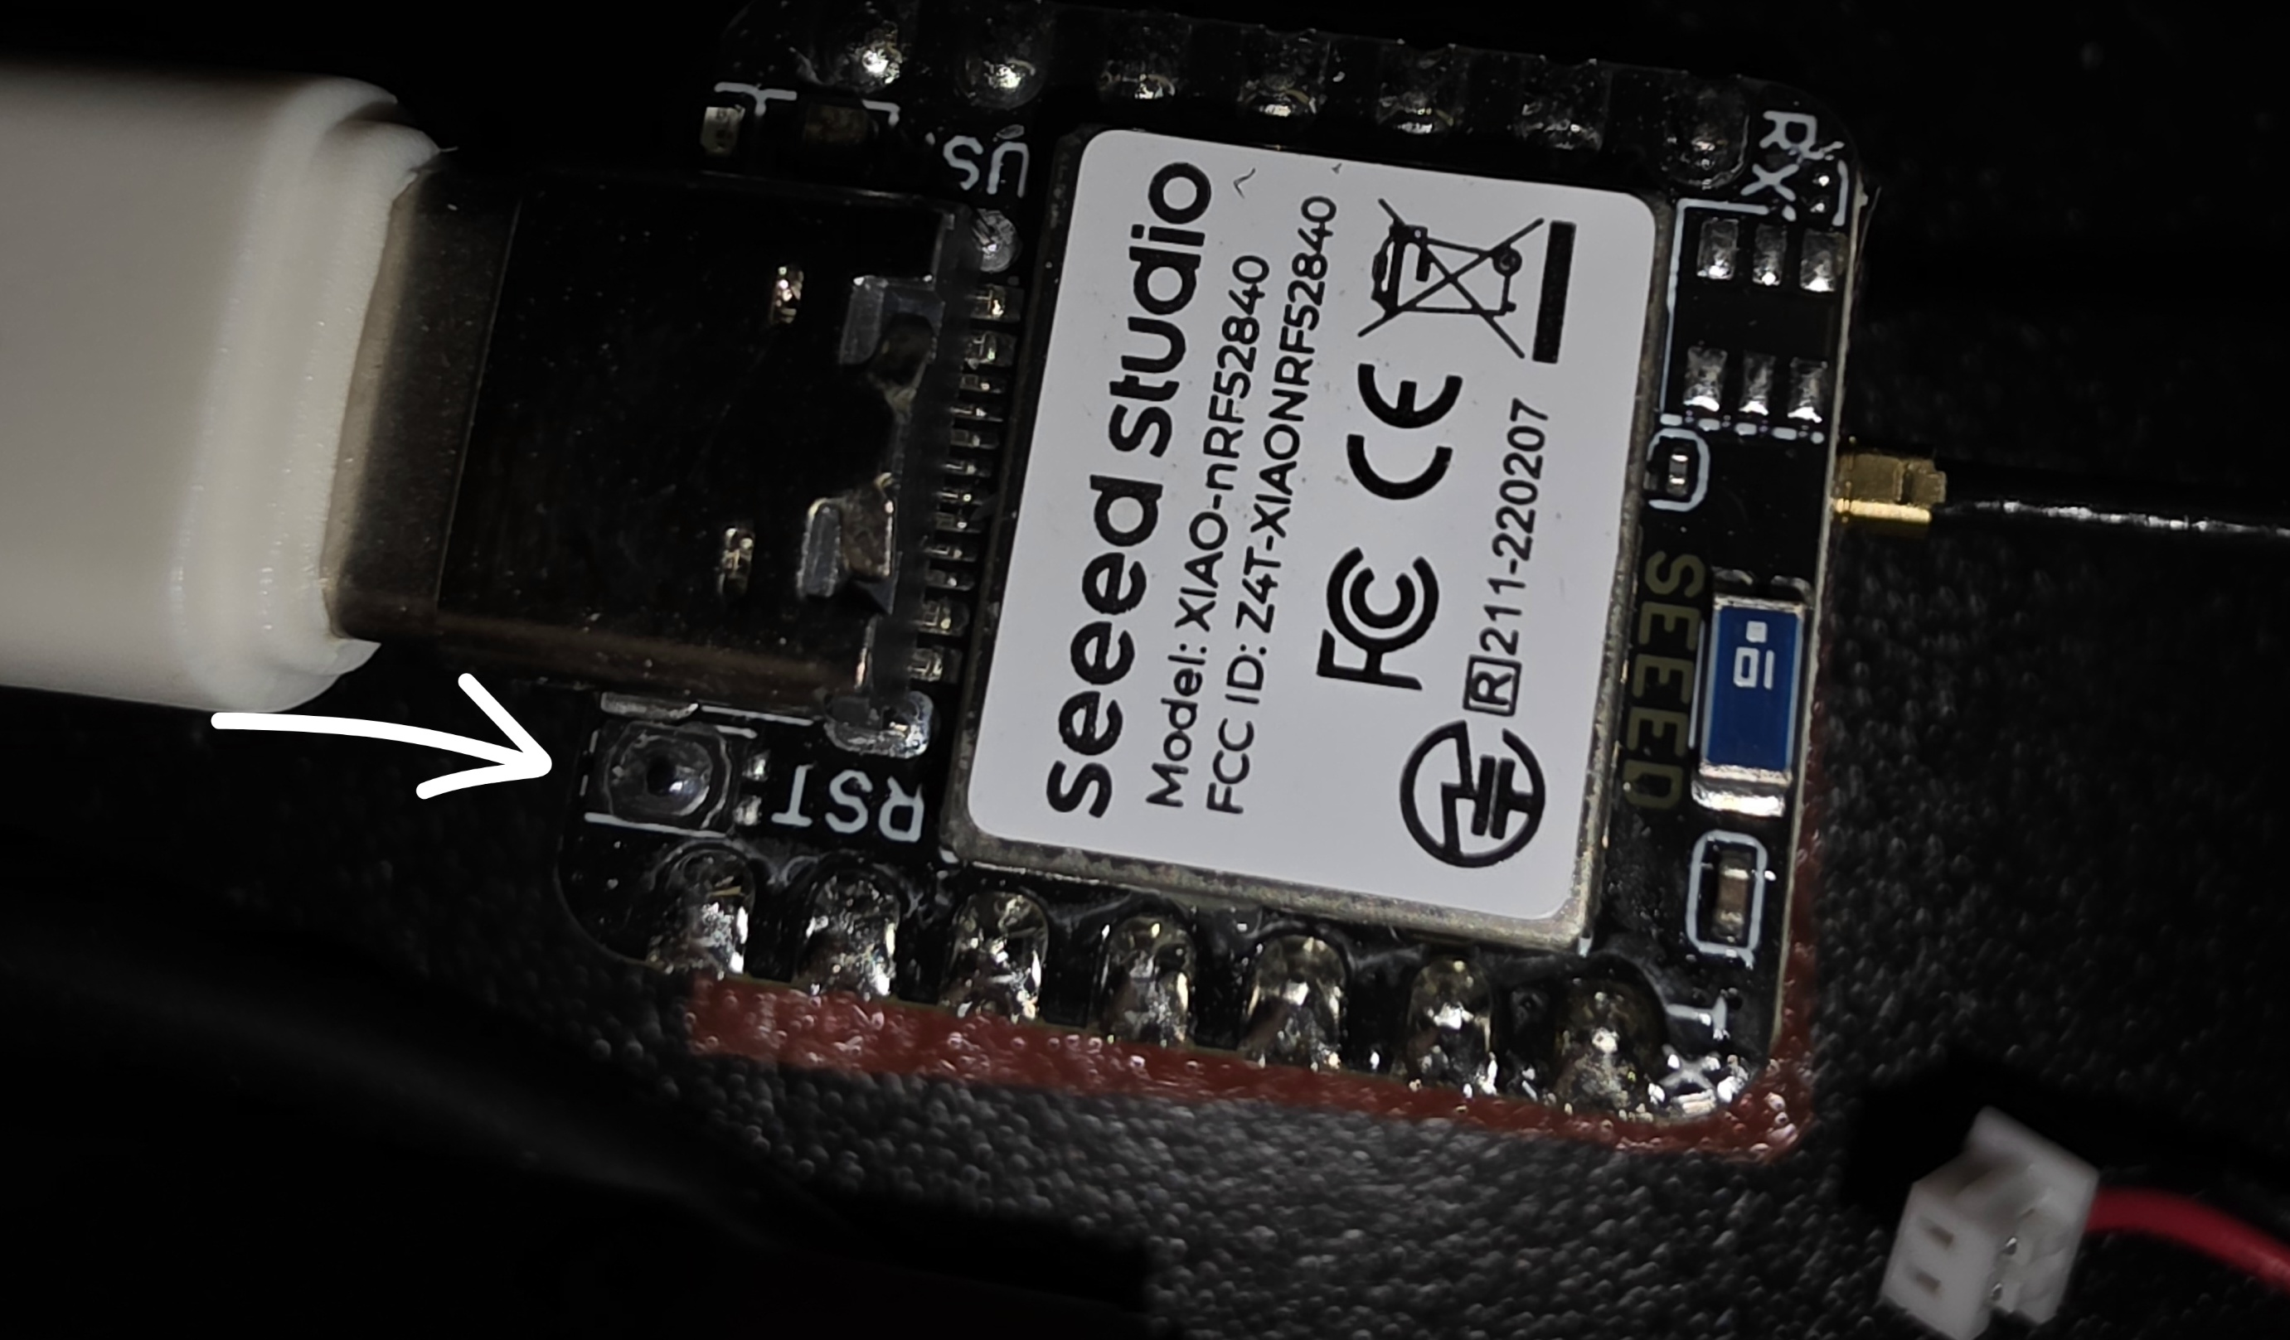
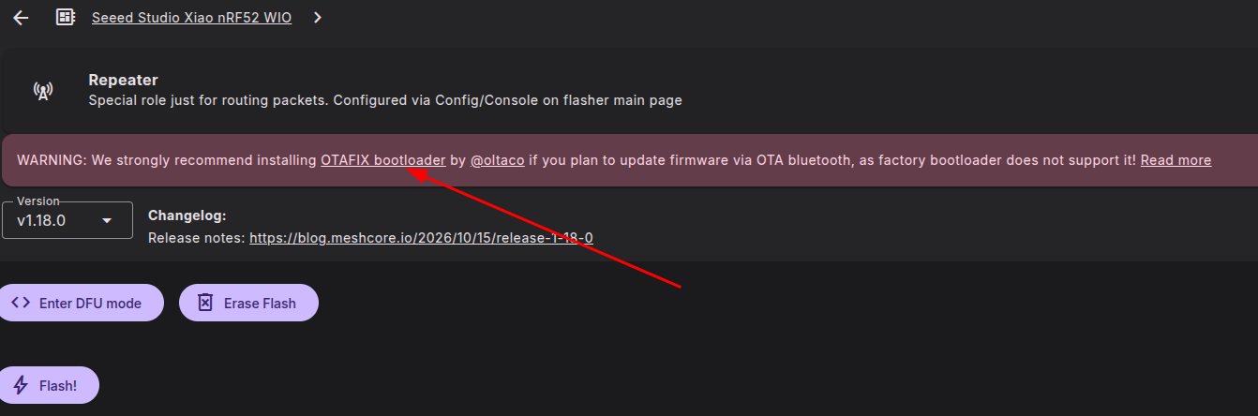
OTAFIX bootloader
DEMONSTRATION
1 Open GitHub releases
2 Download the Sense UF2
3 Double-press RST
OTAFIX releases: https://github.com/oltaco/Adafruit_nRF52_Bootloader_OTAFIX/releases
THE MAKER'S SPACE | MESHCORE 102
9
Notes:
Use the class-approved XIAO nRF52840 Sense OTAFIX UF2. Double-press RST within about half a second. The OTAFIX bootloader enables future Bluetooth firmware updates without reopening the enclosure.
Source: MeshCore102_PresenterGuide.md and class photographs supplied by the presenter.

Slide 10
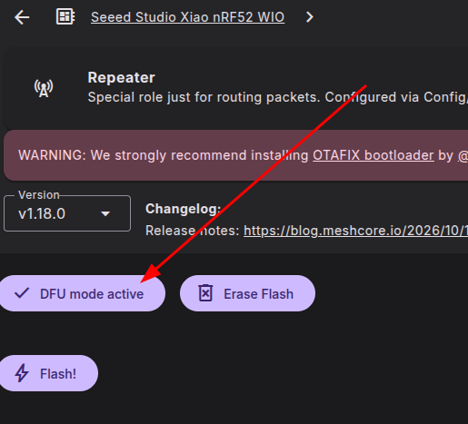
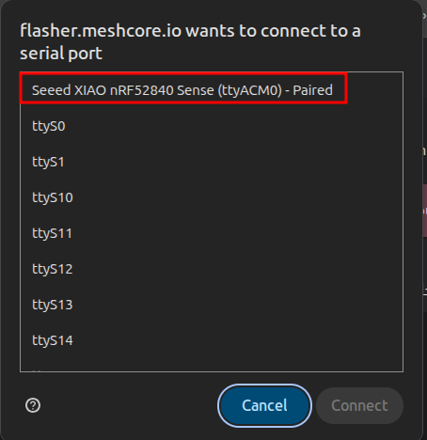
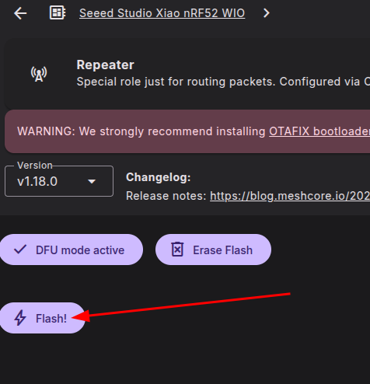
Flash the repeater firmware
DEMONSTRATION
1 DFU mode active
2 Select the USB device
3 Flash and wait
If the device does not appear, refresh the browser and reconnect.
THE MAKER'S SPACE | MESHCORE 102
10
Notes:
Do not disconnect USB while flashing. The browser may ask for the same USB device a second time. Continue only after the flasher reports completion.
Source: MeshCore102_PresenterGuide.md and class photographs supplied by the presenter.

Slide 11
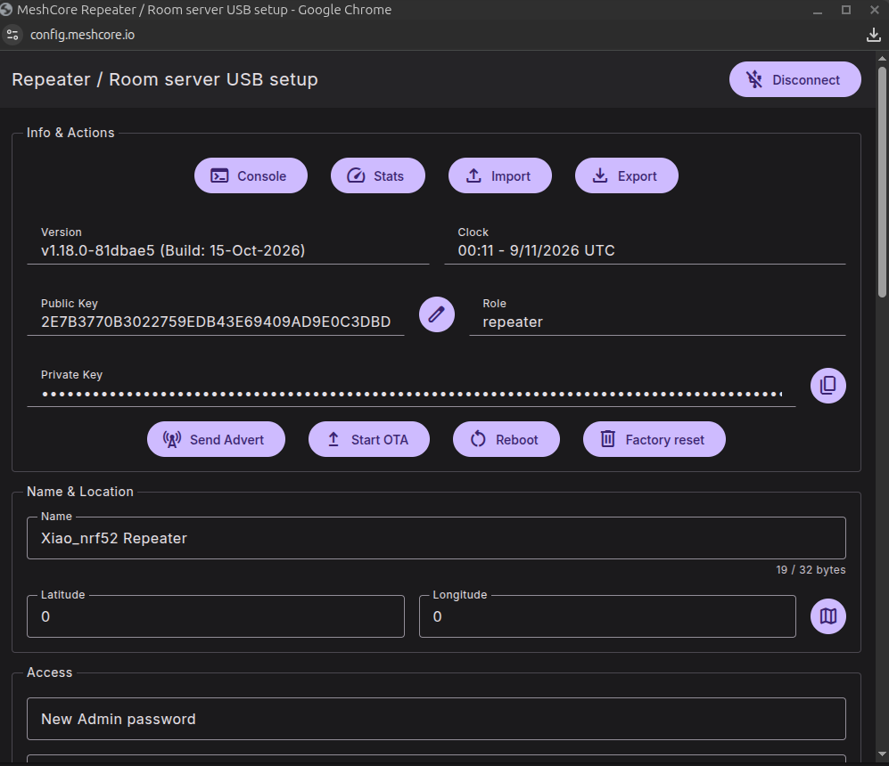
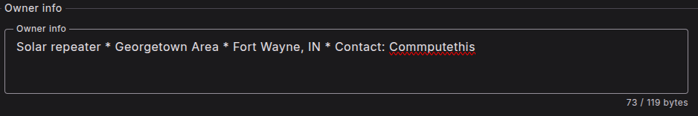
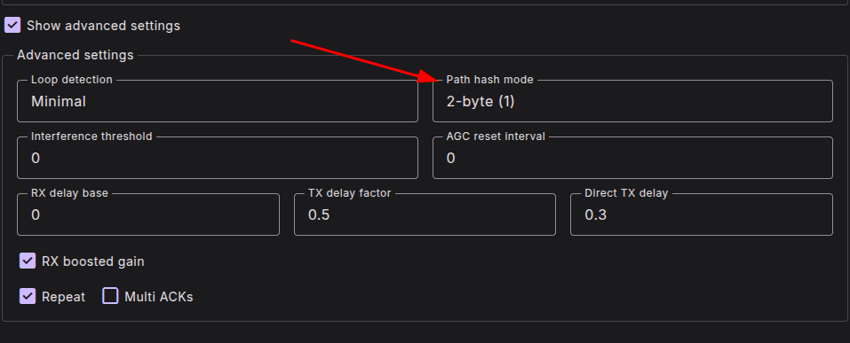
Configure the repeater
DEMONSTRATION
Name
IN.ALL.descriptiveName
Add owner information and record the administrator password.
THE MAKER'S SPACE | MESHCORE 102
11
Notes:
Follow the OKI Mesh repeater configuration guide. Use StateCode.CountyCode.descriptiveName. For Allen County use IN.ALL, with the local Fort Wayne convention IN.ALL.FWA. Explain the 2-byte and 3-byte path-hash choices verbally.
Source: MeshCore102_PresenterGuide.md and class photographs supplied by the presenter.

Slide 12
Recommended NEIMesh settings
PRESET
FREQUENCY
USA
910.525 MHz
BANDWIDTH
SPREADING FACTOR
62.5 kHz
7
CODING RATE
PATH HASH
5
2-byte or 3-byte
Verify current local recommendations before class.
THE MAKER'S SPACE | MESHCORE 102
12
Notes:
Devices must use matching radio settings to communicate. Explain verbally that larger path hashes reduce duplicate ambiguity but consume more routing space and can reduce the available hop count.
Source: MeshCore102_PresenterGuide.md and class photographs supplied by the presenter.

Slide 13
Repeater commands and regions
CONFIGURATION REFERENCE
Recommended CLI settings
Local region hierarchy
set agc.reset.interval 500
set multi.acks 1
set loop.detect minimal
region put us-in
region put nei us-in
region put fwa nei
region allowf *
us-in = Indiana nei = northeast Indiana fwa = Fort Wayne area
THE MAKER'S SPACE | MESHCORE 102
13
Notes:
Talk participants through these settings if time permits. The local weather-alert node already scopes messages to the fwa region. These commands do not have to be completed during class.
Source: MeshCore102_PresenterGuide.md and class photographs supplied by the presenter.

Slide 14
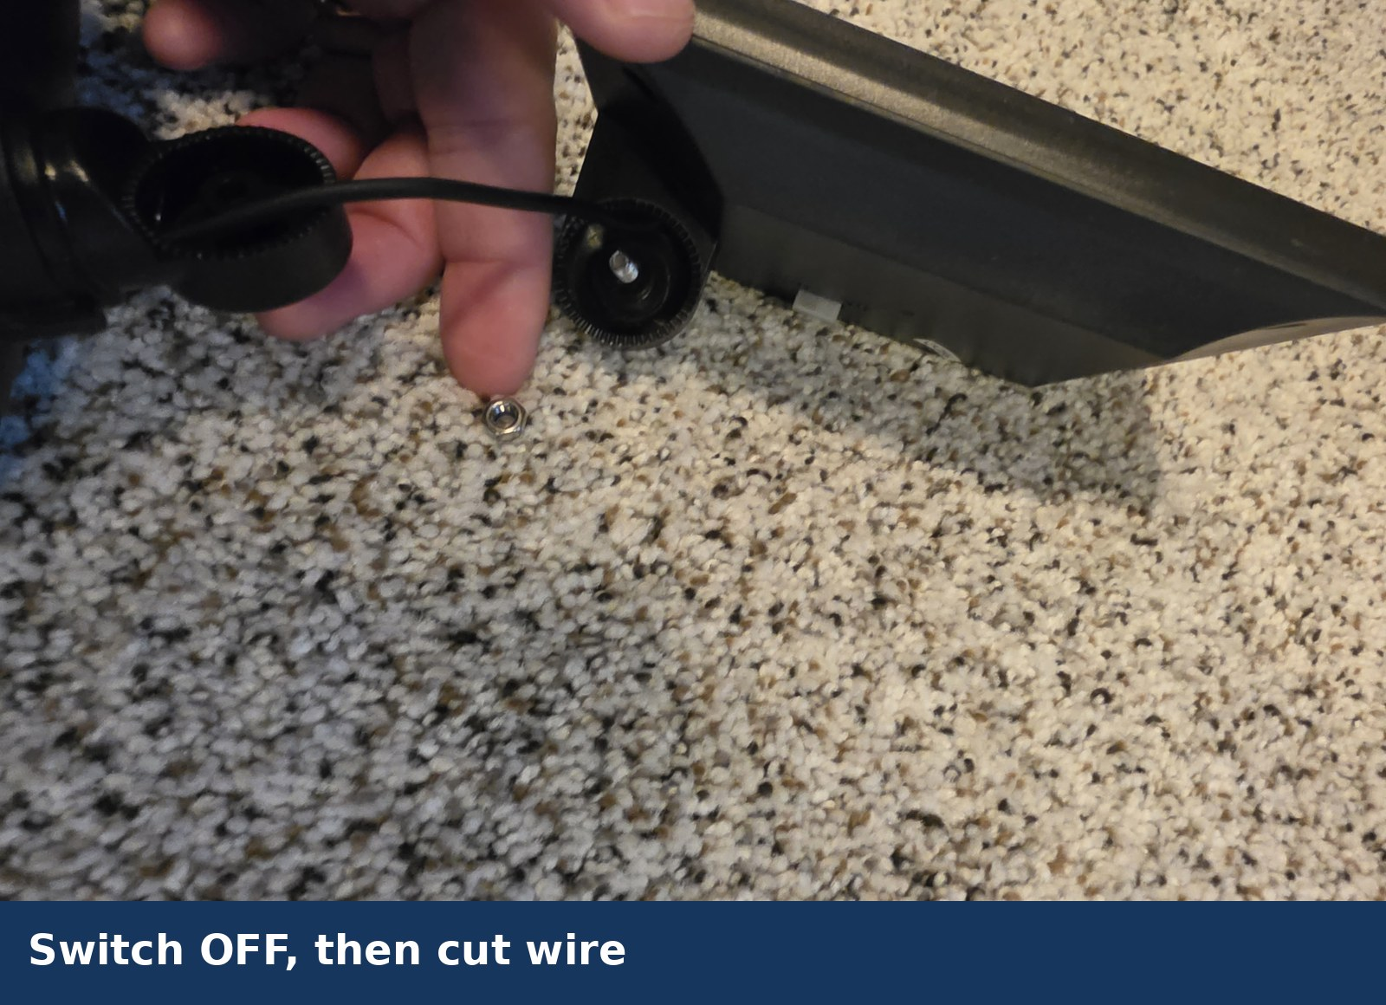
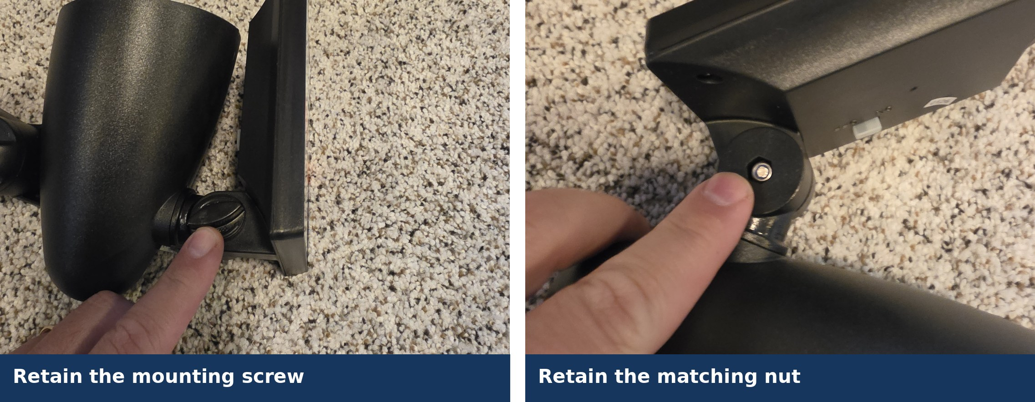
Build start: retain hardware and remove the light
STEPS 2–3
Keep the screw and separate nut
Switch OFF, then cut the wire
THE MAKER'S SPACE | MESHCORE 102
7:10–7:20 PM
14
Notes:
The exact cut location does not matter because the entire wire will be removed. Put all removed hardware in a parts tray.
Source: MeshCore102_PresenterGuide.md and class photographs supplied by the presenter.

Slide 15
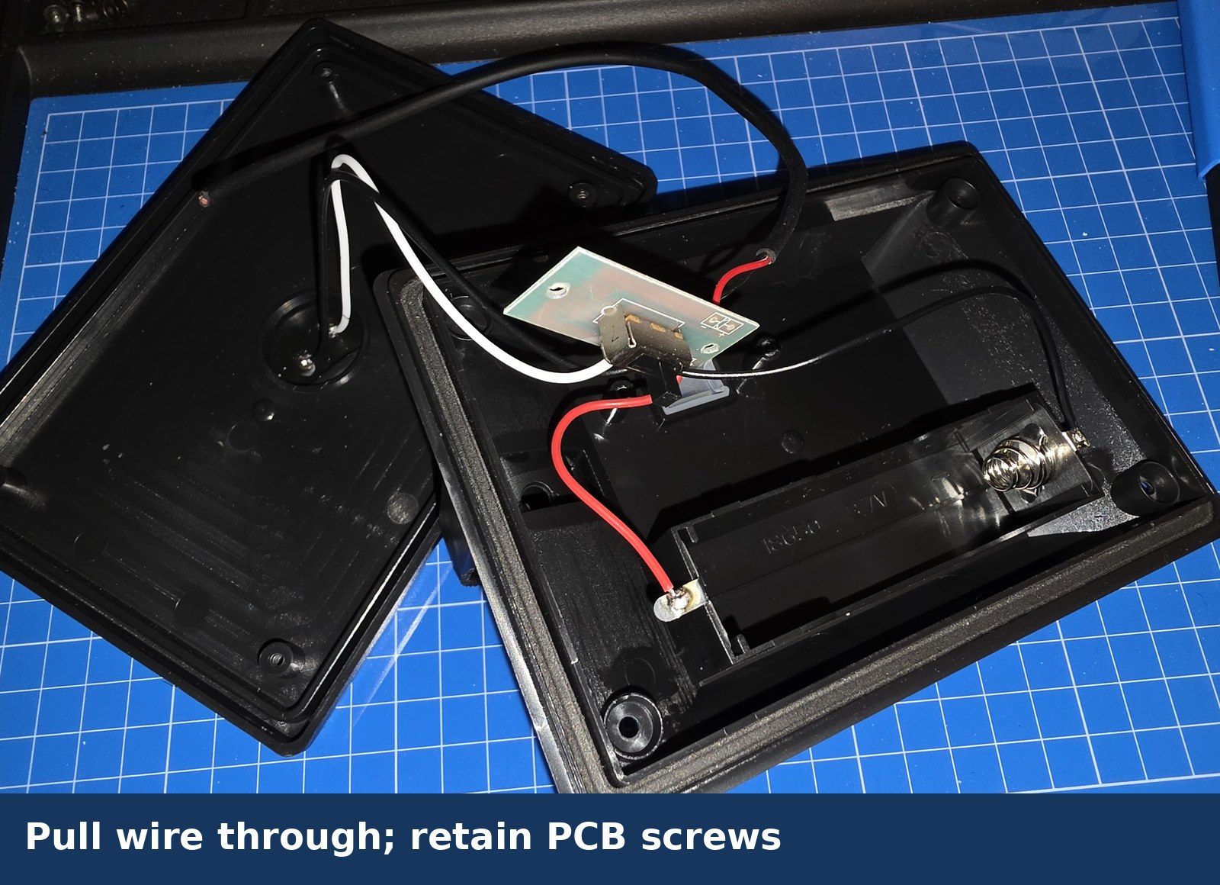
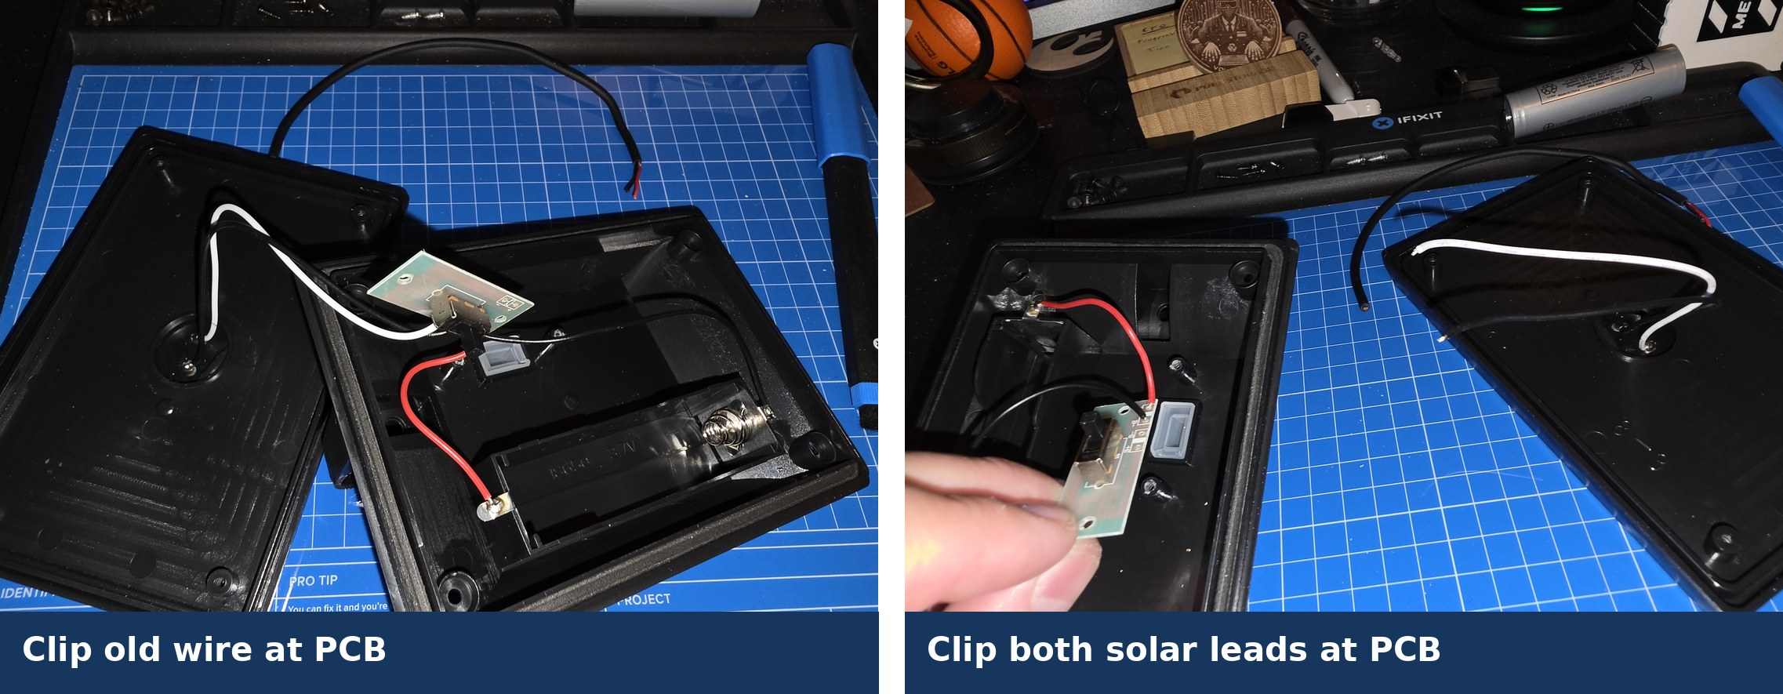
Open the enclosure and remove the battery
STEPS 4–5
Use fingers or a nonconductive tool
Retain the PCB only for its switch
THE MAKER'S SPACE | MESHCORE 102
Checkpoint 1
15
Notes:
Remove the 18650 immediately after opening. Pull the cut wire through, retain the two PCB screws, then clip the unused light wire, both panel leads at the PCB, and battery negative at the PCB.
Source: MeshCore102_PresenterGuide.md and class photographs supplied by the presenter.

Slide 16
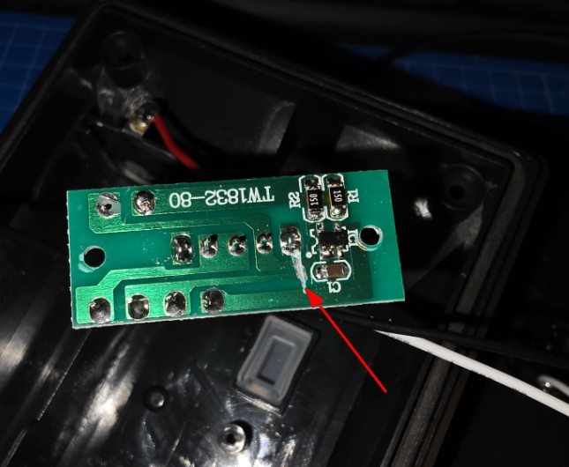
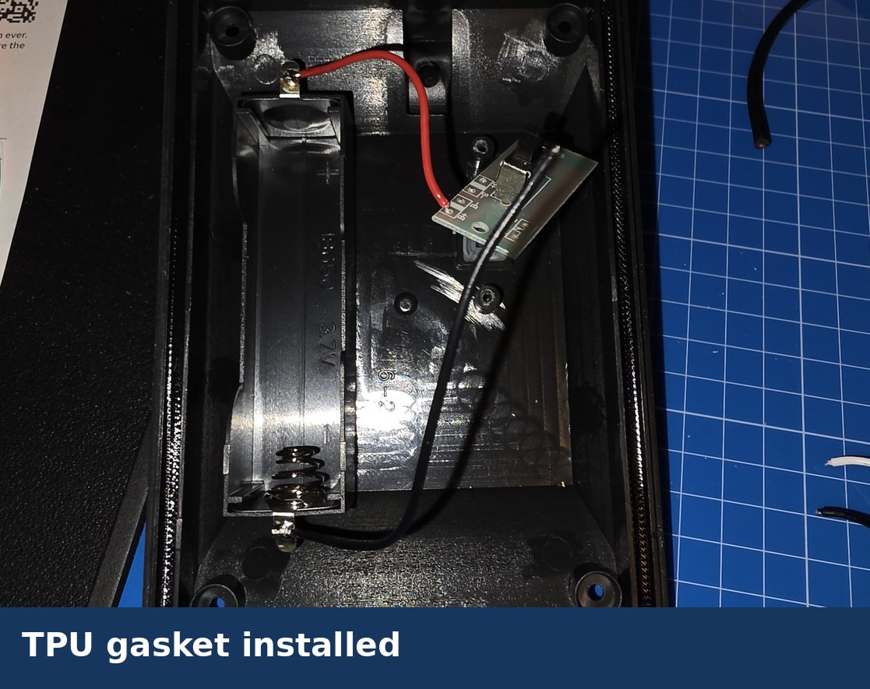
PCB modification and TPU gasket
STEPS 6–7
Instructor demonstration and inspection required
Remove foam, clean the channel, seat TPU evenly
THE MAKER'S SPACE | MESHCORE 102
7:20–7:30 PM
16
Notes:
The battery and panel must remain disconnected. Demonstrate the two marked PCB modifications and how you will inspect them. Do not let participants enter this step ahead of the group.
Source: MeshCore102_PresenterGuide.md and class photographs supplied by the presenter.

Slide 17
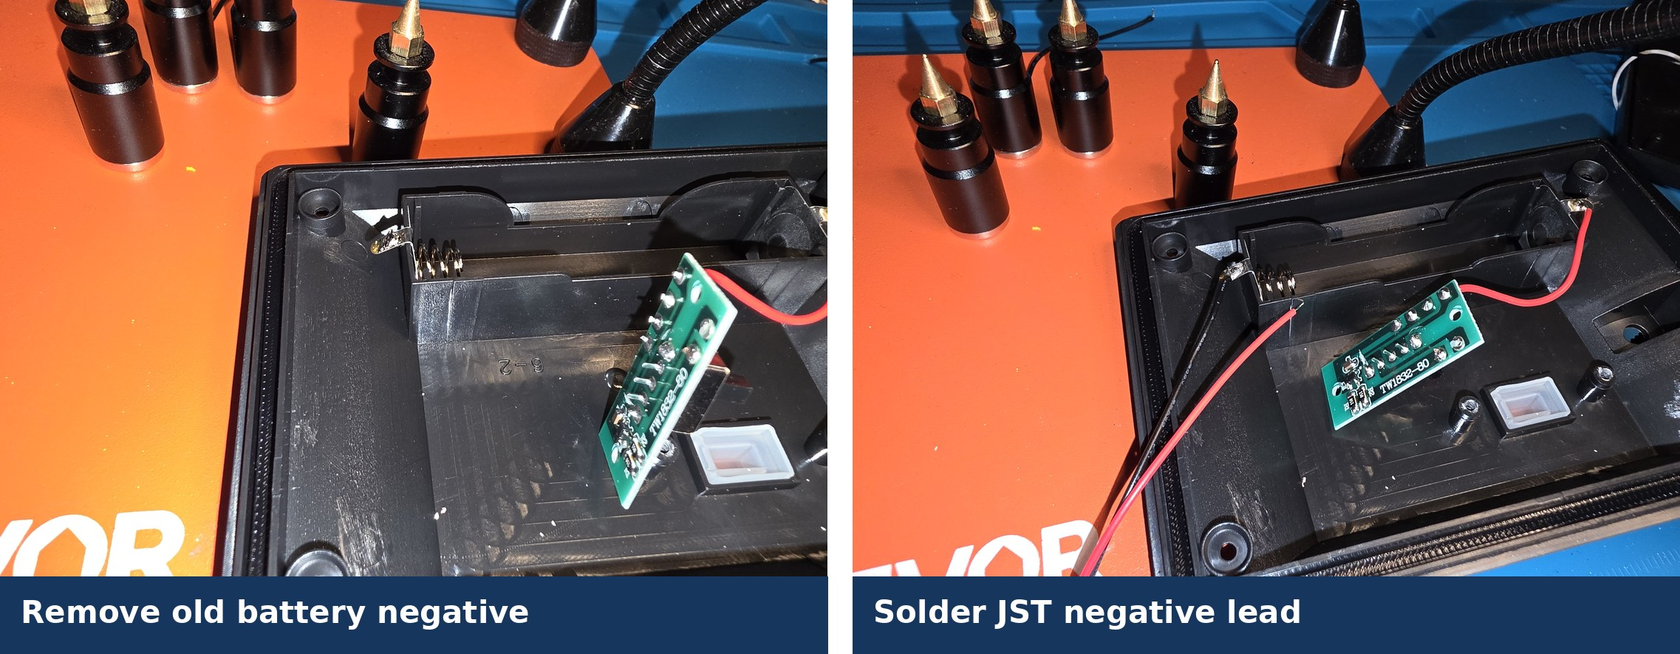
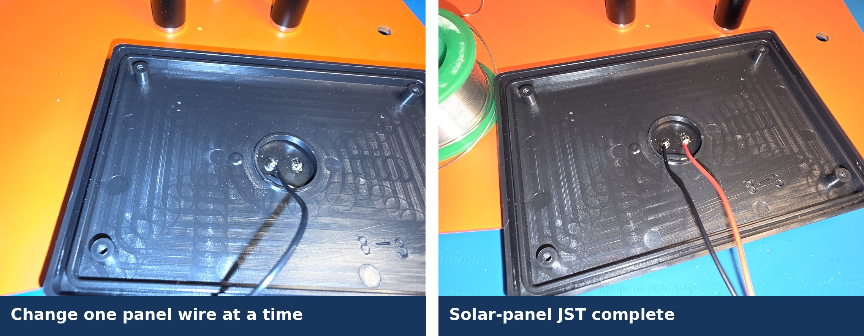
Battery holder and solar-panel JST leads
STEPS 8–9
Battery holder
Panel terminals are unlabeled: change one wire at a time
THE MAKER'S SPACE | MESHCORE 102
7:30–7:50 PM
17
Notes:
For the battery holder, replace negative first, then positive. For the solar panel, remove and replace one conductor before touching the next terminal so polarity is preserved.
Source: MeshCore102_PresenterGuide.md and class photographs supplied by the presenter.

Slide 18
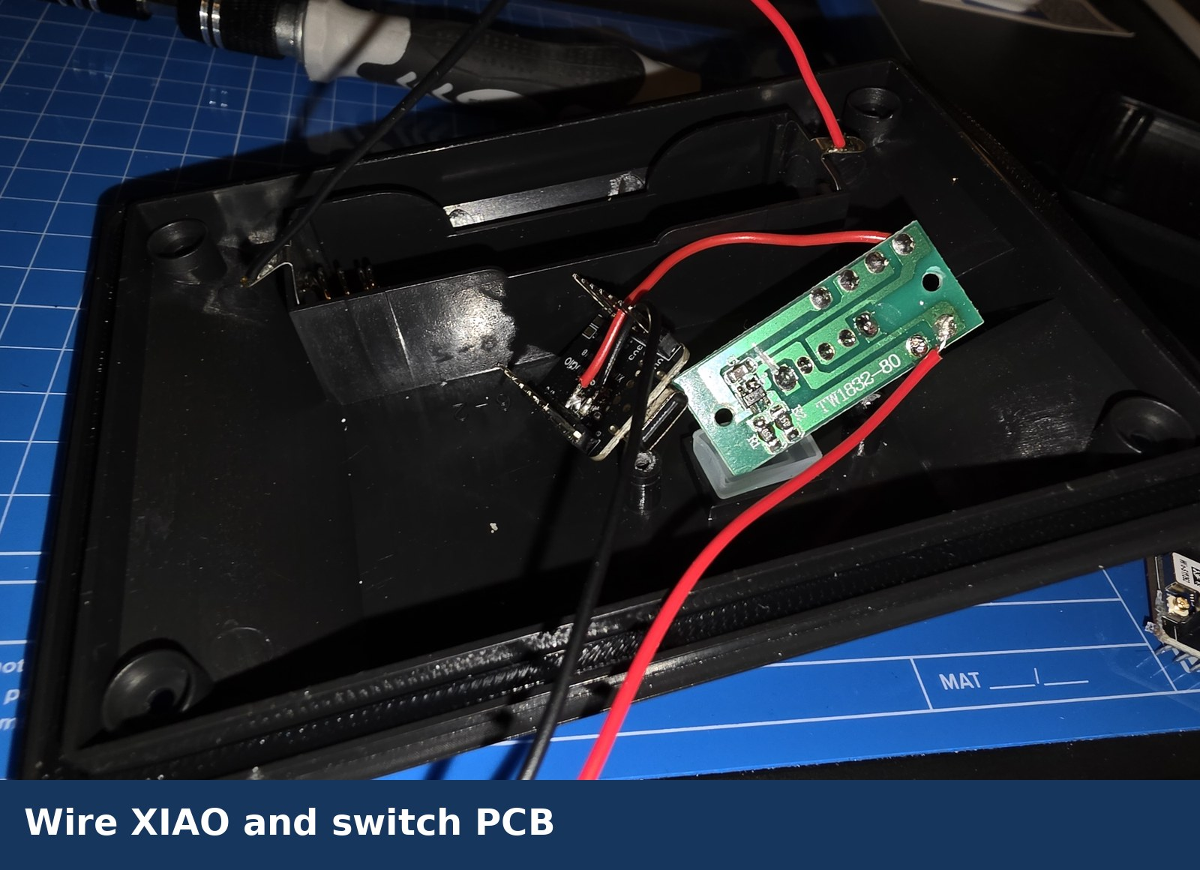
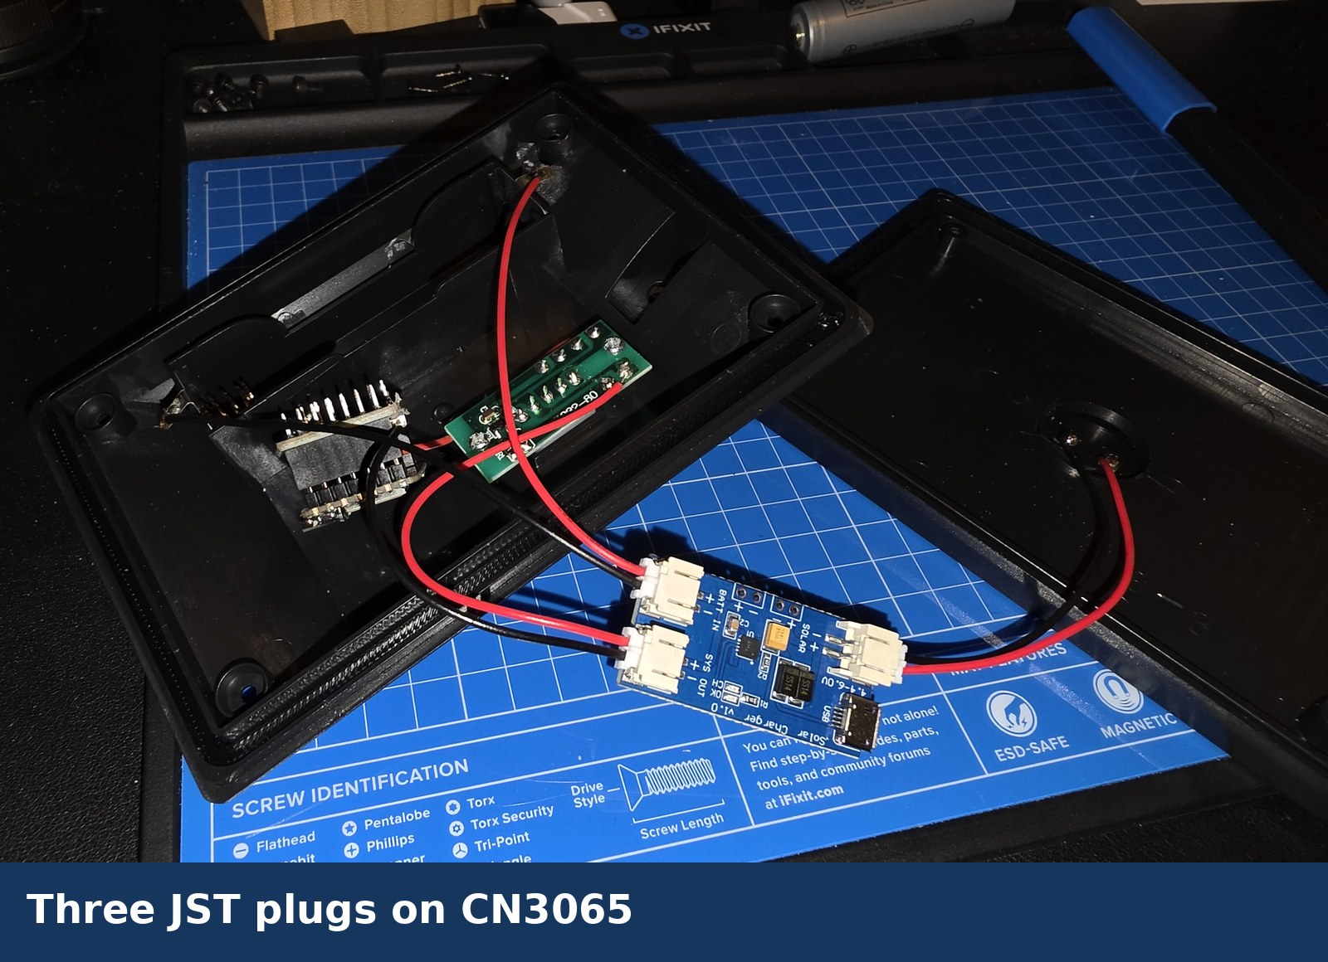
XIAO, switch PCB, and CN3065
STEPS 10–11
BAT+ from original holder positive
BAT− from JST negative
JST positive through the retained switch PCB
Visually verify labeled connections before connecting solar, battery, and SYS OUT
THE MAKER'S SPACE | MESHCORE 102
Checkpoint 3
18
Notes:
The class JST leads were corrected, but students must verify actual polarity. Inspect every solder joint, the switch path, XIAO battery connections, and all three CN3065 connections. Do not install the battery yet.
Source: MeshCore102_PresenterGuide.md and class photographs supplied by the presenter.

Slide 19
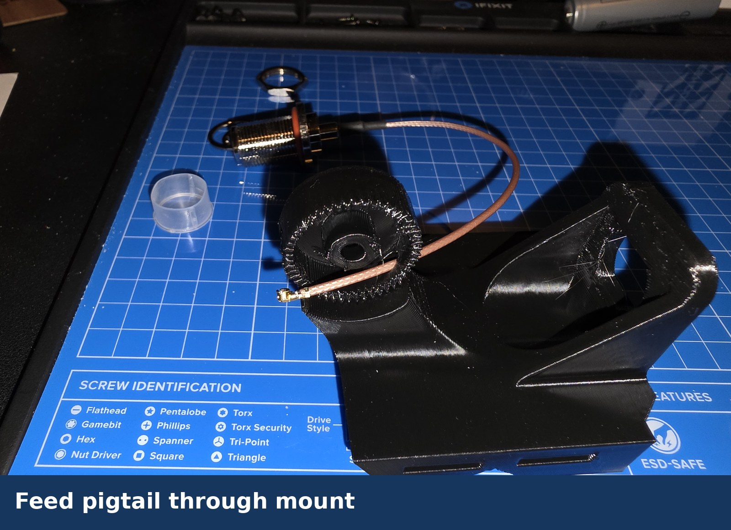
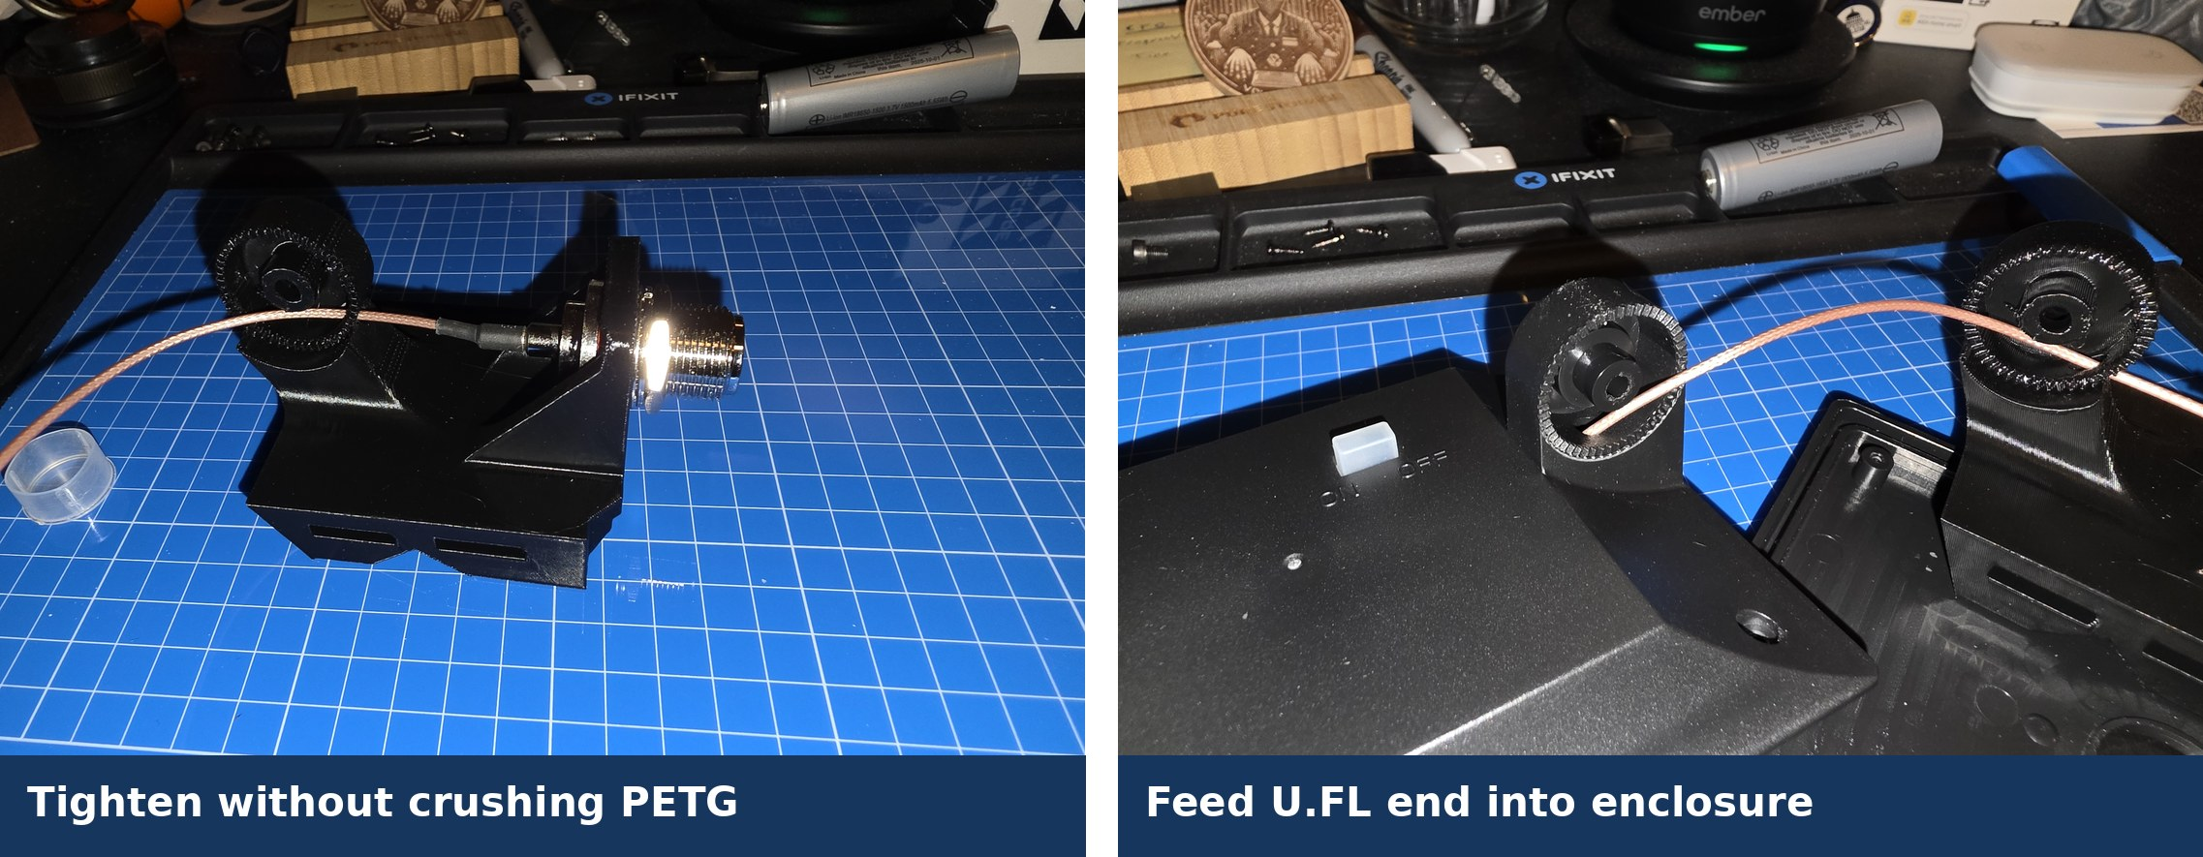
Pigtail and N connector
STEP 12
Feed from the bottom and align the connector's flat sides
Tooth lock washer | flat washer | nut
THE MAKER'S SPACE | MESHCORE 102
7:50–8:10 PM
19
Notes:
The fit is tight and may require controlled pressure. Tighten the connector without crushing the PETG mount. Keep the pigtail bend gentle.
Source: MeshCore102_PresenterGuide.md and class photographs supplied by the presenter.

Slide 20
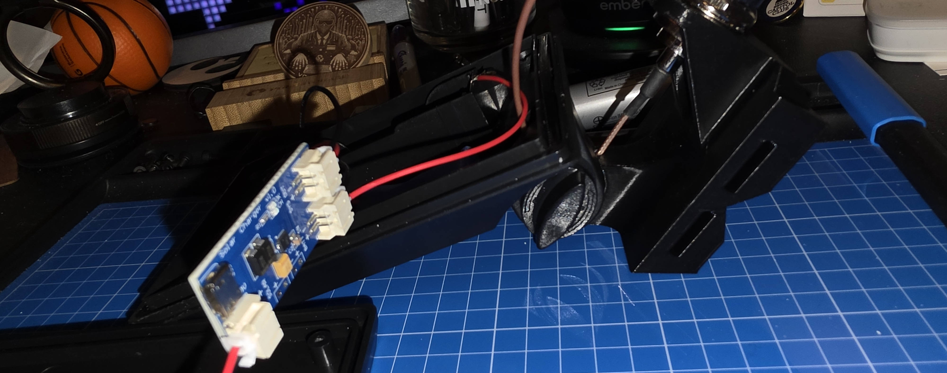
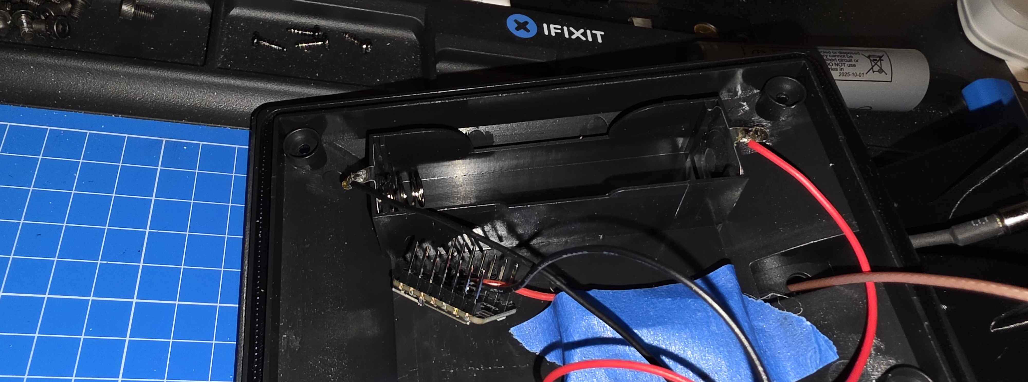
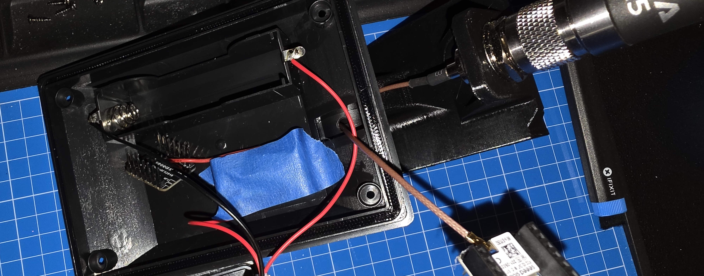
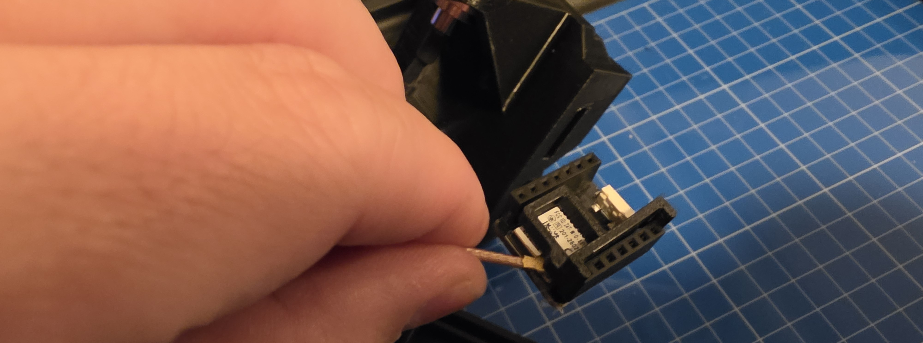
Mount, antenna, switch, and clamp
BUILD STEPS 13 TO 15
Mount attached, ALFA antenna hand-tight
Switch boot seated, PCB screwed down, then taped
Remove the small antenna, then press U.FL straight down
Clamp supports the boards and pigtail
THE MAKER'S SPACE | MESHCORE 102
Checkpoint 4
20
Notes:
Attach the mount with the retained screw and nut. Ensure the rubber switch boot is properly seated. Reinstall the switch PCB with its original screws, cover it with painter's tape, connect U.FL without twisting, and install the antenna clamp.
Source: MeshCore102_PresenterGuide.md and class photographs supplied by the presenter.

Slide 21
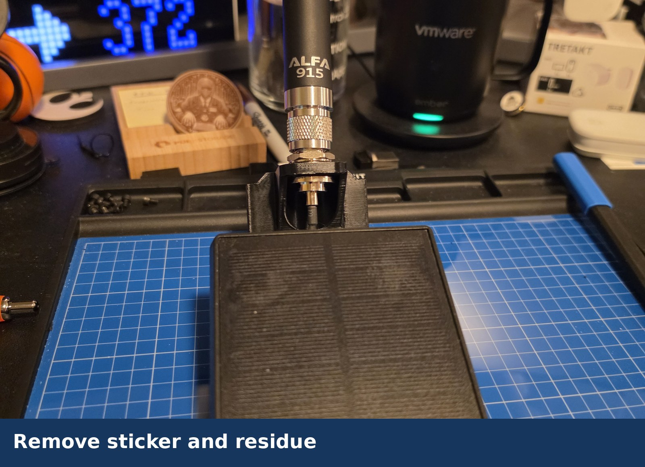
Clean, inspect, and test the open unit
STEPS 16–17
Before battery installation
Clean sticker residue with Goo Gone, then IPA
Inspect labeled wiring, solder joints, trace cuts, JST positions, switch insulation, boot, U.FL, clamp, antenna, and routing
Install the 18650 in the labeled orientation
Test startup, saved settings, LoRa relay, and solar charging
Disconnect the battery immediately for heat, odor, smoke, or abnormal behavior
THE MAKER'S SPACE | MESHCORE 102
8:10–8:20 PM
21
Notes:
The sticker and residue must be removed before testing. A presenter or helper should complete the open-unit inspection before the battery goes in.
Source: MeshCore102_PresenterGuide.md and class photographs supplied by the presenter.

Slide 22
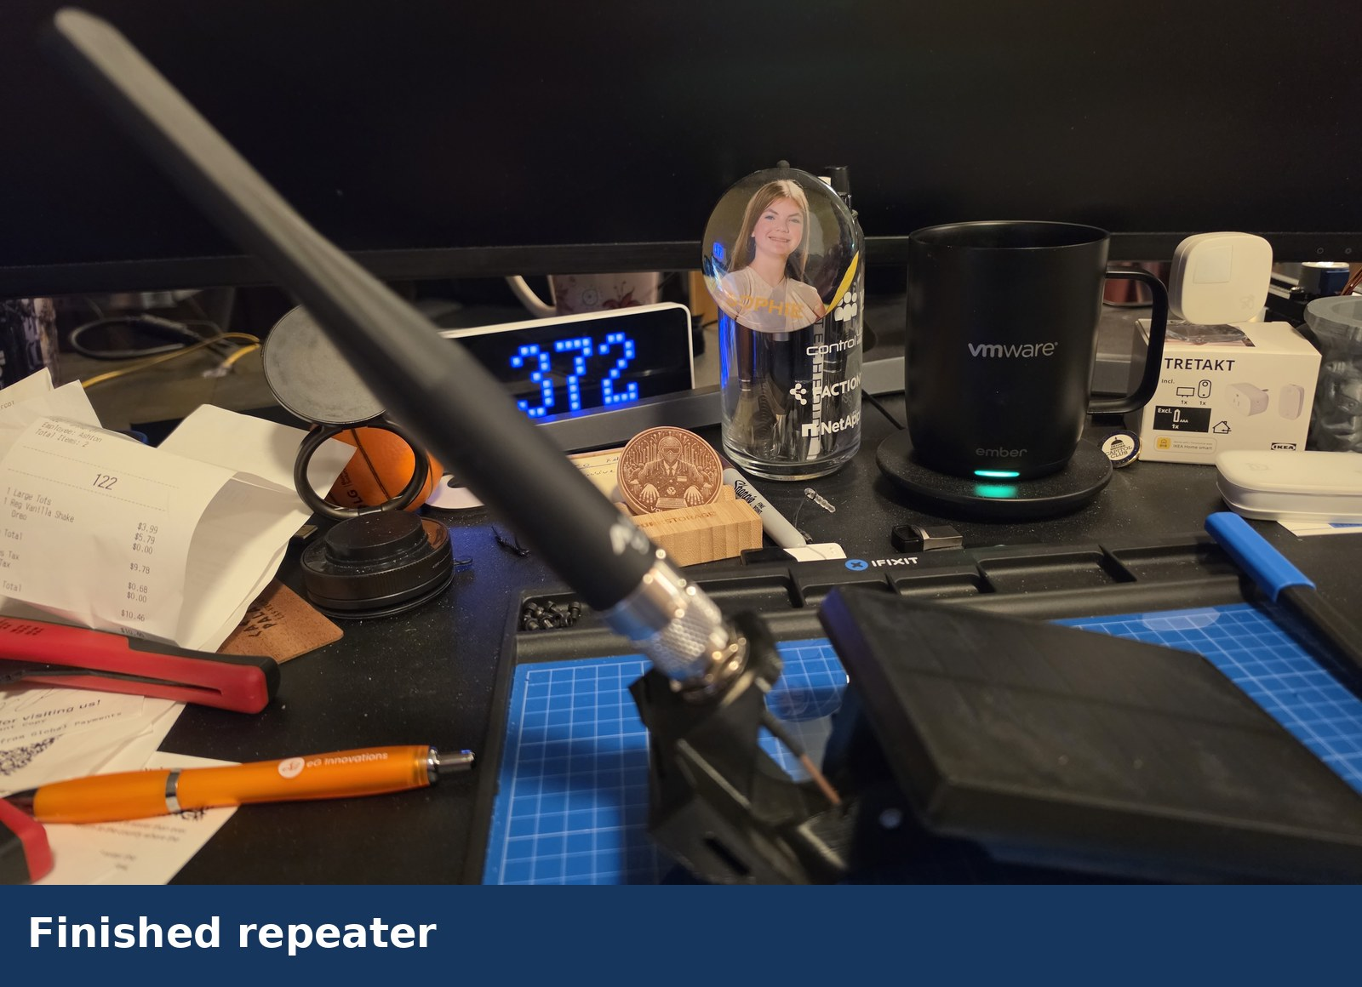
Close, weatherproof, and mount
STEP 18
Arrange parts clear of the screw posts and close without force
Reinstall original enclosure screws gradually
Seal the clean, dry antenna joint with overlapping self-fusing silicone tape
Attach the PETG mount to a pole with zip ties or hose clamps
Keep the antenna vertical and the enclosure oriented to shed water
Zip ties and hose clamps are pole fasteners, not internal cable management.
THE MAKER'S SPACE | MESHCORE 102
8:20 PM
22
Notes:
If a unit is not ready, bag and label its parts and record the next step. Do not bypass an inspection to finish on time. Keep silicone tape off the radiating body of the antenna.
Source: MeshCore102_PresenterGuide.md and class photographs supplied by the presenter.

Slide 23
Set the installed location and clock
POST-INSTALLATION
1 Open the repeater from Contacts and log in
2 Select Command Line at the bottom of the app
3 Enter the coordinates for the installed location
4 Run clock sync after every reboot
COMMAND LINE
set lat <value>
set lon <value>
clock sync
Example
set lat 41.106
set lon -85.06
The clock affects log timestamps only. Correct timestamps make later troubleshooting easier.
THE MAKER'S SPACE | MESHCORE 102
AFTER INSTALLATION
23
Notes:
Complete this procedure after the repeater is installed in its final location.
Log in from Contacts, open Command Line, and replace the latitude and longitude placeholders with the installed decimal coordinates.
Run clock sync after every reboot. The clock affects log timestamps only, but accurate timestamps help during troubleshooting.
Regional commands may be entered during the same command-line session if they have not already been applied.
Source: MeshCore102_PresenterGuide.md and screenshots supplied by the presenter.

Slide 24
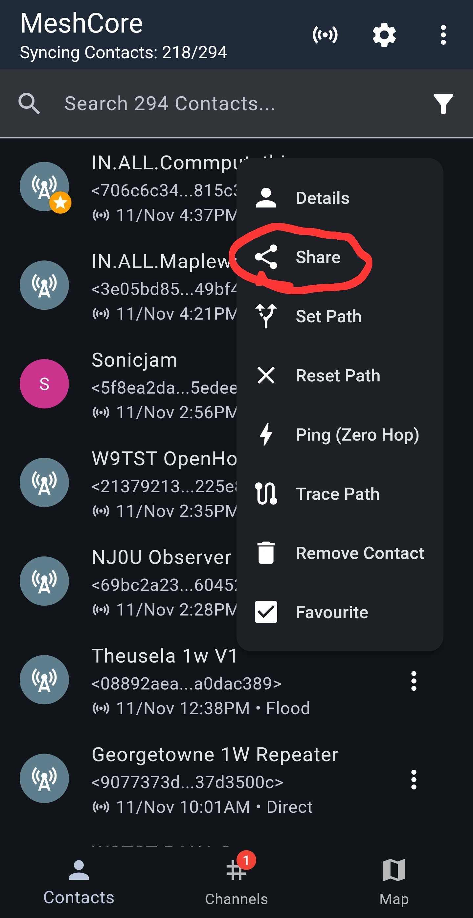
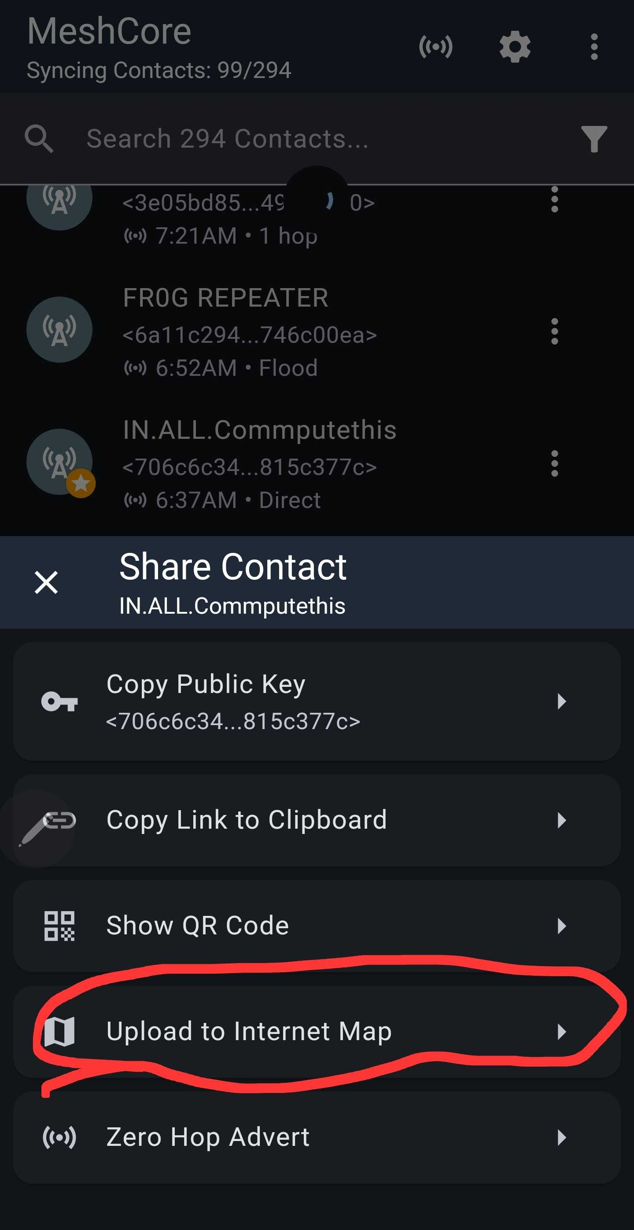
Advertise and publish the repeater
POST-INSTALLATION
1 Return to Contacts
2 Open the repeater's three-dot menu and select Share
3 Select Zero Hop Advert
4 Open Share again and select Upload to Internet Map
If the repeater moves, update the coordinates, advertise again, and upload it again.
Open the repeater menu
and select Share
The Share screen contains
both required actions
THE MAKER'S SPACE | MESHCORE 102
AFTER INSTALLATION
24
Notes:
After saving the installed coordinates and synchronizing the clock, return to Contacts.
Open the repeater's three-dot menu, select Share, and send a Zero Hop Advert.
Open Share again and choose Upload to Internet Map.
Repeat the coordinate, advert, and map steps if the repeater moves.
Source: MeshCore102_PresenterGuide.md and screenshots supplied by the presenter.

Slide 25
A repeater stays useful through maintenance
AFTER SEVERE WEATHER
Inspect the mount, fasteners, enclosure, gasket, tape, and antenna connection.
PERIODICALLY
Clean the solar panel and check for corrosion or moisture.
BEFORE WINTER
Review battery performance and available solar exposure.
AFTER MOVING IT
Retest charging and radio performance.
Document the repeater name and location. Keep it powered, dry, and serviceable.
THE MAKER'S SPACE | MESHCORE 102
8:30 PM
25
Notes:
Close with the importance of placement, permission, documentation, and periodic inspection. Ensure every unfinished unit leaves with labeled parts and a specific next step.
Source: MeshCore102_PresenterGuide.md and class photographs supplied by the presenter.

Slide 26
Thank you for coming!
DECEMBER
No class at The Maker's Space
JANUARY 11
Classes resume
POSSIBLE TOPIC
MQTT
TOPIC STATUS
Still being decided
We look forward to seeing you in January.
THE MAKER'S SPACE | MESHCORE 102
JANUARY 11
26

