Slide 1
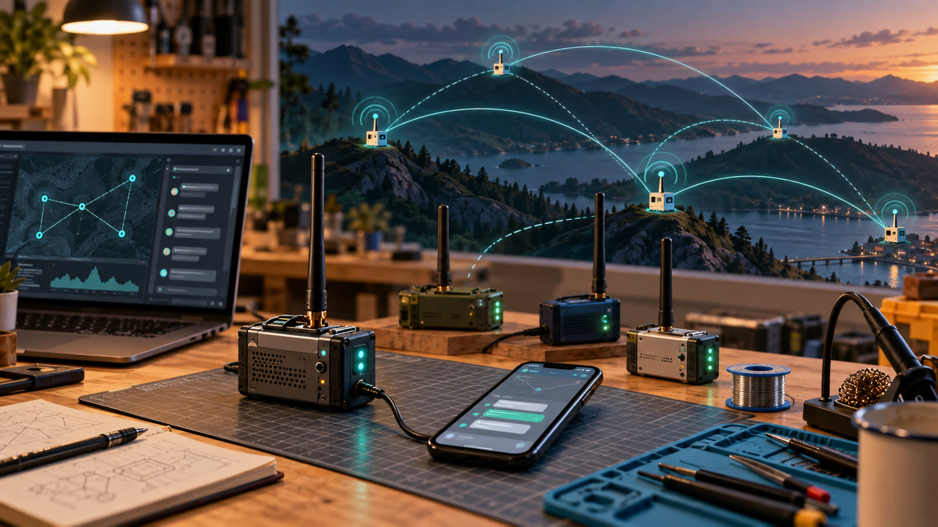
BEGINNER WORKSHOP
MeshCore 101
Build a companion. Join the local mesh. Send your first off-grid message.
Maker's Space • 2-hour hands-on class
Notes:
Welcome attendees. Ask for a quick show of hands: who has used LoRa, Meshtastic, or amateur radio? Emphasize that no prior radio or firmware experience is required. Today ends with an assembled companion, flashed firmware, and a first message.
Sources:
- https://meshcore.io/

Slide 2
MESHCORE 101
What we’ll accomplish
01
02
03
04
UNDERSTAND
ASSEMBLE
FLASH
CONNECT
What MeshCore is, how it routes, and hardware choices
Finish the no-solder companion build safely
Load Companion Bluetooth firmware
Pair the app and send a first message
Soldering is already complete—today is assembly, firmware, and first use.
MAKER'S SPACE
02
Notes:
Preview the flow. Suggested timing: 25 minutes concepts, 35 minutes assembly, 25 minutes flashing and app setup, 20 minutes messaging practice, and 15 minutes for troubleshooting and wrap-up.

Slide 3
MESHCORE 101
What is MeshCore?
An open-source messaging system that uses low-power LoRa radios to communicate without cellular service, Wi‑Fi, or the internet.
LONG RANGE
LoRa radio
LOW POWER
Battery friendly
OFF GRID
No infrastructure
Your phone handles the interface. The companion handles the radio.
ENCRYPTED
Private conversations
MAKER'S SPACE
03
Notes:
Keep this definition simple. MeshCore is software plus compatible LoRa hardware. The phone does not transmit LoRa itself; it talks to the companion over Bluetooth, and the companion transmits over LoRa.
Sources:
- https://meshcore.io/
- https://github.com/meshcore-dev/MeshCore

Slide 4
MESHCORE 101
Why does it exist?
When networks are overloaded
Large events • storms • local outages
Where networks do not reach
Trails • camps • remote property
When a local network is the goal
Neighborhoods • clubs • community projects
It is another communication option—not a replacement for emergency services.
MAKER'S SPACE
04
Notes:
Use relatable examples. Avoid promising guaranteed range or reliability. Terrain, antennas, node placement, congestion, and local participation all matter. MeshCore should complement—not replace—official emergency communications.
Sources:
- https://meshcore.io/

Slide 5
MESHCORE 101
Set the right expectations
GOOD FIT
NOT THE GOAL
Short text messages
Local groups and contacts
Low-power field communications
Community-built coverage
Voice or video
High-speed data
Guaranteed delivery
Automatic emergency response
MAKER'S SPACE
05
Notes:
Explain that MeshCore is optimized for compact text traffic. Successful operation depends on RF conditions and the local network. This framing prevents the common beginner assumption that it behaves like a cellular messenger.
Sources:
- https://meshcore.io/
- https://docs.meshcore.io/faq/

Slide 6
MESHCORE 101
How a message moves
PHONE
COMPANION
MESH
COMPANION
PHONE
App
Bluetooth ↔ LoRa
Repeaters relay
LoRa ↔ Bluetooth
App
Direct when close • relayed when repeaters help • stored only where the system supports it
Bluetooth
LoRa radio
Bluetooth
MAKER'S SPACE
06
Notes:
Walk left to right. Bluetooth is only between the phone and its local companion. LoRa carries the message between radio nodes. Repeaters extend useful paths; they do not create internet access.
Sources:
- https://docs.meshcore.io/faq/

Slide 7
MESHCORE 101
Flood routes and learned routes
CHANNEL MESSAGE
The Maker’s Space private channel uses flood routing
YOUR COMPANION
REPEATER A
REPEATER B
CHANNEL MEMBERS
A flood may travel through several repeater paths. Companions receive messages but do not repeat them.
DIRECT MESSAGE
The mesh can learn a more efficient path
SENDER
CHOSEN REPEATER
CHOSEN REPEATER
RECIPIENT
The first direct message can flood to discover a route. Later messages carry that path, so only matching repeaters retransmit.
If a learned path breaks, retries can flood again and discover another path.
MAKER'S SPACE
07
Notes:
Use the top row to connect the explanation to today's private-channel exercise: channel text messages use flood routing. Repeaters forward eligible traffic; companion clients do not act as repeaters. Use the bottom row for direct messages. The first message can use flood routing. The delivery report returns the repeater path, and later messages can embed that learned route so only repeaters on the path forward it. If the stored route stops working, the app can retry and fall back to flood routing to learn another path.
Sources:
- https://docs.meshcore.io/faq/
- https://github.com/meshcore-dev/MeshCore/blob/main/src/helpers/BaseChatMesh.cpp
- https://github.com/meshcore-dev/MeshCore/blob/main/docs/packet_format.md

Slide 8
MESHCORE 101
Four useful MeshCore roles
1
COMPANION
2
REPEATER
Pairs with a phone
Forwards mesh traffic
This is what we build today
Often placed high with a good antenna
3
ROOM SERVER
4
OBSERVER
Hosts persistent rooms
Reports what it hears
A shared service for a community
Usually a repeater feeding a network analyzer
MAKER'S SPACE
08
Notes:
The same hardware family may support different firmware roles, but today we are flashing Companion Bluetooth. A companion stays with a person and phone; a repeater is infrastructure; a room server adds shared-room behavior. Observer is generally an added repeater function rather than a separate firmware role: it reports packets it hears to a mapping or analysis service.
Sources:
- https://docs.meshcore.io/faq/
- https://analyzer.letsmesh.net/observer/onboard

Slide 9
HARDWARE OPTIONS
Choosing hardware: DIY or ready-built?
DIY / KIT
READY-BUILT
Choose the board, radio, antenna, power, and enclosure.
Easy to customize, repair, and learn from.
Expect assembly, firmware flashing, and testing.
Integrated case, battery, controls, and antenna.
Faster to deploy and easier to hand to a new user.
Usually costs more and offers less flexibility.
Choose the role and environment first—then choose the hardware.
MAKER'S SPACE
09
Notes:
There is no single best MeshCore device. Begin with the job: a pocket companion, a fixed indoor node, or outdoor infrastructure. DIY hardware is ideal for learning and tailoring the build. Ready-built hardware trades flexibility for convenience. In either case, verify the exact device in the current MeshCore flasher and buy the correct regional radio band.
Sources:
- https://meshcore.io/
- https://flasher.meshcore.io/

Slide 10
HARDWARE OPTIONS
Companion hardware options
DIY / MODULAR
READY-BUILT
XIAO nRF52840 + Wio-SX1262
Wio Tracker L1 Pro
Compact and low power—our class build
Integrated screen, controls, GPS, and battery
RAK4631 WisBlock
SenseCAP T1000-E
Modular baseboards, power, sensors, and enclosures
Slim sealed tracker that supports Companion Bluetooth
Heltec LoRa boards
WisMesh Pocket / Tag
Integrated display options; add power and a case
Portable packaged nodes from RAKwireless
For phone use, select a supported device and flash Companion Bluetooth.
MAKER'S SPACE
10
Notes:
These are representative choices, not a complete shopping list. The official MeshCore hardware page currently highlights the Wio Tracker L1 Pro, Heltec v3, WisMesh Pocket, and WisMesh Tag as companion nodes. Seeed documents Companion Bluetooth firmware for the T1000-E. The class XIAO nRF52840 plus Wio-SX1262 and the RAK4631 also appear in the official flasher. Device availability and firmware support change, so check the live flasher before buying.
Sources:
- https://meshcore.io/
- https://flasher.meshcore.io/
- https://wiki.seeedstudio.com/sensecap_t1000_e_meshcore/
- https://downloads.rakwireless.com/Meshtastic/Quick%20Start%20Guide_WisMesh%20RAK4631%20Starter%20Kit.pdf

Slide 11
HARDWARE OPTIONS
Repeater hardware options
DIY / MODULAR
READY-BUILT / PACKAGED
RAK4631 WisBlock
Heltec v3 / v4
XIAO nRF52 + Wio-SX1262
SenseCAP Solar Node P1 Pro
RAK WisMesh Repeater hardware
Vendor-built outdoor nodes
Add an antenna, dependable power, and a weather-appropriate enclosure.
Confirm the exact board, US frequency band, and MeshCore firmware target before purchase.
Commercial hardware may ship with different firmware—plan to flash MeshCore Repeater.
MAKER'S SPACE
11
Notes:
Explain that repeater is a firmware role, not merely a product label. The official flasher supports many boards, including RAK4631, Heltec families, and the XIAO nRF52 Wio combination. MeshCore's hardware page currently lists the SenseCAP Solar Node P1 Pro as a repeater node. RAK WisMesh repeater products are commercially packaged outdoor LoRa hardware, but manufacturer documentation may ship them with Meshtastic; verify the supported RAK target and reflash before deployment.
Sources:
- https://meshcore.io/
- https://flasher.meshcore.io/
- https://store.rakwireless.com/products/wismesh-repeater-mini-v2
- https://docs.rakwireless.com/product-categories/meshtastic/wismesh-repeater/quickstart/

Slide 12
REPEATER TIPS
Repeater placement: height beats hype
1
Fill a real gap
2
Seek height and a clear horizon
Use local maps and field tests; avoid duplicating coverage.
Roofs, towers, and hilltops usually outperform more transmit power.
3
Keep the antenna clear
4
Design power for bad weather
Mount it vertical, away from metal, walls, and noisy electronics.
Allow battery reserve and several low-sun days for solar sites.
5
Weatherproof the whole RF path
6
Test before permanent mounting
Seal entries, add strain relief, and use a drip loop outdoors.
Confirm settings, remote management, and useful links at ground level.
Get site permission, plan safe access, and never power a radio without its antenna.
MAKER'S SPACE
12
Notes:
A repeater is infrastructure, so placement matters more than owning the most powerful radio. MeshCore's official site specifically recommends high locations. Use MeshMapper and local community maps to find weak areas, but verify with real tests. For outdoor mounting, follow the enclosure and antenna manufacturer's weatherproofing, grounding, and mounting guidance. Do not climb or mount equipment without permission and appropriate safety practices.
Sources:
- https://meshcore.io/
- https://meshmapper.net/
- https://map.okimesh.org/
- https://docs.rakwireless.com/product-categories/meshtastic/wismesh-repeater/quickstart/

Slide 13
MESHCORE 101
Mesh communities serving Indiana
INDIANA MESH
NEI MESH
OKI MESH
Central Indiana
Northeast Indiana
Ohio, Kentucky, Indiana
Local coverage and newcomer support
Uses the standard USA settings
Connected with the larger OKI community
Fort Wayne and surrounding region
neimesh.net
Indiana Mesh Discord: #northeast
Regional documentation and maps
Shared channels and coordination
Discord help from nearby operators
Choose the community closest to you, then use the larger regional resources when you need them.
MAKER'S SPACE
13
Notes:
Introduce all three communities so students know where to ask for help after class. Indiana Mesh serves Central Indiana. NEI Mesh covers Northeast Indiana and uses the #northeast channel within the Indiana Mesh Discord. OKI Mesh coordinates across Ohio, Kentucky, and Indiana.
Sources:
- https://www.cimesh.net/
- https://neimesh.net/
- https://discord.gg/tm7wh7RjD7
- https://okimesh.org/

Slide 14
MESHCORE 101
Bookmark these resources
MeshCore
Web Flasher
meshcore.io
flasher.meshcore.io
Project overview, downloads, docs
Install firmware from a supported browser
Indiana Mesh Discord
NEI Mesh
discord.gg/tm7wh7RjD7
neimesh.net
Local help and coordination
Northeast Indiana; use #northeast in Indiana Mesh Discord
OKI Mesh + Discord
MeshMapper
okimesh.org | discord.okimesh.org
meshmapper.net
Regional guide, channels, support
Community-sourced coverage observations
OKI live map
map.okimesh.org
Nearby nodes and regional activity
MAKER'S SPACE
14
Notes:
Pause long enough for attendees to photograph this slide. Point Northeast Indiana attendees to neimesh.net and the #northeast channel within the Indiana Mesh Discord. Mention that community settings matter: OKI's getting-started guide currently calls for the USA/Canada recommended preset and 2-byte path hashes.
Sources:
- https://meshcore.io/
- https://flasher.meshcore.io/
- https://www.cimesh.net/
- https://discord.gg/tm7wh7RjD7
- https://neimesh.net/
- https://okimesh.org/getting-started/
- https://discord.okimesh.org/
- https://meshmapper.net/
- https://map.okimesh.org/

Slide 15
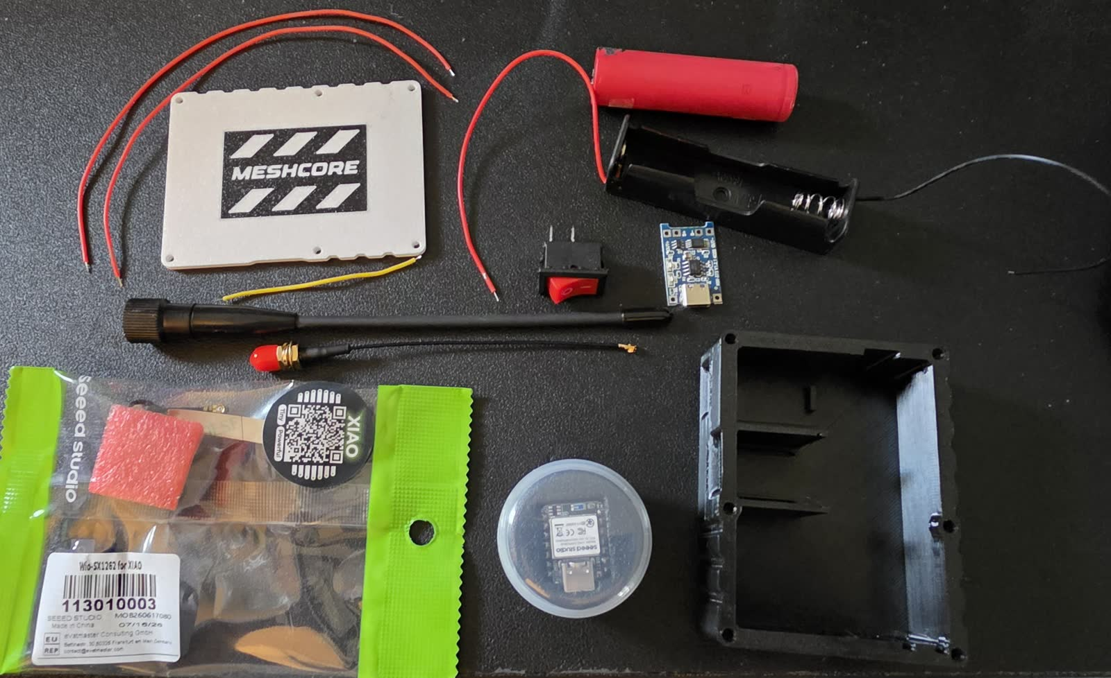
MESHCORE 101
Today’s companion build
PRE-SOLDERED
You will finish:
Radio connection
Board stacking
Case installation
Antenna attachment
Battery installation
Six-screw closure
MAKER'S SPACE
15
Notes:
Set expectations before distributing hardware. All soldering has been completed. Students should not modify wiring or remove installed parts. Point out the case, cover, antenna, pigtail, battery holder, Wio-SX1262, and XIAO nRF52840 in the photo. Photo supplied by instructor.

Slide 16
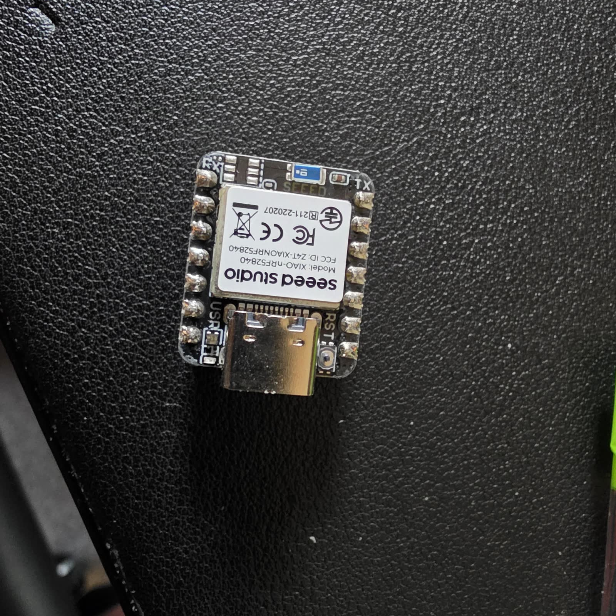
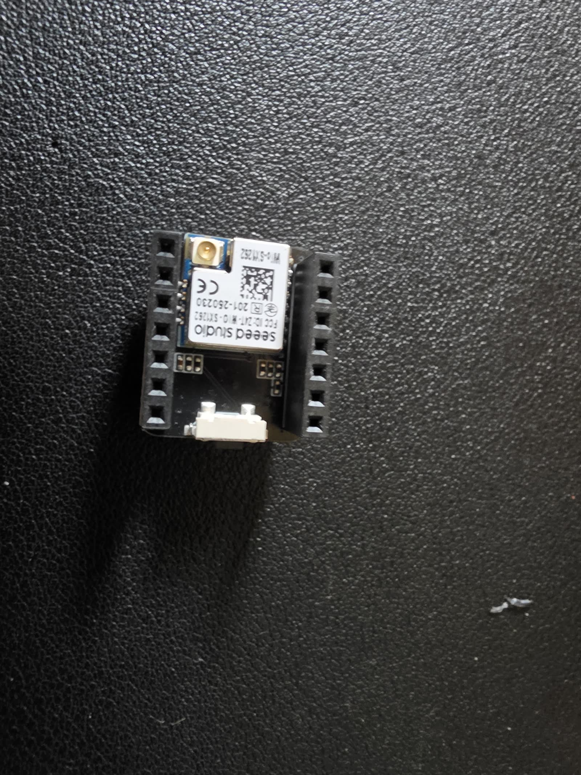
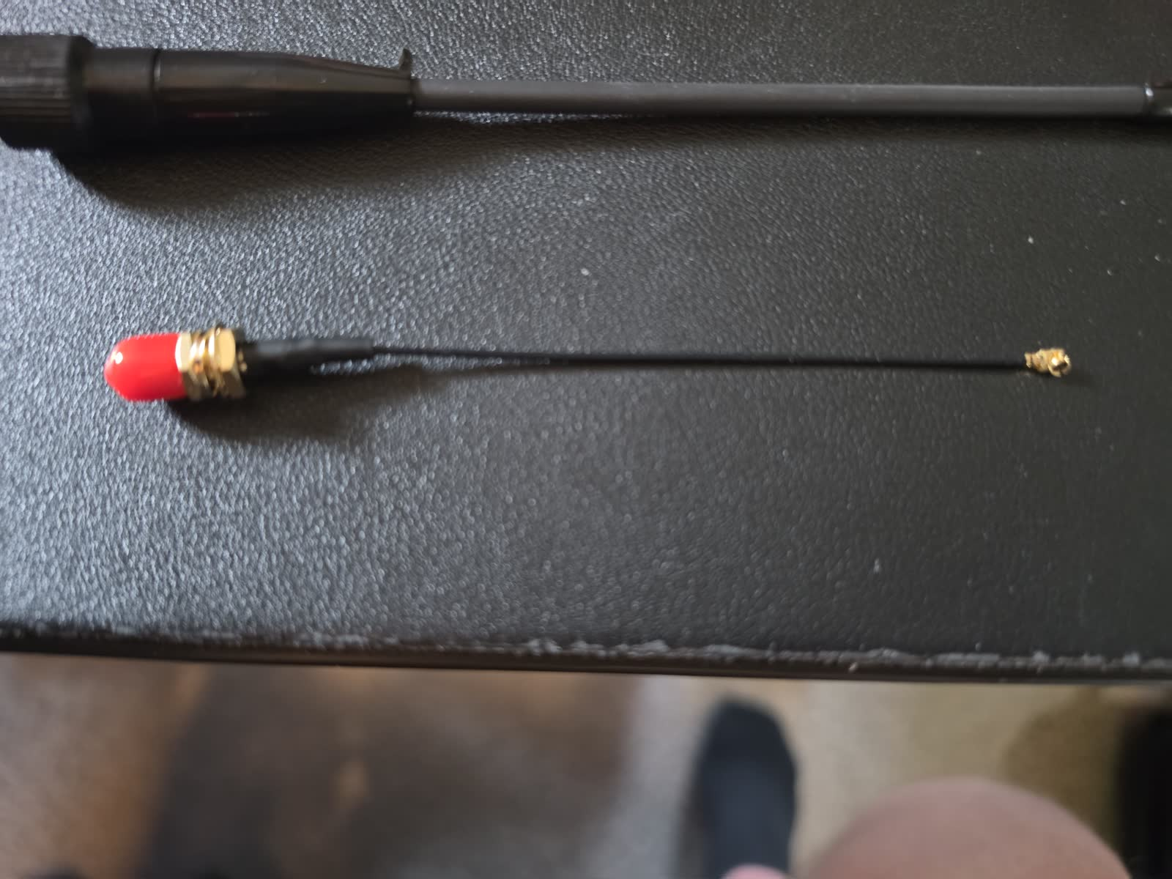
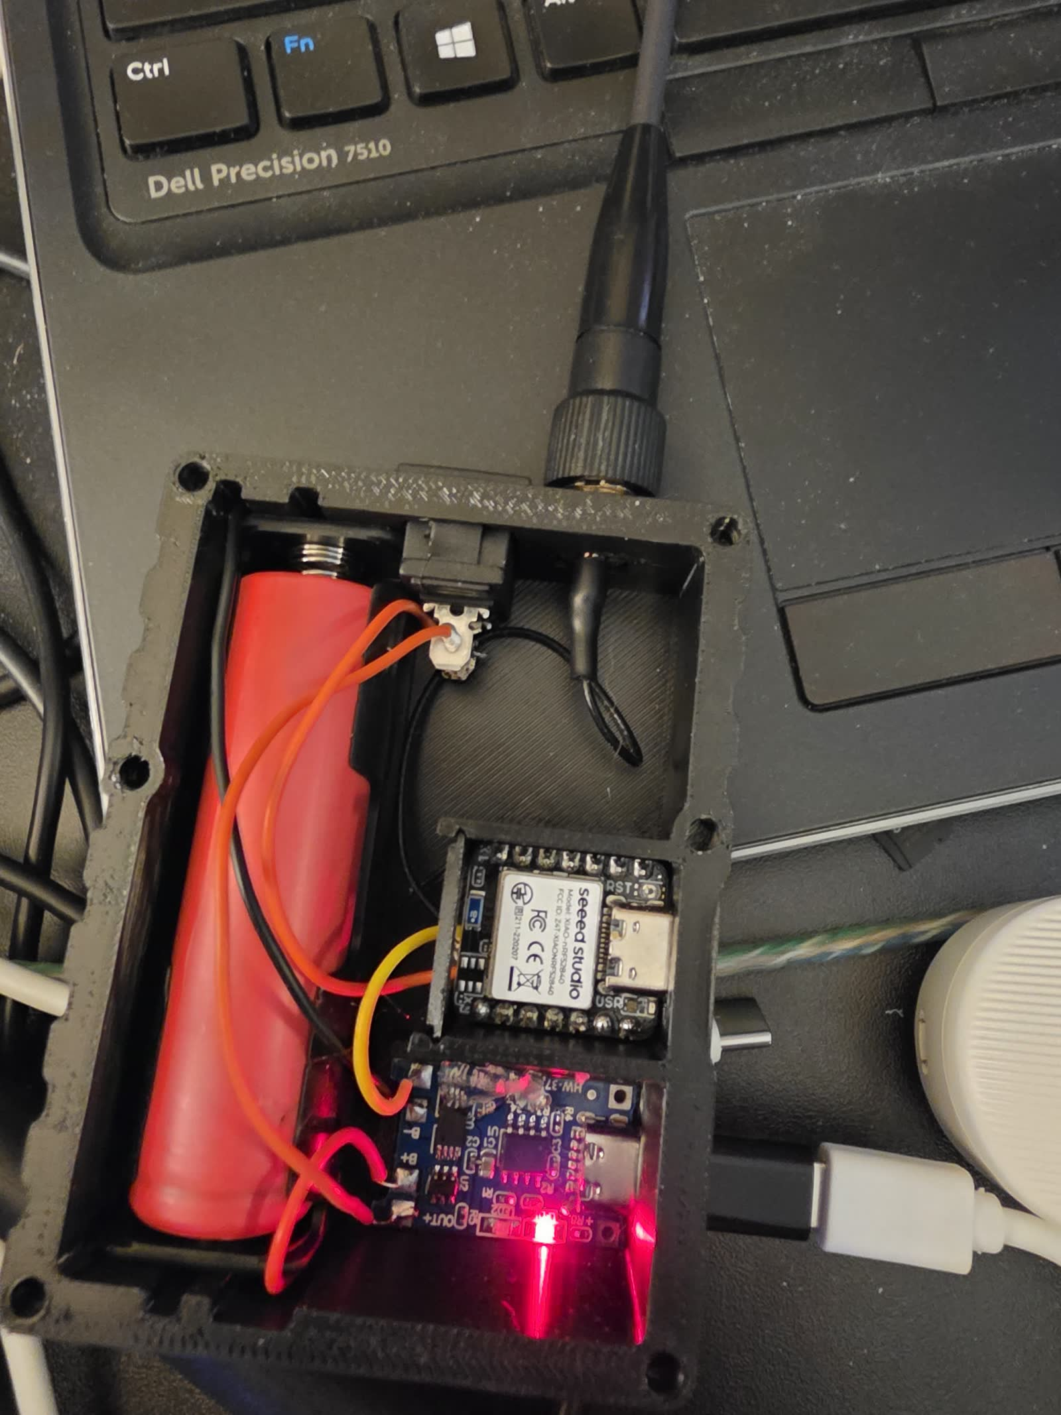
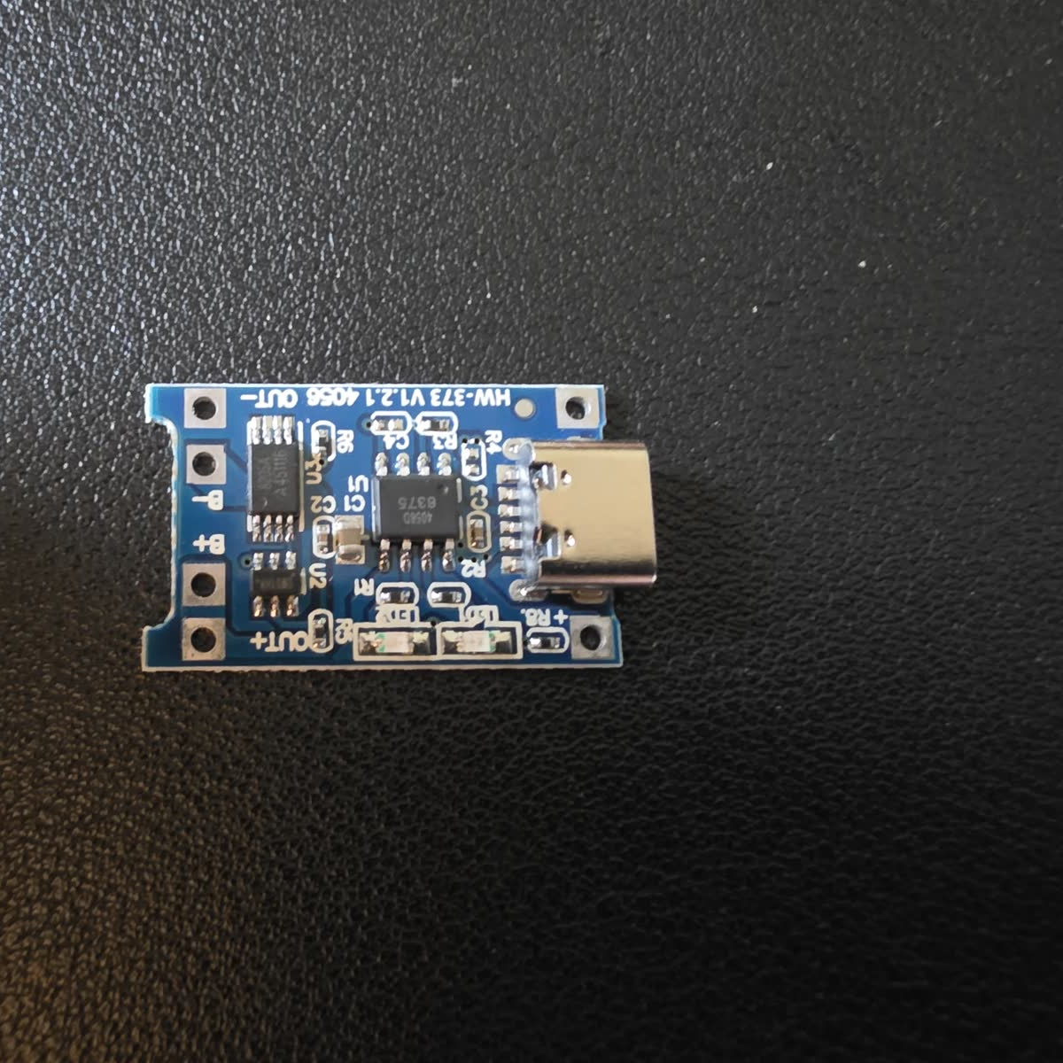
MESHCORE 101
Five key parts in the companion
XIAO nRF52840
Wio-SX1262
Pigtail + antenna
Battery + holder
Protected TP4056
Runs the companion firmware + Bluetooth
LoRa radio board
Carries radio energy safely
Portable power—polarity matters
Charges the 18650 cell and provides protection
MAKER'S SPACE
16
Notes:
Use the physical parts as you name them. The XIAO is the computer and Bluetooth interface. The Wio-SX1262 is the LoRa radio. The pigtail connects the small radio socket to the external antenna connector. The 18650 cell powers the unit. The protected TP4056 module provides the charging connection and battery protection. Photos supplied by instructor.

Slide 17
MESHCORE 101
Assembly order: follow it exactly
1
2
3
4
5
6
Pigtail
Stack boards
Place in case
Attach antenna
Insert battery
Close cover
Critical sequence: the antenna must be connected before the unit is powered on.
MAKER'S SPACE
17
Notes:
Have everyone stop after each step so you can inspect the room. The red-highlighted antenna step is the safety gate: no battery power and no power switch until the antenna path is complete.

Slide 18
MESHCORE 101
Step 1 — Connect the antenna pigtail
1. Align the tiny connector directly over the Wio socket.
2. Press straight down until it seats.
3. Do not lever it sideways or pull on the cable.
MAKER'S SPACE
18
Notes:
Demonstrate with one unit under a camera if possible. These miniature RF connectors are delicate. Alignment matters more than force. Ask students to raise a hand if the connector will not seat; do not let them pry at it. Photos supplied by instructor.

Slide 19
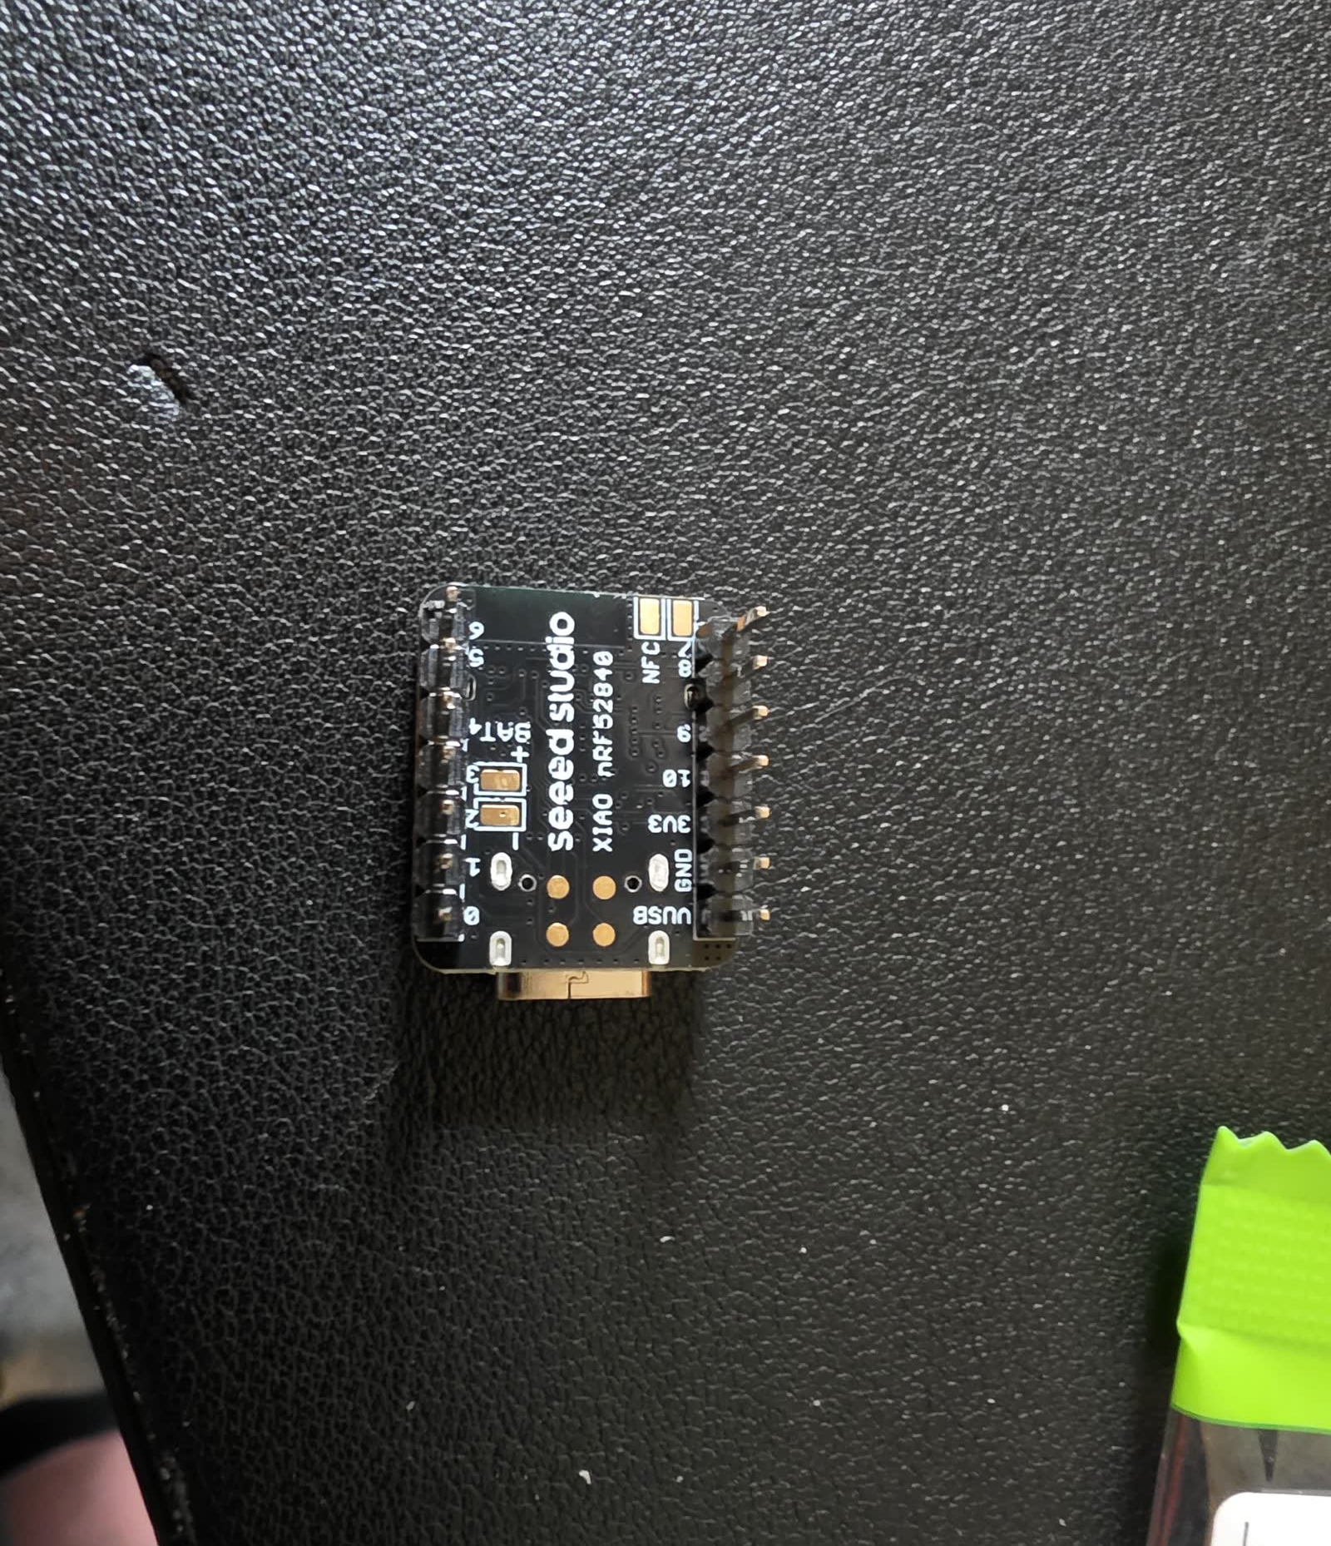
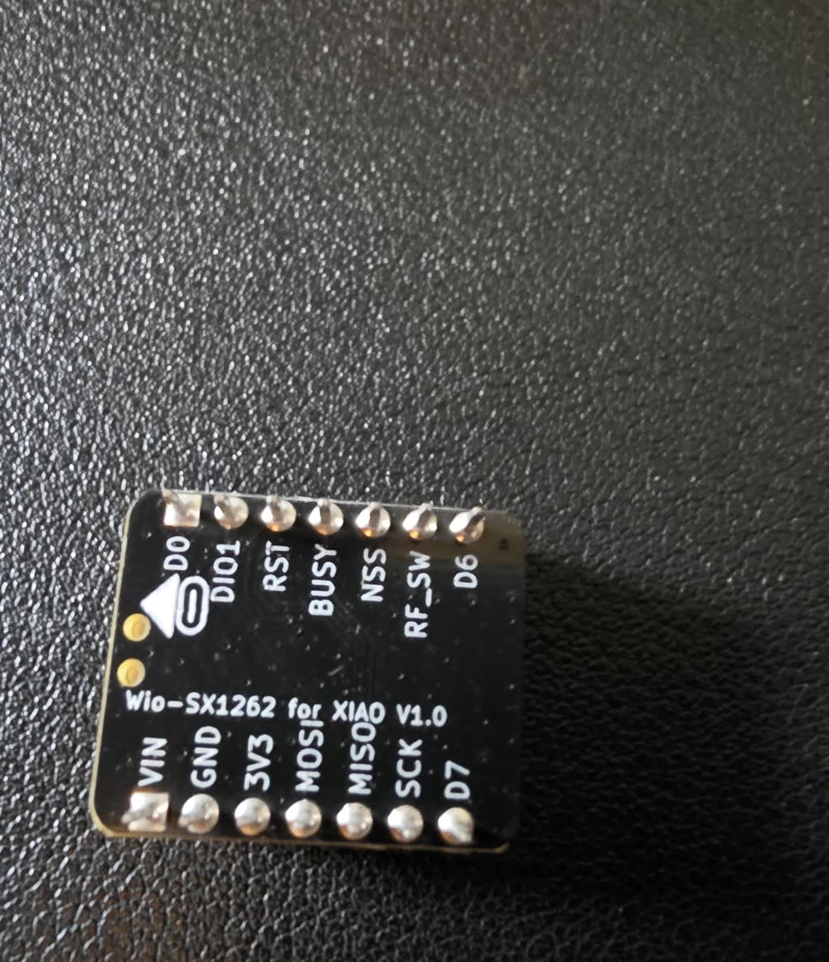
MESHCORE 101
Steps 2–3 — Stack the boards, then place them
ALIGN
PRESS EVENLY
ROUTE GENTLY
MAKER'S SPACE
19
Notes:
Match the headers carefully before pressing. Do not offset the boards by one pin. Press evenly and support the boards so the headers are not bent. Place the stack into its intended case position and keep the pigtail free of sharp bends or pinches. Photos supplied by instructor.

Slide 20
STOP — RADIO SAFETY
Never power the radio without an antenna attached.
Before the switch moves to ON:
✓ Pigtail seated
✓ External antenna tightened
✓ Cable not pinched
SAFETY CHECKPOINT
20
Notes:
Make this a verbal stop point. The transmitter expects an antenna load. Operating without the antenna can reflect energy back into the radio and may damage the RF output stage. Have pairs verify each other before power is applied. Photo supplied by instructor.
Sources:
- https://wiki.seeedstudio.com/wio_sx1262_with_xiao_esp32s3_kit/

Slide 21
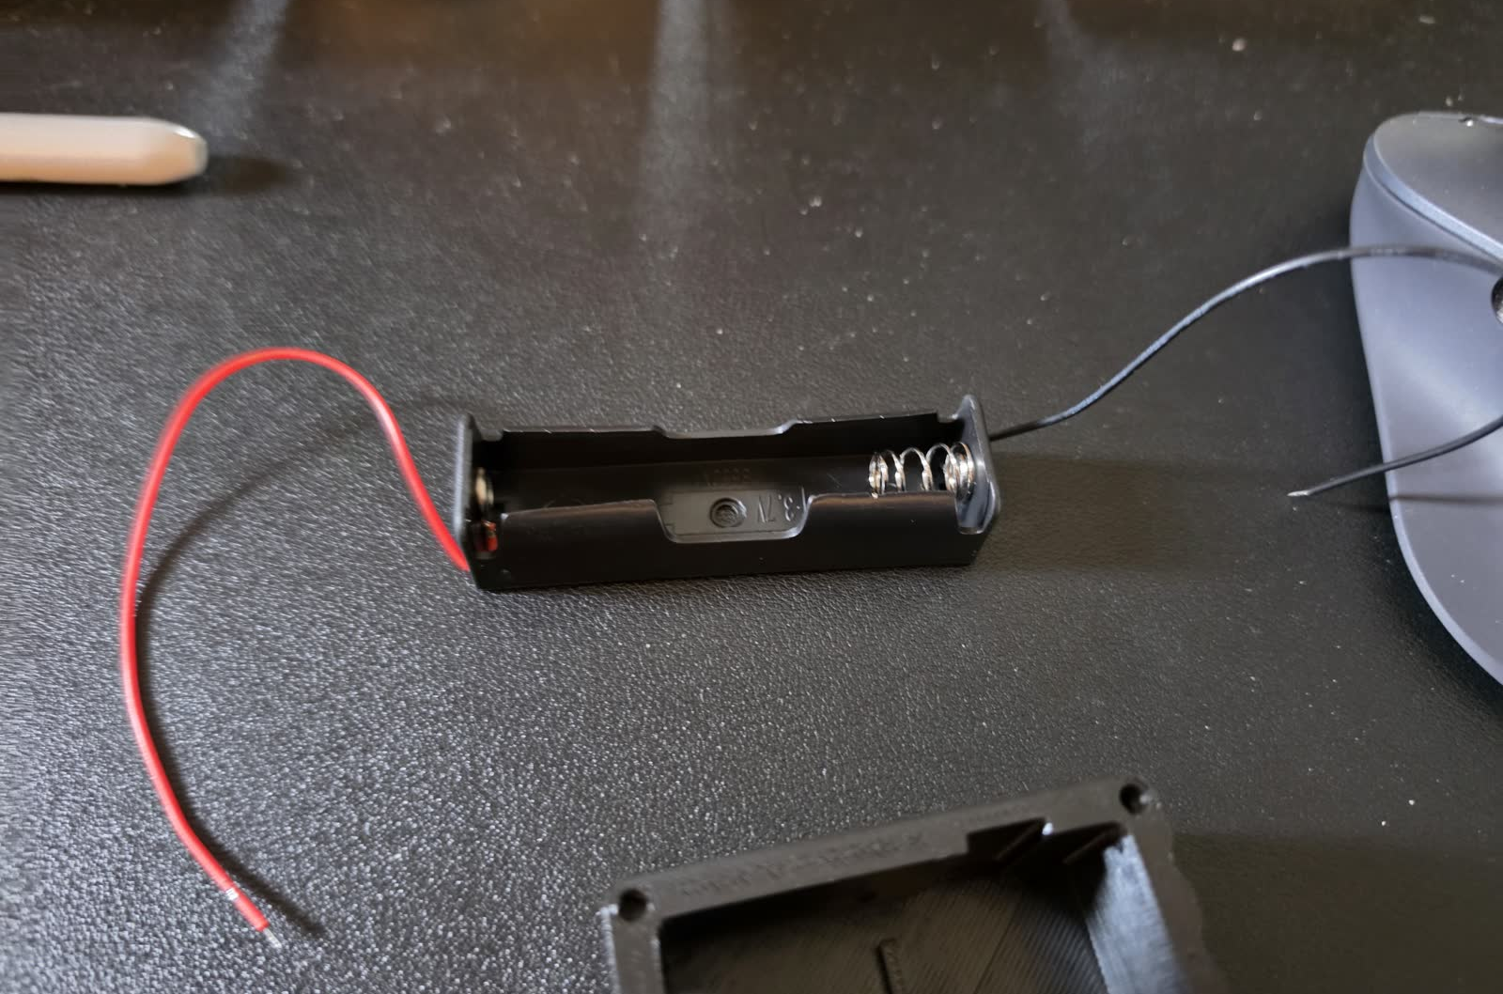
SAFETY CHECKPOINT
Step 5 — Battery direction matters
Before insertion
1. Find the + and − marks on the holder.
2. Match the battery ends to those marks.
MAKER'S SPACE
21
Notes:
Do not describe battery direction from memory or from spring position alone. Use the visible polarity marks on the actual holder. Reverse polarity can damage electronics or create a battery hazard. Inspect every unit before the switch is turned on. Photo supplied by instructor.

Slide 22
MESHCORE 101
Step 6 — Close the case with all six screws
1
Start all six screws loosely
FINAL FIT CHECK
Press the cover down while tightening
No visible gap between the case bottom and the cover.
The screws need steady downward pressure so they bite into the printed plastic.
If a screw spins without gripping, stop and ask for help.
2
3
Tighten evenly—stop before stripping
Six screws • even pressure • snug, not crushed
MAKER'S SPACE
22
Notes:
Demonstrate the downward pressure needed for self-tapping into the printed case. Start all six screws before fully tightening any one screw. Work around the cover so it seats evenly. The goal is no gap—not excessive torque.

Slide 23
MESHCORE 101
Two USB‑C ports, two different jobs
XIAO USB‑C
Use this port to flash firmware and communicate with the microcontroller.
TP4056 USB‑C
Use this port to charge the installed 18650 cell. Follow the instructor’s port callout.
MAKER'S SPACE
23
Notes:
Physically point out both case openings. Students will use the XIAO port for flashing and the TP4056 port for charging. The batteries may be uncharged, but the XIAO can still be flashed from USB with the unit switched off. Photo supplied by instructor.

Slide 24
MESHCORE 101
Flash Companion Bluetooth firmware
1
Connect
Use the XIAO USB‑C port
Before clicking Flash
2
Open
flasher.meshcore.io in a supported browser
✓ Antenna attached
✓ Power switch OFF
✓ Correct XIAO target selected
✓ Companion Bluetooth role selected
✓ Data-capable USB cable
3
Choose
nRF52 • Seeed Studio XIAO nRF52 WIO
4
Select
Companion Bluetooth firmware
5
Flash
Pick the correct USB device and wait for success
Do not unplug during the flash.
MAKER'S SPACE
24
Notes:
Lead the room in lockstep. The flasher's device naming can change slightly; confirm the Seeed Studio XIAO nRF52 WIO target and Companion Bluetooth role on the live page before students proceed. If the board is not detected, first try a known data cable, another USB port, or the bootloader procedure shown by the flasher.
Sources:
- https://flasher.meshcore.io/
- https://docs.meshcore.io/faq/
- https://wiki.seeedstudio.com/XIAO_BLE/

Slide 25
MESHCORE 101
Connect the app and join the local settings
1
Install / open MeshCore
Android, iOS, web, or desktop where supported
2
Pair the companion
Bluetooth permission must be allowed
3
Choose a clear node name
Something local operators can recognize
4
Apply regional settings
USA/Canada (Recommended) • 2-byte path hash for OKI
5
Advertise and listen
Let nearby nodes learn about your companion
MAKER'S SPACE
25
Notes:
Connect one unit first and project the screen. Keep everyone together. For the OKI network, their current guide specifies the USA/Canada recommended preset and 2-byte path hashes. Explain that settings must match the community to communicate effectively.
Sources:
- https://meshcore.io/
- https://okimesh.org/getting-started/

Slide 26
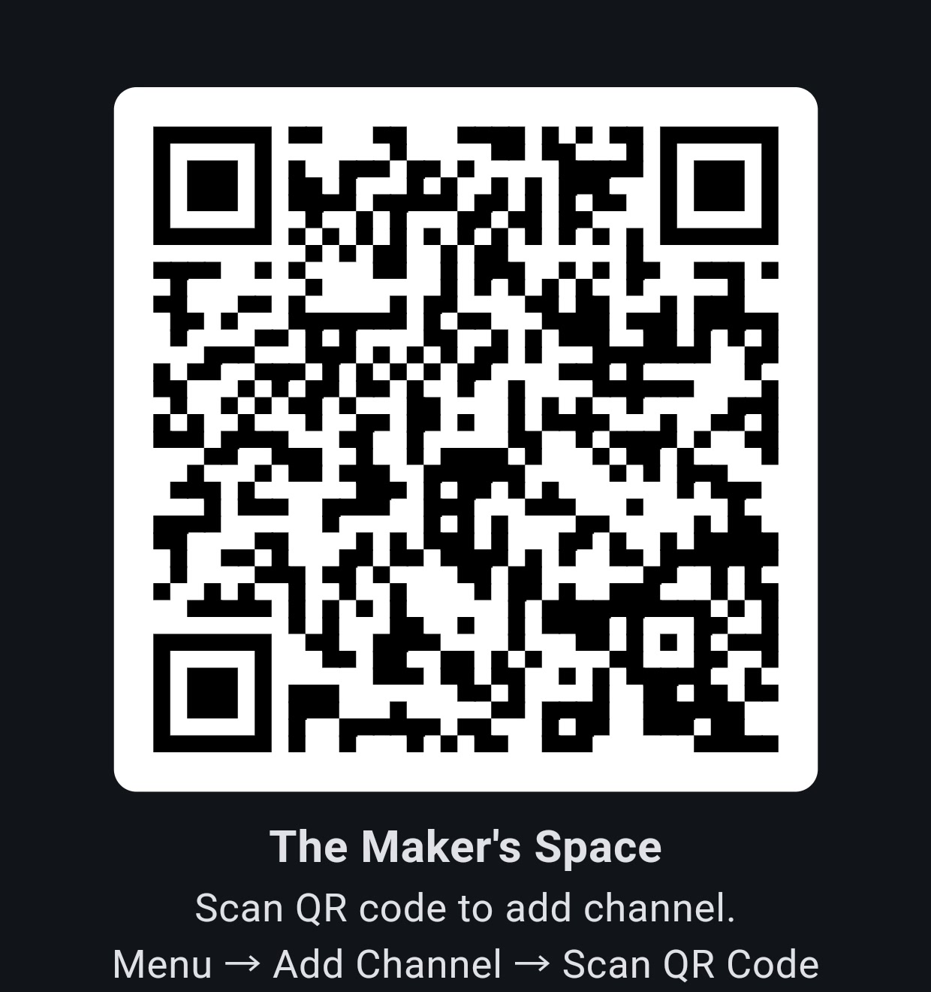
MESHCORE 101
Join The Maker’s Space private channel
1
Open the menu
Choose Add Channel
2
Scan the invitation
Choose Scan QR Code and scan the code
3
Open the channel
Continue to The Maker’s Space
4
Send a test
Post: test. An instructor will reply.
The QR code contains the shared channel secret. Anyone with it can join.
MAKER'S SPACE
26
Notes:
Project this slide and have attendees add the instructor-created private channel by scanning the QR code. Everyone must receive the same channel secret; creating separate private channels would create different keys that cannot communicate. Ask each attendee to send the exact word 'test.' Reply to each message so every attendee confirms both sending and receiving. The QR code and the slide contain access to the channel, so anyone who receives the deck can join. Screenshot supplied by the instructor.
Sources:
- https://github.com/meshcore-dev/MeshCore/blob/main/docs/qr_codes.md
- https://docs.meshcore.io/companion_protocol/#channel-management

Slide 27
YOU’RE ON THE MESH
NEXT STOPS
Keep experimenting.
meshcore.io
meshmapper.net
neimesh.net
map.okimesh.org
okimesh.org
cimesh.net
Move around. Compare antennas. Watch the maps. Ask questions. Help improve local coverage.
Questions?
MAKER'S SPACE
27
Notes:
Invite questions and remind Northeast Indiana attendees about neimesh.net and the #northeast channel within the Indiana Mesh Discord. Before hardware leaves the room, do a final visual check of the antenna, battery direction, switch state, and cover fit. Encourage students to use maps as observations—not promises of guaranteed coverage.
Sources:
- https://meshcore.io/
- https://meshmapper.net/
- https://neimesh.net/
- https://map.okimesh.org/
- https://okimesh.org/
- https://www.cimesh.net/
- https://discord.gg/tm7wh7RjD7

