Slide 1
BACCHIRI!━━Verifiable Measurement Layer
Show threshold compliance.
Keep sensor values private.
A third party can check the day, public threshold, and result. Sensor values remain hidden.
SENSOR VALUES
THIRD PARTY CHECKS
WAVE 1
STAY ON EDGE DEVICE
DAY · THRESHOLD · RESULT
MIDNIGHT PREPRODUCTION
NETWORK VERIFIED
Wave 1 · Source validated 2026-08-29 JST · Midnight record 2026-08-28 JST

Slide 2
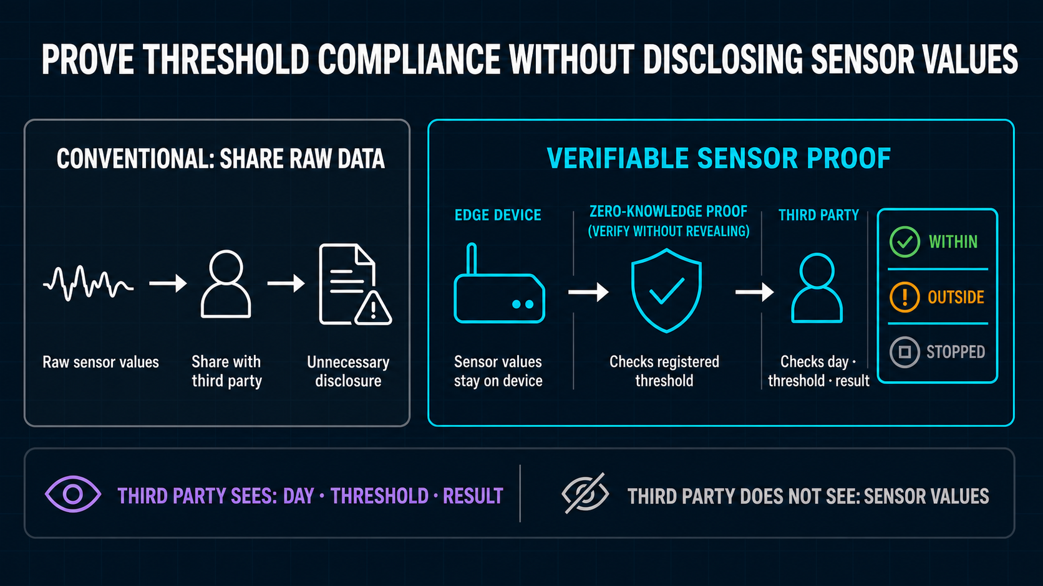
Notes:
Problem and value proposition

Slide 3
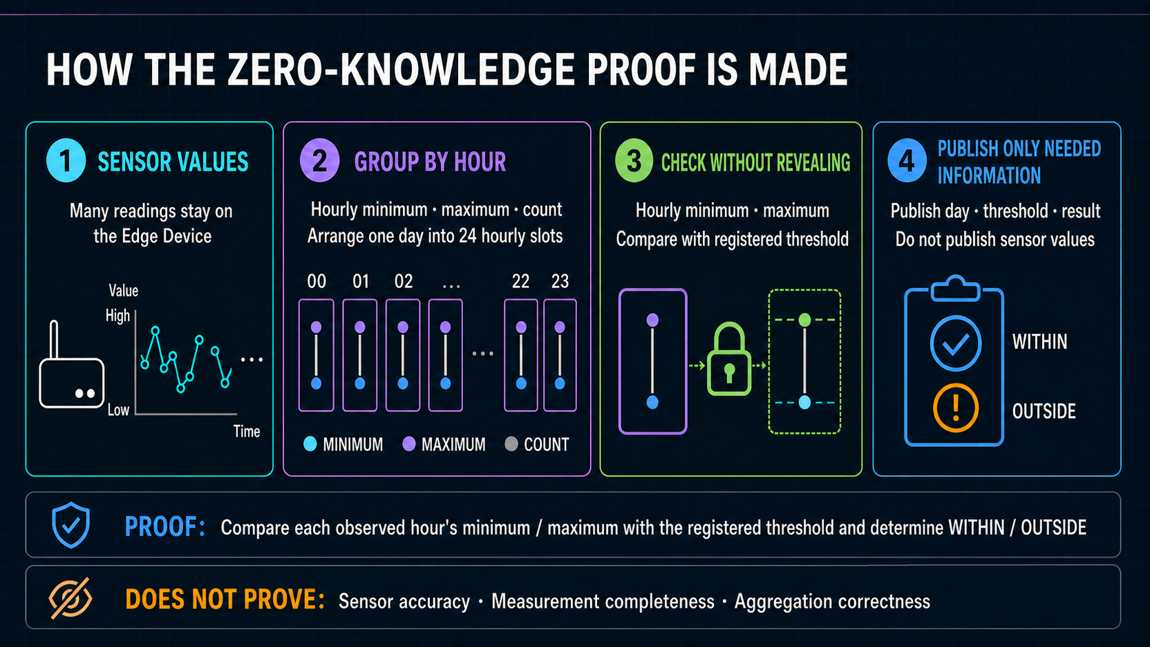
Notes:
From unit-time MIN / MAX to the ZK result

Slide 4
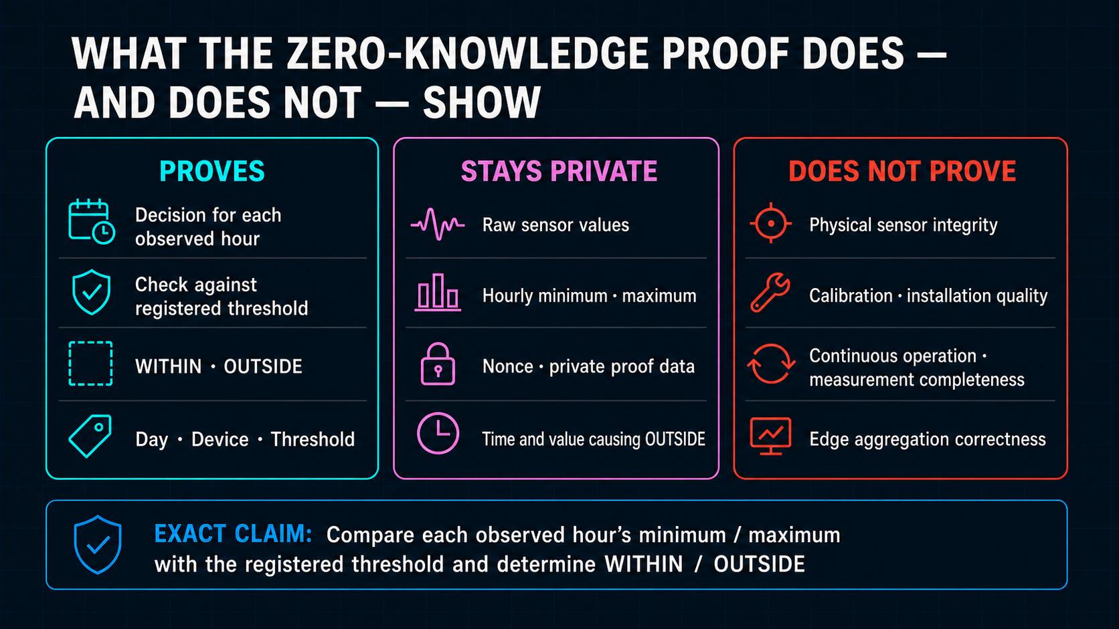
Notes:
Exact claim and non-claims

Slide 5
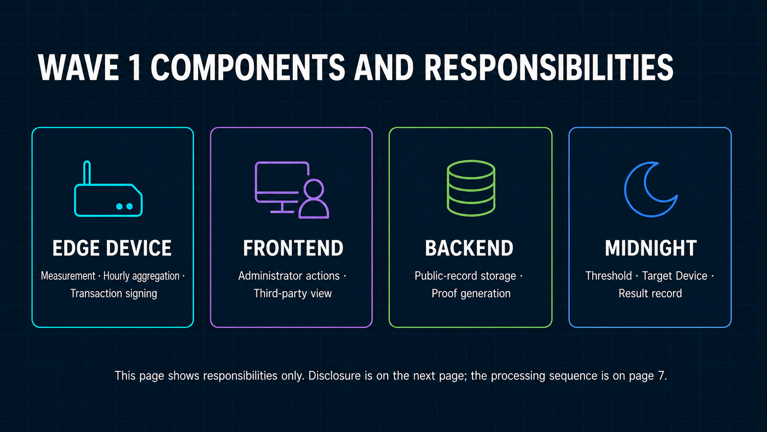
Notes:
Four-domain architecture

Slide 6
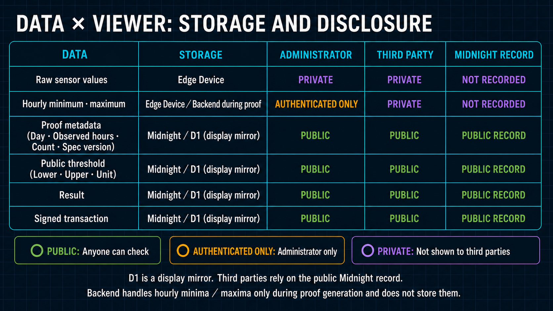
Notes:
Private and public data boundary

Slide 7
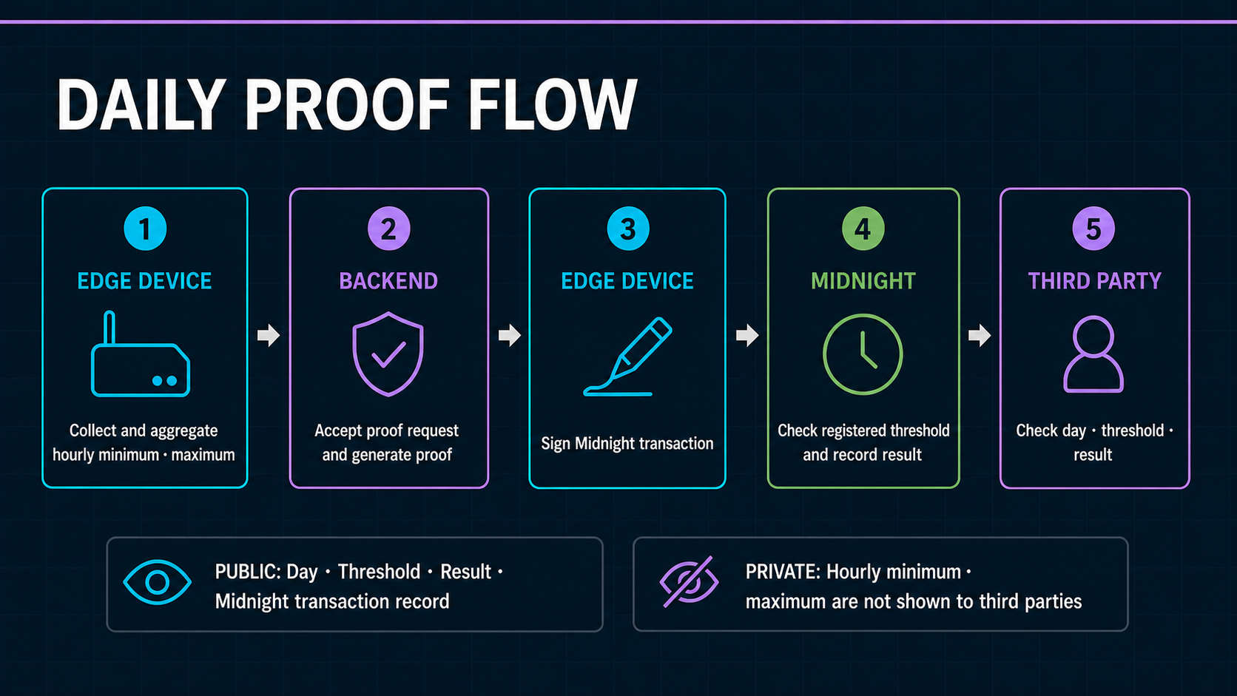
Notes:
Daily proof flow

Slide 8
08 · WORKING PRODUCT
Show the final GUI from action to public verification
Capture follows the completed GUI; the required review evidence is fixed now.
FOUR THINGS THE CAPTURE MUST PROVE
FINAL IMPLEMENTED GUI CAPTURE
01
Device-to-threshold binding
Insert after the GUI freeze
Device operation · Proof request · Midnight transaction · Third-party review
02
One day proved in 24 hourly slots
03
Device-signed Midnight transaction
VIDEO PRODUCTION IS LAST
04
Public view hides MIN / MAX values
Dashboard tests: 26 / 26 PASS

Slide 9
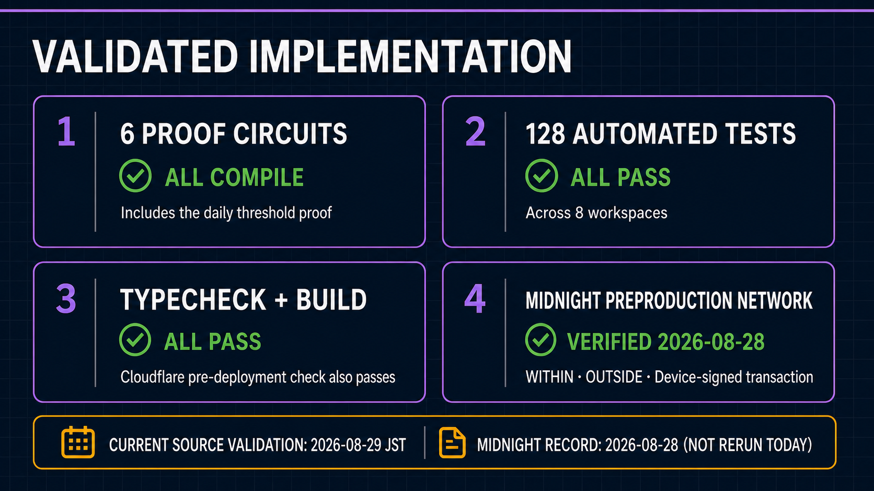
Notes:
Engineering evidence

Slide 10
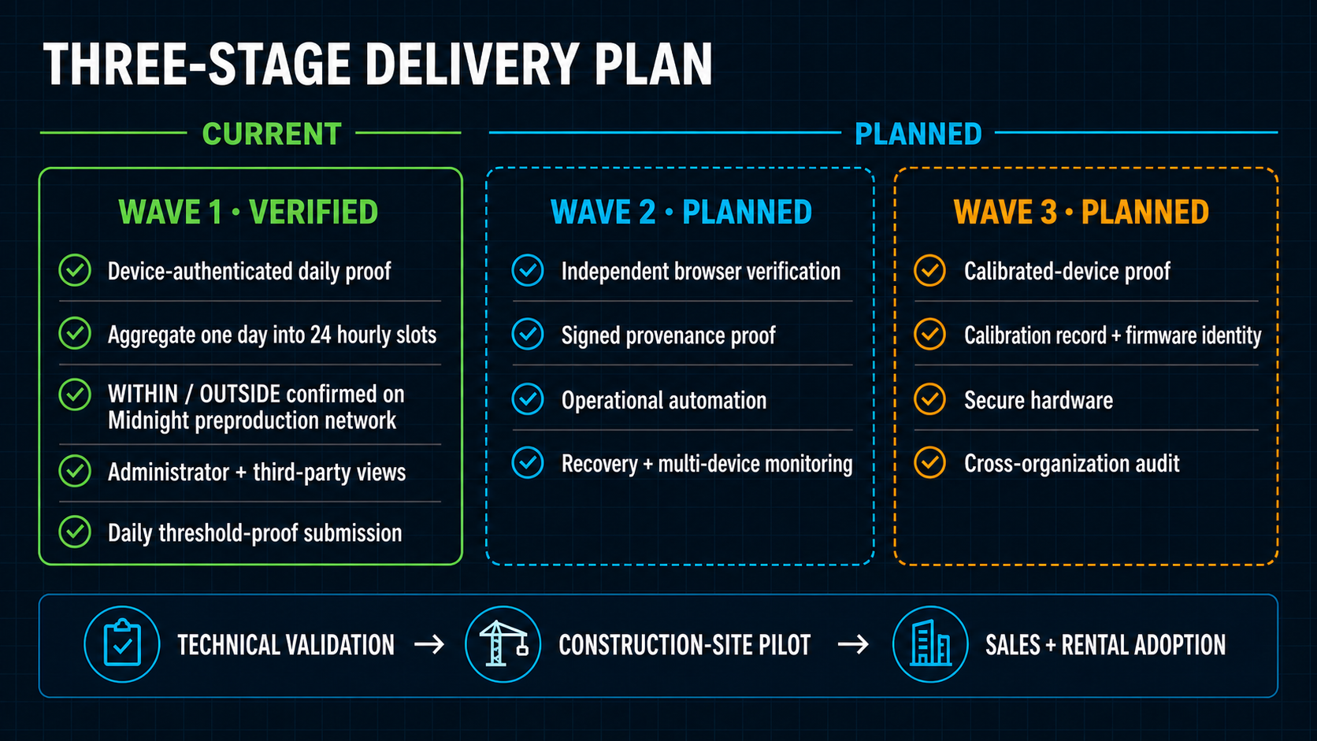
WAVES 2 AND 3 ARE PLANNED, NOT CURRENT
Notes:
Three-wave roadmap

Slide 11
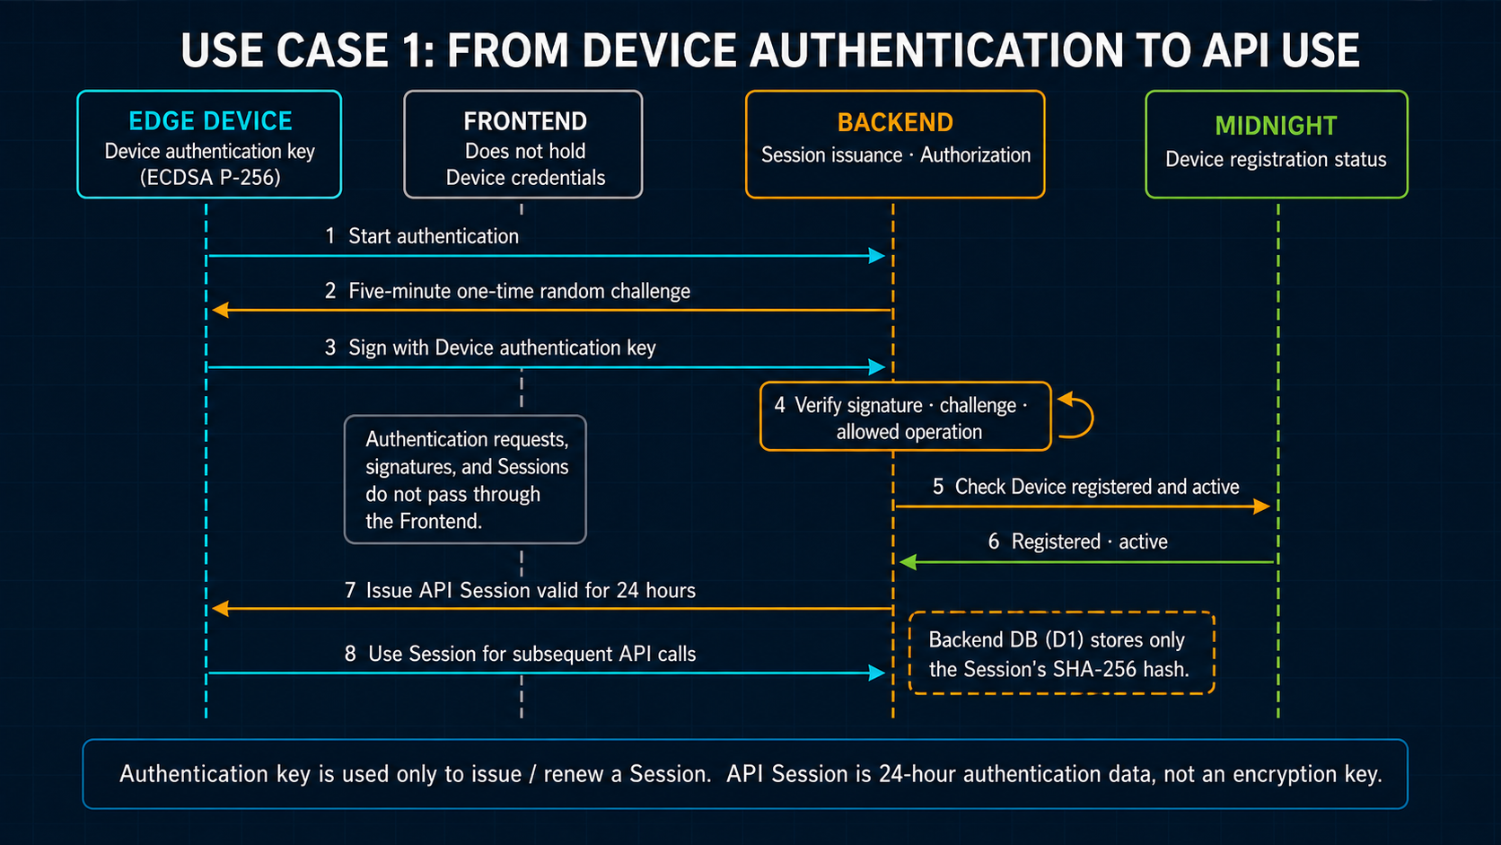
Notes:
Appendix A · Device Identity to API Session

Slide 12
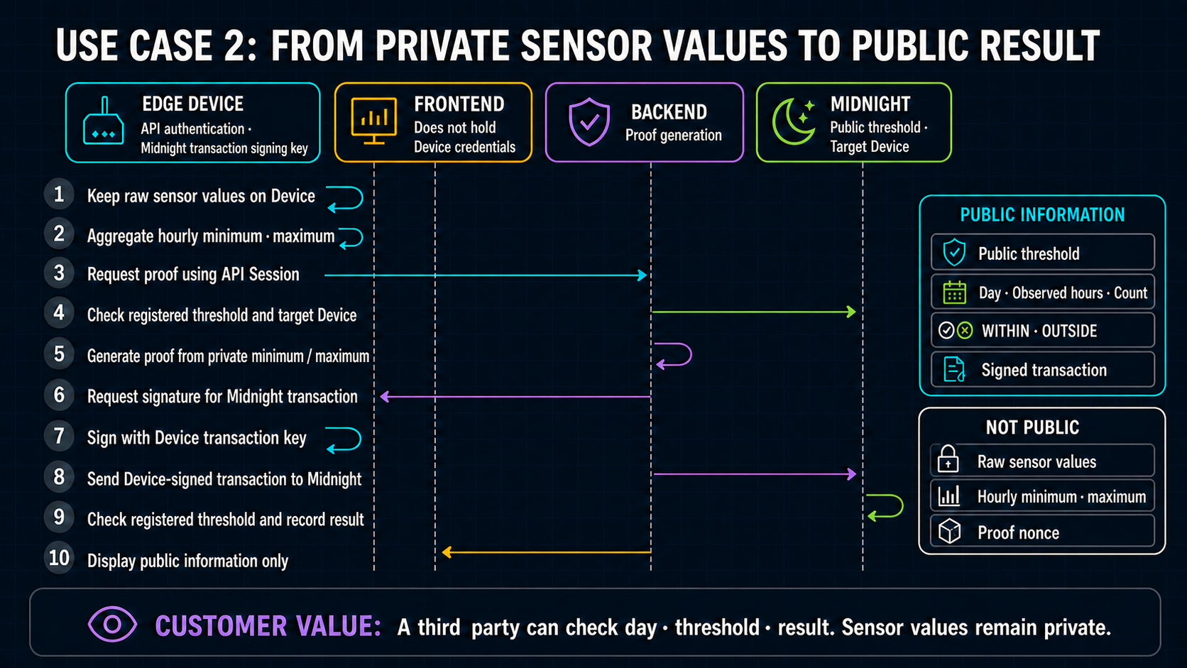
Notes:
Appendix B · Daily attestation credential sequence

