Slide 1
BACCHIRI! / VERIFIABLE MEASUREMENT LAYER
Verify the result.
Keep the readings private.
Measure
Prove
Verify
Capture the source record.
Apply the registered policy.
Share the public evidence.
Private measurements → a result another organization can check
EDIT PREVIEW · NEW GUI RECORDING PENDING
01 / 11
Notes:
Verify the result.
Keep the readings private.,Can another organization check a measurement result without receiving the sensor values? BACCHIRI turns private measurements into public, verifiable evidence, using Midnight and Cloudflare.,Edition new-gui-pitch-20260910; preview. GUI uses controlled synthetic measurements; field operation diagrams describe the separate device path. 02:00 JST is a processing start, not a confirmation deadline.

Slide 2
THE REPORTING PROBLEM
A report asks for trust.
Evidence makes it checkable.
Operator
Reviewer
BACCHIRI
Holds sensitive measurement
records.
Needs the condition, date,
and result.
Binds that result to a
registered policy.
Initial use case: cross-organization measurement reporting
EDIT PREVIEW · NEW GUI RECORDING PENDING
02 / 11
Notes:
A report asks for trust.
Evidence makes it checkable.,Measurement reporting crosses organizational boundaries. Operators hold sensitive records, while reviewers need to know which condition was applied and what happened. Our starting point is a verifiable daily report, with a partner pilot as the next business milestone.,Edition new-gui-pitch-20260910; preview. GUI uses controlled synthetic measurements; field operation diagrams describe the separate device path. 02:00 JST is a processing start, not a confirmation deadline.

Slide 3
01 / REGISTERED PROOF SUBJECT
Bind the Device and policy first
Device
G01
Registered identity
New GUI recording pending
Policy
Public bounds and validity
Capture: Device Workflow → registered Device and applied policy
Authority
Controlled by the Device
Shot placeholder. No recorded action or result is shown.
Controlled browser demo · synthetic measurements
EDIT PREVIEW · NEW GUI RECORDING PENDING
03 / 11
Notes:
Bind the Device and policy first,The GUI demonstration uses a controlled browser Device and generated test measurements. First, we show the registered Device and its public policy. The proof is tied to that identity and to a condition established before the measurement period.,G01: Capture: Device Workflow → registered Device and applied policy,Edition new-gui-pitch-20260910; preview. GUI uses controlled synthetic measurements; field operation diagrams describe the separate device path. 02:00 JST is a processing start, not a confirmation deadline.

Slide 4
02 / PRIVATE DAILY EVIDENCE
One day. Twenty-four hourly slots.
Select
G02
A completed operational
day
New GUI recording pending
Keep private
Readings and proof
opening
Capture: selected date, record count, and private-input availability
Preserve gaps
Missing hours remain NO
DATA
Shot placeholder. No recorded action or result is shown.
Controlled browser demo · synthetic measurements
EDIT PREVIEW · NEW GUI RECORDING PENDING
04 / 11
Notes:
One day. Twenty-four hourly slots.,Select a completed day and check the record count. The private proof input represents twenty-four ordered hourly slots. A threshold violation remains an outside result, and a missing hour remains no data. The public view does not expose the underlying sensor values.,G02: Capture: selected date, record count, and private-input availability,Edition new-gui-pitch-20260910; preview. GUI uses controlled synthetic measurements; field operation diagrams describe the separate device path. 02:00 JST is a processing start, not a confirmation deadline.

Slide 5
03 / AUTHORIZE AND QUEUE
The Device authorizes. The service schedules.
Authorize
G03
Approve the Device
payload
New GUI recording pending
Queue
Track the same Proof Job
ID
02:00 JST starts scheduled processing; confirmation can come later
Wait
Pending is not verified
Shot placeholder. No recorded action or result is shown.
Controlled browser demo · synthetic measurements
EDIT PREVIEW · NEW GUI RECORDING PENDING
05 / 11
Notes:
The Device authorizes. The service schedules.,Request the daily proof and authorize its processing. Keep the Proof Job ID so the request can be matched to its result. In the scheduled setup, eligible work starts at two A.M. Japan time. A queued request is still pending, not a verified result.,G03: 02:00 JST starts scheduled processing; confirmation can come later,Edition new-gui-pitch-20260910; preview. GUI uses controlled synthetic measurements; field operation diagrams describe the separate device path. 02:00 JST is a processing start, not a confirmation deadline.

Slide 6
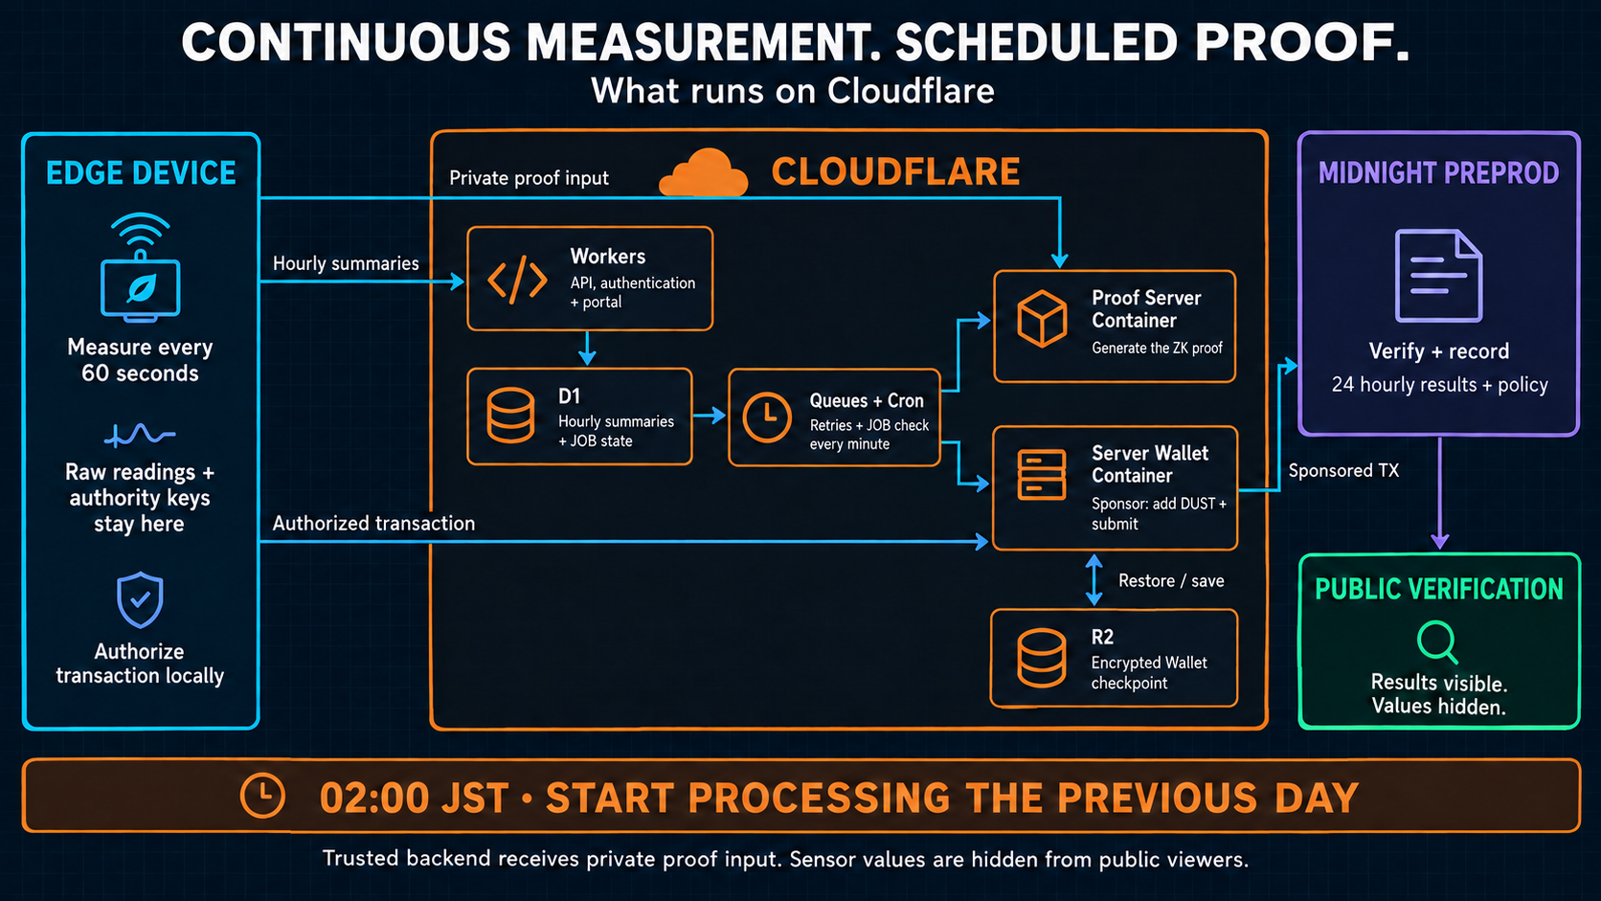
Architecture illustration · field device path
EDIT PREVIEW · NEW GUI RECORDING PENDING
06 / 11
Notes:
Continuous measurement. Scheduled proof.,On the field device, collection continues every minute, with hourly summary uploads. Cloudflare Workers serves the API and portal. D1 tracks jobs; Queues and Cron coordinate processing. Separate containers generate proofs and sponsor transactions, while R2 stores encrypted wallet checkpoints. Private proof inputs reach the trusted backend, but remain hidden from public viewers.,Edition new-gui-pitch-20260910; preview. GUI uses controlled synthetic measurements; field operation diagrams describe the separate device path. 02:00 JST is a processing start, not a confirmation deadline.

Slide 7
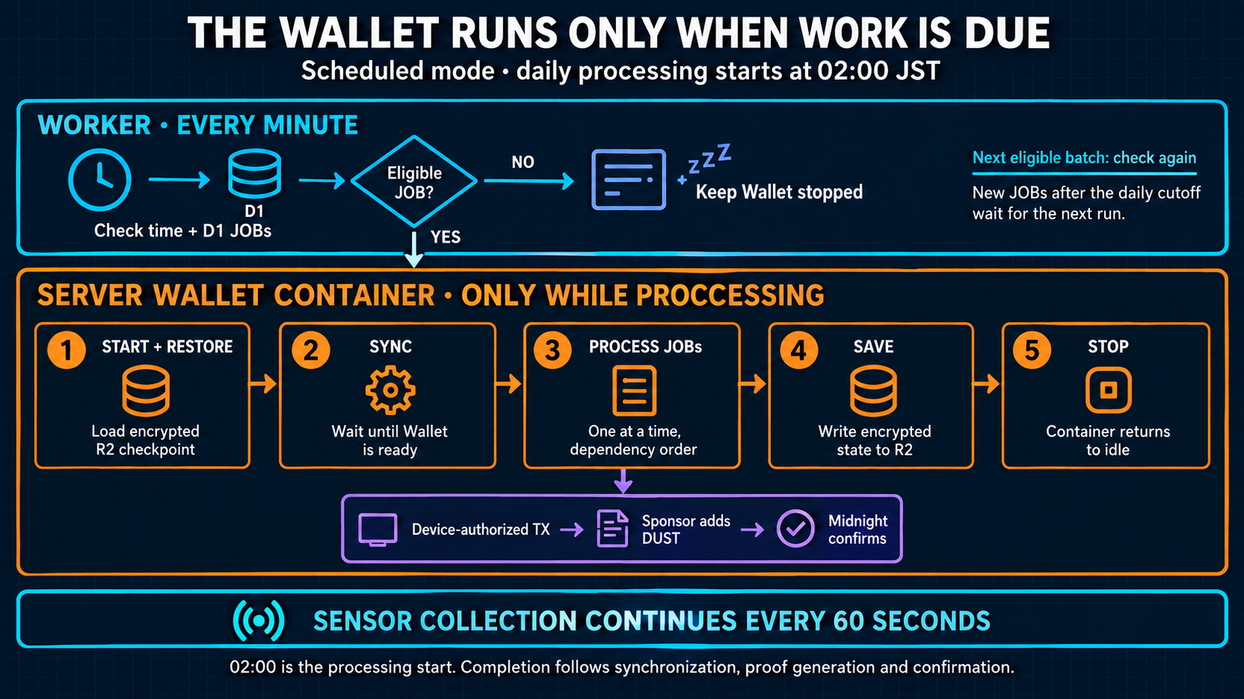
Architecture illustration · field device path
EDIT PREVIEW · NEW GUI RECORDING PENDING
07 / 11
Notes:
Start only when eligible work is due,The Worker checks eligible jobs before starting the wallet. When work is due, the wallet restores its checkpoint, synchronizes, and processes jobs one at a time. The Sponsor adds DUST fees to Device-authorized transactions. After the eligible work finishes, it saves state and stops. Sensor collection continues throughout.,Edition new-gui-pitch-20260910; preview. GUI uses controlled synthetic measurements; field operation diagrams describe the separate device path. 02:00 JST is a processing start, not a confirmation deadline.

Slide 8
04 / CONFIRMED RECORD
Return to the same job after processing
Match
G04
Same Device, day, and job
New GUI recording pending
Confirm
Confirmed transaction
state
Later capture · elapsed waiting time is omitted
Carry forward
Transaction hash for
verification
Shot placeholder. No recorded action or result is shown.
Later capture · elapsed waiting time is omitted
EDIT PREVIEW · NEW GUI RECORDING PENDING
08 / 11
Notes:
Return to the same job after processing,After processing, return to the same job. Match the Device, date, and job identifier, then capture the confirmed transaction hash. This later recording shows the result; the waiting time is omitted from the video.,G04: Later capture · elapsed waiting time is omitted,Edition new-gui-pitch-20260910; preview. GUI uses controlled synthetic measurements; field operation diagrams describe the separate device path. 02:00 JST is a processing start, not a confirmation deadline.

Slide 9
05 / THIRD-PARTY VERIFICATION
A reviewer starts with the transaction hash
Look up
G05
The same confirmed
transaction
New GUI recording pending
Inspect
Day, hourly results, policy
No Device session required for the public verifier
Compare
Public Midnight evidence
Shot placeholder. No recorded action or result is shown.
Controlled browser demo · synthetic measurements
EDIT PREVIEW · NEW GUI RECORDING PENDING
09 / 11
Notes:
A reviewer starts with the transaction hash,Open third-party verification and paste that transaction hash. A reviewer can inspect the operational day, hourly results, applied policy, and public evidence without a Device session. The browser compares public Midnight records. It does not rerun the zero-knowledge proof verifier locally.,G05: No Device session required for the public verifier,Edition new-gui-pitch-20260910; preview. GUI uses controlled synthetic measurements; field operation diagrams describe the separate device path. 02:00 JST is a processing start, not a confirmation deadline.

Slide 10
THE EXACT CLAIM
A precise proof has a clear boundary
Established
Kept private
Still trusted
The relation between
committed input, policy, and
result.
Sensor values in the public
verification view.
Physical accuracy, complete
sampling, source
aggregation, and the
backend.
Cryptographic evidence supports a claim with a defined scope
EDIT PREVIEW · NEW GUI RECORDING PENDING
10 / 11
Notes:
A precise proof has a clear boundary,The proof establishes the relationship between committed input, registered policy, and public result. It does not establish physical sensor accuracy, complete sampling, or correct source aggregation. The current backend is trusted. This boundary makes the evidence useful without overstating what it proves.,Edition new-gui-pitch-20260910; preview. GUI uses controlled synthetic measurements; field operation diagrams describe the separate device path. 02:00 JST is a processing start, not a confirmation deadline.

Slide 11
THE NEXT MILESTONE
Turn a working proof flow
into a measured partner pilot
Demonstrated
Implemented
Next
Core proof flow on Midnight
Preprod.
Field collection and
scheduled Cloudflare
processing.
Validate reliability, review
effort, and willingness to
pay.
Seeking a measurement-reporting workflow and a pilot partner
EDIT PREVIEW · NEW GUI RECORDING PENDING
11 / 11
Notes:
Turn a working proof flow
into a measured partner pilot,The core proof flow works on Midnight Preprod, with field collection and scheduled processing implemented. Next, we want a partner reporting workflow to measure reliability, review effort, and willingness to pay. BACCHIRI makes private measurement results independently checkable.,Edition new-gui-pitch-20260910; preview. GUI uses controlled synthetic measurements; field operation diagrams describe the separate device path. 02:00 JST is a processing start, not a confirmation deadline.

