Slide 1
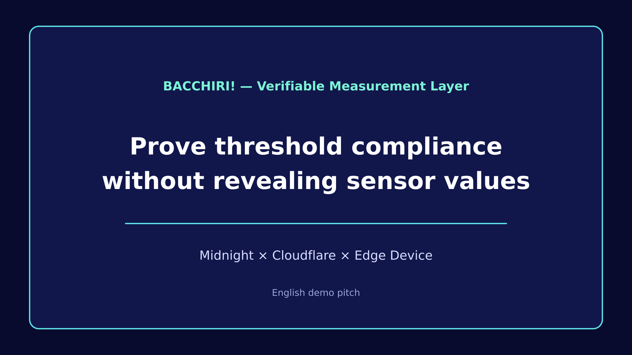
Notes:
Open with the real-world outcome: a reviewer verifies a threshold result without receiving sensor values.

Slide 2
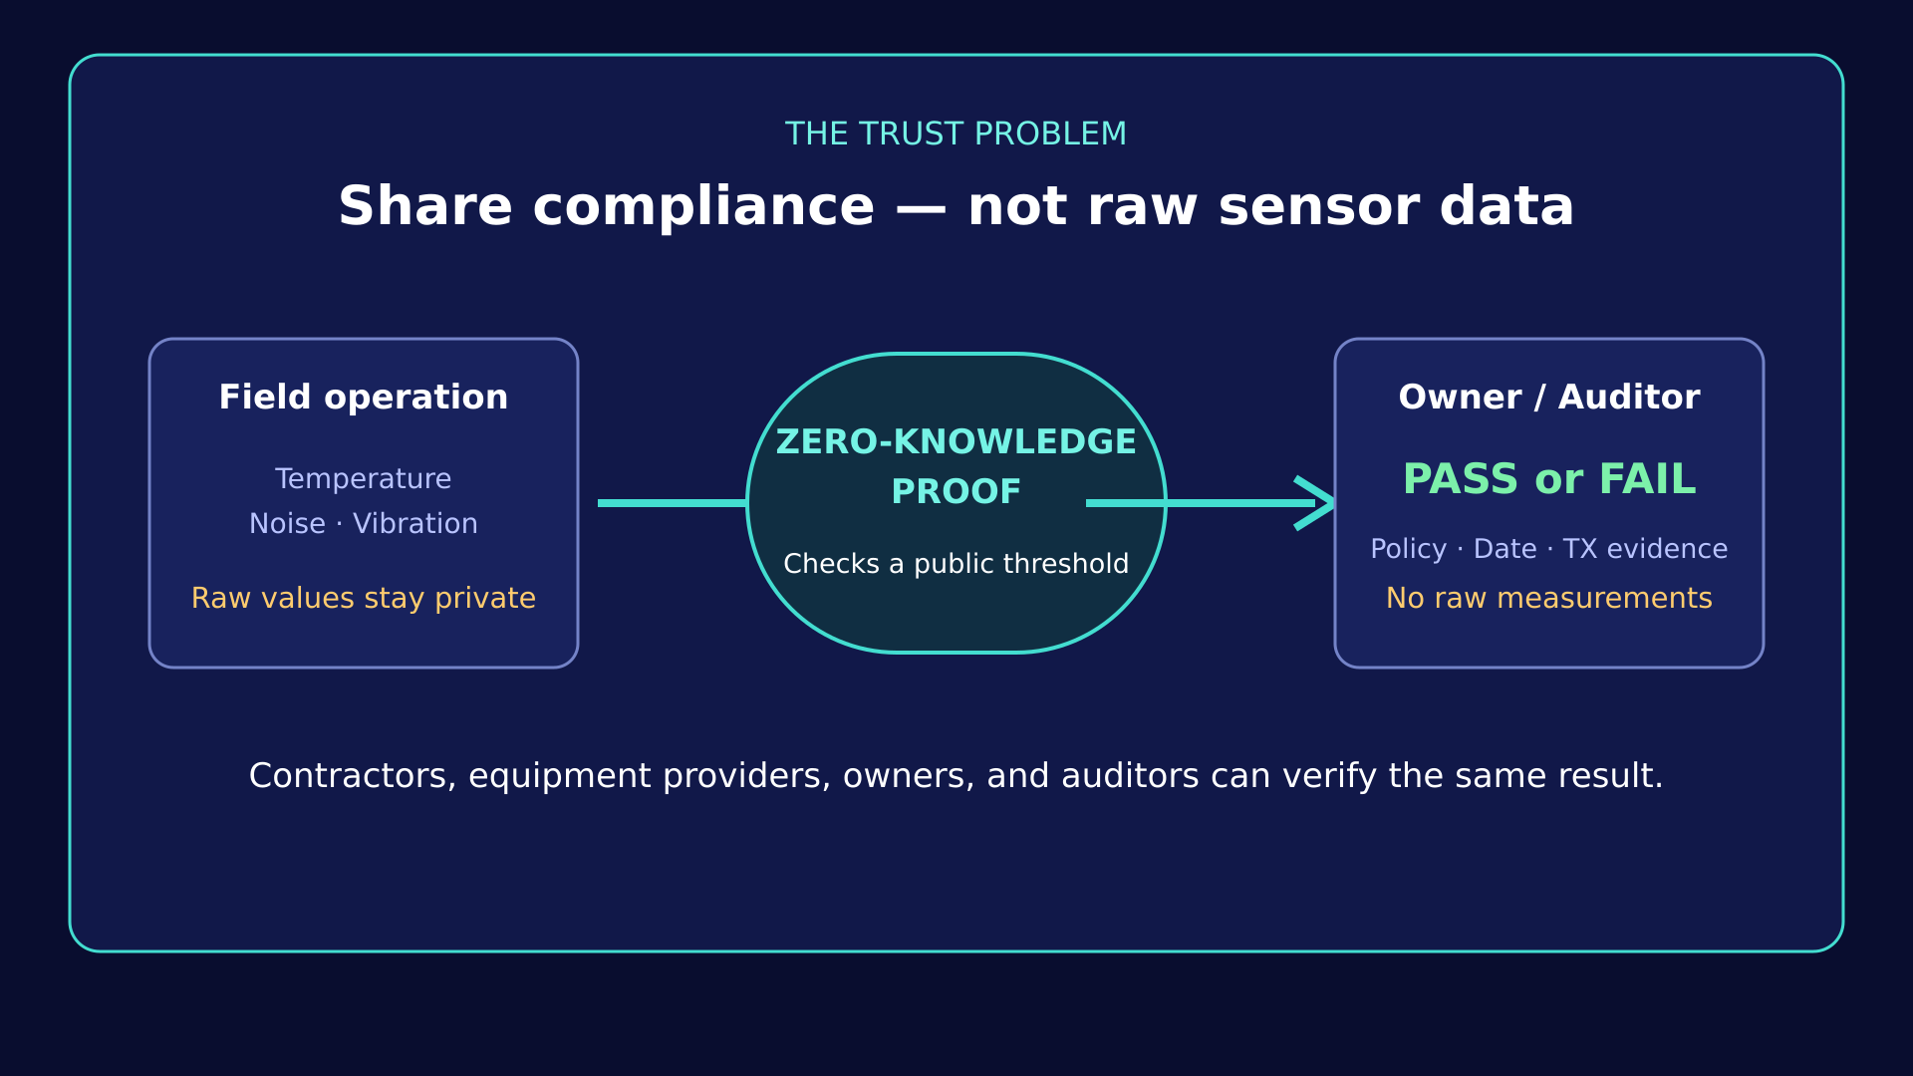
Notes:
Explain the cross-organization trust problem. This is a concept slide, not a transaction screen.

Slide 3
USE CASE
One controlled path from policy to public evidence
The order matters: the public threshold is fixed before private measurements become a proof.
01
02
03
04
05
06
REGISTER
MEASURE
REDUCE
PROVE
AUTHORIZE
VERIFY
Wallet, Device,
and public policy
Raw readings stay
on the Edge
24 hourly MIN / MAX
slots + STOPPED
Private witness checked
against fixed policy
Device approves;
Sponsor adds DUST
Policy, result, and TX
are public
PUBLIC BEFORE OPERATION
MINIMUM PUBLIC EVIDENCE
BACCHIRI! · MIDNIGHT BUILDATHON
Notes:
Follow the same sequence as the demo video. Do not jump ahead to transaction evidence while explaining private sensor evidence.

Slide 4
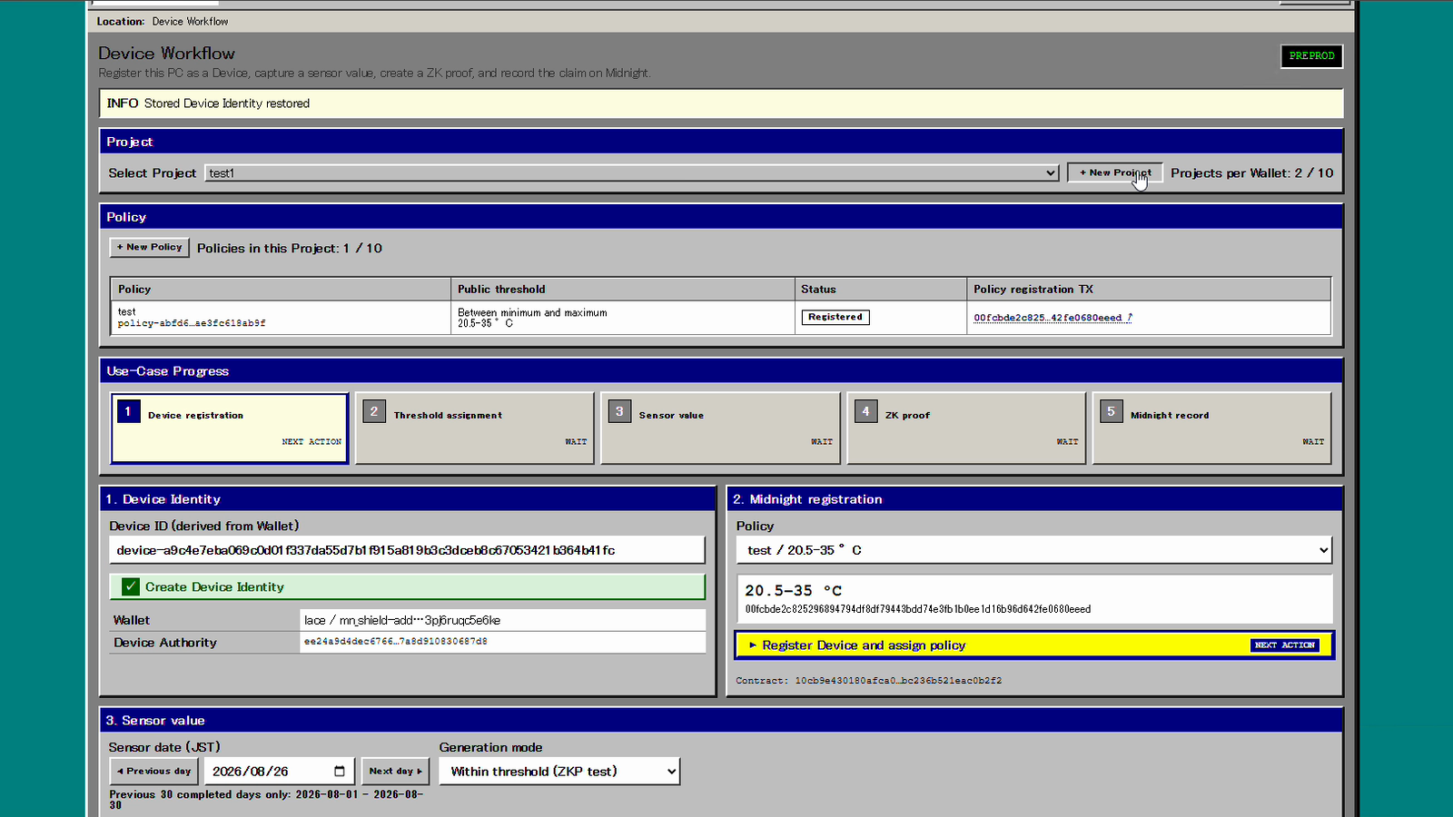
LIVE PRODUCT · STEP 1
Bind the Device to a public threshold before measurement
The GUI shows the connected wallet, Device identity, registered policy, and next authorized action.
1
User-controlled Wallet
Explicitly connects to the DApp
2
Device identity
Bound to its operating authority
3
Public threshold
Registered before proof creation
4
Validity period
Constrains the intended use
BACCHIRI! · MIDNIGHT BUILDATHON

Slide 5
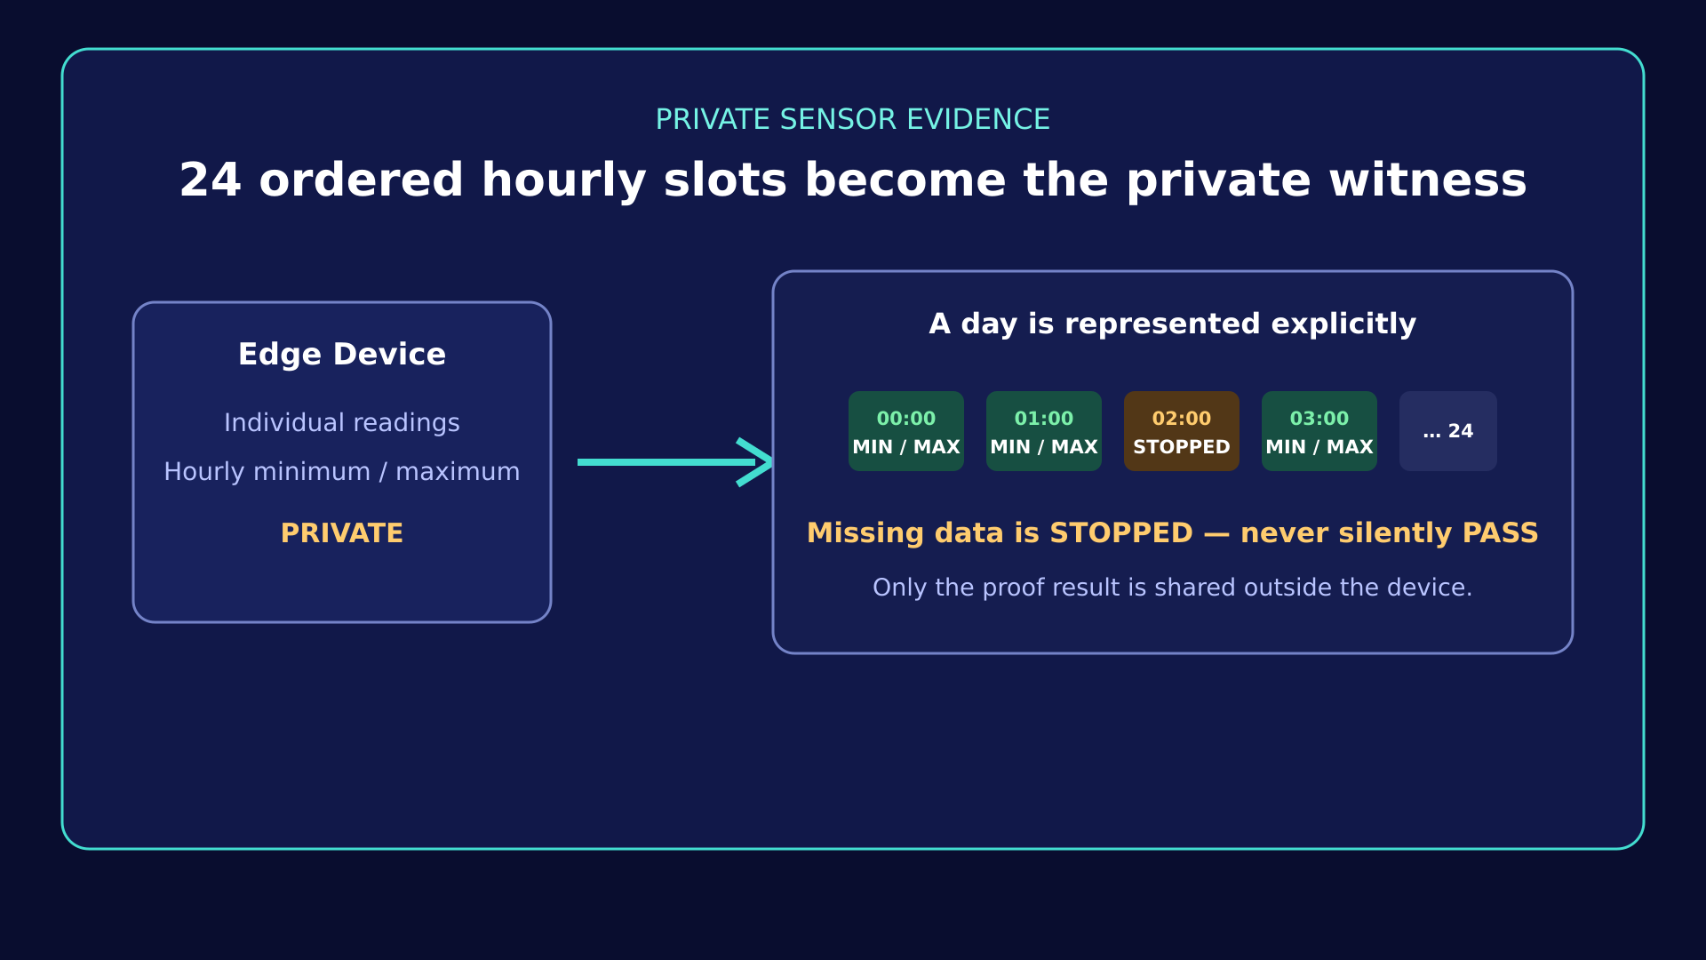
Notes:
This slide explains private sensor evidence. No proof transaction screen is shown here.

Slide 6
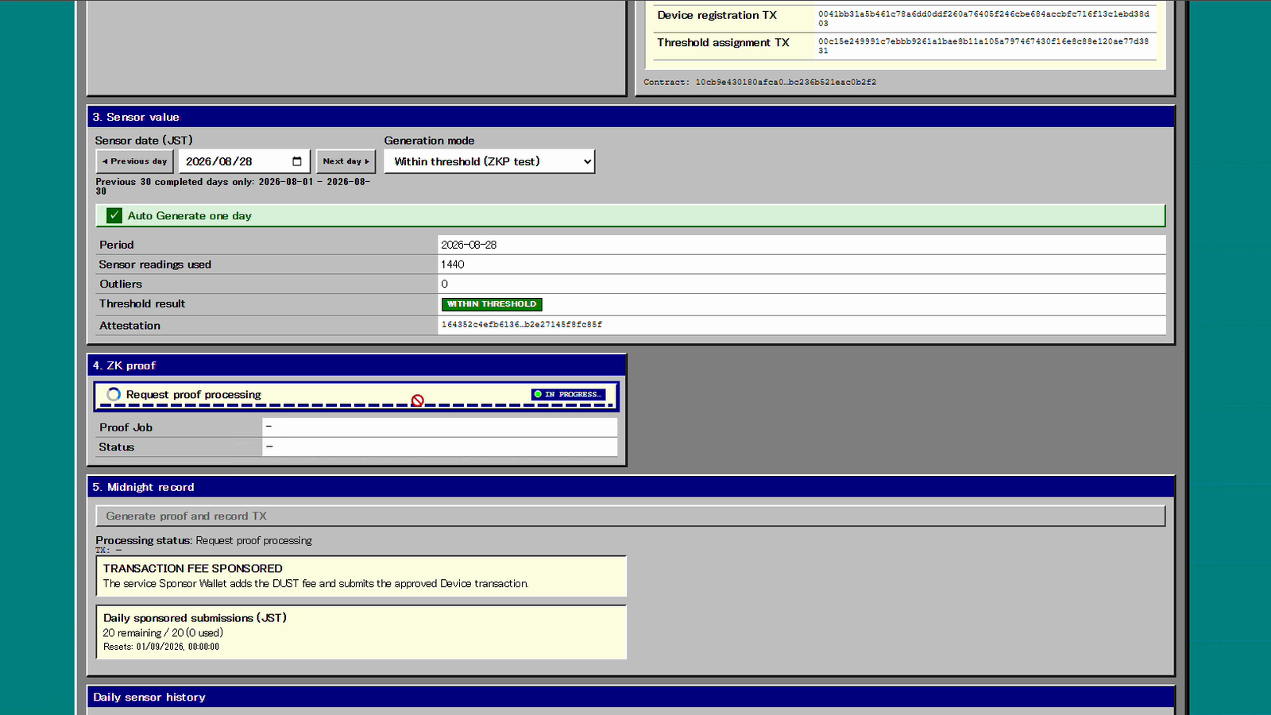
LIVE PRODUCT · STEP 2
Generate the ZK proof against the already registered policy
The private hourly extrema become the witness; the Device cannot substitute a convenient threshold at proof time.
PRIVATE INPUT
Hourly MIN / MAX
STOPPED slots
Proof nonce
PUBLIC OUTPUT
WITHIN / OUTSIDE
Observed hours
Commitment
BACCHIRI! · MIDNIGHT BUILDATHON

Slide 7
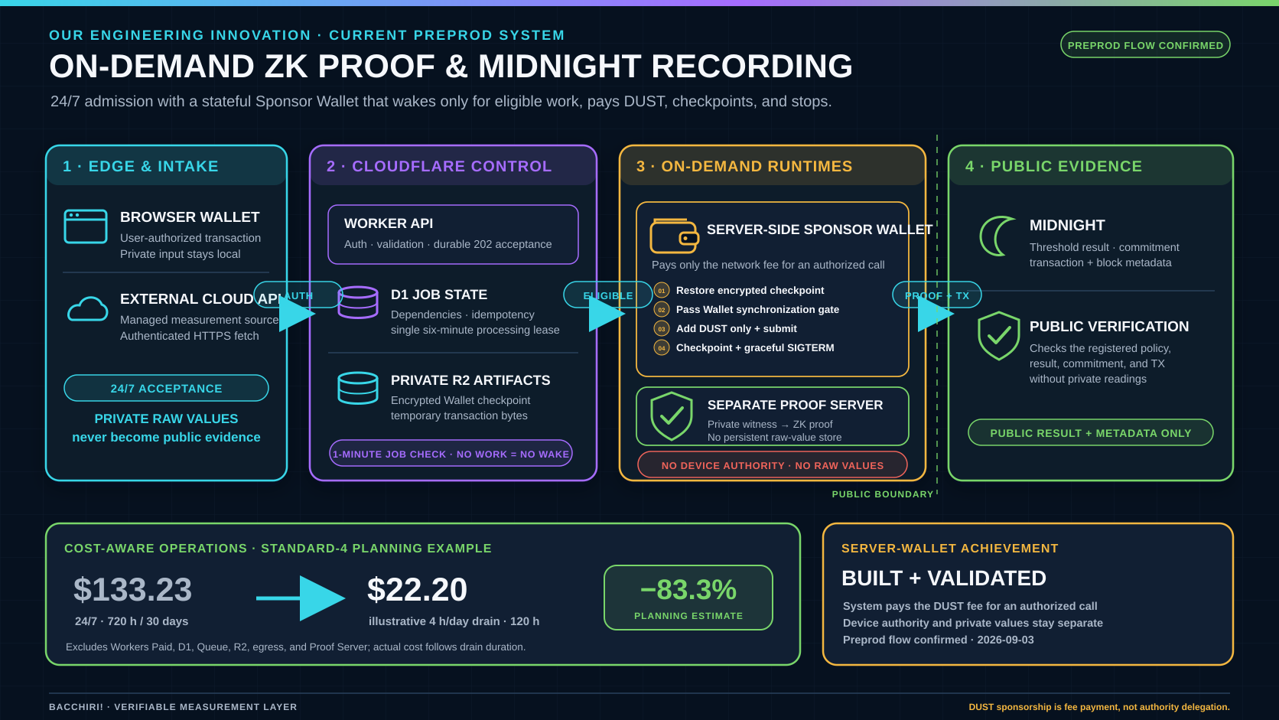
Notes:
Our engineering innovation: 24/7 admission with an on-demand server-side Sponsor Wallet that restores an encrypted checkpoint, waits for synchronization, adds only DUST to an already-authorized transaction, and stops gracefully. The standard-4 planning example compares USD 133.23 for 720 active hours with USD 22.20 for an illustrative 120-hour monthly drain, an estimated 83.3 percent reduction; other Cloudflare services and the Proof Server are excluded.

Slide 8
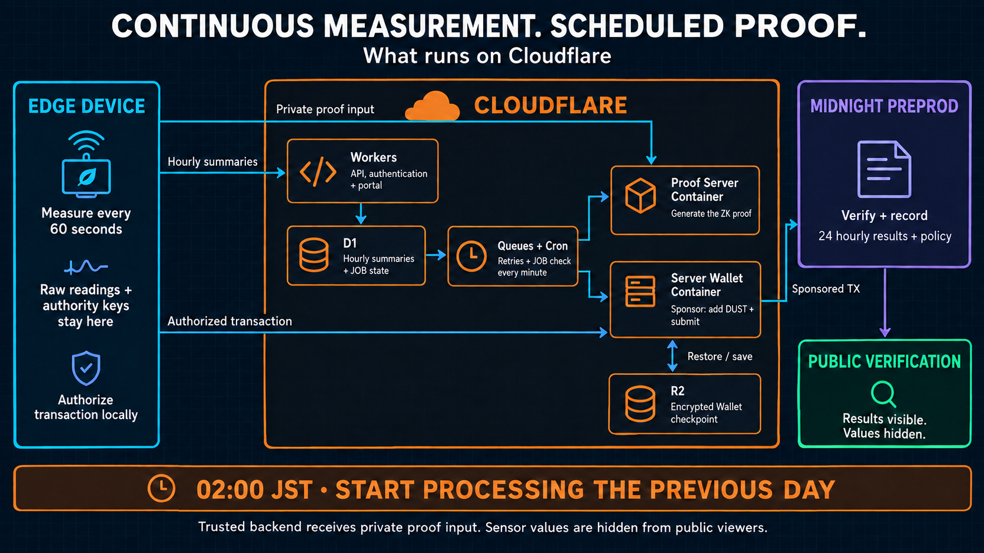
Notes:
Continuous measurement. Scheduled proof.
The field device measures every minute and uploads hourly summaries. Cloudflare Workers handles authentication and the portal. D1 stores workflow state; Queues and Cron coordinate retries. Separate containers generate proofs and sponsor transactions. R2 saves encrypted wallet state. At two A.M. Japan time, processing starts for the previous day. Midnight records the public results. Private proof inputs reach the trusted backend; public viewers cannot see sensor values.
Deployed field integration on Midnight Preprod, checked September 10, 2026. Raw readings and Device authority keys stay on the Device. Hourly summaries and anomaly transitions reach the trusted backend; private proof inputs reach the Proof Server. Device authorization occurs locally before sponsorship. The Sponsor role adds DUST fees and submits the authorized transaction. A 02:00 JST cutoff is a processing start, not guaranteed completion. Missing measurements remain NO DATA. The original GUI footage is historical review evidence, not a live capture of this field workflow.

Slide 9
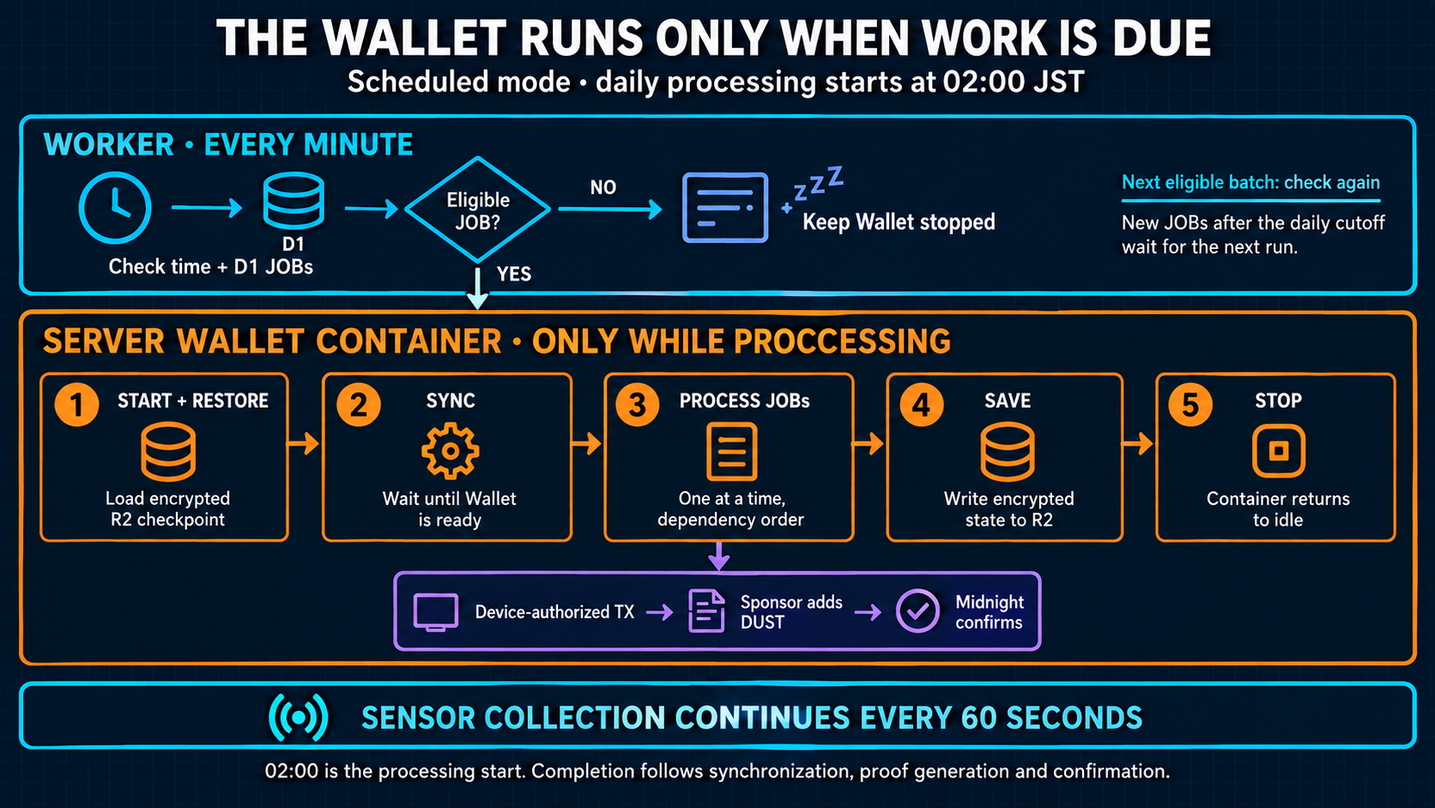
Notes:
The Wallet runs only when work is due
The Worker checks the time and eligible jobs every minute, while the wallet can stay stopped. When work is due, it starts the wallet, restores its encrypted checkpoint, and waits for synchronization. Ready jobs run one at a time. The Sponsor adds DUST to the device-authorized transaction. After eligible work finishes, the wallet saves its state and stops. Sensor collection continues throughout. Jobs arriving after the daily cutoff wait for the next run.
Current operating mode: scheduled, daily start 02:00 JST. Worker Cron reads D1 before calling the Container, so a one-minute JOB check does not imply one-minute Wallet restarts. Synchronization and spendable fee state gate Wallet work. D1 leases serialize operations and protect overlapping Cron calls. Eligible work follows dependency state and oldest runnable acceptance time. Graceful shutdown persists an encrypted R2 checkpoint; restart cooldown is 60 seconds. The Device daily-submit service independently retries completed days every five minutes. Proof generation runs in the separate Proof Server Container.

Slide 10
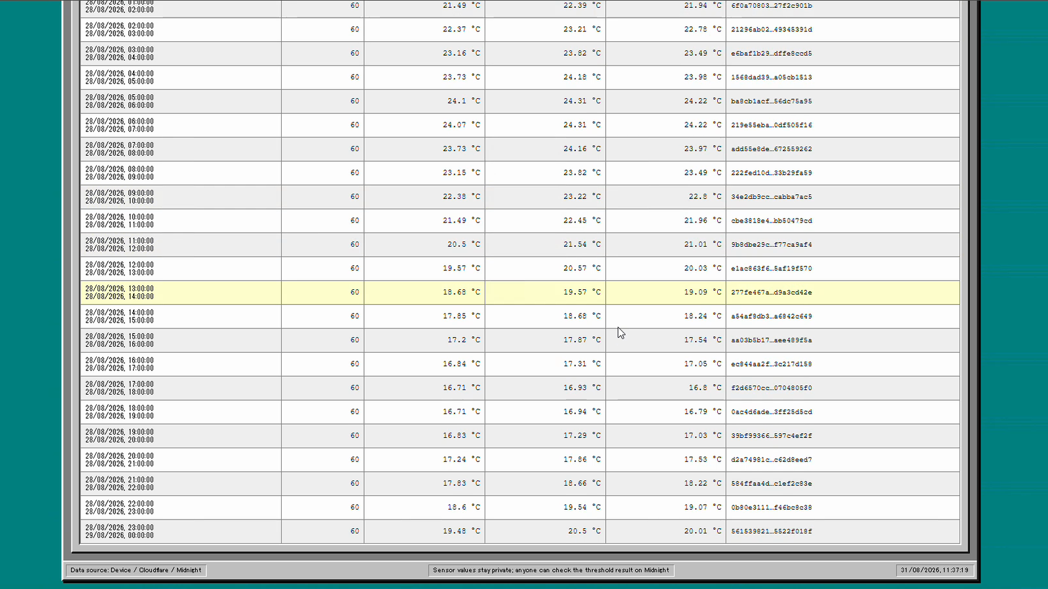
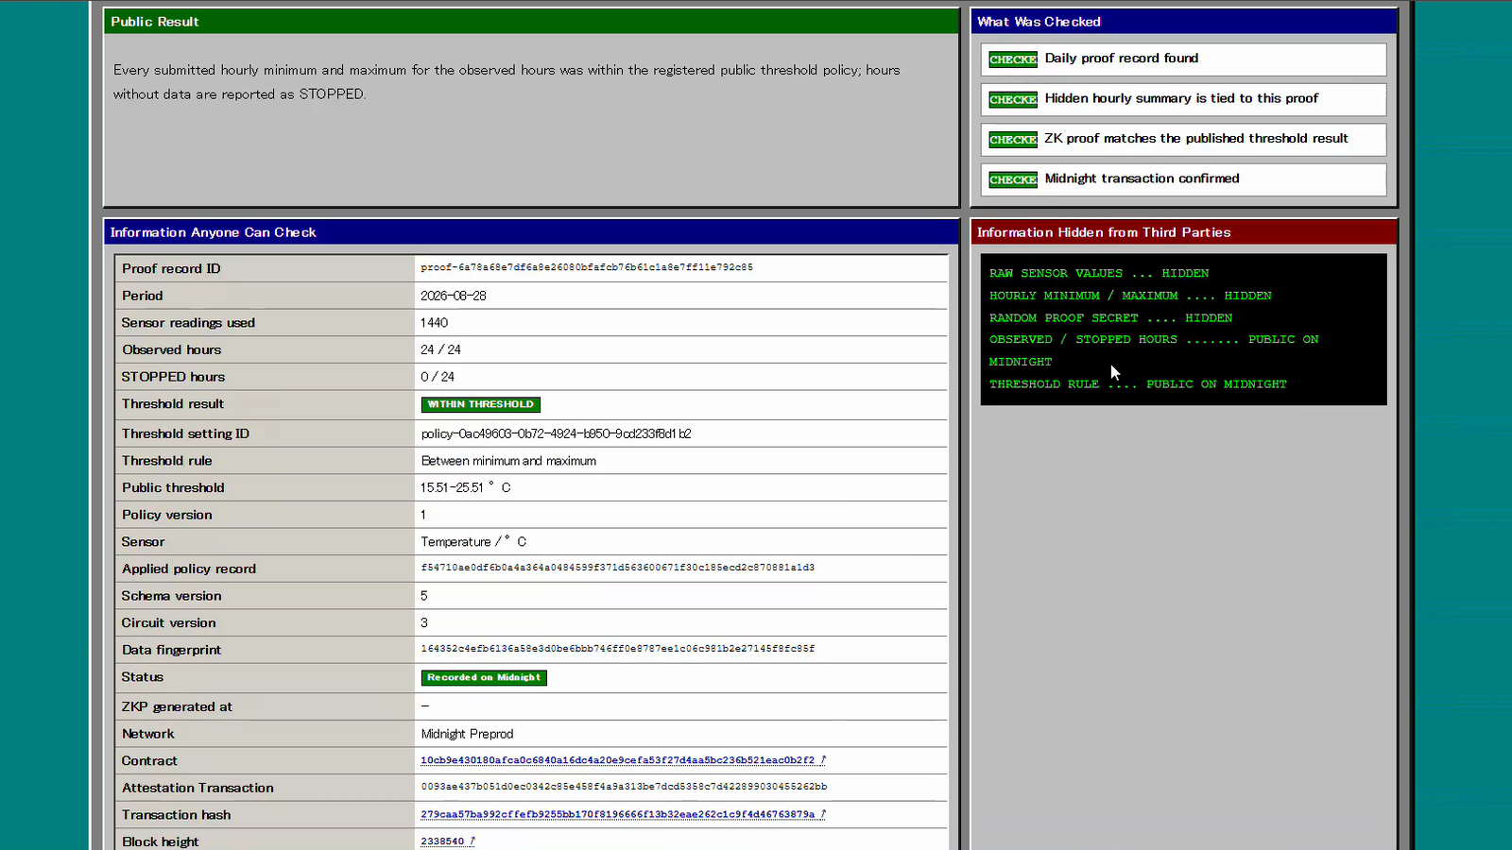
LIVE PRODUCT · STEP 4
A third party checks public evidence — not private measurements
The public view and Midnight Explorer expose policy, result, observed hours, commitment, and transaction evidence.
PUBLIC
Day · Device binding · Threshold · Observed / STOPPED · Result · Commitment · Transaction
PRIVATE
Readings · Hourly MIN / MAX · Nonce
BACCHIRI! · MIDNIGHT BUILDATHON

Slide 11
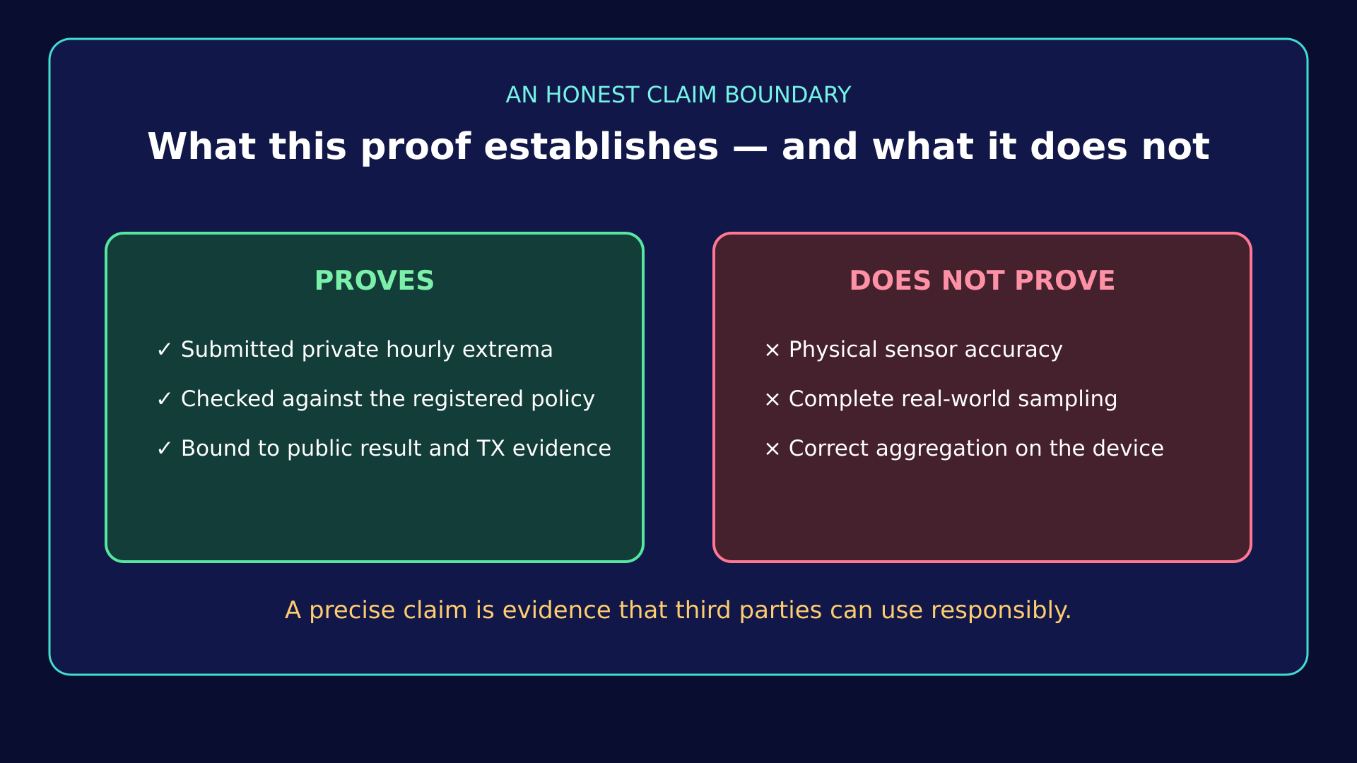
Notes:
Close with the exact claim boundary. The proof does not establish physical sensor truth, complete sampling, or correct local aggregation.

