Slide 1
CZT: 2002 - 2007
Mark Utting, Waikato
Petra Malik, Waikato
Leo Freitas, York

Slide 2
2002: Trends for Z
ISO Z Standard accepted
Commercial Tools not Viable
Decreasing use of Z
  In teaching (Barriers: LaTeX, environment)
  In industry (Barriers: LaTeX/Symbols, tools)
Some active research use
  Spec of concepts (typechk,animate,prove)
  Under-the-hood notation for other tools
  Interest in Z extensions: Object-Z, Circus...

Slide 3

Community Z Tools
An Open Implementation of the ISO Z Standard

Slide 4
Original CZT Goals
An open-source implementation of the ISO Z standard
Integrate existing Z tools (eg. provers)
  XML interchange format
Ease development of new Z tools
Develop new Z tools (animator, translators to/from B, UML, JML etc.)
Integrated end-user environment(s)

Slide 5
Better CZT Goals?
By 2004: CZT developers specifying CZT tools in Z (checking using CZT)
By 2005: 5 users of typechecker
By 2006: students and researchers using an integrated CZT environment
By 2007: people using CZT for specification, animation, test-generation, refinement, development via B etc.

Slide 6
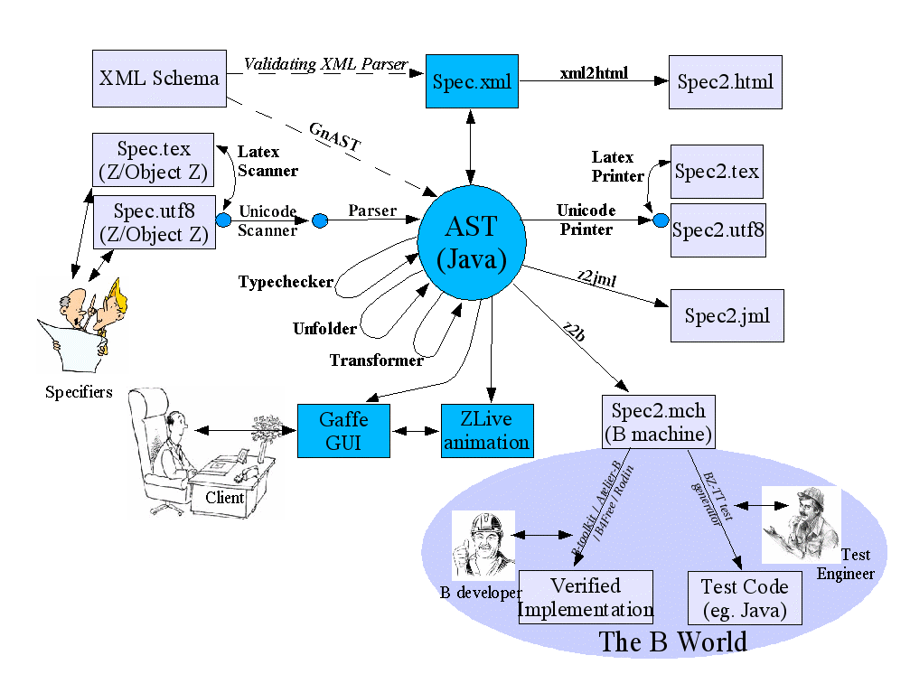
CZT Architecture

Slide 7
An Example Z Specification
InitBirthdayBook
BirthdayBook’
known’ = {}

Slide 8

An Example AST
AxPara
SchText
ConstDecl
DeclName
SchExpr
SchText
InitBirthdayBook
InclDecl
MemPred
DecorExpr
RefExpr
SetExpr
RefExpr
NextStroke
RefName
SetExpr
RefName
known
BirthdayBook

Slide 9
ZML—XML Markup for Z
<AxPara Box=“SchBox”>
<SchText><ConstDecl>
<DeclName><Word>InitBirthdayBook</Word></DeclName>
<SchExpr><SchText>
<InclDecl>
<DecorExpr>
<RefExpr Mixfix=“false”>
<RefName><Word>BirthdayBook</Word></RefName>
</RefExpr>
<NextStroke/>
</DecorExpr>
</InclDecl>
<MemPred Mixfix=“true”>
<RefExpr Mixfix=“false”>
<RefName><Word>known</Word><NextStroke/></RefName>
</RefExpr>
<SetExpr></SetExpr>
</MemPred>
</SchText></SchExpr>
</ConstDecl></SchText>
</AxPara>
<Anns>
<LocAnn Line=”0” Col=”5” Loc=”BBook.czt”/>
</Anns>
<Anns>
<TypeAnn> <PowerType>...</PowerType></TypeAnn>
</Anns>

Slide 10
History of CZT
2001
Andrew Martin proposed the CZT project
2002
Ian Toyn designed an XML DTD for Z. Nick Daley generated Java classes from it
2003
Mark Utting designed an XML Schema for Z. Petra Malik wrote gnast v3 (XML Schema -> Java)

Slide 11
History of CZT continued
July 2003
Project on Sourceforge created
Sept 2003
First release of the core libraries. Gaffe complete.
April 2004
First release of the parser and printer tools
Dec 2004
First release of the type-checker and jEdit plugin

Slide 12

ZB2005 Referee Comments
1. Successes
“The CZT project has done a miraculous job of producing the basis of future Z tools and interfaces to other tools.”
2. Difficulties
“sad to hear that the actual progress […] in terms of realized tools is just the front-end”

Slide 13
History of CZT continued
Mid 2005
First release of Object-Z typechecker (cmdline)
Early 2006
jEdit plugin supports Object-Z, ZLive animator
May 2006
Rules: schema unfolding. Circus parser complete.
August 2006
Eclipse plugin complete.
Gaffe v2 animates bbook.

Slide 14
Recent Work (2006-7)
User Interfaces (3)
Rules
  Schema unfolding etc.
ZLive animator
Object-Z typechecker
Circus tools
Z/Eves connection
Using CZT for case studies

Slide 15
CZT Status – July 2007
Circus Tools
Parser
Typechecker
CodeGen
ModelCheck
Refinement
Z-Eves
via XML
Spivey Z
Jedit
Eclipse

Slide 16



CZT User Interfaces
Command Line
jEdit Plugins
Eclipse Plugin

Slide 17
Command Line Interface
Parsing and typechecking files
  czt spec.zed
  czt -d oz -s ozspec.utf16
Conversion
  czt -d oz –o ozspec.zed ozspec.utf16
Animation
  czt zlive

Slide 18
Command Line Options
Flags:
-d <dialect>
specify the dialect to be used
supported dialects: z, zpatt, oz, circus
-o <outputfile>
specify the output file
-s syntax check only
File ending bindings:
.tex, .zed, .czt → LaTeX mark-up
.utf8, .utf16 → Unicode
.xml, .zml → ZML

Slide 19
jEdit
Programmer’s text editor
Implemented in Java
Unicode support
Open source
Highly customizable
Extensible via plugins

Slide 20
jEdit Plugins
CZT Plugins:
ErrorList clickable list of errors
SideKick framework for high-level language-specific features like structure tree and code completion
Console execute commands from a shell
ZPalette list of Z symbols that can be inserted into the edit buffer
ZSideKick parsing and typechecking of Z specifications; structure browser for Z
ZLive animation shell for Z

Slide 21
Eclipse/CZT Features
New spec wizard
Z Symbol palette
  click to insert
  help messages
Syntax colouring
"Real" schema boxes
Name completion
Background parsing and typechecking
Errors shown 5 ways
Fold paragraphs
Names:
  highlight all uses
  goto definition
Hover: show type info
Outline sidebar
Highlight expression
  Show syntax and type info
Markup conversion

Slide 22
Writing a Z Tool is Easy Now...
Write a CZT visitor class, NewTool
  visitXX(XX) methods for some AST nodes
  visitTerm(Term) defines default behaviour
Add a NewTool object to section manager
  sm.putCmd(NewTree.class,new NewTool())
  NewTool must implement Command interface
All clients can use new tool, just by asking
    sm.get(new Key(“foo”,NewTree.class))

Slide 23
Difficulties Overcome
Grammar Complexities
User-defined Operators (infinite levels)
Many Passes to Lex+Parse+Typecheck
Whitespace/Punctuation Problems → ZStd
Newlines → ZStd
Unicode to LaTeX Conversion
Retaining Line/Col/Begin/End Positions
  jEdit & Eclipse: click to select Z terms

Slide 24
Development Lessons
Test-driven development
Visitor/Factory/Cmd design patterns
Generation from XML
Architecture: multiple markups x dialects
End-user involvement
Frequent small releases
Z Specs of architecture/design
JML Specs of code

Slide 25
CZT: Plans for the Future
NZ Govt funding finishes end of 2007
  1.x people -> 0.x people
Improve ZLive, Z2B, rules (speed)
Industry project that uses CZT
  Z; ZLive+Gaffe; Z2B; MBT
Z Extensions (OZ:Tim, Circus:Leo)

Slide 26

Technical Future Directions
Immutable AST?
Better SectionManager?
  Handle dependencies
  Or use Rodin framework?

