Slide 1

Transforming Z with Rules
Mark Utting, Waikato
Petra Malik, Waikato
Ian Toyn, York
Community Z Tools

Slide 2
Overview
Rationale and Goals
Rule Syntax and Semantics
CZT Tools for Rules
CZT Example Rule Sets
  Schema expression unfolding
  ZLive preprocessing
  Z domain checks
Issues and Challenges

Slide 3
Rationale
Most Z tools need to transform Z terms
ZDeclList decls = sch.getZSchText().getZDeclList();
// now build the binding that is the result
ZDeclList cdecls = zlive_.getFactory().createZDeclList();
for (Decl d : decls) {
if (d instanceof VarDecl) {
ZName name = (ZName) ((VarDecl)d).getZNameList().get(0);
RefExpr ref = zlive_.getFactory().createRefExpr(name);
cdecls.add(zlive_.getFactory().createConstDecl(name, ref));
}
else {
throw new EvalException("Schema should have been unfolded: "+sch);
}
}
BindExpr binding = zlive_.getFactory().createBindExpr(cdecls);
ZName setName = createBoundName();
flat_.add( new FlatSetComp(zlive_,
decls, sch.getZSchText().getPred(), binding, setName));
return setName;
  [D|P] = {D | P · θ[D]}

Slide 4
Goals
Write rules for:
  rewriting expressions/predicates
  inference rules with syntactic side-conditions
Write rules in Z syntax
Use declarative style
  support many different uses/tools
  allow proof of rules

Slide 5
Rule Syntax
rule IncludeDecl
  E =_{se} [D1 | P1]
  [D | true] =_{d} [D2 | P2]
  ► ([D1|true] v [D2|true]) :: ℙ[D3 | true]
  _______________________________
  [E; D | true] =_{d} [D3 | P1 /\ P2]
Jokers for exprs, preds, decllists etc.
  Expr E, E2, E3

Slide 6
Provisos / Side conditions
Type check: ►Expr :: Expr
Calculate: ►Expr is Expr
  ►θ[D|true] ' is E
  ►([D1|true] schemaminus [D2|true]) is E
Freeness: ►Name \ Term
Lookup: ►Name hasDefn Expr

Slide 7
Semantics
When all jokers are fully instantiated
And all provisos are true
Remaining premises and conclusion
  P1
  Pn
  ____
  P
Must be a valid Z theorem:
  P1 ⋀ ... ⋀ Pn ⇒ P

Slide 8
CZT Tools for Rules
Interactive Prover
  Useful for debugging rules
  Shows "Apply" and "Why not?" menus
Automated Depth-First Prover
  Tries all rules in order
  Shallow backtracking
Rewrite Engine
  Rewrite-until-no-change, Top-down

Slide 9
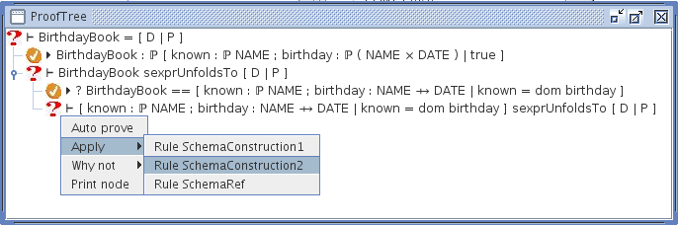
Interactive Prover

Slide 10
CZT Tools for Rules
Interactive Prover
  Useful for debugging rules
  Shows "Apply" and "Why not?" menus
Automated Depth-First Prover
  Tries all rules in order
  Shallow backtracking
Rewrite Engine
  Rewrite-until-no-change, Top-down

Slide 11
Examples
Schema Unfolding/Normalisation
ZLive preprocessing
Domain check generation

Slide 12
Issues and Challenges
(∀x:E ● P) = ⌐(∃x:E ● ⌐P)
  (∀x1:E ● P) = ⌐(∃x2:E ● ⌐P)
  (∀v:E ● P) = ⌐(∃v:E ● ⌐P)
Speed
  Need rule indexing (discrimination trees)

