Slide 1

Mark Utting The University of Waikato
Petra Malik Victoria University of Wellington

Slide 2
Overview
Our Methodology
Theory: Testing Impls vs Specs
Our “Z Unit Test” style
Demonstration
Testing Promotion
Conclusions

Slide 3
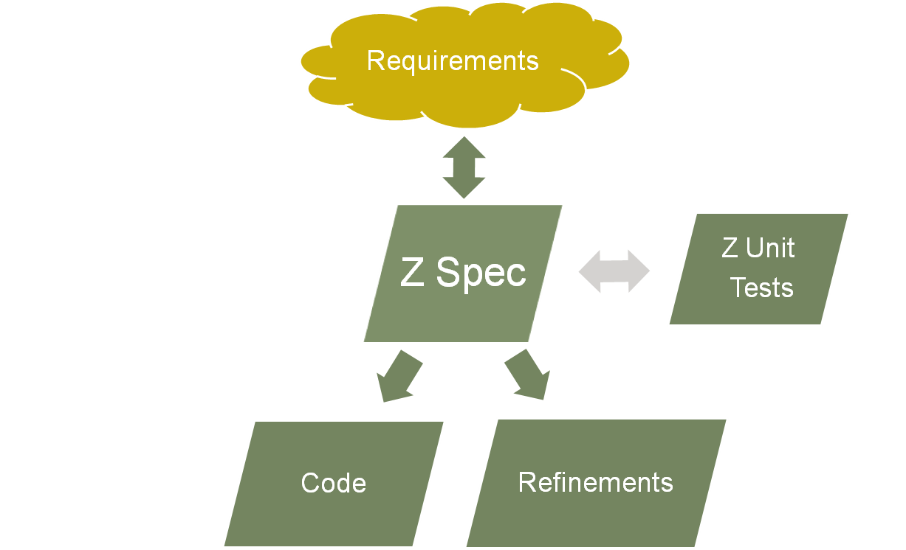
Our Methodology

Slide 4
Validation via ???
Proof (∀Op∙...)
  Abstract properties (similar to the spec)
  Harder to write
  Proofs not automatic
  Strong (universal) properties
Test ⦉x==3,x’==4⦊∈Op
  Very concrete (complementary to spec)
  Easy to write
  (example-oriented)
  Can be automated
  Weak properties
Conclude: these are complementary.
We should use both validation strategies...
We focus on support for testing in this paper

Slide 5
cf. JML
/*@ public normal_behavior
@ assignable \nothing;
@ ensures \result == pennies % 100;
@ for_example
@ requires pennies == 703;
@ assignable \nothing;
@ ensures \result == 3;
@ also
@ requires pennies == -503;
@ assignable \nothing;
@ ensures \result == -3;
@*/
public long cents();

Slide 6
Testing A Spec. (Goal: validate spec)
State
State’
The Spec
Requirements

Slide 7
Testing an Impl. (Goal: verify impl)
State
State’
Start with the Spec

Slide 8
Testing an Impl. (Goal: verify impl)
State
State’
Refinement: strengthen post

Slide 9
Testing an Impl. (Goal: verify impl)
State
State’
Refinement: weaken pre

Slide 10
So...
Validation-testing a spec is completely different to testing an implementation
When validating a spec, we want to manually design our test examples from the informal requirements
Many of the spec-validation tests would not be useful for testing an impl.
  Tests outside of pre(Op) may fail on impl.
  Tests for non-determinism may fail on impl.

Slide 11
Our Z Unit Test Style
Positive Tests
  ⦉x==3,x’==4⦊ ∈ Op
  or { eg1, eg2, eg3 } ⊆ Op
Negative Tests
  ⦉x==3,x’==5⦊ ∉ Op
  ⦉x==3,x’==5⦊ ∈ ¬Op (equivalent)
  ⦉x==3⦊ ∉ pre Op
  or { neg1, neg2, neg3 } ∧ Op = {}

Slide 12

Thanks to: Community Z Tools
Eclipse/CZT
ZLive
Test-Driven Development of Sq==[x,x’:N | x*x=x’]
Eclipse/CZT detects syntax/type errors continually
Separate Z section (DemoTest) for each spec section (Demo)
Eclipse can run ‘zlive –load Demo.tex –test DemoTest’, to check all tests

Slide 13
Promoting our Style
Recall Promotion
  PromOp == Op ∧ΦProm
ΦTestProm == [ΦProm | in?=... ]
PromOpTests == OpTests ∧ ΦTestProm
We know: OpTests ⊆ Op
We want: PromOpTests ⊆ PromOp
  True by construction!
  Can check: (ΦTestProm ↾ PromOpTests)
  = PromOpTests

Slide 14
Conclusions
A Practical TDD Style for Z
Make Students Use It
  Better quality Z specifications
  Easier to mark the Specifications!
Zlive/Jaza animation tools useful for evaluating the tests

