Slide 1
Module 2 Essential Skills for Employment Success: What Families Can Do from Home
Notes:
Slide 1: Title Slide
Talking Points
» Introduce speakers » If time allows have attendees introduce themselves

Slide 2
Session Agenda
The importance of work experiences
Building needed skills for employment
The preparation process: Explore, Prepare, and Act
Alexa’s story
Complete corresponding section of CtLC Employment Portfolio
Notes:
Slide 2: Session Agenda
Purpose of the Slide/Presenter Notes
» To let attendees know which topics the session will cover and any other logistics. Talking Points
» Go over session logistics such as timing, breaks, and location of restrooms.
» This session is intended to help families embrace competitive employment as the preferred
option for their loved one with a disability.
» It will provide information on the importance of work experiences and offer strategies on assisting people with disabilities to build skills needed for employment success.
» At the end of the session we will work through the corresponding section of the Charting the Life Course Family Perspectives on Employment Outcomes Portfolio.
» This session is the second in a three part series designed to increase the capacity of families to support their loved one towards employment success.
Follow-Up/Discussion Questions
» If time allows presenters can ask attendees to describe what they are hoping to get out of the session. What questions about employment do they have going in?
Additional Resources/References
» If session is being done in person, presenter should provide a copy of the slides in notes pages format, the Charting the Life Course Family Perspectives on Employment Outcomes Portfolio, and any other tools and resources referenced during the session.

Slide 3
Group Discussion
Please describe some of your loved one’s strongest skills, experiences, or attributes. (Things that will help them get and keep a job)
What are some skills or supports that your loved one will need to be able to be successful on the job?
Notes:
Slide 3: Group Discussion
Purpose of the Slide/Presenter Notes
» To generate interaction and to set the tone for viewing youth and young adults with disabilities as capable future employees.
Talking Points
» Ask attendees to think about their loved one’s strongest skills, experiences and attributes that would help them become employed. They can be small things like being motivated, friendly, or specifics like being good with technology or knowing how to use power tools. Encourage people to share their answers.
» We do this to give families, caregivers, and professionals the opportunity to look at the people they support in broader terms than just “a person with a disability”.
» Reinforce that all of the skills, attributes, and work experiences being shared are things that employers are looking for.
» Continue the discussion by asking attendees to identify some skills their loved one will need to learn or supports they will need to have to be successful in the workplace. Examples could be “needs to manage time better”, or “will need transportation assistance”.
» Point out that learning new skills and finding the right supports are all part of the career journey.

Slide 4

The Power of Work Experiences
One of the best predictors of employment success for people with disabilities is having meaningful work experiences while in high school.
Informational interview
Job Shadowing
Volunteering
Internships
Paid entry-level job
Notes:
Slide 4: The Power of Work Experiences
Purpose of the Slide/Presenter Notes
» It is important that attendees make the connection between youth employment success and the opportunity to have meaningful work experiences in the community.
Talking Points
» Research suggests that youth, including those with disabilities, who have meaningful work expe- riences or a paid job while in high school will have improved employment outcomes as adults.
» Unfortunately, students with more significant disabilities often don’t have access to these types of work experiences.
» Therefore it is vital that families advocate for these work experiences.
» A work experience is a chance to practice real work, and should be done at a business in the
community doing a job that matches what the student is interested in.
» Consider this example: The young lady pictured on the slide is interested in a career working with animals. She does not know about the wide range of jobs in that field, so she asks a local Veterinarian for an Informational Interview to learn more. She is still interested in learning more so she seeks an opportunity to Job Shadow a Veterinarian Assistant for half a day. To help build her resume she Volunteers once a week at the local animal shelter. When she nears graduation she get an opportunity to work inside an animal clinic as part of an Internship program. Given all of these quality work experiences she finds a Paid Entry-Level Position working as a Vet Tech
Follow-Up/Discussion Questions
» Have any of your loved ones had work experiences before? If so, what were they? » What type of jobs do you think your son or daughter would be interested in exploring?

Slide 5
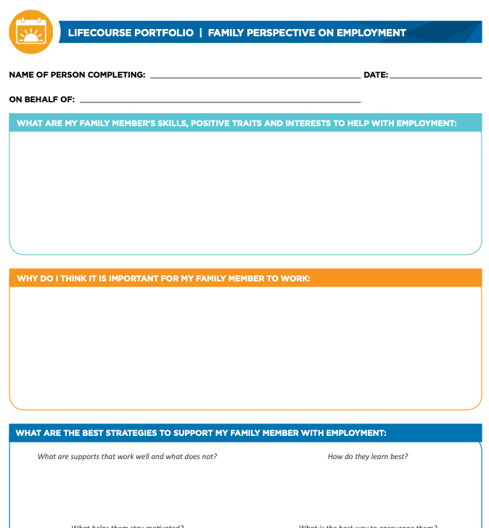
CtLC planning tool section
Notes:
Slide 5: Family Perspective on Employment Outcomes Portfolio
Purpose of the Slide/Presenter Notes
» This slide prepares attendees to complete the corresponding section of the Charting the Life Course Family Perspective on Employment Outcomes Portfolio at the end of the session.
Talking Points
» Please take out your copy of the portfolio.
» In each of the three sessions we will ask you to complete one section of the portfolio to
better help you set goals for competitive employment for your loved one.
» For this session we will focus on answering the questions found in the three boxes on the right side of the first page.
» You may wish to keep this in front of you as we move through the session. Additional Resources/References
» Charting the Life Course resource materials: www.lifecoursetools.com/

Slide 6
Build skills and set expectations at home
Practice applying those skills in the community
Seek jobs that match interests and skills
Notes:
Slide 6: Building Blocks of Employment Success
Purpose of the Slide/Presenter Notes
» This slide offers a model of the building blocks of employment success. The purpose is to simplify the steps so attendees don’t feel so overwhelmed about supporting their youth.
Talking Points
» As a parent or a caregiver it can feel overwhelming to think about your loved one with a signifi- cant disability finding a job being successful. It is OK to have questions and concerns. To make it simpler, we are suggesting you focus on some key building blocks to employment success.
» Begin by setting the expectation with your loved one, and everyone that supports them (including educators), that a paid job in the community is the goal. Use the opportunity to use common responsibilities in the home to build skills.
» Find opportunities for your loved one to practice soft and hard skills in the community. This may include practicing navigating public transportation, making eye contact while speaking, or maintaining appropriate hygiene.
» Resist the temptation to think about “jobs people with disabilities can do”. Rather, seek work experiences and paid jobs that match your loved ones interests and skills. It is OK for people to get entry-level jobs doing thing they may not want to do forever. But it is not OK to put somebody into a job that is restrictive just because they have a disability.
Follow-Up/Discussion Questions
» Do you currently have your loved one do chores in the home?
» When you are in the community with your loved one do you try to find opportunities for
them to practice skills (such as using money or communicating with others)?
» Have you and your loved one talked about various jobs that might match their skills and interests?

Slide 7
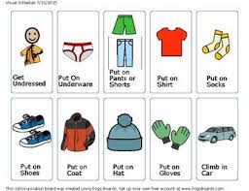
Soft Skills
Teamwork
Being punctual
Dressing appropriately
Responsibility
Good attitude
Notes:
Slide 7: Soft Skills
Purpose of the Slide/Presenter Notes
» If families understand the importance of soft skills in employment success they’ll be more motivated to help build those skills through activities in the home.
Talking Points
» Soft skills are the interpersonal and self-direction skills we all use to be successful in jobs and living independently.
» They are important because every job requires a person to have some level of soft skills.
» These skills include working as part of a team, being places on time, dressing appropriately,
showing initiative, and having a positive attitude.
» For many of us, our soft skills were nurtured through the expectations our families had of our
behavior and level of responsibility.
» Therefore, families of individuals with disabilities can help build these skills and should see it
as important.
» The slide includes an example of a picture board that can be used to work on the steps
needed to get dressed and get to a vehicle.
Follow-Up/Discussion Questions
» Sometimes a person’s disability makes soft skills particularly challenging. » Are there any soft skills that your loved one excels at? » Are there any soft skills that your loved one will find a challenge?
Additional Resources/References
» Skills to Pay the Bills Video Series: www.youtube.com/playlist?list=PL5-XYot2VKQM9o8zNFuVWXMhrNLSTkEpM
» Helping Youth Develop Soft Skills for Job Success: Tips for Parents and Families: www.ncwd-youth. info/publications/helping-youth-develop-soft-skills-for-job-success-tips-for-parents-and-families/

Slide 8






Positive Mental Attitude (PMA) Roll the Dice!
Something I would like other people to know about me is…
I am proud of my ability to…
I am thankful for…
Other people compliment me on my ability to…
I feel really good about myself when…
Something nice I recently did for someone was…
Notes:
Slide 8: Positive Mental Attitude (PMA): Roll the Dice!
Purpose of the Slide/Presenter Notes
» Provides an activity that can be used to boost self-image and positive attitude of youth. Talking Points
» Having a positive attitude self-confidence are among the soft skills employers value most.
» This is a simple activity families or professionals can do with individuals to help them see that they have skills and attributes that others appreciate.
» The slide has a description of the question that should be asked for each possible roll of a die.
» Information gathered can also be included on a vision statement (described later) and a resume.
Follow-Up/Discussion Questions
» Presenters may wish to have an oversized die and run the activity with attendees.

Slide 9
Self Reflection
Self reflection is like looking into a mirror and describing what you see. It is a way of evaluating yourself and how you work.
I am most proud of my ability to
One area I would like to improve is
Some ways I can work to improve this skill are
Notes:
Slide 9: Self Reflection
Purpose of the Slide/Presenter Notes
» Offers an activity to help youth reflect on their current skills and talents, and to plan for acquiring skills they would like to have.
Talking Points
» Another simple activity for building soft skills is self-reflection. This entails having your loved one look into a mirror and describe what they see.
» Some possible reflection questions are listed on the slide. Others might include “What I am most looking forward to about becoming an adult is ______.”, or “What concerns me most about getting a job is ______.”
» Have your loved one tell you their answers if they are comfortable with it and use it as an opportunity to have discussions about self-image, skills and employment.
Follow-Up/Discussion Questions
» Do you believe that your loved one has a strong sense of their own self-worth and skills?
» What can you do as a family member to help your loved one have a positive perception of themselves?

Slide 10
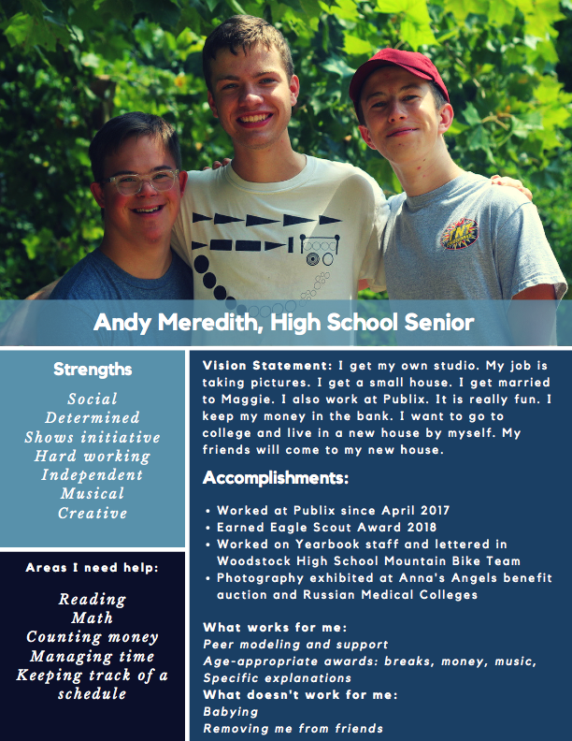
Building a Vision Statement
www.kentuckyworks.org/2018/08/07/brighter-futures-vision-statement/
Notes:
Slide 10: Building a Vision Statement
Purpose of the Slide/Presenter Notes
» Shows an example of a “vision statement” where youth express their goals for the future, identify areas they need support, and detail their strengths and accomplishments.
Talking Points
» This is an example of a Vision Statement where an individual gets the opportunity to express their dreams, goals, accomplishments, preferences, and support needs in their own words.
» This makes for a great classroom activity, or something a family can help with at home.
» The Vision Statement helps people tell their story in a visual way and can double as a resume. It also helps the world see a person not only as a person with a disability, but as a person who has their own dreams, skills, and aspirations.
» The URL on the slide takes you to a Word template of this vision statement. The University of Kentucky has made this available free of charge. Anybody can insert their picture and information and create their own Vision Statement.
Additional Resources/References
» Website with free Vision Statement examples and template: https://www.kentuckyworks.org/2018/08/07/brighter-futures-vision-statement/

Slide 11

Hard Skills
Operating a wheelchair
Counting money
Navigating from point A to point B
Using technology
Getting dressed
Riding a bicycle
Using machinery
Notes:
Slide 11: Hard Skills
Purpose of the Slide/Presenter Notes
» Highlights the importance of teaching youth the real (hard) skills needed to live independently and be successful in employment.
Talking Points
» We previously talked about the importance of soft skills to employment success. But families should also understand the value of teaching their loved one hard skills, or those real world skills that people use to function day to day.
» These include things like navigating from point A to point B, cooking a simple meal, getting dressed, or counting money.
» We certainly understand that the impact of a disability will mean that people may need support achieving some of these skills. It will look differently for everyone. For example cooking a meal may entail following a recipe and using an oven for one person while another may need support to use a microwave safely.
Follow-Up/Discussion Questions
» What are some hard skills that you think would lead to employment success? » What hard skills does your loved one excel at?
Additional Resources/References
» Helping Youth Build Work Skills for Job Success: Tips for Parents and Families: www.ncwd-youth.info/wp-content/uploads/2016/11/infobrief_issue34.pdf

Slide 12
Building Responsibility
Finding ways for young people to have responsibilities helps them be good employees.
Chores
School work
Own bank account
It’s OK for young people to take risks and to experience failure. The goal is to have them give a good effort.
Notes:
Slide 12: Building Responsibility
Purpose of the Slide/Presenter Notes
» Youth with disabilities need opportunities to build responsibility. This slide encourages attendees to consider giving youth chores and allowing them to take risks.
Talking Points
» Sometimes families of youth with significant disabilities shy away from assigning them chores or responsibilities in the home. This may be due to behaviors or mobility/dexterity challenges. However, many of us learned responsibility by having to take care of a pet, do the dishes, or take out the garbage.
» On a broader scale building responsibility can mean that a person is accountable for completing their school work, exercising regularly, or treating others with respect. This ability to be responsible will translate to the workplace.
» Building responsibility might mean that your loved one will need to be pushed to try new things and go outside of their comfort zone. In doing so they may not succeed right away. That is OK, because taking risks and failing is also a valuable learning experience.
Follow-Up/Discussion Questions
» When you were growing up, how did your family help you build responsibility?
» Can you describe a situation where you gave your loved one some extra responsibility? Were
they successful or did they struggle a bit?

Slide 13
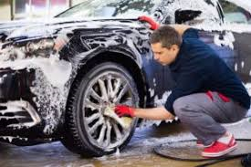
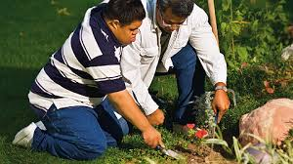

What are Employers Looking For?
We need to translate the skills and talents of youth into what employers are looking for.
“I am _______, and that allows me to ________ .”
Notes:
Slide 13: What are Employers Looking For?
Purpose of the Slide/Presenter Notes
» This slide includes an exercise for youth where they explain a skill or talent they have in terms of its usefulness to an employer.
Talking Points
» It is important to consider what skills employers are looking for in an employee. For example, a retail store will be looking for a person who can operate a cash register or organize stock. A landscaper might want a person who doesn’t mind working outside, is physically strong, or who can use lawn equipment. Your loved ones have skills that can be matched to employer needs.
» Jobs can be “customized” to meet individual strengths and employer needs. For example, a person might not be able to operate a cash register, but is excellent at moving stock from the back to the displays and is helpful and friendly.
» Youth with disabilities may have difficulty translating their strengths and skills to what employers are looking for. The activity on the slide is good practice.
» Help your loved one fill in the blanks of this sentence - “I am ______, and that allows me to _______.” For example, “I am flexible and that allows me to take on new jobs easily.”
Follow-Up/Discussion Questions
» Presenters can have attendees complete this activity by thinking about themselves.
» What are some ways a person who has difficulty communicating could share their skills and
strengths with an employer?

Slide 14
Example
Step 1: Get teen debit card (Greenlight or FamZoo)
Step 2: Load card with $20
Step 3: Work with youth to set a menu
Step 4: Have youth take lead for buying related groceries (under budget)
Step 5: Use debit card to make transaction
Step 6: Have youth help make the meal
Notes:
Slide 14: Example
Purpose of the Slide/Presenter Notes
» This is an example of how a families can take some of the previously mentioned concepts to help youth build skills and responsibility.
Talking Points
» Now, let’s put some of the strategies we been discussing together in an example of something you can do in the home to build skills.
» If they don’t have one already, help them get a teen bank account and debit card. Load the card with $20. Work with them to set a menu for a family dinner. Something that requires multiple ingredients and that needs to be cooked. For example, pork chops, a rice side dish, and green beans; or pasta, red sauce, garlic bread, and salad. Take your loved one to the grocery store and have them purchase components for the meal with their debit card. Finally, help your loved one prepare and serve the meal. Maybe even have everyone in the family dress up for the occasion.
» Theseexercisereinforcesmoneymanagement,planningatasktoanoutcome,organizing,working as part of a team, problem solving, using kitchen appliances, and dressing for the occasion.
Follow-Up/Discussion Questions
» Different people may require more support to do an activity like this. The purpose is to practice skills to the greatest extent they are able.
» Consider using a picture board (also called task boards) to show the steps in the task.
» Celebrate your success while you eat!
Additional Resources/References
» There are many examples of picture boards on websites like Pinterest. Education supply and support websites also offer templates.

Slide 15
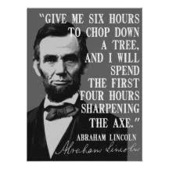
The Process
Explore
Prepare
Act
Notes:
Slide 15: The Process
Purpose of the Slide/Presenter Notes
» This slide introduces the 3 main steps for helping youth through the employment process: Explore, Prepare, and Act.
Talking Points
» It might be easier for a family to think of career preparation in terms of a process with the following steps: 1) Explore, 2) Prepare, and 3) Act.
» The quote on the slide is meant to reinforce the idea that preparation is perhaps the most import step for being successful in a task. We must prepare our youth to be successful in the workplace. Placing people into competitive jobs without the proper skills or supports can sometimes result in a negative experience.
» “Explore” refers to youth exploring the types of career options that match their interests and skills. Often, youth with disabilities have a limited idea of what types of jobs there are in the world. The more we can expose them to different settings and tasks, the wider their job choices may be.
» Once youth have explored some possible career areas it is then necessary to “prepare” them to be successful in the workplace. This entails identifying the skills needed to do their preferred job and assessing if the youth has those skills or needs to acquire them. The previous slides on work experiences and building soft and hard skills speaks to this need.
» Finally it is necessary to “act” on the job goal by seeking a work experience or paid job in the field of interest. Keep in mind that the first job should not be the last job a person ever has, and that it is OK if the first job is challenging.
» It is not uncommon for youth to cycle through this process a few times before they find the right fit for them.
Follow-Up/Discussion Questions
» This is the same process that most of us followed to begin our career path. As stated before, entry-level jobs are very valuable, but our ultimate goal to set youth on a path to have a career in a field that interests them. These steps can be done while a person is working in an entry-level position.
Additional Resources/References
» Understanding the New Vision for Career Development: The Role of Family: www.ncwd-youth.info/publications/understanding-the-new-vision-for-career- development-the-role-of-family/

Slide 16
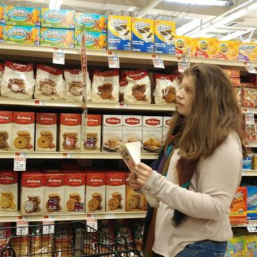
Explore Career Options
Set employment goal early
Build responsibility
Explore community-based options
Advocate for work experiences
Use your networks
Notes:
Slide 16: Explore Career Options
Purpose of the Slide/Presenter Notes
» This slide is to help families and guide the conversation on how they can help their loved one explore careers.
Talking Points
» Employment goals can be set in the home by just having conversations about employment and then exploring online and in the community on a specific interest.
» Families can ask for an employment goal to be added to the IEP so the school can support the individual with a specific employment goal.
» Building independence and confidence in individuals by obtaining different relationships outside of school can help with communication skills as well.
» Have the participants think about their own community/network; are there art classes, sports, internships or dance classes. It never hurts to approach an organization and ask how one can get involved.
» Do you know someone that owns a business that would be willing to consider having your son/daughter work there one day a week? A neighbor that has a dog - would they let your loved one walk the dog?
» The school could help with finding work experiences - an internship that could be created at the school.
Follow-Up/Discussion Questions
» Think about all the different types of jobs that may be available in an employment setting. For example – a flower shop is not just about making floral arrangements. There are many different types of jobs in one setting – think broadly about all of the options.
» It is important for families to understand that they can have a role in supporting and exploring options for employment and by doing so, it will help their loved one better understand what they want and what they don’t want for a job.

Slide 17
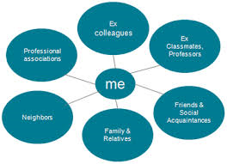
Using Personal Networks
Family
Friends
Places of worship
Businesses you frequent
Neighbors
Book club
Co-workers
Notes:
Slide 17: Using Personal Networks
Purpose of the Slide/Presenter Notes
» This slide encourages families to use their own personal networks to help find work experience and employment opportunities for their youth.
Talking Points
» The term “personal network” may seem formal, but it simply refers to all the people that you know and interact with. It may be family, neighbors, co-workers, friends, people you worship with or are part of your book club. Everybody has a personal network and they are a valuable resource to help find work opportunities for youth.
» Schools and employment programs may be tasked with finding youth work experiences or paid jobs, but they don’t know all the employers in your area. Families can be a partner in the process by suggesting possible work matches and accessing their networks for contacts.
» For example, let’s say a youth wants to explore automotive careers but the school or employment provider does not have any contacts in that industry. The family can ask their network if they know anybody at an auto repair business or dealership, and if they could facilitate a contact (name, phone number, mention that somebody will be contacting them).
» With social media it is easier than ever for people to access their networks. Follow-Up/Discussion Questions
» What was your first job and did your family play a role in helping you get it?

Slide 18







Getting Involved
Notes:
Slide 18: Getting Involved
Purpose of the Slide/Presenter Notes
» Another way youth with disabilities can build employment skills is to be involved in extra- curricular and community based organizations
Talking Points
» Another important strategy for helping youth build responsibility, teamwork skills and social connections is to encourage them to be involved in school and community activities.
» Unfortunately, options can seem limited for such opportunities for youth with significant disabilities. Families are encouraged to prioritize getting youth involved in things like choir, drama, scouting, and sports. Many communities also have unique opportunities like community gardens, clubs catering to specific interests, and church activities.
» Remember that involvement in these activities should be included on the resume or vision statement.
Follow-Up/Discussion Questions
» What were some activities you were involved in as a youth? Can you describe some skills that you acquired as a result?
» Is your son or daughter currently involved in extracurricular or community-based activities? What has been the impact of that involvement?

Slide 19
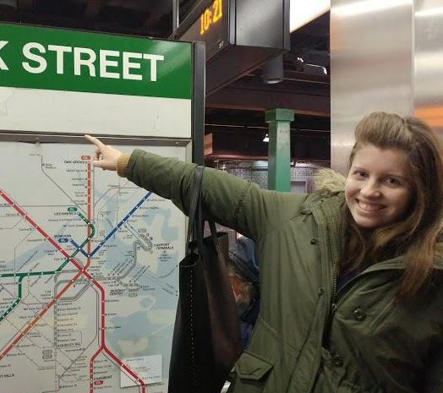
Preparing for Employment
Social Skills
Hygiene
Safety–school, community, transportation, appropriate relationships
Expanded use of technology
Practice independent skills
Focus on the skills needed to obtain and maintain a job!
Notes:
Slide 19: Preparing for Employment
Purpose of the Slide/Presenter Notes
» This slide is intended to help families think about the skills that are necessary to not only obtain a job but also maintain a job.
Talking Points
» Social Skills can enhance and cultivate friendships, help resolve conflict, work on appropriate conversation, and help to reduce anxiety in social situations. These skills are needed in a workplace especially when working with different individuals and can help to work with an employer.
» Hygiene and personal grooming may not be something that someone thinks about as a skill to help stay employed but for some, it is a learned skill.
» For most families, safety is the biggest concern. It is really important that families talk about this as it relates to becoming employed and being out in the community. Schools can help with skill building around safety and preparing students on how to be safe in the community and eventually in the workplace. You can ask the families what it is that they fear and how they think the school could be helpful and what they can do to provide skill and knowledge.
» Technology is a great tool and can support in safety skills for transportation– texting when someone arrives at a destination, using google map, MBTA app., ride share apps that have built in safety features.
» Technology can also be used for communication. A smartphone or device can be used to keep a list of activities that need to be completed at a job site, create a list of conversation starters, and set a timer to get up on time. Ask the school about other ways to use technology to enhance someone’s life and allow them to do more.
» Ask families to think of ways that their loved ones could start to become more independent within the community. Think about the things that we do for our loved ones each day that they could possibly do on their own. Start having them do it themselves but with support that might be needed. Do you brush your daughter’s hair each day? Have her to go in front of a mirror and start to practice and do it herself – first with support and then fade the support. Start to show them how to do their own laundry and purchase items at a store, order food at a restaurant or takeout on the phone.
» Review with families all the skills needed to obtain and maintain a job and to have them start to think about these skills and to work with the school, the community and at home to support their loved one.
Follow-Up/Discussion Questions
» What is your loved one’s biggest strength? » What supports are needed to help your loved one prepare for employment?

Slide 20
Navigating Transportation and Options
Consider all options for transportation
Start early and often– take walks and discuss safety, point out traffic signals – eventually allow for a short walk to the mailbox or a neighbor’s house– baby steps
Travel Training Goal in IEP
Public Transportation/Ride Share/The Ride
Use of Technology
Notes:
Slide 20: Navigating Transportation and Options
Purpose of the Slide/Presenter Notes
» In this slide we want to say up front that we understand that not everyone will be using public transportation and/or ride share but for those that are able to do so, they should think about all of the options available in their area and help to prepare their loved one to access different options.
Talking Points
» The presenter can start by asking everyone if they are apprehensive about their loved one using any type of transportation. Most caregivers do have apprehension and that is why it is so important to make sure all the skills discussed on the previous slide are being worked on in school, at home and in the community.
» Travel training should be added as a goal in the IEP early. Start by being out in the community and going on walks. Progress to more outings in the community with smaller groups and more focus on safety in traveling, finally allowing for small independent trips in your neighborhood such as to mail a letter or take a short walk. Everyone involved needs to feel comfortable with traveling more independently.
» If public transportation is an option, start out with one or two destinations, ride with your loved one and start to fade the support once everyone feels ready – that could mean being on the same bus but not sitting together.
» Technology can be very helpful (as discussed in previous slides). Ride share has safety options (you are able to share your ride with someone else), the MBTA has an app to help navigate the transit system, and they offer travel training
» If traveling independently will NOT be an option, The Ride is something that some may be eligible for and you can still support your loved one by assisting in practicing the skills needed to contact The Ride. They also have a pilot program with reduced fares for ride share
Follow-Up/Discussion Questions
» What is your biggest fear with transportation? » Do you have a goal in your loved one’s IEP around transportation?
Additional Resources/References
» https://help.uber.com/driving-and-delivering/article/share-your-trips-with-family-and-friends- -?nodeId=9890b65b-e204-46a4-8bae-fa444faed74c
» www.mbta.com/accessibility/travel-training
» www.mbta.com/accessibility/the-ride/on-demand-pilot

Slide 21
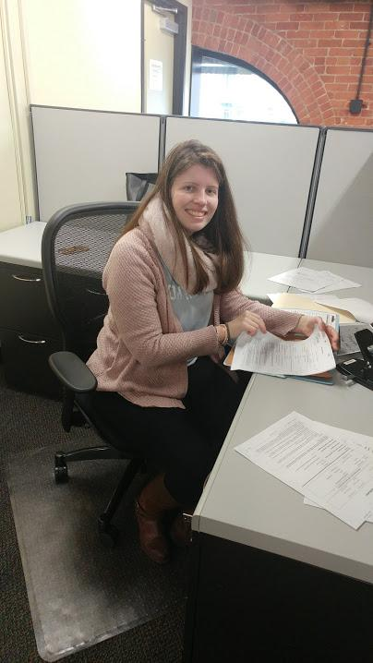
Actions Towards Employment
Less time in school and more time in the community!
Work Experience – every little bit counts!
Break down what a day “on the job” would look like and practice the routine.
Connect with state agencies to understand the support that may be available.
Notes:
Slide 21: Actions Towards Employment
Purpose of the Slide/Presenter Notes
» In this slide the presenter will want the families to think about the actions needed for their loved one to move closer to being employed.
Talking Points
» Not all families will have a loved one that will stay in school until the age of 22 but for those that do, it will be important for them to advocate for more time outside of the school’s four walls and much more time in the community having different types of experiences.
» In the previous slides, we discussed skills needed to be employed, this is a good time to continue to practice those skills in real world situations. Internships, grocery store purchases, taking public transportation, volunteering at a food bank or community center, ordering lunch at a restaurant, practicing taking ride share.
» It is also a good time to start to review what a “day on the job” would look like and practice the routine – preparing the night before by putting out proper clothing, setting a timer to wake up, setting a morning routine, thinking about transportation to and from a work site.
» Communication skills are important for employment. Practice these skill in the community. Technology can be useful, use the iPhone to write down notes and/or lists of what to do on the job – also for some, sentence starters if they get stuck on how to ask basic questions of their peer or manager.
» Discuss state agencies and support that they may provide – Pre ETS, job coach, 688 referral. Don’t put too much focus on this but make sure they know that there are supports available. It is more important to work on the skills needed to get the job at home and in community and not always to rely solely on state services.
Follow-Up/Discussion Questions
» The school can be a great partner by providing opportunities in the community and practicing skills. Have you had this discussion with them?
» Share the MRC Pre-ETS application with participants. Additional Resources/References
» www.mass.gov/service-details/pre-employment-transition-services-pre-ets-0

Slide 22
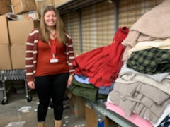
Case Study – Alexa’s Story
Inclusion in school and in the community
Expectation to “pitch in” at home and do chores – just like her sisters but modified
After School at a local Boys & Girls Club – eventually led to more friendships and work opportunity
IEP goals – internships in school, work on transportation skills, social skills, technology, safety, independent living skills
Using Social Capital – Alexa had her first internship at City Hall when she was 15 years old and first paid position at a local floral shop
Notes:
Slide 22: Case Study—Alexa’s Story
Purpose of the Slide/Presenter Notes
» Introduce a story about one family and their daughter Alexa’s journey to employment. Talking Points
» Full inclusion in school and in the community with mentors
» High expectations at home – start at an early age with chores and responsibility
» Practice independence in community
» After School at The Boys & Girls Club of Dorchester to develop more independence and Alexa was eventually employed there
» Employment goals were added to the IEP. There are so many jobs within a school and everyone needs to get creative! School store, office work, bus greeter for younger students etc.
» Using your social capital – look within your community and connections through friends and family – network!
» First job was an internship at City Hall and employed at a local flower shop (using social capital)

Slide 23
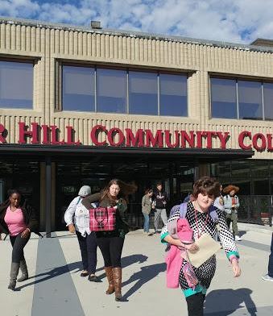
Alexa’s Story, continued
Alexa wanted to go to college – MAICEI and “You’re With Us”
Started spending less time in school and more time out in the community
Person Center Planning – Alexa wants to work in retail
Technology – supports with travel, money management, safety, setting timers/reminders, sentence starters for communication
Working with state agencies on support available after age 22
Alexa got a job at TJ Maxx just prior to leaving school at age 22
Notes:
Slide 23: Case Study: Alexa’s Story, continued
» Higher Education opportunities through MAICEI (dual enrollment) and You’re With Us at Northeastern
» Safety and travel training goal added to the IEP that included Sex Education
» Less time in school and more time out in the community working on skills necessary to
become more independent and employed.
» PersonCenteredPlanningassessmenttooltoplanfutureneedsandgoals.Thesupportsidentified
to be employed were added as new goals to the IEP and an action plan was put in place
» Technology – ride share, money management application, using an iPhone as an alarm clock
and assisting with communication.
» Connecting with state agencies to start the process of what supports would be offered when
turning 22 – support at home and at work.
» The end result - Alexa got a job at TJ Maxx, she has a job coach and she uses Uber and the
MBTA to travel (with safety features). Today she is still with the “You’re With Us” program, auditing classes at Northeastern with mentors and uses Self-Direction with DDS and works at TJ Maxx and Coleen’s Floral Shop.
Follow-Up/Discussion Questions
» All of these experiences led to Alexa being employed. Think about the experiences that your loved one is having now. How can they lead to them being employed?
Additional Resources/References
» www.mass.gov/orgs/department-of-developmental-services
» www.yourewithus.org/
» www.mass.edu/strategic/maicei.asp
» www.mass.gov/dds-self-directed-services#:~:text=DDS%20Self-Directed%20Services%20
Helps%20an%20individual%20to%20have,on%20their%20vision%2C%20path%2C%20prefer- ences%2C%20beliefs%20and%20abilities.

Slide 24
Next Steps: Complete Corresponding Section of CtLC Portfolio
What is my family member good at or interested in?
Why is it important TO ME for my family member to work?
What are the best strategies to support my family member to find and keep a job? (Please answer the 4 sub-questions.)
Notes:
Slide 24: Next Steps: Complete Corresponding Section of CtLC Portfolio
Purpose of the Slide/Presenter Notes
» Provides directions for attendees to complete the corresponding section of the Family Perspectives on Employment Outcomes Portfolio.
Talking Points
» The Charting the Life Course Family Perspective on Employment Outcomes Portfolio is designed to help families map supports, identify personal reasons to explore employment for their loved one, and to set the stage for action steps.
» Families will be asked to complete one portion of the portfolio for each of the 3 sessions in the series.
» Please refer to the right side of the first page of the portfolio and answer the questions: 1) What is my family member good at or interested in? 2) Why is it important TO ME for my family member to work?, and 3) What are the best strategies to support my family member to find and keep a job? (Please answer the 4 sub-questions.)
» If time allows, we can share our answers.

