Slide 1
Module 3 Understanding and Navigating Employment Supports
Notes:
Slide 1: Title Slide

Slide 2
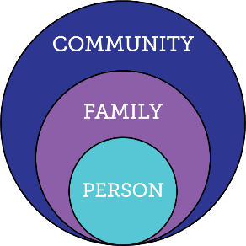
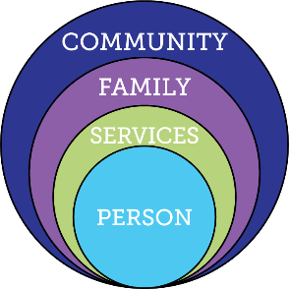

A holistic approach to supports
Everyone exists within the context of family and community
Person in relation to
Traditional
Disability Services
Integrated Services and Supports within context of person, family and community
Notes:
Slide 2: Holistic approach to supports
Purpose of the Slide/Presenter Notes
» This image illustrates the roles of family & community in supporting people with disabilities and the need to think holistically about supports. Note how the “green” service category comes between the person and family/community in the middle illustration; the model on the right is what we want, a more integrated approach that relies on all sources of support.
Talking Points
» Often when we think about transition for young people, we go straight to eligibility for adult disability services.
» But such services are only one piece of the puzzle. Each person – with or without disabilities – is already surrounded by family and community.
» Traditional service models can come between the person and their community, by leading to placement in largely segregated day and employment programming.
» Instead, we can look for ways to combine eligibility-specific disability services with other sources of support. This session will help you identify and start to access the full range of supports available to you and your loved one.

Slide 3
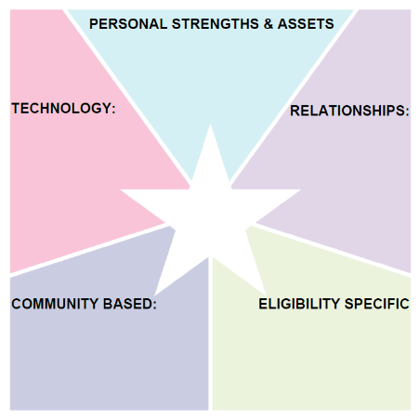
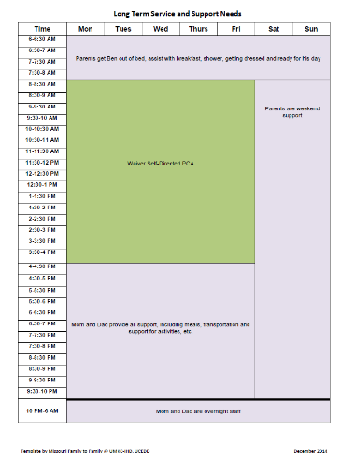
Combining Sources of Support Opens Up Opportunities
Mom, Dad
Ben’s Services & Supports
DDD Self-Directed waiver PCA staff; Medicaid; Special Needs Trust
Notes:
Slide 3: Combining Sources of Support (1)
Purpose of the Slide/Presenter Notes
» Illustrates how thinking about more sources of support can make life more interesting for the individual & provide more respite for parents. Note how Ben’s schedule in the example is all eligibility-specific services, and time with parents.
Talking Points
» We’ll go into each segment of the integrated supports star in more detail later, but this is a good illustration of how thinking more broadly can lead to a richer array of supports and activities.
» Initially, Ben’s family focused primarily on his parents and paid services as sources of support. He spent his days with staff, and evenings & weekends with Mom & Dad.
Additional Resources/References
» Integrated Supports Star examples & videos from LifeCourse Nexus: https://www. lifecoursetools.com/lifecourse-library/foundational-tools/family-perspective/

Slide 4
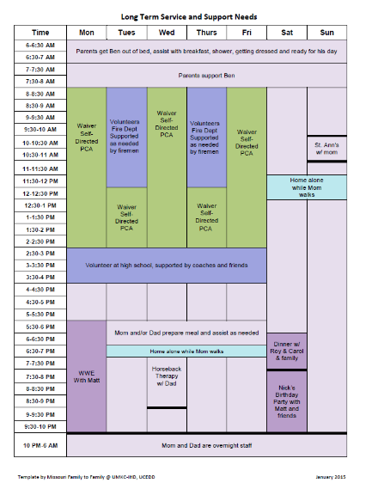
Combining Sources of Support Opens Up Opportunities
Able to stay home alone for up to an hour; has & can use i-pad;
i-pad when home alone; digital watch
Mom, Dad, Matt, Zac, Ali, Chad, Ericka, Roy, Carol, Nick, Spohn,
Ben’s Services & Supports
Firemen at ESFD; coaches & staff at ES high school; Omni bus;
DDD Self-Directed waiver PCA staff; Medicaid; Special Needs Trust
Notes:
Slide 4: Combining Sources of Support (2)
Purpose of the Slide/Presenter Notes
» Illustrates how thinking about more sources of support can make life more interesting for the individual & provide more respite for parents. Note how Ben’s schedule in this image is more colorful & varied.
Talking Points
» When Ben’s family started looking at other sources of support, they identified new ways of thinking about Ben’s days. He learned to stay home alone for short periods of time, with some technology for support and communication. He spent time volunteering at the local fire station. He spent time on evenings and weekends with friends and extended family. All these resources enabled Ben to have a more colorful life – and his parents to have some respite from their role as primary caregivers.

Slide 5
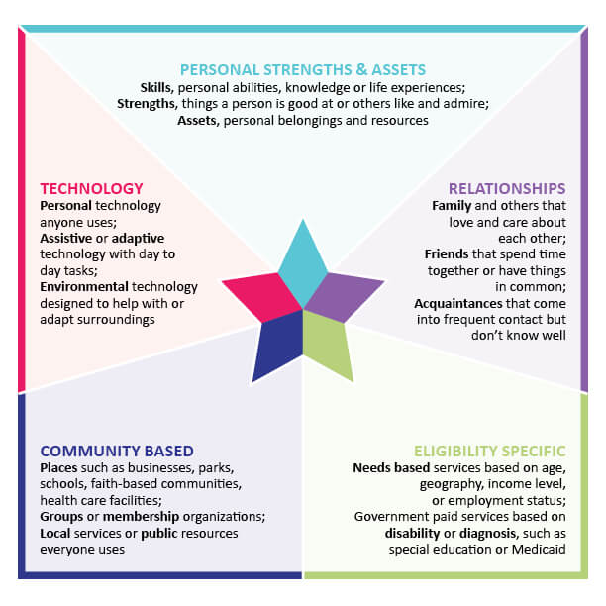
The Integrated Supports Star Can Help Identify Those Sources of Support
Notes:
Slide 5: Integrated Supports Star
Purpose of the Slide/Presenter Notes
» Overall visual of Integrated Supports Star. This is just a lead-in to the following slides which will go into each section in more detail.
Talking Points
» Today we’re going to walk you through the integrated supports star with a goal of identifying how resources in each of these five areas can help support your loved one’s vision for a good life now and in the future.
» The Charting the life course integrated supports star is a tool for identifying supports in five areas. You’ll recognize some of these colors from Ben’s schedule in the previous slide.
» Teal is personal strengths & assets, such as Ben’s gaining the skills to stay home alone for short periods of time.
» Purple is relationships – family, friends, neighbors, and other community members.
» Green is eligibility-specific services such as those provided by schools or DDS.
» Blue is community-based resources such as local businesses, parks and churches
» And pink is technology – both assistive technology specifically for people with disabilities and generic technology such as iPhones and iPads.
» The rest of this module will review the star, point by point.

Slide 6
Notes:
Slide 6: Personal Strengths & Assets (definition)
Purpose of the Slide/Presenter Notes
» Sets the stage for further exploration of this part of the star on next slide.
Talking Points
» Review the definition of personal strengths & assets on this illustration.

Slide 7
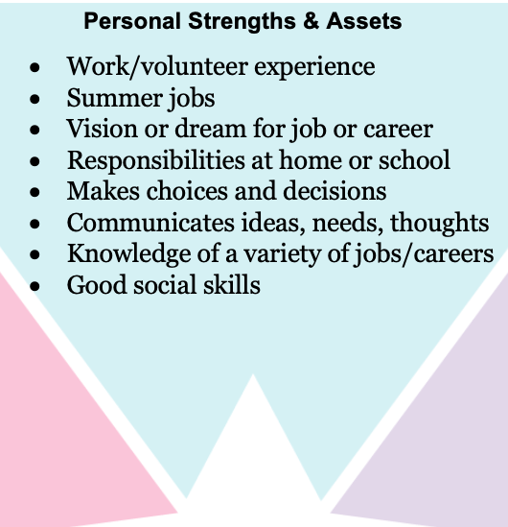
Personal Strengths & Assets
What did you learn from Module 1 that you can enter into the star re: your loved one’s personal strengths & assets?
Notes:
Slide 7: Personal Strengths & Assets (prompt)
Purpose of the Slide/Presenter Notes
» Get participants to reflect on Personal Strengths & Assets. Talking Points
» Ask participants to jot a few ideas in the Personal Strengths and Assets section of the star on their portfolio.
» Personal strengths & assets are an important starting point for thinking about loved one’s supports.

Slide 8
Notes:
Slide 8: Relationships (definition)
Purpose of the Slide/Presenter Notes
» Focus on Relationships; Sets the stage for further exploration of this part of the star on next slide.
Talking Points
» Review the definition on this illustration.

Slide 9
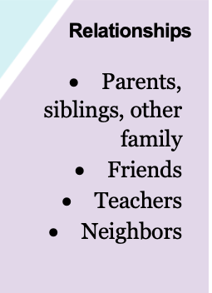
Relationships
Who do you know who has a job your loved one might be interested in?
Who does your loved one know?
How can they build more community relationships now that might lead to future opportunities for jobs or community engagement?
Notes:
Slide 9: Relationships (prompt)
Purpose of the Slide/Presenter Notes
» Get participants to reflect on Relationships Talking Points
» Ask participants to jot a few ideas in the Relationships section of the star on their portfolio.
» Keep in mind not just close relationships but acquaintances too (neighbors, classmates, etc.). We all benefit from having a wide network of loose connections, in addition to our close friends & family members.

Slide 10
Notes:
Slide 10: Technology (definition)
Purpose of the Slide/Presenter Notes
» Define Technology & set the stage for further exploration of this part of the star. Talking Points
» Review the definition on this illustration.

Slide 11
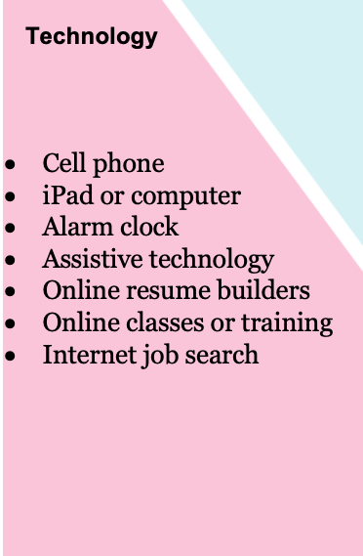
Technology
How do you use technology in your day-to-day life and job?
How does your loved one use technology?
Are there new tools they could be learning to use that will help them with employment in the future?
Notes:
Slide 11: Technology (prompt)
Purpose of the Slide/Presenter Notes
» Get participants to reflect on Technology Talking Points
» Ask participants to jot a few ideas in the Technology section of the star on their portfolio.
» The role of technology has accelerated since COVID-19, with many options for individuals, families and providers to access remote or technology-based supports. A lot of these options use devices you might already have, such as iPhones and iPads.
» Think about the need for not just the technology itself but also the skills to use it safely & maintain an appropriate online persona.

Slide 12
Notes:
Slide 12: Community Based (definition)
Purpose of the Slide/Presenter Notes
» Sets the stage for further exploration of this part of the star on next slide. Talking Points
» Review the definition on this illustration.

Slide 13
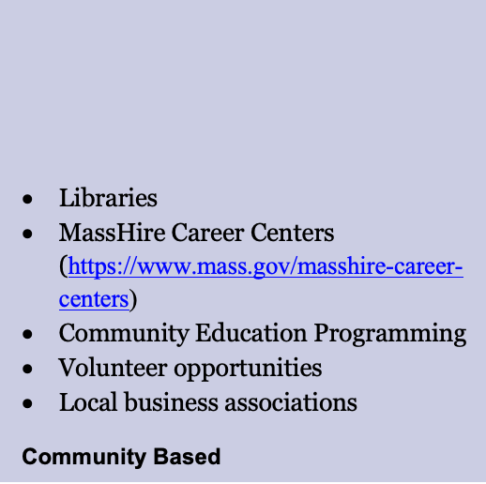
Community Based
Notes:
Slide 13: Community Based (prompt)
Purpose of the Slide/Presenter Notes
» Get participants to reflect on Community Based resources Talking Points
» Ask participants to jot a few ideas in the Community Based section of the star on their portfolio.
» Communities have a lot to offer, including many resources available to anyone in the community with or without a disability. This list and example Community Assets Map can give you some ideas to get started.

Slide 14
Discussion Questions
In filling out your star, what was one thing that surprised you?
What lessons did you learn?
What next steps are you going to take based on what you learned?
Notes:
Slide 14: Discussion Questions
Purpose of the Slide/Presenter Notes
» Lead a discussion of the first four points of the star, using the questions on the slide. If you have a large group, consider setting people up in groups of 5-6, either in person or via Zoom breakouts.

Slide 15
Notes:
Slide 15: Eligibility Specific (definition)
Purpose of the Slide/Presenter Notes
» Sets the stage for further exploration of this part of the star in the next portion of the presentation.
Talking Points
» Review the definition on this illustration.

Slide 16
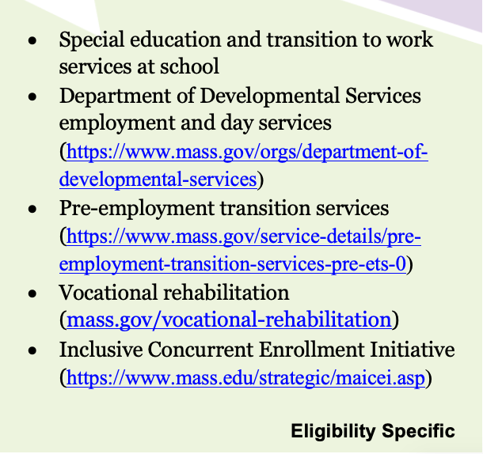
Eligibility Specific: Navigating State Services in Massachusetts
Notes:
Slide 16: Eligibility Specific: Navigating State Services in Massachusetts
Purpose of the Slide/Presenter Notes
» Transition to Part 2 of this module, on eligibility specific services in MA. Talking Points
» Next we will move on to discussing some of the specific eligibility-based services available to youth and families in Massachusetts.

Slide 17
The Role of the School
Base the IEP on post-school goals that will help the student achieve their vision
Prepare the student for meaningful participation in the IEP meeting
Provide support and instruction on self advocacy
Work cooperatively with adult service agencies and invite them to meetings
Prepare students for the world of work and independent living as it relates to their IEP goals
Notes:
Slide 17: The Role of the School
Purpose of Slide
» In this section we will focus on the services available in Massachusetts for students with disabilities. First, we will start with school services.
» Notes to Presenter Be sure to reference the IDEA (the Individuals with Disabilities Education Act). The role of school in transition is centered around IDEA, which mandates that schools help prepare students for post-secondary life.
Talking Points
» These services are required by federal and state laws and should begin at age 14. These boxes illustrate what services the school should provide in addition to academics.
» Example: John’s vision is to work in a garden center. Some appropriate IEP objectives might be travel training, appropriate social greetings, learning about common plants and how to care for them, and working on money management

Slide 18
Tips for Parents re: the IEP process
What is a transition assessment & what to ask for
Track the essential elements:
Individual Transition Plan at age 14
Offer real work experience and paid internships
Information on reaching the age of majority
Schools to issue a 688 referral 2 years before leaving school
Advocating for what your student needs
Stay informed! Join your school’s SEPAC, attend trainings, transition fairs
Notes:
Slide 18: Tips for Parents re: the IEP Process
Purpose of Slide
» Illustrate the key questions parents have and benchmarks that school should provide
» Notes to Presenter These are key elements in developing a transition plan for the student
which then is integrated into the IEP
Talking points
» Transition assessments. There is no one stop shop! The type should be guided by what else do you need to know about the student. What information is missing?
» Know the timelines
» Age 14 transition plan
» 688 referral 2 years before leaving school
» Reaching the age of majority (18 years old). What does this truly mean? Reaching Adulthood, Decision Making Support, financial benefits, voting!
» School offering work experience and internships
» Networking with others can be an important source of both information and support.

Slide 19
Massachusetts Inclusive Concurrent Enrollment (MAICE)
Offers opportunities for students with intellectual disabilities, ages 18–22, to attend college or university
Schools currently participating:
Community Colleges
State Universities
UMASS
Notes:
Slide 19: Massachusetts Inclusive Concurrent Enrollment Initiative
Purpose of Slide
» Provide an overview of the Massachusetts Inclusive Concurrent Enrollment Initiative Notes to Presenter
» This option benefits students who are looking for a college experience. Talking Points
» MACEI is a partnership between the college or university and the school system
» Provide opportunities for taking classes, person centered planning, independent living and travel training, paid work and internships, social opportunities and extracurricular activities on campus.
» Available for students 18-22 who have not passed MCAS or for students 21-22 who have passed MCAS but are still eligible for Special education services
» Currently have 11 sites throughout Massachusetts: Community colleges, state colleges and universities

Slide 20
Vocational Rehabilitation
Provided by Commission for the Blind (MCB) and Massachusetts Rehabilitation Commission ( MRC)
Eligible individuals have physical or mental impairment or are legally blind and causes barriers to employment
Services can include
Interest and aptitude surveys, diagnostic evaluations
Job placement and coaching
Assistive technology
Benefits counseling
College or vocational training
Notes:
Slide 20: Vocational Rehabilitation
Purpose of Slide
» To provide an overview of vocational rehabilitation in Massachusetts Notes to Presenter
» Important to note that 2 state agencies provide VR services- Mass Rehab Commission and Commission for the Blind. Each has their own eligibility criteria
Talking Points
» Describe eligibility of MRC and COB
» Elements of VR- assessment, training, placement
» Benefits Counseling- how work can affect federal and state benefits such as Social Security and MassHealth.

Slide 21
Pre-Employment Transition Services Pre-ETS
Provided by both Mass Commission for the Blind and Mass Rehabilitation Commission.
For any student age 14 years or older with a documented disability
Core Services:
Job exploration counseling , Work readiness training, Work-based learning experiences, Counseling in post-secondary education, Self-advocacy
Provided consultation
Notes:
Slide 21: Pre-Employment Transition Services
Purpose of Slide
» Provides an overview of Pre-ETS services (Pre-Employment Transition Services) Notes to Presenter
» Distinguish that MCB and MRC both have programs, but services are similar. Do not need to formally apply for services as they can access through school.
Talking Points
» Offered in conjunction with schools and community Pre-ETS providers. » Open to any student age 14 -22 who is potentially eligible for services » A doorway to employment- resume preparation, interviews, assessment, etc

Slide 22
Department of Developmental Services (DDS)
Eligibility
Adults with an Intellectual disability ( can include other diagnosis such as Autism, Cerebral Palsy, etc)
Adults with Autism Spectrum Disorder without an Intellectual Disability, Smith-Magenis Syndrome, Prader Willi syndrome
Provides
Day and employment services
Residential supports
Family Support
Service Coordination
Notes:
Slide 22: Department of Developmental Services (DDS)
Purpose of Slide
» Provide an overview of DDS services as an adult Notes to Presenter
» Important to note that as an adult the eligibility shifts. Must have an intellectual disability before the age of 18 or an ASD diagnosis before age 21.
Talking Points
» Basic components at 22 or leaving school- family support, day and employment, residential and service coordination.
» No longer an entitlement based on eligibility and availability of funding
» Services are different for Autism Spectrum Disorder with no Intellectual Disability

Slide 23
DDS Day and Employment Supports
Community Based Day Services ( CBDS)
Pre employment
Community access
Volunteering
Internships
Competitive Integrated Employment
Job Placement
Job Coaching
Group or individualized
Remote
Notes:
Slide 23: DDS Day and Employment Services
Purpose of Slide
» An overview of DDS Day and Employment Services Notes to Presenter
» These are some of the options offered by DDS Talking Points
» Differences between Community Based Day Support and Employment » People can receive both » Some also receive services from MRC or MCB

Slide 24
Tips For Working With DDS
Different Eligibility process for Adult services. You should apply before 18- recommend age 17
Develop a relationship with your family member’s Transition Coordinator.
Have them attend IEP meetings prior to 22
The Transition Coordinator develops the Individual Transition Plan at least 6 months before leaving school.
Access assistance from DDS Central office Ombudsman if needed
Notes:
Slide 24: Tips For Working With DDS
Purpose of Slide
» An overview of tips to transition smoothly to DDS Notes to Presenter
» Emphasize the Importance of the role of the Transition Coordinator from DDS and making sure they are eligible for adult services.
Talking Points
» Importance of a vision statement (Trajectory)
» DDS Transition Coordinator should attend IEP meetings before leaving school
» A 688 referral to adult services is essential 2 years before leaving school
» An Individual Transition Plan documents the needed services as an adult. Must be done 6 months prior to leaving school. The ITP is not an entitlement to services.

Slide 25
Publicly Funded Health Insurance
MassHealth
State of Massachusetts Medicaid Program
Pays for Long term Support Services- Personal Care Assistance, Adult Family Care, Day Habilitation, Skilled Nursing, Durable Medical equipment
Medical expenses- co pays, prescriptions
CommonHealth
Access to MassHealth benefits by paying a premium based on income
Premium Assistance
Reimbursement of private health insurance fees if you carry both MassHealth and private insurance
Medicare
Federal program for adults over 65 or have a qualifying disability or illness
Notes:
Slide 25: Publicly Funded Health Insurance
Purpose of Slide
» Overview of publicly funded healthcare programs in Massachusetts Notes to Presenter
» Important for people to realize at age 18 no longer considered under parents’ income. Important to apply for MassHealth. Pays for many services as an adult
Talking Points
» Explain difference between MassHealth Standard (meets income guidelines) and CommonHealth for the working disabled or for kids under 18 and family is over income. You pay a premium to receive this service
» Premium Assistance is offered if you carry both MassHealth and private health insurance.
» Use a MassHealth Navigator if you need any assistance. Autism Insurance Resource Center, others

Slide 26
Federal Benefits- SSI and SSDI
Social Security Disability Insurance (SSDI)
Supplemental Security income (SSI)
Eligibility
Disabled
Based on Work history
Deceased spouses work history
Parent of a child if disabled before 22
Not means tested
Will also receive Medicare
Eligibility
Disabled
Low Income
Asset limit $2000
Application
Online or visit an office
Will also receive MassHealth
Notes:
Slide 26: Federal Benefits—SSI and SSDI
Purpose of Slide
» Overview of Federal/State benefits Notes to Presenter
» Stress the Importance of Applying at age 18. When you become eligible for SSI MassHealth is automatic and pays for services
Talking Points
» Note differences between SSI and SSDI. » Eligibility and Benefits (info is on slide)

Slide 27
Able Accounts
How much?
Money in the account does not impact Medicaid benefits and balances below $100,000 do not impact SSI benefits.
What can I use it for?
Expenses to help improve health, independence or quality of life
Eligibility
Receiving benefits under Supplemental Security Income (SSI) and/or Social Security Disability Insurance (SSDI).
Disability prior to age 26
Managed by Fidelity Investments For more info contact MEFA-www.mefa.org/save/attainable-savings-plan
Notes:
Slide 27: ABLE Accounts
Purpose of Slide
» What is an ABLE Account? Notes to Presenter
» Account can be set up to save up to $100,000 without affecting benefits Talking Points
» Money can only be used for certain goods and services (i.e., college, buying a car)
» Check out the Massachusetts Educational Finance Authority (MEFA) website to see how to
apply and what you can spend the funds on
» Funds are managed by Fidelity in Massachusetts

Slide 28

Notes:
Slide 28: You Can Work and Still Get Benefits!
Purpose of Slide
» You can still work and collect benefits! Notes to Presenter
» Biggest myth: Work prevents you from collecting benefits Talking Points
» Benefit Counselors at MRC can assist you and answer your questions

Slide 29

Student Earned Income Exclusion ( SEIE)
Student Beneficiaries can work and earn up to $1870 per month and up to a maximum ANNUAL exclusion of $7750 without earnings being counted.
Qualifications:
In grades 7-12 and attending school 12 hours per week
In a college or university for at least 8 hours a week
In a skills training program to prepare them for a paying job at least 12-15 hours per week
SEIE is not automatic and must be requested in writing
Ends one month before the 22nd birthday
Notes:
Slide 29: Student Earned Income Exclusion (SEIE)
Purpose of Slide
» Illustrate the rules around earnings while you are still in school and benefits Notes to Presenter
» Important to have work experience while you are a student. Leads to the likelihood of employment as an adult.
Talking Points
» Illustrate on the slide how much students can earn

Slide 30

Questions and Answers Discussion
Notes:
Slide 30: Questions and Answers and Discussion
Purpose of Slide
» Q&A and discussion Notes to Presenter
» See below for links to state services and advocacy organizations Talking Points
» Discussion: What are one or two adult services do you most envision pursuing to help round out your star?
» If you have a large group and enough remaining time, consider setting people up in groups of 5-6, either in person or via Zoom breakouts, to reflect on their responses to the above question.

