Slide 1
Module 1 Setting Goals and Taking Action
Notes:
Slide 1: Title Slide

Slide 2
Session Goals
Set high expectations around work possibilities
Involve your loved one in imagining and planning for work
Develop ideas by identifying skills and interests
Match those skills and interests to jobs in the community
Put together an employment goal and first action plan
Notes:
Slide 2: Session Goals
Purpose of the Slide/Presenter Notes
» This module introduces Tier 2 of the Train the Trainer module. In the first tier, we explored the idea that work is for everyone, including youth with high support needs, and that competitive employment in the community is possible. This slide lists goals for this session. In this set of slides, we start with some ideas on taking first steps to help set and reach loved one’s employment goals.
Talking Points
» This continues the conversation around work possibilities for youth, including youth with high support needs
» Everyone is capable of working in the community, it’s about finding a good job match for your loved one.
» Getting your loved one involved early in the conversation about work is important
» Most of us want to work at something that interests us
» Helping your loved one identify skills and interests is an early step in finding a good work match
» Knowing what community employers are looking for is important, too
» School can prepare youth for community based work
» This information will help in putting together work goals

Slide 3
Why Work?
Make and manage money
Work with others
Make friends
Learn new skills
Make decisions
Other?
What are some fears about your loved one entering the workforce?
Notes:
Slide 3: Why Work?
Purpose of the Slide/Presenter Notes
» The intention of this slide is to generate interaction and to set the tone for viewing youth and young adults with disabilities as capable future employees. As you review the slide, generate ideas from participants on the benefits of working in a competitive, inclusive, community based job. This will build on information presented in Tier 1 (an overview of work possibilities). This session presents information that will help raise expectations for competitive, inclusive, community based work. It explores ways to identify skills and interests and how they are connected to possible work avenues. At the end of the session, the trainer(s) will help participants develop an initial action plan with the goal of competitive, inclusive, community based work in mind.
Talking Points
» During this session, we hope to explore opportunities for work by talking about expectations for work for youth with disabilities, including youth with high support needs
» Why work? Of course, making money is a main benefit of a job, and your loved one can learn and practice money management skills associated with earning money.
» Many jobs provide opportunities to interact with co-workers on the job, before and after work, and during breaks.
» Work can also be a place to develop closer relationships.
» Work situations provide opportunities to learn other decision-making, social, independent
living, and specific work skills
Follow-Up/Discussion Question(s)
» What are some hopes about your loved one entering the workforce? What about your fears?

Slide 4
Expectations and Work
If you have high expectations for competitive integrated employment, your loved one is more likely to have a job compared to youth whose parents did not hold those high expectations.
Definition**
Competitive integrated employment means full-time or part-time work at minimum wage or higher, with wages and benefits similar to those without disabilities performing the same work, and fully integrated with co-workers without disabilities (Pacer Center).
Notes:
Slide 4: Expectations and Work
Purpose of the Slide/Presenter Notes
» This slide shares information on the importance of having high expectations for work for youth.
Talking Points
» Having high expectations for employment (and in other areas) for your loved one is important.
» Communicate those expectations with your loved one and others early.
» Your loved one is more likely to have a job compared to youth whose parents did not hold
those high expectations.
» Competitive integrated employment means full-time or part-time work at minimum wage or higher, with wages and benefits similar to those without disabilities performing the same work, and fully integrated with co-workers without disabilities.
Follow-Up/Discussion Question(s)
» What are some ways to start talking with your loved one about your expectations for competitive, integrated work?
Additional Resources/References
» https://www.pacer.org/transition/learning-center/laws/workforce-innovation.asp » https://www.thinkwork.org/sites/default/files/files/parent-expectations_F.pdf

Slide 5
Engage and Encourage
Begin early to engage and encourage your loved one to be active in thinking about work possibilities
Encourage and provide opportunities for choice making, self advocacy and self determination at home, in the community, at school
Share your expectations for employment
Ask them to share their interests and skills with you, other family members, friends, trusted adults, school
Respect their ideas and choices
Encourage developing new interests and skills
Allow for changing ideas
Notes:
Slide 5: Engage and Encourage
Purpose of the Slide/Notes to Presenter
» This slide encourages participants to engage and encourage their loved one to envision and move towards their goals for work.
Talking Points
» Making choices, self advocacy, and self determination are important skills to have, so practicing them in different settings is important.
» Having high expectations for work is an ongoing conversation
» Sharing and interests and skills with family members, friends and trusted adults helps in
raising expectations and developing networks.
» Remember that developing work ideas or interests may include areas that haven’t been considered and that may even surprise others.
» Encourage developing new interests and skills.
» As your loved one gets older, tries out new interests, and has more experiences, they may
change their mind about what they want to do.
Follow-Up/Discussion Question(s)
» How can you encourage choice making, self advocacy, and self determination for your loved one throughout their day?
Additional Resources/References
www.aecf.org/m/resourcedoc/aecf-aframeworkforeffectively-2019.pdf#page=4

Slide 6
Talking About Employment
What you can do at home:
Discuss everyday jobs and what people do to earn money
Connect skills and interests to different job types
Visit career exploration websites to find out about jobs
Set a short term goal around employment
School can help:
Ask for support to achieve employment goal
Use school-based Transition Planning Form to explore job interests & build skills
Ask about Pre-ETS programs in your school district
Notes:
Slide 6: Talking About Employment
Purpose of the Slide/Presenter Notes
» This slide lists some ways that families can help their loved one think about work and how they can take steps to set an employment goal.
Talking Points
» Just raising your loved one’s awareness of jobs is a good first step. That means talking about work and jobs in general.
» Connect wok to earning money.
» Point out jobs that you and your loved one see in the community, on TV, or online.
» Connect skills and interests to jobs.
» Think about one step your loved one can take to start to connect their interests to possible jobs.
» School can help prepare for community based work. That includes developing goals and connecting with services, like Pre ETS.
Follow-Up/Discussion Questions
» How are you talking to your loved one about work and earning money?

Slide 7
How do I Help Identify Skills and Interests?
Focus on strengths
Observe what they like to do at school, in the community, or in their free time
Ask love one, family, friends for ideas
Where and when are they their best selves?
Use picture vision boards
Take an interest survey
Notes:
Slide 7: How Do I Help Identify Skills and Interests?
Purpose of the Slide/Presenter Notes
» This slide is shown to help participants think about how to help their loved ones set goals by first identifying skills and interests.
Talking Points
» When we talk about setting goals, it’s often based on a person’s interests and preferences.
» How can you help your loved one to start thinking about goals for work? To begin, focus on
your loved one’s strengths.
» If you or they get stuck on this, consider asking family members, friends and others for their ideas.
» Another way to get some ideas on their interests and strengths is to observe your loved one and take note of what kind of activities make them happy and engaged across different settings like at home, at school, or in the community.
» Using a picture vision board can also help your loved one show their interests and or goals.
» There are also sets of questions or surveys that can help with ideas.
Follow-Up/Discussion Questions
» How does your loved one show their interests and skills? Additional Resources/References
https://artfulparent.com/make-vision-board-works-10-steps/

Slide 8
Ideas to start
Try these tools and resources to gather information and start a plan
Gather information - Positive Personal Profile
Charting the LifeCourse (CrtLC) Planning Trajectories
Massachusetts Career Information System (CIS)
O*NET
Notes:
Slide 8: Ideas to Start
» Purpose of the Slide/Presenter NotesIn this slide, we explore more ways to gather information on skills and interests, and then think about how to match them to types of jobs.
Talking Points
» There are many different tools to help you think about skills, interests, and how to find a job that is a good match
» Charting the Life Course is a type of person centered planning that helps gather information and create goals
» Another type of person centered planning in the Positive Personal profile.
» Using tools like the Massachusetts Career Information System and O*Net is useful in learning
about what jobs might be a good match for your loved one’s interest and skills.
Additional Resources/References
» Charting the Life Course https://www.lifecoursetools.com/
» Massachusetts Career Information System https://portal.masscis.intocareers.org/
» O*NET https://www.onetonline.org/
» Dr. Kit https://www.drkit.org/

Slide 9
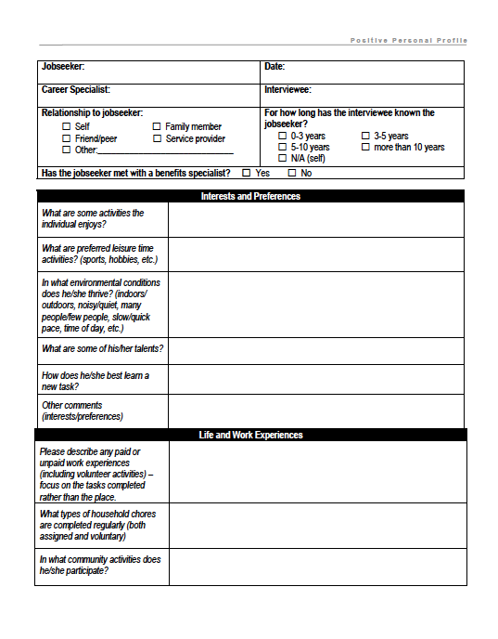
Positive Personal Profile
Many perspectives
Strength based
Experiences
Environment
Dislikes
Accommodations
Travel
Notes:
Slide 9: Positive Personal Profile
Purpose of the Slide/Presenter Notes
» This is an example of a planning tool to help gather information that will lead to a vision and action plan. Information can come from the loved one, family, friends, school or community organization staff. Because information is gathered from different people, it can offer a more holistic view of the person across different environments. There is also a section for generating creative ideas for supporting the individuals as they move forward.
Talking Points
» This profile form can capture detailed information on your loved one from different sources. That information can add to what you observe when you are with your loved one.
» It gathers information on likes, dislikes, work experience, skills, environment and other preferences, accommodation or support needs including transportation
» All this information can help when generating ideas for future activities including work, and thinking about support needs.
» This, like the vision board helps your loved one express goals, interests and preferences Additional Resources/References
» Developing a Positive Personal Profile https://employmentfirstma.org/files/PositivePersonalProfile_Transcen.pdf

Slide 10
Charting the Life course Sharing your loved one’s vision on one page
What do you want to do during daytime (school) hours when school is over?
What does your ideal day look like?
What makes a bad day for you?
Have you thought about college or vocational training for a specific job or career?
What kind of job do you think you would like?
Notes:
Slide 10: Charting the Life Course
Purpose of the Slide/Presenter Notes
» This introduces Charting the Life Course as a way of organizing ideas and developing goals. These questions will help participants generate or refine ideas for what they envision their loved one doing after leaving school.
Talking Points
» Nationally driven, research based planning tool
» Helps answer the question: What do families need to know to support a family member
across the life span?
» An action plan will help your loved one reach their work goals.
» Before creating an action plan, there needs to be a vision or goal. Let’s think about what the vision is for your loved one after they are done with high school.
» Think about what you envision them doing if they had the right supports and resources.
» These are some questions that can help you plan.
Follow-Up/Discussion Questions
» All the questions on this slide are helpful in planning, but often when starting to plan, it’s almost easier to think about what you or your loved one doesn’t want. What are some things you do not want for your loved one?
Additional Resources/References
» Charting the Life Course www.lifecoursetools.com/

Slide 11
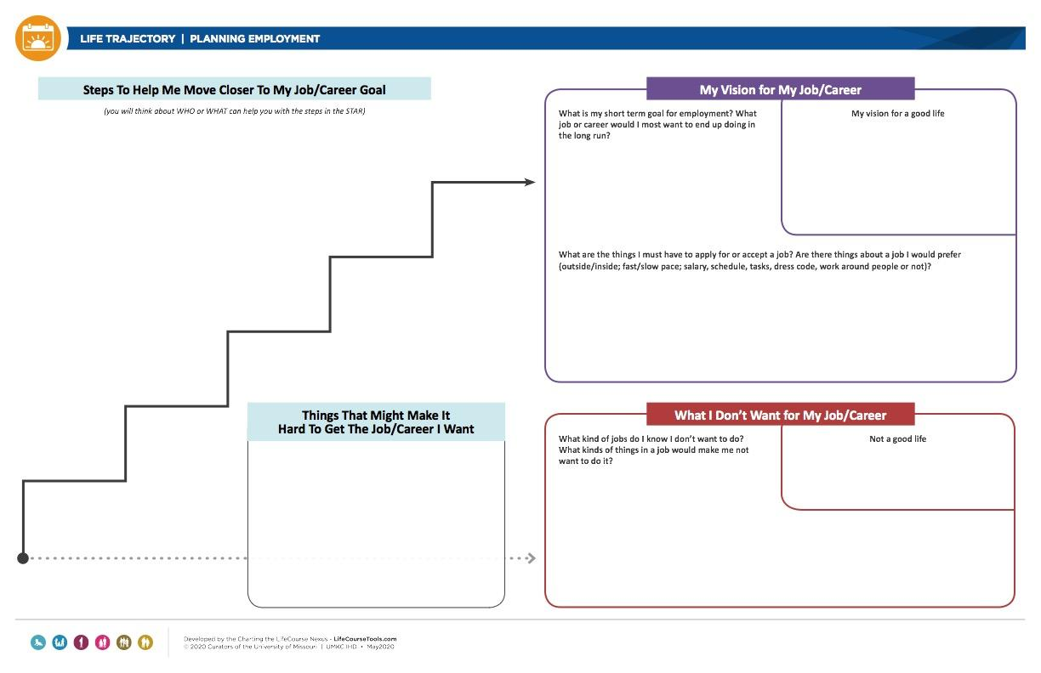
CtLC Trajectory
Notes:
Slide 11: Charting the Life Course Trajectory
Purpose of the Slide/Presenter Notes
» This slide shows a blank CtLC trajectory planning tool for planning for employment. This can help in organizing your thoughts. Some find starting at the “What I want” section helpful, others may find it more helpful to start in the “Dislikes” or “what I don’t want” just below that. Adding comments in the “what has helped” top left and “What has gotten in the way” can offer ideas for supports and resources.
Talking Points
» Here is a planning tool to help think about vision and supports
» The upward arrow points to “My Vision...” Some find that a good place to start.
» Many find the box below that (lower right), “Dislikes” On the previous slide, we talked about this as more helpful as a starting point, especially if you and or your loved one aren’t sure about ideas for work, yet.
» Now take a look at “What has helped” (upper left side) in getting closer to what is wanted or further away from what isn’t (box on the bottom).
» The steps on the upward arrow represent steps you can take to reach your loved one’s vision. For each step, think of something you can do to move you closer to your loved one’s vision
Additional Resources/References
» CtLC Daily Living and Employment Planner www.lifecoursetools.com/lifecourse-library/exploring-the-life-domains/daily-life-and- employment/

Slide 12
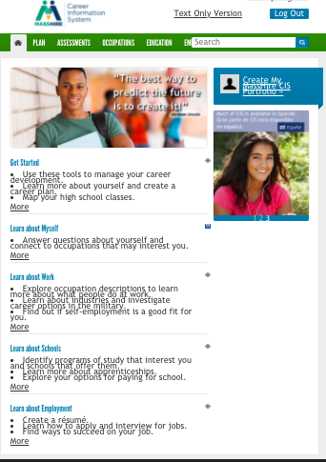
Massachusetts Career Information System
Interests
Types of jobs
Education and Training
https://masscis.intocareers.org/default.aspx
Notes:
Slide 12: The Massachusetts Career Information System
Purpose of the Slide/Presenter Notes
» This slide introduces the MA Career Information System, which can be used to assess interests, find jobs that match interests, and required training or education for specific jobs.
Talking Points
» This site from the US Department of Labor and the MassHire Department of Career Services (MDCS) is designed to provide occupational and educational information to help people make better-informed career and school choices.
» MA CIS is a site that can help figure out interests and find jobs or work areas that match
» It lets you browse so you can learn about a lot of different types of jobs.
Follow-Up/Discussion Questions
» If there is time and internet access, the trainer can demonstrate a session with input from participants.
Additional Resources/References
» Massachusetts Information System https://masscis.intocareers.org/materials/portal/home.html

Slide 13
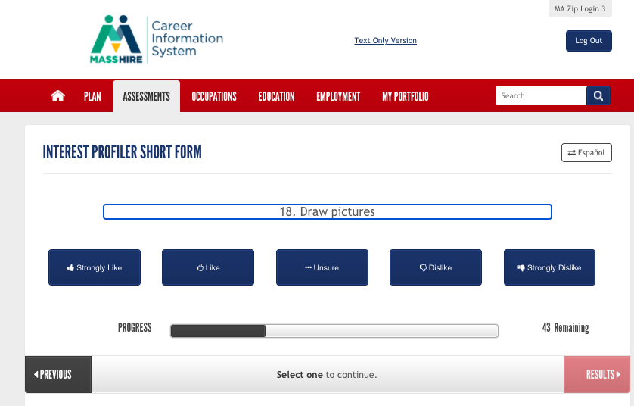
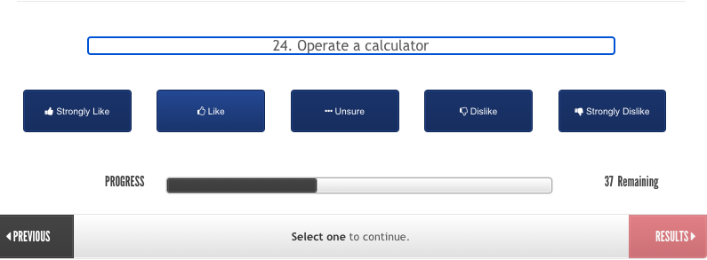
Interest Inventories–Sample Items
Notes:
Slide 13: Interest Inventories—Sample Items
Purpose of the Slide/Presenter Notes
» Here are sample items from the Interest Inventory on the Mass CIS. This interest profiler has 180 items across different job categories. There is a shorter version with 60 questions.
Talking Points
» Here are 2 sample questions form the Interest Inventory » There are 60 questions on the short version and 180 questions in the long form.

Slide 14
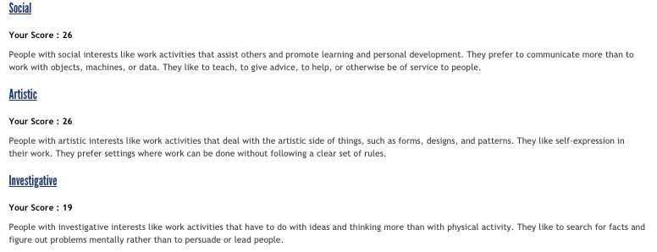
Results from an interest inventory
Notes:
Slide 14: Results from an interest inventory
Purpose of the Slide/Presenter Notes
» This is an example of the Interest Inventory score sheet. It lists scores in different categories: Artistic, social, conventional, enterprising, realistic, investigative. These categories are associated with different jobs, and the higher scores indicate an interest in that area.
Talking Points
» This is an example of the Interest Inventory score sheet. It lists scores in different categories: artistic, social, conventional, enterprising, realistic, investigative.
» These categories are associated with different jobs, and the higher scores indicate an interest in that area.
» This information helps identify possible job or job areas for your loved one.
» Once the inventory is completed, you’ll get a score across different areas that can guide you
and your loved one to potential jobs associated with these scores.

Slide 15
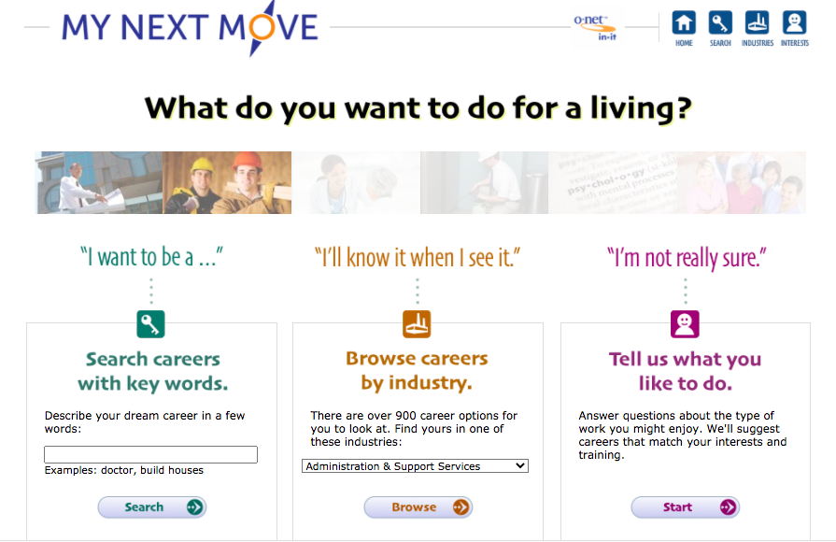
My Next Move
www.mynextmove.org/
Notes:
Slide 15: My Next Move
Purpose of the Slide/Presenter Notes
» This is another career information website from My Next Move / O*NET and the US Department of Labor called My Next Move. This site has information on finding out about interest areas and exploring different jobs and industries.
Talking Points
» Here is another way to discover your interests and match them to possible careers. » This website is from the U.S. Dept. of Labor that matches all these qualities to job types. » Can look at jobs by entering keywords » Can explore jobs by industries, too.
Additional Resources/References
» O*Net Online www.mynextmove.org/

Slide 16
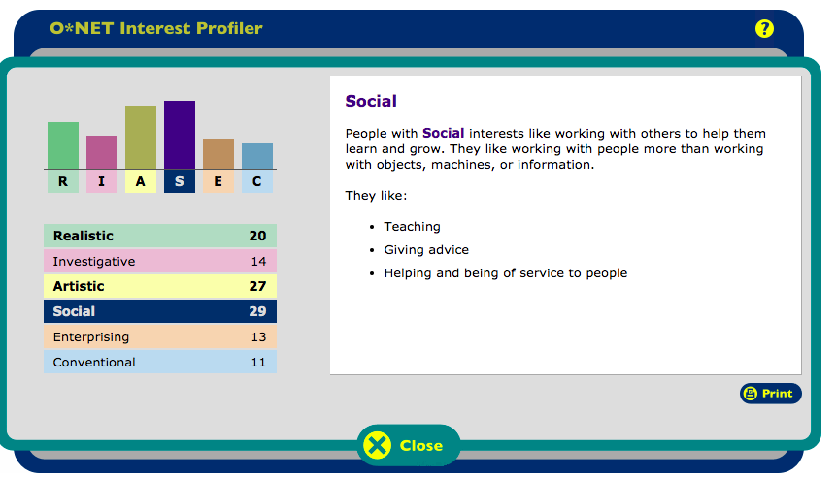
My Next Move O*NET Profiler
Notes:
Slide 16: My Next Move O*Net Profiler
Purpose of the Slide/Presenter Notes
» This shows the results of the interest profiler and a description of the category with the highest score.
Talking Points
» Like the Mass CIS, this will give you scores across different areas.
» There is also information in the job outlook, or the expected numbers of workers needed for
the future
» Online and can be done remotely.
» Can be done at your own pace.
Additional Resources/References
» O*Net Online www.onetonline.org/

Slide 17


Activity
Try one of the interest surveys:
https://masscis.intocareers.org/onet_short_ip/onet_short_ip_intro.aspx
https://www.mynextmove.org/explore/ip
What did you find out?
What kinds of jobs might be a good match?
Do you think this would be helpful for your loved one?
Notes:
Slide 17: Activity
Purpose of the Slide/Presenter Notes
» This is an opportunity for participants to try out one of the career interest websites. Talking Points
» Take a few minutes to explore one or both sites. If you have the time, try finding some jobs based on your interests.
» Try the short form if you only have a few minutes
» Let’s try it out! It’s a good starting point.
» You can also try this out at home with your loved one and at your own pace
Follow-Up/Discussion Questions
» What did you find out? » What kinds of jobs might be a good match for you? » Do you think this would be helpful for your loved one? » What modifications or accommodations would be needed for your loved one to participate?
Additional Resources/References
» Massachusetts Information System https://masscis.intocareers.org/materials/portal/home.html
» My Next Move www.mynextmove.org/explore/ip
» Short form O*Net Profiler https://www.onetcenter.org/dl_tools/ipsf/Interest_Profiler.pdf

Slide 18
Setting a Goal
Goals helps us do the things we want to do and live the life we want to live.
Goals are like a destination on a map.
Different kinds of goals:
Short term
something you want to do soon
help you move closer to the long term goal.
allows time for planning.
Long term
something you want to do in the future.
requires time and planning
may change over time or with experience
Notes:
Slide 18: Setting a Goal
Purpose of the Slide/Presenter Notes
» This introduces goals and goal setting as part of the planning process Talking Points
» You need to set up short term goals to reach your long term goal » It’s ok to change your mind » As you try new things, your ideas and like and dislikes might change » Those changes can give you new ideas and shape new goals
Follow-Up/Discussion Questions
» Are you in the job you thought you would be in when you were younger? How has your career path evolved? How might that path look for your loved one?

Slide 19
Sample Goals
Interest identification
I will identify 3 things I’m interested in. If I’m not sure, I will take an interest survey to get some ideas.
Job awareness
I will find 3 kinds of jobs match my interests and skills
I will list 3 jobs I definitely don’t want
Exploration
I will set up an informational interview with a local business that matches an interest area.
Immersion
I will apply for a job or volunteer position in an area that interests me to gain real work experience.
Notes:
Slide 19: Sample Goals
Purpose of the Slide/Presenter Notes
» This slide shows some sample goals Talking Points
» These are some examples of career goals in the area of interest identification, job awareness, job exploration, and job immersion.
Follow-Up/Discussion Questions
» Do you have examples of employment goals for your loved one? Additional Resources/References
» I’m Determined www.imdetermined.org/

Slide 20
How to communicate vision for work to others
If you haven’t, seek ways to learn about how to advocate for your loved one.
Rehearse talking points
your loved one’s interests & preferences
your expectations for your loved one’s future, including competitive integrated work
home and community activities that currently support your loved one’s vision
Share vision with others
Share supports and accommodations used
Connect with like-minded families, community and school members
Notes:
Slides 20 & 21: How to communicate vision for work to others
Purpose of the Slide/Presenter Notes
» This slide outlines ideas for sharing vision with others and advocating for competitive integrated employment.
Talking Points
» There are family advocacy organizations to help you learn how to advocate for your loved one.
» If you’re not sure how to share your loved one’s vision, including expectations for work, it might
help to write down and rehearse some talking points.
» Share information the kinds of supports and accommodations that your loved one uses at home and at school
» Connect with like-minded families, community and school members through school or community based groups.
» Ask school or agency workers how they’ll help your loved one reach their goals.
» Make sure annual goals are based on appropriate assessments.
» Discuss safety concerns and any ideas you might have on how to address them.
» Paid work in the community before leaving school is a predictor for paid work in the community after leaving school.
Follow-Up/Discussion Questions
» Do you have any suggestions on how, when or where to share information on expectations, vision, work ideas?
Additional Resources/References
» Quick Guide: Preparing Students for Competitive Integrated Employment https://transitionta.org/sites/default/files/Quick_IntegEmploy_Final.pdf

Slide 21
How to communicate vision for work to others
Ask planners how to use this information to create annual goal for employment on the IEP
Ask about assessment related to employment objectives
Address safety concerns
Show how paid work experience in high school is a predictor to CIE after school
Notes:
See Slide 20 for notes & talking points.

Slide 22
Activity
What are some first steps you can take to help support your loved one and their vision?
Notes:
Slide 22: Activity
Purpose of the Slide/Presenter Notes
» This slide explains the Charting the Life Course Planning sheet that was shown earlier on slide 11. This is an opportunity for the participants to start or continue developing a vision and thinking about desired outcomes for their loved one.
Talking Points
» This was shown earlier in this slide presentation.
» Remember, the upward arrow points to “My Vision...” Some find that a good place to start.
» Many find the box below that (lower right), “Dislikes” even more helpful as a starting point, especially if they are not sure about a vision yet.
» Now take a look at “What has helped” (upper left side) in getting closer to what is wanted or further away from what isn’t (box on the bottom).
» The steps on the upward arrow represent steps you can take to reach your loved one’s vision. For each step, think of something you can do to move you closer to your loved one’s vision
Follow-Up/Discussion Questions
» If there is time, the trainer can review each section and suggest that participants begin to make some notes on a copy of the trajectory.
Additional Resources/References
» CtLC Daily Living and Employment Planner www.lifecoursetools.com/lifecourse-library/ exploring-the-life-domains/daily-life-and-employment/

Slide 23

Next Steps
Notes:
Slide 23: Next Steps
Purpose of the Slide/Presenter Notes
» This is the final slide of the presentation. Encourage participants to look over and try out some of the tools shared.
Talking Points
» We’ve reviewed information that can help you and your loved one envision a future that includes work, and develop plans to reach your goals.
» Try out some of the websites to help your loved one match interests to possible job areas.
» Set a small, first goal and fill in the action plan to help you achieve that goal
» End of session follow-up/discussion questions:
» Have you ever tried a kind of planning like the ones we reviewed here?
» If so, what did you like about planning like this? What was hard or not as helpful about this kind of planning? Do you have any advice for someone just starting out?
» If you haven’t planned like this before, what strikes you as helpful? What parts seem hard or not helpful?
» Who might help you start or continue planning like this?
» After participating in this session, what is a first step you can take to:
» Raise your and others’ expectation for competitive integrated work for your loved one?
» Add to what you already know out about your loved one’s interests and preferences?
» Record your vision of work for your loved one?
» Share your plan with others?
Additional Resources
» The Arc Of Massachusetts https://thearcofmass.org/ » Families Organizing for Change https://massfamilies.org/ » The Federation for Children with Special Needs https://fcsn.org/ » Pacer Center https://www.pacer.org/

