Slide 1
Getting in the Door
Karen Flippo
November 30, 2016

Slide 2
How to Make Contact with a Stranger?
Notes:
Make sure you know who is the decision maker.

Slide 3
The First Contact
Notes:
Referral
Cold call

Slide 4
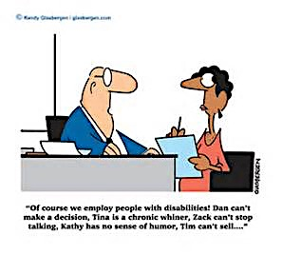

Slide 5
Notes:
Seek First to Understand and then be understood

Slide 6
First Impressions
90 seconds

Slide 7
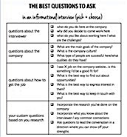
Information Sources

Slide 8
Avoiding Pitfalls of Cold Calling
Personal & professional networks
Membership in associations
Business Advisory Councils
Board of Directors
Business referrals
Others

Slide 9
Job Driven Toolkits
Customized Training
Employer Supports
Labor Market Information
Business Engagement

Slide 10
Load Up on Facts/Needs
Onetonline.org
http://www.mass.gov/lwd/economic-data/
https://www.dol.gov/ofccp/regs/compliance/section503.htm

Slide 11
What Do We Mean By Business Engagement?
Continuous
Strategic
Mutually valuable
Wide ranging
Intensive
Empowering
Institutionally varied
Explore VR, Business Engagement Toolkit
Notes:
Continuous: cultivating long-term relationships rather than episodic; strategic: approaching business in the context of specific plans opportunities and objectives; mutually valuable: solving problems and creating value for both sides; wide ranging; engaging a variety of businesses by using varied methods to recruit and involve a large number. Comprehensive; engage businesses n a variety of issues and activtitives from program development to competency identification : inentive engaging businesses substantively and in depth, such as specific skill sets, long term economic needs, and strengths and weakenesses of current disability pipelines; empowering; encouraging them to develop and assume leadership roles in pathway development and approach them at onset of process rather than at the end; engaging them through a number of channels;

Slide 12
Attitudes
Uninitiated
Inclusives
Choir
Research on hiring people with disabilities hinges on broad cultural factors.
Peter Capelli, Wharton Business School, University of Pennsylvania, 2013
Dr. Capelli
Notes:
Employer attitudes and stereotypes are still a major disincentive to hiring, cost, productivity

Slide 13
How do we get businesses to the choir level?
Uninitiated
Inclusive
Choir
Notes:
Create search tools for job matching, improve targeted training efforts, provide employers with strategies to encourage self disclosure; provide employers with more structured and streamlined resources, inclusive; education peer to peer mentoring; uninitated, success stories rther than statistics, desemsotozatopm tp prmte empathy and nurture progress

Slide 14
Objections

Slide 15
Changing Approaches for Success
Adjust Communicatins
Visual communications
Incorporate disability language and images in all communication
Power of personal stories
Educate staff about-self identification
Employer Engagement Strategies, ODEP, Final Report 2014

Slide 16
Golden Questions
”What can I tell you about the capabilities of the job seekers I work with?”
“How can I help you work through your apprehension?”
“How can we enhance our employment partnership?”
Employment Engagement Strategy, 2013, Social Dynamics, LLC

Slide 17
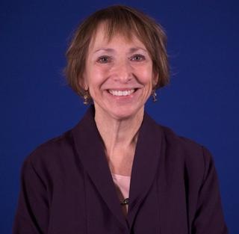
Have questions? Please contact me.
Karen Flippo,
Institute for Community Inclusion, Umass Boston
Karen.Flippo@umb.edu; 617-459-1947

