Slide 1

Building on Success: Expanding Employment Opportunities
Putting Positive Behavior Supports (PBS) to Work in Employment
Presenters: Chris White, Meredith Aalto and Angela Gaudette from Road To Responsibility, Inc. (RTR)
3:00 – 4:00 PM
November 30, 2016

Slide 2
Putting PBS to Work in Employment
Introduction:
Road To Responsibility, Inc. (RTR)
Panel Members (all from RTR):
Chris White, Ed. D. President/CEO, Licensed Psychologist, Licensed Applied Behavior Analyst
Meredith Aalto, Director of Individual Employment Services
Angela Gaudette, Director Taunton OPTS (CBDS)

Slide 3
Putting PBS to Work in Employment
Positive Behavior Supports Brief Overview:
Definition: A systematic, person-centered approach to understanding reasons for behavior and applying evidence-based practices for prevention, proactive intervention, teaching, and responding to behavior, with the goal of achieving meaningful social outcomes, facilitating learning, and enhancing quality of life across the life span.

Slide 4
Putting PBS to Work in Employment
PBS Overview Continued:
PBS combines the science of ABA with a philosophy consistent with community-based services.
“So what’s it really all about?”
Respect. Prevention. Choice. Predictability. Proactive. Teaching.
PERFECT for work settings!

Slide 5
Putting PBS to Work in Employment Three Tiers of Intervention: Universal Supports: Prevention strategies in place for ALL individuals in a given environment… Staff, Consumers and Visitors! Targeted Supports: “Off-the-Shelf” interventions applied generically to provide a person with added support beyond the universal level. Individualized Supports: Fully individualized intervention strategies implemented to meet intensive needs.

Slide 6
Putting PBS to Work in Employment
Fitting PBS into community-based employment:
“How does this really work?”
Universal Supports:
Know the person: interests, strengths, weaknesses
Know the job: expectations, environment, supervisory style
Communicate clearly and be format-sensitive!

Slide 7
Putting PBS to Work in Employment
Universal Supports:
Place the individual in situations to succeed! Remember Bill Belichick!
Provide information and support to the employer early and as often as needed!
Ultimately, the job match is everything!

Slide 8
Putting PBS to Work in Employment
Universal Supports Case Study:
J. P. – Meredith Aalto

Slide 9
Putting PBS to Work in Employment
Targeted and Individualized Supports:
Identify needs early (preferably before job-placement occurs).
Get clinical support
Understand the function of unwanted behavior
Use least restrictive approach and be consistent!

Slide 10
Putting PBS to Work in Employment
Targeted and Individualized Supports- Case Study
D. K. – Angela Gaudette
Work is the best behavior plan!
One of the best tools I have to teach the skills required for Competitive Employment is through Supportive Employment.
Over the years I have been able to see this work, and would like to share with you all David’s employment journey.

Slide 11
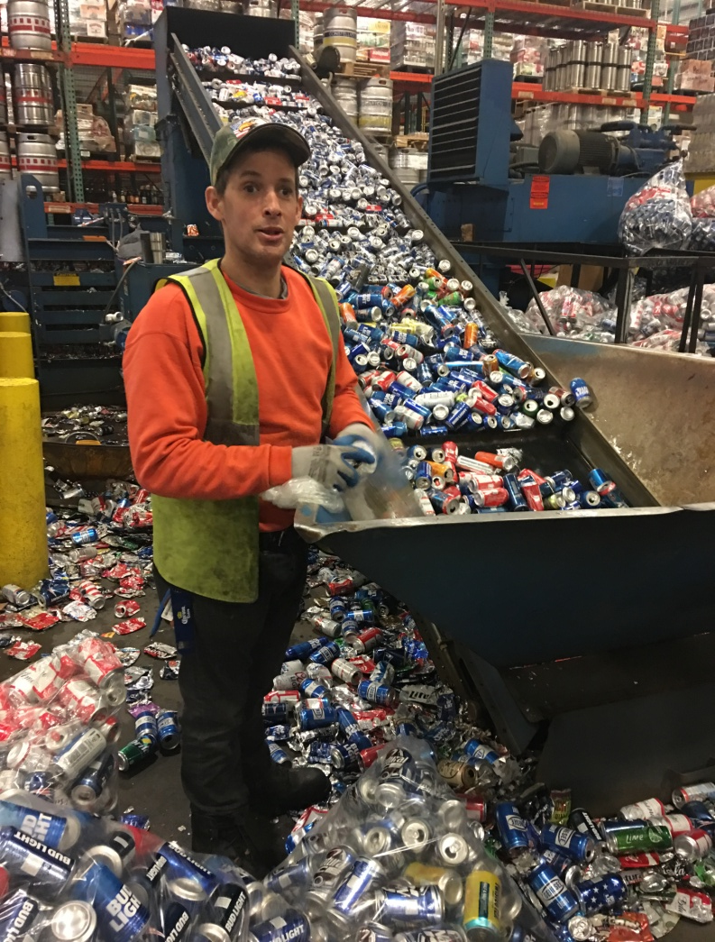
Putting PBS to Work in Employment
Meet David.
Started RTR in September of 1997.
RTR implemented a BSP in 2002.
Target behaviors included;
Verbal threats of aggression and elopement
Intimidating co-workers
Improper phone usage
Bringing too many items to work (i.e. 3 of his binders that held 500 CDs, laptop, stereo, portable DVD player).
He would sometimes remember to bring his lunch!
In 2005 I met David for the first time and this is when David began working 1-2 days a week at RTR’s supportive employment enclave L-Knife &Son.

Slide 12
Putting PBS to Work in Employment
L-Knife & Son
Alcohol Distributor and Redemption.
Located in Kingston Ma.
Founded in 1898 a Sheehan Family Company.
RTR Taunton is in charge of Can Redemption.
RTR Plymouth in charge of Glass Redemption
Work starts a 9:30-2:00pm.
Skills required.
Work in a fast-paced setting.
Able to lift and push up to 50lbs.
Follow safety procedure in accordance to L-Knife policies.

Slide 13
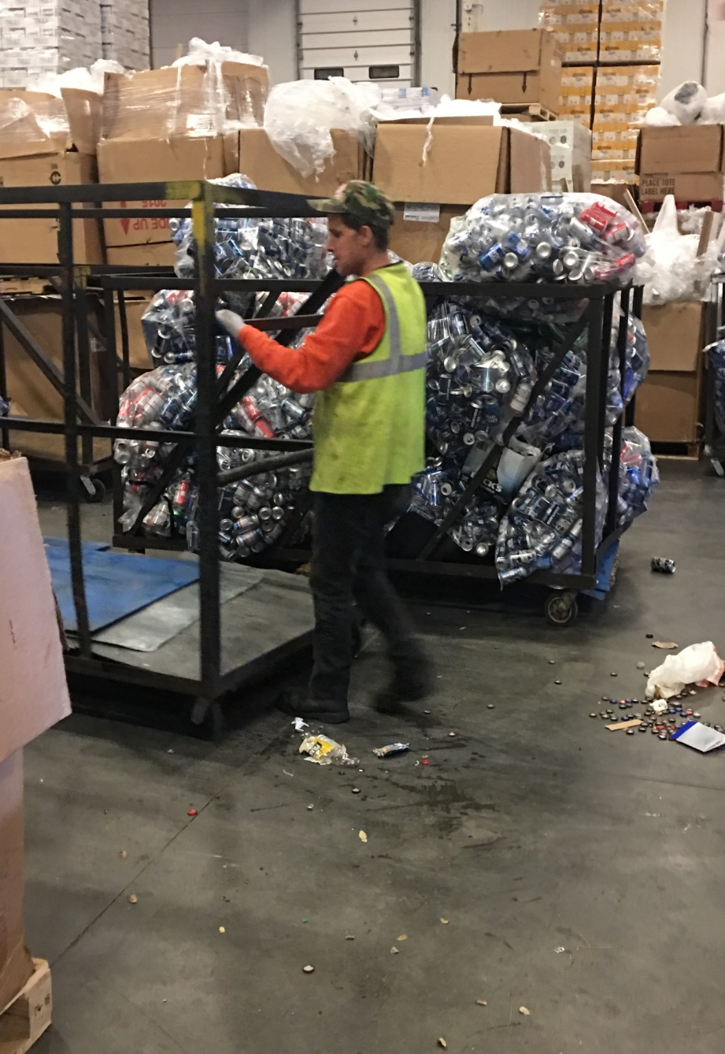
Putting PBS to Work in Employment
David began slowly increasing his hours at L-Knife.
Also slowly decreasing his targeted behaviors.
He began learning how to administer his own medication.
Was trained to use his Epi-Pen independently.
Increased his home alone and independent community access.
David’s 2016 ISP was held in October.
David now attends L-Knife 5 days a week.
Only takes 2 days off a month to expand his knowledge of cooking. As well as completing the vehicle inspections for RTR’s company vans.
Guess what else happened at his ISP!

Slide 14
Putting PBS to Work in Employment
David graduated from his RTR BSP!

Slide 15
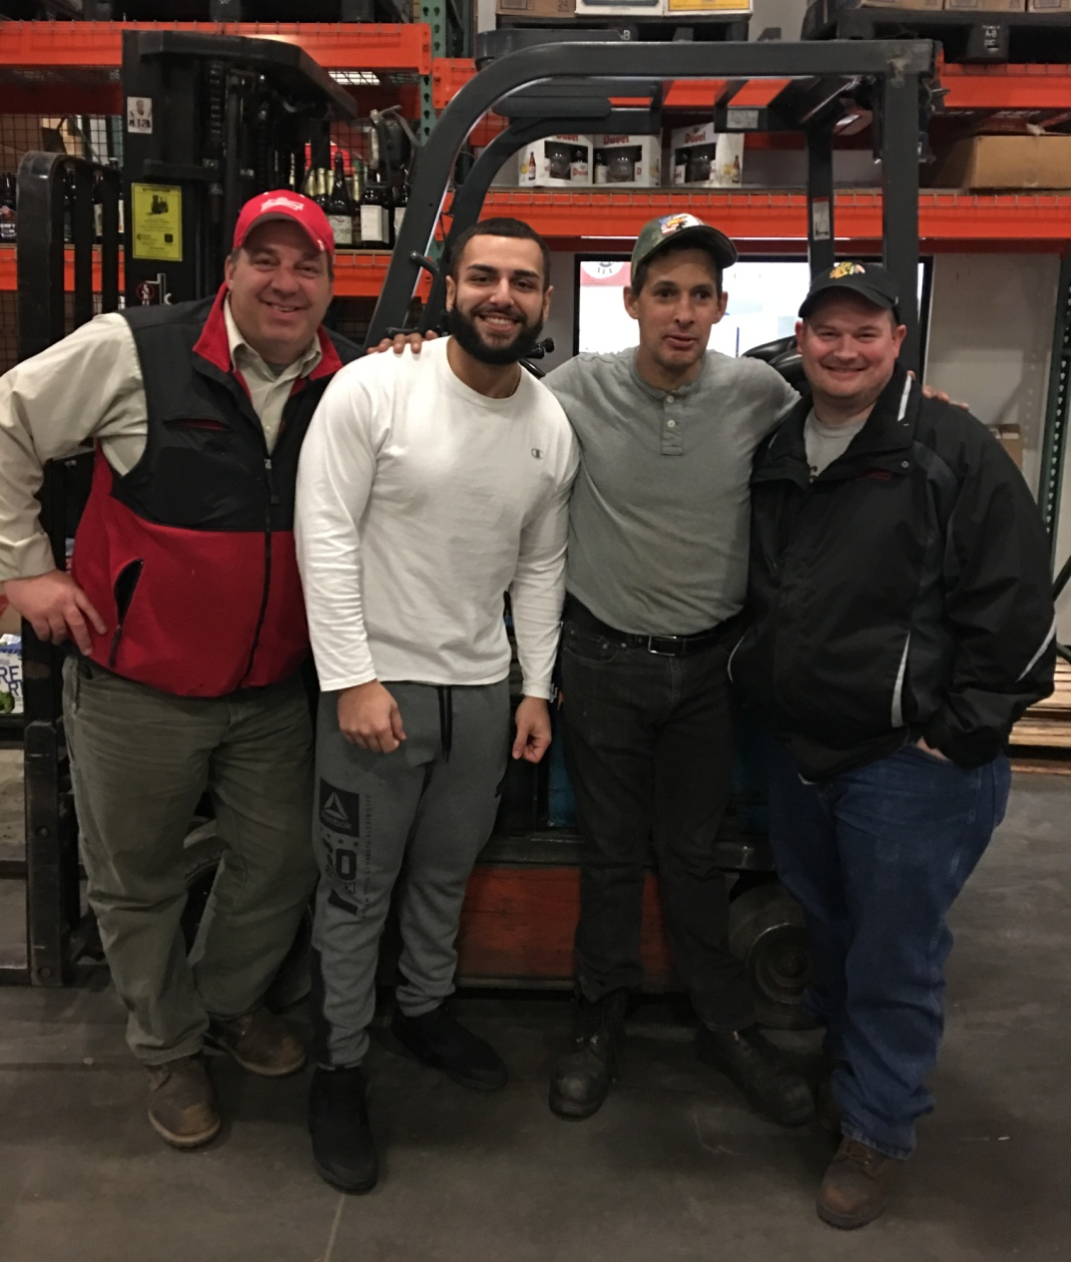
Putting PBS to Work in Employment
Quotes from L-Knife Supervisors.
“David has always been a hard worker, who I can rely on to get the job done!” Andy (far left)
“My go to guy!” Jesse (left to David)
“Always makes me laugh.” Matt (right to David)

Slide 16
Putting PBS to Work in Employment
Wrap-Up
PBS as a tool for empowerment
Bringing in other supports
Importance of real integration on the job
Commitment
QUESTIONS??

